Slide 1
Big Data @Rhodes
O. Smirnov (Rhodes University & SKA SA)

Slide 2
RATT & RARG
Rhodes Centre for Radio Astronomy Techiques & Technologies
  Myself, Justin, 3 postdocs, ~12 graduate students
  3 visiting supervisors
Radio Astronomy Research Group (RARG),
SKA SA
  2(+2) postdocs, 3.2 senior astronomers
Associates: 1-2 postdocs, 2 graduate students

Slide 3
Data Problems
Development of calibration & imaging algorithms
From raw visibilities to (astronomer-quality) calibrated images and source catalogs
Simulations
  Use simulations to derive design of future telescopes and observing strategies
Big data coming by default
  When your data reduction outputs 500 Gb in one go...
High quality DR has a human in the loop
  #1 problem for coming years

Slide 4
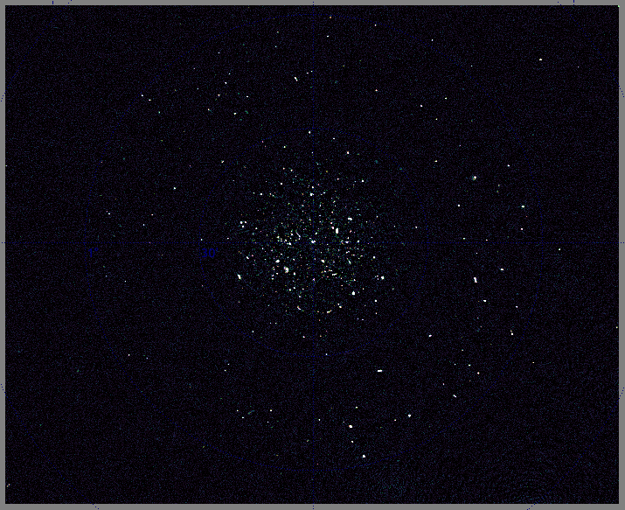
3.2 million DR imaging
(with R. Perley, NRAO)

Slide 5
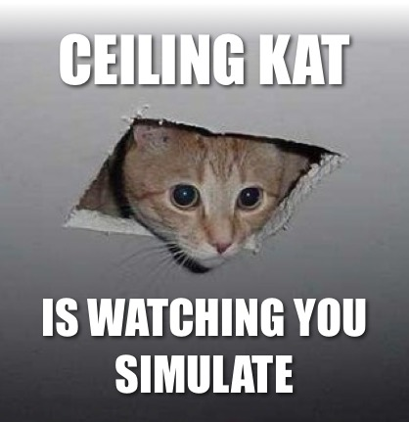


Sphesihle Makhathini
Rhodes Centre for Radio Astronomy Techniques and Technologies
Online End-to-End Simulator for the SKA and its pathfinder/precursor Instruments

Slide 6
Simulations
RODRIGUES: online simulations tool
  Browser-based
  Pipeline running on backend at CHPC or GCE
  Uses CyberSKA viewer to deliver results
  Purpose: imaging algorithm verification, delivery of simulated data sets to MeerKAT etc. users
Massive simulation experiments
  e.g. “artefact floor” in deep HI pointings and its dependence on telescope parameters
  e.g. determined observed vs. model HI mass function and develop empirical corrections

Slide 7
Facilities
Local algorithm development cluster
  3x 32-core Xeons, 512 GB RAM, a few 10's Tb storage
  K10/K20/K40 GPUs
Google Cloud Engine (via SKA SA)
  (also investigating Amazon EC2)
  Lots of CPU power on demand, but slow to shift data in/out
  Well suited to sims and algorithmic experiments
CHPC cluster

Slide 8
Problems
Diverse software & hardware requirements
Mixed pipelines composed of many packages
Humans in the loop

Slide 9
Pyxis
Python eXtensions for Interferometry Scripting
Simulate
Calibrate
Develop
Access to Interferometry packages through a single interface
Standardize Interferometry scripting
Pyxis Pipeline
MeqTrees
CASA
LWIMAGER
WSClean
LOFARSoft
Other

Slide 10

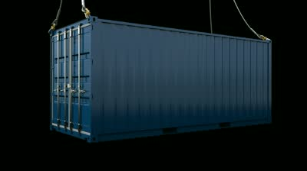
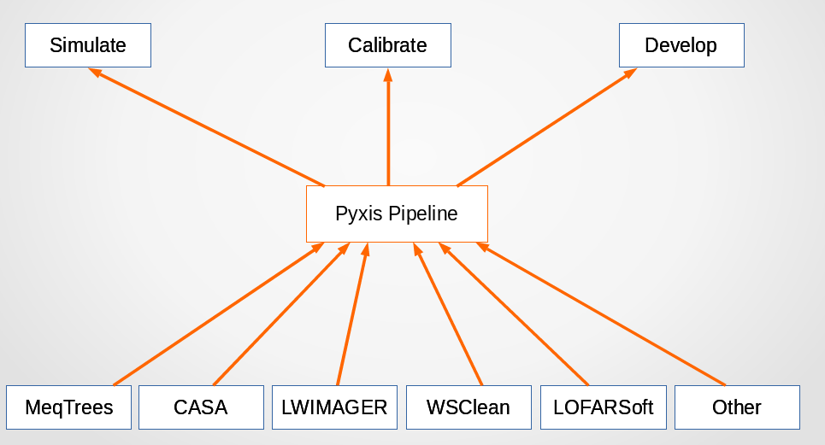
Creates isolated environment that can be shipped and
run on a different machine, cloud, cluster etc., without much fuss
Avoid installing and getting packages to play nice on different platforms
Develop pipeline/package in some distribution (ubuntu)
Dockerize pipeline and required packages
Collaborator/User only has to worry about installing Docker.
Adopted by Google for GCE

Slide 11
Priorities
Development of an automated pipeline for high-DR survey data
  Test on JVLA data for now
Machine learning (new postdoc coming in)

