Slide 1

Installing MeqTrees
O. Smirnov (ASTRON)

Slide 2
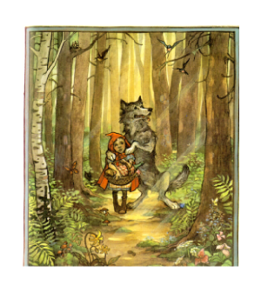
Oxford Repositories
Thanks to lots of hard work by Chris Williams.
1.0 release
  Ubuntu 8.04 and 8.10
1.1 pre-release
  E-mail sent around
  Ubuntu 8.04, 8.10, 9.04
  OpenSUSE 11
  Fedora 11
  Lots of things still broken
We need testing!

Slide 3
Repository Installation
Download .deb file from wiki
  Or from the secret download page (for pre-release)
Install .deb file (gdebi or dpkg -i)
This is only a link to the Oxford repository, not MeqTrees itself!
apt-get update
apt-get install meqtrees
subsequently: apt-get upgrade

Slide 4
MeqTree Components
Purr: in Python path
MeqTrees itself
  Meqbrowser and associated components: in Python path
  Meqserver binary: anywhere
Cattery: “official” scripts
  Added to Python path on-the-fly
Waterhole: free-for-all
  Likewise
  Not in official packages, needs to be checked out
Bonus: lwimager
  package lwcasaimager (formerly casarest)

Slide 5
The Bleeding Edge
Releases are infrequent
  1.0: March 2009, 1.1: October(?) 2009
  Can't really do it any faster, as testing is such an issue
All the good stuff changes fast
  Waterhole
  Cattery
  New nodes!
Advanced users need to track the repository version

Slide 6
The Subversion Repository
svn://lofar9.astron.nl/var/svn/repos/trunk
  mainline development
  Timba, Frameworks/Cattery, makems, etc.
svn://lofar9.astron.nl/var/svn/repos/release
  release code
svn://lofar9.astron.nl/var/svn/repos/branches
  development branches
svn://lofar9.astron.nl/var/svn/repos/doc
  documentation
To check stuff in:
  Get account on lofar9
  Use svn+ssh://[username@]lofar9.astron.nl/

Slide 7
Tracking The Waterhole
$ svn co svn://lofar9.astron.nl/var/svn/repos/trunk/Waterhole
# creates directory called Waterhole (your “working copy”)
$ cd Waterhole
$ svn up
# updates your working copy
# does NOT overwrite your local changes!
Waterhole/contrib/XYZ # your personal directory
import Timba.Contrib.XYZ # access in Python
# meqbrowser looks for Waterhole in standard places
(~/Waterhole...) or at $MEQTREES_WATERHOLE_PATH
your initials

Slide 8
Tracking The Cattery
$ svn co svn://lofar9.astron.nl/var/svn/repos/trunk/Frameworks/Cattery
# meqbrowser looks for Cattery in standard places
(~/Cattery...) or at $MEQTREES_CATTERY_PATH
# check your About... dialog

Slide 9
Building From Source
$ svn co svn://lofar9.astron.nl/var/svn/repos/trunk/Purr
$ svn co svn://lofar9.astron.nl/var/svn/repos/trunk/Timba
$ cd Timba
$ less README_build.txt
$ Tools/Build/bootstrap_cmake debug # or 'release'
This configures a build directory (build/debug), you can have many independent builds.
$ cd build/debug
$ make # -j2, -j4, depending on number of CPUs

Slide 10
Where's The Build?
Things end up residing at various locations:
  build/debug
  build/debug/MeqServer/meqserver
  PyApps/src/meqbrowser.py
How do you know what to run?
Timba/install/timba-init.sh
Symlink trees contain symlinks to the various bits in the build tree and the source tree
  Timba/install/symlinked-debug
  Timba/install/symlinked-release

Slide 11
Switching Between Builds/Symlink Trees
$ source ~/Timba/install/timba-init.sh
$ timba-setup debug # or 'release'
This sets your PATH, PYTHONPATH and LD_LIBRARY_PATH to point to the appropriate bits of MeqTrees
Put it in your .bashrc
To verify:
$ which meqbrowser.py
/home/oms/Timba/install/symlinked-debug/bin/meqbrowser.py
$ which meqserver
/home/oms/Timba/install/symlinked-debug/bin/meqserver

Slide 12
Clean Rebuild
$ rm -fr build/debug
$ Tools/Build/bootstrap_cmake debug

Slide 13
Bugzilla
http://lofar9.astron.nl/bugzilla
Sign up to submit bugs

Slide 15
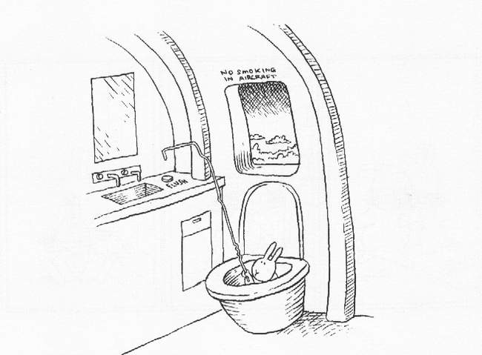
The End!

