Slide 1
BASP 2013 Summary
(Radio)

Slide 2
BASP 2011
Radio people: (*yawn*) this is how we do it
Medical imaging people: (*yawn*) this is how we do it
Signal processing people: (*yawn*) this is how you should be doing it
Yves & Jason: ok, let's add some skiing
It worked!

Slide 3
BASP 2013
Two types of talks:
  Analysis: ok, we've measured something, what do we do with it?
  Calibration & imaging: actually, you haven't even measured what you think you've measured

Slide 4
Analysis
M. Hobson, J-L. Starck, F. Abdalla, D. Jacobs
  Going from measurements to cosmological and astrophysical parameters
  Bayesian vs. sparse (BS) standoff
  Quite advanced methods, compared to calibration (use of priors, constraints, sparsity, etc.)

Slide 5
Calibration & Imaging
Radio interferometry is difficult (Smirnov, Tasse)
  Problems in Timbuktu can hurt you here
Optical interferometry is even more difficult (E. Thiebaut, B. Kloppenborg)
  Enough problems without going to Timbuktu
Radio techniques over the past decade: slow progress

Slide 6
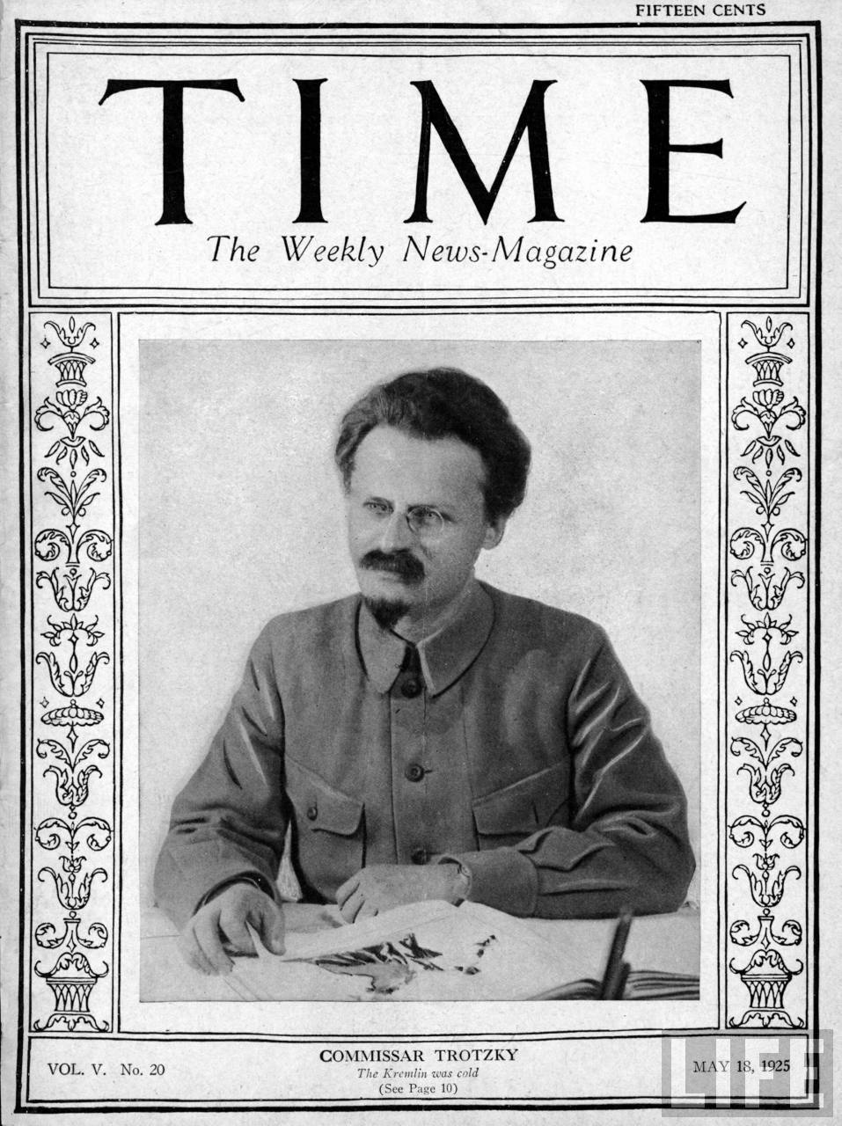
Calibration & Imaging
Radio interferometry is difficult (Smirnov, Tasse)
  Problems in Timbuktu can hurt you here
Optical interferometry is even more difficult
(E. Thiebaut, B. Kloppenborg)
  Enough problems without going
  to Timbuktu
Radio techniques over the past
decade: very slow progress
  But a revolution is in the air

Slide 7
Calibration & Imaging Progress
Lots of ideas from the signal processing side
  Blind calibration, factor analysis (S. Wijnholds)
  RFI separation (A. Sardarabadi)
Fundamental information capacity (T. Carozzi)
BS methods percolating in
CS in radio interferometry coming of age (!!)
  SARA (R. Carrillo) very promising, understanding of the w spread spectrum effect (L. Wolz)
  Optical interferometry leading the way

Slide 8
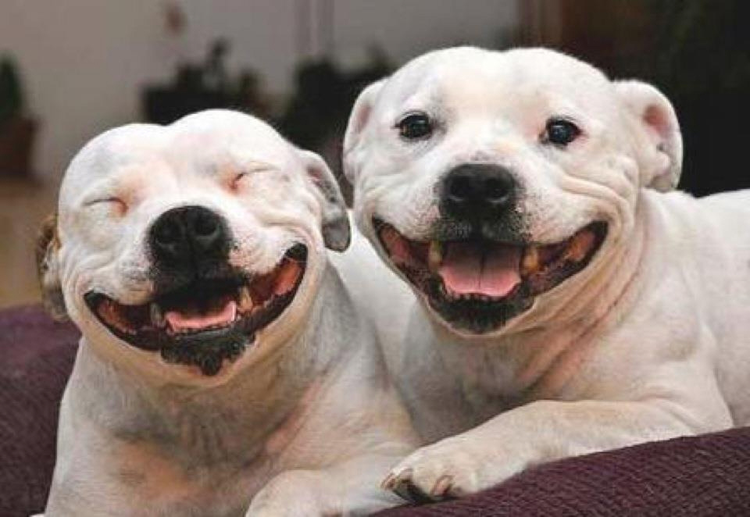
Prospects Are Good!

