Slide 1
Discussion Session
Exploration of discovery space –
real-time response

Slide 3
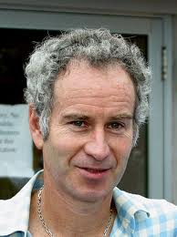
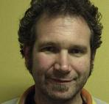
The Burning Issue
Who can tell the difference in real-time?
John McEnroe
Ben Stappers

Slide 4
Issues
Real-time capabilities of present facilities
  Limitations? What would you improve?
  What would you not bother with?
What big science has come out of these capabilities?
  Why not more?
What do we need for SKA1?
What's the main science promise?

Slide 6
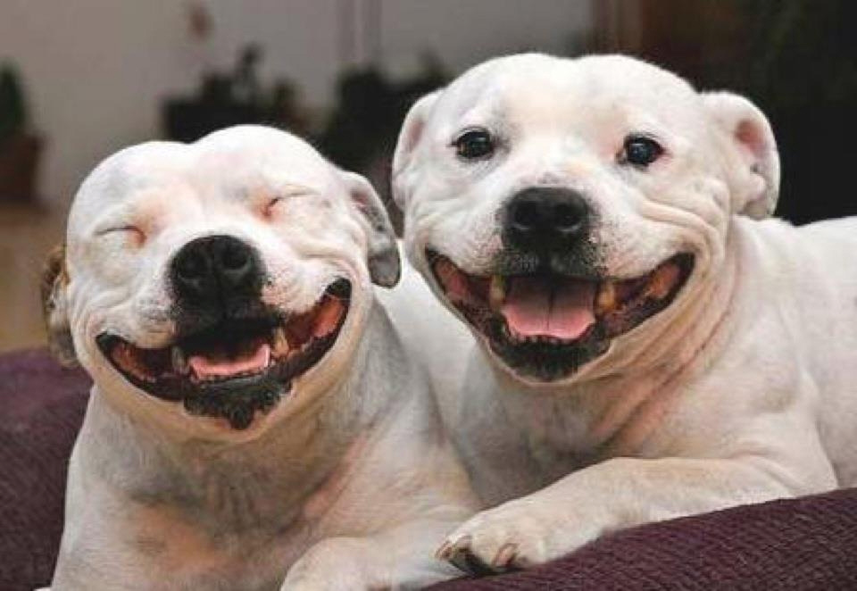
Prospects Are Good!

