Slide 1
Tigger, Owlcat, and the use of Python for “Serious” Things
O. Smirnov

Slide 2
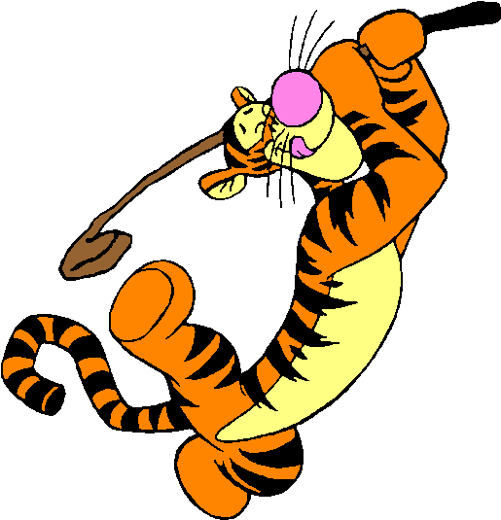
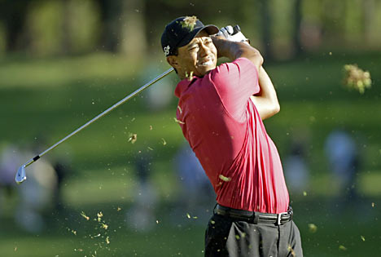
Tigger
An integrated sky model management and data product visualization solution leveraging the synergy of Python packages and APIs delivered with modern Unix-based platforms.
Luxury software for luxury problems.

Slide 3
Local Sky Models
(and source catalogs)
Information overload!
  Wetware problem
3C147 project:
  300 sources
  ...some need differential gains solutions
  Others can probably be moved to an image
  Need to deal with subsets, etc.
Hybrid models (components plus images plus shapelets plus whatever)

Slide 4
Hybrid models
Sources plus images plus shapelets...

Slide 5
Image Viewing
Inspired by Karma (kvis), the world's most advanced FITS viewer...
...with the world's most abysmal user interface
  The little-appreciated “Infinite Number of Green Windows” UI paradigm

Slide 6
Python Is Faster
Than Most People Think
Still thought of as a “scripting language” by some
Is actually an excellent general purpose language
  Only really “too slow” for very specific things
  Can be slow if badly written
  (...but then badly written C++ doesn't work at all)

Slide 7
Donald Knuth
(First Law Of Smirnov According To Noordam)
“Premature optimization is the root of all evil.” - Donald Knuth
“More computing sins are committed in the name of efficiency (without necessarily achieving it) than for any other single reason - including blind stupidity.” - W.A. Wulf
Choice of language is often a premature optimization:
“This will obviously be too slow if I write it in language X, I'm going to write it in language Y from the start.”

Slide 8
Why Python?
We are often attached to languages for emotional reasons
Nothing particularly groundbreaking about Python, just many small things:
  Clear syntax
  Straightforward OO
  Readable code (by default)
  Easy to make lightweight APIs
A HUGE collection of packages
  numpy/scipi
  GUIs: (Qt, ...)
  pyrap/casacore
  formats: FITS, HDF5, MS, etc...

Slide 9
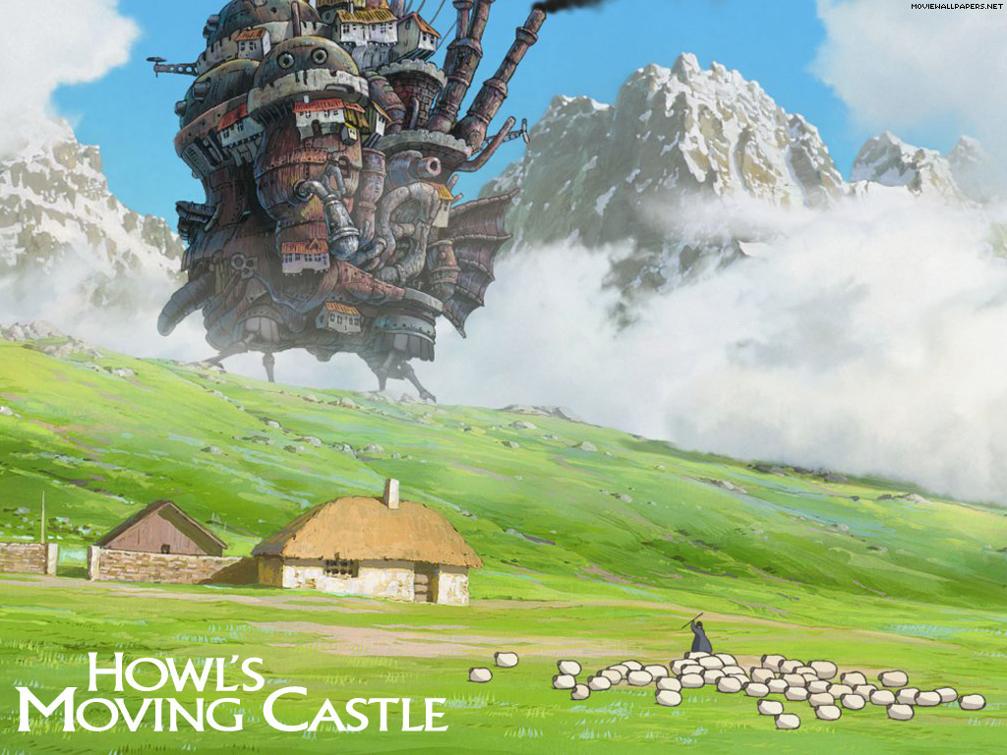
The CASA Distribution Model

Slide 10

Pythonville
CASA

Slide 11
What's Important About Python
Great “glue” because it offers so many things to glue together (and vise versa)
Tigger as an example:
  Qt4: industrial-strength GUI
  Qwt: plotting, visualization
  numpy/scipy: data processing
  Pyfits: reading FITS images
  astLib: coordinate conversions
Favourite silly question: “can you make it read format X”:
  Of course! (For all X != CASA)
For CASA, Python is just Glish++

Slide 12
Owlcat
A loosely-integrated and low-cohesion agile data management solution leveraging the synergy of Python packages and APIs to deliver end-user functionality not available in professionally managed packages designed using modern software development procedures and processes for use-case and requirements analysis.

Slide 13
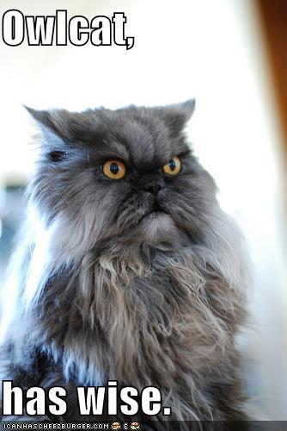
Owlcat
Loose collection of scripts for all the little odd jobs (uv-data management!) missing from big packages
MS manipulation
  Split/combine
  Proper weighting!
Simple flagging
Non-interactive plotting

Slide 14
Crucial Feature Of Owlcat
Lightweight
Just a bunch of scripts, most of which originate from a version 0 slapped together in under an hour
Nothing an “astronomer” couldn't do.

Slide 15
Why Is This Important?
We're not going to calibrate the SKA in Python
We're certainly not going to calibrate the SKA in C++ either!
If Duncan is right, we're not going to calibrate it at all
...unless we come up with orders of magnitude improvements in algorithms
This is a wetware problem, not a software one
  We're not going to solve it by going off and working harder on our algorithms
Need to get more wetware involved.
  Can't afford to have a High Priesthood anymore
  simple tools are crucial.

Slide 16
casacore/pyrap
THE most important project in our field today
MS is our common format, for better or for worse
casacore/pyrap provides the connection.
Which enables everybody to play with data.
Lack of official support is ridiculous!

