Slide 1
The Measurement Equation
Hamaker, Bregman, Sault (1996):
Hamaker (2000) Paper IV:

Slide 2
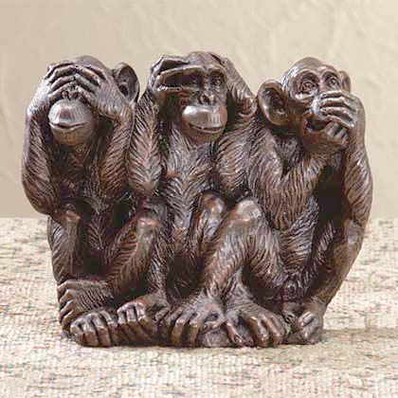
The Classical Approach To Polarization
Q
U
V

Slide 3
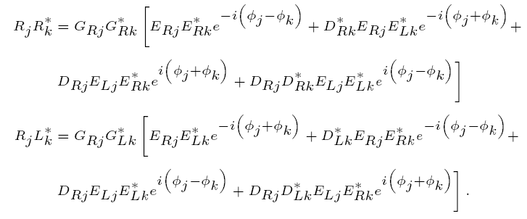
Scalar Equations for
Polarization Selfcal
M.E. version:
(With thanks to Huib Jan van Langevelde)

Slide 4
Why Is This So Important?
Makes things easy
  Common language, common description
Polarization
  No longer just a sideshow
  LOFAR beams, differential F.R.: polarization MUST be included in calibration form the beginning
Direction-dependent effects (DDEs)

Slide 5
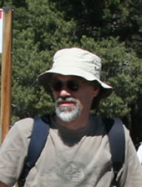
Our Showcase Image

Slide 6
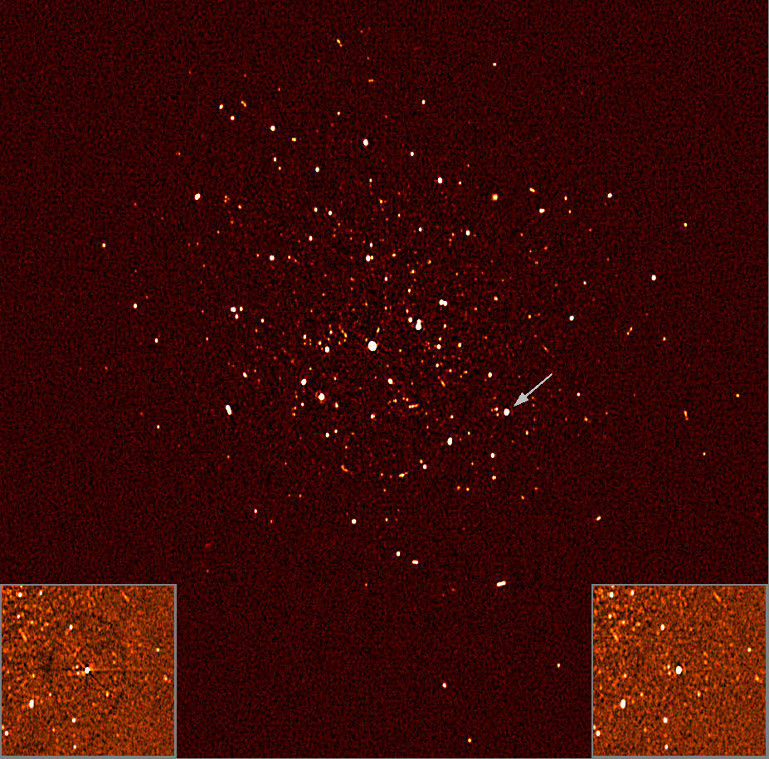
3C147 @21cm
Single 12h
synthesis
22 Jy peak
13.5 μJy noise
1,600,000:1 DR
Achieved by
Ger de Bruyn
with NEWSTAR
(regular selfcal)
DDEs
(“Luxury problems”)

Slide 7
Differential Gains
2 mJy!
Turn out to be phase gradients consistent with position shifts...

Slide 8
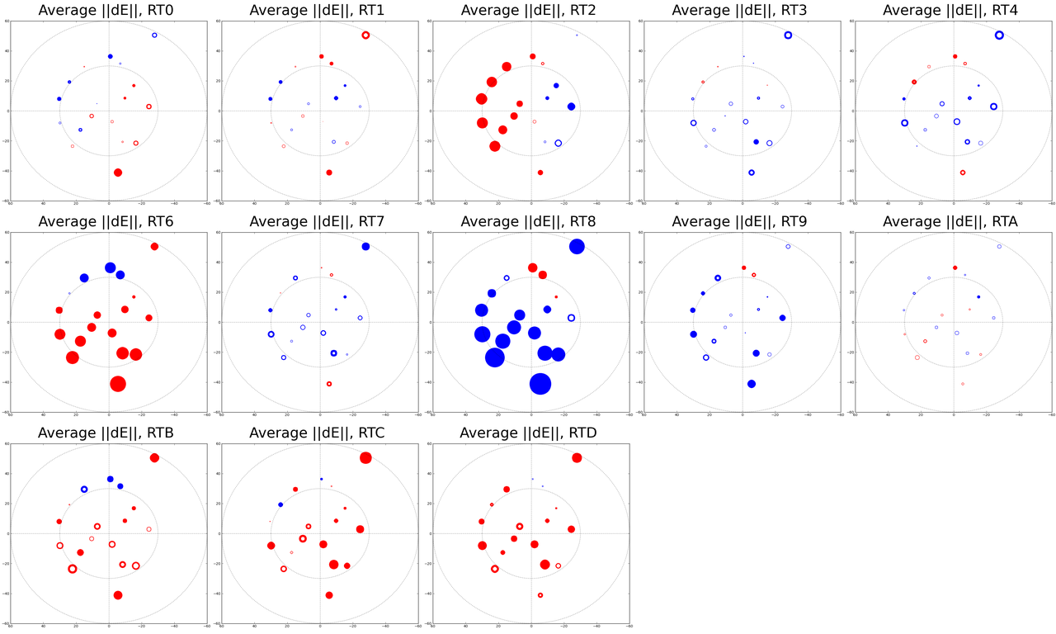
Spot The Mispointing...

Slide 9
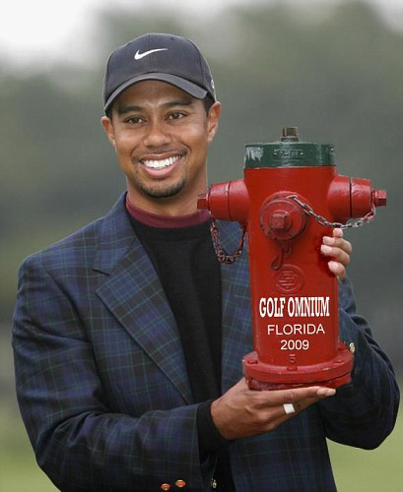
WSRT: 40 Years Of Fretting
Over “Luxury Problems”?
We've been worried about things other telescopes can barely detect
Polarization: this gave us
the Measurement Equation
DDEs: WSRT's luxury
problems will be routine for
the SKA
  Time to get ready...

