Slide 1
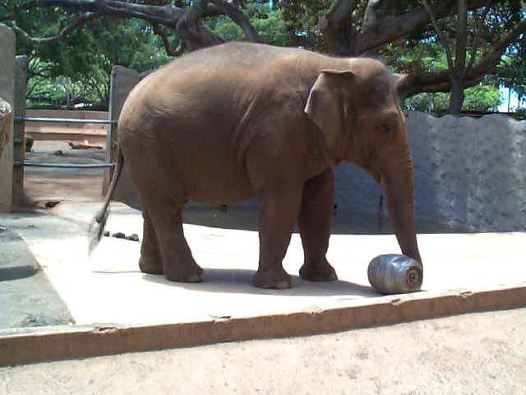
3GC3 Unofficial Awards

Slide 2
The Rules
Five categories
Democratically (i.e. us three) decide on the nominations
Put it to the vote (by popular acclaim)
Take a rough measure of the acclaim and democratically decide on the winner.

Slide 3
1. Statement Of The Conference
Ludwig: “If you stare at this plot long enough, you'll understand why CLEAN works.”
Sarod: “It's the most robust.”
Cyril: “His boss made him do it. Putain!”

Slide 4
2. Fresh Face Of The Conference
Patrice

Slide 5
3. Question Of The Conference
Manu: “How would you sell SAGEcal?”
Mitch: “So, at the MWA …(insert blank)..........”
Jan: “This reminds me of the image sharpness criterion we used before the Great War. Can you comment on that?”

Slide 6
4. Absentia Of The Conference
Tony Willis
Ian Heywood
Leon Trotsky

Slide 7
5. Talk Of The Conference
Ludwig: CS Intro
Robert: DR Limits
Maaijke: Ionosphere
Rick: 10+ hours, take your pick

