Slide 1
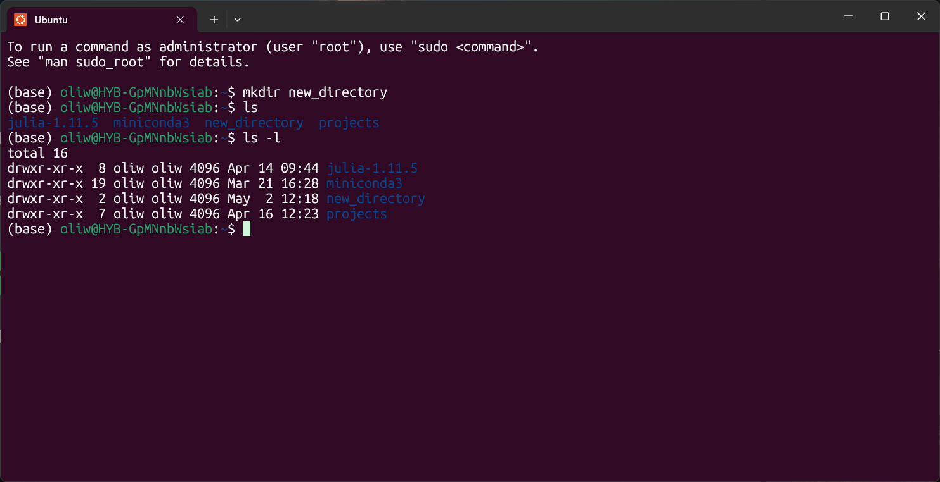
File
permissions
Size in bytes
Link
count
Group
Modification date and time
Owner
Name

