Slide 1
Find Target Data Fast! A Method and Its Behavior of Target Data Collection for Online Annotation using Machine Learning Method
Ruide LI *, Yoko YAMAKATA ** and Keishi TAJIMA *,
* Graduate School of Informatics, Kyoto University
** Graduate School of Information Science and Technology, The University of Tokyo
Notes:
Hello all. I am Ruide Li from Kyoto University. And I will give a presentation about our work. The title is called Find Target Data Fast! A Method and Its Behavior of Target Data Collection for Online Annotation using Machine Learning Method.

Slide 2
Introduction
Notes:
So I will begin from the introduction.

Slide 3
Scenario
Twitter mining task for rescue information in disaster (target data)
People want as many target tweets as possible
Human Examination Phase
A system to pick up a data and let human examine
Examining non-target data is a waste of time and human resource during this urgent situation, so try to select data most likely to be a target
Switch
Model Prediction Phase
Results of human examination can be used as labels, so that we can train a machine learning model
The model should provide a ranking of target likelihood, rather than just giving a decision boundary
Notes:
First let’s imagine a scenario like this. There is a Twitter mining task for rescue information in natural disaster. We call these tweets related to disaster information as target data. People may want to find as many target tweets as possible, but do not care that much about tweets of other topics. So there should be a two-phase process to handle this situation.
[POINT] At the early phase, we call human examination phase, The system should pick up a data and let human examine whether the data is target or not. Non-target examination will be a waste of time and human resources during this urgent situation, so the system should try to select data most likely to be a target
[POINT] And at the later phase, which we call it model prediction phase, like its literal meaning, we train a machine learning model and use the model to predict the remaining data, since the results of human examination can be used as labels.
Also, Rather than just giving a decision boundary, This classifier should also provide a ranking of target likelihood of the unlabeled data, in order to help rescue teams to make rescue plans.

Slide 4
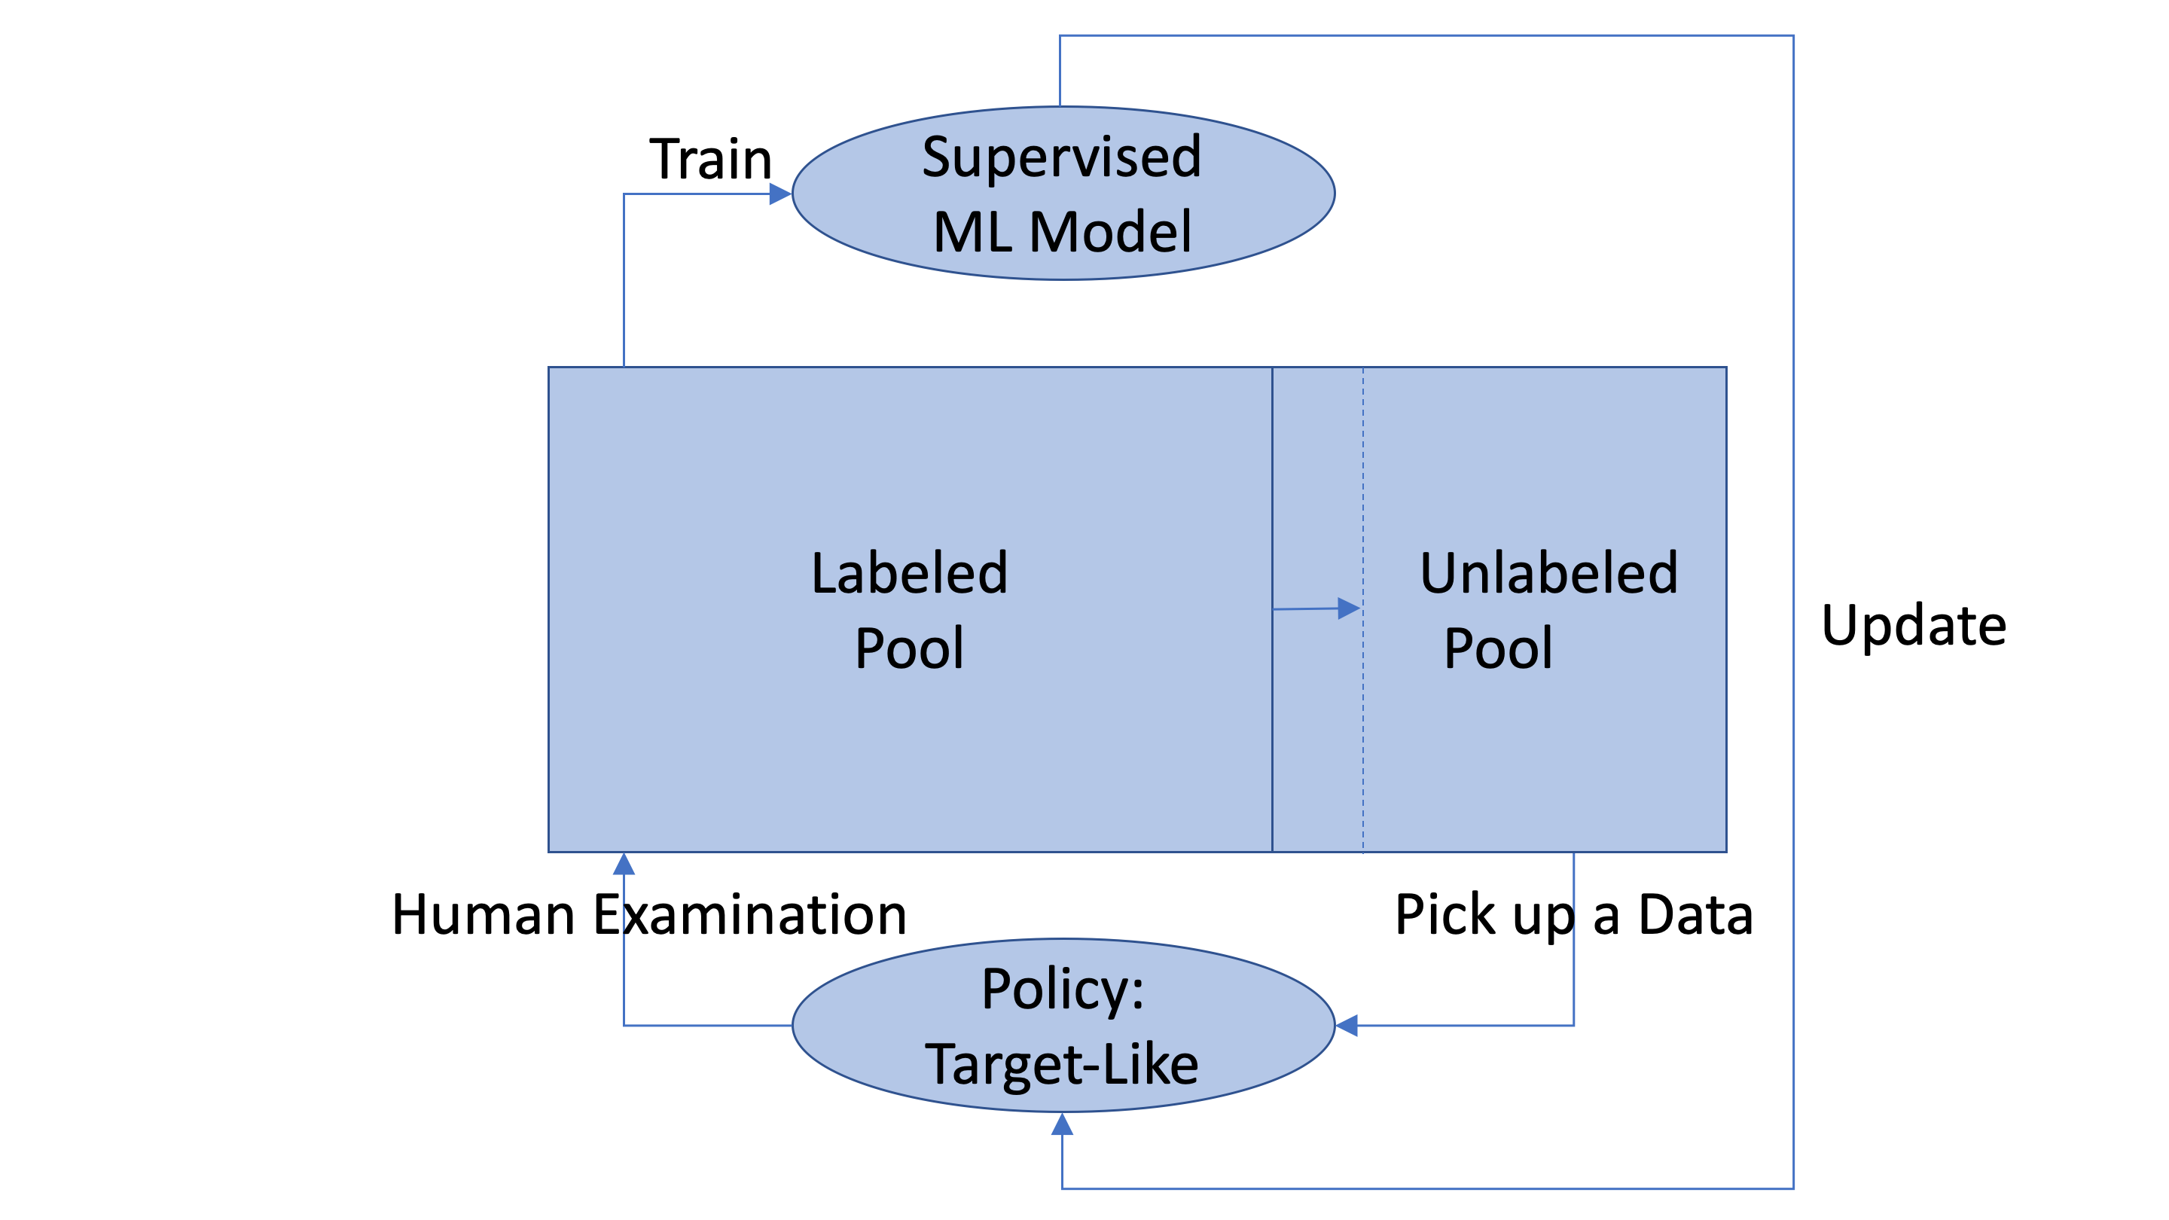
Flow Chart of Human Examination Phase
Notes:
And here is a flow chart of the process. First we begin with human examination phase. Well, this is an iterative process. [POINT] at each step, according to a selecting policy, the system pick up a data from unlabeled data pool for human examination. And we can use this labeled pool to train a supervised machine learning model. Also, the model may update the selecting policy backward.

Slide 5
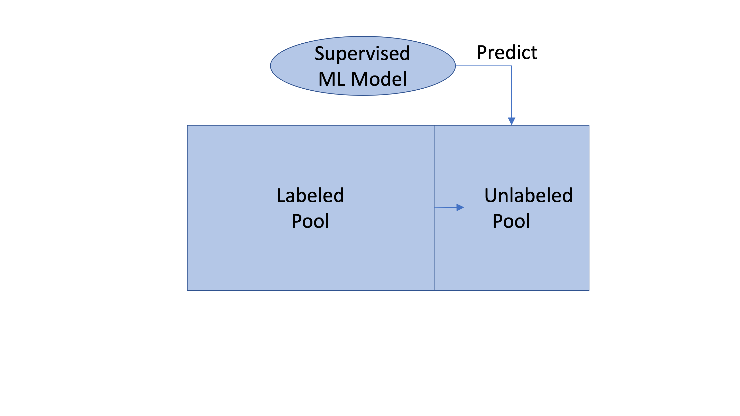
Flow Chart of Model Prediction Phase
Notes:
And when the model is well trained, we switch to model prediction phase, in which we use the obtained model to predict the remaining unlabeled data

Slide 6
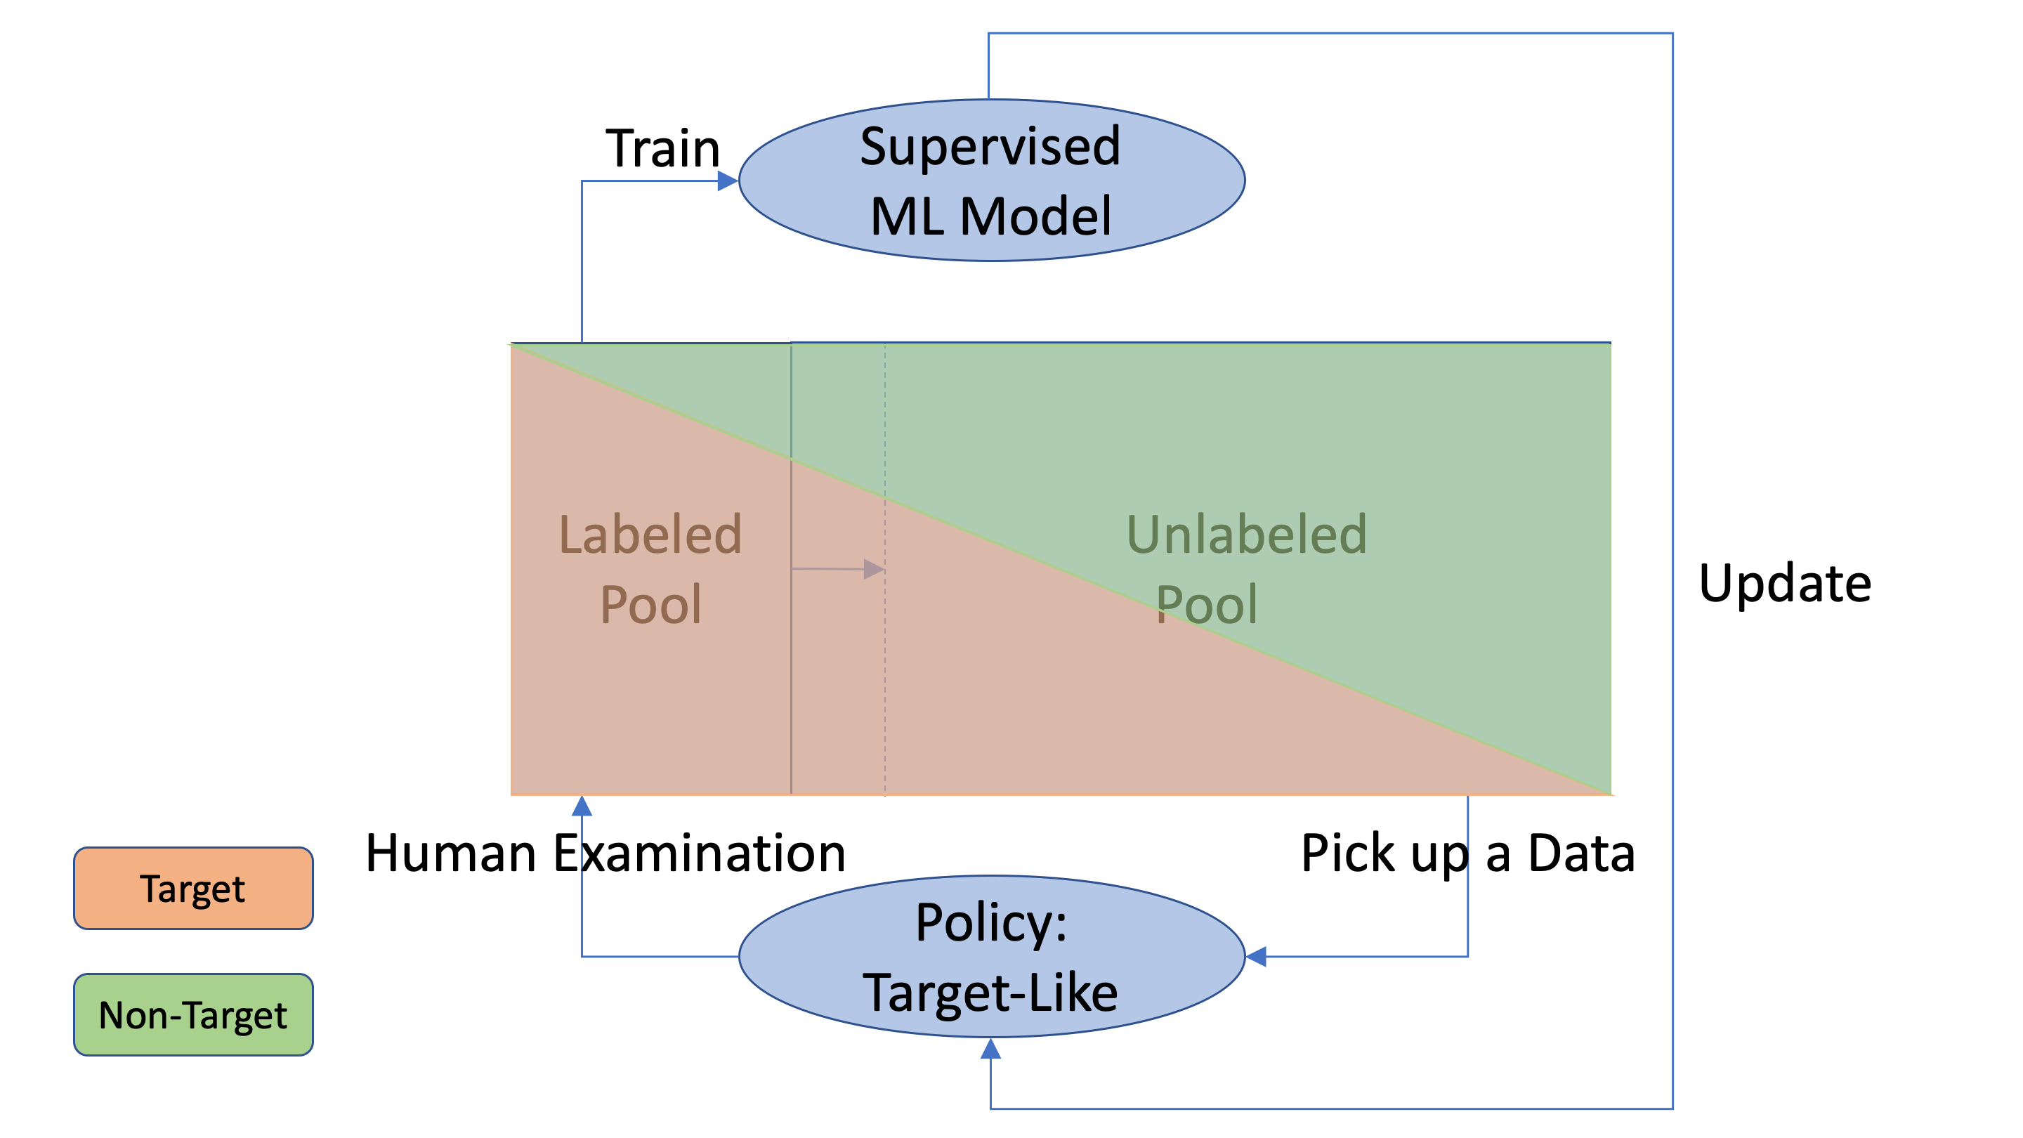
Human Examination Phase 1
Notes:
So Here, let’s check the details in human examination phase. [POINT] this orange box means target data, and green box means non-target data.
And if we suppose that there are equal target and non-target data in the whole dataset, then at the early steps [POINT]
, the system is finding more target-like data, and as a result, the labeled pool is extremely biased towards target data [POINT].

Slide 7
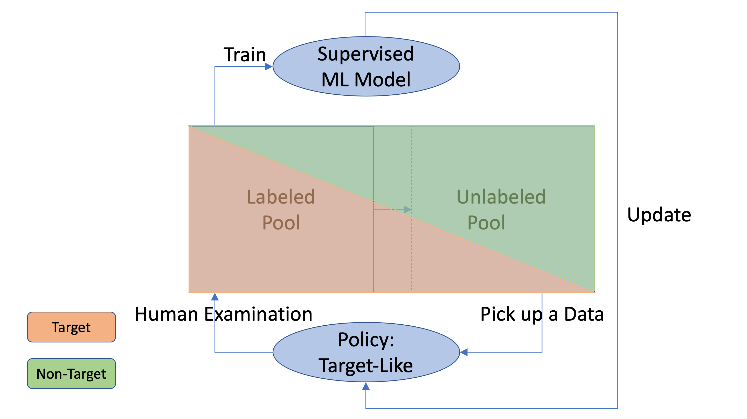
Human Examination Phase 2
Notes:
And as target data become less and less in the unlabeled pool, [POINT]
the system will pick up more non-target data.

Slide 8
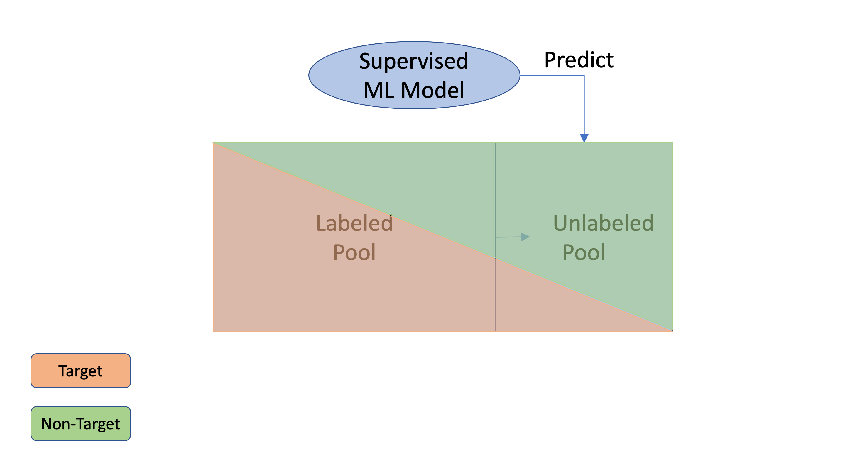
Model Prediction Phase
Notes:
And the labeled pool is able to gradually get rid of the bias [POINT],
and we can train a model with better performance, so that we can switch to model prediction phase.

Slide 9
Problem Definition
Notes:
So here, we define a new kind of problem,

Slide 10
Target Extraction Learning
Presumption: A fixed pool of unlabeled data
Purpose: Extracting target data faster with less human examination of non-target data
Approach: A two-phase method
Human Examination Phase (Early Phase): The system chooses a data most likely to be target, query for human examinations, and use the results also to train a model
Model Prediction Phase (Later Phase): Switch to model prediction from human examination, by providing a ranking of target likelihood
Notes:
which we call it target extraction learning. In this problem, we presume that there is A fixed pool of unlabeled data. The purpose is to Extract target data faster with less human examination of non-target data. And from the previous scenario, there should be a two-phase method to handle this problem. At the human examination phase, The system should choose a data most likely to be a target, query for human examination, and use the results to train a model. And then switch to model prediction phase, in which the model should provide a ranking of target likelihood.

Slide 11
Requirement in Human Examination Phase
Should examine as less non-target data as possible
Choose data that are most likely to belong to the target class
“Target extraction methods”
Evaluation metric
Positive Coverage:
The “found” proportion of target data
Notes:
So with the requirement in human examination phase, to evaluate any approach of this, we use the metric of positive coverage. It evaluates the proportion of labeled target data in all target data. For example, in this figure. The horizontal axis is the size of human examination, and the vertical axis is the value of positive coverage. well, the green curve is target extraction method, and the red curve is random sampling. so we can see that random sampling is giving a linear result as expected, and target extraction method is finding much more target data than random sampling.

Slide 12
Requirement in Model Prediction Phase
Use labeled data to train a machine learning model
The model should predict a target likelihood of the remaining unlabeled data
Evaluation metric
R-precision:
Evaluate the ranking of target likelihood
Notes:
As for requirement in model prediction phase, to evaluate the prediction performance of obtained model, we use the metric of r-precision in this case, because we focus on the ranking as I mentioned.
[POINT] So in this figure, random sampling is giving a better ranking than target extraction method at the early steps.

Slide 13
Problem 1: Target-Performance Dilemma
For the requirement in human examination phase
We find more target-like data, the labeled data is biased towards target data
Training becomes difficult due to the biased training set
For the requirement in model prediction phase
To train a good model, we need a training set without bias
Notes:
However, we find out that here comes a dilemma between model performance and target data extraction. for the requirement in human examination, we will get a biased training set, but if we want to train a good model, we need a training set without bias.

Slide 14
Problem 1: Performance-Target Dilemma
The model will not learn well if only focusing on target extraction
The reason is that labeled pool is biased towards target data
Notes:
it turns out that in the left figure, although the target extraction method is much better at finding target data than random sampling, it shows a poor f1 score at the early steps in the right figure.

Slide 15
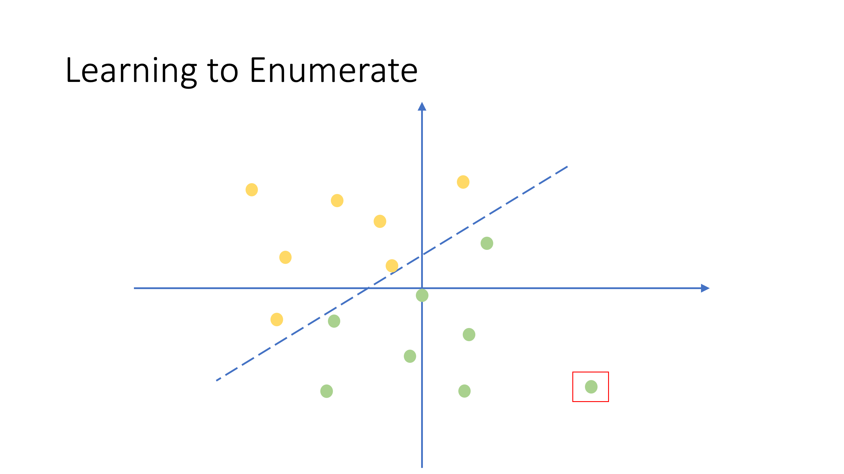
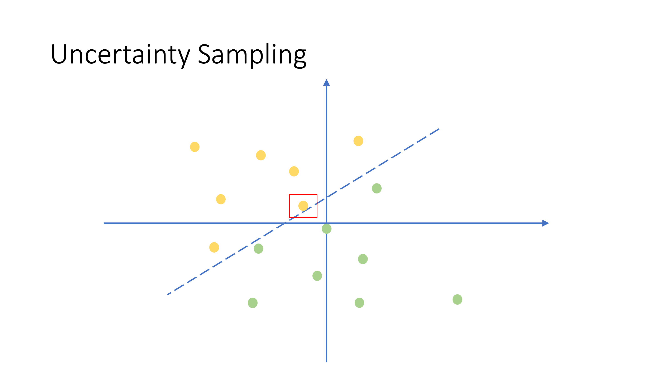
Related Work
For the requirement in human examination phase, “Learning to Enumerate” [Joger et al., 2016] tries to find target data faster
Select samples with high confidence of target class
For the requirement in model prediction phase, uncertainty sampling makes the model learn faster by feeding more difficult samples (low confidence)
In binary classification, 0.5 confidence given by current model
Notes:
About existing related work, for the requirement in human examination phase, Joger et al. have proposed a method called Learning to Enumerate, trying to find target data faster. The idea is to select data with high confidence of target class.
[POINT] for example, in linear model, we can pick up the farthest data to the decision boundary.
While for the requirement in model prediction phase, Uncertainty sampling makes the model learn faster by feeding more difficult samples. The term difficult here is defined as samples with low confidence.
[POINT] for example, we can pick up the nearest data to the decision boundary.

Slide 16
Problem 2: Difficulty in Estimation
We want to switch to model prediction phase, but how to know whether the model is well-trained or not?
Usually, there is no test set for evaluation in real application
It is possible to split a part of labeled data as test set
Estimation becomes difficult due to the bias from original real world distribution
A split test set of labeled pool
An independent test set
Notes:
Another problem is that when to switch to model prediction, and how to know whether the model is well-trained or not? Usually, there is no test set for evaluation in real application. An alternative is to split a part of labeled pool as test set. This is reasonable in random sampling. but when we extract more target-like data, the labeled pool is biased. And as a result, estimation becomes difficult.
[POINT] these are f1 score on a split test set of labeled pool on the left, and f1 score on a totally independent test set on the right. the one on the right is the real performance of the model, we try to use the left one to estimate the right one, but we can see that they are giving totally different results.

Slide 17
Simulation for Research Purpose
Oracle Test Set: An independent test set to evaluate the real performance of obtained model
Without bias
Not available in real application
Current Test Set: A split part of labeled data, to give feedback
Biased towards target data
Available in real application
Notes:
So to evaluate the details in the process, we propose a simulation framework for research purpose. We define two new concepts in this framework. The first one is Oracle Test Set, this is A test set to evaluate the real performance of obtained model. This test set is without any bias, but not available in real application.
Another concept is called Current Test Set. This can be obtained as a split part of labeled pool. The purpose of current test set is to provide a Feedback of model performance in real application. Current test set is biased, but available in real application.

Slide 18
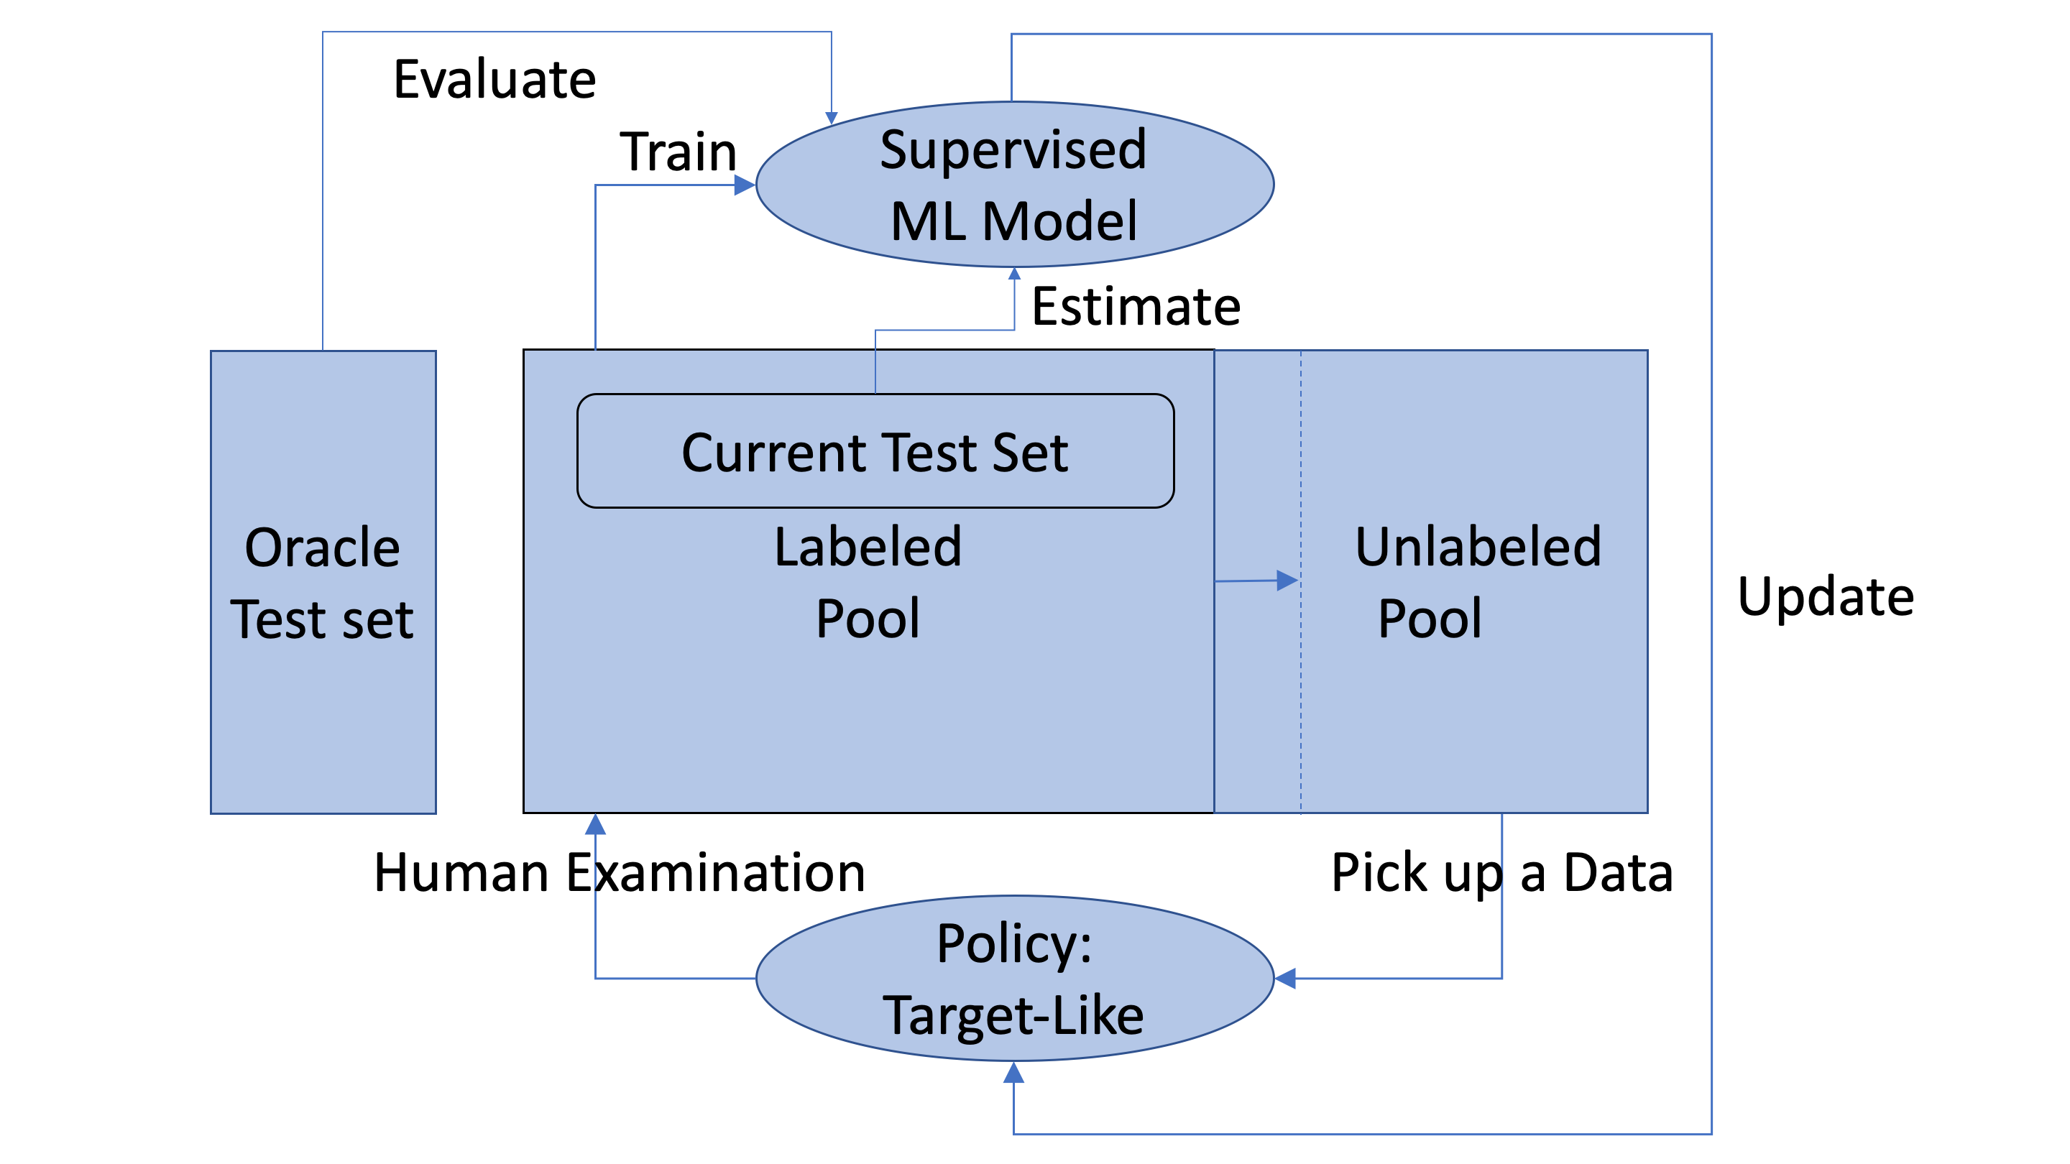
Simulation for Research Purpose
Notes:
This a flow chart of simulation for research purpose. [POINT] For evaluation, we use the oracle test set, which is totally independent to this process. And the current test set is a split part of the labeled pool.

Slide 19
Proposed Approach
Notes:
And I will continue to introduce our proposed approach.

Slide 20
Random Starter Method (for Problem 1)
We give the human examination phase with a “warm” start of random sampling
10% random sampling at start, and then implement target extraction method
This is not an improving approach, but a compromised one to balance the trade-off between model performance and target extraction
Notes:
For the first problem of target performance dilemma, The key idea of this random starter method is to begin the human examination phase with a “warm” start of random sampling. However, This is not an improving approach, but a compromised one to balance the trade-off between model performance and target extraction.

Slide 21
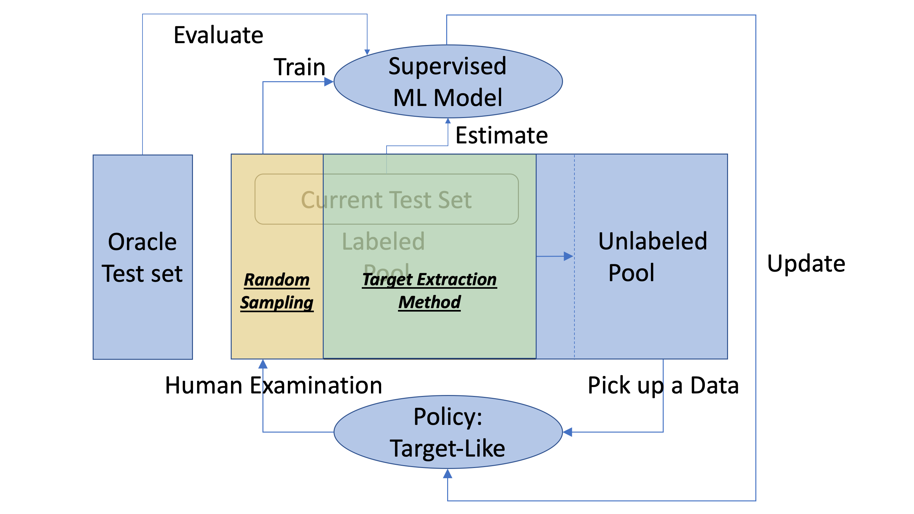
Random Starter Method
Notes:
This is the flow chart of proposed random starter method. [POINT] At the start, we implement random sampling, and then switch to target extraction method.

Slide 22
When to Switch? (for Problem 2)
We observe metric curves on current test set
Use experimental phenomena to estimate whether the model is well-trained or not
Details will be explained in experiments part
Notes:
And for the other problem of estimation difficulty, we propose to observe metric curves on current test set, and use a regular phenomena to estimate whether the model is well-trained or not. Because we use experimental results, details will be explained in the following experiment part.

Slide 23
Experiments
Notes:
And I will talk about our experiments.

Slide 24
Datasets
Document classification tasks
Dataset 1:
SMS messages
SPAM/HAM classification
1500 total
50% SPAM messages (target)
Dataset 2:
Movie Reviews
Positive (Rating 1~5) / Negative (Rating 6~10) classification
4000 total
20% positive reviews (target)
Notes:
For the datasets used in experiments, we mainly focus on Document classification tasks. And to deal with the influence of data balancy, we compared balanced data and unbalanced data. The datasets are text messages and movie reviews.

Slide 25

Machine Learning Model Selection
Support Vector Machine
Sufficient performance, efficient to train, robust to hyper-parameters
Long Short Term Memory
Random Forest
Notes:
For machine learning model selection, we compared support vector machine, long short term memory, and random forest. We finally chose SVM since it gives sufficient performance, and it is much more efficient to train and also robust to hyper-parameters.

Slide 26
Experiments
Results on Dataset 1 (SMS Messages, Balanced Data)
Notes:
I will discuss the results on dataset 1 at first. This is a balanced dataset.

Slide 27
Target-Performance Trade-off (Problem 1)
Although random starter method cannot find target data as fast as pure target extraction method, it provides a sufficient R-precision
Notes:
From the aspect the target-performance dilemma. In these results, we can see that the random starter method in blue curve is giving a compromised behavior [POINT]. Although it cannot find target data as fast as the pure method, it gives a sufficient ranking performance.

Slide 28
Estimation of Model Performance (Problem 2)
Current Test Set
(current estimation)
“Current precision pit”: After finding most target data, the training can get rid of the influence of the bias
Oracle Test Set
(real performance)
Notes:
And about estimation difficulty, The figure in red box [POINT] is the f1-score on oracle test set, which is the real performance. And on the top [POINT] are f1 score and precision on current test set. We try to use these to estimate the real performance. We can see an obvious pit in precision on current test set. Although f1-score on current test set and oracle test set goes different at the early steps, they converge after striding over the pit. So when we observe this pit in real application, it is reasonable to use current f1-score to evaluate the model.
The reason of this current precision pit is because that after finding most target data, the system will pick up more non-target data, and the labeled pool, which is our training set, is able to get rid of the influence of bias and begin to learn the classification task.

Slide 29
Experiments
Results on Dataset 2 (Movie Reviews, Unbalanced Data)
Notes:
And we continue to the results on dataset 2, which is an unbalanced dataset.

Slide 30
Target-Performance Trade-off (Problem 1)
R-precision is opposite on balanced and unbalanced data, but random starter method showed compromised results on both
Notes:
from the aspect of target-performance dilemma. We can see that in R-Precision, it is opposite on the balanced data and unbalanced data, this time target extraction gives better model, because obviously, the labeled pool is more balanced at the early steps.[POINT]
And the random starter method is able to provide a stable compromised result, no matter the data is balanced or not.

Slide 31
Estimation of Model Performance (Problem 2)
Current Test Set
(current estimation)
F1-score on current/oracle test set begin to converge after striding over the “current precision pit”
Oracle Test Set
(real performance)
Notes:
and about estimation difficulty, similarly, we use current f1 score and precision to estimate oracle f1 score.
[POINT] we can see that the there is a pit in current precision, too.
So the current precision pit is a signal that the model is being properly trained, and we can switch to model prediction after striding over the pit.

Slide 32
Conclusion
Notes:
Finally, I will discuss about the conclusion from this research.

Slide 33
Conclusion
We defined Target Extraction Learning Problem
Purpose: Extract target data faster
Human Examination Phase: Querying more target-like data
Model Prediction Phase: Switch from human examination to model prediction
Dilemma between target data extraction and model performance
Bias towards target data
Try to estimate the performance with experimental phenomena
A “pit” in precision curve on current test set
Evaluation on current and oracle test set converges after the “pit”
Proposed a trade-off approach
Use random sampling as a “warm” start
Gives compromised results, both on balanced and unbalanced data
Notes:
First, we defined a new problem called Target Extraction Learning. The purpose is to Extract target data faster, and we propose a two-phase approach. At human examination phase, the system should Query more target-like data for examination, and at model prediction prediction phase, we Switch from human examination to model prediction. We also analyze the Dilemma between target data extraction and model performance due to the Bias towards target data. And we Try to estimate the performance with experimental phenomena. We can observe A “pit” in precision curve on current test set, and we are able to estimate the model performance since the results on current test set and oracle test set begin to converge after striding over the pit. Finally, we proposed a trade-off approach with a warm start of random sampling, and it gives compromised results, both on balanced and unbalanced data.

