Slide 1
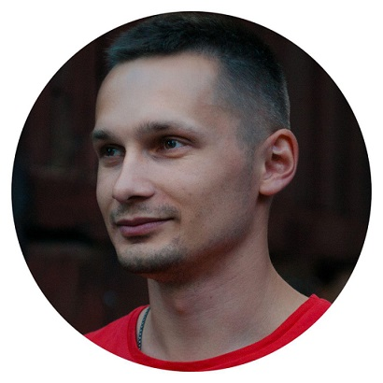

CI/CD pipeline for web app
Oleg Roztorguiev
Kharkiv DevOps KhNURE

Slide 2

o1eg.pp.ua

Slide 3
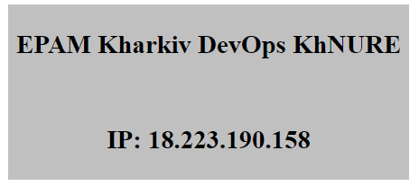
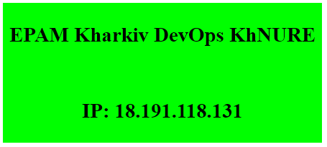
o1eg.pp.ua
Github

Slide 4

Magic happening now
Please wait...

Slide 5









Tools

Slide 6
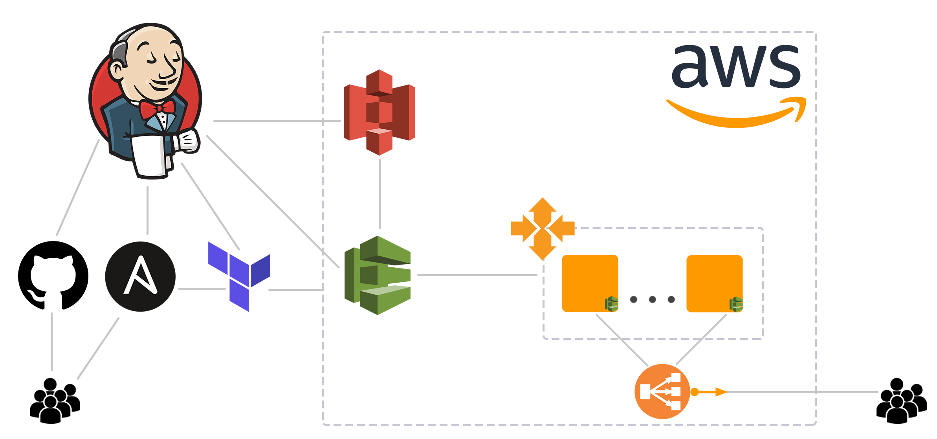
Project architecture
S3
Auto Scaling Group
CodeDeploy
Elastic IP
Developers
Load balancer
Users

Slide 7
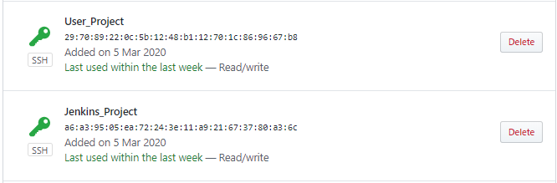
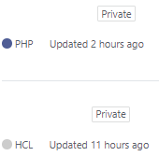
Github
project_site
project_iac

Slide 8
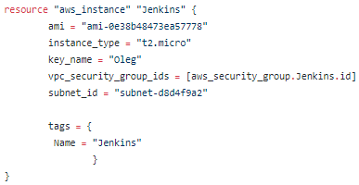
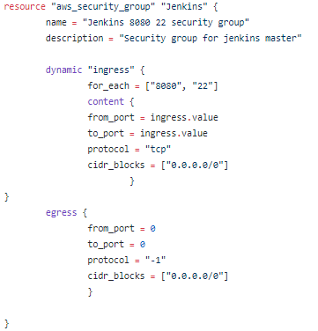
Terraform
EC2 instance
Security group

Slide 9
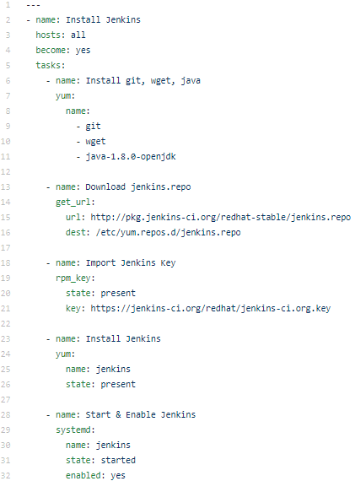
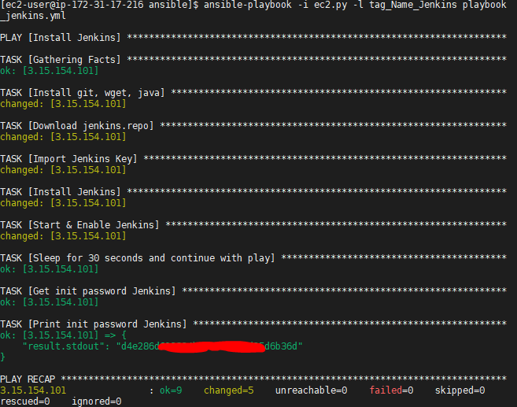
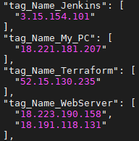
Ansible
Dynamic inventory
ansible-playbook -i ec2.py -l tag_Name_Jenkins playbook_jenkins.yml

Slide 10
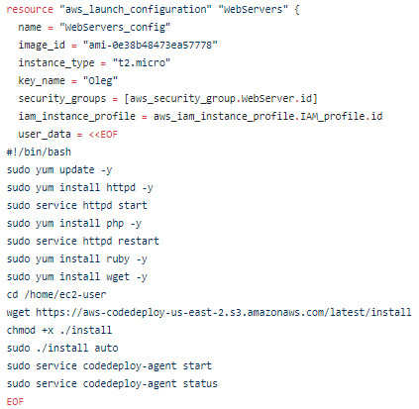

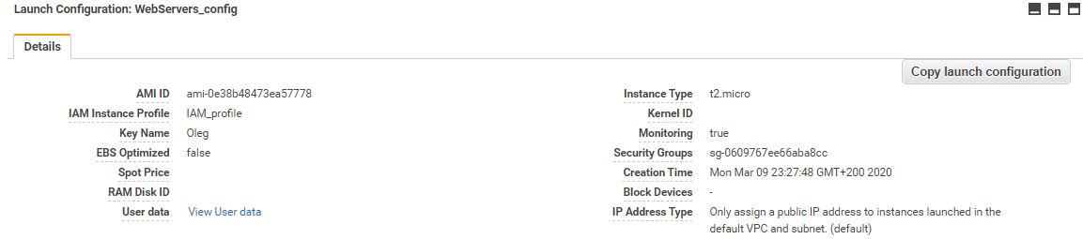

Slide 11
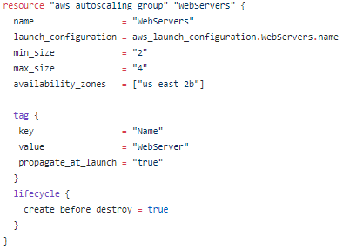
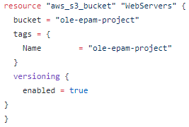
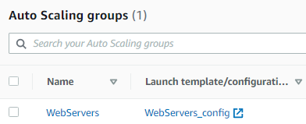


Slide 12
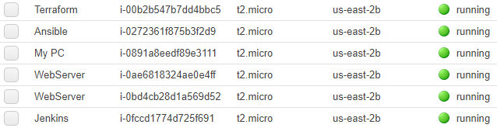
AWS

Slide 13
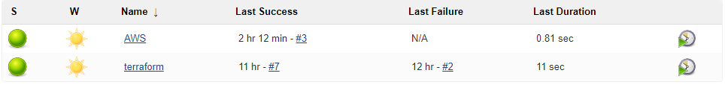
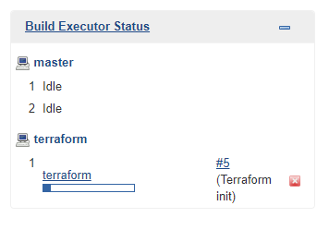
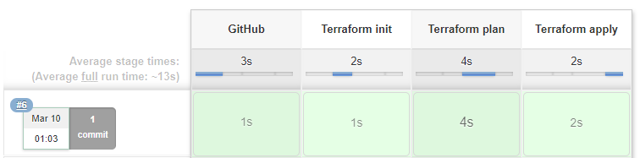
Jenkins

Slide 14
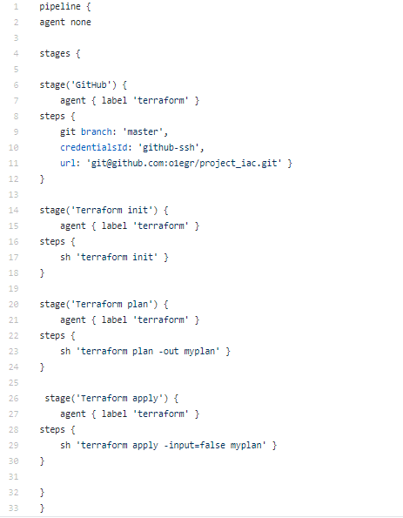
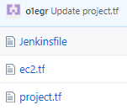
Jenkinsfile

Slide 15

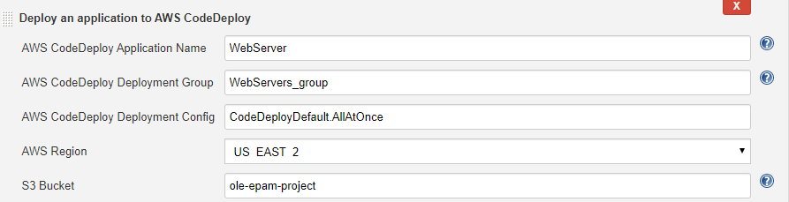
AWS Codedeploy Plugin

Slide 16
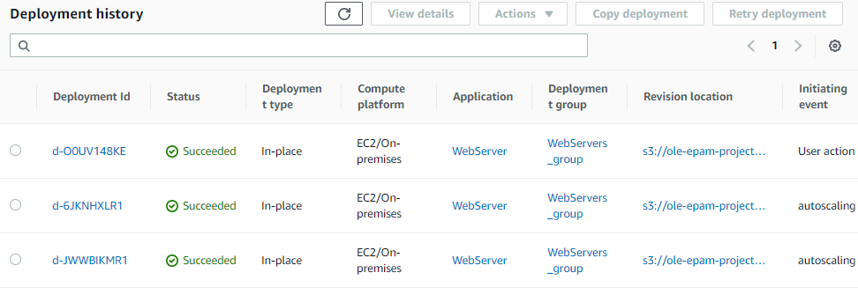
AWS Codedeploy

Slide 17
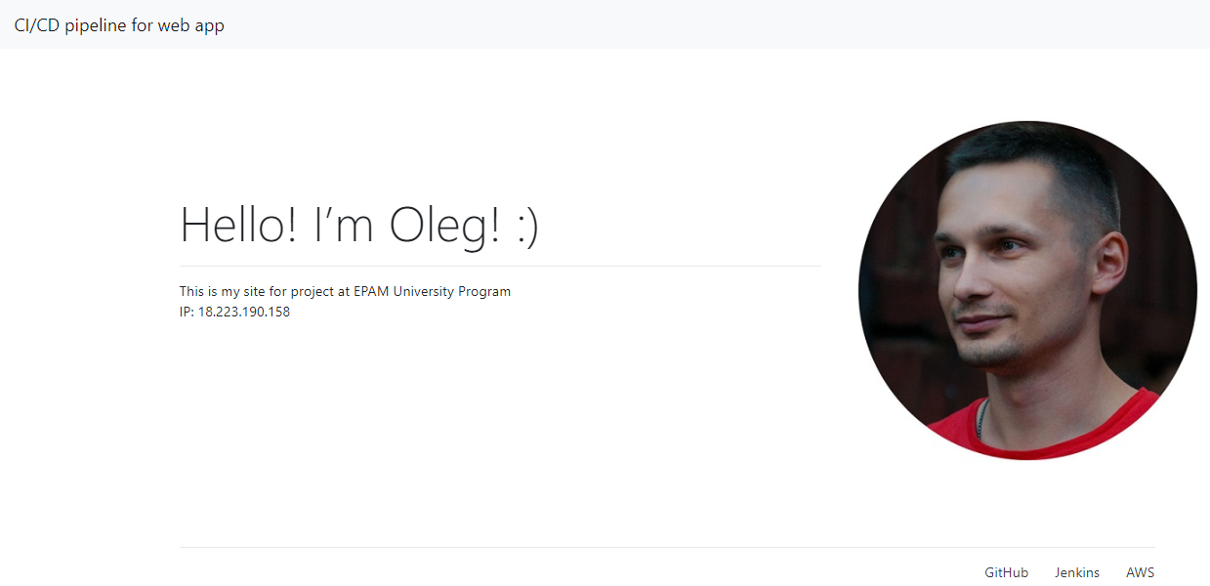
After deploy

Slide 18
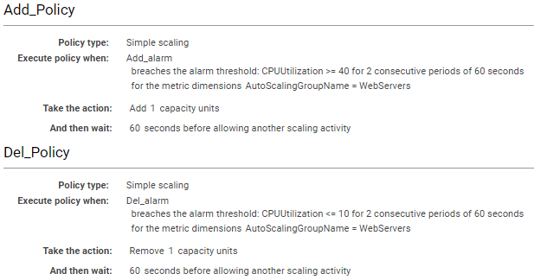
Auto Scaling

Slide 19

Auto Scaling

Slide 20
Thank you for attention!
Q&A

