Slide 1
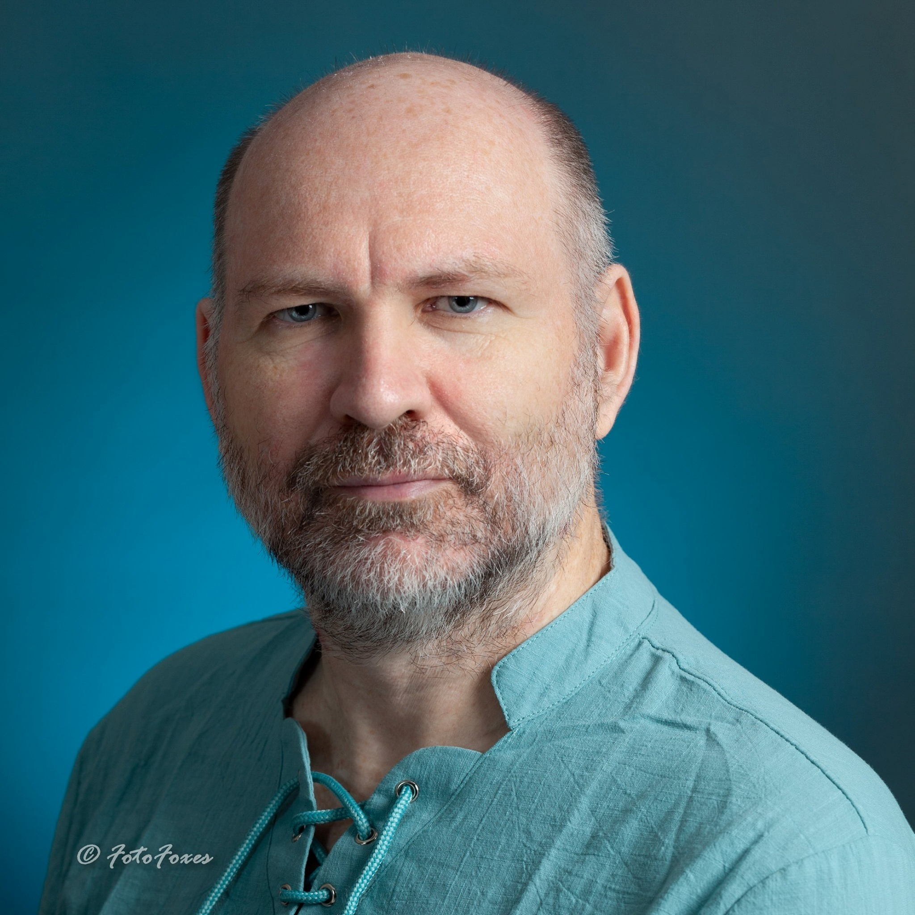
Alex Fedin
20+ years in the software engineering

Slide 2






Intro
Software Engineer with 20+ years of total experience
Worked in a broad field of technologies
Significantly contributed into a wide variety of things we use and will use in our everyday life
Led big teams, small teams, overseas teams

Slide 3
Projects Overview
NASA UAS Traffic Management (UTM) Project
Led a group for the multi-year UTM project, helped to create a research platform to manage large numbers of drones flying at low altitudes in the US. Collaborated with internal and external partners across various industries, academia, and government agencies to research and develop the platform.
NASA Data & Reasoning Fabric (DRF) Project
Developed data and reasoning services platform for the traditional and emerging air mobility ecosystem; engaged stakeholders in use-cases and demonstrated key data and reasoning functions; helped to develop business plan for self-sustaining advanced air mobility data and reasoning services marketplace.
NASA Artemis Project (get back to the Moon)
Developed a tool to convert Matlab mathematical models to CUDA C+ code. Through the Artemis missions, NASA will be able to land the first woman and person of color on the Moon, explore more of the lunar surface than ever before, collaborate with commercial and international partners, and establish a long-term presence on the Moon. Ultimately, this will set the stage for sending the first astronauts to Mars.

Slide 4
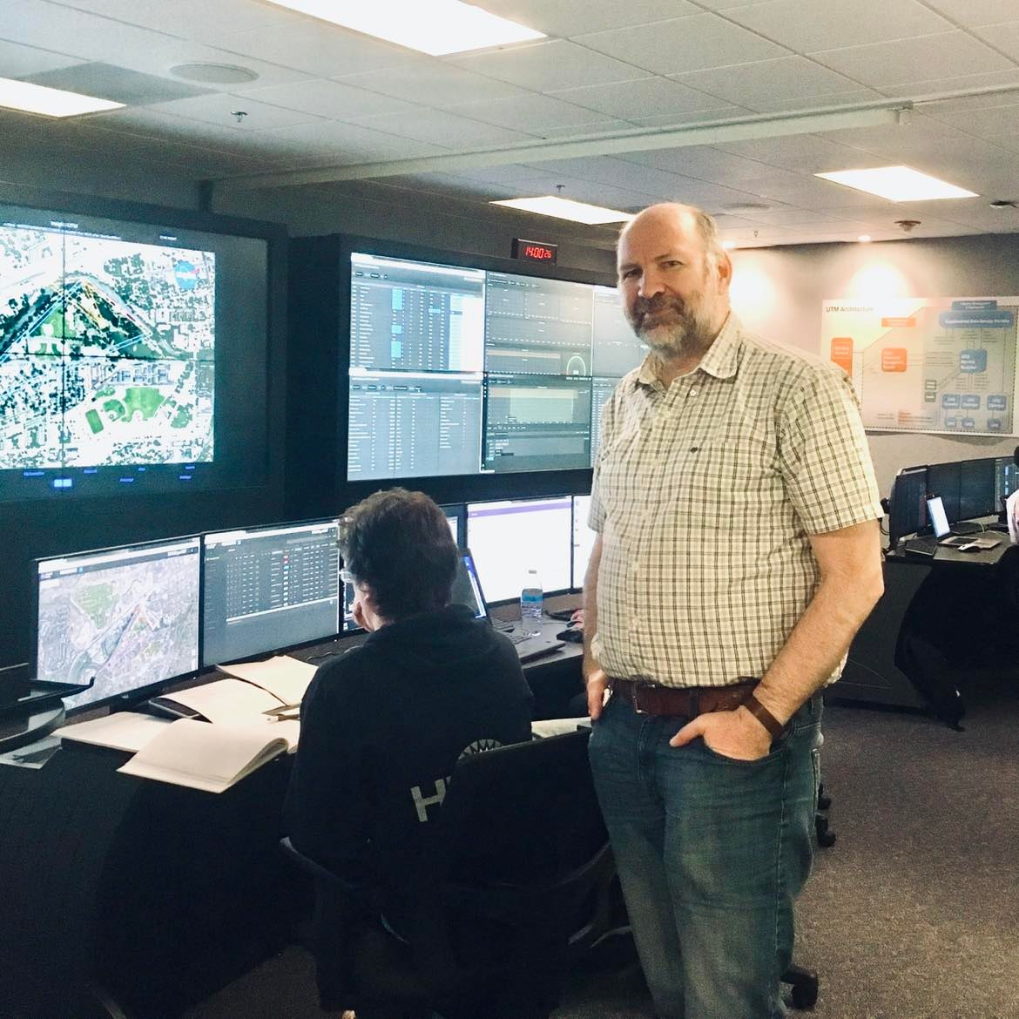
Commitments
NASA UTM
Led the design and implementation of the soft-realtime telemetry ingestion and validation services which were successfully used under a serious load at NASA test sites in Nevada and Texas.
NASA DRF
Led the design and implementation of the:
robust registration and discovery set of protocols based on Torrent DHT
decentralized authentication mechanisms
NASA Artemis
Proposed, designed and implemented a transpiler to convert Matlab models to CUDA C++

Slide 5
Media
Unmanned Aircraft Systems Traffic Management (UTM)
Data & Reasoning Fabric (DRF)
Artemis Mission

Slide 6
5. Q&A

Slide 7
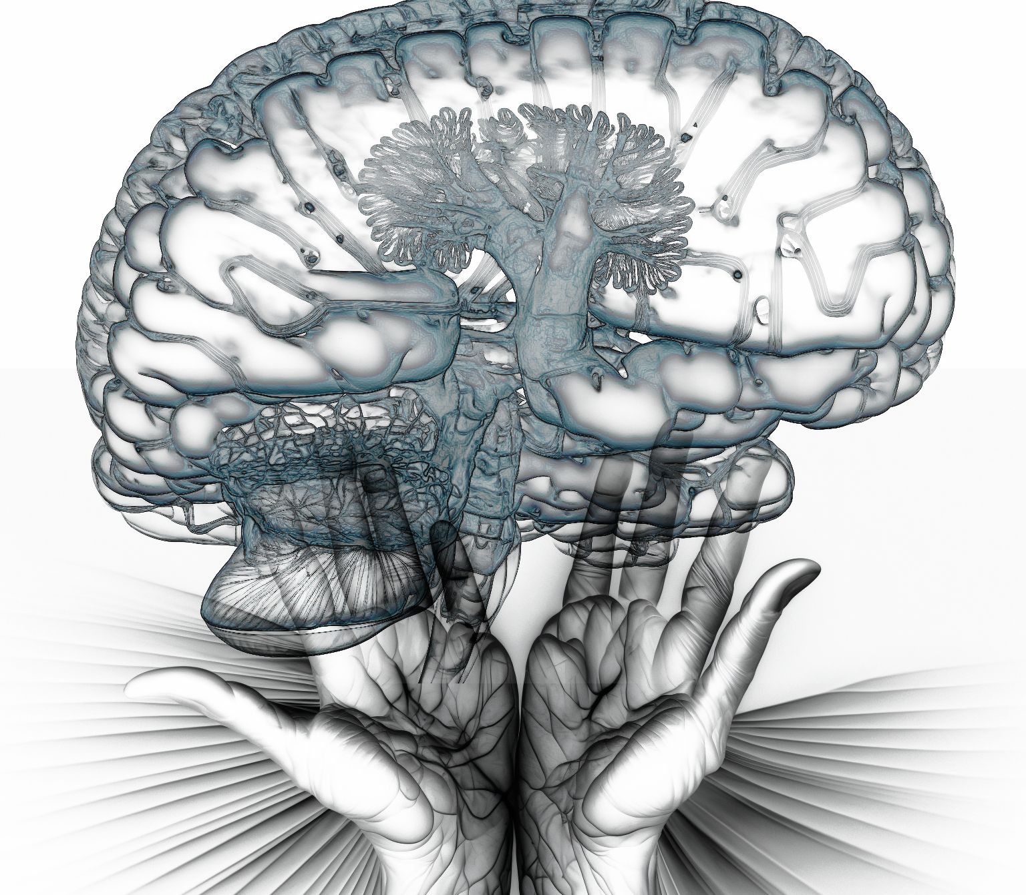
Conclusion

