Slide 1
NoLock Social
A next-generation platform rebuilding digital trust with decentralized identity in a $12B market.
A next-generation platform rebuilding digital trust with decentralized identity in a $12B market.
A next-generation platform rebuilding digital trust with decentralized identity in a $12B market.
Pre-Seed Investment Opportunity
• Next-Generation Trust Infrastructure
• Decentralized Identity and Social Tools
• $12.1B Market | 25% Annual Growth Rate
Source: Market Research Future (MRFR)
Rebuild Trust in the Digital Space

Slide 2
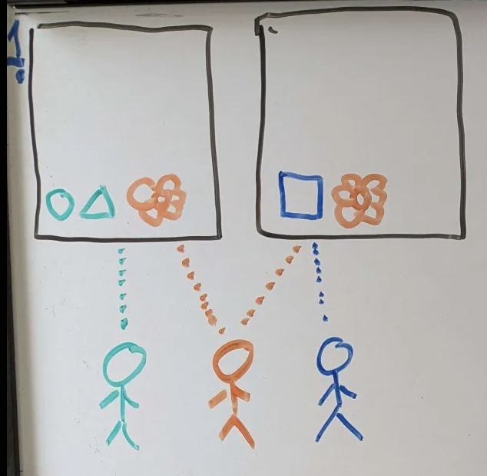
The Problem I
Distrust in Digital Space
Content authenticity issues and lack of ownership create fundamental digital trust challenges.
Content authenticity issues and lack of ownership create fundamental digital trust challenges.
Content authenticity issues and lack of ownership create fundamental digital trust challenges.
Content authenticity issues and lack of ownership create fundamental digital trust challenges.
Content authenticity issues and lack of ownership create fundamental digital trust challenges.
• **Content that can be secretly modified**
• No guarantee that what you see is what was produced
• Source: Reuters Digital News Report
• **No inherent ownership means no responsibility**
• Rampant misinformation without accountability
• Source: World Economic Forum
"76% of users struggle to identify authentic content in digital spaces"
Content authenticity issues and lack of ownership create fundamental digital trust challenges.
• **Content that can be secretly modified**
• No guarantee that what you see is what was produced
• Source: Reuters Digital News Report
• **No inherent ownership means no responsibility**
• Rampant misinformation without accountability
• Source: World Economic Forum
"76% of users struggle to identify authentic content in digital spaces"
Critical Issues:
• Content that can be secretly modified
• No guarantee that what you see is what was produced
• Source: Reuters Digital News Report
• No inherent ownership means no responsibility
• Rampant misinformation without accountability
• Source: World Economic Forum
"76% of users struggle to identify authentic content in digital spaces"
Content that can be secretly modified
No guarantee that what you see is what was produced
Source: Reuters Digital News Report
No inherent ownership means no responsibility
Rampant misinformation without accountability
Source: World Economic Forum
• Content that can be secretly modified
• No guarantee that what you see is what was produced
• No inherent ownership means no responsibility
• Rampant misinformation without accountability
Content that can be secretly modified
No guarantee that what you see is what was produced
Source: Reuters Digital News Report
No inherent ownership means no responsibility
Rampant misinformation without accountability
Source: World Economic Forum
**Content that can be secretly modified**
No guarantee that what you see is what was produced
Source: Reuters Digital News Report
**No inherent ownership means no responsibility**
Rampant misinformation without accountability
Source: World Economic Forum
"76% of users struggle to identify authentic content in digital spaces"
"76% of users struggle to identify authentic content in digital spaces"
"76% of users struggle to identify authentic content in digital spaces"
"76% of users struggle to identify authentic content in digital spaces"

Slide 3
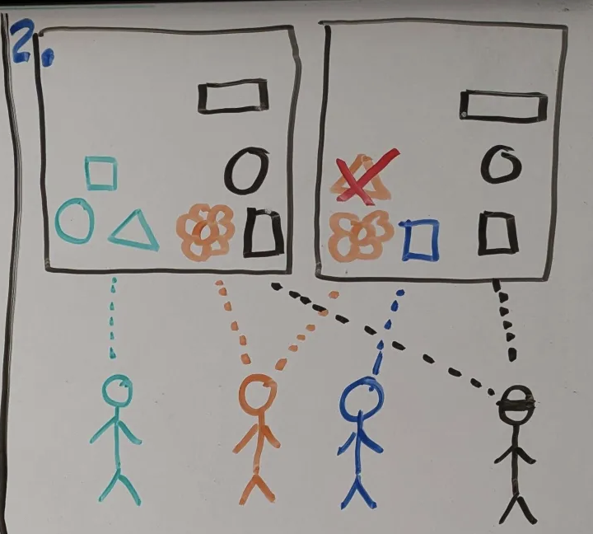
Digital Vulnerability
The Problem II
Centralized data vulnerabilities and the surveillance economy compromise user privacy and security.
Centralized data vulnerabilities and the surveillance economy compromise user privacy and security.
• **Centralized data storage risks**
• Single point of failure for billions of users
• Frequent breaches compromising sensitive information
• Source: Identity Theft Resource Center
• **User data as business model**
• $450B market built on privacy exploitation
• Source: Harvard Business Review
"Digital infrastructure is increasingly built on extractive economics rather than value creation"
Serious Vulnerabilities:
• Centralized data storage risks
• Single point of failure for billions of users
• Frequent breaches compromising sensitive information
• Source: Identity Theft Resource Center
• User data as business model
• $450B market built on privacy exploitation
• Source: Harvard Business Review
"Digital infrastructure is increasingly built on extractive economics rather than value creation"
**Centralized data storage risks**
Single point of failure for billions of users
Frequent breaches compromising sensitive information
Source: Identity Theft Resource Center
**User data as business model**
$450B market built on privacy exploitation
Source: Harvard Business Review
"Digital infrastructure is increasingly built on extractive economics rather than value creation"

Slide 4
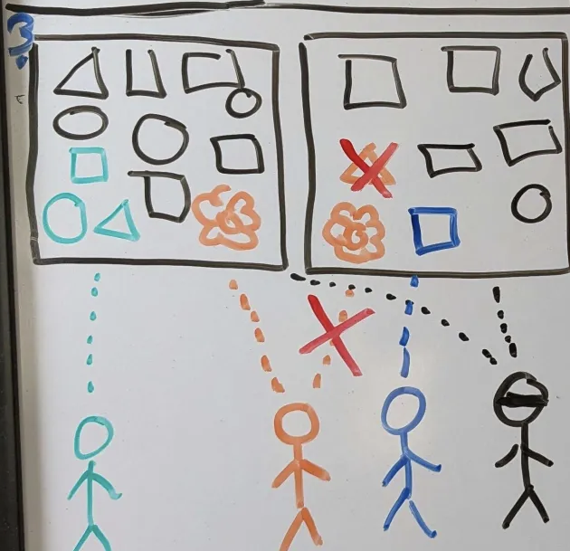
The Problem III
Trust Without Verification
Current digital systems require blind trust in central authorities without transparency.
Current digital systems require blind trust in central authorities without transparency.
• **Trust without verification**
• Systems rely on blind trust in central authorities
• No transparency into data integrity
• Source: World Economic Forum Trust Report
• **Siloed ecosystems**
• Walled gardens prevent interoperability
• User lock-in through platform dependence
• Source: Competition in Digital Markets Report
"83% of consumers express concern about how their data is being used online"
Fundamental Design Flaws:
• Trust without verification
• Systems rely on blind trust in central authorities
• No transparency into data integrity
• Source: World Economic Forum Trust Report
• Siloed ecosystems
• Walled gardens prevent interoperability
• User lock-in through platform dependence
• Source: Competition in Digital Markets Report
"83% of consumers express concern about how their data is being used online"
**Trust without verification**
Systems rely on blind trust in central authorities
No transparency into data integrity
Source: World Economic Forum Trust Report
**Siloed ecosystems**
Walled gardens prevent interoperability
User lock-in through platform dependence
Source: Competition in Digital Markets Report
"83% of consumers express concern about how their data is being used online"

Slide 5
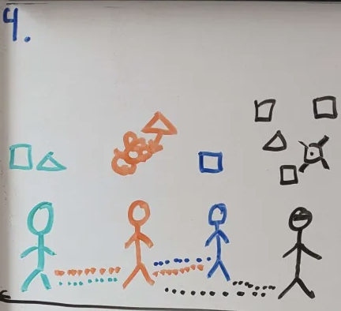
Our Vision
A New Digital Infrastructure
Building a new trust layer based on cryptographic proof rather than blind trust.
Building a new trust layer based on cryptographic proof rather than blind trust.
• **Rebuilding digital trust through decentralized technology**
• User-controlled identity and content verification
• Source: Web3 Foundation
• **Digital interactions based on cryptographic proof, not blind trust**
• Transparent content verification without central authority
• Source: MIT Digital Currency Initiative
• **Networks of trust that mimic real-world social dynamics**
• Content filtering through trusted relationships, not algorithms
• Source: Nature: Human Behavior
""Creating digital spaces where trust can be earned rather than assumed""
Building a New Trust Layer:
• Rebuilding digital trust through decentralized technology
• User-controlled identity and content verification
• Source: Web3 Foundation
• Digital interactions based on cryptographic proof, not blind trust
• Transparent content verification without central authority
• Source: MIT Digital Currency Initiative
• Networks of trust that mimic real-world social dynamics
• Content filtering through trusted relationships, not algorithms
• Source: Nature: Human Behavior
""Creating digital spaces where trust can be earned rather than assumed""
**Rebuilding digital trust through decentralized technology**
User-controlled identity and content verification
Source: Web3 Foundation
**Digital interactions based on cryptographic proof, not blind trust**
Transparent content verification without central authority
Source: MIT Digital Currency Initiative
**Networks of trust that mimic real-world social dynamics**
Content filtering through trusted relationships, not algorithms
Source: Nature: Human Behavior
""Creating digital spaces where trust can be earned rather than assumed""

Slide 6
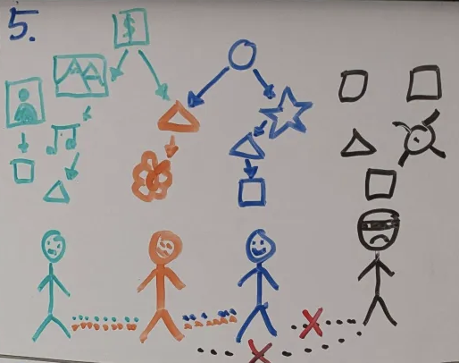
Market Opportunity
Decentralized Social Networks & Digital Trust
A rapidly growing $12B market projected to reach $101B by 2033 with clear TAM/SAM/SOM breakdown.
A rapidly growing $12B market projected to reach $101B by 2033 with clear TAM/SAM/SOM breakdown.
• $12.13 billion in 2023
• Projected to reach $101.2 billion by 2033
• 25% CAGR
• Source: Market Research Future (MRFR)
• $4.8 billion (40% of TAM)
• Identity & content verification segments
• Source: Grand View Research
• Year 1: $24 million (0.5% of SAM)
• Year 3: $240 million (5% of SAM)
• Based on projected adoption rates for Web3 technologies
A rapidly growing $12B market projected to reach $101B by 2033 with clear TAM/SAM/SOM breakdown.
Market Analysis:
Total Addressable Market (TAM):
• $12.13 billion in 2023
• Projected to reach $101.2 billion by 2033
• 25% CAGR
• Source: Market Research Future (MRFR)
Serviceable Addressable Market (SAM):
• $4.8 billion (40% of TAM)
• Identity & content verification segments
• Source: Grand View Research
Serviceable Obtainable Market (SOM):
• Year 1: $24 million (0.5% of SAM)
• Year 3: $240 million (5% of SAM)
• Based on projected adoption rates for Web3 technologies
Market Analysis:
• $12.13 billion in 2023
• Projected to reach $101.2 billion by 2033
• 25% CAGR
• Source: Market Research Future (MRFR)
• $4.8 billion (40% of TAM)
• Identity & content verification segments
• Source: Grand View Research
• Year 1: $24 million (0.5% of SAM)
• Year 3: $240 million (5% of SAM)
• Based on projected adoption rates for Web3 technologies
$12.13 billion in 2023
Projected to reach $101.2 billion by 2033
25% CAGR
Source: Market Research Future (MRFR)
$4.8 billion (40% of TAM)
Identity & content verification segments
Source: Grand View Research
Year 1: $24 million (0.5% of SAM)
Year 3: $240 million (5% of SAM)
Based on projected adoption rates for Web3 technologies

Slide 7
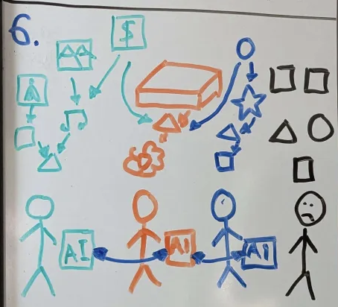
Our Solution
Universal Content-Addressable Storage
Our core technology uses content-addressable storage with superior efficiency and security.
Our core technology uses content-addressable storage with superior efficiency and security.
• **Content identified by cryptographic hash, not location**
• Guarantees content authenticity and integrity
• Source: Computer Science principles of CAS
• **Secure, conflict-free data synchronization across devices**
• Eliminates single points of failure
• Source: IPFS Documentation
• **Significant reduction in storage space and network traffic**
• 40-60% more efficient than traditional content-addressed storage
• [Source: Our proprietary benchmarks]()
""Our unique implementation of CAS technology provides the foundation for rebuilding digital trust""
Core Technology:
• Content identified by cryptographic hash, not location
• Guarantees content authenticity and integrity
• Source: Computer Science principles of CAS
• Secure, conflict-free data synchronization across devices
• Eliminates single points of failure
• Source: IPFS Documentation
• Significant reduction in storage space and network traffic
• 40-60% more efficient than traditional content-addressed storage
• [Source: Our proprietary benchmarks]()
""Our unique implementation of CAS technology provides the foundation for rebuilding digital trust""
**Content identified by cryptographic hash, not location**
Guarantees content authenticity and integrity
Source: Computer Science principles of CAS
**Secure, conflict-free data synchronization across devices**
Eliminates single points of failure
Source: IPFS Documentation
**Significant reduction in storage space and network traffic**
40-60% more efficient than traditional content-addressed storage
[Source: Our proprietary benchmarks]()
""Our unique implementation of CAS technology provides the foundation for rebuilding digital trust""

Slide 8
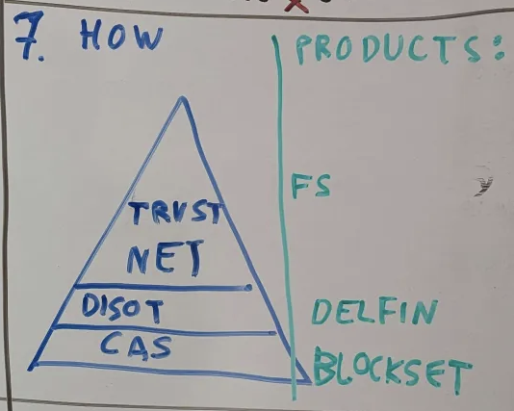
Business Model
Dual Revenue Streams
Dual revenue streams combining B2C freemium subscriptions and B2B technology licensing.
Dual revenue streams combining B2C freemium subscriptions and B2B technology licensing.
• Freemium subscription model
• Free tier: Core identity & basic social features
• Premium tier: $7.99/month for advanced features
• Enhanced privacy controls
• Content discovery algorithms
• Extended storage
• Source: Social platform pricing benchmarks
• Enterprise identity solutions: $10K-50K/month
• Decentralized storage infrastructure: $5K-30K/month
• Custom implementations: Project-based pricing
• Source: Web3 B2B pricing models
"Projected gross margins: 75-85% | [Industry benchmark source](https://medium.com/breadcrumb/saas-economics-gross-margin-part-1-919df3eb8e8e)"
Two-Pronged Approach:
• Freemium subscription model
• Free tier: Core identity & basic social features
• Premium tier: $7.99/month for advanced features
• Enhanced privacy controls
• Content discovery algorithms
• Extended storage
• Source: Social platform pricing benchmarks
• Enterprise identity solutions: $10K-50K/month
• Decentralized storage infrastructure: $5K-30K/month
• Custom implementations: Project-based pricing
• Source: Web3 B2B pricing models
"Projected gross margins: 75-85% | [Industry benchmark source](https://medium.com/breadcrumb/saas-economics-gross-margin-part-1-919df3eb8e8e)"
Freemium subscription model
Free tier: Core identity & basic social features
Premium tier: $7.99/month for advanced features
Enhanced privacy controls
Content discovery algorithms
Extended storage
Source: Social platform pricing benchmarks
Enterprise identity solutions: $10K-50K/month
Decentralized storage infrastructure: $5K-30K/month
Custom implementations: Project-based pricing
Source: Web3 B2B pricing models
"Projected gross margins: 75-85% | [Industry benchmark source](https://medium.com/breadcrumb/saas-economics-gross-margin-part-1-919df3eb8e8e)"

Slide 9
DISOT
Decentralized Immutable Source of Truth
DISOT enables mutable data with immutable history through digital signatures.
""DISOT creates a foundation for trusted content that can be updated while maintaining verifiable history""
DISOT enables mutable data with immutable history through digital signatures.
Building on CAS:
• Uses digital signatures to allow mutable data
• Combines content immutability with data evolution
• Identity linked to content through cryptographic proof
• Source: Digital Signatures in Distributed Systems
• No third-party trust required
• Verification through mathematics, not authority
• 3x more efficient than blockchain alternatives
• [Source: Our benchmarks versus Ethereum and Filecoin]()
• Patented implementation technology
• 8 provisional patents filed and pending
• [Source: US Patent & Trademark Office]()
""DISOT creates a foundation for trusted content that can be updated while maintaining verifiable history""
""DISOT creates a foundation for trusted content that can be updated while maintaining verifiable history""

Slide 10
Networks of Trust
Social Connections Based on Trust
const add = a => b => a + b
export default add
Networks of Trust mirror how humans naturally establish trust relationships in the real world.
Networks of Trust mirror how humans naturally establish trust relationships in the real world.
""Our trust networks mirror how humans naturally establish and maintain trust in the real world""
Subjective Trust:
• Social connections based on real-world trust
• No centralized "trust score" or black-box algorithm
• Source: Social Network Trust Models
• Trust delegation across networks
• Discover new content through weighted social connections
• Natural information filtering through trusted relationships
• Source: Trust Propagation Models
• Progressive trust building
• Trust evolves through repeated positive interactions
• Source: Trust in Digital Environments
""Our trust networks mirror how humans naturally establish and maintain trust in the real world""
const strawberryJam = 12_00n
const honey = 14_00n
export default {
strawberryJam,
honey,
}
const transaction = {
from: "p256k1:dj920f091238f4911md91590s3908g0sqcqp892985829gh387sq",
to: "p256k1:asjo3o248500wcuwo138902839fds3du90sskdp234960240jfoy",
amount: 1023_57n,
}
export default transaction
""Our trust networks mirror how humans naturally establish and maintain trust in the real world""

Slide 11
FunctionalScript
Content-Addressable Programming
FunctionalScript provides a 40% performance improvement for content-addressable operations.
""FunctionalScript makes building with content-addressable storage as easy as working with traditional databases""
FunctionalScript provides a 40% performance improvement for content-addressable operations.
Key Technology:
• Purpose-built language for immutable data operations
• Compatible with JavaScript for easy adoption
• 40% performance improvement over generic solutions
• [Source: Our benchmark tests versus JavaScript IPFS implementations]()
• Highly scalable for decentralized applications
• Deterministic execution for consistent results
• Optimized for content-addressable operations
• Source: Programming Language Performance Comparisons
• Proprietary innovation with patent protection
• Core IP with significant competitive barriers
• [Source: Our Patent Portfolio]()
""FunctionalScript makes building with content-addressable storage as easy as working with traditional databases""
""FunctionalScript makes building with content-addressable storage as easy as working with traditional databases""

Slide 12
Blockset
Blockset democratizes industrial-grade content-addressable storage for everyday use.
""Blockset makes industrial-grade content-addressable storage accessible and practical for everyday use""
Blockset democratizes industrial-grade content-addressable storage for everyday use.
Key Innovation:
• Core content-addressable storage technology
• Developed by our CTO Sergey Shandar
• [Source: Our Technical Documentation]()
• Democratizes CAS for individual users
• Previously only feasible for large infrastructure providers
• Now accessible for everyday applications
• [Source: Storage Efficiency Benchmarks]()
• Significant technical advantages
• 60% storage savings versus traditional IPFS
• 40% bandwidth reduction over competitors
• [Source: Our Internal Testing]()
""Blockset makes industrial-grade content-addressable storage accessible and practical for everyday use""
Core CAS Technology
""Blockset makes industrial-grade content-addressable storage accessible and practical for everyday use""

Slide 13
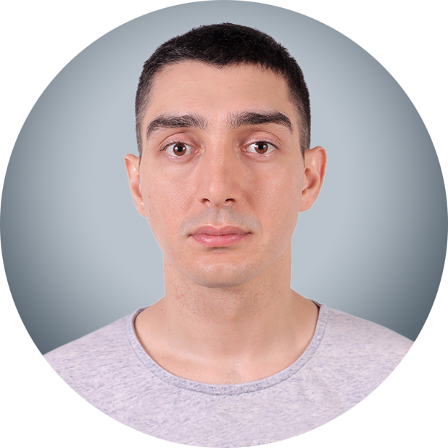



Delfin
Gela
Rodion
Decentralized Social Network
Alex
Delfin delivers a decentralized social network with user-owned identity and content.
Delfin delivers a decentralized social network with user-owned identity and content.
""Delfin is our flagship consumer application demonstrating the power of NoLock's technology stack""
Consumer Application:
• Decentralized social network based on trust models
• User-controlled content sharing and discovery
• Source: Decentralized Social Media Report
• User-owned identity and content
• Self-sovereign digital identity
• True content ownership with verifiable provenance
• Source: Self-Sovereign Identity Models
• Freemium model with advanced features
• Free tier for basic functionality
• $7.99/month premium tier for enhanced capabilities
• Source: Social Media Revenue Models
""Delfin is our flagship consumer application demonstrating the power of NoLock's technology stack""
""Delfin is our flagship consumer application demonstrating the power of NoLock's technology stack""

Slide 14
Benefits
Core Advantages
Our platform offers future-proof technology, offline functionality, and verifiable content.
Our platform offers future-proof technology, offline functionality, and verifiable content.
Platform Benefits:
• Future-Proof Technology
• Easy protocol and cryptography upgrades without data loss
• Source: Protocol Evolution in Distributed Systems
• Offline Functionality
• Works reliably without constant internet connectivity
• Source: Offline-First Web Applications
• Verifiable Content
• Ensures data authenticity and integrity through cryptographic proof
• Source: Content Verification Methods
• Personalized Trust
• User-defined trust ratings based on individual networks
• Source: Personalized Recommendation Systems

Slide 15
AI Foundation
Enabled by Content Addressing
Content-addressable AI ensures provenance and transparency for training data and models.
""Our infrastructure provides a foundation for truly trustworthy AI that users can verify, not just trust""
Content-addressable AI ensures provenance and transparency for training data and models.
AI Integration:
• Content-addressable AI training data
• Ensures provenance and reproducibility of models
• Source: AI Data Provenance
• Verifiable AI models
• Hash-based validation of model versions
• Transparent training lineage
• Source: Model Transparency Guidelines
• Trust-based AI recommendations
• Recommendations filtered through personal trust networks
• No black-box algorithmic manipulation
• Source: Trust in AI Systems
""Our infrastructure provides a foundation for truly trustworthy AI that users can verify, not just trust""
""Our infrastructure provides a foundation for truly trustworthy AI that users can verify, not just trust""

Slide 16
Product Overview
Platform & Applications
Our dual product strategy creates a complete ecosystem from infrastructure to user experience.
""Our products form a complete ecosystem for rebuilding digital trust from infrastructure to user experience.""
Our dual product strategy creates a complete ecosystem from infrastructure to user experience.
Dual Product Strategy:
• Social networking with trust-based content filtering
• Self-sovereign digital identity management
• Immutable content publishing & verification
• [Source: Our Product Roadmap]()
• Content-addressable storage infrastructure (CAS)
• Decentralized identity protocols
• Trust network API & developer tools
• [Source: Our Technical Documentation]()
""Our products form a complete ecosystem for rebuilding digital trust from infrastructure to user experience.""
""Our products form a complete ecosystem for rebuilding digital trust from infrastructure to user experience.""

Slide 17
Technology Advantage
Our Key Differentiators
Our key differentiators include proprietary technology with patent protection.
"8 provisional patents filed covering core technologies"
Our key differentiators include proprietary technology with patent protection.
Proprietary Technology Stack:
• Guarantees content authenticity and integrity
• 3x more efficient than blockchain alternatives
• [Source: Our Benchmark Testing]()
• Proprietary algorithm for weighted trust networks
• Enables personalized content filtering without black-box algorithms
• [Source: Our Research Publications]()
• Purpose-built for immutable data operations
• 40% performance improvement over generic solutions
• [Source: Language Performance Benchmarks]()
"8 provisional patents filed covering core technologies"
"8 provisional patents filed covering core technologies"

Slide 18
Competitive Landscape
Positioning in the Market
We combine the best elements of centralized usability and decentralized security.
"NoLock Social combines the usability of centralized platforms with the security of decentralized systems."
We combine the best elements of centralized usability and decentralized security.
Market Positioning:
• Twitter/X, Facebook: Rely on central authorities and closed algorithms
• Signal, Telegram: Better privacy, but limited functionality
• Our advantage: User-controlled identity + network effects
• Source: Compare centralized platforms
• Mastodon, Bluesky: Federation, not true decentralization
• IPFS, Filecoin: Storage focused, not social layer
• Our advantage: Complete stack with seamless UX + trust networks
• Source: Web3 social networks
"NoLock Social combines the usability of centralized platforms with the security of decentralized systems."
"NoLock Social combines the usability of centralized platforms with the security of decentralized systems."

Slide 19
Go-to-Market Strategy
Adoption & Growth Plan
Three-phase GTM strategy from developer adoption to mainstream users with clear metrics.
"Customer acquisition cost target: $3.50 per user | [Benchmark source](https://www.profitwell.com/recur/all/customer-acquisition-cost)"
Three-phase GTM strategy from developer adoption to mainstream users with clear metrics.
Multi-Phase Approach:
• Open core technology to developers
• Build 10 reference implementations
• Target: 5,000 developers
• Strategy: Developer-first adoption
• Focus on privacy-conscious users
• Partner with 3-5 influencers in target communities
• Target: 100,000 active users
• Market: Privacy-focused segment size
• Release enterprise partnerships
• Launch simplified onboarding for non-technical users
• Target: 1M+ active users
• Reference: Web3 adoption curves
"Customer acquisition cost target: $3.50 per user | [Benchmark source](https://www.profitwell.com/recur/all/customer-acquisition-cost)"
"Customer acquisition cost target: $3.50 per user | [Benchmark source](https://www.profitwell.com/recur/all/customer-acquisition-cost)"

Slide 20
Traction & Milestones
Progress & Roadmap
Demonstrated progress with early partnerships, developer traction, and clear roadmap.
Demonstrated progress with early partnerships, developer traction, and clear roadmap.
Progress To Date:
• Core infrastructure built and tested
• Alpha version of Delfin application
• [Source: Our GitHub Repository]()
• Integration with personal finance company for identity verification
• Two developer teams building on our API
• [Source: Our Partnership Announcements]()
• 2,500+ developers in early access program
• 15,000+ waitlist signups
• [Source: Our Internal Metrics]()
Next 12 Months:
• Public beta launch (Q3 2023)
• Enterprise partner program (Q4 2023)
• Full production launch (Q2 2024)
• [Source: Our Product Roadmap]()

Slide 21
Investment Ask
Funding Request & Use of Funds
Seeking $2.5M pre-seed funding to reach key milestones toward Series A readiness.
• Engineering team expansion (45%)
• Product development (30%)
• Marketing & user acquisition (15%)
• Operations & legal (10%)
• Reference: Typical fund allocation
• Public beta launch with 50,000+ active users
• Enterprise partnership program with 3-5 signed partners
• Complete patent portfolio for core technologies
• Benchmark: Successful pre-seed to seed metrics
• 18 months to Series A readiness
• Key metrics for next round: 150K+ users, $800K ARR
• Source: Funding benchmarks
• $10-12M (aligned with comparable pre-seed Web3 infrastructure projects)
• Reference: Web3 valuations
Seeking $2.5M pre-seed funding to reach key milestones toward Series A readiness.
Engineering team expansion (45%)
Product development (30%)
Marketing & user acquisition (15%)
Operations & legal (10%)
Reference: Typical fund allocation
Public beta launch with 50,000+ active users
Enterprise partnership program with 3-5 signed partners
Complete patent portfolio for core technologies
Benchmark: Successful pre-seed to seed metrics
18 months to Series A readiness
Key metrics for next round: 150K+ users, $800K ARR
Source: Funding benchmarks
$10-12M (aligned with comparable pre-seed Web3 infrastructure projects)
Reference: Web3 valuations

Slide 22
TEAM
Sergey
Alex
Gela
Rodion
Vladimir, Nikita, Eldar,Denis

