Slide 1
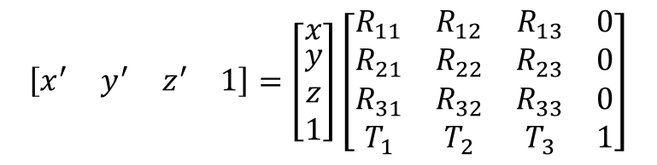

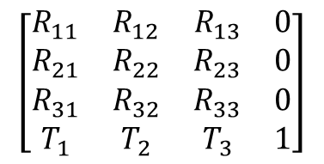
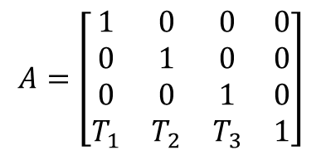
$$\left[\begin{matrix}x^{′} & y^{′} & z^{′} & 1\end{matrix}\right]=\left[\begin{matrix}x \\ \begin{aligned}y \\ z \\ 1\end{aligned}\end{matrix}\right]\left[\begin{matrix}R_{11} & R_{12} & R_{13} & 0 \\ R_{21} & R_{22} & R_{23} & 0 \\ R_{31} & R_{32} & R_{33} & 0 \\ T_{1} & T_{2} & T_{3} & 1\end{matrix}\right]$$
$${\vec{r}}^{′}=\vec{r}A$$
$$\left[\begin{matrix}R_{11} & R_{12} & R_{13} & 0 \\ R_{21} & R_{22} & R_{23} & 0 \\ R_{31} & R_{32} & R_{33} & 0 \\ T_{1} & T_{2} & T_{3} & 1\end{matrix}\right]$$
$$A=\left[\begin{matrix}1 & 0 & 0 & 0 \\ 0 & 1 & 0 & 0 \\ 0 & 0 & 1 & 0 \\ T_{1} & T_{2} & T_{3} & 1\end{matrix}\right]$$

Slide 2
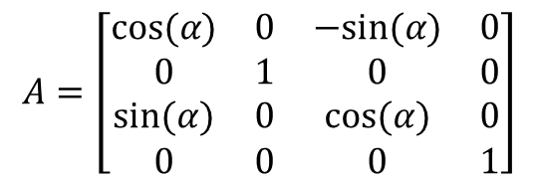
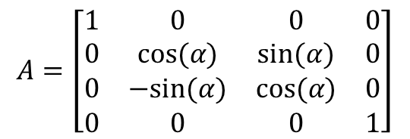
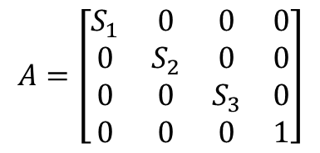
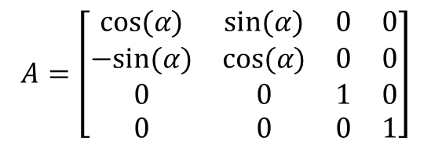
$$A=\left[\begin{matrix}1 & 0 & 0 & 0 \\ 0 & cos⁡(α) & sin⁡(α) & 0 \\ 0 & −sin⁡(α) & cos⁡(α) & 0 \\ 0 & 0 & 0 & 1\end{matrix}\right]$$
$$A=\left[\begin{matrix}cos⁡(α) & 0 & −sin⁡(α) & 0 \\ 0 & 1 & 0 & 0 \\ sin⁡(α) & 0 & cos⁡(α) & 0 \\ 0 & 0 & 0 & 1\end{matrix}\right]$$
$$A=\left[\begin{matrix}cos⁡(α) & sin⁡(α) & 0 & 0 \\ −sin⁡(α) & cos⁡(α) & 0 & 0 \\ 0 & 0 & 1 & 0 \\ 0 & 0 & 0 & 1\end{matrix}\right]$$
$$A=\left[\begin{matrix}S_{1} & 0 & 0 & 0 \\ 0 & S_{2} & 0 & 0 \\ 0 & 0 & S_{3} & 0 \\ 0 & 0 & 0 & 1\end{matrix}\right]$$

Slide 3

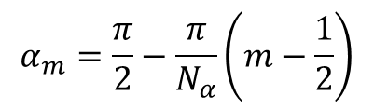
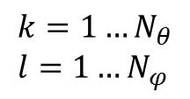
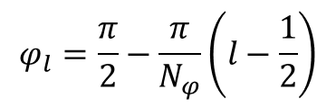
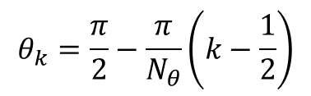
$$θ_{k}=\frac{π}{2}−\frac{π}{N_{θ}}\left(k−\frac{1}{2}\right)$$
$$φ_{l}=\frac{π}{2}−\frac{π}{N_{φ}}\left(l−\frac{1}{2}\right)$$
$$k=1…N_{θ} \\ l=1…N_{φ}$$
$$α_{m}=\frac{π}{2}−\frac{π}{N_{α}}\left(m−\frac{1}{2}\right)$$
$$m=1…N_{α}$$
Z
θ
Y
X
ϕ

Slide 4
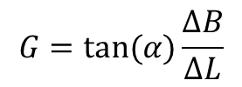
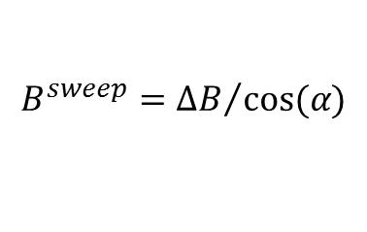

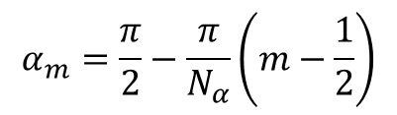
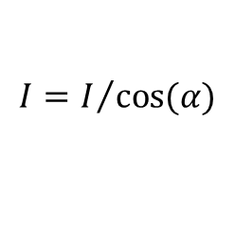
$$α_{m}=\frac{π}{2}−\frac{π}{N_{α}}\left(m−\frac{1}{2}\right)$$
$$m=1…N_{α}$$
$$B_{}^{sweep}={∆B}/{cos⁡(α)}$$
$$G=tan⁡(α)\frac{∆B}{∆L}$$
Absorption:
$$I=I/{cos⁡(α)}$$

Slide 5
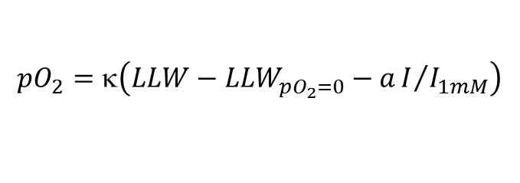
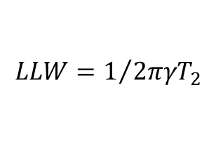
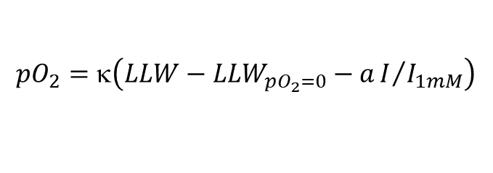
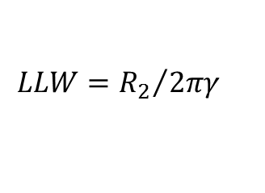
$$LLW=1/{{2πγT}_{2}}$$
$${pO}_{2}=κ\left(LLW−{LLW}_{pO_{2}=0}−aI/{I_{1mM}}\right)$$
$$LLW={R_{2}}/{2πγ}$$
$${pO}_{2}=κ\left(LLW−{LLW}_{pO_{2}=0}−aI/{I_{1mM}}\right)$$

