Slide 1
Add/Update
Delete
Populate_Listbox_parent_()
Populate_Details_()
SelectedIndexChange_()
Populate_Listbox_child_1
Populate_Listbox_child_2
Populate_Listbox_child_...
Populate_Listbox_child_1
Repeat for child 1……

Slide 2
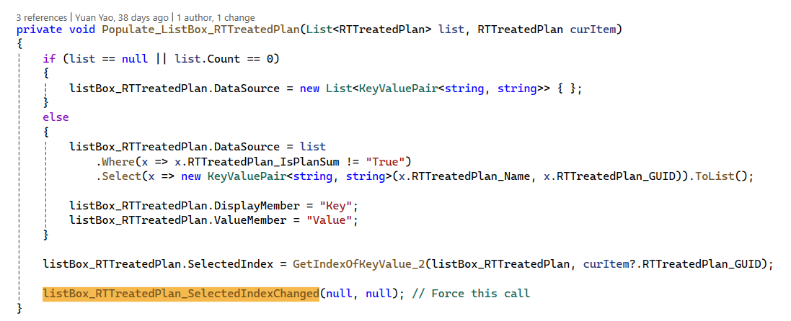
Populate_Listbox_parent_()

Slide 3
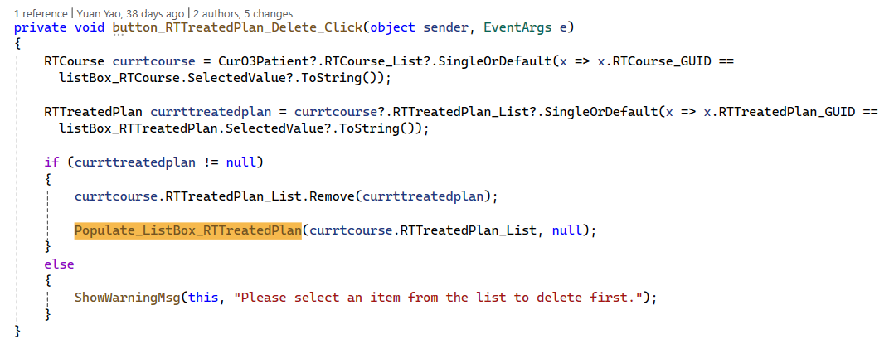
Delete

Slide 4
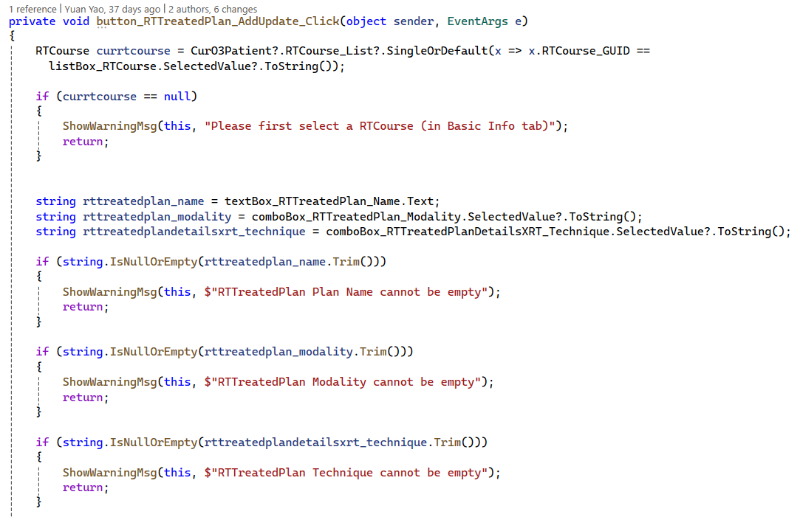
Add/Update 1/3
Check if ancestor exist & Check if essential properties are provided

Slide 5
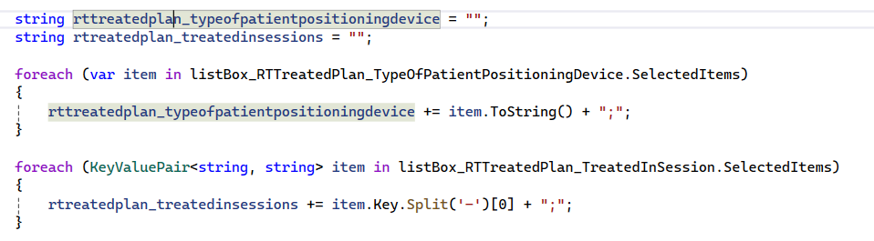
Add/Update 2/3
Special properties - can be optional for many key elements

Slide 6
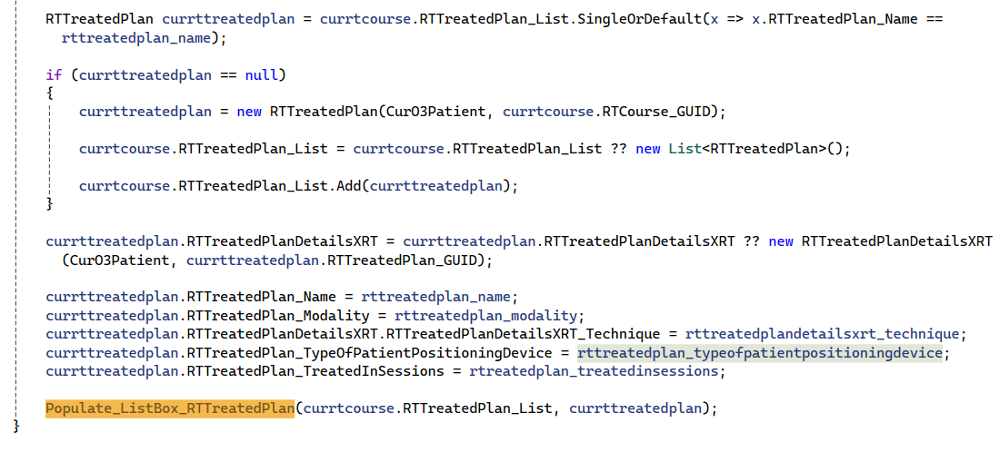
Add/Update 3/3
Identify existing one and update, or create new and populate

Slide 7
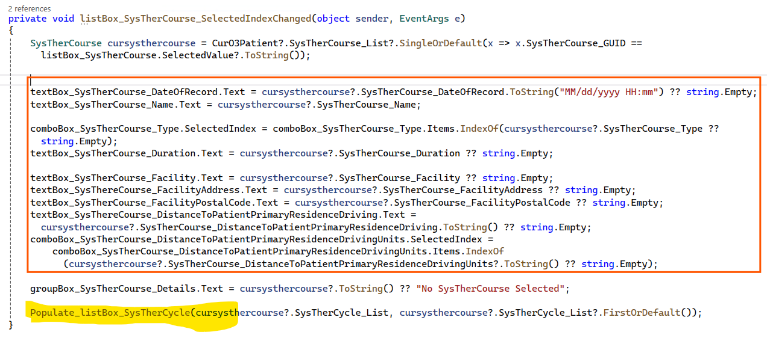
SelectedIndexChange_()
Example 1 – Populate_Details_() is merged in. Child Populate_ListBox_() is called.

Slide 8
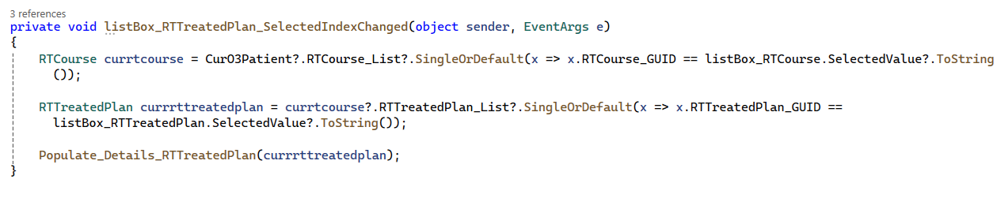
SelectedIndexChange_()
Example 2 – Populate_Details_() is separated
See next page for Populate_Details_()

Slide 9
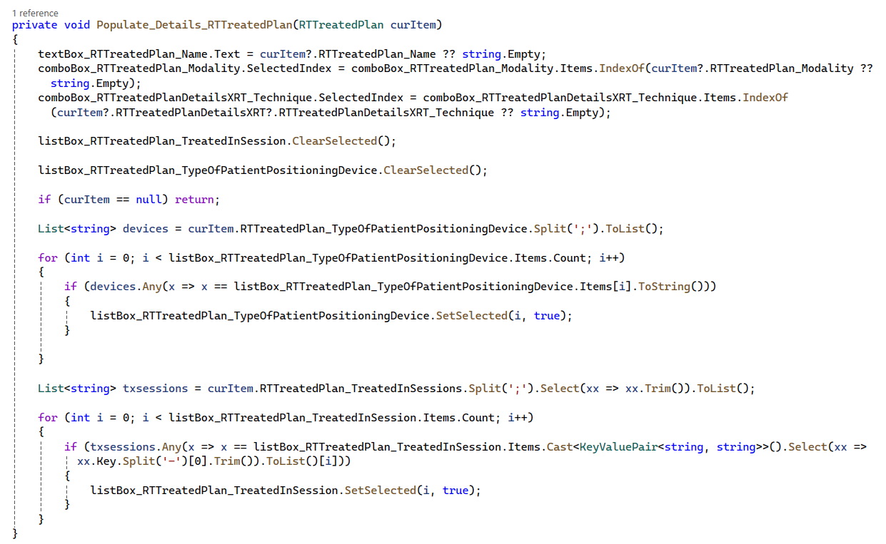
Populate_Details_()

