Slide 1

CT GROUP OF INSTITUTIONS MAQSUDAN
SUBMITTED BY:
Sahil
Roll no=1916094
Btech CSE 8th sem

Slide 2
Project Name
S2 Fitness

Slide 3
Introduction to Project
The “system" has been developed to override the problems prevailing in the practicing manual system.
Our website is a health club membership management system.
It is designed for gyms and health clubs manage the details of Gym, Trainer, Member, Facility, Fitness Class , Time Slot.

Slide 4
Objectives
Digitalize and create an automated system.
Faster than the existing system.
Buy products Online
User-friendly environment

Slide 5
Drawbacks in Existing system
Required a lot of paperwork
Lack of storage space for handwritten documents.
Information is not available globally
Existing system was manual
Time consuming

Slide 6
Module
Adimin Module
Member Module
Trainer Module

Slide 7
Admin Module
Login
Manage Equipment
Manage Trainer
View member
Manage products
Manage order
Access/Denail

Slide 8
Member Module
Login to the system
Register
Edit profile
Place order
View Diet plan
View Report
Activity / workout plans

Slide 9
Trainer Module
Manage Member
Daily updates
Member activity
Assign Diet plan
Assign Exercise

Slide 10
Technologies used
Front-end: HTML
CSS
JS
Bootstrap
Angular
Back-end : Nodejs
Express.js
MongoDB

Slide 11



FRONT END
HTML:Hyper Text Markup Language
CSS :Cascading Style Sheet
JS: JavaScript
Bootstrap

Slide 12

Angular
Angular is written in TypeScript
Speed and Performance.
Faster Development Process.
Miško Hevery, Inventor of Angular,2009
open-source
Lightweight

Slide 13

Backend: Nodejs
Node.js is an open source server environment
Node.js runs on various platforms
Node.js uses JavaScript on the server
Very Fast
Written in 2009

Slide 14

MongoDB
MongoDB(Database)
open-source document database
high performance
Fast speed
MongoDB was founded in 2007

Slide 15
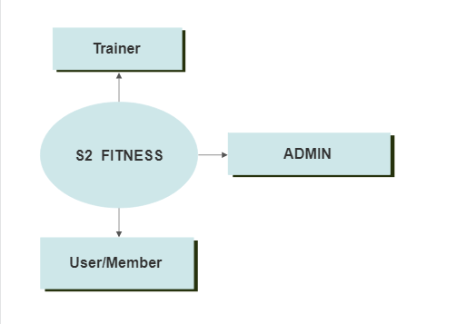
DFD DAIGRAMS
Level 0 DFD

Slide 16
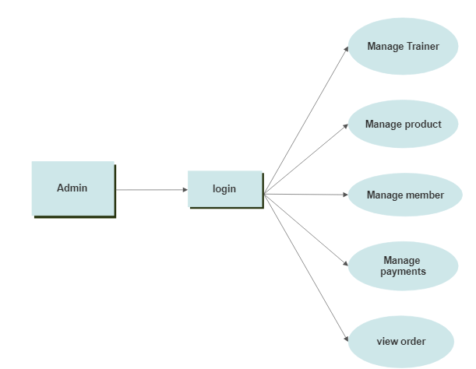
ADMIN DFD
Level 1 DFD

Slide 17
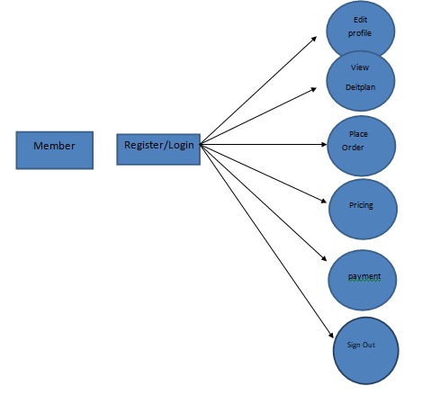
MEMBER DFD
Level 1 DFD

Slide 18
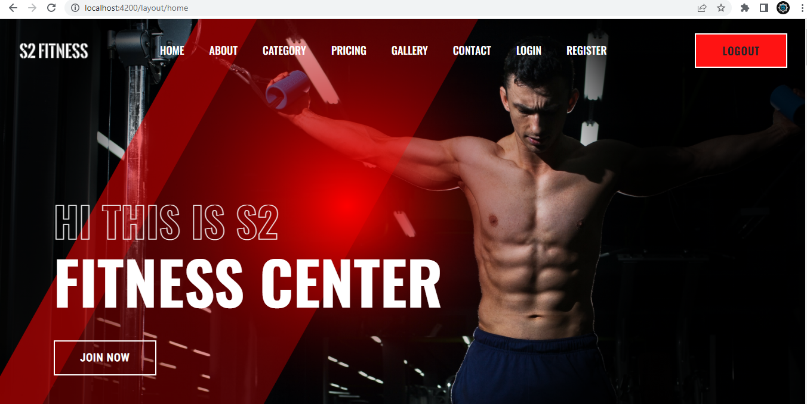
Project Outputs
Home page

Slide 19
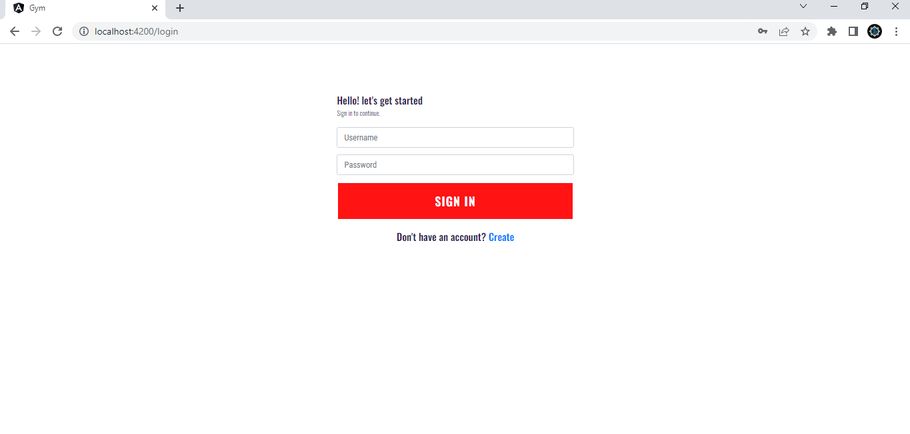
Login page

Slide 20
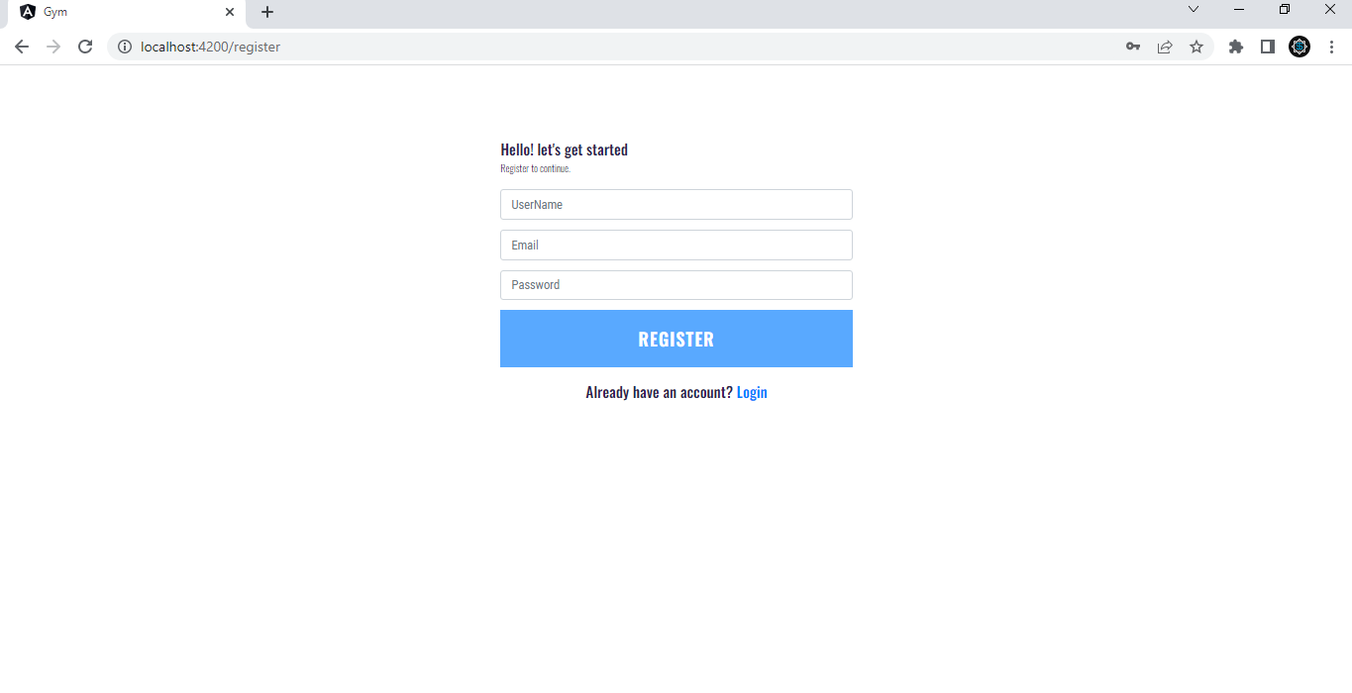
Register page

Slide 21
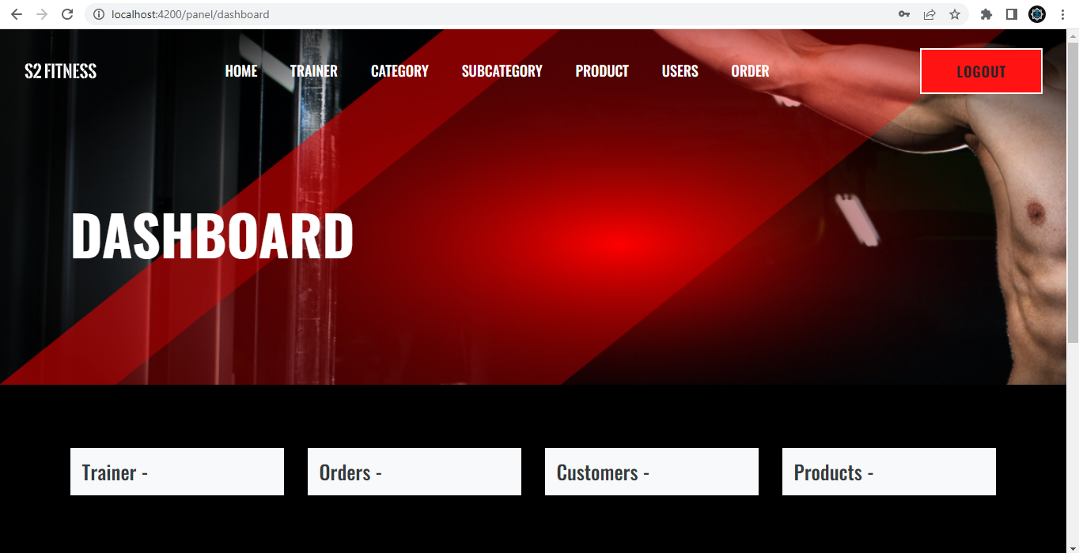
Admin layout page

Slide 22
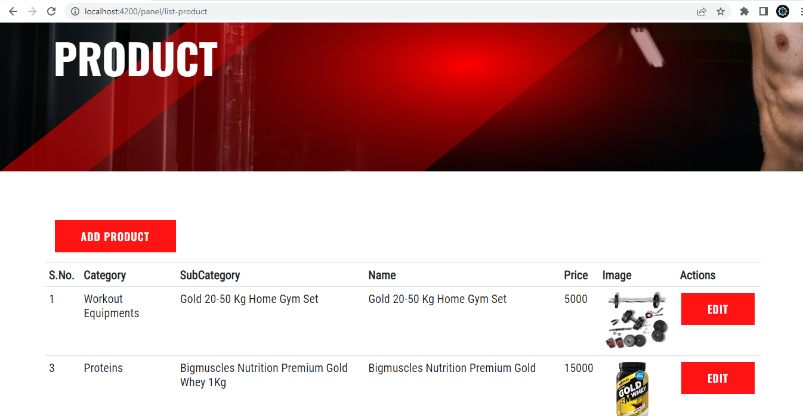
Product page

Slide 23
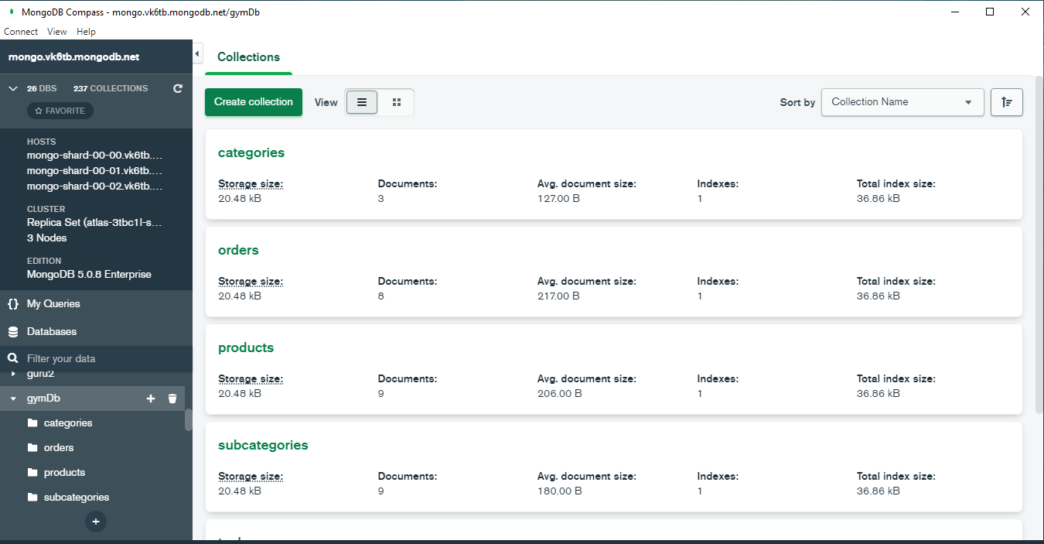
MongoDB Collection

Slide 24
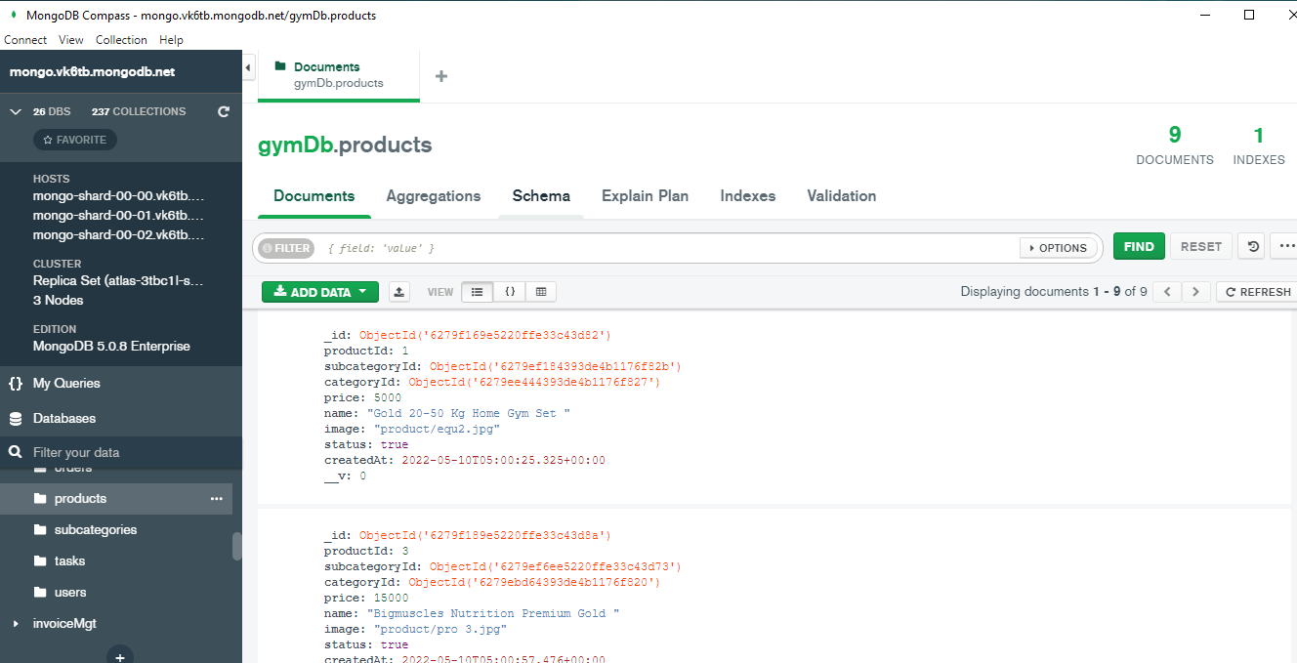
Product Collection

Slide 25


