Slide 1
Docker Training Day 1

Slide 2
Virtualization
What is Virtualization ?
Benefits of Virtualization?
What to Virtualize ?

Slide 3
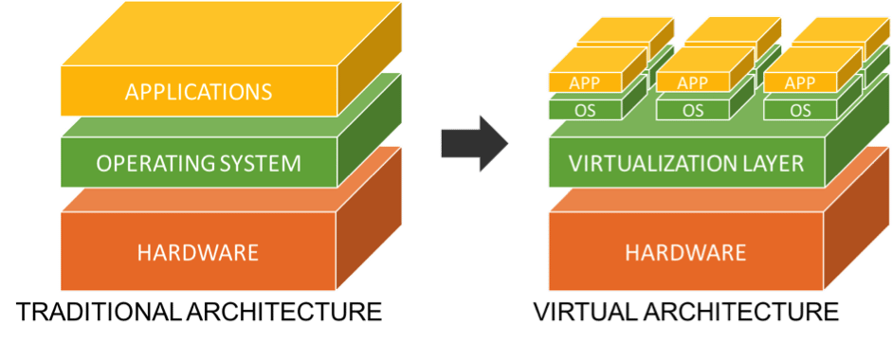

Slide 4
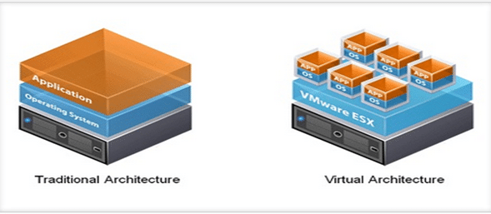

Slide 5
Containerization
What is Containerization ?
Benefits of Containerization?
Virtualization Vs Containerization

Slide 6
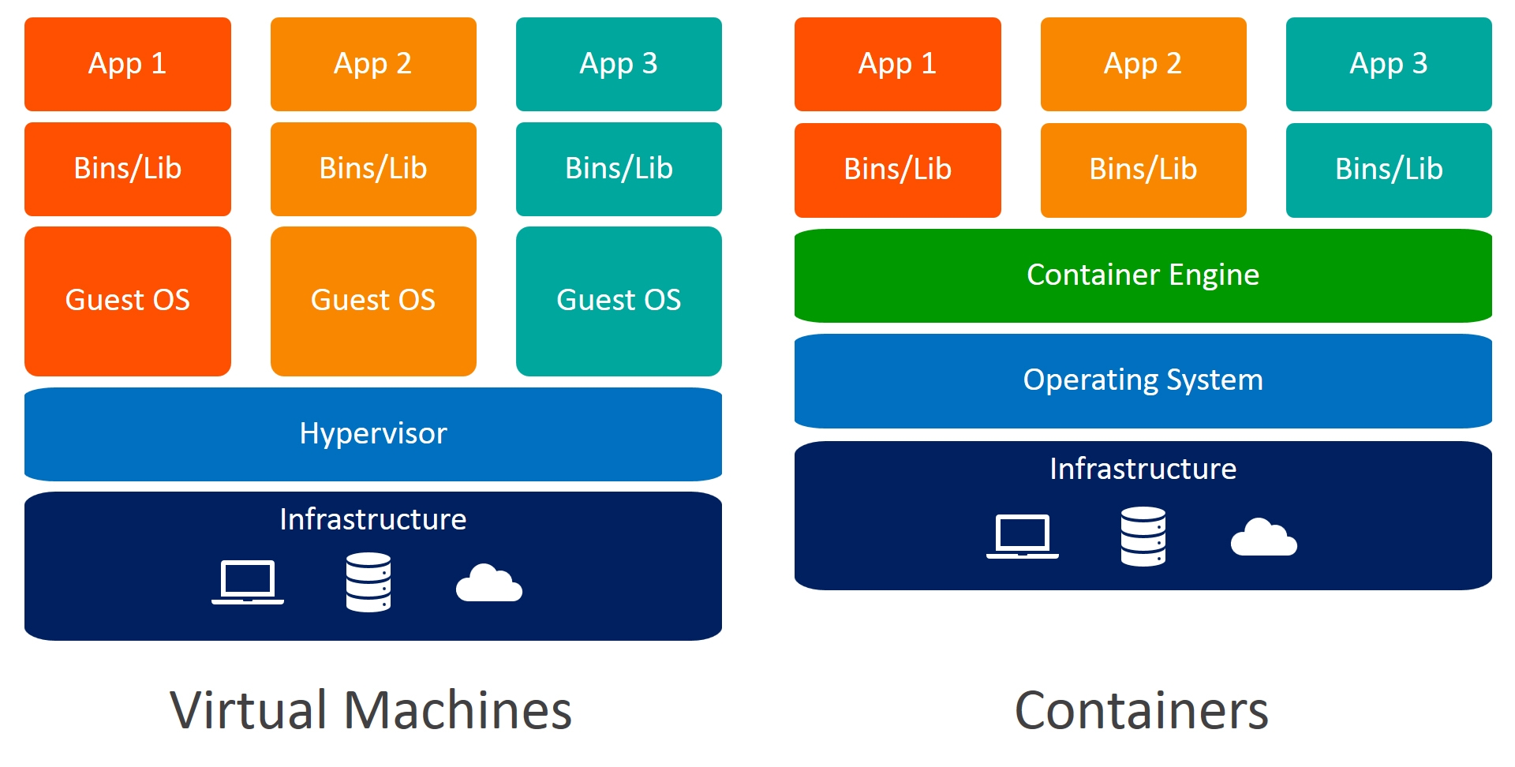

Slide 7
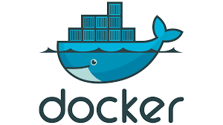
Docker
Docker makes development efficient and predictable
Easy to build , run and share

Slide 8
Getting Started
docker run busybox docker run nginx
docker run –d nginx docker run –p 80:80 –d nginx
Exercise Files link :

Slide 9
Essential Concepts
Docker Container
Docker Image
Docker Registry
Docker Volumes

