Slide 1
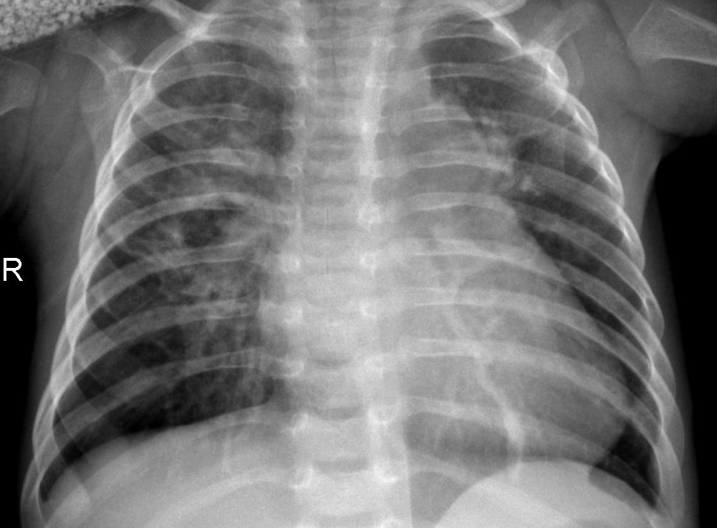
Pneumonia detection
Using Convolutional neural networks to classify x-ray images of patients with pneumonia

Slide 2
Method
Use the CNN(s) from previous exercises in this course as skeleton code
Reshape the data (X-ray images) to an appropriate size
Apply training augmentations
Adam optimization function, lr scheduling
Applied regularization techniques, weight decay, small batch size
Compared with a fine-tuned ResNet18 model

Slide 3
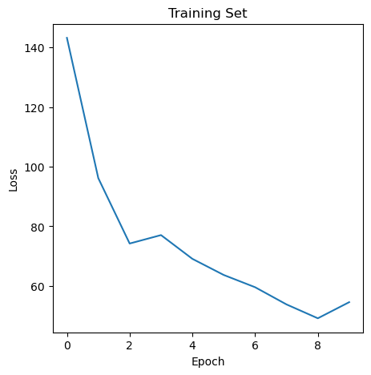
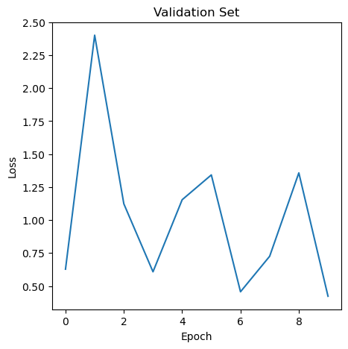
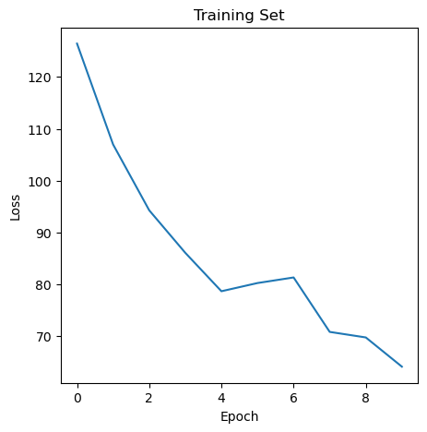
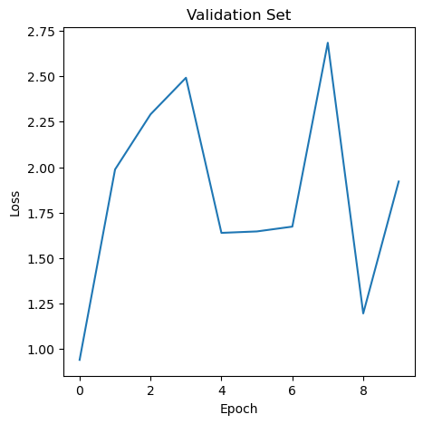
Results
Custom CNN
A working custom-made small CNN with 84% test set accuracy
A fine-tuned ResNet18 model with 83% test set accuracy
Fine-tuned ResNet18
Notes:
Hasnt completely converged

Slide 4
Learning outcomes
Deeper knowledge of ResNet18 and CNNs (1)
Insight into how AI can be used in the field of medicine (3)
Better understanding of the importance of initialization (5)

Slide 5
Conclusion
Two working CNNs were made, both exceeding expectations.
We got a deeper understanding of both ResNet and CNNs in general

