Slide 1
Machine Learning as a Service
Oguzhan Uyar

Slide 2

Agenda
What is “as a Service”
Introduction MLaaS
Platforms
Examples
  Microsoft Azure
  Amazon SageMaker
Conclusion

Slide 3
What is “as a Service”
“a service is a transaction in which no physical goods are transferred from the seller to the buyer”
Example: Games as a Service
  Sports games have yearly cycles (FIFA15, FIFA16, FIFA17, ..)
  Get rid of yearly releases, release only FIFA (as a Service)
  Ongoing development (game modes, gameplay, engine, bug fixes)
  Stats and transfer updates, form, injuries, bans, custom events

Slide 4
Introduction MLaaS
MLaaS is an umbrella definition of automated and semi-automated cloud platforms that cover most infrastructure issues such as data pre-processing, model training, and model evaluation, with further prediction. Prediction results can be bridged with your internal IT infrastructure through REST APIs.
Startup costs are low-to-no
Seamless leverage of cloud resources for scale-ups = €’s
Open source ML options are common
Very large models possible
Open data sets proliferating

Slide 5
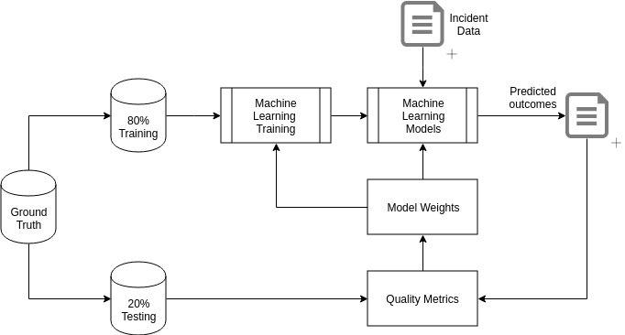
Introduction MLaaS
Typical ML Cycle

Slide 6
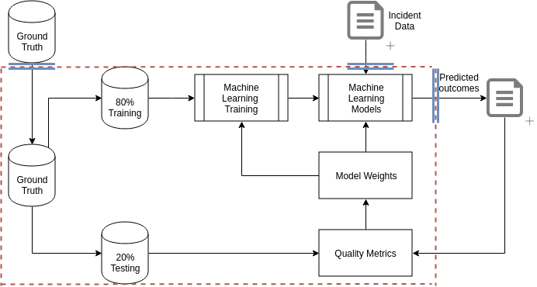
Introduction MLaaS
MLaaS Cycle

Slide 7
Platforms
Amazon (ML and SageMaker)
Microsoft (Azure ML Studio/Service)
Google (Prediction API and ML Engine)
IBM (Watson ML)

Slide 8
Platforms (Amazon ML)
Predictive Analytics
One of the most automated solutions
  Load data from multiple sources
  Data preprocessing operations automatically
    Categorical fields detection
    Numerical fileds detection
    Nothing to do for user (dimension reduction and whitening)
Prediction capacities restricted
  Binary- / Multiclass-Classification
  Regression
No unsupervised learning methods
User doesn’t have to know ML methods
  Amazon chooses automatically after inspecting provided data

Slide 9
Platform (Amazon SageMaker)
Basically AWS services (EC2, ECS, S3) cobbed together
Open source SageMaker libraries (Python, Spark)
  Libs provide unified wrapper for many best-in-class algortihms,
  Frameworks (TensorFlow, Apache MXNet)
Published docker images for each built-in algorithm
One-shop for examples: https://github.com/awslabs/amazon-sagemaker-examples
  How to use algorithms
  Actual data sets
  Runnanble notebooks

Slide 10
Platform (Amazon SageMaker)
JupyterNotebook Instances
  Deploys an EC2 instance with pre-installed libraries & environments
  Notebook right in the Browser
Jobs
  Creating a training Job
  Running the training Job
    Distributed training Jobs aswell
  Trained model is a serialized model artifact

Slide 11
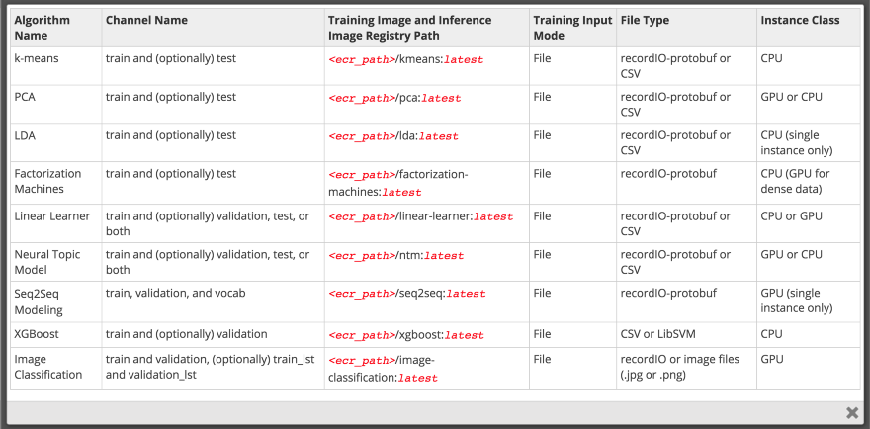
Platform (Amazon SageMaker)

Slide 12
Platform (Amazon SageMaker)
Linear learner is a supervised method for classification and regression
Factorization machines is for classification and regression designed for sparse datasets
XGBoost is a supervised boosted trees algorithm that increases prediction accuracy in classification, regression, and ranking by combining the predictions of simpler algorithms
Image classification is based on ResNet, which can also be applied for transfer learning
Seq2seq is a supervised algorithm for predicting sequences (e.g. translating sentences, converting strings of words into shorter ones as a summary, etc.)
K-means is an unsupervised learning method for clustering tasks
Principal component analysis is used for dimensionality reduction
Latent Dirichlet allocation is an unsupervised method used for finding categories in documents
Neural topic model (NTM) is an unsupervised method that explores documents, reveals top ranking words, and defines the topics (users can’t predefine topics, but they can set the expected number of them)
DeepAR forecasting is a supervised learning algorithm used for forecasting time series that employs recurrent neural networks (RNN)
BlazingText is a natural language processing (NLP) algorithm built on the Word2vec basis, which allows it to map words in large collections of texts with vector representations
Random Cut Forest is an anomaly detection unsupervised algorithm capable of assigning anomaly scores to each data point

Slide 13
Platform (Amazon SageMaker)
Use your self defined algorithms via Docker
Or integrated frameworks:
  TensorFlow
  Keras
  Gluon
  Caffe2
  Torch
  MXNet
  others

Slide 14
Platform (Amazon SageMaker)
Models
  Models in the API are about metadata
    Defines a model, including a pointer to actual serialized model artifact
  Deployment of the model for SageMaker by hosting
    EC2 instance type for hosting
    Number of Instances
    Name

Slide 15
Platform (Amazon SageMaker)
Endpoints
  Is the runtime setup providing inferences on the model
  Managed by SageMaker and exposed via HTTP
  Creating Endpoint Configuration
    Metadata describing how to route traffic to one or more models
    Inidcates instance count and type
  Creating Endpoint
    Name and Configuration to use

Slide 16
Platform (Amazon SageMaker)
Tearing Down (cleaning up and containing costs)
  Notebooks can be easily started and stopped (no costs when not in use)
  Job instances are automatically terminated when job finished (or terminated)
  Endpoint instances are a place where costs can add up quickly
    Typically a lot larger than notebook instances
    The catch: can’t simply stop an endpoint, got to be deleted

Slide 17

Platform (MS Azure ML Studio)
Cloud-based predictive-analytic service
Streamlined experience for all skill levels
Accompanied by Azure Machine Learning Studio
  Browser based tool
  Drag&Drop interface for building ML models
  Pre-defined processes & features range of algorithms
  Built-in support for R and Python
  Exposable as web service
  Many examples from the user base (Cortana Intelligence Gallery)

Slide 18
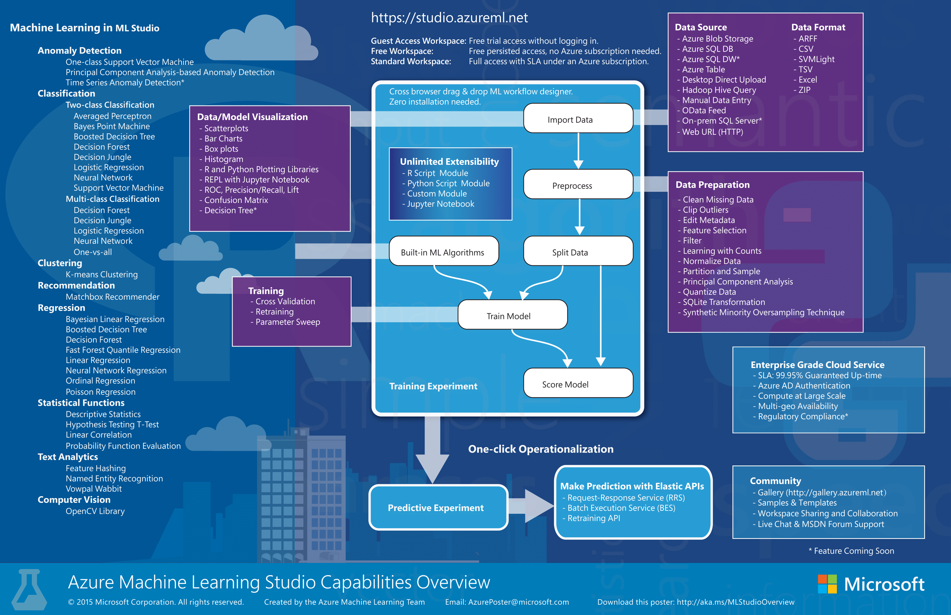

Slide 19
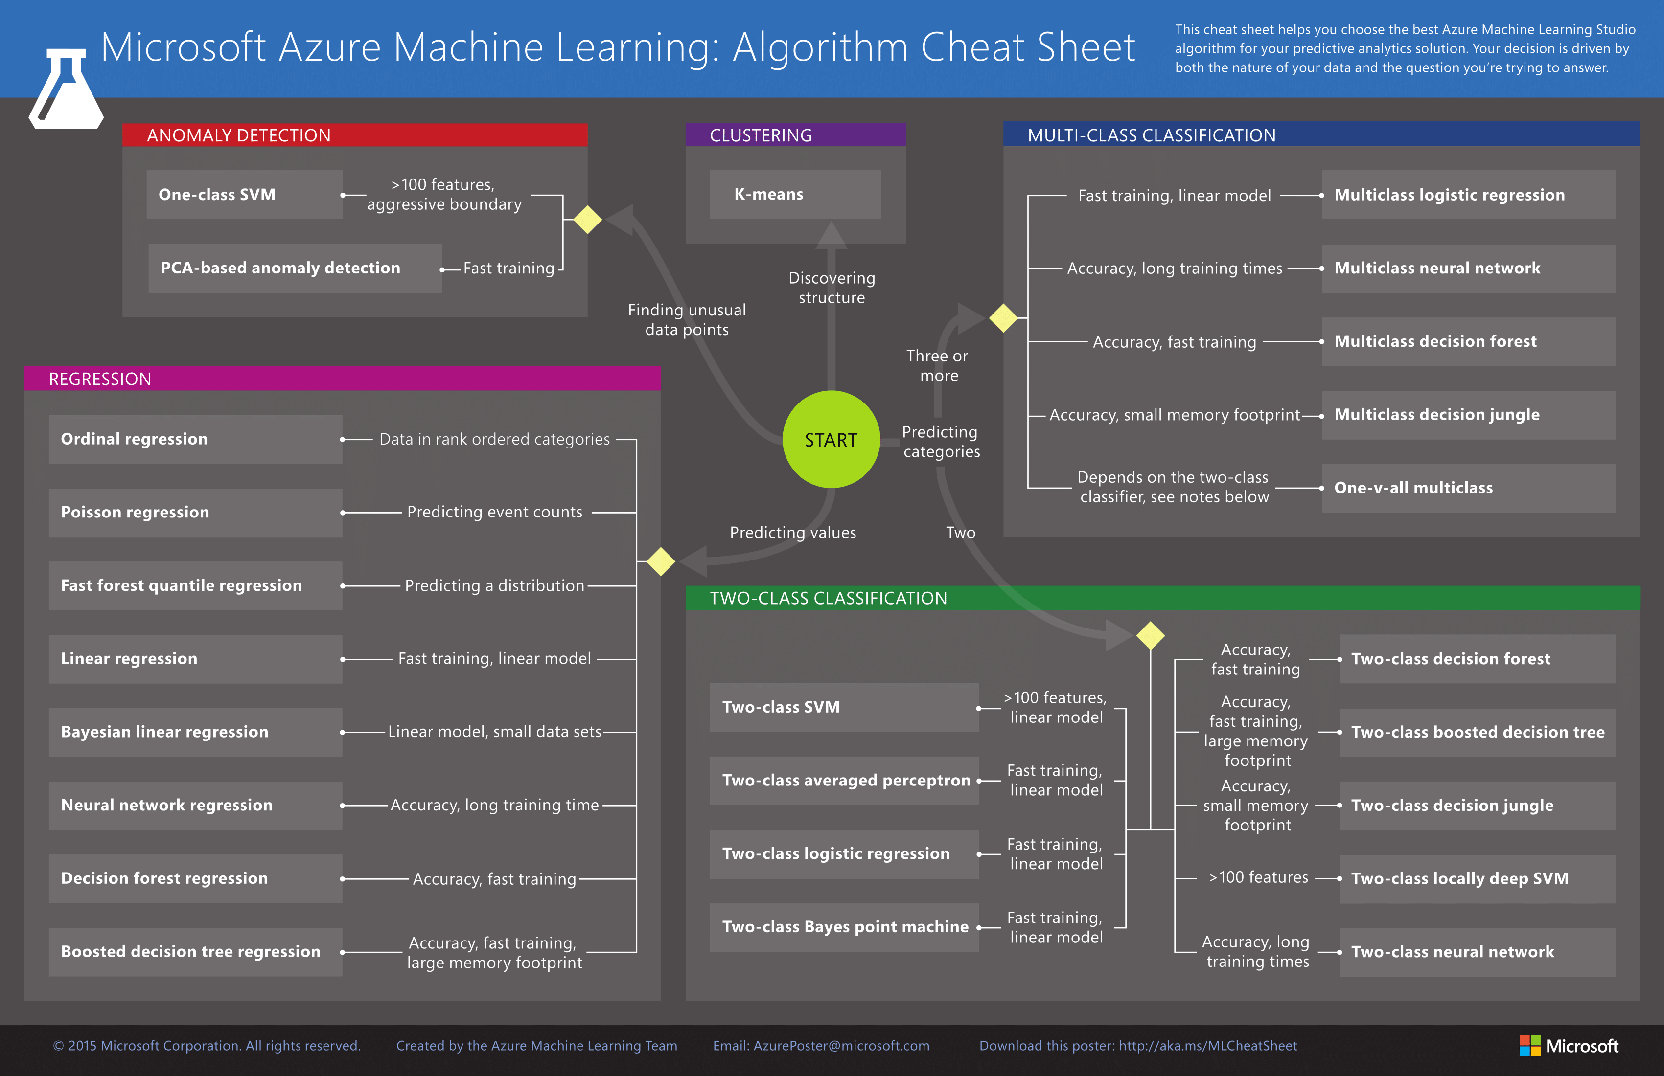

Slide 20
Platform (MS Azure ML Service)
Different to Azure ML Studio in:
  No graphical Drag&Drop interface
  No built-in ML methods, requires custom engineering
  Aimed for rather experienced data scientists
    Python Packages
      Computer vision, forecasting, text analysis, hardware acc.
    Experimentation
      Testing different approaches to a model and choosing the most fitting one from the point you left off
    Model management
      Environment to host, version, manage, monitor
    Workbench
      Desktop and command-line environment
    Visual Studio Tools for AI
      Basically, an extension to VS adding tools to work with deep learning products

Slide 21
Platform (Google Prediction API)
Deprecated
Google pulled the plug on April 30, 2018
Resembles Amazon ML
  Minimalistic approach for solving 2 issues: Binary- / Multiclass-classification & regression
  Deployment of models via REST API
No disclosure which algorithms utilized for predictions
No customizing of models
Whats next?
  Testing: Cloud AutoML (currently in beta)
    Claims: allowing people with no DS expertise to train models in a automated manner

Slide 22
Platform (Google ML Engine)
Adressed to experienced data scientists
Very flexible
Suggests using cloud infrastructure with TensorFlow as a ML driver
  Additionally: testing other popular Frameworks (XGBoost, Scikit, Keras)
Pretty similar to SageMaker in principle

Slide 23
Platform (IBM Watson ML Studio)
Advertised for both, beginners and experienced data scientists
Offers two approaches: automated and manual
Like Amazon ML and Google Prediction API; it has a model builder which runs fully automated
  Data processing
  Preparing models
  Deploying models

Slide 24
Platform (IBM Watson ML Studio)
Automated solution provides three main tasks:
  Binary- / Multiclass-Classification
  Regression
Choose between:
  Fully automated approach,
  Pick the ML methods to be used

Slide 25
Platform (IBM Watson ML Studio)
Logistic regression
Decision tree classifier
Random forest classifier
Gradient boosted tree classifier
Naive Bayes
Linear regression
Decision tree regressor
Random forest regressor
Gradient boosted tree regressor
Isotonic regression

Slide 26
Platform (IBM Watson ML Studio)
Additionally: training workflow with flow editor interface
  Similar to Azure ML Studio (Drag&Drop)
Also provides advanced capabilities
  Jupyter Notebooks with frameworks
    TensorFlow, Scikit, PyTorch, others

Slide 28
Conclusion
Easy to get lost in variety of solutions available
Hart to get grip in the solutions
They differ in algos, required skills and eventually even tasks
High likelyhood that another vendor will suddenly roll out something that matches your needs
Bradford Cross, founding partner at DCVC, argues that ML-as-a-services isn’t a viable business model. According to him, it falls in the gap between data scientists who are going to use open source products and executives who are going to buy tools solving tasks at the higher levels. However, it seems that the industry is currently overcoming its teething problems and eventually we’ll see far more companies turning to ML-as-a-service to avoid expensive talent acquisitions and still possess versatile data tools.

