Slide 1
Machine Learning as a Service
State of the Art und Example
Oguzhan Uyar

Slide 2

Agenda
What is “as a Service”
Introduction MLaaS
Platforms
Examples
  Algorithm: Gradient Boosting
  Code: Amazon SageMaker (XGBoost)
Conclusion

Slide 3
What is “as a Service”
“a service is a transaction in which no physical goods are transferred from the seller to the buyer”
Example: Games as a Service
  Sports games have yearly cycles (FIFA15, FIFA16, FIFA17, ..)
  Get rid of yearly releases, release only FIFA (as a Service)
  Ongoing development (game modes, gameplay, engine, bug fixes)
  Stats and transfer updates, form, injuries, bans, custom events
3

Slide 4
Introduction MLaaS
MLaaS is an umbrella definition of automated and semi-automated cloud platforms that cover most infrastructure issues such as data pre-processing, model training, and model evaluation, with further prediction. Prediction results can be bridged with your internal IT infrastructure through REST APIs.
Startup costs are low-to-no
Seamless leverage of cloud resources for scale-ups = €’s
Open source ML options are common
Very large models possible
Open data sets proliferating
4

Slide 5
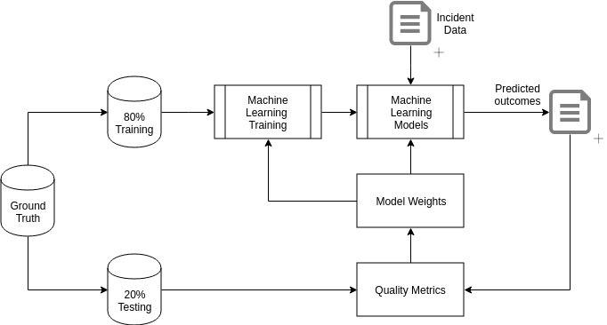
Introduction MLaaS
Typical ML Cycle
5

Slide 6
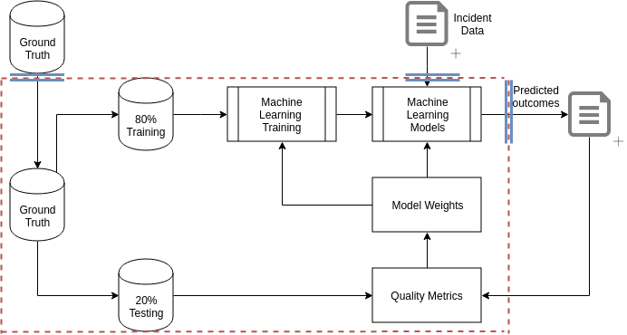
Introduction MLaaS
MLaaS Cycle
6

Slide 7
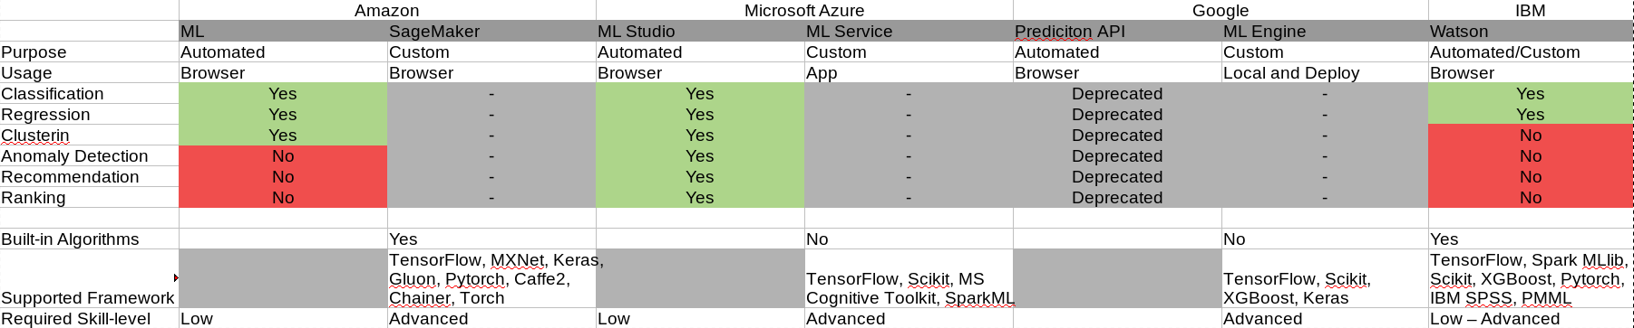
Platforms: Overview
7

Slide 8
Platform (Amazon SageMaker)
Linear learner is a supervised method for classification and regression
Factorization machines is for classification and regression designed for sparse datasets
XGBoost is a supervised boosted trees algorithm that increases prediction accuracy in classification, regression, and ranking by combining the predictions of simpler algorithms
Image classification is based on ResNet, which can also be applied for transfer learning
Seq2seq is a supervised algorithm for predicting sequences (e.g. translating sentences, converting strings of words into shorter ones as a summary, etc.)
K-means is an unsupervised learning method for clustering tasks
Principal component analysis is used for dimensionality reduction
Latent Dirichlet allocation is an unsupervised method used for finding categories in documents
Neural topic model (NTM) is an unsupervised method that explores documents, reveals top ranking words, and defines the topics (users can’t predefine topics, but they can set the expected number of them)
DeepAR forecasting is a supervised learning algorithm used for forecasting time series that employs recurrent neural networks (RNN)
BlazingText is a natural language processing (NLP) algorithm built on the Word2vec basis, which allows it to map words in large collections of texts with vector representations
Random Cut Forest is an anomaly detection unsupervised algorithm capable of assigning anomaly scores to each data point
8

Slide 9
Platform (IBM Watson ML Studio)
Logistic regression
Decision tree classifier
Random forest classifier
Gradient boosted tree classifier
Naive Bayes
Linear regression
Decision tree regressor
Random forest regressor
Gradient boosted tree regressor
Isotonic regression
9

Slide 10
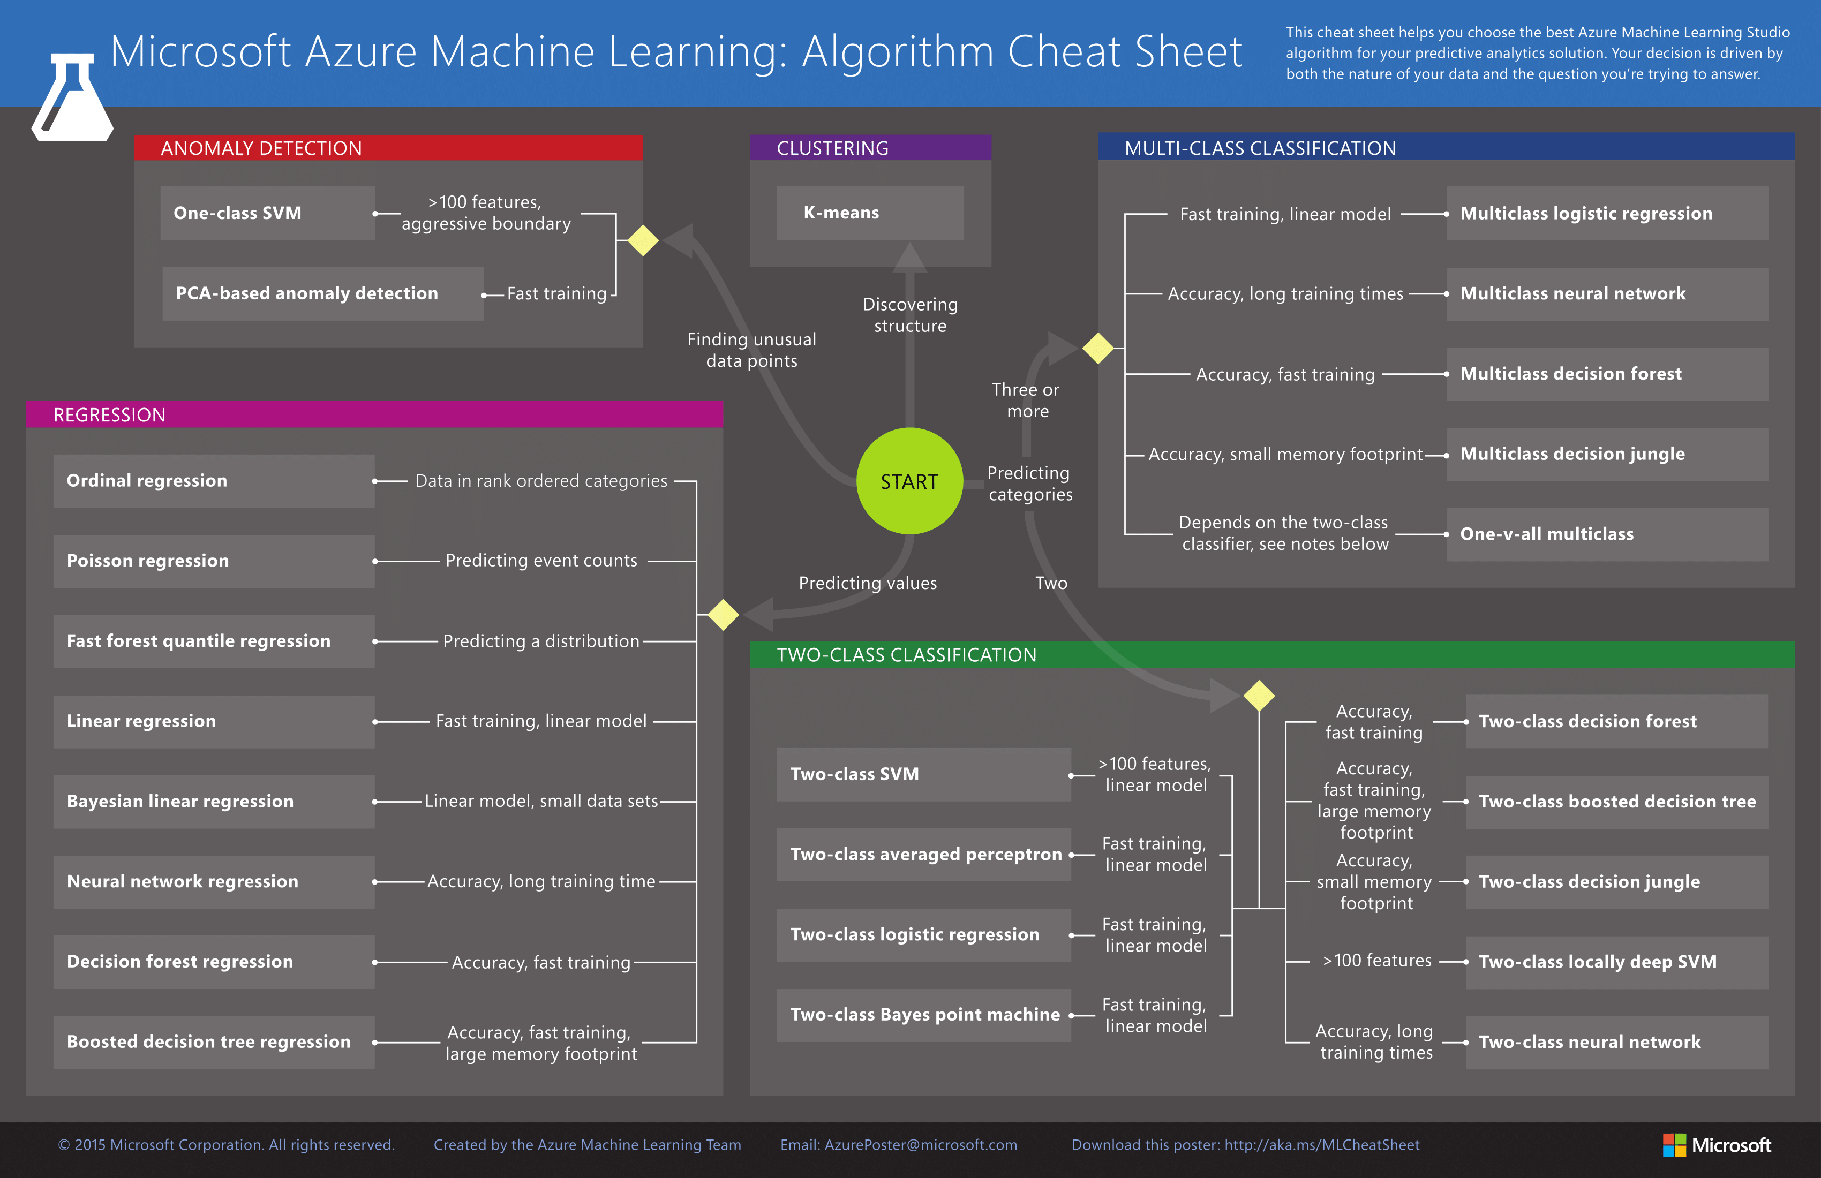

Slide 11
Gradient Boosting
Extremely popular, leading method of winning in Kaggle competitions
Builds ensemble of successive trees
  Each tree learning & improving on previous
Combination of many week successive trees
  Produces a powerfull ‘committee’
11

Slide 12
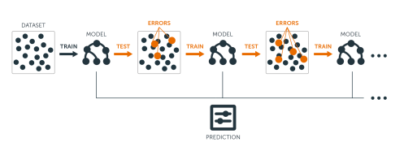
Gradient Boosting
Boosting adds new models sequentially
Each iteration trains weak base-learner, considering error of former (whole ensemble)
12

Slide 13
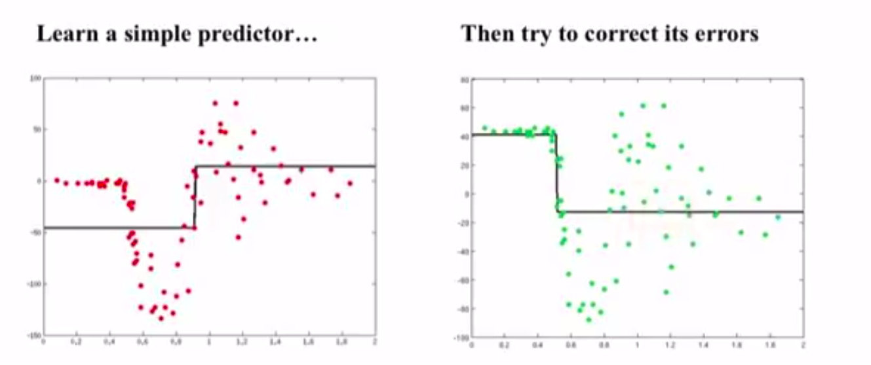
Gradient Boosting
13

Slide 14
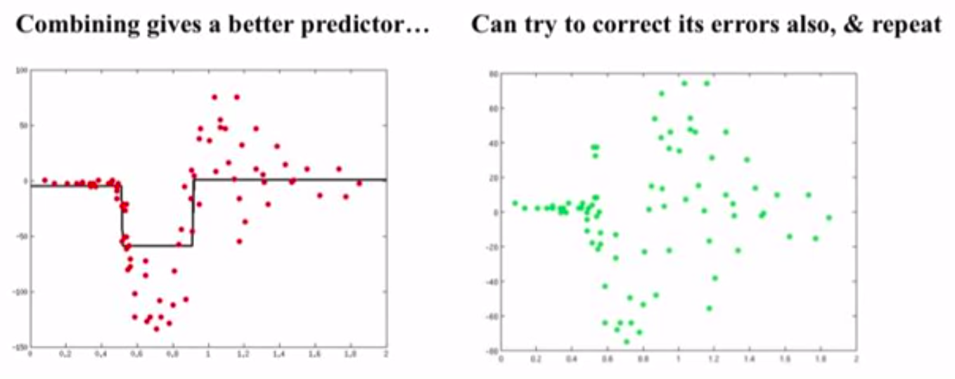
Gradient Boosting
14

Slide 15
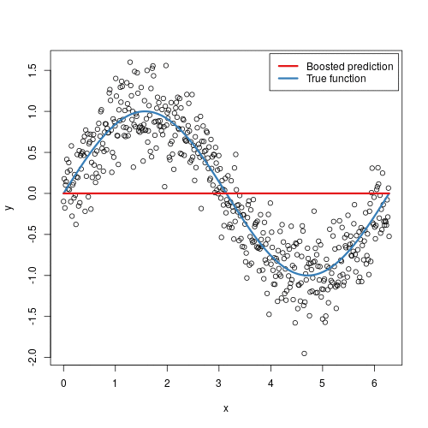
Gradient Boosting
15

Slide 16
Example
SageMaker XGBoost Example

Slide 17
Conclusion
Easy to get lost in variety of solutions available
Hard to get grip in the solutions
They differ in algo’s, required skills and eventually even tasks
High likelyhood that another vendor will suddenly roll out something that matches your needs
It seems that the industry is currently overcoming its teething problems and eventually we’ll see far more companies turning to ML-as-a-service to avoid expensive talent acquisitions and still possess versatile data tools.
17

Slide 18
Sources
https://xgboost.readthedocs.io/en/latest/tutorials/model.htmlhttps://xgboost.readthedocs.io/en/latest/tutorials/model.html
https://docs.aws.amazon.com/sagemaker/latest/dg/whatis.html
https://docs.microsoft.com/en-us/azure/machine-learning/
https://www.altexsoft.com/blog/datascience/comparing-machine-learning-as-a-service-amazon-microsoft-azure-google-cloud-ai-ibm-watson/
https://aws.amazon.com/de/blogs/machine-learning/create-a-model-for-predicting-orthopedic-pathology-using-amazon-sagemaker/

Slide 19
Images
https://uc-r.github.io/public/images/analytics/gbm/boosted_stumps.gif
https://uc-r.github.io/public/images/analytics/gbm/boosted-trees-process.png

