Slide 1

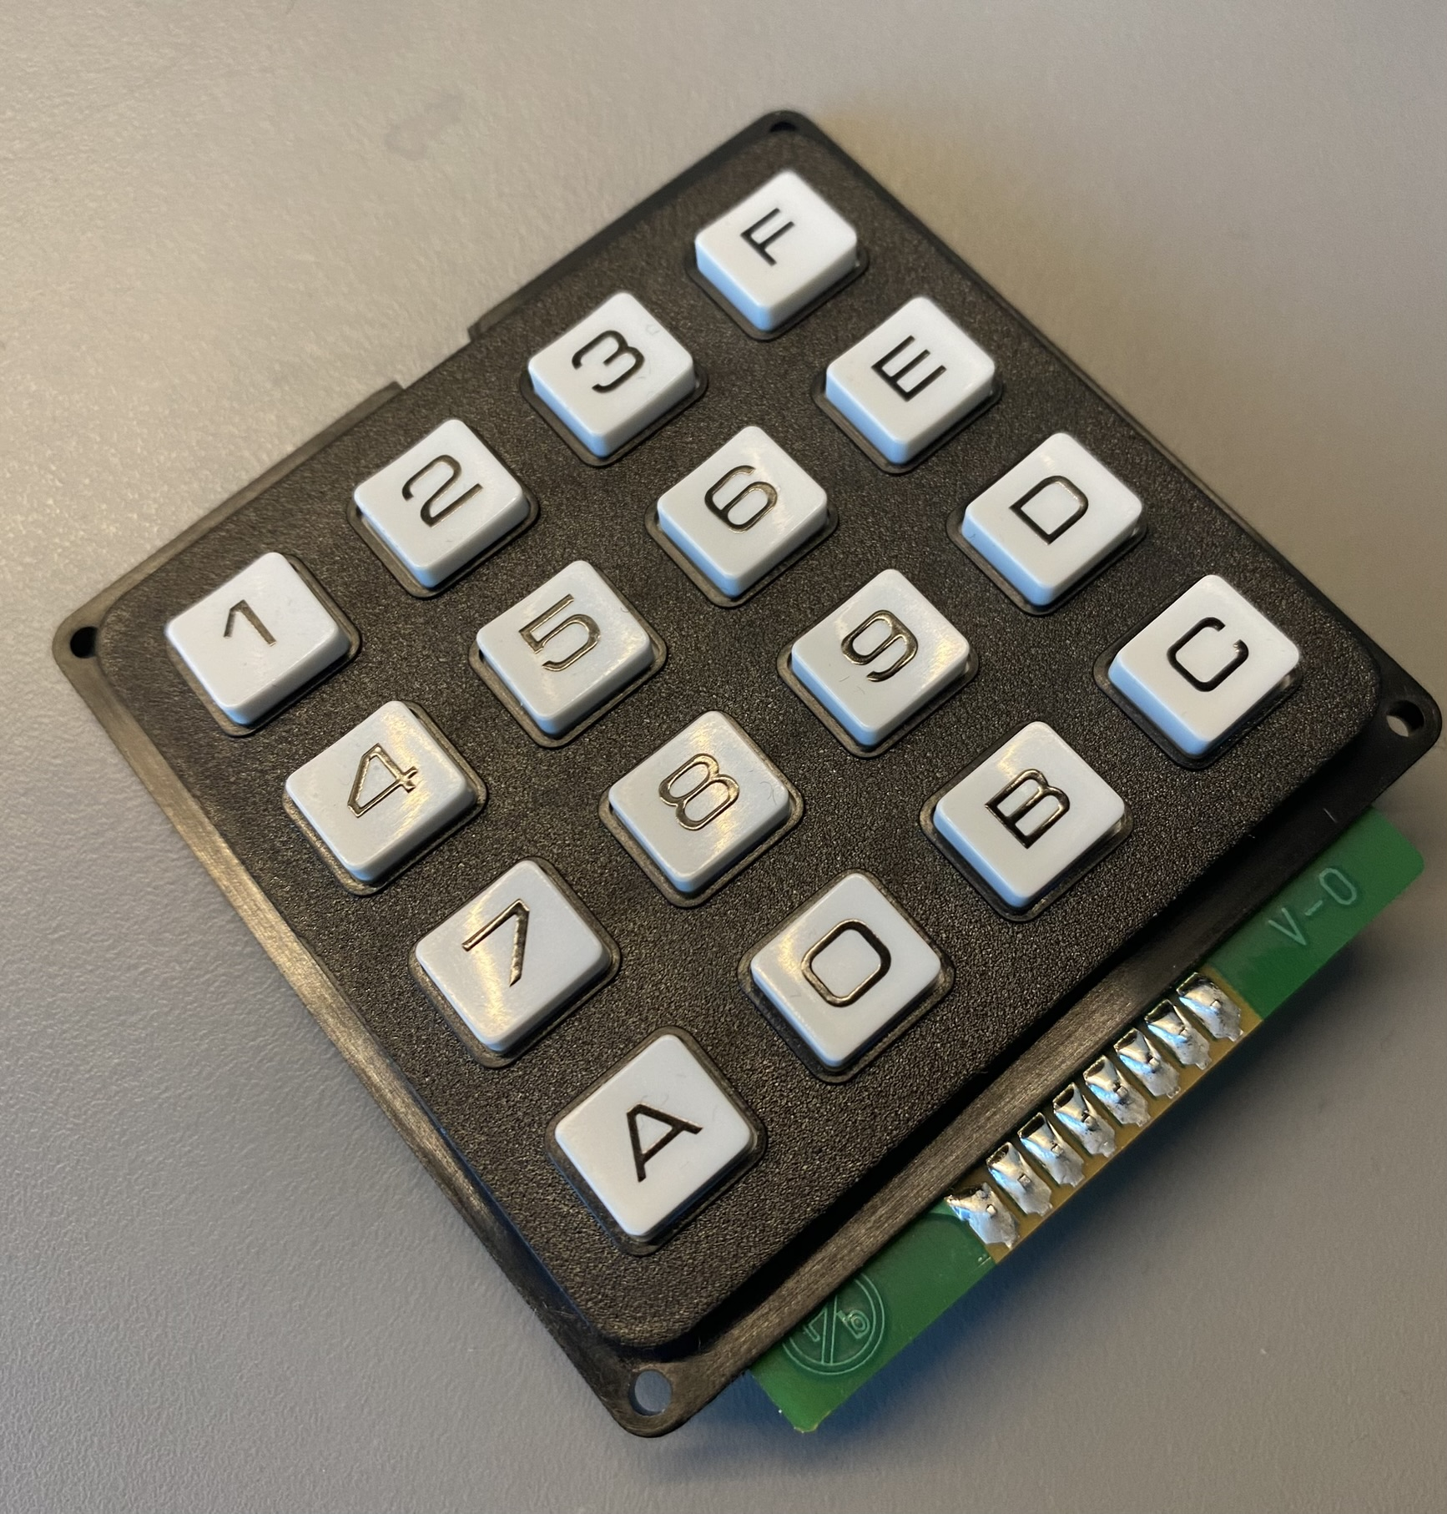
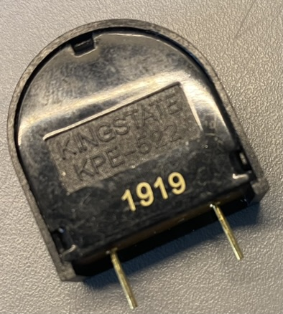
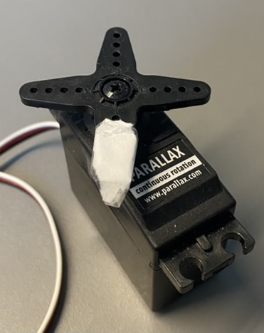
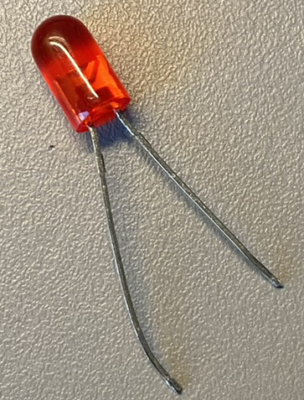
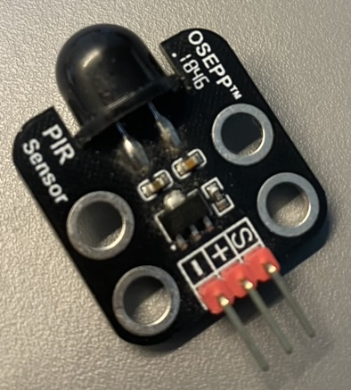
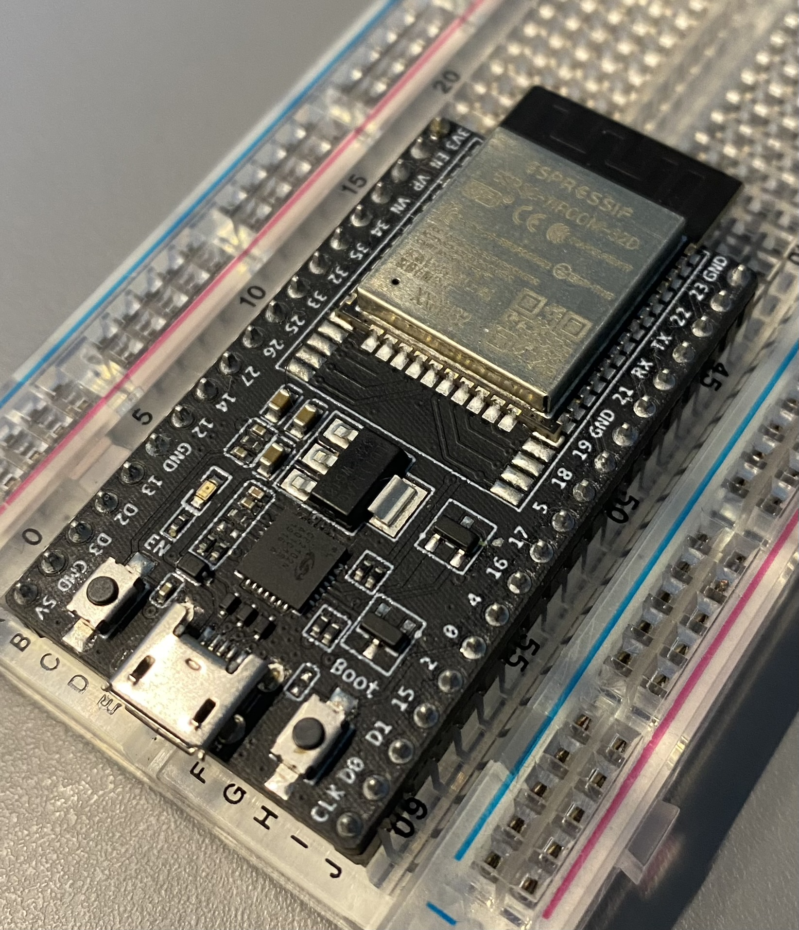
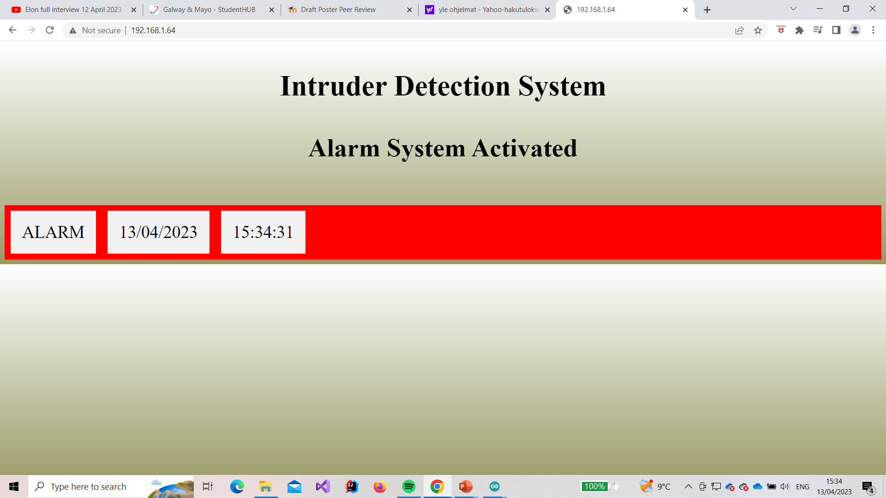
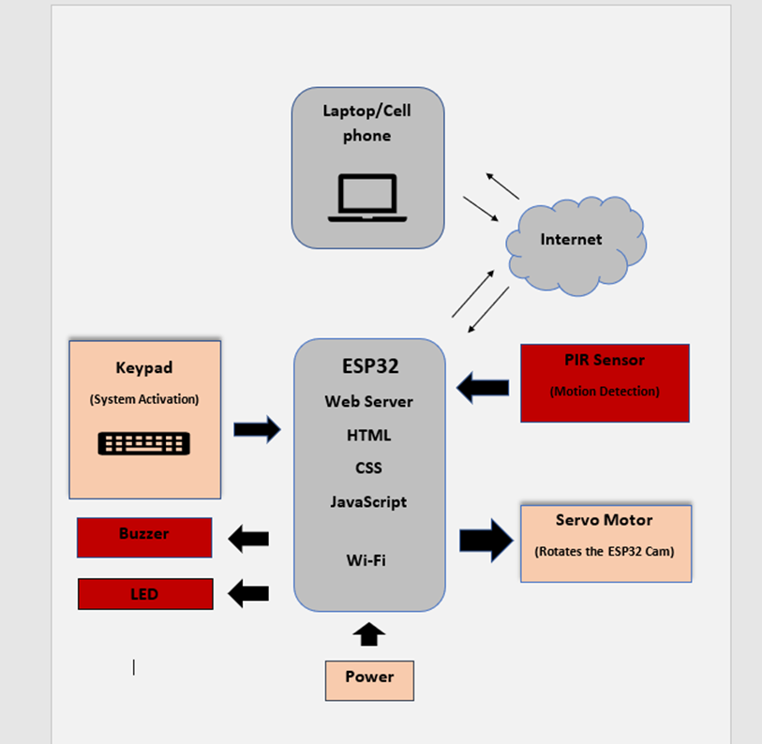
Intruder Detection System
      Project by Dan Koskiranta
      BENG in Software & Electronic Engineering
Project Description
Features
The Intruder Detection System is designed to increase the security of peoples homes. With the help of this system, anyone can feel a bit safer about their property. You can regularly monitor the status of your home remotely with the help of a web browser. Using a web browser, a request must be sent to the ESP32 web server which will respond with a web page.
The system is activated and
deactivated by entering a code from the keypad
The ESP32 sends a PWM
(Pulse Width Modulation)
signal to the servo motor to
start rotating between 0 and
180 degrees continuously.
A PIR (Passive Infrared)
sensor connected to the servo
will scan the area to detect any temperature changes from room temperature to body temperature. This change in temperature is sent as a signal to the ESP32 board. The signal will trigger an alarm.
The signal will
trigger a buzzer for
sound alarm.
An LED is used for
visual alarm indication.
An ESP32 web
server is created to
display the alarm.
With the website the user is able to monitor their house constantly.
Architecture Diagram
Sustainability
Web page
This project has an impact on UN sustainable development goal 11.1. The project could potentially affect sustainable cities and communities. This project is planned to increase security, so it can make human settlements safer and therefore our communities safer.
Because of the low cost of this project, anyone can use this system to increase the security of their house.

