Slide 1









Slide 2











Slide 3










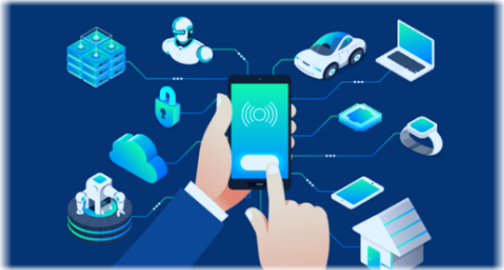




IoT
Internet of Things

Slide 4










Slide 5










Slide 6










Slide 7


















Slide 8







