Slide 1
PRESS RELEASE
COVID-19 RAPID SURVEYS BUSINESS TRACKER HIGHLIGHTS OF FINDINGS FIRST EDITION OF WAVE I
3 August 2020
Notes:
Self explanatory

Slide 2
Scope
Motivation
Notes on Methods
Highlights of findings
Upcoming Activities
2

Slide 3
Motivation - 1\2
COVID-19 from both a health and non-health perspective has unquestionably affected business operations and performance
In what dimensions have been businesses been affected?
Some of which include:
Disruptions in labour supply as a result of COVID-19 related morbidity, mortality, self exclusion from work and disarranged telework engagement
Business closures in view of partial lockdown of Greater Accra and Kumasi
Slow down and disturbances in demand of goods and services due to diverse reasons including wider effects of partial lockdown, anxiety among consumers and border closures
Interruptions in supply of inputs and access to finance given mobility restrictions, global disturbances
Trough in sales and profits
3
Notes:
(maybe mention that this was the first telephone survey ever done by GSS

Slide 4
Motivation – 2\2
Which type (size and sector) of businesses have been affected and in what ways?
Did the effects vary depending background characteristics including ownership structure, location, age, legal status and registration and in what ways?
How did businesses respond?
What next?
Recovery
Stimulus
Benefits
Reemployment
Expectations
Desired policies
Duration
4
Notes:
(maybe mention that this was the first telephone survey ever done by GSS

Slide 5
Notes on Methods – 1\3
Reached out to both non-household and household businesses
Stratified sample was guided by regional, business and sector of operation representations
Target sample size was 5675 businesses
Non-response (decline and unreachable) occasioned a replacement sample of 4248 businesses
Response rate was 76 percent - Interviewed 4311 businesses
5
Notes:
(maybe mention that this was the first telephone survey ever done by GSS

Slide 6
Notes on Methods – 2\3
Sample drawn from:
The Ghana Business Register(Integrated Business Establishment Survey, 2015),
Non-farm establishments from Ghana Living Standards Survey (2017) and
National Board for Small Scale Industries (NBSSI)
Computer Assisted Telephone Interviews was used for data collection
Data collection spanned the May 26 - June 17 2020
Partial lockdown in Greater Accra and Kumasi occurred between March 31 and April 19 2020
The borders have since March 22 2020 been closed
6
Notes:
(maybe mention that this was the first telephone survey ever done by GSS

Slide 7
Notes on Methods – 3/3
Instrument collected information on over 70 analysable variables
Context
Size of Establishments | Number and Percentage of Establishments | Number and Percentage of Persons Engaged
Large | 2539 (0.39%) | 515,152 (16.6%)
Medium | 9333 (1.46%) | 371,743 (12.0%)
Small | 117,329 (18.38%) | 1,219,792 (39.3%)
Micro | 509,033 (79.76%) | 996,230 (32.1%)
Total | 638,234 (100.0%) | 3102917 (100.0%)
Number of privates businesses is 523329
7

Slide 8
KEY FINDINGS:
UNI & BI-VARIABLE ANALYSIS
8

Slide 9
Business Closures
Close to 30,000 businesses have closed down as a result of COVID-19 pandemic and the related responses
About 85,000 businesses are still closed down as a result of COVID-19 pandemic and the related responses
9
Notes:
During the lockdown
35.7% of business establishments closed down
24.3% of household firms closed down
Currently
16.2% of business establishments still closed
20% of the firms recovered after closure

Slide 10
Business Closures by Size of Business
More than two-thirds of businesses that were either permanently or temporarily closed were micro-sized firms
The proportion of micro-sized businesses that remained closed post partial lockdown further increased and widened
10

Slide 11
Business Closures by Sector
About a quarter of businesses engaged in the provision of accommodation and food services remain closed down
About one in every 10 businesses in manufacturing, health-related, retail and wholesale and construction/utilities are still closed down
11
Notes:
During partial lockdown
Most affected sectors are Education (65.4%), financial (47%), transport(46.4)
After lookdown
* Most affected sectors are education(63%), Transport(34%), Accommodation(24%)

Slide 12
Slow down in demand for goods and services
More than 476,000 businesses experienced a decrease in the demand for their goods and services as a result of COVID-19 and its related responses
Only about 26,000 businesses indicated an increase in their demand for goods and services over the period of the partial lockdown
12
Notes:
Generally 91% of firms reported decrease in sales with Trade sector being most affected.

Slide 13
Interruptions in supply of inputs and access to finance
About 252,000 (51%) of all firms faced difficulties in finding inputs
On the average, close to 131,000 businesses indicated that they had challenges accessing finance with the most being businesses in other services (more than 57,000) and the least are businesses engaged in the agriculture & other industries sector, about 11,000.
13
Notes:
Half of establishments had difficulties in sourcing inputs. Accommodation and food sector are mostly affected.
Three quarters of all firms experienced reduction in cash flows. This is due largely to decline in sales; with trade sector being most affected followed by manufacturing
One quarter of all firms experienced decrease in finance.

Slide 14
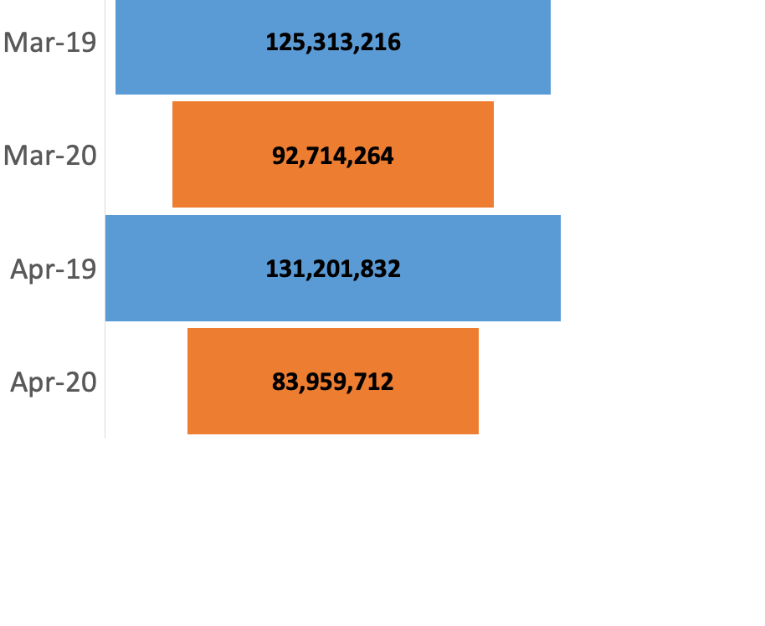
Trough in Sales (GHC)
Relative to March 2019, sales of businesses in March 2020 dropped by 26 percent
In April 2020, sales of businesses was 10 percentage points lower than the year-on-year change in March 2020
14

Slide 15
Trough in Sales (Million GHC) by Sector
Gains recorded in the manufacturing sub-sector between March and April 2019 were not realised over the same period in 2020
Accommodation and Food Sub-sector recorded the highest trough in sales by 57 percent, followed by Trade 35 percent. Other services recorded the least dip of 5 percent
15
Notes:
Half of establishments had difficulties in sourcing inputs. Accommodation and food sector are mostly affected.
Three quarters of all firms experienced reduction in cash flows. This is due largely to decline in sales; with trade sector being most affected followed by manufacturing
One quarter of all firms experienced decrease in finance.

Slide 16
Response - Jobs & Wages
41,952 (1.4%) workers lost their jobs during partial lockdown
Workers in Accommodation and Food sub-sector mostly affected
46.1% of business reduced wages for 770,124 (25.7%) workers
Other Services sub-sector were mostly affected
 | Laid off workers (%) |  | Reduced wages (%)
 | Firms | Workers | Firms | Workers
Business establishments | 4.0 | 1.4 | 46.1 | 25.7
Sector
Manufacturing | 4.3 | 1.0 | 54.5 | 14.8
Agric & Other Industries | 5.7 | 1.0 | 39.7 | 11.7
Trade | 2.3 | 1.2 | 40.5 | 28.0
Accommodation / Food | 6.7 | 5.0 | 33.8 | 30.5
Other Services | 4.4 | 1.3 | 50.1 | 36.3
16

Slide 17
Response - Use of digital solutions
Less than 10 percent of businesses adopted or intensified the use of internet for their operations
Close to two-fifths of businesses adopted the use of mobile money for business transactions
17
17
Notes:
Half (49.7%) of households with at least one child below five years indicated that the child was due for a scheduled vaccination since March 16.
While 7 out of 10 received their vaccinations,

Slide 18
Expectations
Expectations about sales
No underlying assumption - both sales and employment will respectively decrease by one percent and five percent in the next three months
On the assumption that the outturn will be worse in the next three months, sales will drop by 24 percent and employment 15 percent
In the event, where the effects of COVID-19 subsides in the next three months, businesses expect sales to increase by 25 percent and employment 4 percent.
Expectations about employment
18
18

Slide 19
Desired Policies
Top 3 policies firms desire
Loans with subsidized interest rates (61%)
Cash transfer (32%)
Deferral of rent payment (21%).
19

Slide 20
Highlights
COVID-19 pandemic and the related responses compelled about 115,000 businesses to either permanently or temporarily close down
Sales of businesses reduced by 26 percent between March 2019 and March 2020 and by 36 percent between April 2019 and April 2020
Accommodation and Food sub -sector recorded the highest dip of 57 percent
More than 45, 000 workers lost their jobs during partial lockdown. Workers in Accommodation and food sector were mostly affected
More than 770,000 workers of businesses had their wages reduced
Less than 10 percent of businesses adopted or intensified the use of internet for their operations
On the average, close to 131,000 businesses indicated that they had challenges accessing finance
More than 60 percent of firms are calling for subsidized interest rates
20

Slide 21
Upcoming Activities
Institutionalised regular releases for at least the next six months
Determine factors that lessen or heighten the effects of COVID-19 and related responses on sales and employment of businesses
Assess the variation of sales and employment across geographical areas and other background characteristics
Estimate the net impact of COVID-19 on performances of businesses
Examine the effectiveness of the innovative coping strategies of businesses
Analyse the responsiveness of Government’s interventions
Wave II of this survey to be conducted in August 2020
21
21

