Slide 1

Integrating oVirt and Foreman to Empower your Data-Center
Barak Azulay
Senior Manager
Red Hat
oVirt Workshop – Dusseldorf 2014

Slide 2
What are we going to learn?
Life-cycle of physical servers
Bare-metal provisioning
Foreman
Integrating oVirt and Foreman
Future work

Slide 3



Life-Cycle of Physical Servers
Three Steps For Managing Physical Hardware
Provision Initial startup
Configure
Monitor

Slide 4
Life-Cycle of Physical Servers
Your Data Center

Slide 5
Life-Cycle of Physical Servers
New Server Arrived

Slide 6
Life-Cycle of Physical Servers
Series Of Racks Are Arrived

Slide 7
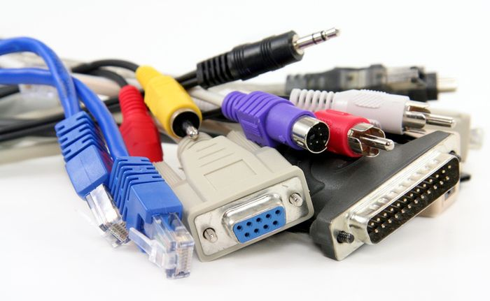
Life-Cycle of Physical Servers

Slide 8

Life-Cycle of Physical Servers
Install OS

Slide 9

Life-Cycle of Physical Servers
C5-E
Laptop/Console
C6-E
C7-E
S1-A
C8-E
S1-A = 00:11:22:33:44:55
S2-A = 0A:1B:C2:CC:44:55
C8-E = A3:AA:C7:92:12:32
…..

Slide 10

Life-Cycle of Physical Servers
Initial Setup

Slide 11
Life-Cycle of Physical Servers
Monitor And Update – Drift Management

Slide 12

Life-Cycle of Physical Servers

Slide 13

Life-Cycle of Physical Servers
BUT A5-C != 0A:1B:CC:44:55
Typo ??
A5-C

Slide 14
Better Do it Remotely
Bare metal provisioning - register “just arrived” servers to central management software
Get hardware specs
Provision, configure and monitor the servers

Slide 15

Foreman

Slide 16
Foreman
5 years old open source project
Largest installation =~ 5000 active hosts
Homepage – http://theforeman.org
Overall Projects http://github.com/theforeman
#theforeman on freenode

Slide 17

Foreman
Foreman
Provision
Foreman
Configurator
Foreman
Management

Slide 18
Foreman
Foreman
Provision
PXE Boot
Foreman
Configurator
Foreman
Management
Ubunto
RHEL
Fedora
CentOS

Slide 19
Foreman
Passwords
Keys
Users
Services
Foreman
Provision
Foreman
Configurator
Foreman
Management
Chef
Puppet
Reports

Slide 20
Foreman
Foreman
Provision
Foreman
Configurator
Foreman
Management

Slide 21
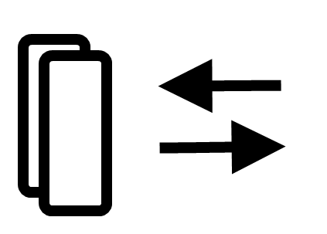










Foreman – Main Components
DNS
DHCP
Rest API
TFTP
Puppet
Web Interface
Interface
UI, API, Cli
Smart Proxy
Provision templates
Host groups
Puppet classes
Parameters
Compute
Resources
Configuration Management

Slide 22
Bare-Metal
Provisioning

Slide 23
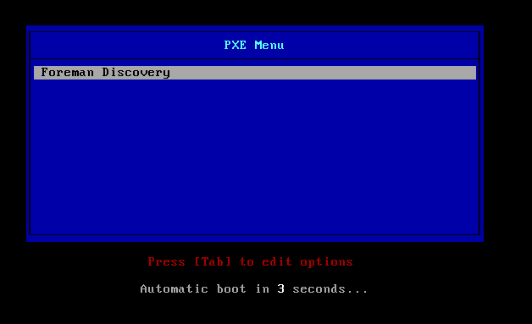
Bare-Metal Provisioning with Foreman
Tiny OS

Slide 24
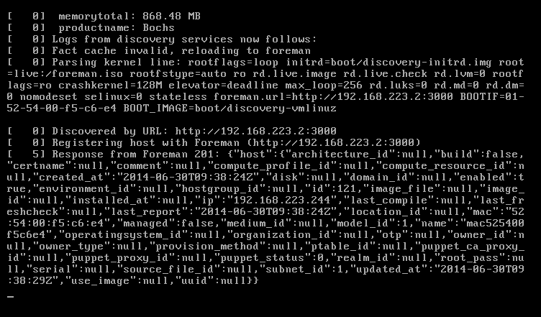
Bare-Metal Provisioning with Foreman
Tiny OS

Slide 25
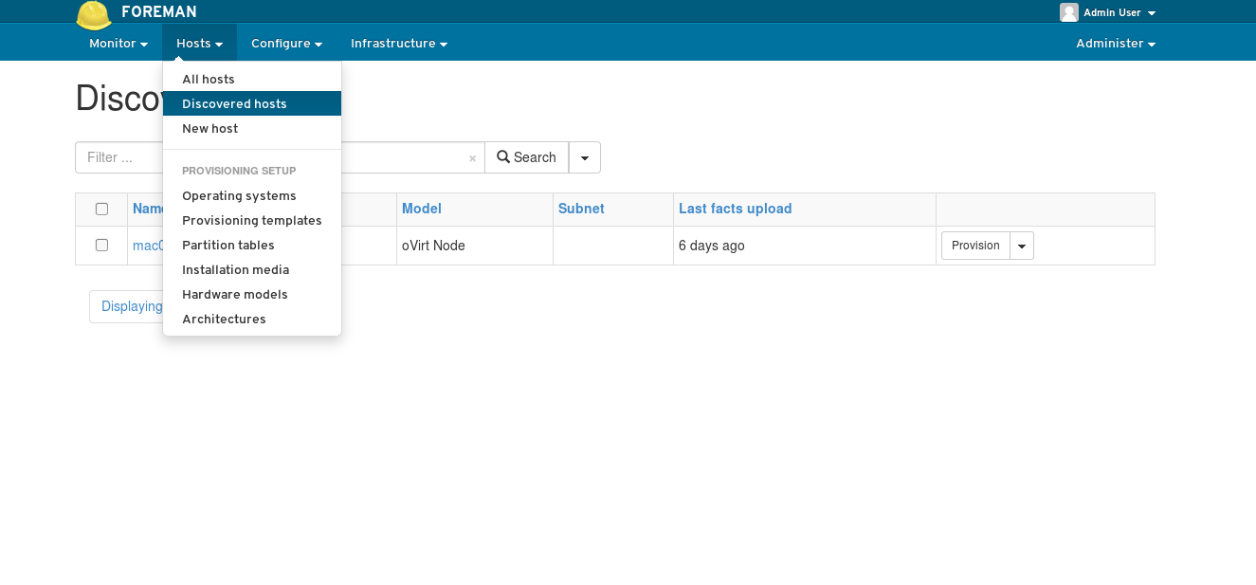
Discovered Hosts (new in 3.5)

Slide 26
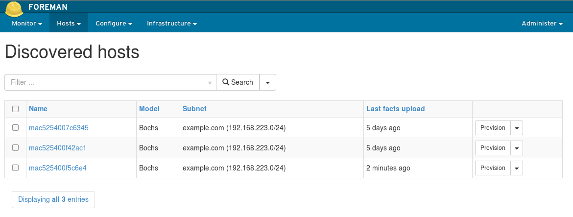
Bare-Metal Provisioning with Foreman

Slide 27
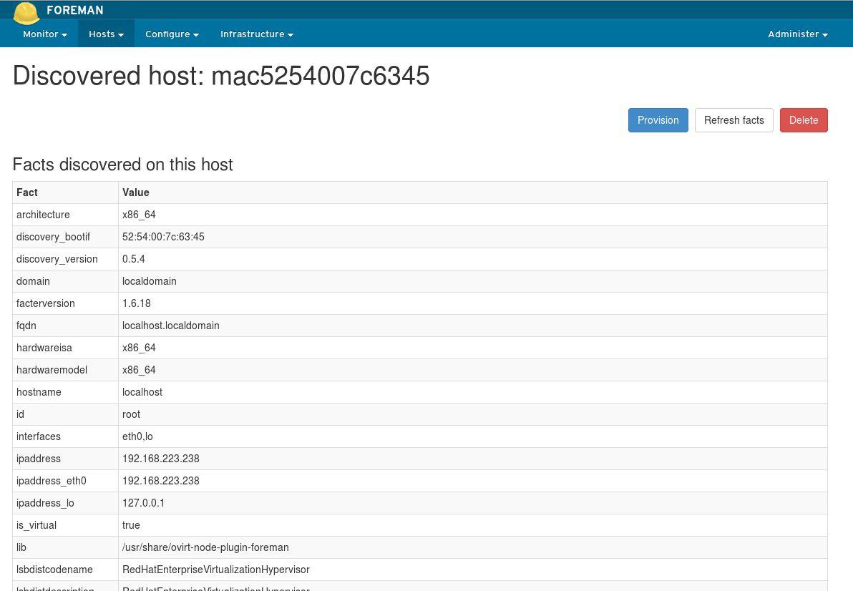
Bare-Metal Provisioning with Foreman

Slide 28
What about Virtualization?
What about Virtualization?

Slide 29
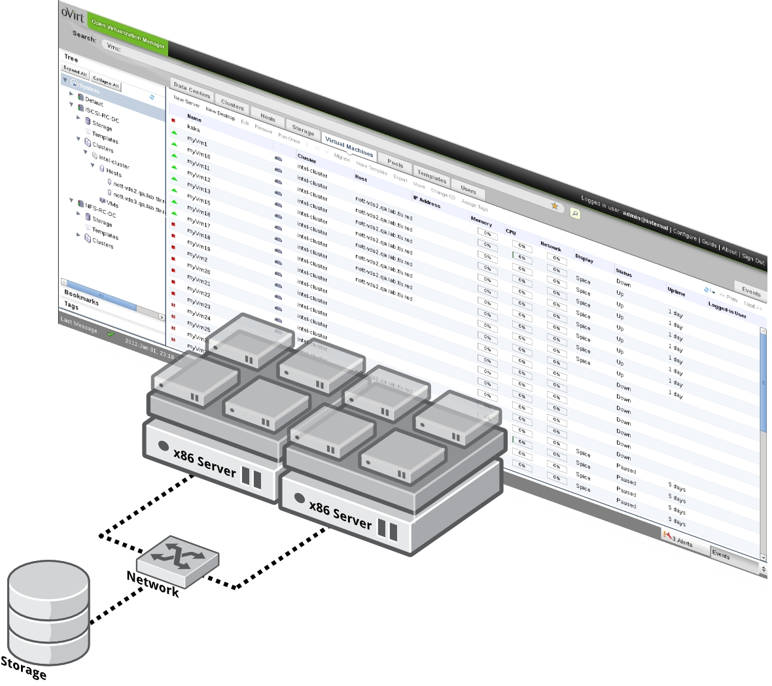
Virtualization == oVirt

Slide 30
Let's combine the two

Slide 31
oVirt-Foreman Integration
External Providers
  Foreman
  Glance
  Quantum
In oVirt 3.3
  Consume already provisioned Foreman hosts
In oVirt 3.5
  Bare-Metal provisioning – From Bare-Metal to a running hypervisor in one step
  Requires ovirt_provision_plugin to be installed in foreman

Slide 32
Foreman-oVirt Integration
Compute Resources
  You can add hosts to foreman that rely on oVirt Vms
  This functionality also exists for other Virtualization/Cloud providers

Slide 33
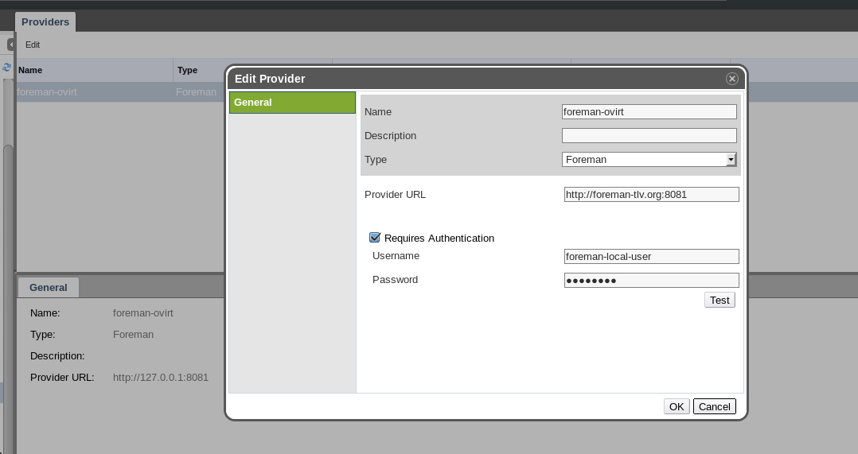
oVirt-Foreman Integration

Slide 34
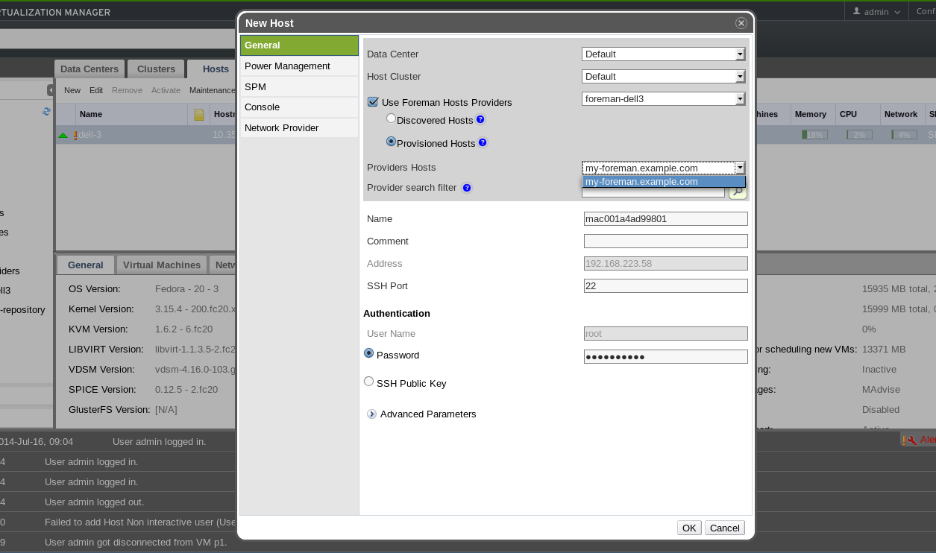
Provisioned Hosts (since oVirt 3.3)

Slide 35
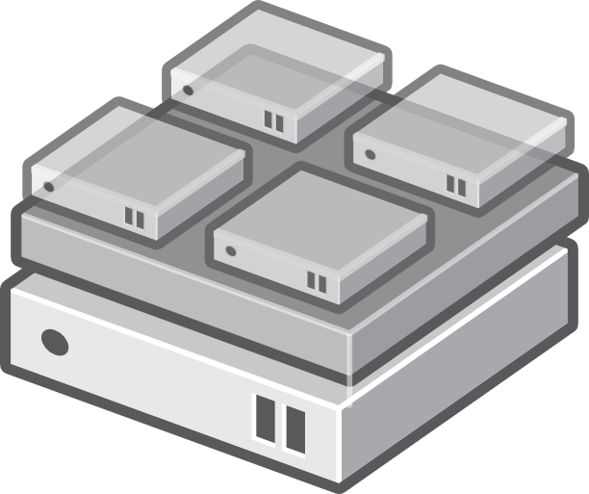

Discovered Hosts (new in 3.5)

Slide 36
Discovered Hosts (new in 3.5)
00:11:22:33:44:55
0A:1B:C2:CC:44:55
A3:AA:C7:92:12:32
Engine

Slide 37
Discovered Hosts (new in 3.5)
00:11:22:33:44:55=192.168.1.2
0A:1B:C2:CC:44:55=192.168.1.56
A3:AA:C7:92:12:32=192.168.1.66

Slide 38
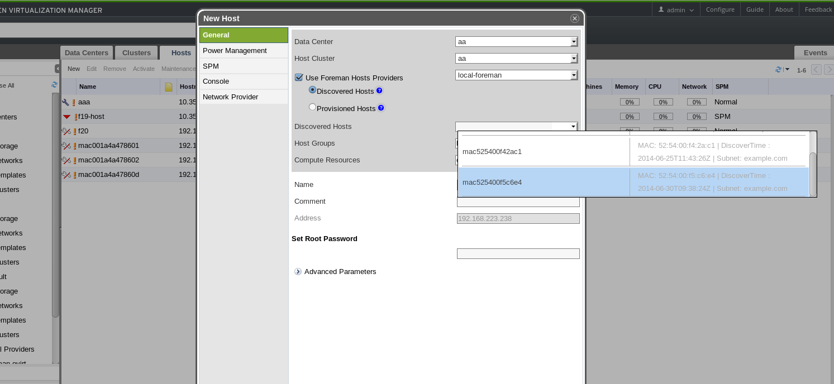
Discovered Hosts (new in 3.5)

Slide 39
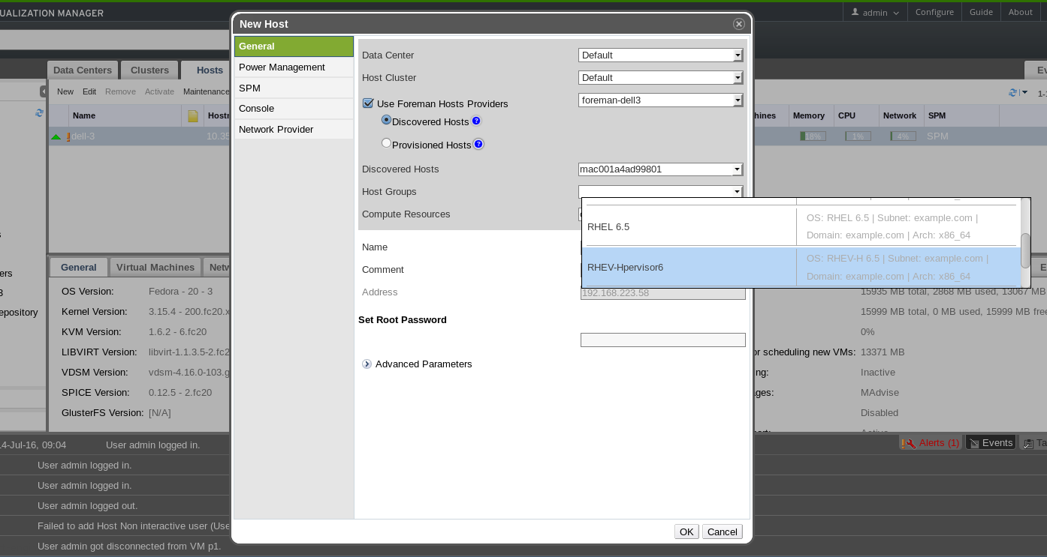
Discovered Hosts (new in 3.5)

Slide 40
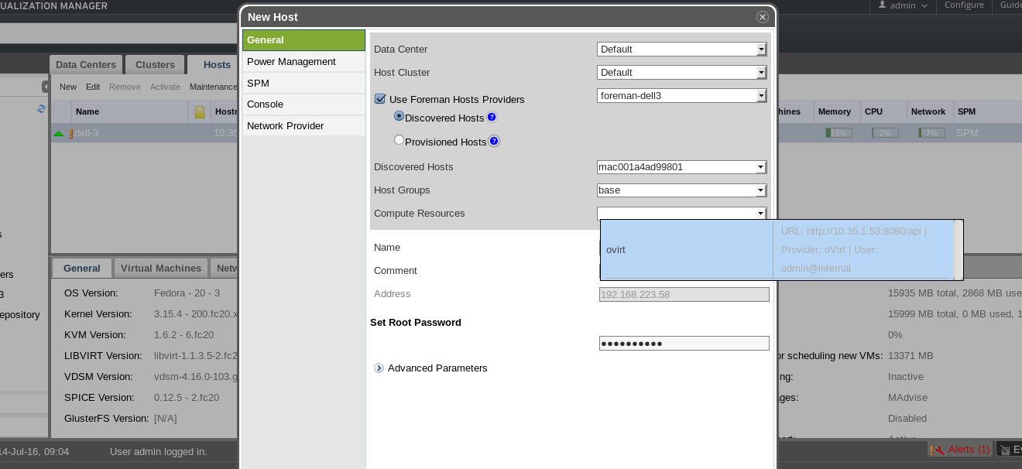
Discovered Hosts (new in 3.5)

Slide 41
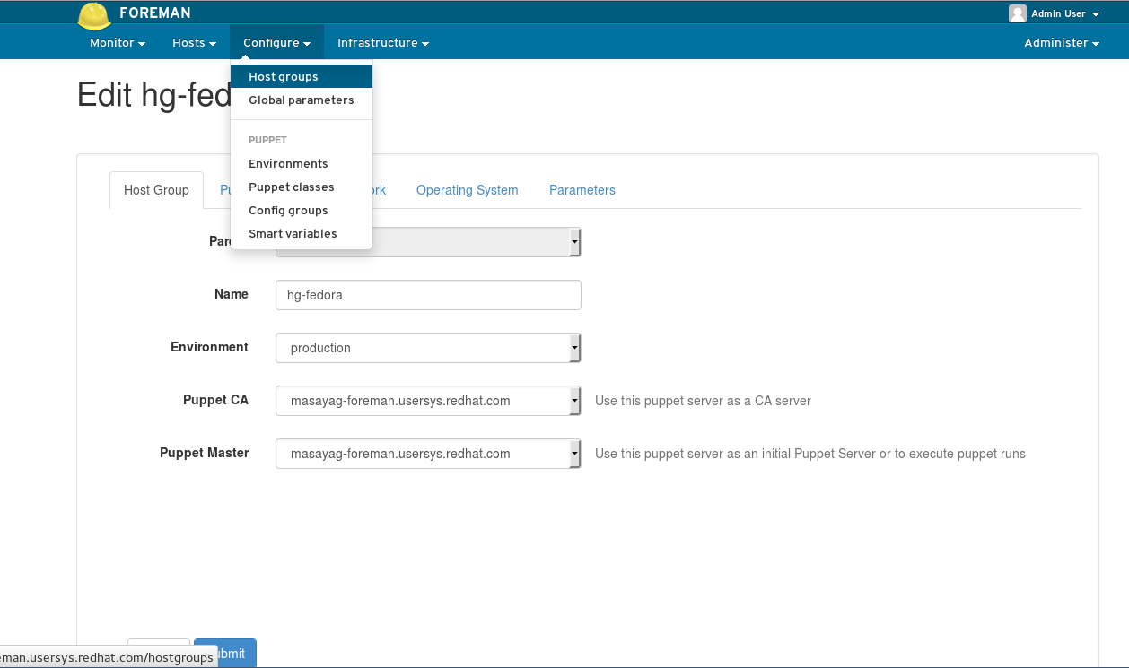
Discovered Hosts (new in 3.5)

Slide 42
Behind the Scenes

Slide 43
Discovered Hosts (new in 3.5)
Provision
Provision Host
192.168.1.53

Slide 44
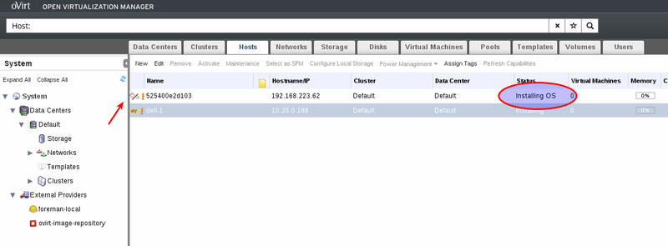
Discovered Hosts (new in 3.5)

Slide 45
Discovered Hosts (new in 3.5)
Turn it
Into
a hypervisor
Provisioned
Successfully

Slide 46
Hypervisor is up and running

Slide 47
Future Work
Host configuration management through oVirt
VM Provisioning
UX Improvements

Slide 48
Summary (what do I get out here with?)
Foreman
External Providers in oVirt
Foreman-oVirt Integration
  Bare-Metal to Hypervisor in one-step
Feature page
  http://www.ovirt.org/Features/AdvancedForemanIntegration

Slide 49
More info
oVirt - http://www.ovirt.org
Red-Hat developer blog – http://developerblog.redhat.com
Mailing lists
  users@ovirt.org
  arch@ovirt.org
  engine-devel@ovirt.org
IRC Channel - #oVirt channel on irc.oftc.net

Slide 50
THANK YOU !
Barak Azulay
bazulay@redhat.com

