Slide 1


Vdsm hooks – for developers
Ayal Baron
abaron@redhat.com

Slide 2
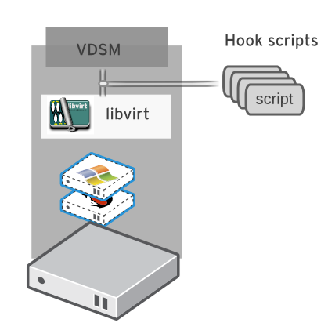
Hooks
“Hook” is a mechanism for customizing system flow
  Mostly used to define scripts that modify VM operation

Slide 3
Hooks
Hook scripts are called at specific system / VM lifecycle events
    VDSM (management agent) Start / Stop
    Before VM start, After VM start
    On VM stop
    Before VM migration source / destination
    After VM migration source / destination
    Before and After VM Pause
    Before and After VM Continue
    Before and After VM Hibernate
    Before and After VM resume from hibernate
    Before and After VM set ticket
    Coming soon - Hotplug NIC, Hotplug Disk...
Hooks can modify a virtual machine's XML definition before VM start
Hooks can run system commands – eg. Apply firewall rules to a VM
New in 3.1

Slide 4
Available hooks
directlun (deprecated)
faqemu
fileinject
floppy
hostusb
hugepages
isolatedprivatevlan
nestedvt
numa
pincpu
promisc
qemucmdline
qos
scratchpad
smbios
sriov
vhostmd
vmdisk
vmfex

Slide 5
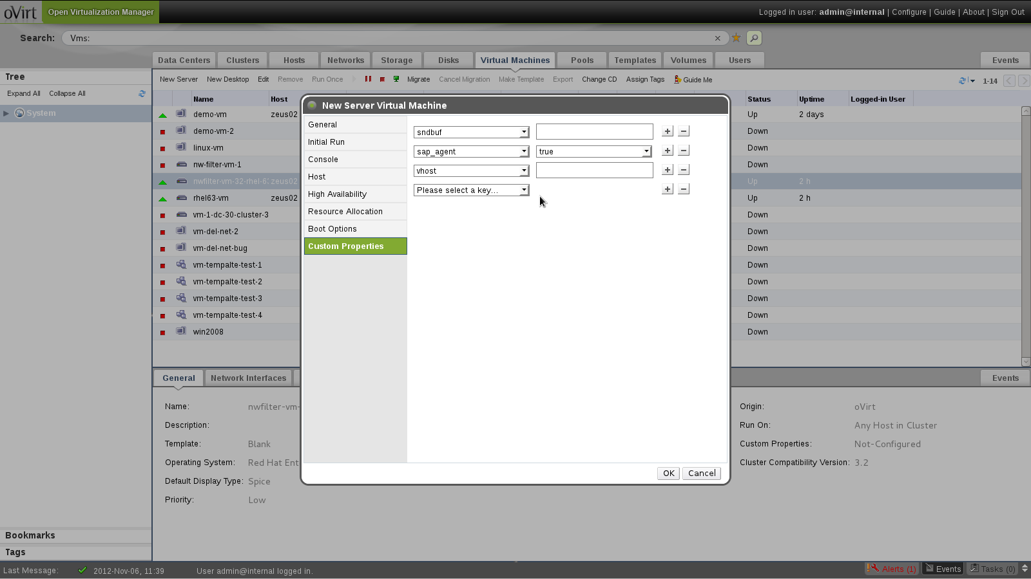
Custom Properties

Slide 6
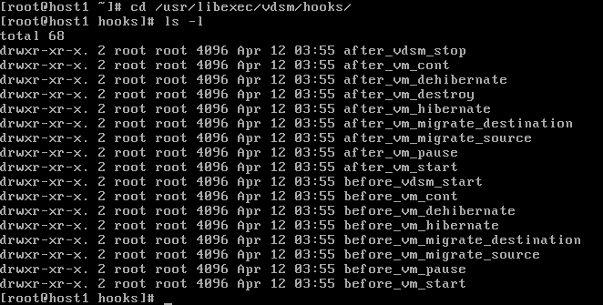

Hooks
Hooks are installed in /usr/libexec/vdsm/hooks

Slide 7
Flow control
Each hook is a separate package (rpm)
Currently no distribution mechanism, however, otopi* may be configured to deliver hook rpms
Once installed – always runs
Information is passed through environment variables
  “if 'directlun' in os.environ:”
All the information in “custom properties” is passed to all hooks
Any executable script/binary
Requires knowledge of libvirt xml format
otopi -- oVirt Task Oriented Pluggable Installer

Slide 8
Fake Qemu – Makefile.am
include $(top_srcdir)/build-aux/Makefile.subs
dist_vdsmexec_SCRIPTS = \
vdsm-faqemu
CLEANFILES = \
config.log \
$(nodist_vdsmexec_SCRIPTS)
EXTRA_DIST = \
after_vdsm_stop.py \
before_vm_start.py
install-data-local:
$(MKDIR_P) $(DESTDIR)$(vdsmhooksdir)/after_vdsm_stop
$(INSTALL_SCRIPT) $(srcdir)/after_vdsm_stop.py \
$(DESTDIR)$(vdsmhooksdir)/after_vdsm_stop/10_faqemu
$(MKDIR_P) $(DESTDIR)$(vdsmhooksdir)/before_vm_start
$(INSTALL_SCRIPT) $(srcdir)/before_vm_start.py \
$(DESTDIR)$(vdsmhooksdir)/before_vm_start/10_faqemu
uninstall-local:
$(RM) $(DESTDIR)$(vdsmhooksdir)/after_vdsm_stop/10_faqemu
$(RM) $(DESTDIR)$(vdsmhooksdir)/before_vm_start/10_faqemu

Slide 9
Fake Qemu – before_vm_start.py
import hooking
from vdsm.config import config
if config.getboolean('vars', 'fake_kvm_support'):
domxml = hooking.read_domxml()
graphics = domxml.getElementsByTagName("graphics")[0]
graphics.removeAttribute("passwdValidTo")
for memtag in ("memory", "currentMemory"):
memvalue = domxml.getElementsByTagName(memtag)[0]
while memvalue.firstChild:
memvalue.removeChild(memvalue.firstChild)
memvalue.appendChild(domxml.createTextNode("20480"))
for cputag in domxml.getElementsByTagName("cpu"):
cputag.parentNode.removeChild(cputag)
devices = domxml.getElementsByTagName('devices')[0]
if devices.getElementsByTagName('emulator'):
pass # TODO override emulator tag
else:
emulator = domxml.createElement('emulator')
emulatorPath = domxml.createTextNode('/usr/libexec/vdsm/vdsm-faqemu')
emulator.appendChild(emulatorPath)
devices.appendChild(emulator)
hooking.write_domxml(domxml)t

Slide 10
Hooking.py
import os
from xml.dom import minidom
from storage.misc import execCmd
from vdsm.utils import tobool
def read_domxml():
return minidom.parseString(file(os.environ['_hook_domxml']).read())
def write_domxml(domxml):
file(os.environ['_hook_domxml'], 'w').write(domxml.toxml(encoding='utf-8'))

Slide 11
DirectLUN hook (deprecated) - Files
before_vm_start.py
after_vm_destroy.py
before_vm_migrate_destination.py
Makefile.am
sudoers.vdsm_hook_directlun
README

Slide 12
DirectLUN – Makefile.am
EXTRA_DIST = \
after_vm_destroy.py \
before_vm_migrate_destination.py \
before_vm_start.py \
sudoers.vdsm_hook_directlun
install-data-hook:
chmod 440 $(DESTDIR)$(sysconfdir)/sudoers.d/50_vdsm_hook_directlun
install-data-local: install-data-sudoers
$(MKDIR_P) $(DESTDIR)$(vdsmhooksdir)/before_vm_start
$(INSTALL_SCRIPT) $(srcdir)/before_vm_start.py \
$(DESTDIR)$(vdsmhooksdir)/before_vm_start/50_directlun
$(MKDIR_P) $(DESTDIR)$(vdsmhooksdir)/after_vm_destroy
$(INSTALL_SCRIPT) $(srcdir)/after_vm_destroy.py \
$(DESTDIR)$(vdsmhooksdir)/after_vm_destroy/50_directlun
$(MKDIR_P) $(DESTDIR)$(vdsmhooksdir)/before_vm_migrate_destination
$(INSTALL_SCRIPT) $(srcdir)/before_vm_migrate_destination.py \
$(DESTDIR)$(vdsmhooksdir)/before_vm_migrate_destination/50_directlun
uninstall-local: uninstall-data-sudoers
$(RM) $(DESTDIR)$(vdsmhooksdir)/before_vm_start/50_directlun
$(RM) $(DESTDIR)$(vdsmhooksdir)/after_vm_destroy/50_directlun
$(RM) $(DESTDIR)$(vdsmhooksdir)/before_vm_migrate_destination/50_directlun
install-data-sudoers:
$(MKDIR_P) $(DESTDIR)$(sysconfdir)/sudoers.d
$(INSTALL_DATA) $(srcdir)/sudoers.vdsm_hook_directlun \
$(DESTDIR)$(sysconfdir)/sudoers.d/50_vdsm_hook_directlun
uninstall-data-sudoers:
$(RM) $(DESTDIR)$(sysconfdir)/sudoers.d/50_vdsm_hook_directlun

Slide 13
DirectLUN – before_vm_start.py
if 'directlun' in os.environ:
try:
luns = os.environ['directlun']
domxml = hooking.read_domxml()
devices = domxml.getElementsByTagName('devices')[0]
createDirectory(DEV_DIRECTLUN_PATH)
for lun in luns.split(','):
try:
lun, options = lun.split(':')
except ValueError:
options = ''
options = options.split(';')
srcpath = DEV_MAPPER_PATH + '/' + lun
if not os.path.exists(srcpath):
sys.stderr.write('directlun: device not found %s\n' % srcpath)
sys.exit(2)
uuid = domxml.getElementsByTagName('uuid')[0]
uuid = uuid.childNodes[0].nodeValue
devpath = DEV_DIRECTLUN_PATH + '/' + lun + '-' + uuid
cloneDeviceNode(srcpath, devpath)
sys.stderr.write('directlun: adding lun %s\n' % devpath)
diskdev = createDiskElement(domxml, devpath, lun, options)
sys.stderr.write('directlun: adding xml: %s\n' % diskdev.toxml())
devices.appendChild(diskdev)
hooking.write_domxml(domxml)
except:
sys.stderr.write('directlun: [unexpected error]: %s\n' %
traceback.format_exc())
sys.exit(2)

Slide 14
DirectLUN – after_vm_destroy.py
if 'directlun' in os.environ:
try:
luns = os.environ['directlun']
domxml = hooking.read_domxml()
for lun in luns.split(','):
try:
lun, options = lun.split(':')
except ValueError:
options = ''
uuid = domxml.getElementsByTagName('uuid')[0]
uuid = uuid.childNodes[0].nodeValue
devpath = os.path.join(DIRECTLUN_PATH, lun + '-' + uuid)
removeDeviceNode(devpath)
hooking.write_domxml(domxml)
except:
sys.stderr.write('directlun after_vm_destroy: [unexpected error]: '
'%s\n' % traceback.format_exc())
sys.exit(2)

Slide 15
How to contribute
Repository:
  http://git.fedorahosted.org/git/?p=vdsm.git
Mailing lists:
  vdsm-devel@lists.fedorahosted.org
  vdsm-patches@lists.fedorahosted.org
IRC:
  #vdsm on Freenode
Core Team:
Dan Kenigsberg, Saggi Mizrahi, Igor Lvovsky, Eduardo Warszawasky, Federico Simoncelli, Douglas Landgraf, Peter Savelyev, Yeela Kaplan, Ayal Baron

Slide 16

THANK YOU !
http://www.ovirt.org

Slide 17
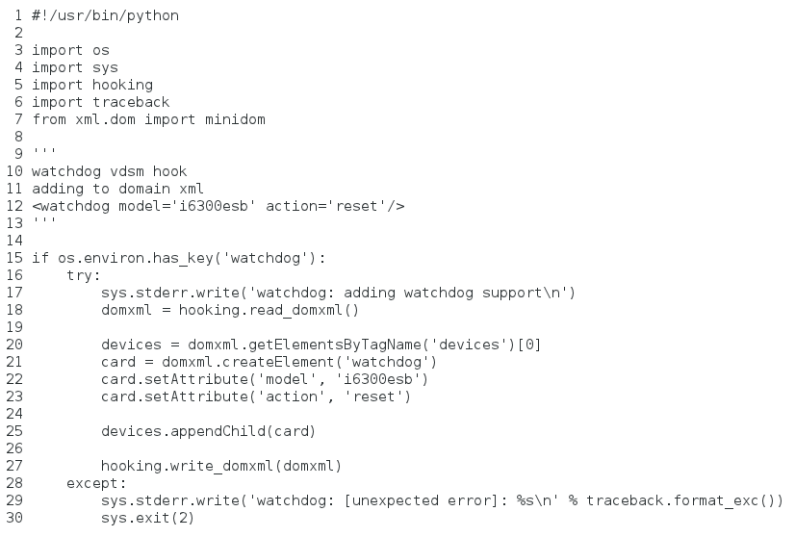
Hooks

