Slide 1


oVirt
Open Virtualization Managment
KVM forum 2013
Livnat Peer
Red Hat
Notes:
Today I'm going to share with you Why oVirt is a great open source virtualization managment solution for managing your KVM based Vms.
I'm going to focus on three aspects:
1. Simplicity - show how simple it is to install and get up and running
2. Stable

Slide 2
Using KVM
/usr/libexec/qemu-kvm -name vm-f16-buildmachine -S -M rhel6.4.0 -cpu Westmere -enable-kvm -m 2048 -smp 2,sockets=2,cores=1,threads=1 -uuid a8ccdb60-8a42-44f5-9669-d74c3b2eff43 -smbios type=1,manufacturer=Red Hat,product=RHEV Hypervisor,version=6Server-6.4.0.4.el6,serial=30353036-3837-4247-3831-30394635324C_78:e7:d1:22:46:d8,uuid=a8ccdb60-8a42-44f5-9669-d74c3b2eff43 -nodefconfig -nodefaults -chardev socket,id=charmonitor,path=/var/lib/libvirt/qemu/vm-f16-buildmachine.monitor,server,nowait -mon chardev=charmonitor,id=monitor,mode=control -rtc base=2013-10-08T12:16:16,driftfix=slew -no-shutdown -device piix3-usb-uhci,id=usb,bus=pci.0,addr=0x1.0x2 -device virtio-serial-pci,id=virtio-serial0,bus=pci.0,addr=0x4 -drive if=none,media=cdrom,id=drive-ide0-1-0,readonly=on,format=raw,serial= -device ide-drive,bus=ide.1,unit=0,drive=drive-ide0-1-0,id=ide0-1-0 -drive file=/rhev/data-center/f79b0b28-c82f-11e0-8739-78e7d1e48c4c/5bab6470-8825-4e3a-b408-ebcde93678b6/images/4c213cd2-c4d5-441b-a1ac-dfb1a6868699/11b3e132-50a5-481b-b48b-e3b1f2879e69,if=none,id=drive-virtio-disk0,format=qcow2,serial=4c213cd2-c4d5-441b-a1ac-dfb1a6868699,cache=none,werror=stop,rerror=stop,aio=native -device virtio-blk-pci,scsi=off,bus=pci.0,addr=0x5,drive=drive-virtio-disk0,id=virtio-disk0,bootindex=1 -drive file=/rhev/data-center/f79b0b28-c82f-11e0-8739-78e7d1e48c4c/5bab6470-8825-4e3a-b408-ebcde93678b6/images/02330fa2-d1ff-48e0-a843-842c2376756f/5a283126-4d27-4eef-86dd-fb538d8d08e4,if=none,id=drive-virtio-disk1,format=qcow2,serial=02330fa2-d1ff-48e0-a843-842c2376756f,cache=none,werror=stop,rerror=stop,aio=native -device virtio-blk-pci,scsi=off,bus=pci.0,addr=0x6,drive=drive-virtio-disk1,id=virtio-disk1 -netdev tap,fd=31,id=hostnet0,vhost=on,vhostfd=32 -device virtio-net-pci,netdev=hostnet0,id=net0,mac=00:1a:4a:23:12:13,bus=pci.0,addr=0x3,bootindex=2 -chardev socket,id=charchannel0,path=/var/lib/libvirt/qemu/channels/vm-f16-buildmachine.com.redhat.rhevm.vdsm,server,nowait -device virtserialport,bus=virtio-serial0.0,nr=1,chardev=charchannel0,id=channel0,name=com.redhat.rhevm.vdsm -chardev socket,id=charchannel1,path=/var/lib/libvirt/qemu/channels/vm-f16-buildmachine.org.qemu.guest_agent.0,server,nowait -device virtserialport,bus=virtio-serial0.0,nr=2,chardev=charchannel1,id=channel1,name=org.qemu.guest_agent.0 -chardev spicevmc,id=charchannel2,name=vdagent -device virtserialport,bus=virtio-serial0.0,nr=3,chardev=charchannel2,id=channel2,name=com.redhat.spice.0 -spice port=5904,tls-port=5905,addr=10.35.16.4,x509-dir=/etc/pki/vdsm/libvirt-spice,tls-channel=main,tls-channel=display,tls-channel=inputs,tls-channel=cursor,tls-channel=playback,tls-channel=record,tls-channel=smartcard,tls-channel=usbredir,seamless-migration=on -k en-us -vga qxl -global qxl-vga.ram_size=67108864 -global qxl-vga.vram_size=67108864

Slide 3
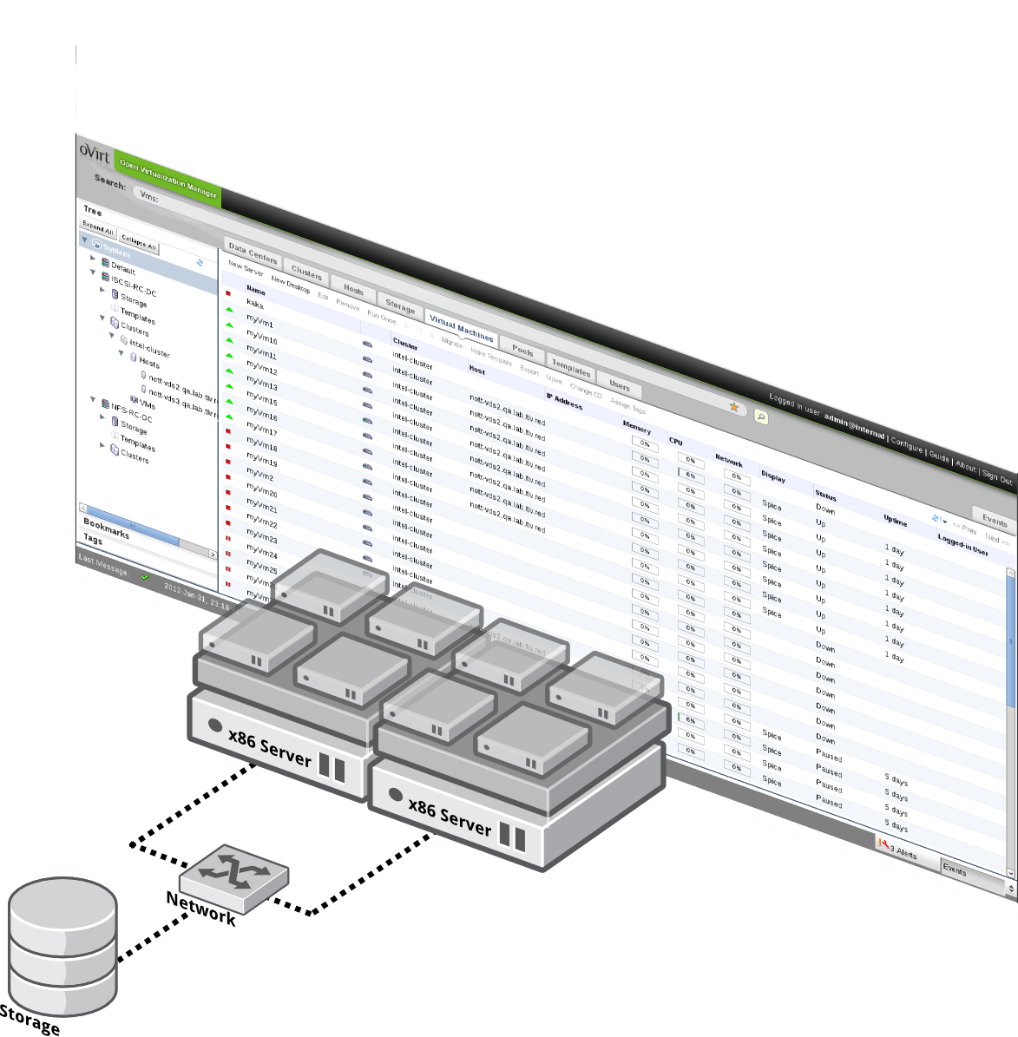
What is oVirt?
Large scale, centralized management for server and desktop virtualization
Based on leading performance, scalability and security infrastructure technologies
Focus on KVM for best integration/performance
Provides an open source alternative to vCenter/vSphere
Notes:
rhev-m manages rhev-h and rhel hypervisor
Based on kvm – part of linux, benefits from linux, feature velocity --> leading spec results,
KVM (for Kernel-based Virtual Machine) is a full virtualization solution for Linux on x86 hardware containing virtualization extensions (Intel VT or AMD-V). It consists of a loadable kernel module, kvm.ko, that provides the core virtualization infrastructure
Pets and Cattle

Slide 4
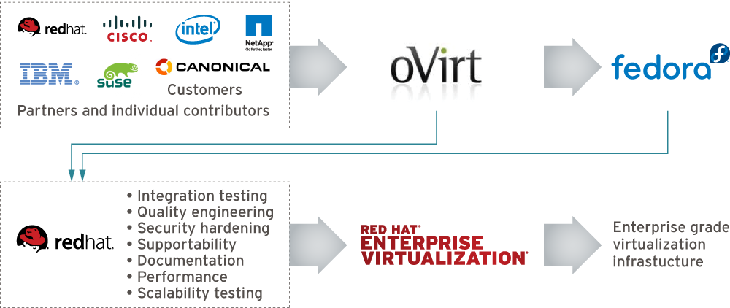
Who is behind it
Notes:
Open source for 2 years
Release cycle is every 6 months so we already have 4 stable versions out there, the lasts one that was released in September is oVirt 3.3 that included features like integration with gluster openstack cloud-init
http://community.redhat.com/ovirt-3-3-spices-up-the-software-defined-datacenter-with-openstack-and-gluster-integration/

Slide 5
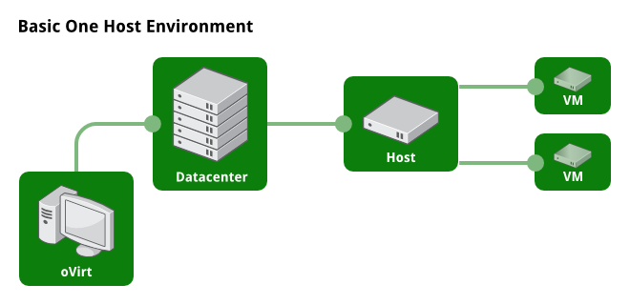
One Host Environment
Notes:
What kind of topologies you can manage via oVirt

Slide 6
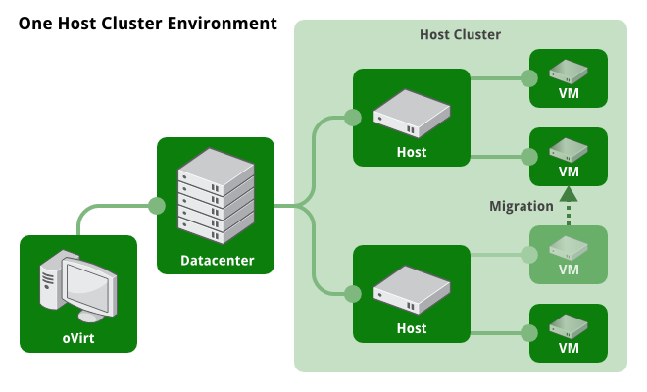
Multiple hosts

Slide 7
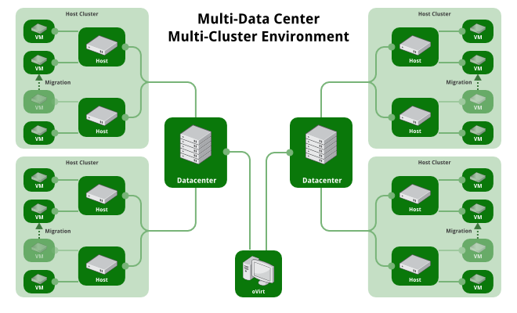
Multi-Datacenter/Multi-Host

Slide 8



oVirt Users

Slide 9
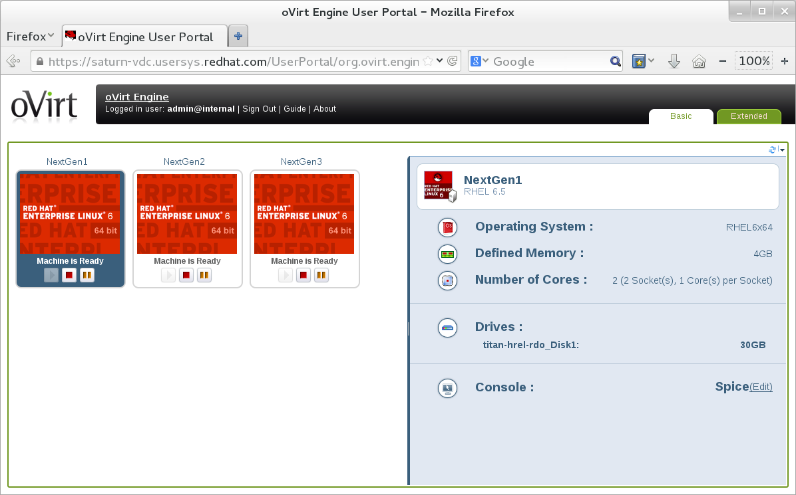
User Portal

Slide 10
oVirt Users

Slide 11
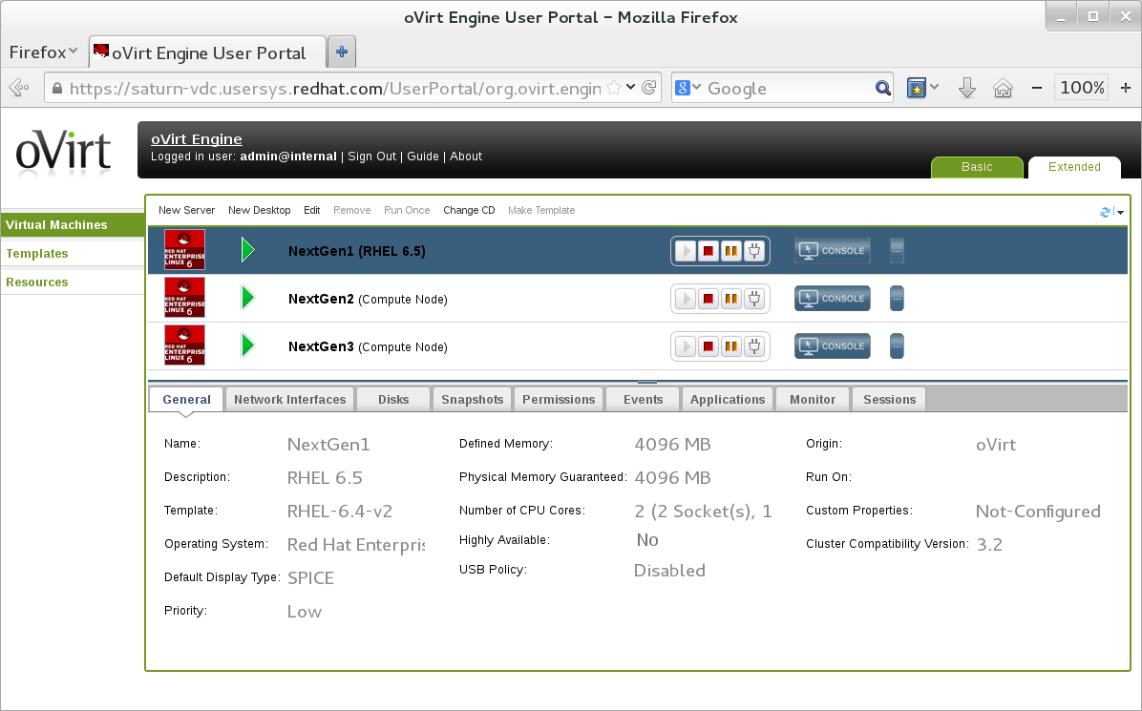
Self Provisioning Portal

Slide 12
oVirt Users

Slide 13
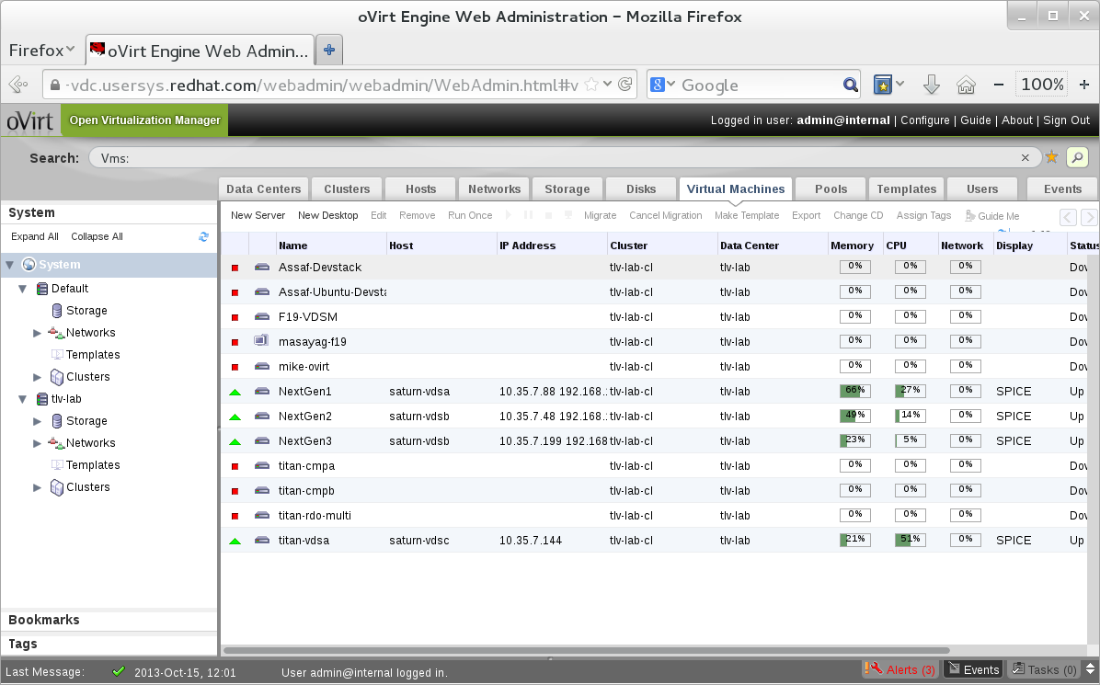
Web administration

Slide 14
Three Pillars of Management
Simplicity
Stability
Functionality

Slide 15
Simplicity
Installation
  sudo yum install -y ovirt-engine
  sudo engine-setup
Varied user interaction mechanisms
  Intuitive web interface
  Python CLI
  Python/Java SDK
Ovirt Node
Configuration
  One place, single utility

Slide 16
Quickstart – All in one
Execute:
  sudo yum install -y ovirt-engine ovirt-engine-setup-plugin-allinone
  sudo engine-setup
Connect to the web UI
Use oVirt
<Live demo>

Slide 17


oVirt Node
Standalone hypervisor
  Small footprint ~ 170MB
    Customized 'spin' of Fedora + KVM
    'Just enough' Fedora to run virtual machines
    Runs on all RHEL hardware
    with Intel VT/AMD-V CPUs
  Easy to install, configure and upgrade
    PXE boot, USB boot, CD or Hard drive

Slide 18
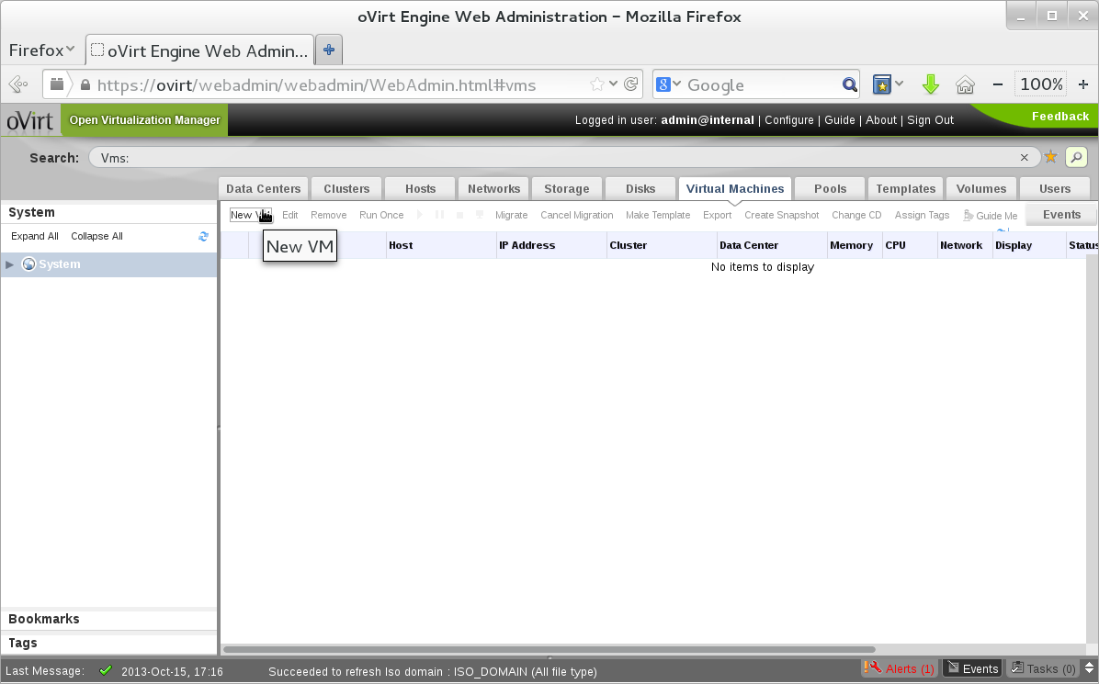

Add a VM

Slide 19
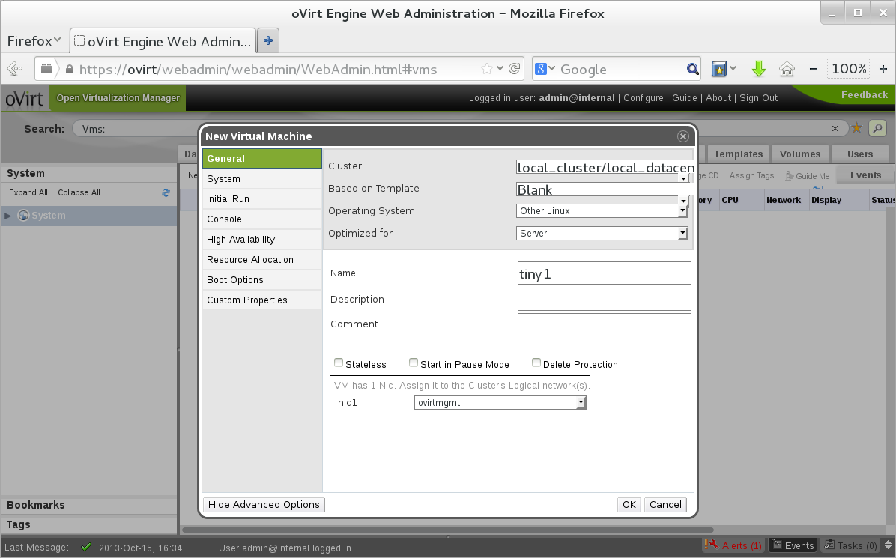
Fill in the VM details

Slide 20
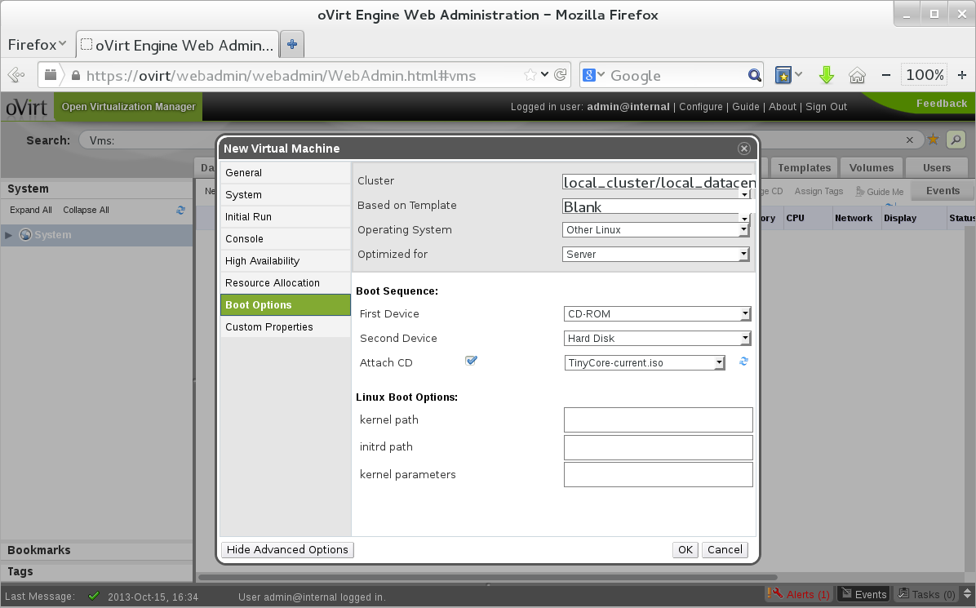
Select ISO to load from

Slide 21
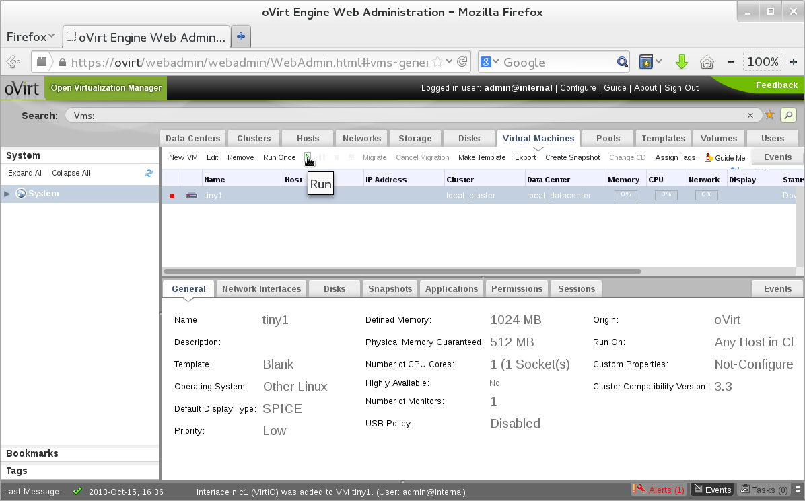

Run your VM

Slide 22
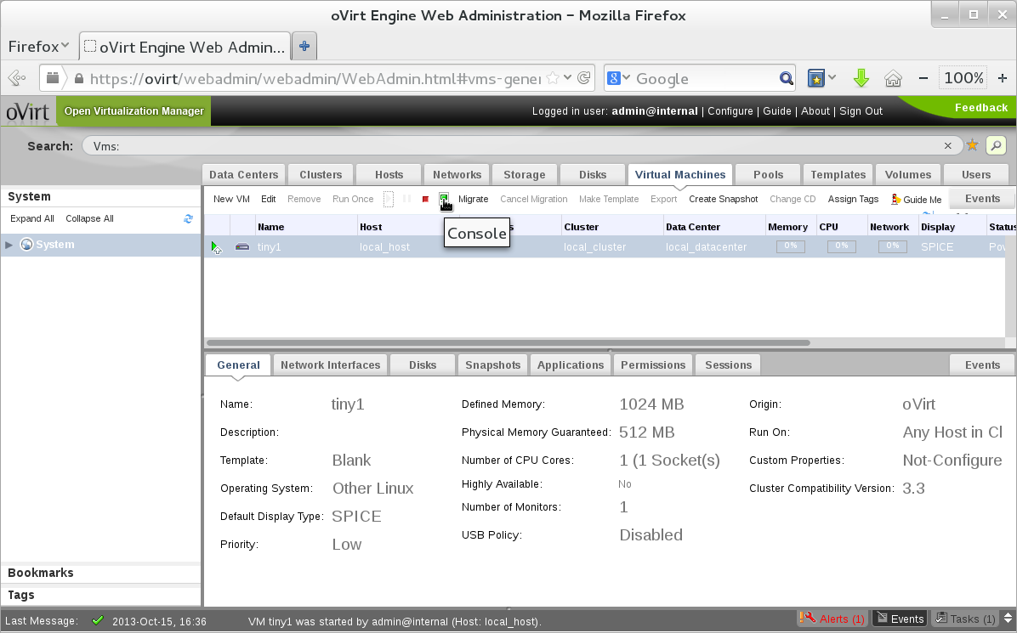

Once VM starts, open console

Slide 23
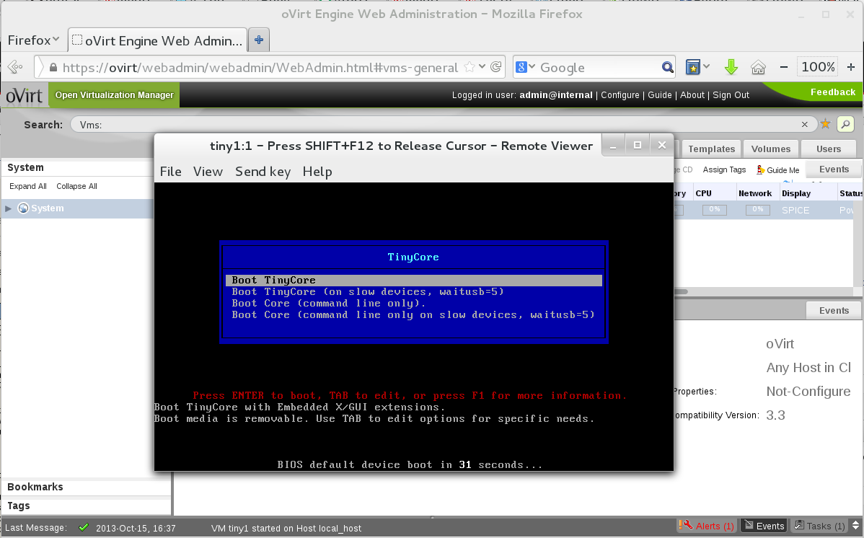
Voila – VM is running!

Slide 24
Stability
Involvement of big companies
  RHEV is based on oVirt
  IBM, Netapp, Cisco etc.
Open governance model - Merit based
Regular release schedule
  Well known release schedule
  Stabilization periods
  Community test days
CI
Active users community
  Deployed in production, Alter Way

Slide 25
Functionality - Full control
Control every aspect of your data center
  Host deployments
  Virtual networking configuration
  Storage configuration
  Resilience policies
  Quotas & QoS
Control every aspect of the VM
  Storage & networking
  High availability
  Fine tuning

Slide 26
Advanced Functionality
History DB & reports
Quota: CPU, Memory, Storage
Neutron, Glance integration
VM live snapshot with RAM
Storage Live Migration
System scheduler
Network QoS
virt-disk resize
Many more....

Slide 27

Architecture

Slide 28
Architecture From 30,000 Feet
Hosts (VDSM)
Engine
Client (web portals)
Notes:
Centralized management system
3 main actors
Client – view setup information and submit actions
Server –HA service, process the queries and actions submitted by the clients
Serves as inventory
Many actions requires operations in the host level
Agent – Tailored to the management needs
Provides all functionality in the host level

Slide 29
Components Overview
Postgres
Engine
Java
SDK/CLI
Python/Java
AD
R
E
S
T
Admin Portal
GWT
LDAP
User Portal
GWT
Guest agent
Guest agent
Shared Storage
FC/iSCSI/NFS...
Linux VM
Win VM
Linux/Windows
client
VDSM
Host | Node
SPICE
Local Storage

Slide 30
The Guest
RHEV
Agent
virtio-
net
virtio-block
virtio-serial
spice
qxl
virtio-balloon
Linux | Windows Guest
spice
client
RHEL | RHEV-H

Slide 31

Customization Options

Slide 32
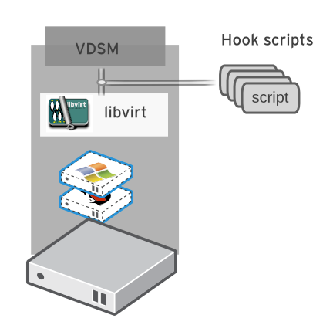
Hooks
“Hook” mechanism for customization
  Allows administrator to define scripts to modify VM operation
    eg. Extend or modify VM configuration

Slide 33
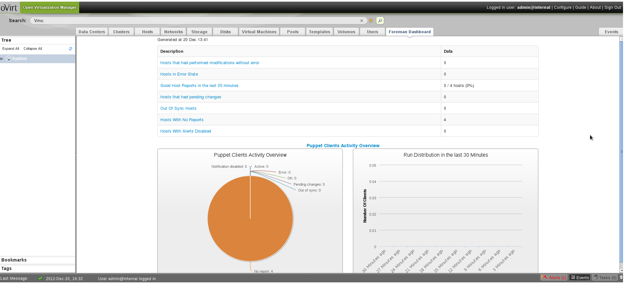
UI-Plugin: Foreman main tab

Slide 34
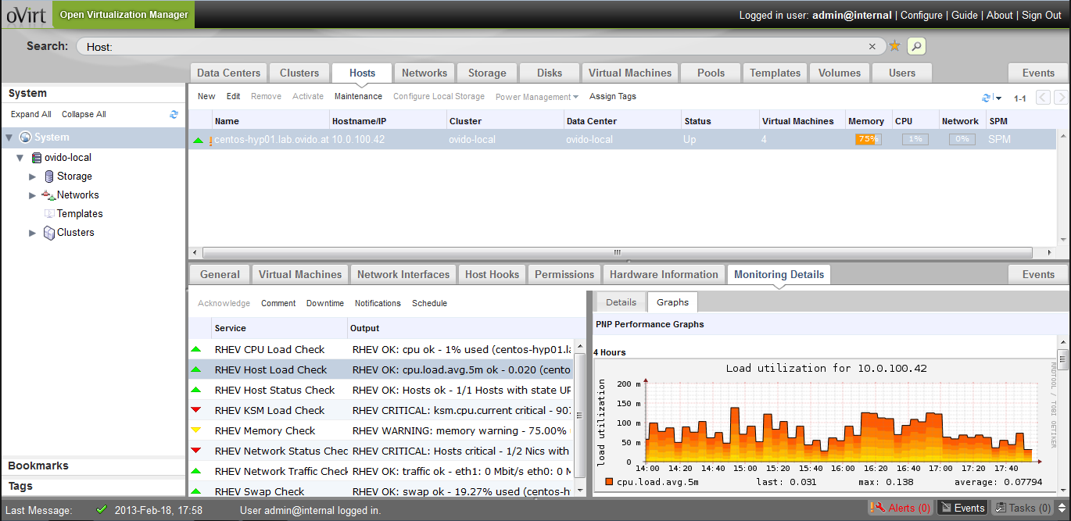
UI-Plugin: oVirt Monitoring sub-tab
More info at: https://labs.ovido.at/monitoring/wiki/ovirt-monitoring-ui-plugin

Slide 35


Slide 36
Getting oVirt
Obtain from oVirt website -
  http://www.ovirt.org/Download
Fedora repositories
Live USB - http://wiki.ovirt.org/wiki/OVirt_Live
Build from source

Slide 37
How To Contribute
Join the community
- Find bugs, File Them, Correct Them.
- Translate, Write Documentation.
- Design Interfaces, Develop new features
- Share your experiences.
Everyone can make a difference.
Mailing lists:
  http://lists.ovirt.org/mailman/listinfo
IRC:
  #ovirt on OFTC
Website and Repository:
  http://www.ovirt.org
  http://www.ovirt.org/wiki
  http://www.ovirt.org/project/subprojects/

Slide 38

THANK YOU !
http://www.ovirt.org

