Slide 1


oVirt Architecture
Itamar Heim
iheim@redhat.com

Slide 2
Agenda
oVirt Components
  Engine
  Clients
  Host
    Engine Agent - VDSM
  Guest
Storage Concepts
Data Warehouse & Reports
User flows

Slide 3
Architecture From 30,000 Feet
Servers
Engine
Client

Slide 4
The Real World
Web Clients
DB
Engine
Python SDK
Python CLI
LDAP
Server
R
E
S
T
Guest agent
Spice
client
Shared
Storage
Guest
Host
VDSM
Local Storage

Slide 5
RHEV-M Engine
VM & Template Life Cycle
create, schedule, snapshot
Load
Balancing
HA
Storage
Configuration & Monitoring
Network
Configuration & Monitoring
Host
Register/Install
Host
Monitoring
Host
Maintenance
Host
Fencing
Authentication, Authorization
Audit
Inventory

Slide 6

RHEV-M Engine
Postgres
DB
Engine
Active
Directory
RHDS
R
E
S
T
IDM

Slide 7
The Real World
Web Clients
DB
Engine
Python SDK
Python CLI
LDAP
Server
R
E
S
T
Guest agent
Spice
client
Shared
Storage
Guest
Host
VDSM
Local Storage

Slide 8
The Clients
Admin Portal
User Portal
Engine
R
E
S
T
Python SDK
Python CLI

Slide 9
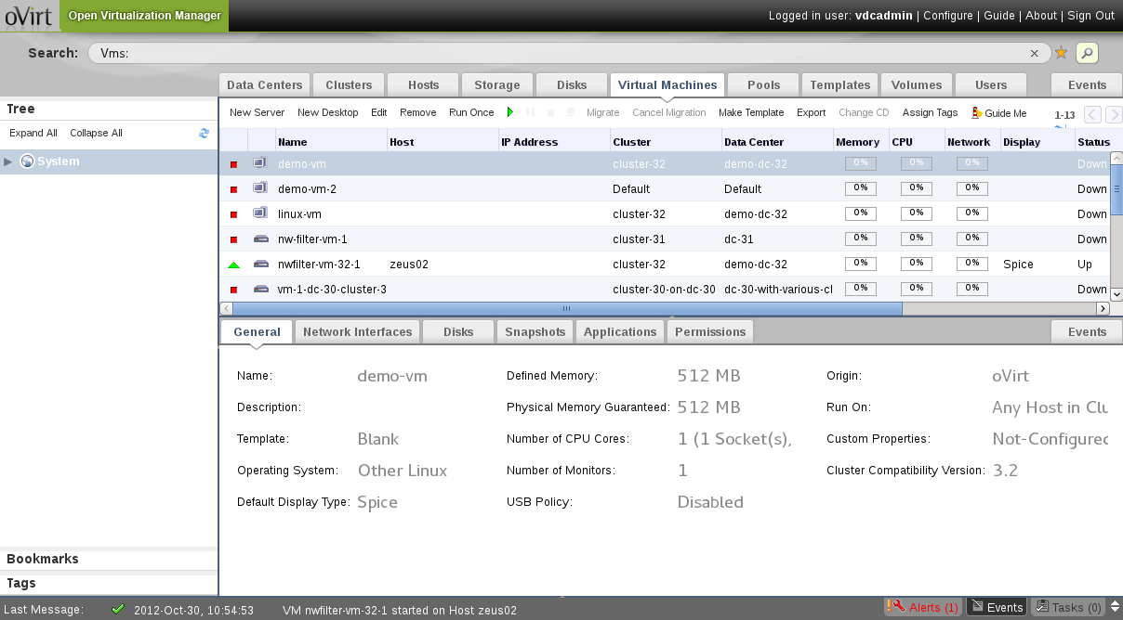
Admin Portal

Slide 10
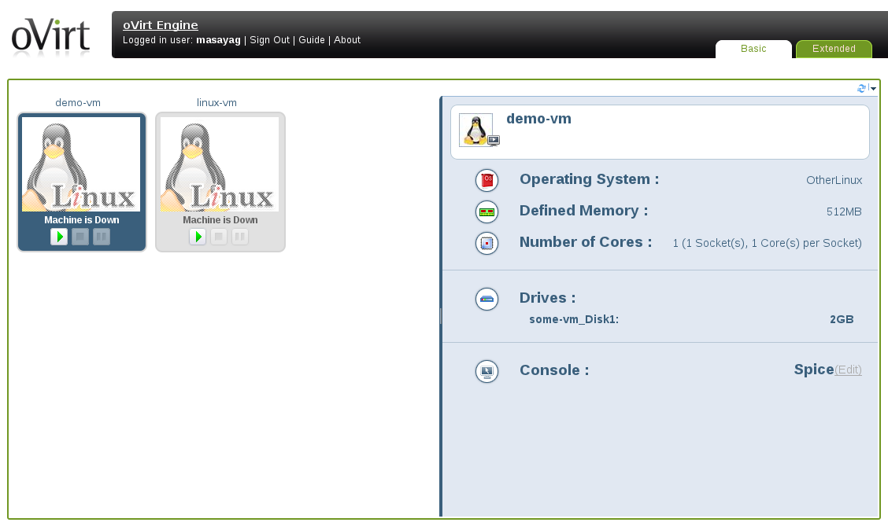
User Portal

Slide 11
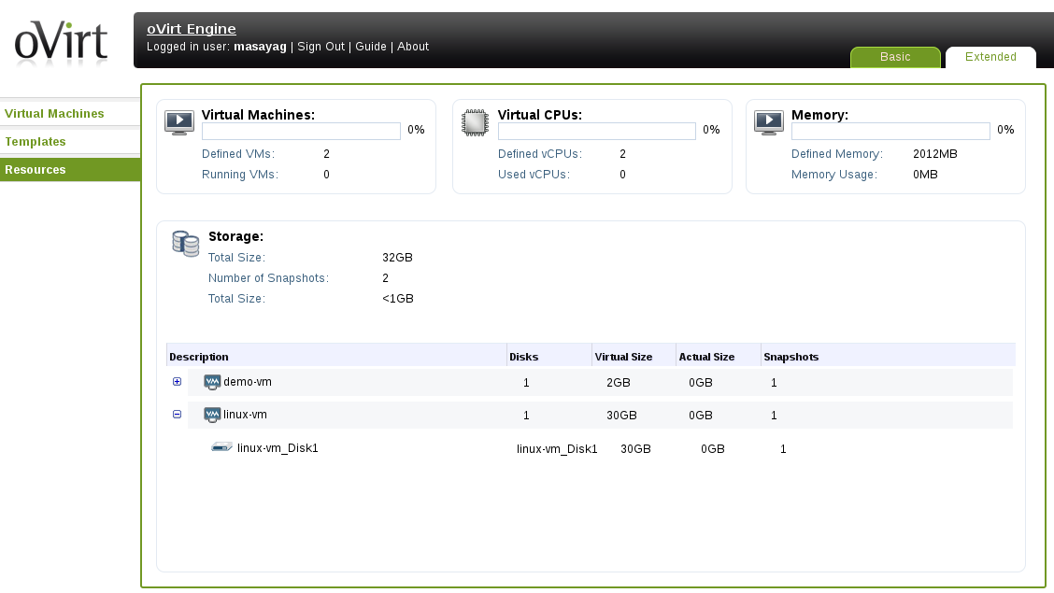
Power User Portal

Slide 12
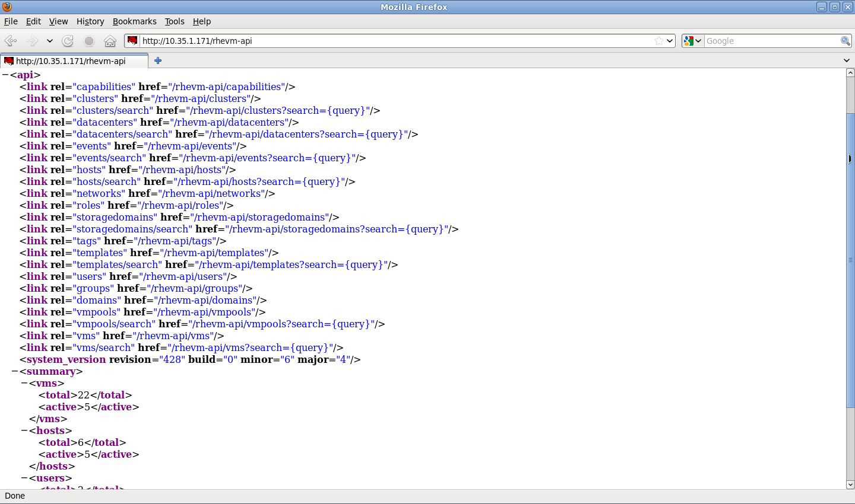
REST API

Slide 13
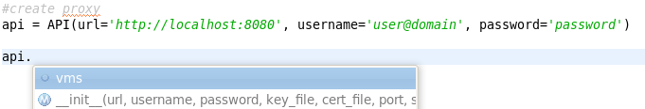

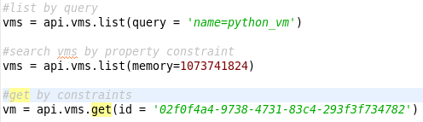

SDK

Slide 14
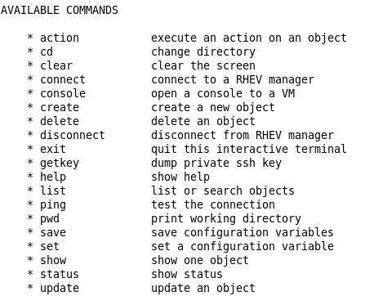
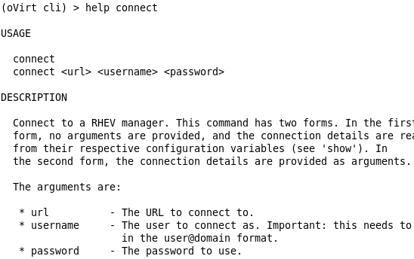
CLI

Slide 15
The Real World
Web Clients
DB
Engine
Python SDK
Python CLI
LDAP
Server
R
E
S
T
Guest agent
Spice
client
Shared
Storage
Guest
Host
VDSM
Local Storage

Slide 16
The Host
Engine
Fedora
Ovirt Node
QEMU/KVM
libvirt
VDSM
KSM
Configuration Monitoring :
Network, Storage, Host, VMs

Slide 17
The Real World
Web Clients
DB
Engine
Python SDK
Python CLI
LDAP
Server
R
E
S
T
Guest agent
Spice
client
Shared
Storage
Guest
Host
VDSM
Local Storage

Slide 18
The Guest
guest
Agent
virtio-
net
virtio-block
virtio-serial
spice
qxl
virtio-balloon
Linux | Windows Guest
spice
client
Fedora | ovirt-Node | RHEL

Slide 19
Virtio Balloon
Guest Memory space:
Space for other
guest applications
Balloon
Inflate
Space for other
guest applications
Balloon
deflate

Slide 20
Putting the Pieces Together
Web Clients
DB
Engine
Python SDK
Python CLI
LDAP
Server
R
E
S
T
Guest agent
Spice
client
Shared
Storage
Guest
Host
VDSM
Local Storage

Slide 21
Storage Concepts
Shared
Storage
Host
Host
Host
Host
Local Storage

Slide 22
Storage Concepts
Storage Pool
Storage
Domain
* Storage
Domain
Storage
Domain
* Master Storage Domain
Storage
Domain
Storage Pool Manager
(SPM)

Slide 23
Data Warehouse
Operational
DB
ETL
History
DB
API

Slide 24
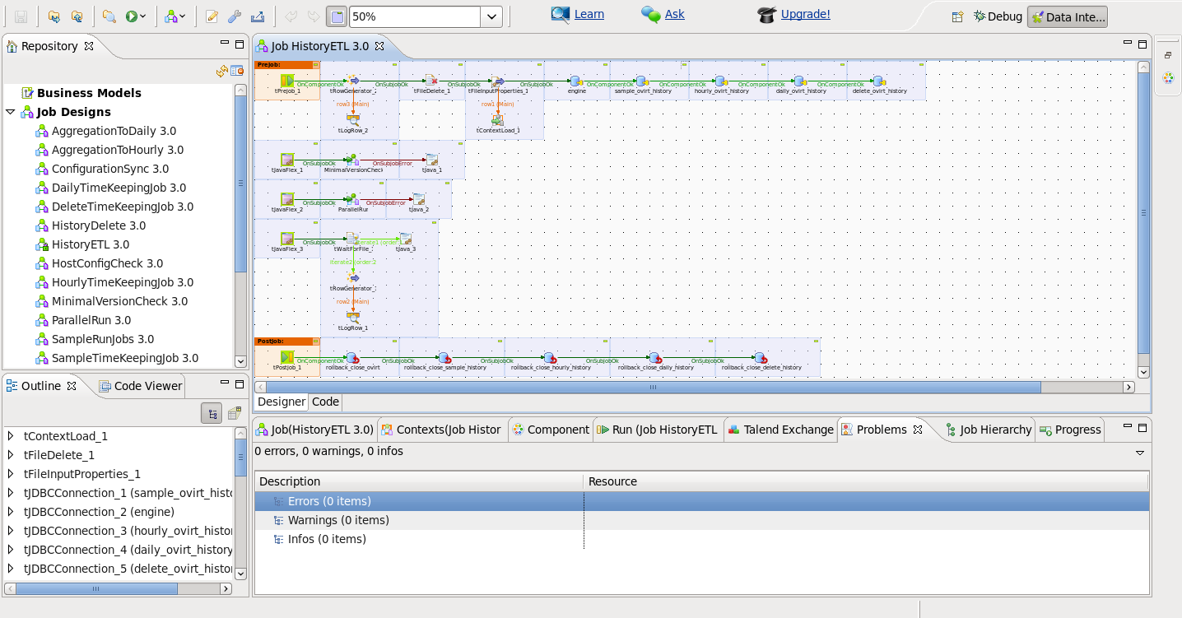
Talend Open Studio

Slide 25
DWH & Reports
Operational
DB
ETL
History
DB
API
Jasper
Report
Server
Predefined reports
Customized reports

Slide 26
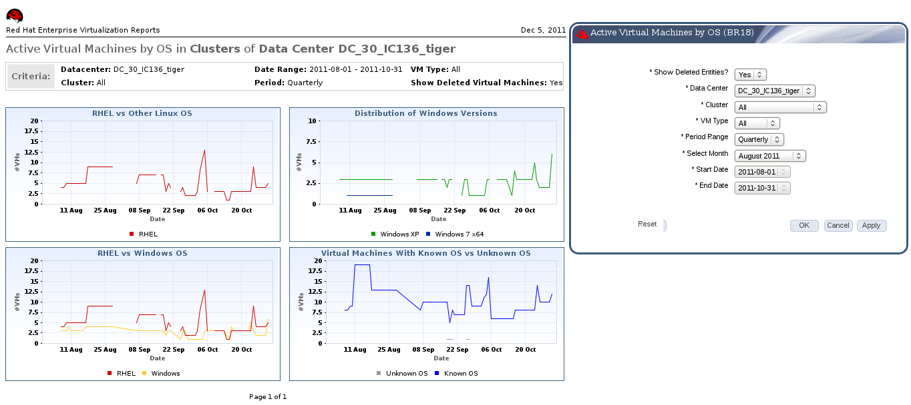
Example Report

Slide 27
User Flows
Create
Start
Stop

Slide 28
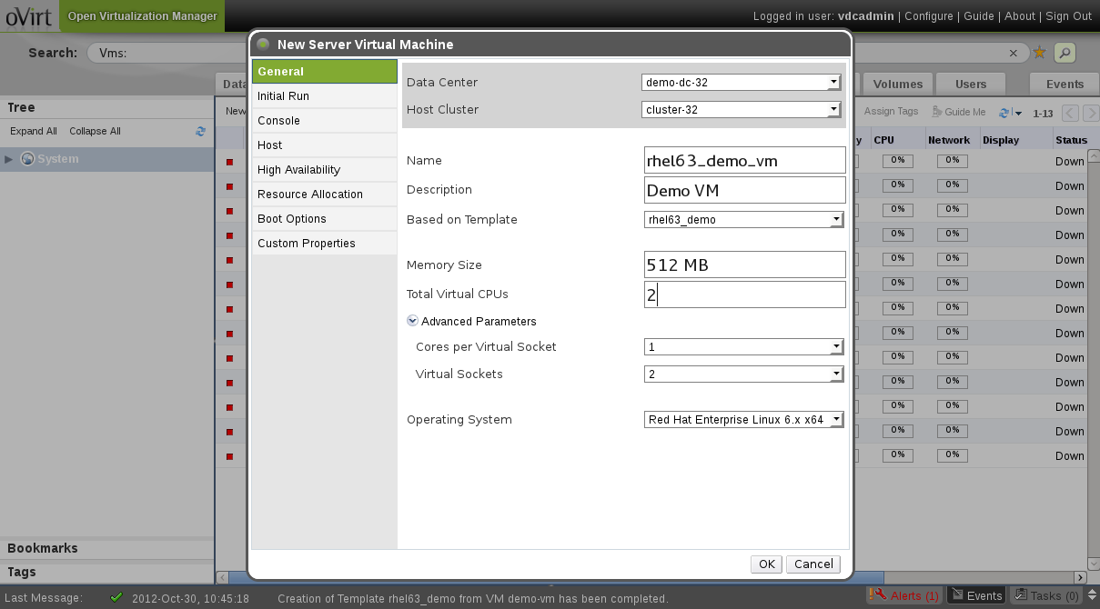
Create VM From Template

Slide 29
Create VM From Template
DB
Postgres
Admin Portal
Engine
SPM Node
VDSM
SD

Slide 30
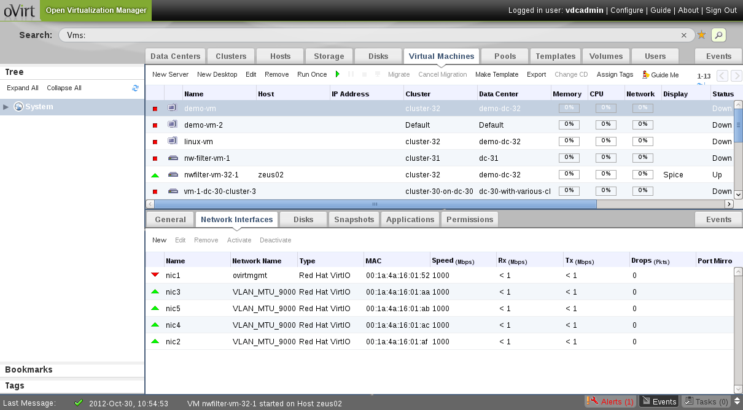
Run a VM

Slide 31
Run a VM
Choose a host on which to start the VM
Admin Portal
Engine
Guest
VDSM
libvirt
QEMU
KVM
libvirt

Slide 32
What are Hooks?
A mechanism for customization
Allows the administrator to manipulate the VM life cycle
Points of manipulation
  Before / after VM start
  Before / after VM migration in/out
  On VM stop
  Etc.

Slide 33
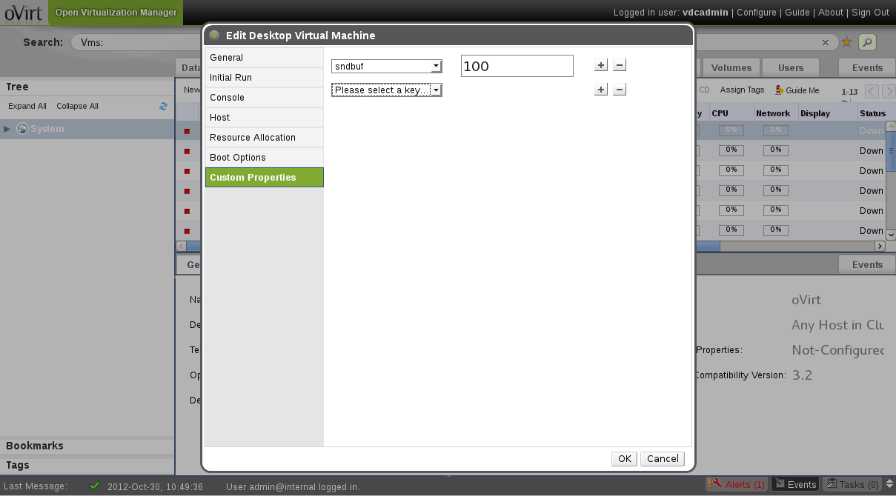
Use Hooks

Slide 34
Start VM With Hooks
Choose a host on which to start the VM
Admin Portal
Engine
Guest
VDSM
libvirt
QEMU
KVM
libvirt
Manipulate
libvirt XML

Slide 35
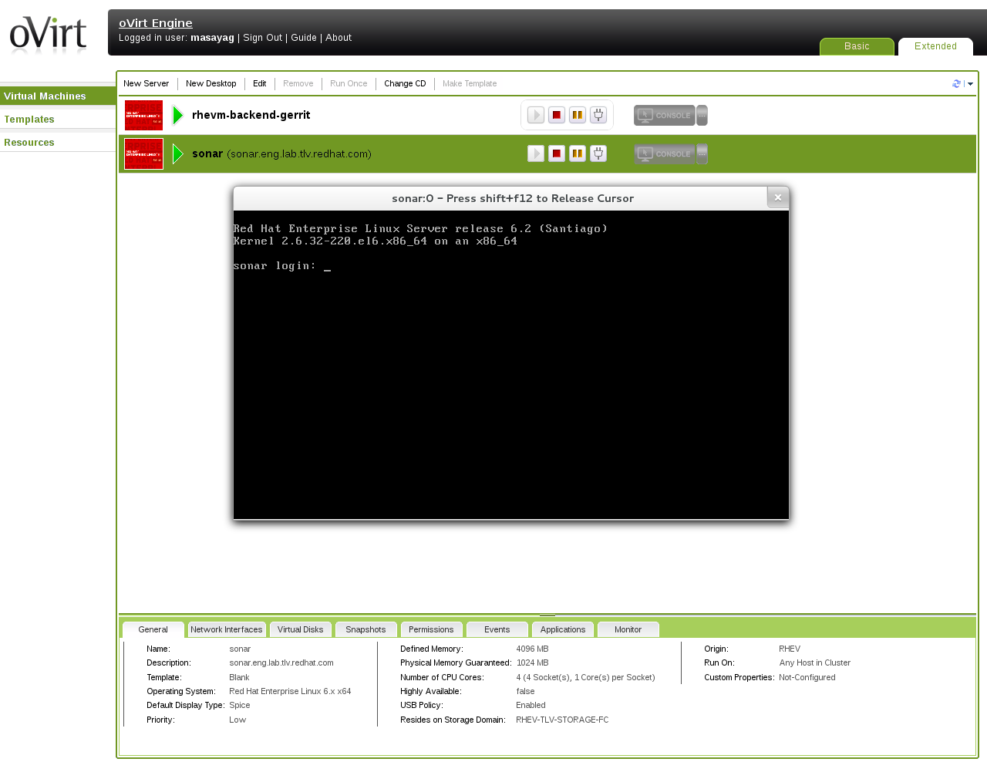
Connect to Guest

Slide 36
Connect To Guest
User Portal
Active-x
XPI
Spice client
Spice Protocol
Return ticket
Set ticket
Guest
Engine
QEMU/KVM
VDSM
libvirt
Spice Server

Slide 37
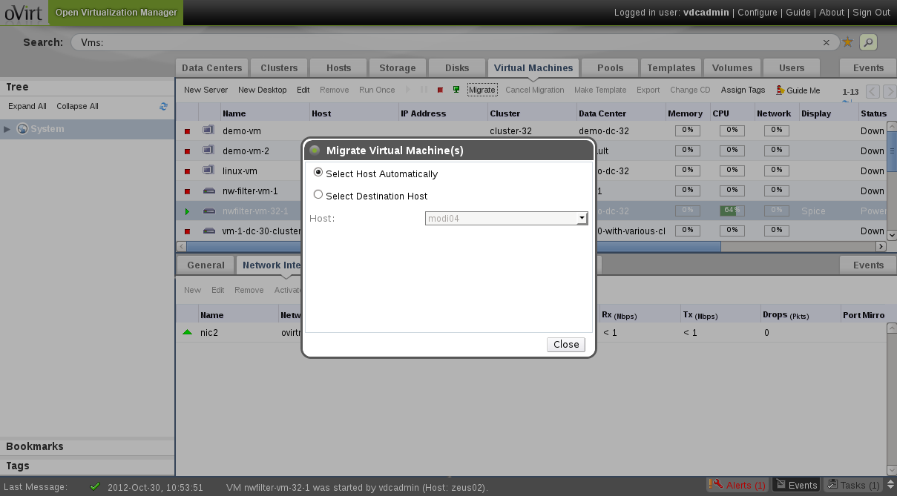
VM Migration

Slide 38
VM Migration
Admin Portal
Engine
SRC Host
DST Host
VDSM
Prepare
VDSM
libvirt
libvirt
QEMU
KVM
QEMU
KVM

Slide 39
Summary
Review of various oVirt components
User Action -> Flow in the system
Everything is open sourced
  http://www.ovirt.org

Slide 40
Get Involved!
Wiki
  http://www.ovirt.org/wiki
Mailing lists
  users@ovirt.org — oVirt Platform user list
  announce@ovirt.org — oVirt Platform announce list
  engine-devel@ovirt.org — oVirt-engine devel list
  node-devel@ovirt.org — oVirt-node devel list
IRC
  #ovirt on irc.oftc.net

Slide 41

THANK YOU !
http://www.ovirt.org

