Slide 1


Supporting and Using EC2/CIMI on top of oVirt via Deltacloud
Oved Ourfali
Senior Software Engineer – Red Hat
Netapp-oVirt Workshop
January 2013
Notes:
Hey All.
My name is Oved.
I'm a Senior Software Engineer at Red Hat, and today I'm show you how to use EC2/CIMI on top of oVirt, via deltacloud.

Slide 2



Agenda
Overview
  oVirt Engine
  Deltacloud
Motivation
Cloud APIs
Deltacloud-oVirt Integration
Examples (Main focus on EC2 and CIMI on top of oVirt)
Future work
Summary
Questions
Notes:
Let's go over the agenda.
I'll start with an Overview, talking about the oVirt engine,Then I'll talk about the motivation for exposing EC2/CIMI APIs on
Top of ovirt, describing
Some cloud APIs, and their differences.
, and proceed to describing deltacloud, which enables
Ovirt to support that.
After the overview, I'll talk about the integration with deltacloud
Describe the different use-cases, and Show some samples of using
EC2 and CIMI on top of oVirt
There is always future work, so I'll go over that as well
Finish with a Summary, and I'll leave a few minutes for Questions.
If something isn't clear, and it can't wait til the end of the lecture,
Please raise your hand, and I'll do my best to answer your questions.

Slide 3

oVirt Engine
The oVirt engine is a large scale, centralized virtualization management platform
Provides IaaS capabilities
Every capability is exposed via rich API, UI, CLI and SDK
Notes:
Ok.
So the ovirt engine is a large scale, sentralized managements for virtualization, based on leading performance, scalability and security technologies.
we provide IaaS capabilities
And each such capability is exposed via our rich UI, REST API, CLI and SDK

Slide 4



Deltacloud
Open source Apache project
Abstracts the differences between cloud providers
Supports Deltacloud, EC2 and CIMI APIs
Since EC2 and CIMI were added lately they might have defects / bugs
Supports many cloud providers
  EC2
  oVirt
  Eucalyptus
  OpenNebula
  OpenStack
  .....
Notes:
Deltacloud is an open source apache project
Abstracts the differences between cloud providers.
Read from the slide

Slide 5


Motivation
Heterogeneous virtualization environment
Existing software working with common cloud APIs like EC2
  Aeolus / CloudForms – cloud management software
  Synaps – CloudWatch implementation over EC2 API
  Heat (Openstack project)
    CloudFormation and CloudWatch support
    POC to support Deltacloud
  Automated scripts
  ....
Notes:
So, what is it good for?
Why enabling commen cloud APIs on top of Ovirt?
It is good for creating on premis private cloud environments, on top of existing ovirt-based IasS environemnts.
Make integration with cloud providers in hetrogenous environments easier
Useful for cloud client applications (if you can work with EC2/CIMI, you can work with oVirt)
Some examples are Aeolus and cloud forms, which are cloud management software
CloudWatch which is a cloud monitoring software
......

Slide 6
Bottom Line
If you work with
EC2 / CIMI / Deltacloud API
you can use it on top of oVirt!
Notes:
So, what is it good for?
Why enabling commen cloud APIs on top of Ovirt?
It is good for creating on premis private cloud environments, on top of existing ovirt-based IasS environemnts.
Make integration with cloud providers in hetrogenous environments easier
Useful for cloud client applications (if you can work with EC2/CIMI, you can work with oVirt)
Some examples are Aeolus and cloud forms, which are cloud management software
CloudWatch which is a cloud monitoring software
......

Slide 7
Cloud APIs
DMTF CIMI API
  Cloud Infrastructure Management Interface
  http://dmtf.org/standards/cloud
  V1 was published in August, 29th, 2012
  Still new API, but aims to be the cloud standard API
EC2 API – Amazon Elastic Cloud API
Deltacloud API
Notes:
Now, let's go over some Cloud APIs.
There is EC2 API, which is the Amazon Elstic cloud API
DMTF CIMI which is a Cloud Infrastructure Management interface which was published in last August, by the DMTF
We Also have deltacloud API
I'll talk about all these APIs in the next slides

Slide 8
CIMI API
REST based API
Main entities:
  Machines - configuration, image, template
  Volumes - images, configuration, image, template
  Networks
    Network
    Network Configuration
    Forwarding Group
    Network Template
    Network Port
    Network Port Configuration
    Network Port Template
Notes:
CIMI API
REST based API
Which allows performing basic operations on top of basic HTTP requsts
The main entities in the CIMI API are:
Mahcines – compute resource
A Machine is created using a Machine Template, which is composed of the configuration – CPU/memory, and the image which is basically the storage that this machine will see.
Volume – storage resource that is attached to machines
It can have images – several snapshots of the same volume
It is also created using a template, which contains both a configuration and an image (guest interface for example can be a configuration)
Same goes for networks, which are a set of interconnected logical services, with the purpose of forwarding data
Templates
Port – which is attached to machines

Slide 9

EC2 API
API to Amazon Elastic Cloud, that allows to perform various actions
HTTP GET/POST
  Endpoint—Entry point to act on
  Action—Action to perform on the endpoint
  Parameters—Request parameters
SOAP
Notes:
The EC2 API is an API to Amazon Elastic Cloud, that allows to perform various actions
It supports either HTTP GET/POST, or SOAP
The endpoint is the entry point
The action is just the action we want to do in this resource, and obviously actions require parameters

Slide 10
EC2 API
Main entities:
  AMI – template that contains a software configuration
  Instance Type – instance hardware configuration
  Instance – compute resource
  EBS Volume – storage resource
  Networking entities (IP Addresses, NetworkInterface, Network ACL, Network ACL entries....)
  Region – different geographical locations where data centers reside
  Availability Zone – isolated from failures in other zones
Notes:
Main instances in EC2 are
AMI
Instance Type
Instance
Region
Availability zone

Slide 11
Deltacloud API
REST based API
Main entities:
  Instances
  Images
  Hardware Profiles
  Realms
  Storage Volumes and Snapshots
  Networking Entities
    IP Addresses
    Load Balancers
    Firewalls

Slide 12
Deltacloud
Deltacloud Server
CIMI API
EC2 API
Deltacloud API
EC2 driver
oVirt driver
Eucalyptus driver
Amazon EC2
oVirt
Eucalyptus
Notes:
So, as you can see in the diagram, it exposes 3 APIs, CIMI, EC2 and deltacloud API, supporting multiple drivers such as EC2, ovirt, Eucalyptus, VMWare Vsphere, Azure, OpenStack, OpenNebula....

Slide 13
Deltacloud-oVirt integration
oVirt Driver
rbovirt
REST API
oVirt Engine
Notes:
As for the integration between deltacloud and ovirt, there is an ovirt driver, which uses a ruby library called rbovirt, which uses the REST API in order to work with the ovirt engine

Slide 14


Install and Run the Deltacloud Server
Installing Deltacloud via GEM
Running Deltacloud
  First set the API_PROVIDER in the following format
    API-URL; DataCenter-ID ; USER/ADMIN (default to ADMIN)
  Then, run the deltacloud daemon
Run the following commands as super user:
$ yum install rubygems gcc-c++ libxml libxslt libxslt-devel
$ gem install rake deltacloud-core
$ export API_PROVIDER=”http://ovirt-server:port/api;;USER”
$ deltacloudd -i rhevm -f cimi,ec2,deltacloud
Notes:
The DC-id can also be specified via the X-deltacloud-Provider HTTP header option
Note that more than one frontend can be used in the same deltacloud server
You can use these set of commands in order to install deltacloud
Once installed, you need to get a DC-id, so you can use the ovirt CLI to do that
Then, you run deltacloud as follows:

Slide 15
Install and Run the Deltacloud Server
Installing Deltacloud via RPM
Configure Deltacloud
  Set the DRIVER, API_PROVIDER and API_FRONTEND in /etc/sysconfig/deltacloud-core
    API_PROVIDER=”http://ovirt-server:port/api;;USER”
    API_FRONTEND=”cimi,ec2,deltalcoud”
    DRIVER=”rhevm”
Running the Deltacloud service
  systemctl start deltacloud-core.service
Run the following command as super user:
$ yum install deltacloud-core-all
Notes:
The DC-id can also be specified via the X-deltacloud-Provider HTTP header option
Note that more than one frontend can be used in the same deltacloud server
You can use these set of commands in order to install deltacloud
Once installed, you need to get a DC-id, so you can use the ovirt CLI to do that
Then, you run deltacloud as follows:

Slide 16
Install and Run the Deltacloud Server
Admin API requests are DC-specific, whereas User ones are system-wide
The API_PROVIDER can be changed by setting the “X-Deltacloud-Provider” HTTP Header on every request
Notes:
Just read from the slide

Slide 17
Examples
Notes:
Just read from the slide

Slide 18
Basic Operations - EC2
The following EC2 operations are supported when using Deltacloud on top of oVirt engine:
  Get Clusters (Availability Zones)
  Get Templates (AMI – Amazon Machine Images + Instance Type)
  Get VMs (Instances)
  Create new VM (Run Instances)
  Start VM (Start Instances)
  Stop VM (Stop Instances)
  Delete VM (Terminate Instances)
Notes:
Just read from the slide

Slide 19
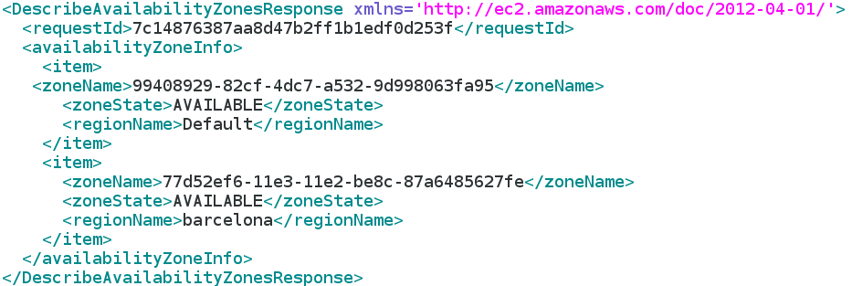
Basic Operations - EC2
Get oVirt Clusters
  HTTP GET
  http://localhost:3001/ec2/?Action=DescribeAvailabilityZones

Slide 20
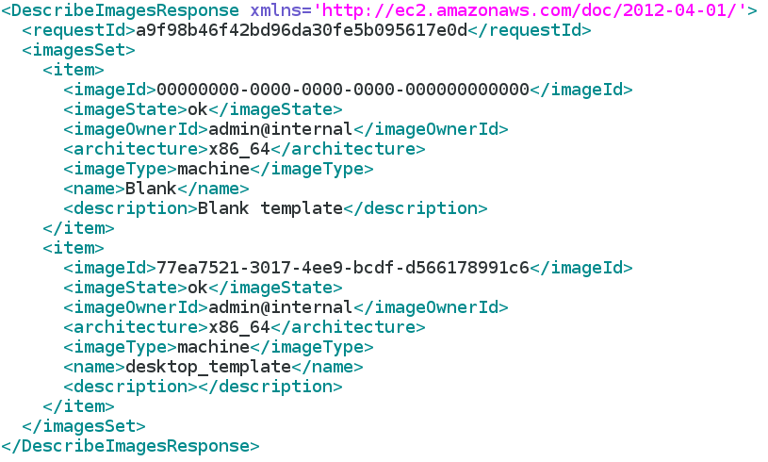
Basic Operations - EC2
Get oVirt Templates
  HTTP GET
  http://localhost:3001/ec2/?Action=DescribeImages

Slide 21
Basic Operations - EC2
Create VM from Template, in a Cluster
(EC2 - run an instance, created from an image, in an availability zone)
  HTTP GET
  http://localhost:3001/ec2/?Action=RunInstances&Placement.AvailabilityZone=77d52ef6-11e3-11e2-be8c-87a6485627fe&ImageId=77ea7521-3017-4ee9-bcdf-d566178991c6
  Other options
    UserData=..... (Pass user data to the VM via hook. Will need to support the native oVirt VM Payload feature)
    InstanceType=... (Will be supported when we introduce flavors in oVirt)

Slide 22
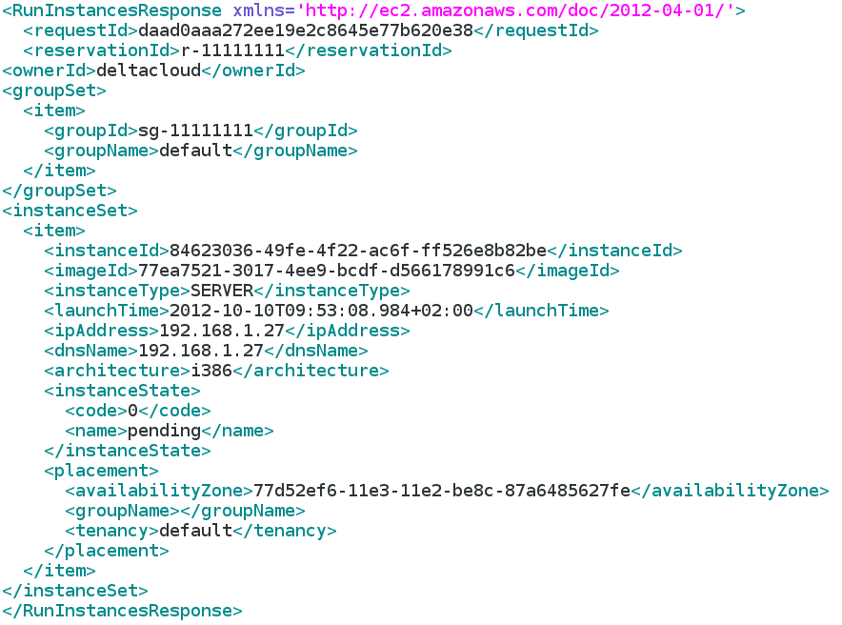
Basic Operations - EC2
Response
Notes:
That's a security group. Currently hardcoded one

Slide 23
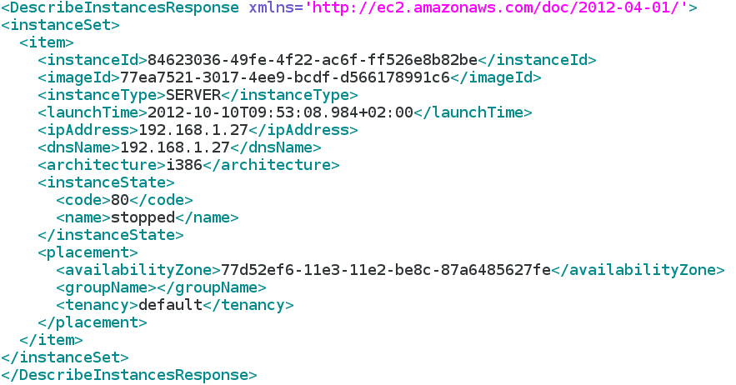
Basic Operations - EC2
Get VM
  HTTP GET
  All instances - http://localhost:3001/ec2/?Action=DescribeInstances
  Specific instance - http://localhost:3001/ec2/?Action=DescribeInstances&InstanceId.1=84623036-49fe-4f22-ac6f-ff526e8b82be”

Slide 24
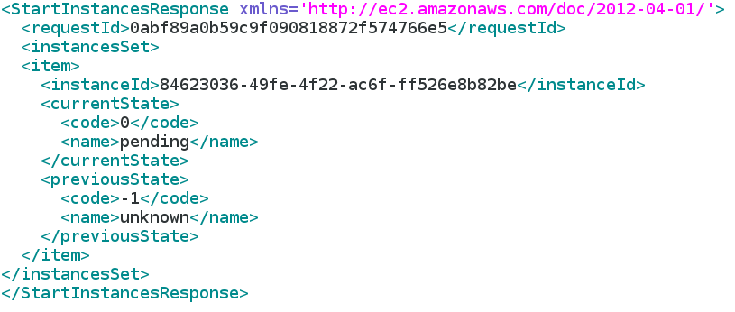
Basic Operations - EC2
Start VM
  HTTP GET
  http://localhost:3001/ec2/?Action=StartInstances&InstanceId.1=84623036-49fe-4f22-ac6f-ff526e8b82be”

Slide 25
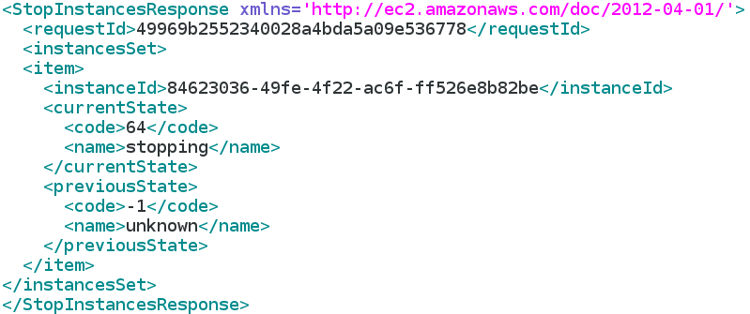
Basic Operations - EC2
Stop VM
  HTTP GET
  http://localhost:3001/ec2/?Action=StopInstances&InstanceId.1=84623036-49fe-4f22-ac6f-ff526e8b82be”

Slide 26
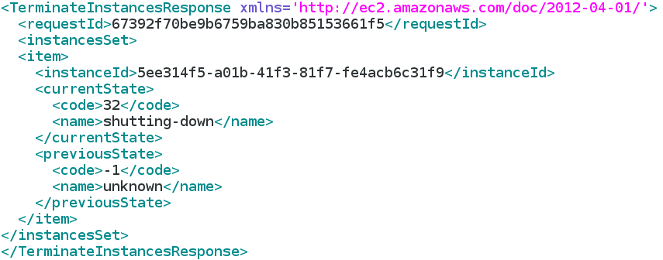
Basic Operations - EC2
Delete VM
  HTTP GET
  http://localhost:3001/ec2/?Action=TerminateInstances&InstanceId.1=84623036-49fe-4f22-ac6f-ff526e8b82be”

Slide 27
Basic Operations - CIMI
The following CIMI operations are supported when using Deltacloud on top of oVirt engine:
  Get Templates (Get Images)
  Get VMs (Get Machines)
  Create new VM (Create Machine)
  Start VM (Start Machine)
  Stop VM (Stop Machine)
  Delete VM (Delete Machine)

Slide 28
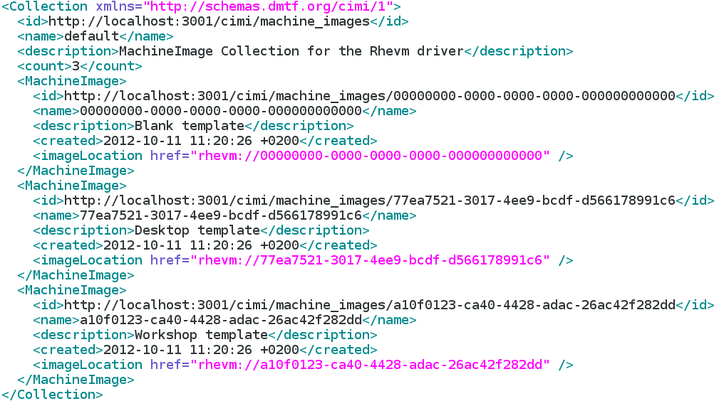
Basic Operations - CIMI
Get Templates
  HTTP GET
  http://localhost:3001/cimi/machine_images
Notes:
Unfortunately, according to the CIMI spec, the ID is the resource URL, the name is the ID, and the description is the name... a bit confusing, but that's according to the spec.

Slide 29
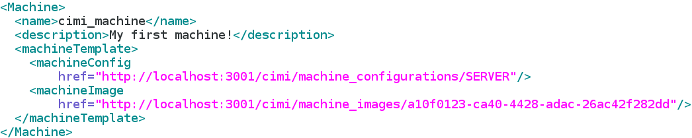
Basic Operations - CIMI
Create VM
  HTTP POST
  http://localhost:3001/cimi/machines
  Body

Slide 30
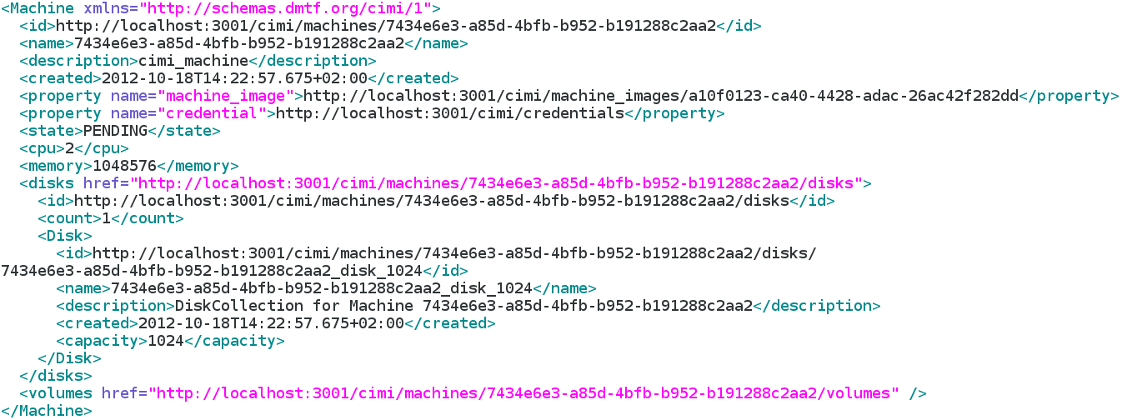
Basic Operations - CIMI
Response:

Slide 31
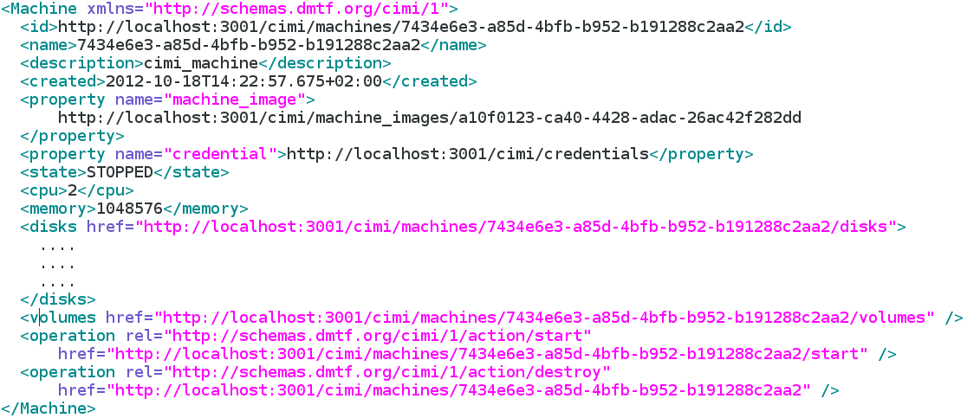
Basic Operations - CIMI
Get VM
  HTTP GET
  http://localhost:3001/cimi/machines/7434e6e3-a85d-4bfb-b952-b191288c2aa2
Notes:
Unfortunately, according to the CIMI spec, the ID is the resource URL, the name is the ID, and the description is the name... a bit confusing, but that's according to the spec.

Slide 32
Basic Operations - CIMI
Start VM
  HTTP POST
  http://localhost:3001/cimi/machines/81e0908a-04da-4859-8a92-f80d071a2e4c/start
  Body:
  Response:
    HTTP CODE 200

Slide 33

Basic Operations - CIMI
Stop VM
  HTTP POST
  http://localhost:3001/cimi/machines/81e0908a-04da-4859-8a92-f80d071a2e4c/stop
  Body:
  Response:
    HTTP CODE 200

Slide 34
Basic Operations - CIMI
Delete VM
  HTTP DELETE
  http://localhost:3001/cimi/machines/1bac66da-7ecc-4e19-bc91-0623c5448fc9
  Response:
    HTTP CODE 200

Slide 35
Future Work (oVirt / Deltacloud)
General
  Supporting VM configuration/instance type (not yet part of oVirt)
  Better mapping and support for networks
  Better mapping and support for storage volumes (Integrate into Deltacloud)
  Supporting VM Payload (Deltacloud)
EC2
  Supporting more EC2 options/actions (oVirt / Deltacloud)
CIMI
  Supporting more CIMI options/actions/entities (oVirt / Deltacloud)
  Support updating resources (Deltacloud will need to support that and integrate with oVirt)

Slide 36
Summary
oVirt provides a strong IaaS management environment
Enabling the use of common cloud APIs on top of this environment is very useful
Deltacloud exposes common cloud APIs on top of oVirt
More work is needed!
Projects who would like to use this integration - we would be happy to know about it, guide you, and help! Please contact us on users@ovirt.org

Slide 37

Useful Links
oVirt
  Users mailing list users@ovirt.org
  http://ovirt.org
Deltacloud
  Developer mailing list dev@deltacloud.apache.org
  http://deltacloud.apache.org
  #deltacloud on Freenode
My blog
  http://ovedou.blogspot.com

Slide 38

THANK YOU !
http://www.ovirt.org
ovedo@redhat.com
ovedo at #ovirt (irc.oftc.net)

