Slide 1


oVirt UI Plugin Infrastructure and the oVirt-Foreman plugin
Oved Ourfali
Senior Software Engineer – Red Hat
oVirt Workshop
January 2013
Notes:
Hey All.
My name is Oved.
I'm a Senior Software Engineer at Red Hat, and today I'm show you how to use EC2/CIMI on top of oVirt, via deltacloud.

Slide 2


Agenda
oVirt UI-Plugin infrastructure
Cross-Origin principal
The oVirt-Foreman UI-plugin
Future work
Questions
Notes:
Let's go over the agenda.
I'll start with an Overview, talking about the oVirt engine,Then I'll talk about the motivation for exposing EC2/CIMI APIs on
Top of ovirt, describing
Some cloud APIs, and their differences.
, and proceed to describing deltacloud, which enables
Ovirt to support that.
After the overview, I'll talk about the integration with deltacloud
Describe the different use-cases, and Show some samples of using
EC2 and CIMI on top of oVirt
There is always future work, so I'll go over that as well
Finish with a Summary, and I'll leave a few minutes for Questions.
If something isn't clear, and it can't wait til the end of the lecture,
Please raise your hand, and I'll do my best to answer your questions.

Slide 3

oVirt Engine UI-Plugin Infrastructure
Extend or customize oVirt Engine functionality by allowing to add UI components to the Admin Portal (Webadmin)
Plugins integrate with the Admin Portal on the client side using JavaScript
Plugins can be packaged and distributed for use with the oVirt Engine
Notes:
Deltacloud is an open source apache project
Abstracts the differences between cloud providers.
Read from the slide

Slide 4

oVirt Engine UI-Plugin Infrastructure
Simple and flexible plugin infrastructure
  The Admin Portal exposes a plugin API
  Plugins consume the API
  The Admin Portal invokes plugins at key events during the application runtime
Plugins are loaded via iframe elements
  Decouple Web Admin application from the actual plugin code
  Provide a sandbox environment with regard to plugin code execution
Notes:
Deltacloud is an open source apache project
Abstracts the differences between cloud providers.
Read from the slide

Slide 5
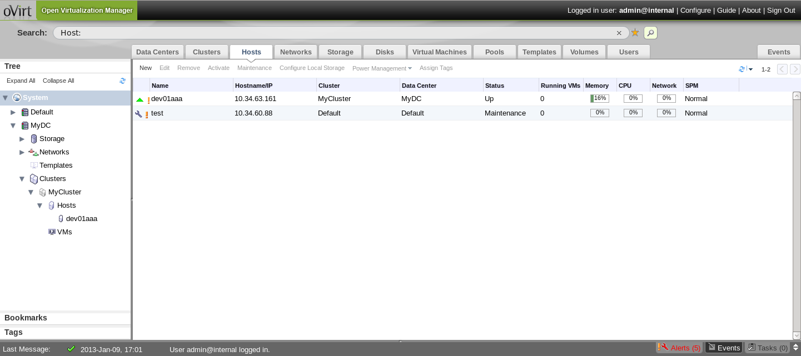
Web Admin user interface

Slide 6
Web Admin user interface

Slide 7
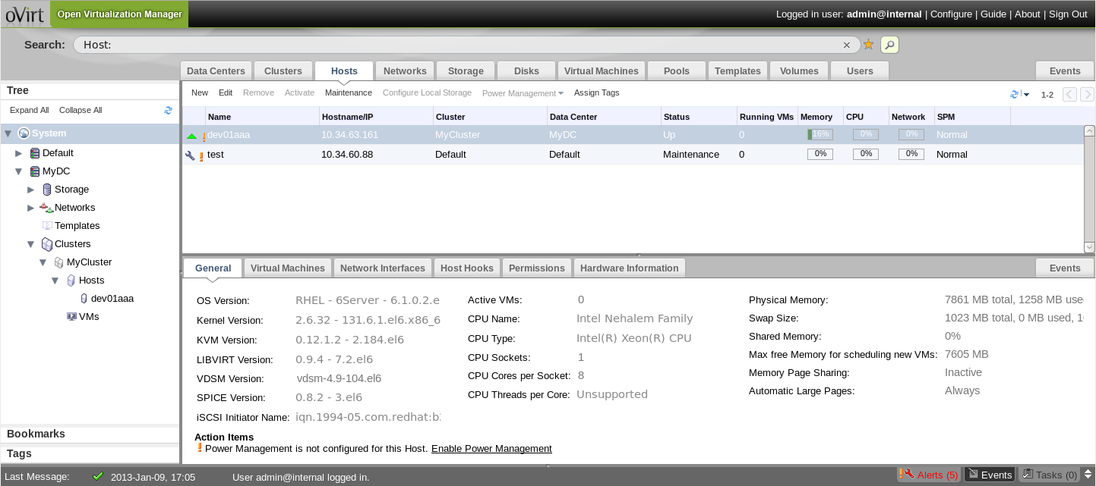
Web Admin user interface

Slide 8
Web Admin user interface

Slide 9
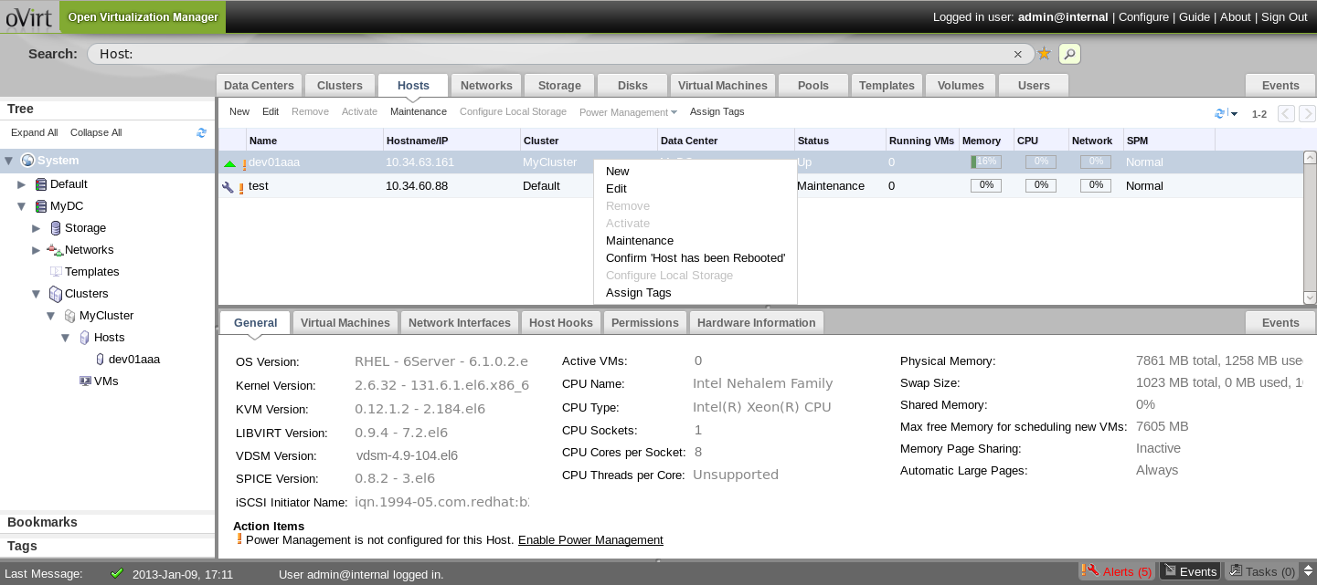
Web Admin user interface

Slide 10
Pluggable UI Components
Main Tabs
  plugin can add a new custom main tab, which loads a URL in a new iframe
Action buttons and context menu actions
  plugin can add a new action button inside an existing main tab, each button will be also mapped to a context menu item
Sub-Tabs
  plugin can add a Sub-Tab for existing main tab, to show selected entity details. The Sub-Tab loads a URL in an iframe (in the future will support grid / key-value pairs)
Notes:
Deltacloud is an open source apache project
Abstracts the differences between cloud providers.
Read from the slide

Slide 11
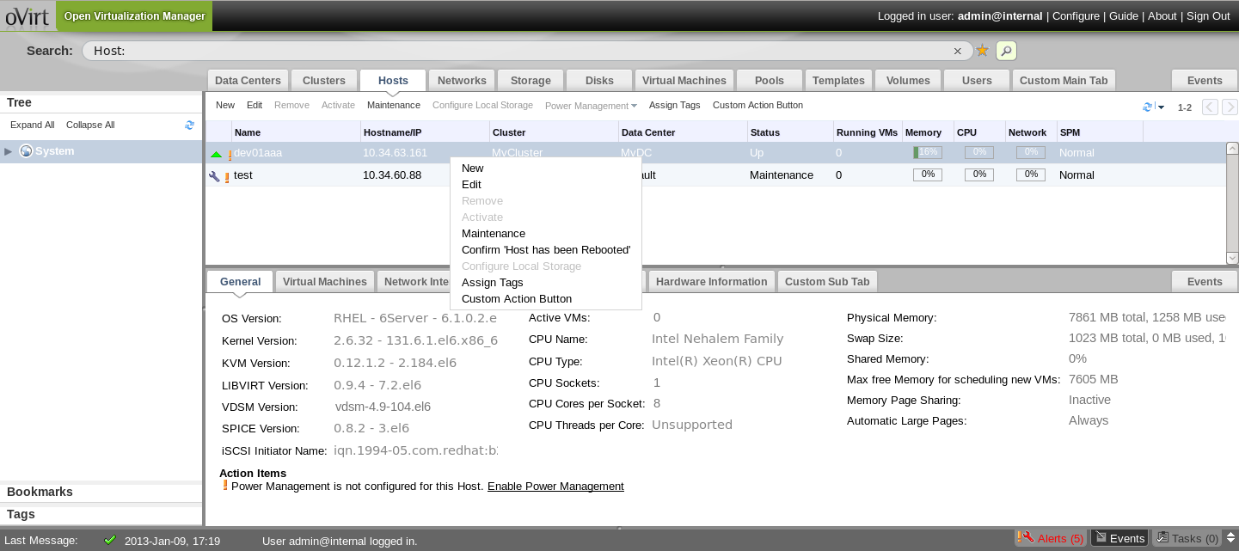
Pluggable UI Components

Slide 12

Plugin Definition
The plugin definition contains the following
  name – Unique plugin name
  url – URL of the start.html file
  resourcePath – where the plugin resource files are placed
  config – plugin configuration
Notes:
Just read from the slide

Slide 13
Plugin API
ready - indicates that the plugin is ready for initialization
register - registers plugin event handler functions
configObject - returns the plugin configuration object
addMainTab - dynamically adds a new main tab
addSubTab - dynamically adds a new sub-tab
addMainTabActionButton - dynamically adds a new main tab action button + context menu item
showDialog - opens some URL in a new browser window/tab
Notes:
Deltacloud is an open source apache project
Abstracts the differences between cloud providers.
Read from the slide

Slide 14
Plugin API
setTabContentUrl - dynamically changes the URL associated with a sub-tab
setTabAccessible - dynamically shows/hides a sub-tab
loginUserName - returns the logged-in user name
loginUserId - returns the logged-in user name
Notes:
Deltacloud is an open source apache project
Abstracts the differences between cloud providers.
Read from the slide

Slide 15
Plugin Events
UiInit - code that runs upon plugin initialization
UserLogin - indicates that the user logged in
UserLogout - indicates that the user logged out
RestApiSessionAcquired – the plugin infrastructure creates a REST session for the plugin to use
Selection Changes
  DataCenter, Cluster, Disk, Host, Storage, Template, VirtualMachine
  Event name is <Entity>SelectionChange where Entity is one of the above
Notes:
Deltacloud is an open source apache project
Abstracts the differences between cloud providers.
Read from the slide

Slide 16
Same-Origin Policy
Security concept for browser-side programming languages such as JavaScript
Permits scripts running on pages from the same site to access each others properties and methods, while restricting access to methods and properties across pages on different sites
One JavaScript code that originates from one end point (http(s)://server1:port1) cannot access another endpoint's properties and methods
Notes:
So, what is it good for?
Why enabling commen cloud APIs on top of Ovirt?
It is good for creating on premis private cloud environments, on top of existing ovirt-based IasS environemnts.
Make integration with cloud providers in hetrogenous environments easier
Useful for cloud client applications (if you can work with EC2/CIMI, you can work with oVirt)
Some examples are Aeolus and cloud forms, which are cloud management software
CloudWatch which is a cloud monitoring software
......

Slide 17
Same-Origin Policy in UI-Plugins
In our case, the plugin's origin is the URL of the engine server (http(s)://engine-server:port)
Plugin code can't do HTTP requests to a different origin and access the response, different properties and methods in it
Notes:
So, what is it good for?
Why enabling commen cloud APIs on top of Ovirt?
It is good for creating on premis private cloud environments, on top of existing ovirt-based IasS environemnts.
Make integration with cloud providers in hetrogenous environments easier
Useful for cloud client applications (if you can work with EC2/CIMI, you can work with oVirt)
Some examples are Aeolus and cloud forms, which are cloud management software
CloudWatch which is a cloud monitoring software
......

Slide 18
Approaches to deal with the Same-Origin Policy
Rendering URL in an iframe is allowed (so if you just want main/sub-tabs to work, then you're good)
JSONP – JSON with padding
CORS – Cross Origin Resource Sharing
Using a proxy (or in specific, Apache's mod_proxy or mod_ssl)
Notes:
So, what is it good for?
Why enabling commen cloud APIs on top of Ovirt?
It is good for creating on premis private cloud environments, on top of existing ovirt-based IasS environemnts.
Make integration with cloud providers in hetrogenous environments easier
Useful for cloud client applications (if you can work with EC2/CIMI, you can work with oVirt)
Some examples are Aeolus and cloud forms, which are cloud management software
CloudWatch which is a cloud monitoring software
......

Slide 19
Rendering URL in an iframe
If you would like to show a specific URL (using HTTP GET) in a main/sub-tab, and constructing the URL doesn't require any information from the other origin, then just do it
However, if you do need information, then perhaps the next approach will be good for you
Pros
  Simple
Cons
  Very limited and specific use-case
Notes:
So, what is it good for?
Why enabling commen cloud APIs on top of Ovirt?
It is good for creating on premis private cloud environments, on top of existing ovirt-based IasS environemnts.
Make integration with cloud providers in hetrogenous environments easier
Useful for cloud client applications (if you can work with EC2/CIMI, you can work with oVirt)
Some examples are Aeolus and cloud forms, which are cloud management software
CloudWatch which is a cloud monitoring software
......

Slide 20
Using JSONP
JSON with padding
Enabled you to get JSON data (HTTP GET) from a server in a different origin
Useful if you need JSON data to construct URLs to for the main/sub-tab iframe
Notes:
So, what is it good for?
Why enabling commen cloud APIs on top of Ovirt?
It is good for creating on premis private cloud environments, on top of existing ovirt-based IasS environemnts.
Make integration with cloud providers in hetrogenous environments easier
Useful for cloud client applications (if you can work with EC2/CIMI, you can work with oVirt)
Some examples are Aeolus and cloud forms, which are cloud management software
CloudWatch which is a cloud monitoring software
......

Slide 21

Using JSONP - Example
Define some callback
Use JQUERY to get the JSON data, passing a callback argument
The result would be
And it would call the callback, which will get the data
Notes:
So, what is it good for?
Why enabling commen cloud APIs on top of Ovirt?
It is good for creating on premis private cloud environments, on top of existing ovirt-based IasS environemnts.
Make integration with cloud providers in hetrogenous environments easier
Useful for cloud client applications (if you can work with EC2/CIMI, you can work with oVirt)
Some examples are Aeolus and cloud forms, which are cloud management software
CloudWatch which is a cloud monitoring software
......

Slide 22
Using JSONP
Pros
  Simple
Cons
  Requires server-side support
  Only supports getting JSON data
  Need to adapt client code to work with JSONP (simple)
Notes:
So, what is it good for?
Why enabling commen cloud APIs on top of Ovirt?
It is good for creating on premis private cloud environments, on top of existing ovirt-based IasS environemnts.
Make integration with cloud providers in hetrogenous environments easier
Useful for cloud client applications (if you can work with EC2/CIMI, you can work with oVirt)
Some examples are Aeolus and cloud forms, which are cloud management software
CloudWatch which is a cloud monitoring software
......

Slide 23
CORS – Cross Origin Resource Sharing
CORS is a mechanism that allows a web page to make requests to another domain
Client request should contain the HTTP Header
  Origin: http://my-server.example.com
Response
  Access-Control-Allow-Origin: http://my-server.example.com (or * for all)
Pros
  Supports operations other than HTTP GET on JSON
Cons
  Requires both browser and server-side support
Notes:
So, what is it good for?
Why enabling commen cloud APIs on top of Ovirt?
It is good for creating on premis private cloud environments, on top of existing ovirt-based IasS environemnts.
Make integration with cloud providers in hetrogenous environments easier
Useful for cloud client applications (if you can work with EC2/CIMI, you can work with oVirt)
Some examples are Aeolus and cloud forms, which are cloud management software
CloudWatch which is a cloud monitoring software
......

Slide 24
Using a Proxy
One can define a proxy, that once calling one origin, will make the request to the other origin
Thus, it is the client side both requests are in the same origin
Example using Apache's mod_proxy
  ProxyPass /other_origin http://other-server:other-port/other_application
  ProxyPassReverse /other_origin http://other-server:other-port/other_application
Requests to http://my-server/other_application are safe to use from within the originating application, and allows all the freedom you need
Notes:
So, what is it good for?
Why enabling commen cloud APIs on top of Ovirt?
It is good for creating on premis private cloud environments, on top of existing ovirt-based IasS environemnts.
Make integration with cloud providers in hetrogenous environments easier
Useful for cloud client applications (if you can work with EC2/CIMI, you can work with oVirt)
Some examples are Aeolus and cloud forms, which are cloud management software
CloudWatch which is a cloud monitoring software
......

Slide 25
Using a Proxy
Pros
  No changes needed in the client code
  No browser support needed
Cons
  Using a proxy does have some overhead
  requires special configuration at the originating server-side
Notes:
So, what is it good for?
Why enabling commen cloud APIs on top of Ovirt?
It is good for creating on premis private cloud environments, on top of existing ovirt-based IasS environemnts.
Make integration with cloud providers in hetrogenous environments easier
Useful for cloud client applications (if you can work with EC2/CIMI, you can work with oVirt)
Some examples are Aeolus and cloud forms, which are cloud management software
CloudWatch which is a cloud monitoring software
......

Slide 26
oVirt-Foreman UI-Plugin
Notes:
Just read from the slide

Slide 27

Foreman Overview
Machines Life Cycle Management
  Integrates with Puppet, and acts as web front end to it
  Provisioning until the point puppet is running, allowing Puppet to do what it does best
  Shows a Systems Inventory (based on Facter)
  Provides real time information about hosts status based on Puppet reports
  Managing virtualization and cloud environments
  Managing DNS, DHCP, TFTP, PuppetCA, CMDB etc
oVirt-Foreman integration
  See Foreman data on oVirt Vms
  Dashboard
  ....
Notes:
Let's go over the agenda.
I'll start with an Overview, talking about the oVirt engine,Then I'll talk about the motivation for exposing EC2/CIMI APIs on
Top of ovirt, describing
Some cloud APIs, and their differences.
, and proceed to describing deltacloud, which enables
Ovirt to support that.
After the overview, I'll talk about the integration with deltacloud
Describe the different use-cases, and Show some samples of using
EC2 and CIMI on top of oVirt
There is always future work, so I'll go over that as well
Finish with a Summary, and I'll leave a few minutes for Questions.
If something isn't clear, and it can't wait til the end of the lecture,
Please raise your hand, and I'll do my best to answer your questions.

Slide 28
Current Scope
Dashboard Main-Tab
VM Foreman Details Sub-Tab – Shows the Foreman Host Details
VM Foreman Graphs Sub-Tabs – Shows the Foreman Host Graphs only
Behind the scenes - SSO between oVirt and Foreman
Notes:
Just read from the slide

Slide 29
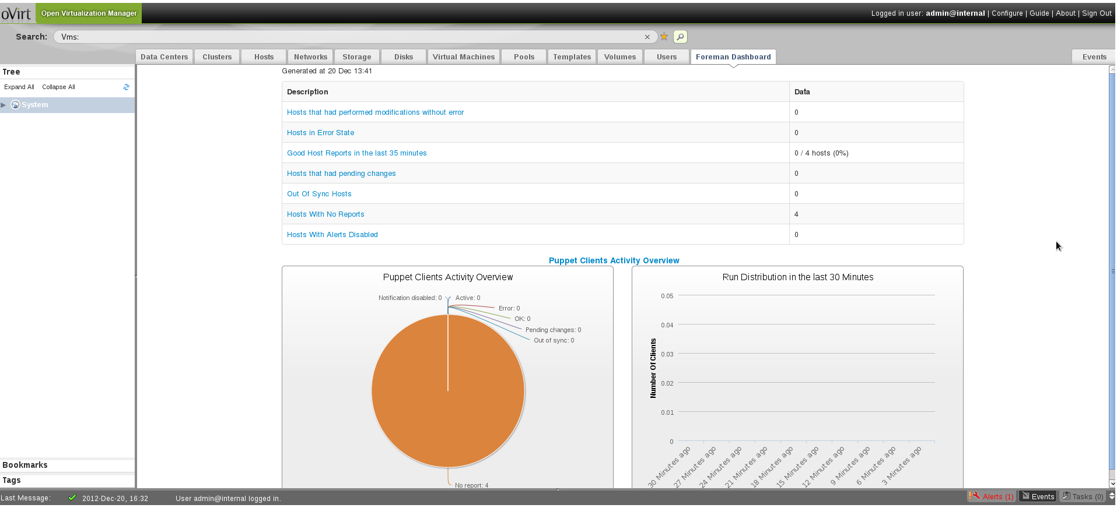
oVirt Plugin – Dashboard
Notes:
Just read from the slide

Slide 30
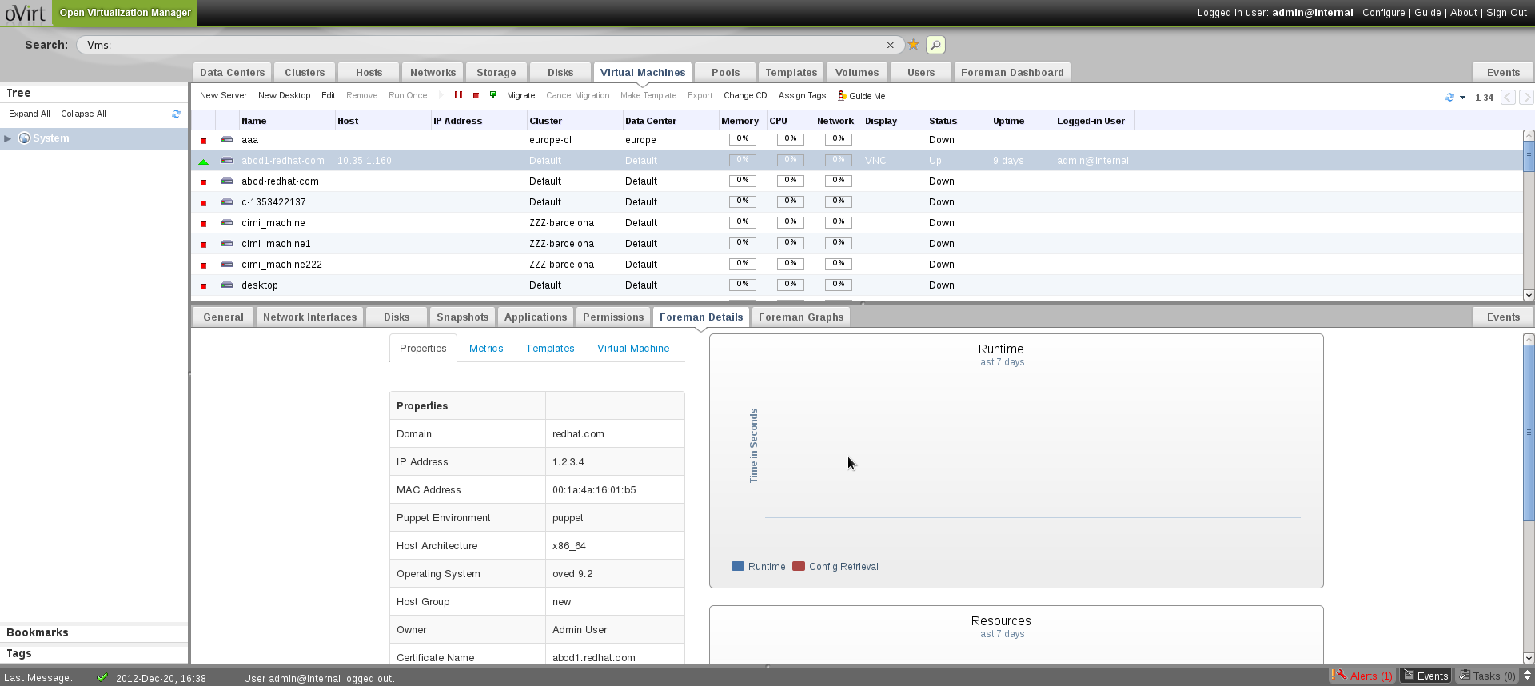
oVirt Plugin – VM Foreman Details
Notes:
Just read from the slide

Slide 31
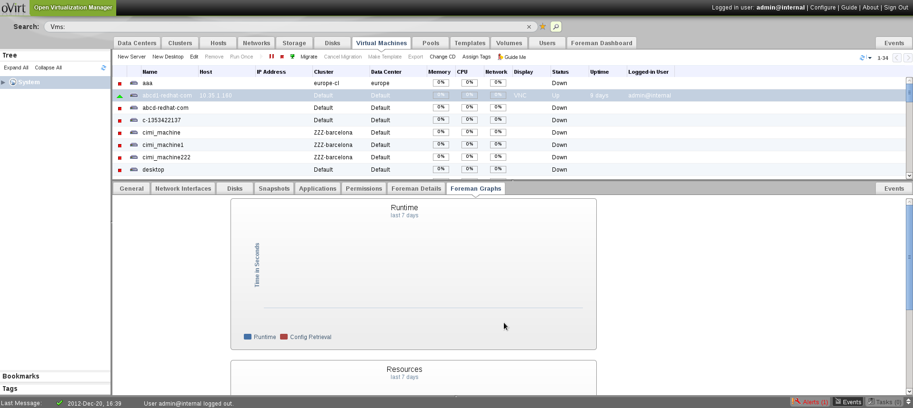
oVirt Plugin – VM Foreman Graphs
Notes:
Just read from the slide

Slide 32
oVirt Plugin
The oVirt UI-plugin is composed of 2 files
  foreman.json – contains the plugin definition file
  foreman_files/start.html – contains the plugin itself
Custom configuration can be put in
  /etc/ovirt-engine/ui-plugins/foreman-config.json
Notes:
Just read from the slide

Slide 33
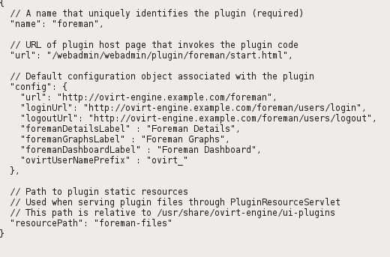
oVirt Plugin – Definition file
foreman.json
Notes:
Deltacloud is an open source apache project
Abstracts the differences between cloud providers.
Read from the slide

Slide 34
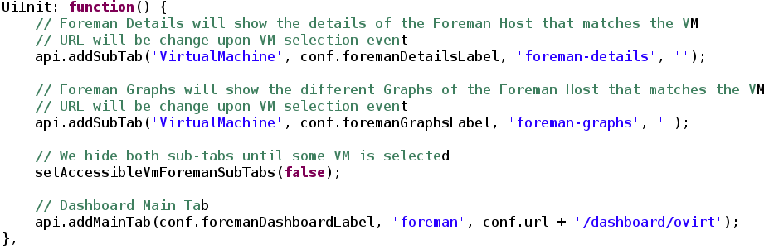
oVirt Plugin – start.html file
Register section - register the following event handlers
  UiInit – add the main/sub tabs
Notes:
Just read from the slide

Slide 35
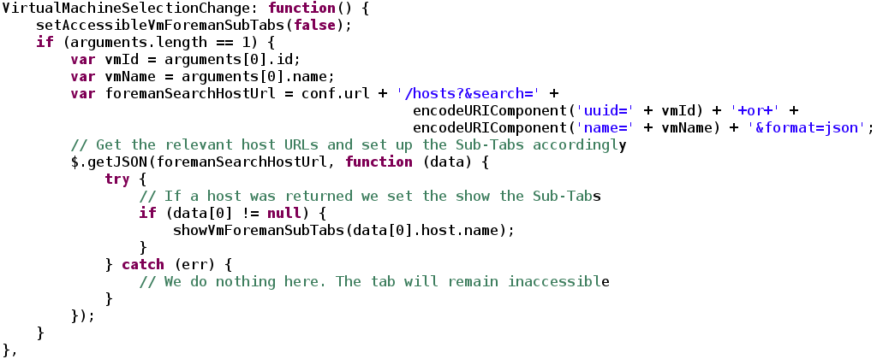
oVirt Plugin – start.html file
RestApiSessionAcquired – relogin to Foreman
VirtualMachineSelectionChange – set sub-tabs URL if the selected VM exists in Foreman
Notes:
Just read from the slide

Slide 36

oVirt Plugin – start.html file
UserLogout – logout from Foreman
Notes:
Just read from the slide

Slide 37
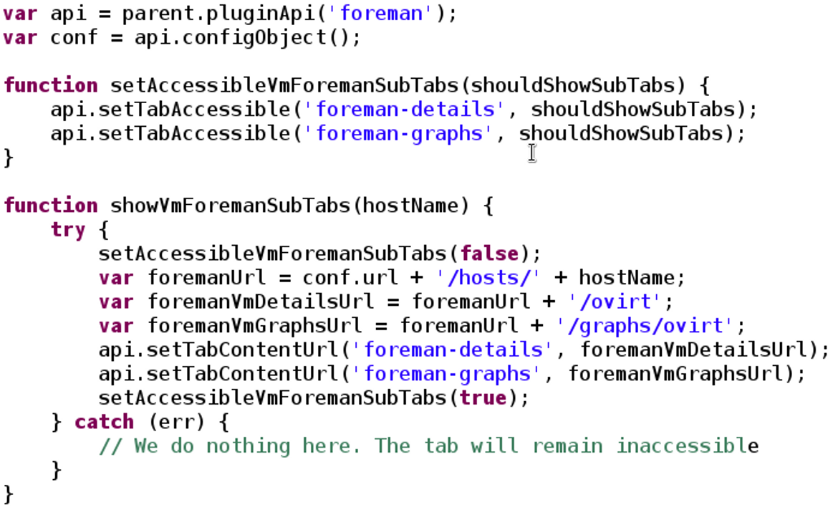
oVirt Plugin – start.html file
Helper functions
Notes:
Just read from the slide

Slide 38
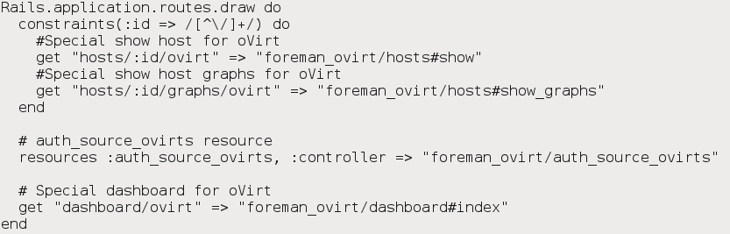


Foreman Plugin
The Foreman plugin composed of several files
  config/initializers/ovirt_setup.rb
    Adds new oVirt role to Foreman
    Adds oVirt authentication sources – one per oVirt compute resource
  config/routes.rb – defines the different routes (show host, show host graphs, dashboard)

Slide 39
Foreman Plugin
models/foreman_ovirt/user_extensions.rb
  Every-time a user logs in through the oVirt authentication source, it is granted with the oVirt role automatically
models/foreman_ovirt/auth_source_ovirt.rb
  The oVirt authentication source model
controllers - contains the hosts, dashboard and authentication source controllers
views – contains the host view (dashboard uses the standard Foreman view)
views/layouts
  Contains a main application layout without header and footer, to fit the oVirt iframe embedded view

Slide 40
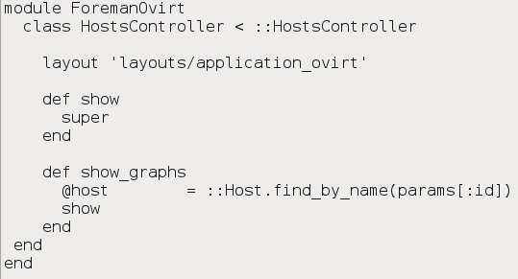
Foreman Plugin
Hosts controller

Slide 41
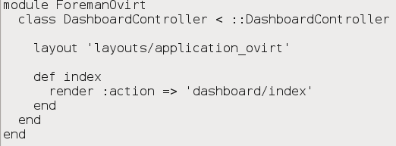
Foreman Plugin
Dashboard controller

Slide 42
Installation
Prerequisites
  oVirt version 3.2
  Foreman version 1.1 RC2 and above

Slide 43
Installation
Foreman side
  Add a file called foreman_ovirt.rb under the bundler.d directory containing
    gem 'foreman_ovirt'
  Run Bundle install from the foreman root directory
  Foreman needs to run in /foreman URL root either by
    Export RAILS_RELATIVE_URL_ROOT="/foreman" before running Foreman
  or by setting the following definition in /etc/sysconfig/foreman
    RAILS_RELATIVE_URL_ROOT="/foreman"
  Run Foreman

Slide 44
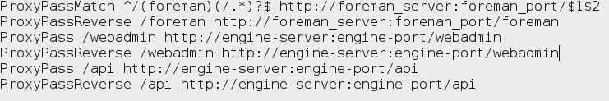
Installation
oVirt side
  Get the plugin files from git://gerrit.ovirt.org/samples-uiplugins.git
  Place the files from the foreman-plugin directory to /usr/share/ovirt-engine/ui-plugins, and edit the foreman.json file as needed
  Configure mod_proxy
  Restart the engine and Apache, and you're good to go! (make sure you browse to the URL as defined in the proxy, otherwise it won't work)
  If you already have oVirt engine proxy configuration just add the foreman ones
  For SSL configuration check http://ovedou.blogspot.com

Slide 45
Future Work – UI plugin infrastructure
Custom dialogs in Web Admin UI style
Form and table based custom {main|sub} tabs
Pass proper REST API like entities to plugins
Review and manage plugins in Web Admin UI
What do you want to see?

Slide 46
Future Work – Foreman plugin
Support sync oVirt VMs with Foreman Hosts (either in the oVirt or Foreman side)
RPM packages for both sides of the plugin
Other data that might be relevant
  Reports
  Facts

Slide 47
Useful Links
foreman_ovirt github repo https://github.com/oourfali/foreman_ovirt
oVirt-Foreman UI plugin in the UI plugins repo
http://gerrit.ovirt.org/gitweb?p=samples-uiplugins.git;a=summary
or just git clone git://gerrit.ovirt.org/samples-uiplugins.git
Feel free to contact me for help, either personally, or via the oVirt users mailing list
http://ovedou.blogspot.com
ovedo@redhat.com
users@ovirt.org
Daniel's blog (Shell in a Box plugin) http://derezvir.blogspot.co.il

Slide 48

THANK YOU !
http://www.ovirt.org
ovedo@redhat.com
ovedo at #ovirt (irc.oftc.net)

