Slide 1
oVirt
Live Storage Migration (Under The Hood)
Ayal Baron
Engineering Manager, Red Hat
January 2013

Slide 2
Agenda
Live Storage Migration in a Nutshell
Live Storage Migration Types
Some Prerequisites
Constraints and Limitations
General Overview
Flow Overview
SPM/HSM API
Detailed Flow and Sequence Diagram
Above and Below (oVirt Engine, libvirt and QEMU)

Slide 3
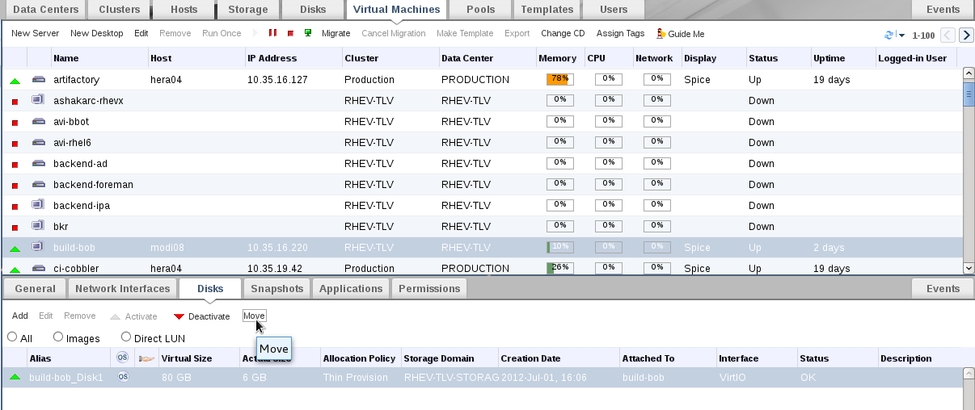
Move Disk

Slide 4
Live Storage Migration in a Nutshell
Definition
Live Storage Migration is the ability to move one or more VM disks from one storage to another while the VM is running
Motivation
Facilitate storage hardware upgrades
Move or clone VM disks across different (and eventually geographically separated) data centers
SLA

Slide 5
Live Storage Migration Types
With Shared Storage
The hypervisor is able to access both the source and destination storage backends
The virtual machine remains on the same host
Without Shared Storage
The hypervisor is not able to access both the source and destination storage
The virtual machine is live migrated to a different host that is able to access the destination storage

Slide 6

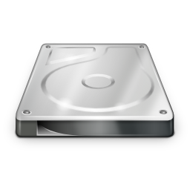
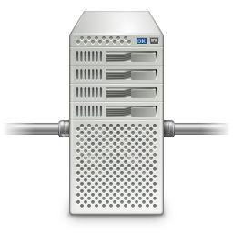
Overview With Shared Storage
Host A
Host A
VM
VM
Virtual Disk
Virtual Disk
Storage A
Storage B
Storage A
Storage B

Slide 7
Overview Without Shared Storage
Host A
Host B
VM
VM
Virtual Disk
Virtual Disk
Storage A
Storage B

Slide 8
Some Prerequisites
General understanding of the oVirt architecture and few VDSM basics
Virtual disks as ordered collection (chain) of volumes, e.g.:
General understanding of the QCOW format and how VDSM handles the QCOW watermark on block storage domains
Volume 1
Volume 2
Volume 3

Slide 9
Constraints and Limitations
All the image manipulations must be done by the Storage Pool Manager (SPM)
Most of the data transfer is offloaded (now – SPM, future – Xcopy)
Initial focus on shared storage between homogeneous storage domain types
An image (volume chain) should not be spread among multiple storage domains
It is important to maintain the source image structure (“external snapshots”)

Slide 10
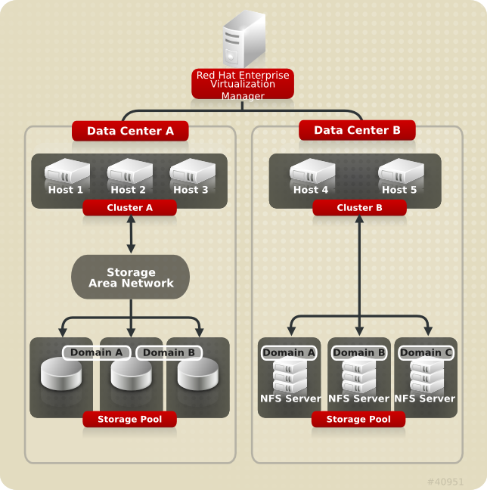
Storage Architecture
Centralized storage system
(disk images, templates, etc...)
Storage Domain
A standalone storage entity
(implemented with NFS, FCP, iSCSI, FCoE, and SAS)
Stores the images and associated metadata
Only true persistent storage for VDSM
Storage Pool
Aggregates several Storage Domains
(it will be deprecated in the future)
Supposed to simplify cross domain operations

Slide 11
Storage Architecture
File Storage Domains
Use file system features for segmentation
Use file system for synchronizing access
Sparse files
Better image manipulation capabilities
Volumes and metadata are files
1:1 Mapping between domain and mount / directory

Slide 12
Storage Architecture
Block Storage Domains
Use LVM for segmentation
Very specialized use of LVM
Mailbox
  Thin provisioning
Devices managed by device-mapper and multipath
Domain is a VG
Metadata is stored in a single LV and in LVM tags
Volumes are LVs

Slide 13
Storage Architecture
Master Domain
Used to store:
  Pool metadata
  Backup of OVFs
  (treated as blobs)
  Async tasks
  (persistent data)
Contains the clustered lock for the pool

Slide 14
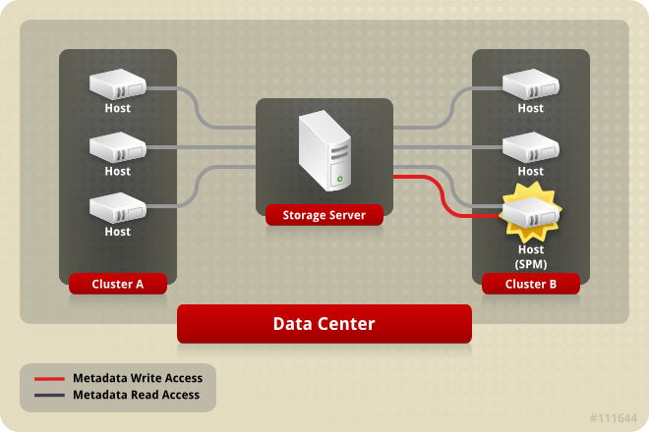
Storage Pool Manager (SPM)
The SPM is a role assigned to one host in a data center giving the host sole authority to make all storage domain structure changes
The role of SPM can be migrated to any host in a data center
Creation, deletion and manipulation of Virtual Disks, Snapshots and Templates
Allocation of storage for sparse block devices (on SAN)
Single meta data writer
SPM lease mechanism (Chockler and Malkhi 2004, Light-Weight Leases for Storage-Centric Coordination)
Storage-centric mailbox

Slide 15
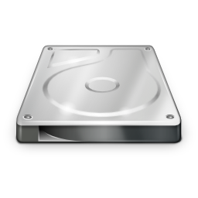
Flow Overview 1/4 – Initial State
Volume 1

Slide 16
Flow Overview 2/4 – Live Snapshot
Volume 1
Volume 1
Volume 2

Slide 17
Flow Overview 3/4 – Replica & Copy
Volume 1
Volume 1
Volume 2
Volume 1
Volume 2
Volume 1'
Volume 2'

Slide 18
Flow Overview 4/4 - Completion
Volume 1
Volume 1
Volume 2
Volume 1
Volume 2
Volume 1'
Volume 2'
Volume 1'
Volume 2'

Slide 19
SPM API – cloneImageStructure
taskId = cloneImageStructure(spUUID, sdUUID, imgUUID, dstSdUUID)
spUUID storage pool
sdUUID source storage domain
imgUUID image to clone
dstSdUUID destination storage domain
Volume 1
Volume 2
Clone Structure
Volume 1'
Volume 2'

Slide 20
SPM API – syncImageData
taskId = syncImageData(spUUID, sdUUID, imgUUID, dstSdUUID, syncType)
spUUID storage pool
sdUUID source storage domain
imgUUID image to clone
dstSdUUID destination storage domain
syncType synchronization type (ALL, INTERNAL, ...)
Volume 1
Volume 2
Synchronize Data
Volume 1'
Volume 2'

Slide 21
HSM API – diskReplicateStart/Finish
result = diskReplicateStart(vmId, srcDisk, dstDisk)
result = diskReplicateFinish(vmId, srcDisk, dstDisk)
vmId virtual machine id
srcDisk source disk
dstDisk destination disk
read write
Volume 1
Volume 2
Volume 1'
Volume 2'
write only

Slide 22
Detailed Flow – Initial Live Snapshot
SPM/HSM – initial live snapshot to minimize the amount of data replicated by the qemu process
Volume 1
Volume 1
Volume 2

Slide 23
Detailed Flow – Clone Image Structure
SPM – clone the image structure from the source storage domain to the destination storage domain
taskId = cloneImageStructure(spUUID, sdUUID, imgUUID, dstSdUUID)
Volume 1
Volume 2
Clone Structure
Volume 1'
Volume 2'

Slide 24
Detailed Flow – Replicate and Sync
HSM – start replicating the virtual machine writes on the destination storage domain
SPM – synchronize the internal volumes data
result = diskReplicateStart(vmId, srcDisk, dstDisk)
taskId = syncImageData(spUUID, sdUUID, imgUUID, dstSdUUID, syncType)
read write
Volume 1
Volume 2
Synchronize Data
Volume 1'
Volume 2'
write only

Slide 25
Detailed Flow – Finish
HSM – complete the switch to the destination storage domain
result = diskReplicateFinish(vmId, srcDisk, dstDisk)
Volume 1
Volume 2
Volume 1'
Volume 2'

Slide 26
Detailed Flow – High Watermark 1/3
The watermark limit is monitored on the VM host as for any other regular virtual disk
read write
Volume 1
Volume 2
Synchronize Data
Volume 1'
Volume 2'
write only
High Watermark Limit

Slide 27
Detailed Flow – High Watermark 2/3
The source and destination volumes data is written using the QCOW cluster size granularity (the size is the same)
When the watermark limit is reached the destination volume is extended first
read write
Volume 1
Volume 2
Synchronize Data
Volume 1'
Volume 2'
write only
High Watermark Limit

Slide 28
Detailed Flow – High Watermark 3/3
After the destination volume has been successfully extended also the source is extended
In case any of the extensions fails the VM is paused (ENOSPC) and the replica is not interrupted
read write
Volume 1
Volume 2
Synchronize Data
Volume 1'
Volume 2'
write only
High Watermark Limit

Slide 29
Detailed Flow – Error Handling
In case of errors it is possible to interrupt the replication and fallback to the source storage domain
read write
Volume 1
Volume 2
Synchronize Data
Volume 1'
Volume 2'
write only
result = diskReplicateFinish(vmId, srcDisk, srcDisk)
Volume 1
Volume 2

Slide 30
Sequence Diagram
Preliminary Live Snapshot
Engine
HSM
(VM Host)
SPM
cloneImageStructure
diskReplicateStart
syncImageData
extendVolume
extendVolume
syncImageData Task
diskReplicateFinish

Slide 31
In Depth – Closing the Gap
Live snapshot and disk replication are not one atomic operations
Volume 1
Volume 1
Volume 2
A small amount of data is synchronized by a QEMU block job
read write
Volume 1
Volume 2
Synchronize Data
QEMU background synchronization
Volume 1'
Volume 2'
write only

Slide 32
Low Level API
Relevant libvirt API:
  blockRebase(disk, base, bandwidth, flags)
    VIR_DOMAIN_BLOCK_REBASE_COPY
    Starts a copy (replica/mirroring) instead of a regular block pull
    VIR_DOMAIN_BLOCK_REBASE_SHALLOW
    Consider only the top volume (leaf)
    VIR_DOMAIN_BLOCK_REBASE_REUSE_EXT
    Reuse an existing pre-initialized volume (prepared by the SPM)
  blockJobAbort(disk, flags)
    VIR_DOMAIN_BLOCK_JOB_ABORT_PIVOT
    Switch to the destination volume (destination storage domain)
Relevant QEMU commands:
  drive-mirror
  block-job-complete

Slide 33
oVirt Engine Changes
Serial Execution of Asynchronous Tasks
Allow an engine command to fire a series of asynchronous SPM tasks in order to allow complex flows (e.g. Live Storage Migration) to be implemented
CommandBase
SPMAsyncTaskHandler
SPMAsyncTaskHandler
SPM
executeAction()
SPM Action and Task Polling
executeAction()
Ovirt Engine
VDSM Host
http://wiki.ovirt.org/wiki/Features/Serial_Execution_of_Asynchronous_Tasks_Detailed_Design

Slide 34
Useful Links and Mailing Lists
Useful Links in the oVirt Wiki http://wiki.ovirt.org/wiki/
  /Features/Serial_Execution_of_Asynchronous_Tasks_Detailed_Design
  /Features/Design/StorageLiveMigration
  /Features/Serial_Execution_of_Asynchronous_Tasks
Mailing lists
  arch@ovirt.org users@ovirt.org
  vdsm-devel@lists.fedorahosted.org
  engine-devel@ovirt.org
IRC
  #ovirt on OFTC
  #vdsm on Freenode

