Slide 1


Hello, UI Plugins!
Tutorial on writing simple plugin
Based on presentation by:
Vojtech Szöcs
Software Engineer, Red Hat
January 23, 2013
Notes:
Legal stuff
Oxygen Icons (LGPL)
Nuvola Icons (LGPL)

Slide 2

In this tutorial, we will ...
Fly through UI plugin basics
Walk through main steps in plugin development
Learn about supported API functions / events
End up with a working plugin that you can play with
Have fun!

Slide 3
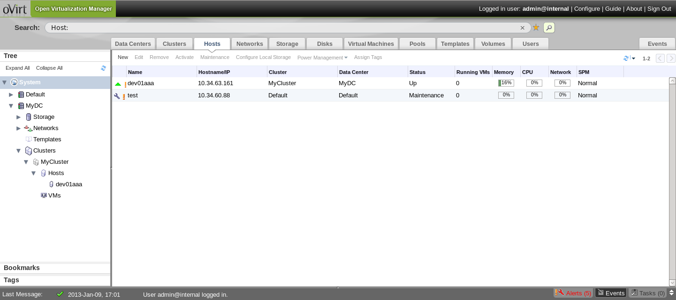
UI plugin basics
Extend oVirt Web Admin user interface

Slide 4
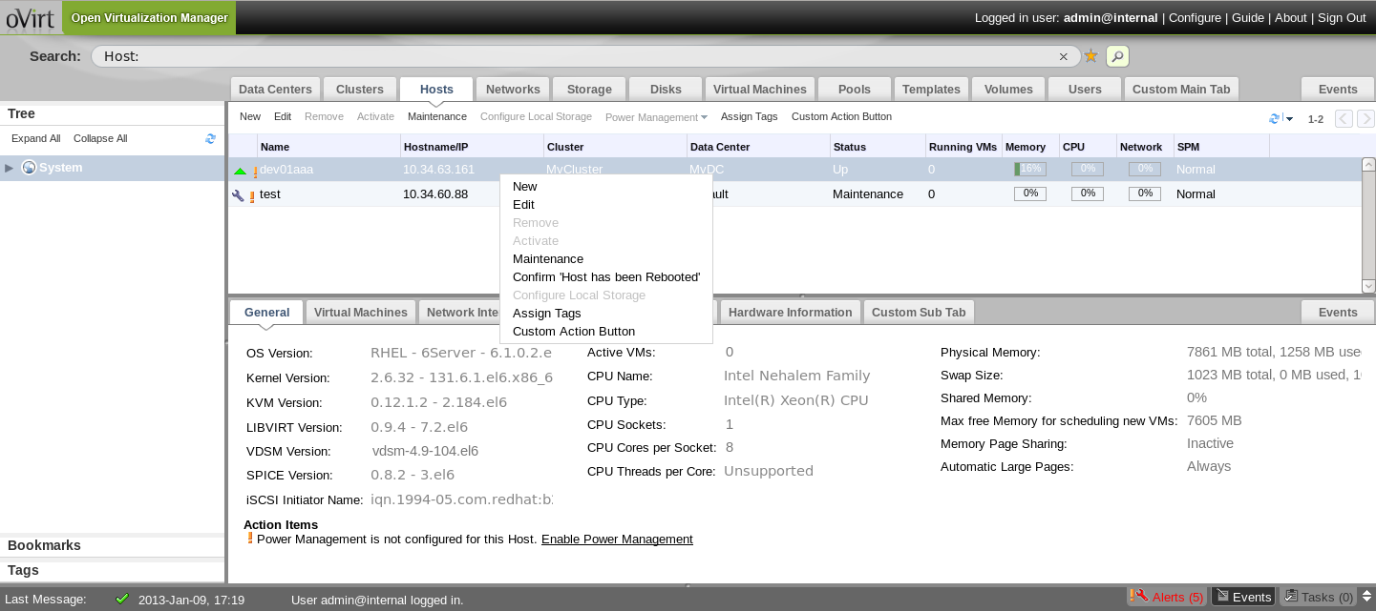
What's currently possible

Slide 5



Discovering plugins
(1) HTTP GET WebAdmin.html
(3) Web Admin with UI Plugin data
Web browser
oVirt Engine
(2)
Plugin meta-data files (descriptors)
/usr/share/ovirt-engine/ui-plugins/my-plugin.json
Plugin configuration files
/etc/ovirt-engine/ui-plugins/my-plugin-config.json
Engine machine
Notes:
(1) Client requests Web Admin application from oVirt Engine application server (JBoss AS)
(2) As part of handling the given request, server-side plugin infrastructure discovers and reloads plugin meta-data and configuration from local file system
(3) Currently valid plugin meta-data and configuration is embedded into Web Admin web page, so that plugins can be loaded during Web Admin startup
As a result, changing plugin meta-data or configuration can be done “on the fly” (without restarting Engine)

Slide 6

Loading plugins
(1) HTTP GET
PluginHostPage.html
Plugin iframe
container
(3) Plugin resource
(4)
oVirt Engine
Web Admin
Plugin
API
(2)
Plugin resource files
/usr/share/ovirt-engine/ui-plugins/
<resourcePath>/PluginHostPage.html
Engine machine
Notes:
(1) To load the given plugin, HTML iframe element is attached to Web Admin page structure (DOM), which causes the web browser to start fetching the iframe content asynchronously in the background
Plugin iframe content, also called plugin host page, bootstraps the plugin by invoking plugin code (JavaScript) within the context of the iframe element
(2) oVirt Engine provides means of serving static plugin resources from local file system (PluginResourceServlet)
(3) Plugin host page is loaded into the iframe element, with plugin code being evaluated within the iframe context
(4) Plugin code interacts with Web Admin through the plugin API object

Slide 7
Writing plugins
<!DOCTYPE html>
<html>
<head>
<!-- Fetch additional resources if necessary -->
<script type="text/javascript" src="jquery-min.js"></script>
<!-- Actual plugin code -->
<script>
// Access plugin API from iframe context
var api = parent.pluginApi('myPlugin');
// Register plugin event handler functions
api.register({
UiInit: function() {
api.addMainTab('Foo Tab', 'foo-tab', 'http://foo.com/');
}
});
// Tell plugin infrastructure that we are ready
api.ready();
</script>
</head>
<body> <!-- HTML body is intentionally empty --> </body>
</html>
Notes:
First, we obtain an instance of plugin API object for our plugin, providing plugin name (“myPlugin”) as argument
Since plugin code runs within the context of an iframe, we need to use “parent” to reference top-level Web Admin context, in which the plugin API object is exposed
Next, we register plugin event handler functions that correspond to various application events
A plugin doesn't necessarily have to define all supported event handler functions – the presence of a function simply indicates that the plugin is interested in the given event
Plugin event handler functions are called by the plugin infrastructure at key events during Web Admin runtime (one-to-many communication)
UiInit represents a special one-time initialization event, fired after the plugin reports in as ready and before other events are fired by Web Admin (good place for one-time UI initialization)
Finally, we tell the plugin infrastructure that our plugin is ready for use, and we can expect UiInit function to be called after WebAdmin enters the appropriate state (main section)

Slide 8
UI plugin basics
Plugin descriptor
  Meta-data + default configuration
  /usr/share/ovirt-engine/ui-plugins/<descriptorName>.json
Plugin user configuration
  Override default configuration, tweak runtime behavior
  /etc/ovirt-engine/ui-plugins/<descriptorName>-config.json
Plugin host page
  Hosts actual plugin code (JavaScript)
  /usr/share/ovirt-engine/ui-plugins/<resourcePath>/<hostPage>.html

Slide 9
Plugin descriptor
Meta-data + default configuration
/usr/share/ovirt-engine/ui-plugins/<descriptorName>.json
{
// A name that uniquely identifies the plugin (required)
"name": "foo",
// URL of plugin host page that invokes the plugin code (required)
"url": "/webadmin/webadmin/plugin/foo/start.html",
// Default configuration object associated with the plugin (optional)
"config": { "band": "ZZ Top", "classic": true, "score": 10 },
// Path to plugin static resources (optional)
// Used when serving plugin files through PluginResourceServlet
// This path is relative to /usr/share/ovirt-engine/ui-plugins
"resourcePath": "foo-files"
}

Slide 10
Plugin user configuration
Override default configuration, tweak runtime behavior
/etc/ovirt-engine/ui-plugins/<descriptorName>-config.json
{
// Custom configuration object associated with the plugin (optional)
// This overrides the default plugin descriptor configuration, if any
"config": { "band": "AC/DC" },
// Whether the plugin should be loaded on WebAdmin startup (optional)
// Default value is 'true'
"enabled": true,
// Relative order in which the plugin will be loaded (optional)
// Default value is Integer.MAX_VALUE (lowest order)
"order": 0
}

Slide 11
Runtime plugin configuration
Merge user configuration (if any)
on top of default configuration (if any)
{ "band": "ZZ Top", "classic": true, "score": 10 }
+
{ "band": "AC/DC" }
=
{ "band": "AC/DC", "classic": true, "score": 10 }

Slide 12
Plugin lifecycle
Defined
Loading
Ready
Initializing
In Use
Failed
Notes:
“Defined” – the plugin has been defined (registered) through its meta-data and the corresponding iframe element has been created (initial state)
“Loading” – the iframe element has been attached to DOM, with plugin host page being fetched asynchronously in the background (waiting for the plugin to report in as ready)
“Ready” – the plugin has indicated that it is ready for use by calling “ready” API function (will proceed with plugin initialization after WebAdmin enters appropriate state – main section)
“Initializing” – the plugin is being initialized by calling UiInit event handler function (UiInit function will be called just once during the lifetime of a plugin, before calling any other event handler functions)
“In Use” – the UiInit event handler function has completed successfully, we can now call other event handler functions as necessary (plugin is in use)
“Failed” – an uncaught exception escaped while calling plugin event handler function, which indicates internal error within the plugin code (plugin is removed from service)

Slide 13

Main steps in plugin development
Write plugin descriptor
Write plugin host page
See plugin in action
Notes:
This quick tutorial puts all the knowledge we have learned so far into practice
It takes only two steps to write a simple plugin

Slide 14
Supported API functions
addMainTab(label, historyToken, contentUrl)
addSubTab(entityTypeName*, label, historyToken, contentUrl)
setTabContentUrl(historyToken, contentUrl)
setTabAccessible(historyToken, tabAccessible)
String
Boolean
Number
Object
* supported values
Cluster, DataCenter, Disk, Host,
Storage, Template, VirtualMachine

Slide 15
Supported API functions
addMainTabActionButton(entityTypeName*, label, buttonInterface)
showDialog(title, contentUrl, width, height)
loginUserName()
loginUserId()
String
Boolean
Number
Object
* supported values
Cluster, DataCenter, Disk, Host,
Storage, Template, VirtualMachine

Slide 16
Supported API events
UserLogin(fullUserName, userId)
UserLogout()
RestApiSessionAcquired(sessionId)
{entity*}SelectionChange(selectedItems[])
String
Boolean
Number
Object
* supported values
Cluster, DataCenter, Disk, Host,
Storage, Template, VirtualMachine

Slide 17
Useful links
http://www.ovirt.org/wiki/Features/UIPlugins
git://gerrit.ovirt.org/samples-uiplugins
http://lists.ovirt.org/mailman/listinfo/engine-devel

Slide 18
Thank you!
http://www.ovirt.org/
My details
ovedo@redhat.com
ovedo at #ovirt (irc.oftc.net)
ovedou.blogspot.com
Vojtech's details
vszocs@redhat.com
vszocs at #ovirt (irc.oftc.net)

