Slide 1


Scripting And Integration with oVirt
Oved Ourfali, ovedo@redhat.com
Senior Software Engineer, Red-Hat
Based on slides by:
Simon Grinberg, sgrinber@redhat.com
Michael Pasternak, mpastern@redhat.com
January 2013

Slide 2


Agenda
Introduction
oVirt API
  Overview
  Examples
oVirt Shell (CLI)
  Overview
  Examples
oVirt SDK
  Overview
  Examples

Slide 3
What can I do with it?
Infrastructure configuration
  Host configuration and management
  Network and storage configuration
Virtual machine (VM) configuration and management
  Networking for the Guest, Virtual disks, VM properties
User management
Daily maintenance and VM lifecycle management
Advanced operations not available in the GUI
And much more ...

Slide 4

Where would I use it?
Scripting and utilities
A way to integrate with other software used in the organization
Automation of tasks – provisioning and management
Software development – of specific add-ons or applications
Performance monitoring and reports

Slide 5

API methods
REST
https://host:port/api/vms
Returns:
XML/JSON/...
<vm id="aee0dbce-1591-44d4-9052-c2209b3e45b8" href="/api/vms/aee0dbce-1591-44d4-9052-c2209b3e45b8">
<name>Austin</name><actions>
<link rel="shutdown" href="/api/vms/aee0dbce-1591-44d4-9052-c2209b3e45b8/shutdown"/>
<link rel="start" href="/api/vms/aee0dbce-1591-44d4-9052-c2209b3e45b8/start"/>
....................
SDK (Python/Java)
api.vms.list()
Returns:
list of VM objects
Shell
list vms
Returns:
Formatted text
id : 18df94a7-048f-4306-9cfd-a74e8ea3b907
name : Boston
description : Main service for Boston
cluster-id : 99408929-82cf-4dc7-a532-9d998063fa95
cpu-topology-cores : 2
cpu-topology-sockets : 1

Slide 6
What method to use?
Depends on
  Who you are and what is your role?
  What you are trying to do?
  What is the level of your expertise?
Few examples
  System Administrator who is managing small virtualized servers, using the Shell interface for a quick troubleshoot
  Datacenter admin, running large virtualized environment, using the SDK to automate provisioning and managing hundreds of virtual machines
  Software developer who integrates creating his own libraries over REST API

Slide 7
API Concepts
All APIs integrate through the oVirt engine
All types of APIs are based on the web services interface
  REST as the core
  SDK on top of REST
  Shell implemented on top the Python SDK
Backward and forward compatibility
Secure access

Slide 8
oVirt API

Slide 9
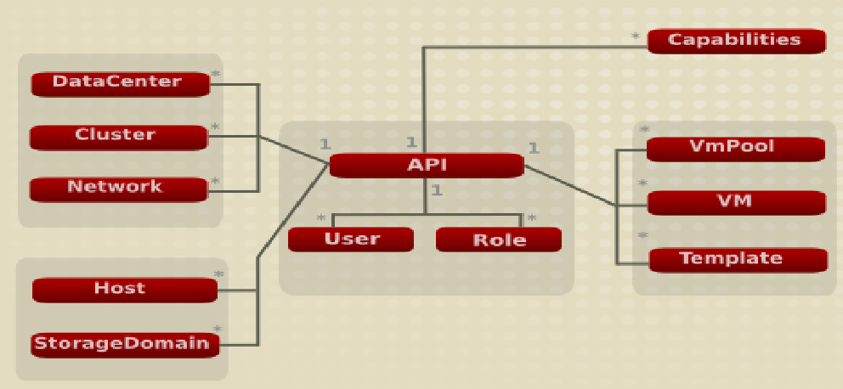

oVirt-API
Restful API
Container: Jboss
Framework: RESTeasy
URI: http(s)://server:port/api/
Notes:
Assumption: Everyone are familiar withoVirt, or at least with the basics of what is required from to manage Enterprise data center Virtualiztion.
-----------
Middle: The REST service, you can log in with you user (which implies roles and permissions)
-----------
Bottom left: Physical resources
-----------
Upper left: Logical partitioning
-----------
Right: Your Virtual Machine, and capabilities queries
-----------
All as mentioned are the same for the API – resources and collection of resources

Slide 10
HTTP methods in REST
GET
Requests a representation of the specified resource. Requests using GET (and a few other HTTP methods) "SHOULD NOT have the significance of taking an action other than retrieval."
POST
Submits data to be processed to the identified resource. The data is included in the body of the request.
PUT
Uploads a representation of the specified resource
DELETE
Deletes the specified resource
Notes:
Use Get to view/brows
-----------
Post to Create new resources / Activate Actions
-----------
PUT to modify
-----------
DELETE to destroy

Slide 11
Media types
XML
<vms>
<vm id=”xxx”>
<name>yyy<name>
</vm>
</vms>
JavaScript Object Notation (JSON)
{
“vms” : [
“vm” : {
“id” : ”xxx”,
“name” : ”yyy” } ]
}
Notes:
For example:
-----------
Partial XML representation of a VM and name and ID properties
-----------
* Same in JSON
-----------
* Just use your preferred

Slide 12
oVirt-API URI structure
http(s)://server:port/api/aaa/xxx-xxx/bbbb/yyy-yyy
1 2 3 4 5 6 7
1. protocol
2. server endpoint details
3. entry point (base resource)
4. collection
5. resource
6. sub-collection
7. sub-resource
Notes:
As I've said everything is accessible via URIs
-----------
-----------
This is the structure of the the longest where the entry point is the .../api/ and the actual URI access at at any entry point beyond that stopping at the API level or continue diving into hierarchy

Slide 13
oVirt-API Resource Structure
<vm id="xxx" href="/api/vms/xxx"> identification details
<name>vm1_iscsi</name>
<status>DOWN</status>
<memory>10737418240</memory>
<cpu>
<topology cores="1" sockets="1"/>
</cpu>
<start_time>2011-07-13T12:05:34.931Z</start_time>
<creation_time>2011-05-31T16:47:51+03:00</creation_time>
<actions>
<link rel="start" href="/api/vms/xxx/start"/>
<link rel="stop" href="/api/vms/xxx/stop"/>
</actions>
<link rel="disks" href="/api/vms/xxx/disks"/>
<link rel="nics" href="/api/vms/xxx/nics"/>
<cluster id="zzz" href="/api/clusters/zzz"/>
<template id="yyy" href="/api/templates/yyy"/>
</vm>
Metadata
Resource details
Actions
Links to related
resources
Notes:
Self explanatory

Slide 14
oVirt-API How-to (the methods)
To list all collection resources, use GET
GET http(s):/server:port/api/vms
To retrieve specific resource, use GET
GET http(s)://server:port/api/vms/{ID}
To create a resource, use POST
POST http(s)://server:port/api/vms
<vm>...</vm>
To update the resource, use PUT
PUT http(s)://server:port/api/vms/{ID}
<vm><name>new_name</name></vm>
To remove the resource, use DELETE
DELETE http(s)://server:port/api/vms/{ID}
Notes:
No need – just show the hierarchy live

Slide 15
Clients / Tools
Any HTTP library/client can be used as a
a client for oVirt-API
Common used clients are
  Firefox REST Client
  Chrome REST-Client
  Linux: curl / wget
...

Slide 16
Example - GET
GET http(s)://server:port/api/vms/{ID}
curl -v -u "user@domain:password" -H "Content-type: application/xml" -X GET http(s)://server:port/api/vms/{ID}
Notes:
CURL is a nice command line HTTP client
-----------
This GET example produced an XML presentation of a specific Virtual Machine
-----------
The headers are a must for the REST application to respond properly.

Slide 17

Example - CREATE
Create VM
POST http(s)://server:port/api/vms
<vm>
<name>my_new_vm</name>
<cluster id="xxx" />
<template id="yyy" />
</vm>
curl -v -u "user@domain:password" -H "Content-type: application/xml"
-d '<vm> <name>my_new_vm</name>
<cluster><name>cluster_name</name></cluster>
<template><name>template_name</name></template>
</vm>' 'http(s)://server:port/api/vms'
Notes:
As mentioned to create a new resource you need to POST.
-----------
Sending the resource XML representation in this case of a Virtual Machine.
-----------
Each resource had it's own minimal set of required parameters to be sent in order to allow creation.

Slide 18
Example - UPDATE
Update
PUT http(s)://server:port/api/vms/xxx
<vm>
<name>new_name</name>
</vm>
echo "<vm><name>new_name</name></vm>" > /tmp/upload.xml
curl -v -u "user@domain:password"
-H "Content-type: application/xml"
-T /tmp/upload.xml
'http(s)://server:port/api/vms/xxx'
Notes:
CURL automatically defaults to PUT when using -T options from a file.
-----------
Note that you only need to send the properties you need to modify – not the full object.

Slide 19
Example - DELETE
Delete
DELETE http(s)://server:port/api/vms/xxx
curl -v -u "user@domain:password" -X DELETE http(s)://server:port/api/vms/xxx

Slide 20


RSDL - RESTful Services Description Language
Describes parameter constraints
Easy way to understand
  How to create the resource
  What actions are available on a collection
  What parameters to pass
    Mandatory/optional/read-only
    Type
    Overloads
Notes:
Provides a full description of existing resources, their parameter, expected value etc
-----------
With that you can easy build your own libraries on top ofoVirt's REST API

Slide 21
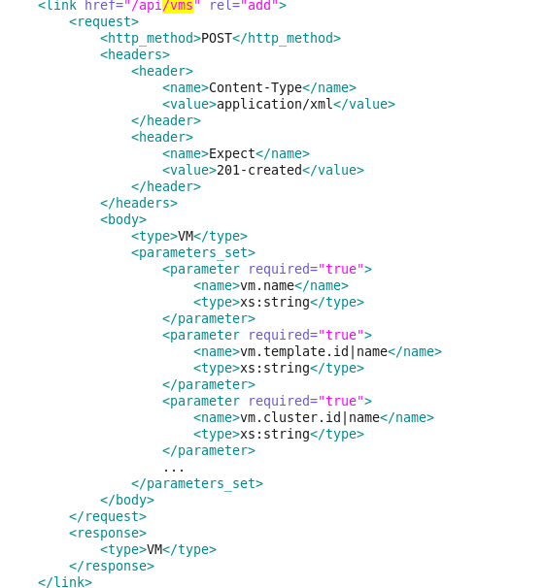
RSDL link description (http(s)://engine:port/api?rsdl)
Notes:
So let's look at a VM description
-----------
It's easy to list all parameters ,the values they except and whether they are required or optional (during creation)

Slide 22
Additional Functionality
User-level API
  oVirt version 3.2 supports user-level API
  In order to use it, you need to pass the “filter” HTTP header, with a value of “true”
Session support
  We use cookies to allow using the REST API without having to re-authenticate on every request
  See more details in http://wiki.ovirt.org/Features/RESTSessionManagement
Notes:
Provides a full description of existing resources, their parameter, expected value etc
-----------
With that you can easy build your own libraries on top ofoVirt's REST API

Slide 23
oVirt Shell
Command Line Interface

Slide 24

oVirt Shell
Concepts
  Interactive shell
  Use tab for auto-completion
  Use arrow keys to browse previous commands
  Ability to execute scripts
  Pipe output into shell commands

Slide 25
oVirt Shell - Smart help
help is dynamically created for each command
  help <command> [arguments] [options]
Help command
  help add
Help command argument
  help add storagedomain
Or if it's for operation on a subcollection context
  help add storagedomain --datacenter-identifier yyy

Slide 26
oVirt Shell - Connect
When running the ovirt-shell, you'll get a disconnected prompt
To connect as an administrator, run
  [oVirt shell (disconnected)]# connect --url "http://server:port/api" --user "user@domain" --password "password"
and as a user run
  [oVirt shell (disconnected)]# connect --url "http://server:port/api" --filter --user "user@domain" --password "password"
then you should get the “connected” prompt
  [oVirt shell (connected)]#

Slide 27
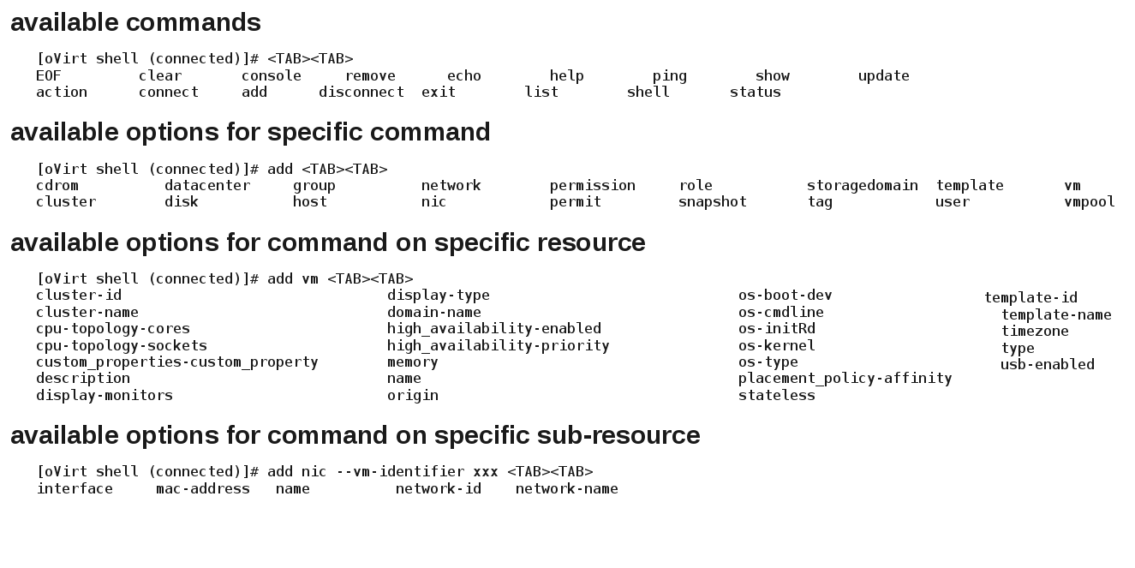
oVirt Shell - Smart auto-completion

Slide 28
oVirt Shell – Querying for Resources
list <resource>
  Provides a list of these resources, minimal details
list <resource> --show-all
  Provides a list of these resources, full details
list <resource> --kwargs "param=val"
  list resources using client side filtering
  list vms --kwargs name=p*
list <resource> --query "param=val"
  list resources using oVirt query engine filtering
Etc...

Slide 29
oVirt Shell – Resource Manipulation
oVirt Shell – Actions
add
update
remove
Action on resource
  action <resource> <name> <action>
Action on sub-resource
  action <sub-resource> <name> <action> --<resource>-identifier <name>

Slide 30
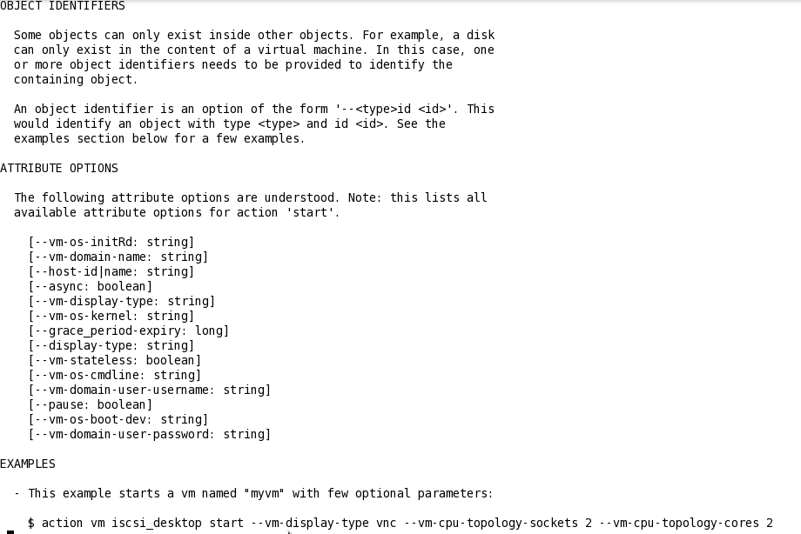
oVirt Shell – Help on Actions

Slide 31
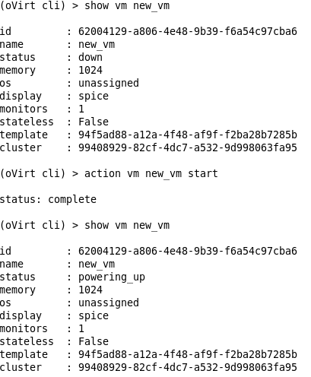
oVirt Shell - Actions

Slide 32
oVirt Shell - Examples
Action with parameters
  action host Atlantic install --root_password pm123456
Create and update
  add vm --name BaseRHEL6 --memory 1073741824 --template-name Blank --cluster-name Default
  update vm BaseRHEL6 --os-type rhel_6x64
  add nic --vm-identifier BaseRHEL6 --name nic1 –network-name ovirtmgmt

Slide 33
oVirt Shell - Examples
Create and attach Disks
  create disk --size 10737418240 --wipe_after_delete False --format raw --sparse True --interface virtio --storage_domains-storage_domain "storage_domain.name=myImageStore" --bootable True
  create disk --id bc2454d0-2539-41c3-85c2-91cfbdfbede3 --vm-identifier BaseRHEL6
Or
  create disk --size 10737418240 --wipe_after_delete False --format raw --sparse True --interface virtio --storage_domains-storage_domain "storage_domain.name=myImageStore" --vm-identifier BaseRHEL6

Slide 34

oVirt Shell - Examples
Create Template
  create template --vm-name BaseRHEL6 --name BaseRHEL6
Create VM from Template
  create vm --template-name BaseRHEL6 --name myRHEL --cluster-name Default
Remove VM
  remove vm my_new_vm

Slide 35
oVirt SDK

Slide 36
oVirt SDK
Mainly used for integration or advanced automation
Object oriented
Slides will show the python SDK. Java SDK was released a few weeks ago
More information on the Java SDK can be found in http://www.ovirt.org/Java-sdk

Slide 37
oVirt SDK
Concepts
  Complete protocol abstraction
  Full compliance with the oVirt API architecture
  Auto-completion
  Self descriptive, intuitive and easy to use
  Auto-generated
Notes:
Though presented now it is the bases of the Shell meaning that the Shell is just a utility written using this SDK. This how powerful the SDK is

Slide 38
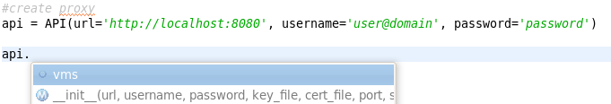

oVirt SDK - Examples
- Creating the proxy
Additional options:
filter=True for user-level API (default is False – admin API)
persistent_auth=True for using API REST sessions (default is False)
- Listing all collections
- Listing collection's methods.
Notes:
This is an example of some common tasks.
-----------
Connection – provide required connection parameters for you manager instance
-----------
List resource in a collection and ... what operations are available,
-----------
Notice the convenient auto complete in case you use an IDE.

Slide 39
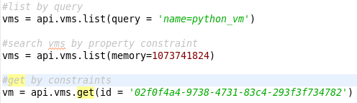

oVirt SDK - Examples
- Querying collection with the search engine.
- Querying collection by custom constraint.
- Querying collection for specific resource.
- Accessing resource methods and properties.
Notes:
Custom constraint means client side filtering

Slide 40

oVirt SDK - Examples
- Accessing resource properties and sub-collections
- Accessing sub-collection methods

Slide 41
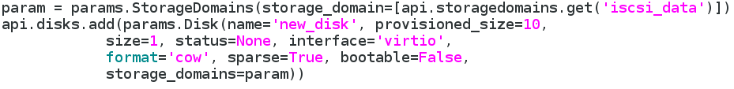
oVirt SDK - Examples
- Creating a VM resource
- Creating a Disk resource
- Attach a disk to a VM, and activate it

Slide 42


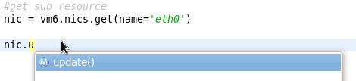
oVirt SDK - Examples
- Querying sub-collection by custom constraint.
- Retrieving sub-collection resource.
- Accessing sub-collection resource properties and methods.

Slide 43

Useful Links:
Wiki
http://ovirt.org/wiki/Category:Api
http://www.ovirt.org/wiki/SDK
http://www.ovirt.org/wiki/CLI
Git repository
git://gerrit.ovirt.org/samples-portals.git
My Details:
ovedo@redhat.com
ovedo in #ovirt on irc.oftc.net
ovedou.blogspot.com
Mailing lists:
users@ovirt.org
engine-devel@ovirt.org
IRC:
#ovirt on irc.oftc.net

Slide 44
Thank you

