Slide 1

MOM + oVirt:
Nurturing our
Virtual Machines
Adam Litke <agl@us.ibm.com>

Slide 2
The goal:
“As an oVirt administrator,
I want to run more virtual
machines with the same
amount of hardware.”

Slide 3
What is overcommitment?
To promise more resources than we have available
  CPU, Memory, Disk space, bandwidth
What happens when Vms use all of the resources?
This is a very complex subject
We can make it easy for oVirt users

Slide 4

Overcommitment in oVirt
Storage overcommitment
KSM – Kernel Samepage Merging
Memory ballooning
I/O and network bandwidth limits
… many additional possibilities

Slide 5
Managing ksm
KSM reduces amount of memory needed in exchange for some CPU cycles
Run ksmd only when beneficial
  Free memory is low and we need more
  Most of the memory is being used for vms
Dynamically adjust scanning parameters

Slide 6
Managing memory ballooning
Under pressure: guests swap, not host
Make incremental balloon adjustments
Host memory pressure | Take this action ...
Moderate | Inflate balloons. Guests retain some free memory
Severe | Inflate balloons more. This will cause cache pressure and guest swapping.
Low | Deflate balloons. Gradually return guests to full memory size.

Slide 7
Managed migration
Sometimes a host will run out of resources
Only option: reduce load
Select the best VM to migrate
  Can use priority or metrics to decide
Raise an event
oVirt engine will respond by migrating the vm to another host or powering it off.

Slide 8
Deployment requirements
Host statistics collection
Guest statistics (from guest agent)
Host-level manager to interpret stats and apply a policy
User-selectable management policies
New vdsm apis
GUI enablement in ovirt-engine

Slide 9
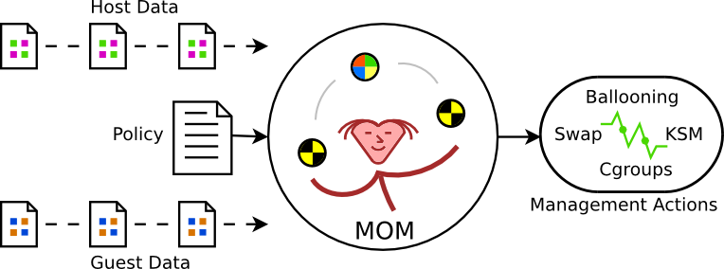
Introducing mom
Guest tracking
Stats collection
Fully extensible
Dynamic
policy engine
Support for ksm and ballooning

Slide 10
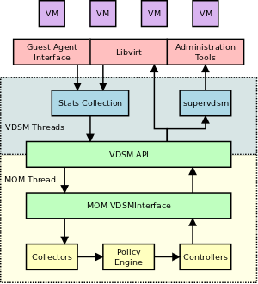
Integration strategy
MOM threads run within vdsmd
Stats collected via the vdsm API
Ksm / ballooning operations via vdsm API
Vdsm installs a default MOM policy

Slide 11
Future work
Merge vdsm patches
Add ballooning API to vdsm
Work on oVirt-specific MOM policies
Add cgroup RSS limits to libvirt and vdsm
Webadmin policy selection GUI
Lots of other possibilities...

Slide 12
Links and resources
http://www.ovirt.org/news-and-events/workshop/
oVirt feature page
  http://ovirt.org/wiki/Features/MomIntegration
MOM source code
  https://github.com/aglitke/mom
MOM memory overcommitment study
  http://www.ibm.com/developerworks/linux/library/l-overcommit-kvm-resources/index.html
  http://www.linux-kvm.org/wiki/images/e/e8/2010-forum-litke-kvmforum2010.pdf
Managing resources on other hypervisors
  http://www.stanford.edu/class/cs240/readings/waldspurger.pdf

Slide 13

Questions?

