Slide 1

Development process
Douglas Schilling Landgraf
Software Engineer @ Red Hat

Slide 2
Bugzilla

Slide 3
Bugzilla
Bugzilla is a tracking system
The same platform to all members of team
Easy to track issues (developers and non developers)
Available filters: component, version, assigner, target release and others
Knowledge kept in available to all not in personal emails
Easily integrated with others projects, like gerrit
There are libraries for for interacting with Bugzilla
Notes:
What is Ovirt?
ROBUST PLATFORM
FEATURE REACH
SVI & VDI
MANAGING VIRTUALIZED DC – THOUSANDS OF VMS ?HYPERVISORS
KVM
A PARALLEL to VMWARE VSPHERE/ VCENTER
SINGLE POINT OF MANAGEMENT – NET STORAGE

Slide 4
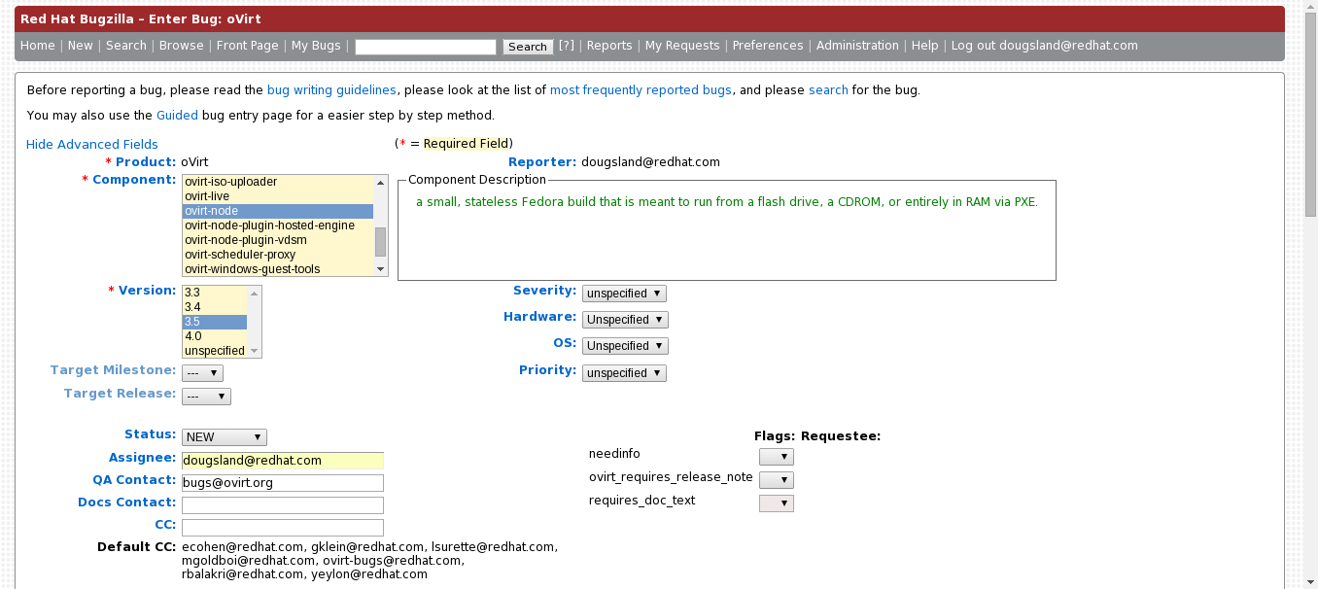
Reporting an issue
https://bugzilla.redhat.com/enter_bug.cgi?product=oVirt
http://www.ovirt.org/Reporting_a_bug
Notes:
What is Ovirt?
ROBUST PLATFORM
FEATURE REACH
SVI & VDI
MANAGING VIRTUALIZED DC – THOUSANDS OF VMS ?HYPERVISORS
KVM
A PARALLEL to VMWARE VSPHERE/ VCENTER
SINGLE POINT OF MANAGEMENT – NET STORAGE

Slide 5
Fields
All fields are import but keep in mind during report:
  Product/Component
  Version/Release
  Target Release
  Flags
  If possible share reproducer
  Attach logs if exist
  What about needinfo?
Notes:
What is Ovirt?
ROBUST PLATFORM
FEATURE REACH
SVI & VDI
MANAGING VIRTUALIZED DC – THOUSANDS OF VMS ?HYPERVISORS
KVM
A PARALLEL to VMWARE VSPHERE/ VCENTER
SINGLE POINT OF MANAGEMENT – NET STORAGE

Slide 6
What status meant?
NEW
ASSIGNED
POST
MODIFIED
VERIFIED
ON_QA
CLOSED
RELEASE PENDING
Notes:
What is Ovirt?
ROBUST PLATFORM
FEATURE REACH
SVI & VDI
MANAGING VIRTUALIZED DC – THOUSANDS OF VMS ?HYPERVISORS
KVM
A PARALLEL to VMWARE VSPHERE/ VCENTER
SINGLE POINT OF MANAGEMENT – NET STORAGE

Slide 7
Request For Enhancement
All requested made by bugzilla
Project Manager (PM) will evaluate
Developers, PM and QA will target a release and arrange the details
A wiki page is created with the details of implementation
http://wiki.ovirt.org
Feature is tested during all alpha, RC phases
Notes:
What is Ovirt?
ROBUST PLATFORM
FEATURE REACH
SVI & VDI
MANAGING VIRTUALIZED DC – THOUSANDS OF VMS ?HYPERVISORS
KVM
A PARALLEL to VMWARE VSPHERE/ VCENTER
SINGLE POINT OF MANAGEMENT – NET STORAGE

Slide 8
How the development is made?

Slide 9
Communication
Mailing lists
  User-oriented lists
    Announce@ovirt
    Users@ovirt
  Developer-oriented lists
    Devel@ovirt
  Project governance and management
    Board@ovirt
    Infra@ovirt
    Marketing@ovirt
Notes:
What is Ovirt?
ROBUST PLATFORM
FEATURE REACH
SVI & VDI
MANAGING VIRTUALIZED DC – THOUSANDS OF VMS ?HYPERVISORS
KVM
A PARALLEL to VMWARE VSPHERE/ VCENTER
SINGLE POINT OF MANAGEMENT – NET STORAGE

Slide 10
Communication
IRC
  We are on irc.ofct.net #ovirt
Weekly Meetings
  oVirt has a weekly synchronization meeting which is held on IRC
Notes:
What is Ovirt?
ROBUST PLATFORM
FEATURE REACH
SVI & VDI
MANAGING VIRTUALIZED DC – THOUSANDS OF VMS ?HYPERVISORS
KVM
A PARALLEL to VMWARE VSPHERE/ VCENTER
SINGLE POINT OF MANAGEMENT – NET STORAGE

Slide 11
Development
All oVirt projects contain a git tree
We use branch for releases
  master
  ovirt-3.4
  ovirt-3.5
Which branch should I send my contribution?
We do use gerrit.ovirt.org as code review and project management
Notes:
What is Ovirt?
ROBUST PLATFORM
FEATURE REACH
SVI & VDI
MANAGING VIRTUALIZED DC – THOUSANDS OF VMS ?HYPERVISORS
KVM
A PARALLEL to VMWARE VSPHERE/ VCENTER
SINGLE POINT OF MANAGEMENT – NET STORAGE

Slide 12
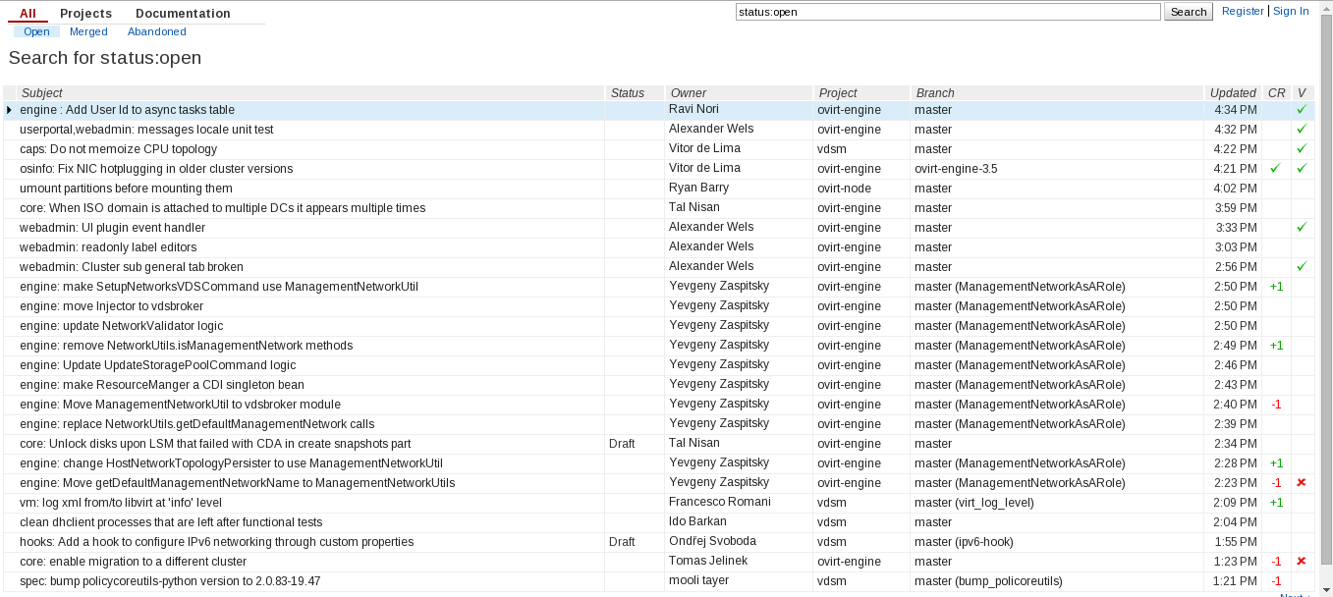
First look at gerrit
http://gerrit.ovirt.org
Notes:
What is Ovirt?
ROBUST PLATFORM
FEATURE REACH
SVI & VDI
MANAGING VIRTUALIZED DC – THOUSANDS OF VMS ?HYPERVISORS
KVM
A PARALLEL to VMWARE VSPHERE/ VCENTER
SINGLE POINT OF MANAGEMENT – NET STORAGE

Slide 13
More about gerrit
Gerrit is a free, web based team software code review tool
Who writes bug free code?
Who knows all best-practices of programming?
All people in the process can improve skills
Notifications by e-mail
Notes:
What is Ovirt?
ROBUST PLATFORM
FEATURE REACH
SVI & VDI
MANAGING VIRTUALIZED DC – THOUSANDS OF VMS ?HYPERVISORS
KVM
A PARALLEL to VMWARE VSPHERE/ VCENTER
SINGLE POINT OF MANAGEMENT – NET STORAGE

Slide 14
Sending a contribution
Register an user in Gerrit (OpenID or Fedora Account System)
Set SSH keys in Gerrit Settings
$ git clone git://gerrit.ovirt.org/ovirt-node
Add the gerrit Change-id generator to the tree
  $ scp -p gerrit.ovirt.org:hooks/commit-msg .git/hooks/
Add Signed-off-by (SOB) script into commit-msg
  SOB=$(git var GIT_AUTHOR_IDENT | sed -n 's/^\(.*>\).*$/Signed-off-by: \1/p')
  grep -qs "^$SOB" "$1" || echo "$SOB" >> "$1"
Notes:
What is Ovirt?
ROBUST PLATFORM
FEATURE REACH
SVI & VDI
MANAGING VIRTUALIZED DC – THOUSANDS OF VMS ?HYPERVISORS
KVM
A PARALLEL to VMWARE VSPHERE/ VCENTER
SINGLE POINT OF MANAGEMENT – NET STORAGE

Slide 15
Sending a contribution
Setting git user.name and user.email
  $ git config --global user.name "Douglas Schilling Landgraf"
  $ git config --global user.email dougsland@redhat.com
<make your changes into the source>
$ git add <source changed>
$ git commit
http://www.ovirt.org/Working_with_oVirt_Gerrit
Notes:
What is Ovirt?
ROBUST PLATFORM
FEATURE REACH
SVI & VDI
MANAGING VIRTUALIZED DC – THOUSANDS OF VMS ?HYPERVISORS
KVM
A PARALLEL to VMWARE VSPHERE/ VCENTER
SINGLE POINT OF MANAGEMENT – NET STORAGE

Slide 16
Commit and push
“Commit Template”
    SUBJECT
    Description
    Bug-Url: http://..
    (if exists)
Notes:
What is Ovirt?
ROBUST PLATFORM
FEATURE REACH
SVI & VDI
MANAGING VIRTUALIZED DC – THOUSANDS OF VMS ?HYPERVISORS
KVM
A PARALLEL to VMWARE VSPHERE/ VCENTER
SINGLE POINT OF MANAGEMENT – NET STORAGE

Slide 17
Commit and push
Rebase with current master
$ git fetch -v
$ git rebase origin/master
Send the change to gerrit
  $ git push gerrit.ovirt.org:ovirt-node HEAD:refs/for/master
Notes:
What is Ovirt?
ROBUST PLATFORM
FEATURE REACH
SVI & VDI
MANAGING VIRTUALIZED DC – THOUSANDS OF VMS ?HYPERVISORS
KVM
A PARALLEL to VMWARE VSPHERE/ VCENTER
SINGLE POINT OF MANAGEMENT – NET STORAGE

Slide 18
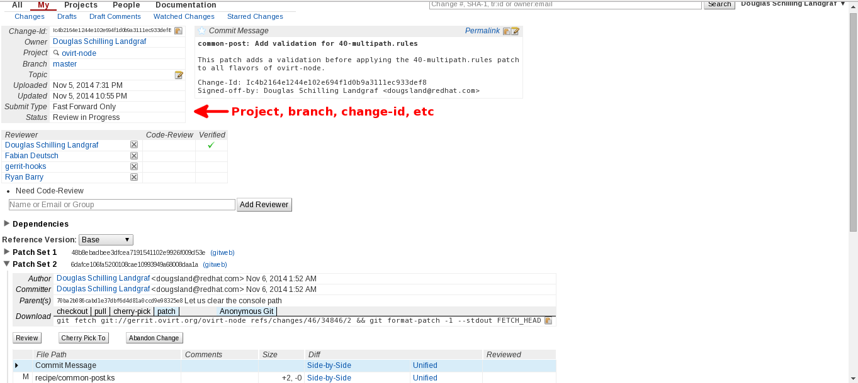
Reviewing
Notes:
What is Ovirt?
ROBUST PLATFORM
FEATURE REACH
SVI & VDI
MANAGING VIRTUALIZED DC – THOUSANDS OF VMS ?HYPERVISORS
KVM
A PARALLEL to VMWARE VSPHERE/ VCENTER
SINGLE POINT OF MANAGEMENT – NET STORAGE

Slide 19
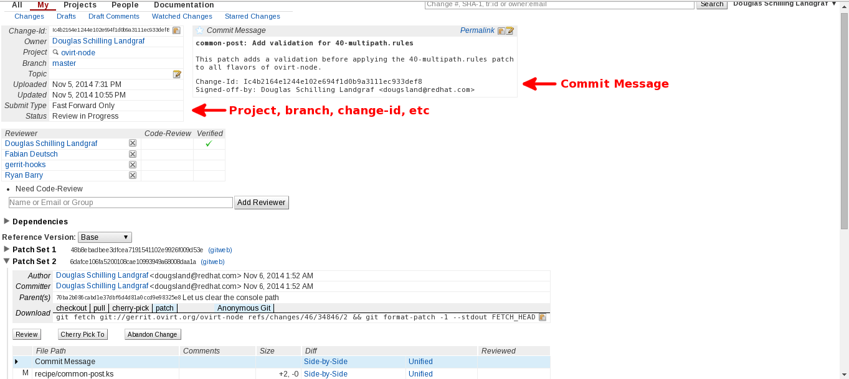
Reviewing
Notes:
What is Ovirt?
ROBUST PLATFORM
FEATURE REACH
SVI & VDI
MANAGING VIRTUALIZED DC – THOUSANDS OF VMS ?HYPERVISORS
KVM
A PARALLEL to VMWARE VSPHERE/ VCENTER
SINGLE POINT OF MANAGEMENT – NET STORAGE

Slide 20
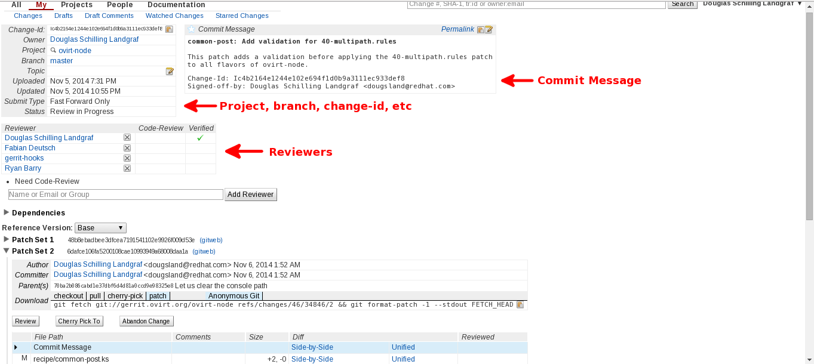
Reviewing
Notes:
What is Ovirt?
ROBUST PLATFORM
FEATURE REACH
SVI & VDI
MANAGING VIRTUALIZED DC – THOUSANDS OF VMS ?HYPERVISORS
KVM
A PARALLEL to VMWARE VSPHERE/ VCENTER
SINGLE POINT OF MANAGEMENT – NET STORAGE

Slide 21
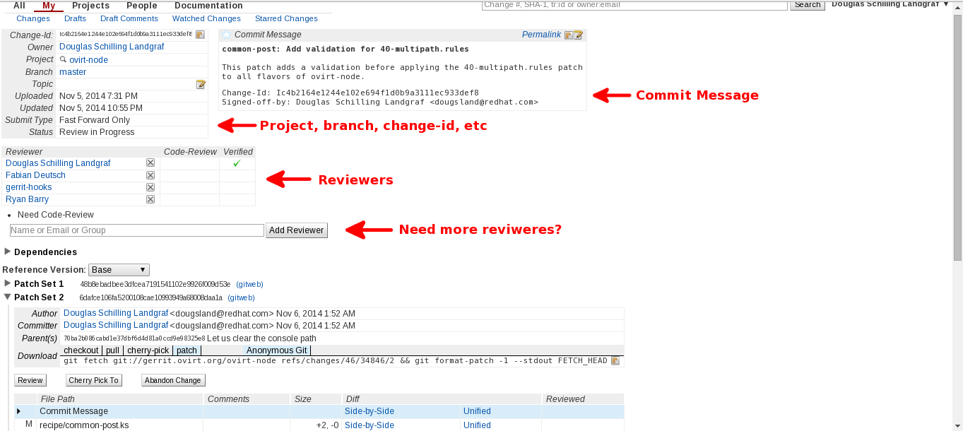
Reviewing
Notes:
What is Ovirt?
ROBUST PLATFORM
FEATURE REACH
SVI & VDI
MANAGING VIRTUALIZED DC – THOUSANDS OF VMS ?HYPERVISORS
KVM
A PARALLEL to VMWARE VSPHERE/ VCENTER
SINGLE POINT OF MANAGEMENT – NET STORAGE

Slide 22
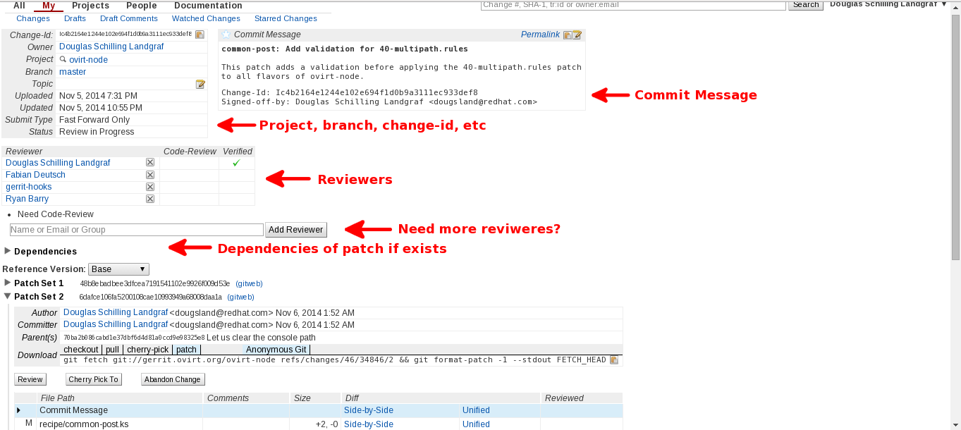
Reviewing
Notes:
What is Ovirt?
ROBUST PLATFORM
FEATURE REACH
SVI & VDI
MANAGING VIRTUALIZED DC – THOUSANDS OF VMS ?HYPERVISORS
KVM
A PARALLEL to VMWARE VSPHERE/ VCENTER
SINGLE POINT OF MANAGEMENT – NET STORAGE

Slide 23
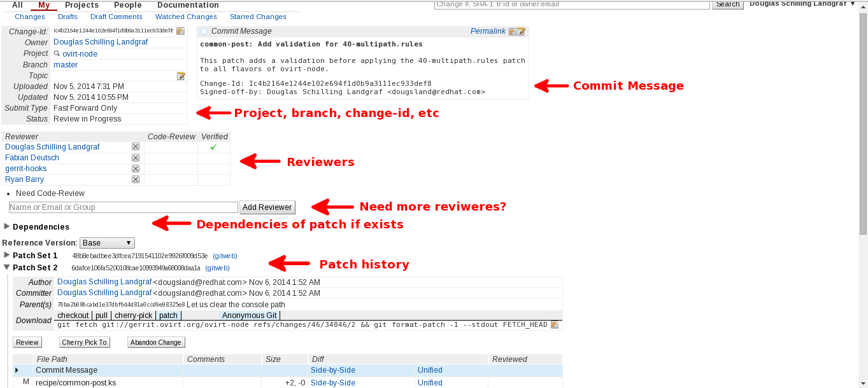
Reviewing
Notes:
What is Ovirt?
ROBUST PLATFORM
FEATURE REACH
SVI & VDI
MANAGING VIRTUALIZED DC – THOUSANDS OF VMS ?HYPERVISORS
KVM
A PARALLEL to VMWARE VSPHERE/ VCENTER
SINGLE POINT OF MANAGEMENT – NET STORAGE

Slide 24

Reviewing
Notes:
What is Ovirt?
ROBUST PLATFORM
FEATURE REACH
SVI & VDI
MANAGING VIRTUALIZED DC – THOUSANDS OF VMS ?HYPERVISORS
KVM
A PARALLEL to VMWARE VSPHERE/ VCENTER
SINGLE POINT OF MANAGEMENT – NET STORAGE

Slide 25
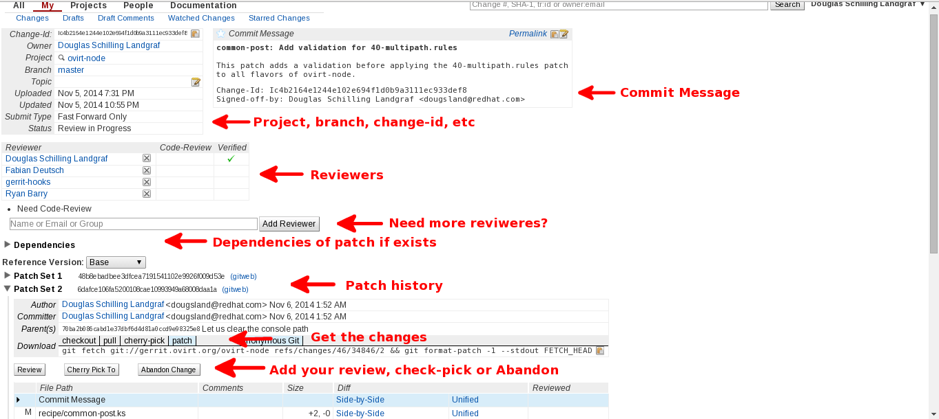
Reviewing
Notes:
What is Ovirt?
ROBUST PLATFORM
FEATURE REACH
SVI & VDI
MANAGING VIRTUALIZED DC – THOUSANDS OF VMS ?HYPERVISORS
KVM
A PARALLEL to VMWARE VSPHERE/ VCENTER
SINGLE POINT OF MANAGEMENT – NET STORAGE

Slide 26
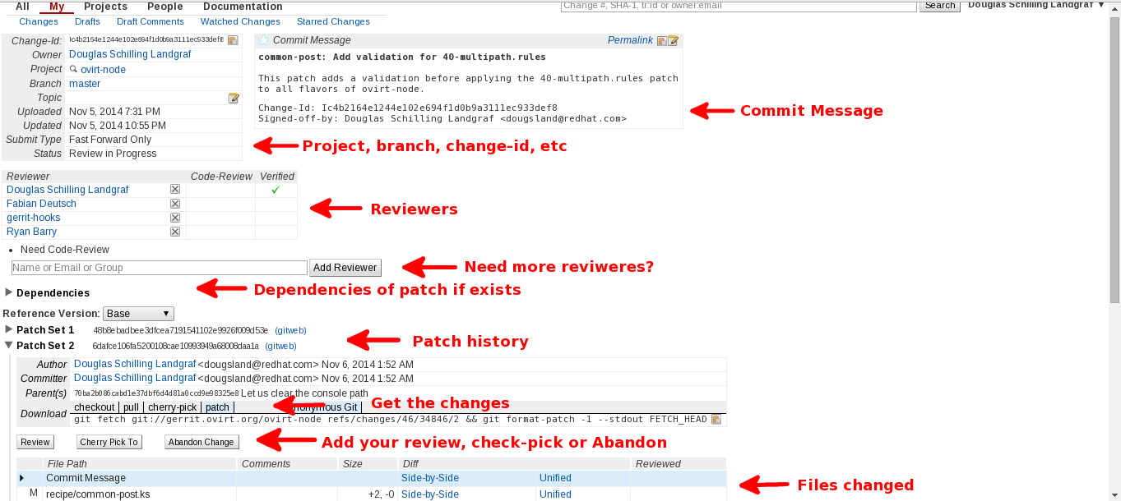
Reviewing
Notes:
What is Ovirt?
ROBUST PLATFORM
FEATURE REACH
SVI & VDI
MANAGING VIRTUALIZED DC – THOUSANDS OF VMS ?HYPERVISORS
KVM
A PARALLEL to VMWARE VSPHERE/ VCENTER
SINGLE POINT OF MANAGEMENT – NET STORAGE

Slide 27
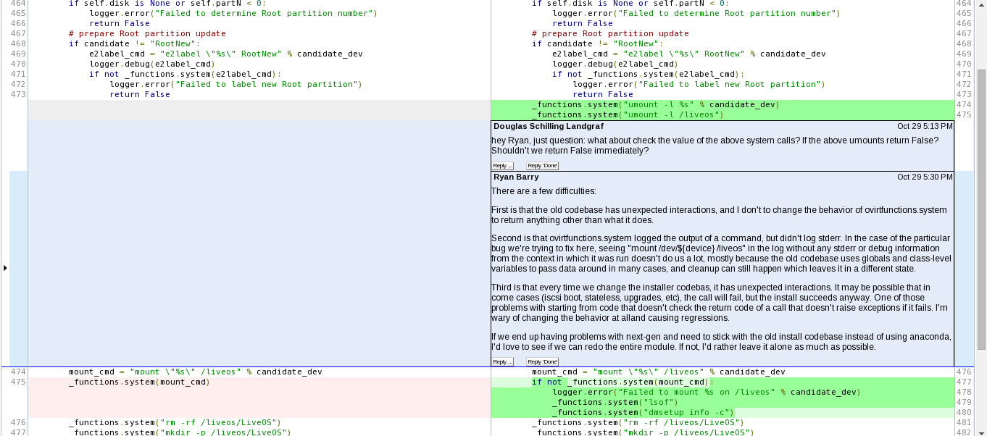
Reviewing
Notes:
What is Ovirt?
ROBUST PLATFORM
FEATURE REACH
SVI & VDI
MANAGING VIRTUALIZED DC – THOUSANDS OF VMS ?HYPERVISORS
KVM
A PARALLEL to VMWARE VSPHERE/ VCENTER
SINGLE POINT OF MANAGEMENT – NET STORAGE

Slide 28
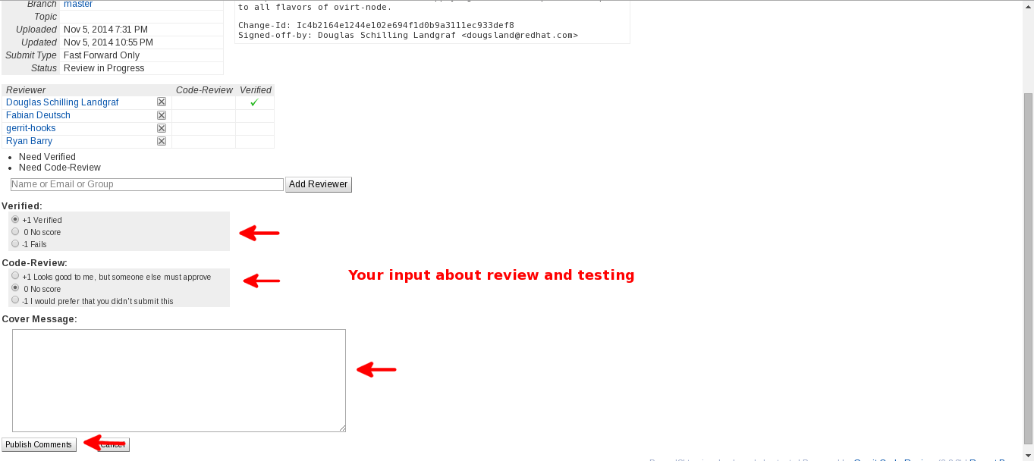
Reviewing
Notes:
What is Ovirt?
ROBUST PLATFORM
FEATURE REACH
SVI & VDI
MANAGING VIRTUALIZED DC – THOUSANDS OF VMS ?HYPERVISORS
KVM
A PARALLEL to VMWARE VSPHERE/ VCENTER
SINGLE POINT OF MANAGEMENT – NET STORAGE

Slide 29
Tips
Do not abuse the review flags
If you disagree, dislike, have a suggestion/question, write it.
Don't take the suggestion/question/-1 as personal
Use it as a tool of “skill enhancer”
+1 verified = The change is tested
-1 would prefer that you didn't submit this = Not ready yet
-2 Do not submit = It will break something or not compatible
Notes:
What is Ovirt?
ROBUST PLATFORM
FEATURE REACH
SVI & VDI
MANAGING VIRTUALIZED DC – THOUSANDS OF VMS ?HYPERVISORS
KVM
A PARALLEL to VMWARE VSPHERE/ VCENTER
SINGLE POINT OF MANAGEMENT – NET STORAGE

Slide 30
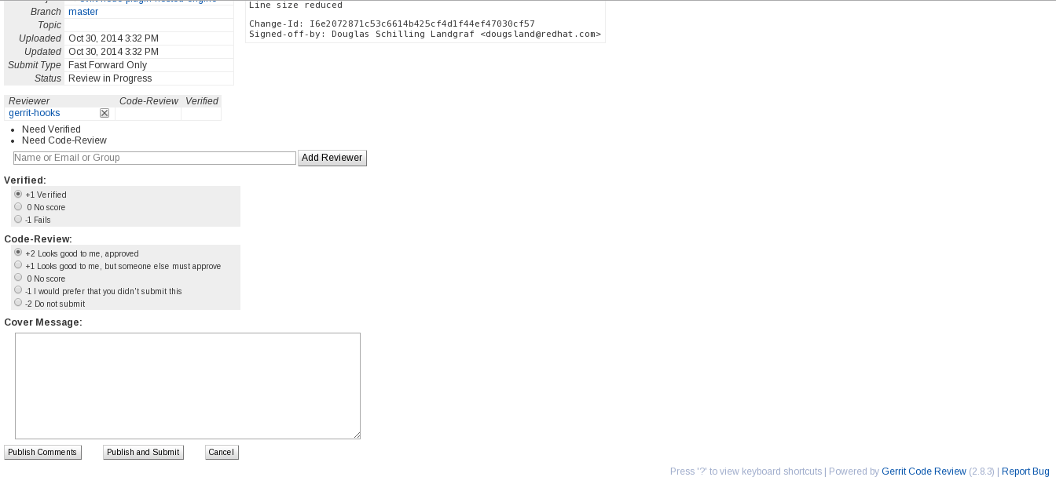
Review: The maint(s) view
Notes:
What is Ovirt?
ROBUST PLATFORM
FEATURE REACH
SVI & VDI
MANAGING VIRTUALIZED DC – THOUSANDS OF VMS ?HYPERVISORS
KVM
A PARALLEL to VMWARE VSPHERE/ VCENTER
SINGLE POINT OF MANAGEMENT – NET STORAGE

Slide 31
How to became a maint?
Commitment to the project
Quality contributions to the project in the areas:
Community
    One must interact with others, and share vision and knowledge
Documentation
    Without it, the stuff remains only in the minds of the authors
Vision
    A clear vision and consensus is needed
Code
    Discussion goes nowhere without code
http://www.ovirt.org/Becoming_a_maintainer
Notes:
What is Ovirt?
ROBUST PLATFORM
FEATURE REACH
SVI & VDI
MANAGING VIRTUALIZED DC – THOUSANDS OF VMS ?HYPERVISORS
KVM
A PARALLEL to VMWARE VSPHERE/ VCENTER
SINGLE POINT OF MANAGEMENT – NET STORAGE

Slide 32
Jenkins on the reviews
  An extendable open source continuous integration server
  The below tools can be triggered in every patch sent to oVirt
  projects depending of type of programming language
    PEP8
    Pylint
    Pyflakes
    Checkstyle
    findbugs
    ...
  Maintainers don't merge patches with a valid -1 from jenkins
Notes:
What is Ovirt?
ROBUST PLATFORM
FEATURE REACH
SVI & VDI
MANAGING VIRTUALIZED DC – THOUSANDS OF VMS ?HYPERVISORS
KVM
A PARALLEL to VMWARE VSPHERE/ VCENTER
SINGLE POINT OF MANAGEMENT – NET STORAGE

Slide 33
Jenkins on release
  All projects are build often
  Artifacts will be used when the project is ready for release
  Want to contribute or learn more about jenkins?
    Contact infra@ovirt
Notes:
What is Ovirt?
ROBUST PLATFORM
FEATURE REACH
SVI & VDI
MANAGING VIRTUALIZED DC – THOUSANDS OF VMS ?HYPERVISORS
KVM
A PARALLEL to VMWARE VSPHERE/ VCENTER
SINGLE POINT OF MANAGEMENT – NET STORAGE

Slide 34
Some numbers
  Contributors
  ovirt-engine: 145
  vdsm: 146
  ovirt-node: 50 and increasing!! ;-)
  List members:
  - users@ovirt.org: 764
  - users-pt@ovirt.org: 46
  - devel@ovirt.org: 386
Notes:
What is Ovirt?
ROBUST PLATFORM
FEATURE REACH
SVI & VDI
MANAGING VIRTUALIZED DC – THOUSANDS OF VMS ?HYPERVISORS
KVM
A PARALLEL to VMWARE VSPHERE/ VCENTER
SINGLE POINT OF MANAGEMENT – NET STORAGE

Slide 35
Questions?
Ready to contribute?
Notes:
What is Ovirt?
ROBUST PLATFORM
FEATURE REACH
SVI & VDI
MANAGING VIRTUALIZED DC – THOUSANDS OF VMS ?HYPERVISORS
KVM
A PARALLEL to VMWARE VSPHERE/ VCENTER
SINGLE POINT OF MANAGEMENT – NET STORAGE

Slide 36
Get Involved!
http://www.ovirt.org
http://lists.ovirt.org/mailman/listinfo/users
http://lists.ovirt.org/mailman/listinfo/users-pt
http://lists.ovirt.org/mailman/listinfo/devel
dougsland AT redhat DOT com
dougsland AT #ovirt (irc.oftc.net)

