Slide 1
Elastic Overkill: Is Cloud Really The Be-All End-All for Everyone?
FISL 15
Brian Proffitt
oVirt Community Manager
bkp@redhat.com
@TheTechScribe

Slide 2
Cloud, cloud, cloud.

Slide 3
I Blame Amazon.com.

Slide 4
I Blame Amazon.com. Really.

Slide 5
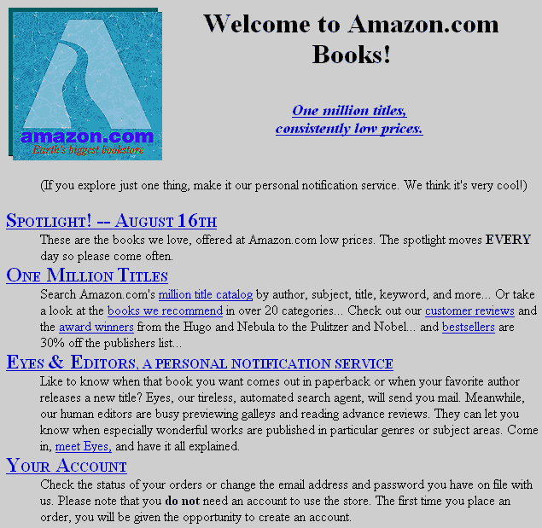
Notes:
Founded in 1995, Amazon soon became one of the flagship user of cloud technologies, thanks to Christmas and holiday buying patterns that placed massive seasonal loads on their servers.
Which they then decided to rent out.

Slide 6
Elasticity Is The Secret Sauce.
Notes:
Elasticity and automation of resources is the key to cloud computing.

Slide 7
But What About Everyone Else?

Slide 8
Size Doesn't Matter.

Slide 9
Enterprise, Start-up, Consumer...
Notes:
In The Cloud, No One Cares If You're A Suit

Slide 10
...It's All The Same.
Notes:
From an IT perspective, work is about delivering services to the end user. At a fundamental level, it does not matter if you are providing services to 10 users or 1000.

Slide 11
You = Provider
Notes:
It's all about one provider...

Slide 12
Them = Customer
Notes:
...and one user.

Slide 13
One Of You. Many Of Them.
Notes:
But the world is not virtual. It's still a one-to-many relationship.

Slide 14
How Do You Scale?

Slide 15
Welcome to Virtualization Land

Slide 16
What Virtualization Delivers

Slide 17
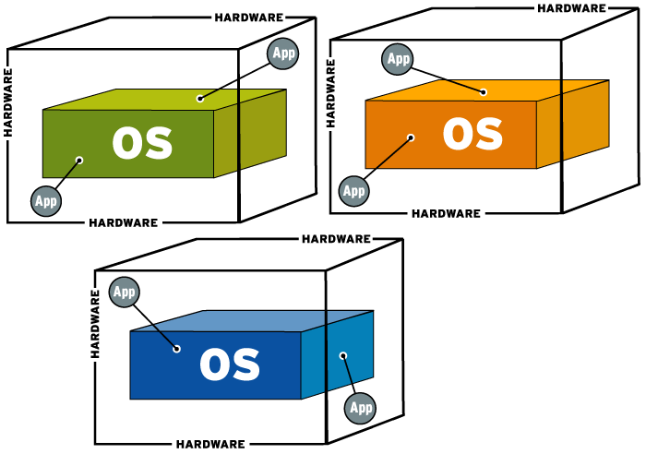
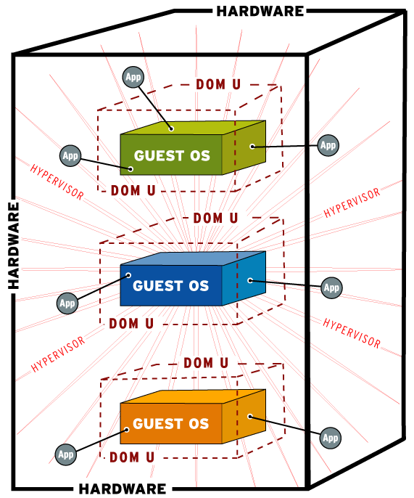
After
Before
Notes:
Coding for cloud (automation, scalability) is not necessary.
Easier migration
Faster return on investment

Slide 18
Hardware Consolidation
Notes:
Fewer, bigger servers

Slide 19
Workload Management
Notes:
Oversubscribed services get more hardware

Slide 20
Application Protection
Notes:
Fault tolerance
High availability
Live migration
Quality of Service
Network
Disk
Compute
Memory

Slide 21
Resource Scalability
Notes:
Add more hardware and modify resources allocated to VM on the fly

Slide 22
Legacy Applications
Notes:
Coding for cloud (automation, scalability) is not necessary.

Slide 23



KVM management application
Open Source alternative to vSphere
Widely deployed hypervisor
Hosted by Linux Foundation since April 2013
Ganeti
Developed by Google to manage clusters
Manages KVM and Xen nodes

Slide 24
oVirt

Slide 25
oVirt: Large-Scale, Centralized
Notes:
Large-scale centralized management for server and desktop virtualization.

Slide 26
oVirt: Scalable
Notes:
Based on leading performance, scalability and security infrastructures.

Slide 27
oVirt: vSphere Alternative
Notes:
Open source vCenter/vSphere alternative

Slide 28
oVirt: Community
Notes:
Merit-based open governance model
Built using the best concepts from the Apache and Eclipse foundations.
Governance split between board and projects
oVirt Projects
Multiple Projects under the oVirt brand

Slide 29
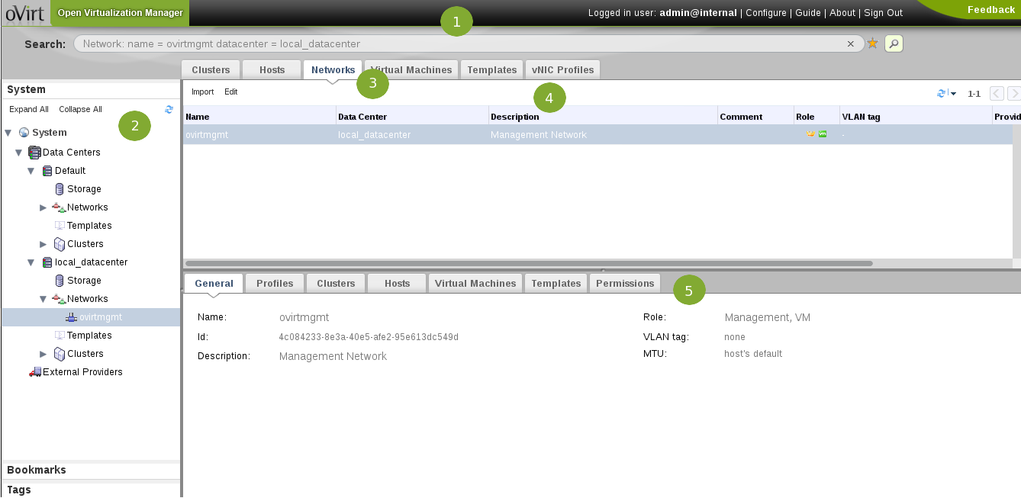
Notes:
Header: This bar contains the name of the logged in user, the sign out button, the option to configure user roles.
Navigation Pane: This pane allows you to navigate between the Tree, Bookmarks and Tags tabs. In the Tree tab, tree mode allows you to see the entire system tree and provides a visual representation your virtualization environment's architecture.
Resources Tabs: These tabs allow you to access the resources of oVirt. You should already have a Default Data Center, a Default Cluster, a Host waiting to be approved, and available Storage waiting to be attached to the data center.
Results List: When you select a tab, this list displays the available resources. You can perform a task on an individual item or multiple items by selecting the item(s) and then clicking the relevant action button. If an action is not possible, the button is disabled.
Details Pane: When you select a resource, this pane displays its details in several subtabs. These subtabs also contain action buttons which you can use to make changes to the selected resource.

Slide 30
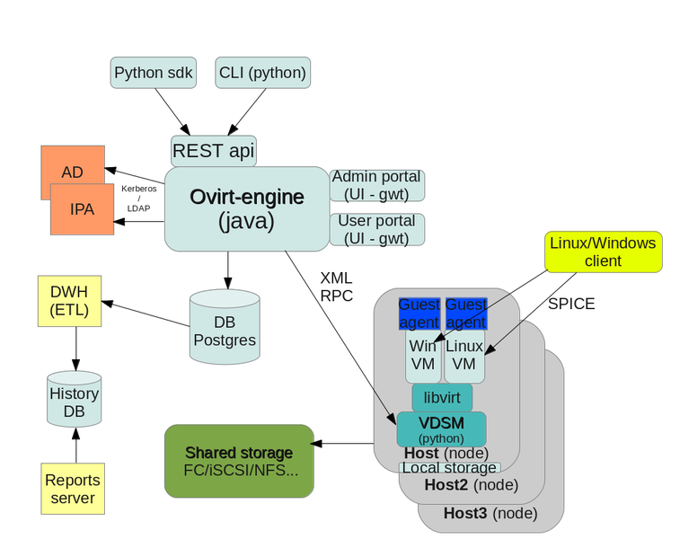
Notes:
Merit-based open governance model
Built using the best concepts from the Apache and Eclipse foundations.
Governance split between board and projects
oVirt Projects
Multiple Projects under the oVirt brand

Slide 31
Engine
Notes:
JBoss-based Java application
Communicates with hypervisor nodes
Manages VM lifecycle
Controlled with
Admin Portal
User Portal
REST API
Python SDK
CLI

Slide 32
Engine
Node
Notes:
Stand-alone hypervisor
Small footprint ~170 MB
Customized “spin” of Fedora and CentOS with KVM
“Just enough” Fedora to run virtual machines
Runs on all RHEL/CentOS hardware with Intel VT/AMD-V CPUs
Easy to install, configure, and upgrade
PXE boot, USB boot, CD, or hard drive
Full Host
Fedora, RHEL or CentOS host, with an installed VDSM and libvirt to act as a hypervisor
Flexible
Add monitoring agents, scripts, etc.
Leverage existing OS infrastructure
Hybrid mode capable

Slide 33
Engine
Node
Storage
Notes:
Local storage on the VMs
Storage domains such as
NFS
iSCSI
Fibre Channel
POSIX storage (Gluster)
Storage domains
Disk images for Vms
Exported Vms
.ISO images for installation media

Slide 34
Have We Met?

Slide 35







DASHBOARD
(Horizon)
IDENTITY SERVICE
(Keystone)
COMPUTE
(Nova)
BLOCK STORAGE
(Cinder)
NETWORKING
(Quantum)
IMAGE SERVICE
(Glance)
OBJECT STORE
(Swift)
Notes:
A subset of the OpenStack Basic Tenants
Scalability and elasticity are the main goals
Any feature that limits our main goals must be optional
All required components must be horizontally scalable
Always use shared-nothing architecture

Slide 36
Engine/Dashboard
Identity
Reporting
Node/Compute
Storage

Slide 37
oVirt | OpenStack
Scale up | Scale out
HA VMs – expect to stay up | Stateless VMs – expect to be redundant
Resiliency in platform | Resiliency in application
VMs need shared storage | VMs need shared storage
Need to define VLANs | Need to define VLANs
Needs dashboard | Needs dashboard
Notes:
Scale Up
Servers are like pets.
Pets are given names, are unique, lovingly hand raised and cared for. When they get ill, you nurse them back to health
Scale Out
Servers are like cattle.
Cattle are given numbers and are almost identical to each other. When they get ill, you get another one.

Slide 38
oVirt: Virtualization Now...

Slide 39
... With Cloud Later

Slide 40
Horizon
FreeIPA for
Identity, shared
with Keystone
Neutron for SDN
Nova Driver for oVirt
Glance, Cinder
Notes:
Shared image storage with Glance
Shared block storage (Gluster, NFS, iSCSI, FCoE for oVirt, Cinder for OpenStack, consuming same storage)
Shared SDN framework (define oVirt VLANS with Neutron)
Ability to monitor and control oVirt VMs in Horizon
Freedom to gradually migrate “old” to “new”

Slide 41
One Path To Performance
Notes:
Get virtualization savings now, with cloud complexity
“Single pane of glass” to allow management of traditional virtualization and private and public IaaS
Enables policy enforcement
Facilitates service migration
Frees you from vendor lock-in
CloudForms Management Engine – Open Sourcing soon.

Slide 42
THANK YOU !
http://ovirt.org/
#ovirt irc.oftc.net
users@ovirt.org
@ovirt

