Slide 1
oVirt: How to Connect with a Mature Open Source Project
FISL 15
Brian Proffitt
oVirt Community Manager
bkp@redhat.com
@TheTechScribe

Slide 2
First, a Stipulation.

Slide 3
Free software is awesome.

Slide 4
But getting it right can be hard.

Slide 5
Sometimes more than others.

Slide 6
Beginnings matter.

Slide 7
Linux.

Slide 8
Linux the kernel.

Slide 9
Started small. Started free.

Slide 10
Built from the ground up.

Slide 11
Less features -> More features

Slide 12
Organic, free growth. Led by a nurturing gardener.

Slide 13
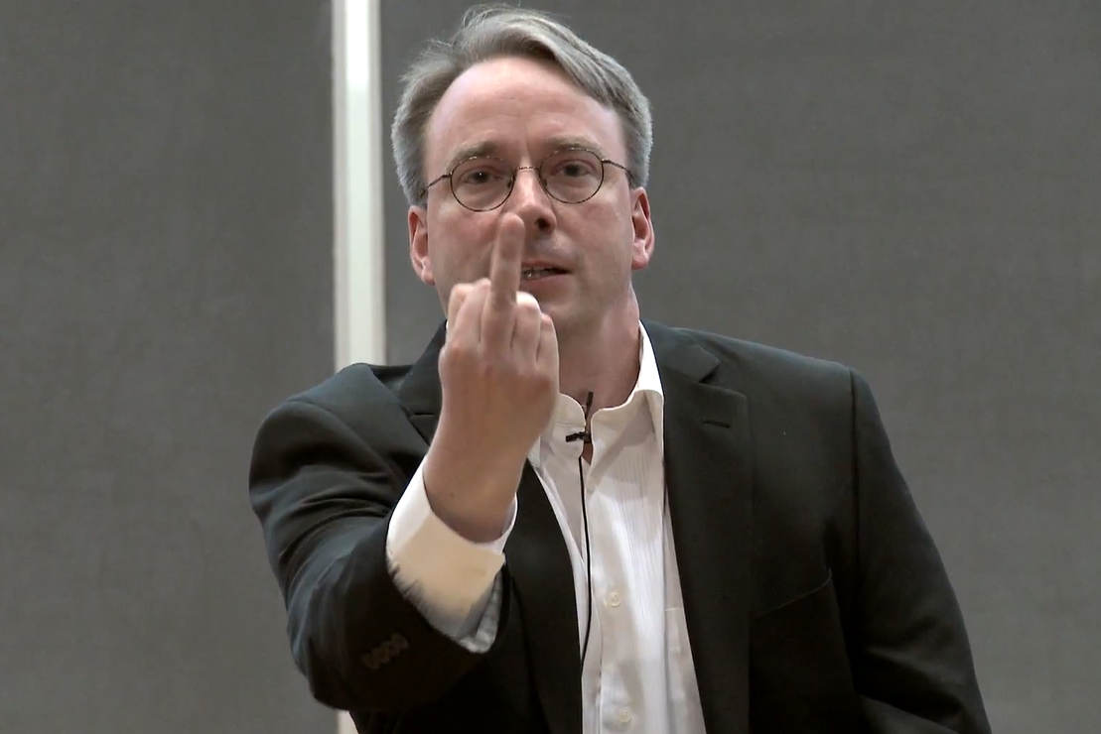

Slide 14
(Well, a gardener.)

Slide 15
oVirt.
Notes:
You knew what Linux the kernel was, but let's talk quickly about what oVirt is.

Slide 16
oVirt: Large-Scale, Centralized
Notes:
Large-scale centralized management for server and desktop virtualization.

Slide 17
oVirt: Scalable
Notes:
Based on leading performance, scalability and security infrastructures.

Slide 18
oVirt: vSphere Alternative
Notes:
Open source vCenter/vSphere alternative

Slide 19
oVirt: Community
Notes:
Merit-based open governance model
Built using the best concepts from the Apache and Eclipse foundations.
Governance split between board and projects
oVirt Projects
Multiple Projects under the oVirt brand

Slide 20
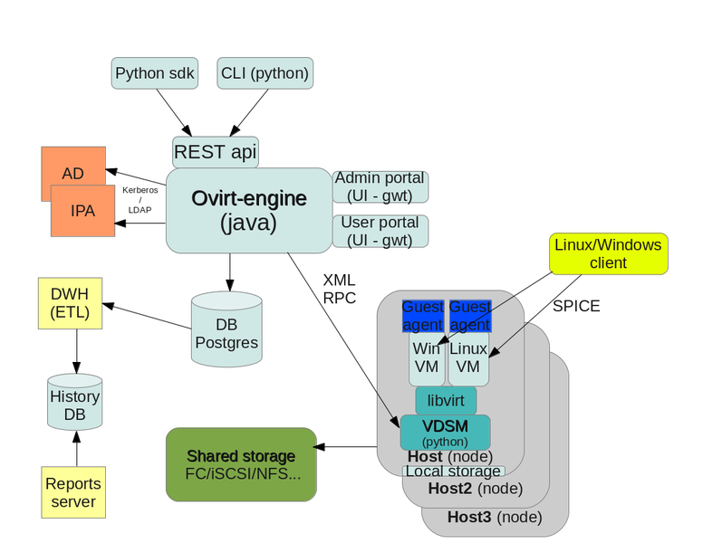

Slide 21
Engine
Notes:
JBoss-based Java application
Communicates with hypervisor nodes
Manages VM lifecycle
Controlled with
Admin Portal
User Portal
REST API
Python SDK
CLI

Slide 22
Engine
Node
Notes:
Stand-alone hypervisor
Small footprint ~170 MB
Customized “spin” of Fedora and CentOS with KVM
“Just enough” Fedora to run virtual machines
Runs on all RHEL/CentOS hardware with Intel VT/AMD-V CPUs
Easy to install, configure, and upgrade
PXE boot, USB boot, CD, or hard drive
Full Host
Fedora, RHEL or CentOS host, with an installed VDSM and libvirt to act as a hypervisor
Flexible
Add monitoring agents, scripts, etc.
Leverage existing OS infrastructure
Hybrid mode capable

Slide 23
Engine
Node
Storage
Notes:
Local storage on the VMs
Storage domains such as
NFS
iSCSI
Fibre Channel
POSIX storage (Gluster)
Storage domains
Disk images for Vms
Exported Vms
.ISO images for installation media

Slide 24
oVirt the virtual datacenter management platform.

Slide 25
Started small. Started closed.

Slide 26
Built from the ground up.
In Python, then C#.

Slide 27
Less features -> More features

Slide 28
Organic, closed growth. Led by a commercial entity.

Slide 29
Then freed.

Slide 30
The secret origin of oVirt.

Slide 31
2007.
Notes:
oVirt started life in late 2007 as a Python application to manage KVM.

Slide 32
2009.
Notes:
In 2009, we moved to oVirt to a Qumranet management application which would have become oVirt 2.

Slide 33
2009.
Notes:
Except they didn't tell anyone.

Slide 34
Enter RHEV.
Notes:
oVirt at this point (on which the first version of RHEV was based) was a C# application which worked on Windows, and the console was an ActiveX browser extension - so from 2009 to the end of 2011, oVirt did not see a lot of traction, either developer or user.
But this was not “oVirt 2,” there was only RHEV 2.0 which was proprietary, closed source.

Slide 35
oVirt was in chrysalis.
Notes:
From 2009-2011, there was no public release of oVirt. Just a commercial release of RHEV 2.0.

Slide 36
2011.
Notes:
From 2009-2011, there was no public release of oVirt. Just a commercial release of RHEV 2.0.

Slide 37
oVirt 3.0.
Notes:
oVirt 3.0 was launched in November 2011, and instantly got a lot of traction. The major change was the move to Java for the engine, and the creation of a Spice console for Firefox, making it 100% free software, running on Linux top to bottom.

Slide 38
It was a beautiful butterfly.
Notes:
But now there was a problem. oVirt had undergone a massive transition from closed to open.

Slide 39
What had to change?

Slide 40
Build environment/tools.
Notes:
Highly customized build environment and tools. This is the #1 reason why the majority of proprietary software cannot simply be set loose as open source - its completely unusable to all except the developer team that built it.
When developing open source software, there are a few standard ways to build software. All of them are terrible at producing highly optimized executable programs for running at the highest level of efficiency, but they're great for giving developers a simple, standardized way to build and distribute software. The process of making proprietary software build with standardized open source build tools is non-trivial.
Most open source projects, by contrast, came out of the crib compiling with GCC.

Slide 41
Proprietary third-party libraries.
Notes:
3rd party libraries, also proprietary, that you do not have permission to include in your open source code. Even if your code can build with GNU autotools and GCC, to use one example, you probably have to rewrite some not-insignificant portion of the code.
This takes time and effort away from developers who will be spending time ripping and replacing many pieces of code and not implementing new features.
This varies from project to project, but it afflicts the vast majority of projects like oVirt going from closed to open.

Slide 42
Bad security practices.
Notes:
Bad security practices. When developers think nobody else is looking, they do all sorts of crazy things. And as long as features are developed on schedule, nobody bats a eye. It is this primacy of feature development over code quality that can result in some horrendous security holes.
Obvious exceptions aside, there is lots of evidence that open source software is more secure than its proprietary counterparts.

Slide 43
Bad coding practices.
Notes:
Bad coding practices. For the same reasons as before, i.e., feature primacy and nobody's looking, developers tend to work with the latest and greatest from other software packages, especially when it comes to runtime scripting engines, libraries and tools.
This is great if you're a developer and you want to more easily add the latest and greatest features to your code. This is terrible if you're the poor sod in operations assigned to installing this pile of goop. Add to this the usual disdain developers have for ops, and developers don't actually care that they've made life harder for operations folks.

Slide 44
The team itself.
Notes:
The team itself would change. Two years of hard work on opening the code would effectively change their attitudes about open source, and make it far easier for them to accept work in an open source community.

Slide 45
oVirt did it. But what remained?
Notes:
oVirt accomplished these tasks, but it was still left with a problem: as an open source project, it was very feature-rich with a full roadmap.
This meant that code contributions to oVirt had to fit within a very mature roadmap and new coders have a very steep learning curve.

Slide 46
How to connect?

Slide 47
Part 1: Spread the Word.
Notes:
By expanding the user base for oVirt, we raise awareness of the platform and get people thinking about ways they can improve upon the software.
We don't ignore developers, but we are consistently trying to make it easier for users to join the community, which should ultimately lead to more developers by attrition.

Slide 48
Part 2: Build New Doors.
Notes:
We are in the process of building a new API showcase that will highlight existing APIs and plug-ins into oVirt.
This will not only add new functionality to oVirt, it also lowers the barrier for entry for developers. By building these new doors, we expand the ways developers can touch oVirt.

Slide 49
How's it been going?
Notes:
- Email list activity is +46% year on year - we're getting an average of between 2000 and 3000 emails from an average of 160 to 200 people per
month at the moment - most of those are on our Users mailing list
- We're seeing huge traction in small business, educational institutions, and smaller hosting services companies.
Some references we have in the pipeline:
- Productization: Red Hat Enterprise Virtualization, WindRiver Open Virtualization
- Hosting/services companies: Alter Way, IT Novum, LinuxLand GmbH
- Educational institutions: Université Paris Dauphiné, Keele University, ARNES (research lab in Slovenia), University of Seville
(ETSII)
- Small business: Nieuwland, Oxilion, ..
- Enterprise: HP, Brussels Airport Company.

Slide 50
Pretty good so far.
Notes:
Contributing companies instead:
* IBM: Kimchi, MOM, Debian support and more.
* NetApp: Integration with their storage technology
* HP: UI plug-ins, and working on Nova integration for oVirt Engine
* Symantec: Disaster Recovery as a service for oVirt
* Intel: Trusted computing support, Wind River productization of oVirt

Slide 51
Where do we go from here?
Notes:
The API showcase
Formalization of partnership program
More users! More!

Slide 52
THANK YOU !
http://ovirt.org/
#ovirt irc.oftc.net
users@ovirt.org
@ovirt

