Slide 1
CPU SLA em Virtualização
Amador Pahim
Senior Software Maintenance Engineer Red Hat

Slide 2
SLA
"A service-level agreement is a negotiated agreement between two or more parties, where one is the customer and the others are service providers."
http://en.wikipedia.org/wiki/Service-level_agreement

Slide 3
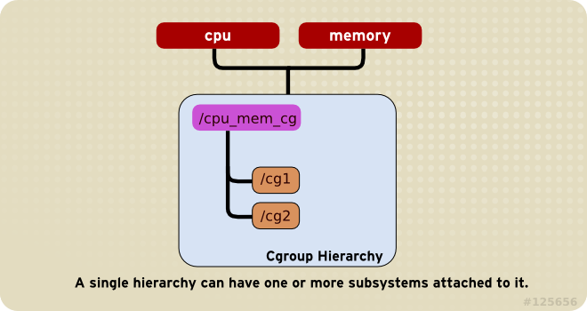
cgroups

Slide 4
CPU cgroup facilities
Share
  Proportional provisioning (weight)
  Minimum value for resource usage
Bandwidth control for Completely Fair Scheduler
  Maximum limit for resource usage

Slide 5
“share”
Configure a process “A” to use 2x the CPU time of a process “B”
  # echo 2048 > /sys/fs/cgroup/.../VMA/cpu.shares
  # echo 1024 > /sys/fs/cgroup/.../VMB/cpu.shares
1024
2048
1024
66,66%
33,33%

Slide 6
CPU shares - Virt
# cat /sys/fs/cgroup/cpu,cpuacct/machine.slice/ machine-qemu\\x2dvm01.scope/cpu.shares
1024
# cat /sys/fs/cgroup/cpu,cpuacct/machine.slice/ machine-qemu\\x2dvm02.scope/cpu.shares
1024

Slide 7
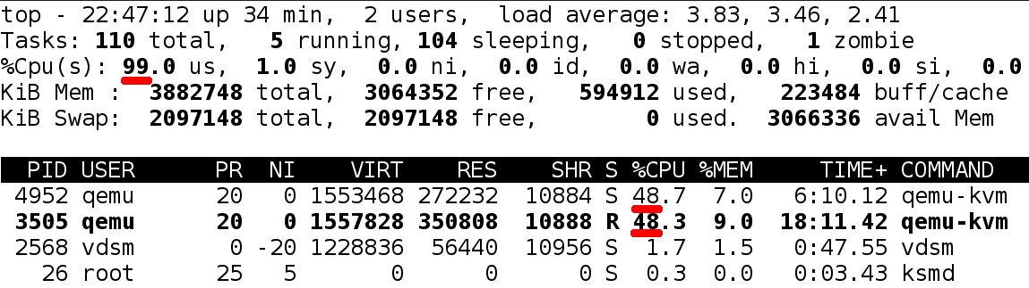
CPU shares - Virt

Slide 8
CPU shares - Virt
<domain>
...
<cputune>
...
<shares>2048</shares>
...
</cputune>
...
</domain>

Slide 9
CPU shares - Virt
virsh # schedinfo vm01
...
cpu_shares : 2048
...
virsh # schedinfo vm02
…
cpu_shares : 1024
...

Slide 10
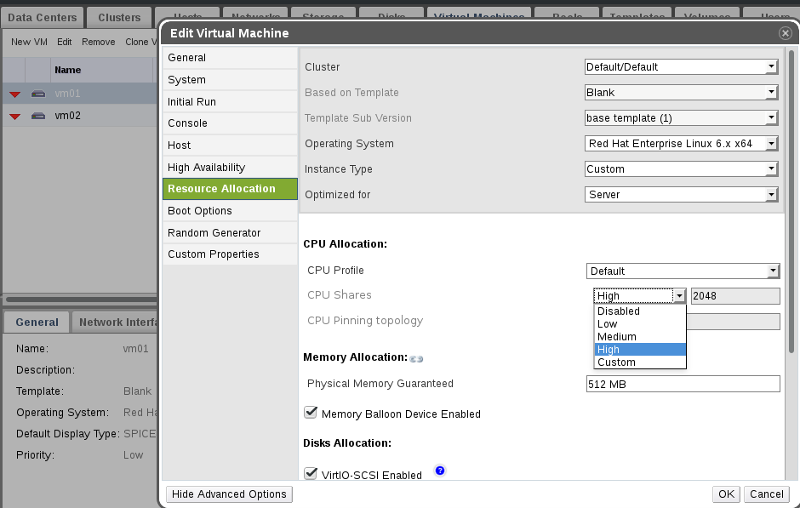
CPU shares - Virt

Slide 11
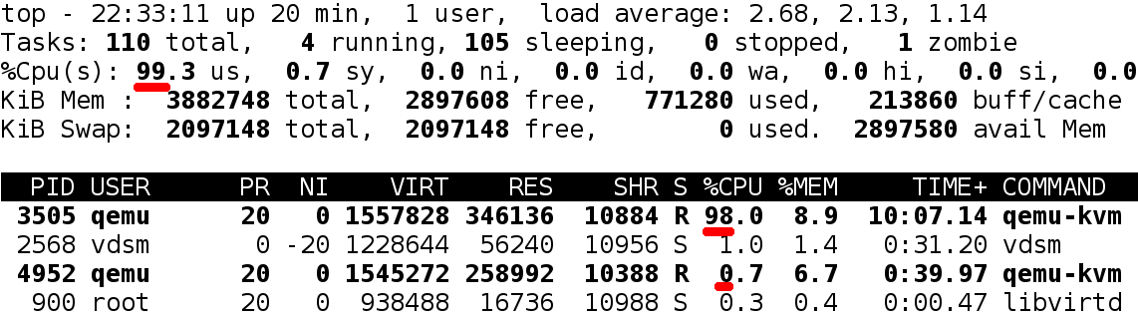
CPU shares - Virt

Slide 12
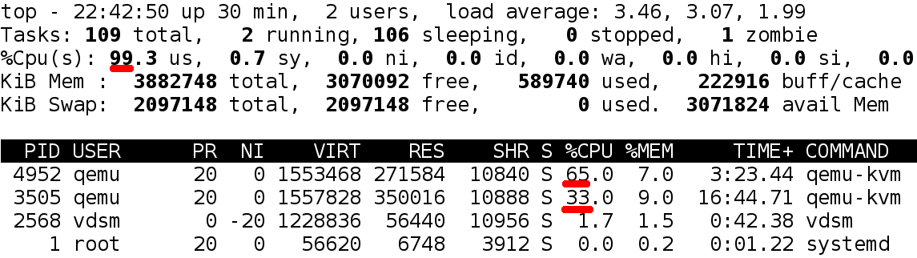
CPU shares - Virt

Slide 13
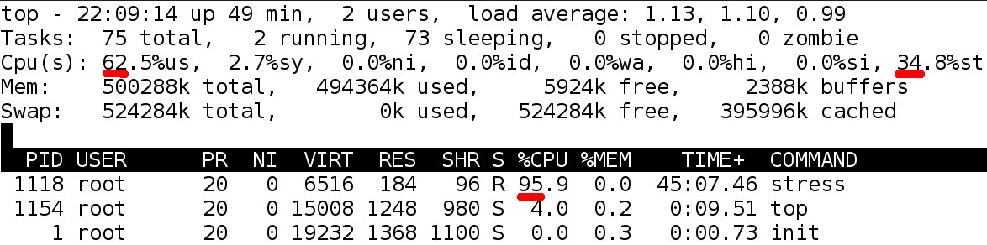
CPU shares - Virt

Slide 14
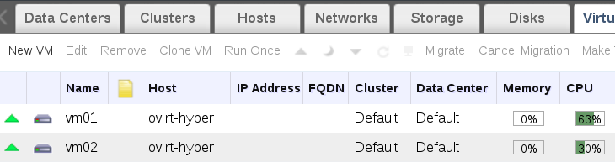
CPU shares - Virt

Slide 15
“CFS”
Within a period, a process (or group) can consume up to a given number (quota) of (CPU) time.
# echo 50000 > .../cpu.cfs_quota_us
# echo 100000 > .../cpu.cfs_period_us

Slide 16
CPU CFS - Virt
<domain>
...
<cputune>
...
<period>100000</period>
<quota>50000</quota>
</cputune>
...
</domain>

Slide 17
CPU CFS - Virt
virsh # schedinfo vm01
...
vcpu_period : 100000
vcpu_quota : 50000
...
virsh # schedinfo vm02
…
vcpu_period : 100000
vcpu_quota : 10000
...

Slide 18
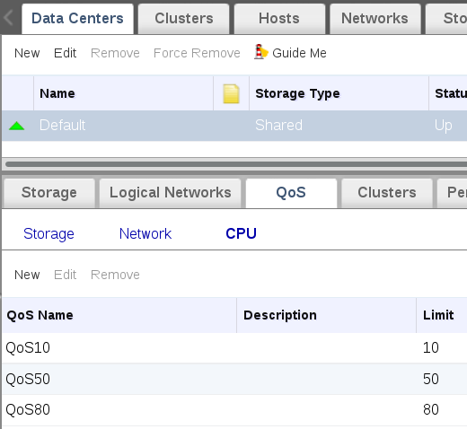
CPU CFS - Virt

Slide 19
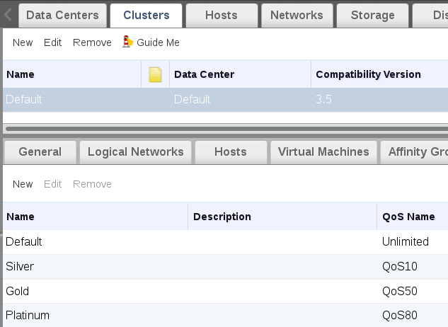
CPU CFS - Virt

Slide 20
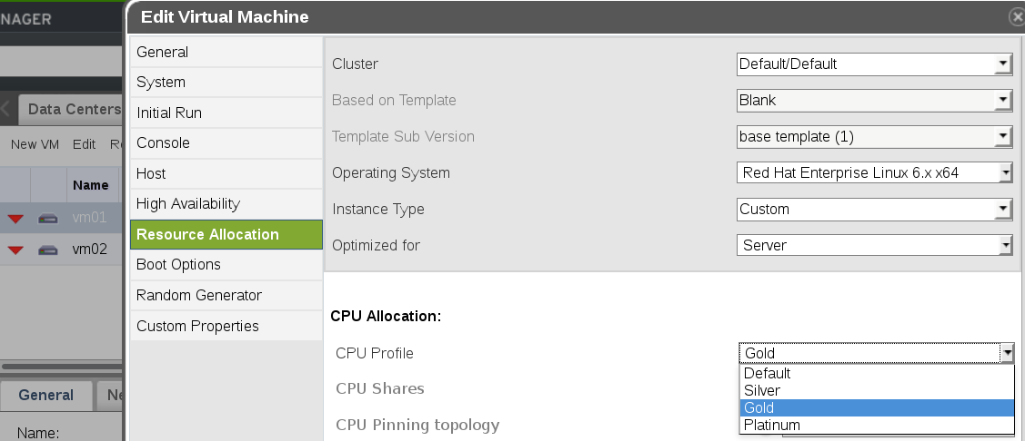
CPU CFS - Virt

Slide 21
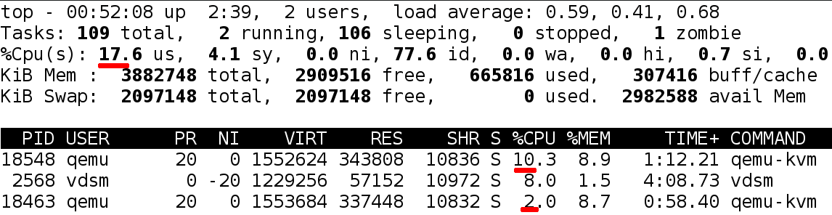
CPU CFS - Virt

Slide 22
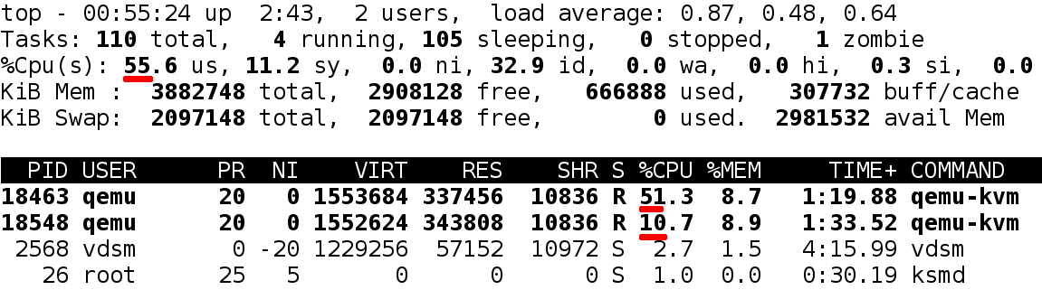
CPU CFS - Virt

Slide 23
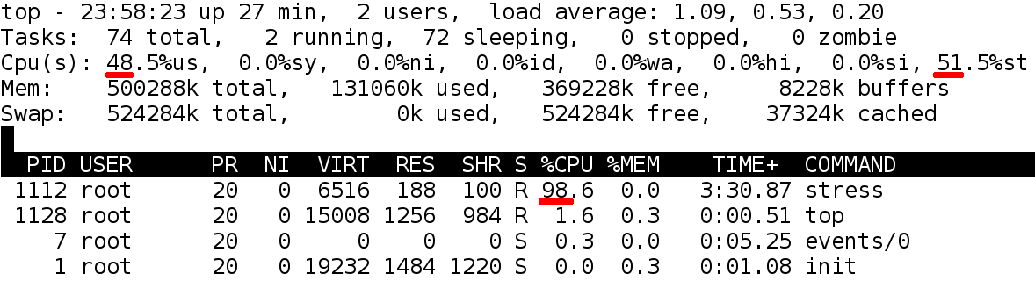
CPU CFS - Virt

Slide 24
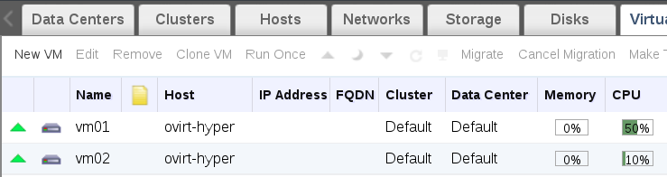
CPU CFS - Virt

Slide 25
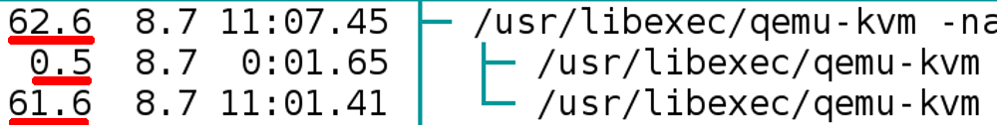
!!!

Slide 26

What is oVirt?
Large scale, centralized management for server and desktop virtualization
Based on leading performance, scalability and security infrastructure technologies
Provide an open source alternative to vCenter/vSphere
Focus on KVM for best integration/performance
Focus on ease of use/deployment
Notes:
What is Ovirt?
ROBUST PLATFORM
FEATURE REACH
SVI & VDI
MANAGING VIRTUALIZED DC – THOUSANDS OF VMS ?HYPERVISORS
KVM
A PARALLEL to VMWARE VSPHERE/ VCENTER
SINGLE POINT OF MANAGEMENT – NET STORAGE

Slide 27
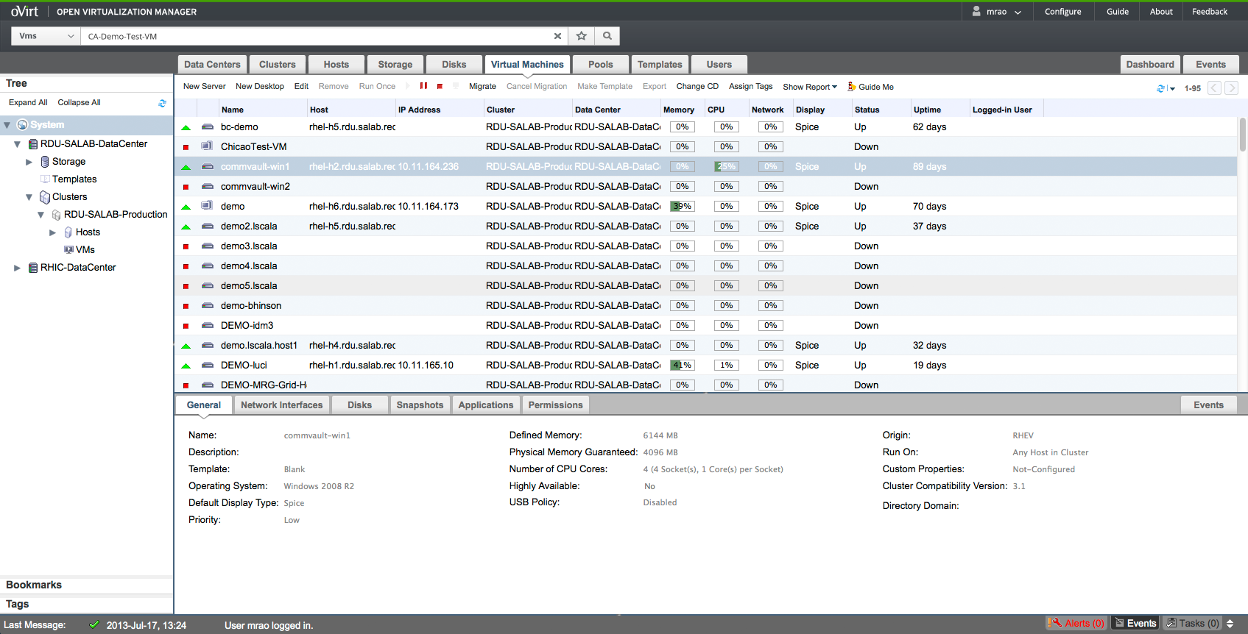
Administration Portal

Slide 28
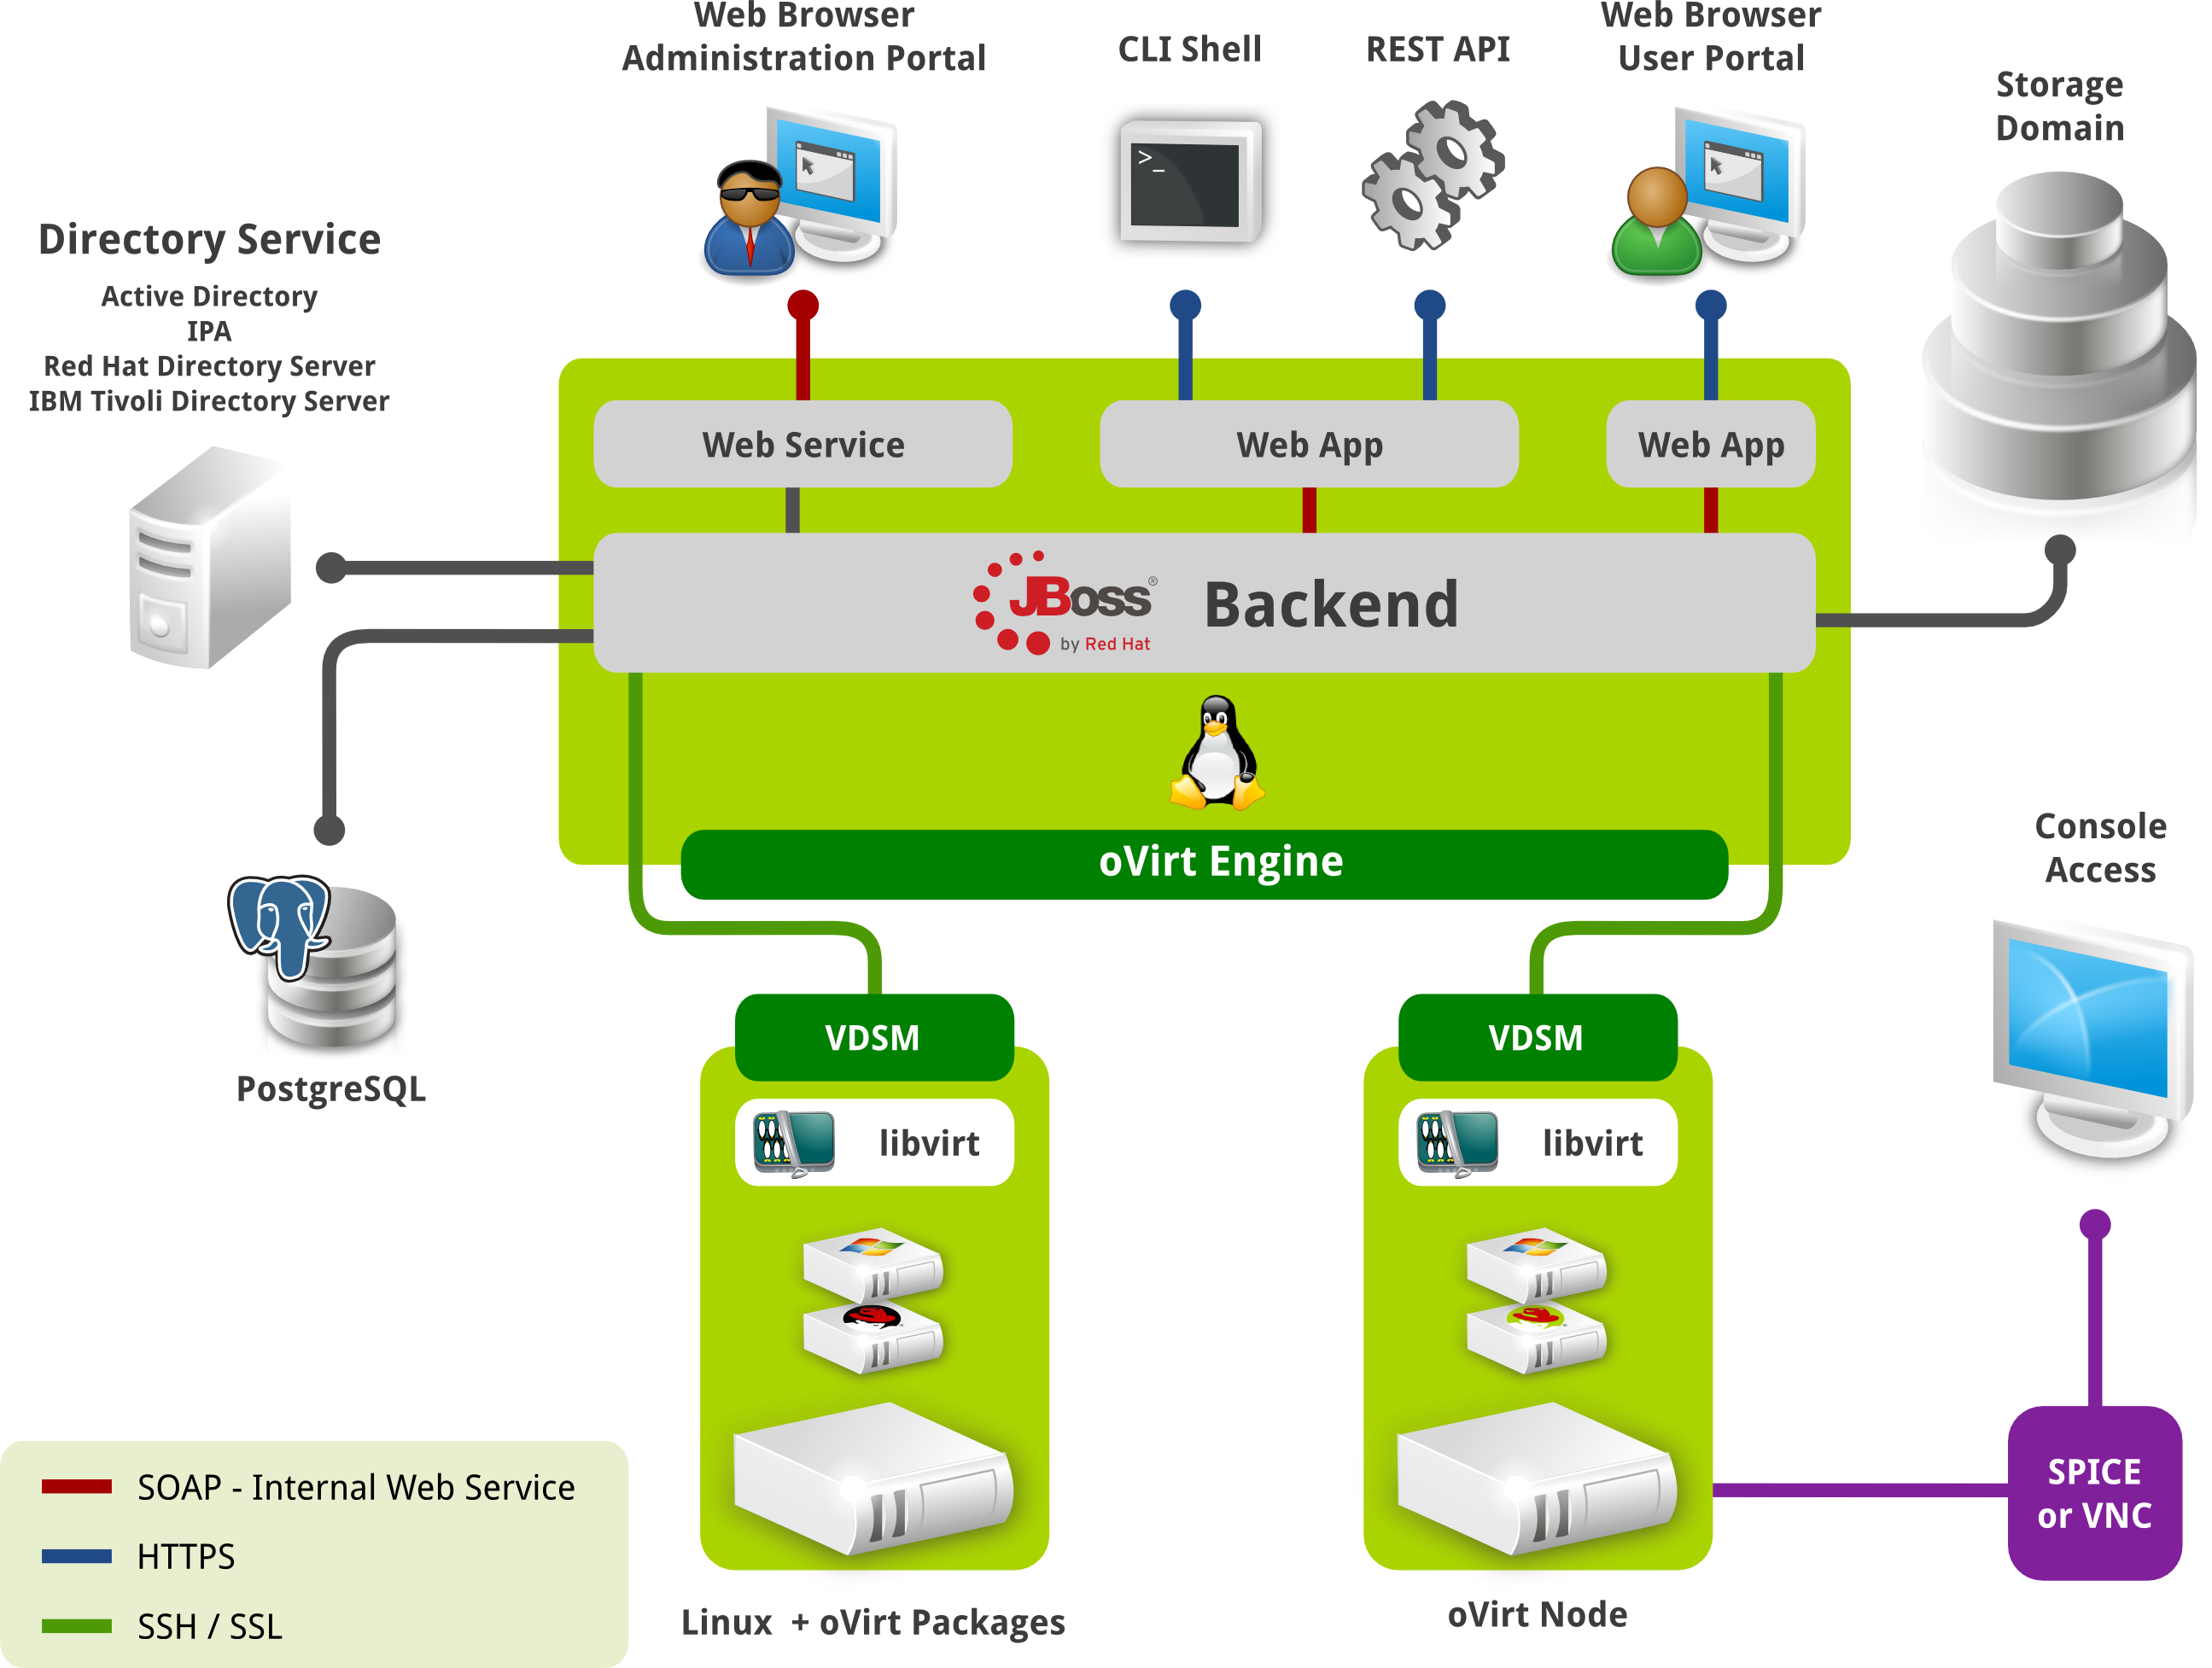

Slide 29
How does oVirt handle it?
Engine sends policy attributes
VDSM converts them to MoM policy (constants only)
MoM merges constants with the actual policy logic files
Policy is enforced, results are collected and sent back to engine

Slide 30
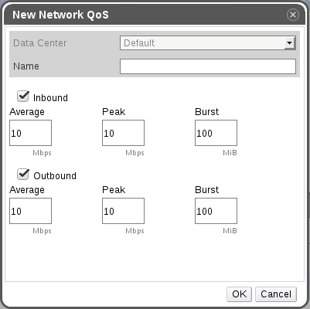
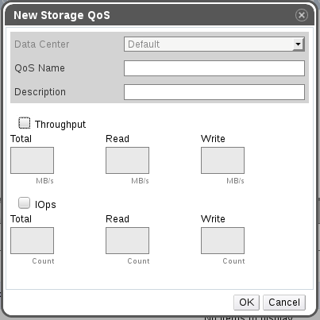

Slide 31
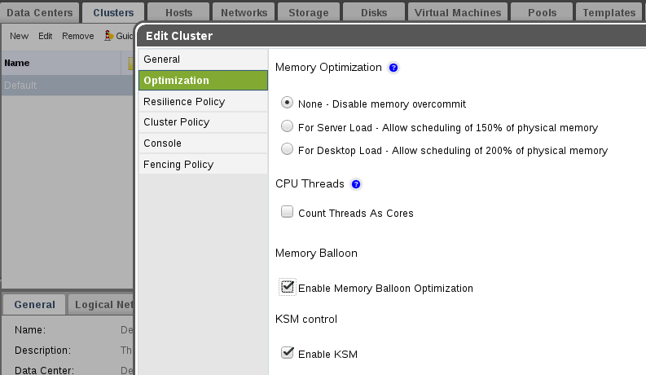

Slide 32
Thank you!
apahim @ #ovirt (OFTC)

