Slide 1
Integrando o Docker em seu ambiente de Virtualização
Amador Pahim
Senior Software Maintenance Engineer Red Hat

Slide 2
Virtualization: The New Default
“80% of all new logical server shipments virtualized in 2014 and forecasted to increase to 88% by 2017” (IDC, Oct 2014)

Slide 3

What is oVirt?
Large scale, centralized management for server and desktop virtualization
Based on leading performance, scalability and security infrastructure technologies
Provide an open source alternative to vCenter/vSphere
Focus on KVM for best integration/performance
Focus on ease of use/deployment
Notes:
What is Ovirt?
ROBUST PLATFORM
FEATURE REACH
SVI & VDI
MANAGING VIRTUALIZED DC – THOUSANDS OF VMS ?HYPERVISORS
KVM
A PARALLEL to VMWARE VSPHERE/ VCENTER
SINGLE POINT OF MANAGEMENT – NET STORAGE

Slide 4
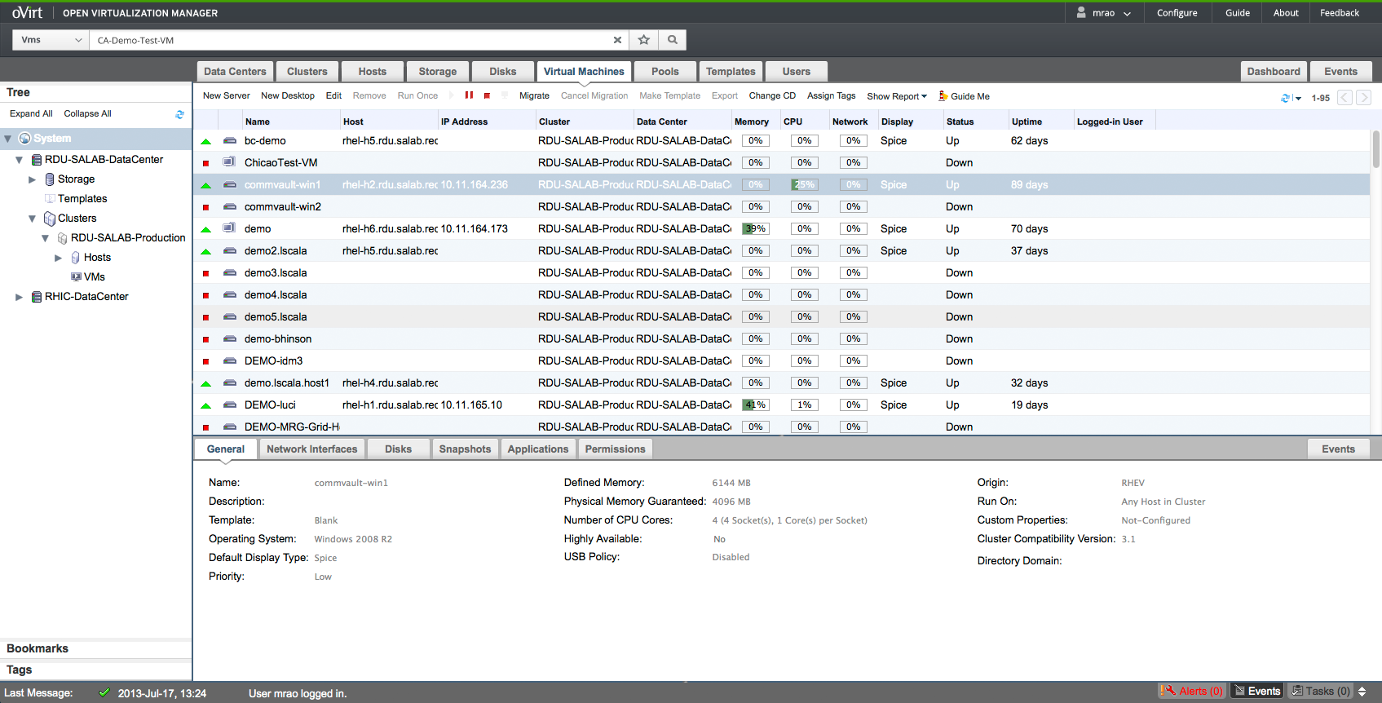
Administration Portal

Slide 5
Docker
Open platform to build, ship, and run distributed applications
Applications quickly assembled from components
The same application can run unchanged on laptops, data center VMs, and any cloud

Slide 6

Ecosystem
Lightweight operating system
Designed to run applications in Docker containers
Hosts based on Red Hat Enterprise Linux (RHEL), Fedora, and CentOS

Slide 7
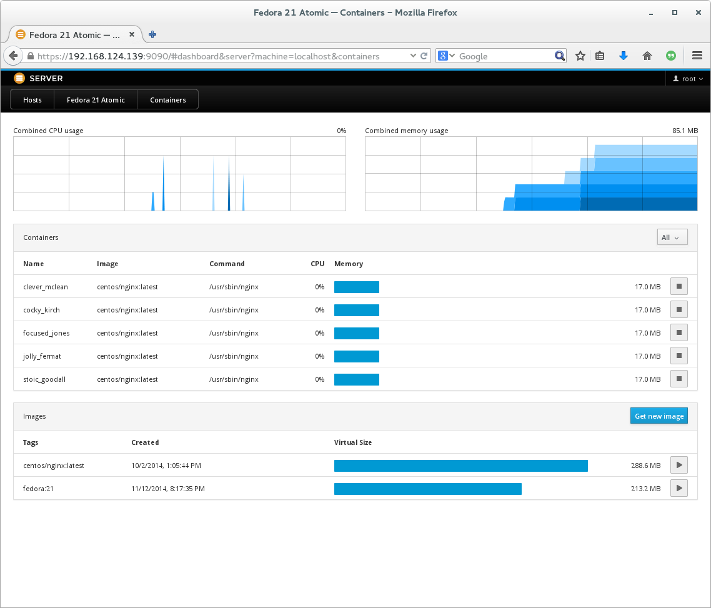
Ecosystem

Slide 8

Ecosystem
Open Source orchestration system for Docker containers
Scheduling
Actively manages workloads

Slide 9
How can we (oVirt) benefit?

Slide 10
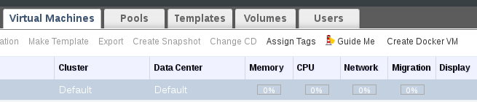
Run Containers in VMs

Slide 11
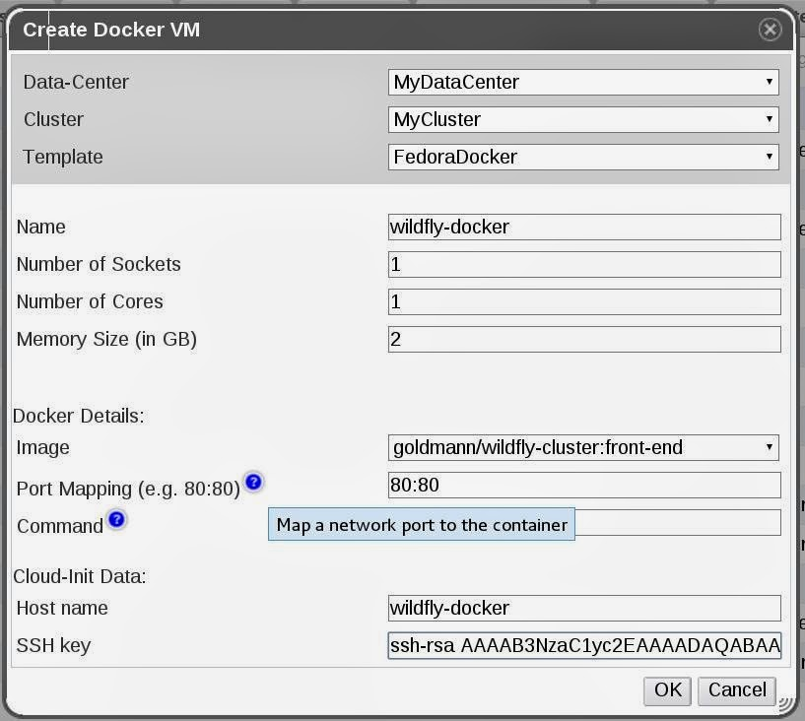
Run Containers in VMs

Slide 12
Kubernetes Cloud Provider
Discover Docker VMs in oVirt
Simple configuration
[connection]
uri = https://ovirt-engine:443/ovirt-engine/api
username = admin@internal
password = admin
[filters]
vms = tags=kubernetes

Slide 13

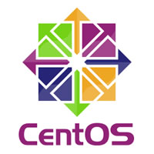

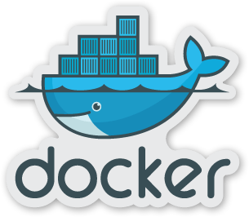
oVirt + Docker + Kubernetes
oVirt Cloud Provider
oVirt Hypervisor
oVirt Hypervisor

Slide 14
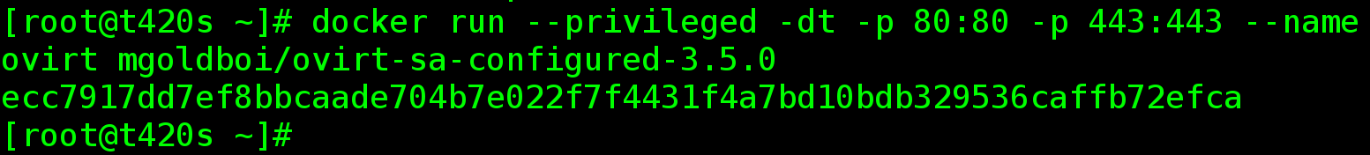
“Dockerized” oVirt

Slide 15
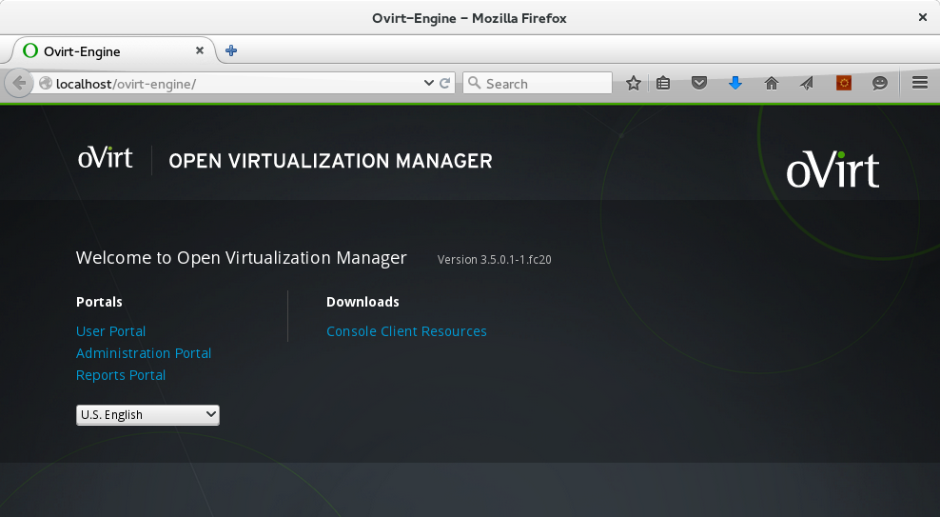
“Dockerized” oVirt

Slide 16
Running Containers
oVirt is not aware of Containers
oVirt may include tools and plugins to help you visualizing containers in the Data Center

Slide 17
VMs x Containers
Seamless management?
Live migration?
Security?
Monolithic Scheduler?
Who is in charge?

Slide 18
Docker Integration (draft)
Enable to communication with docker registries
  List of images
Define a new container
  Underlying image, port mappings, resource allocation limits and the command to execute
"Docker support" flag in the Host

Slide 19
Docker Integration (draft)
`docker pull` first
  Store information about local images per host
Run container with replication
Enable external container storage via bind-mount

Slide 20
Docker Integration (draft)
UI
  Containers main tab
  Docker registries in Storage main tab

Slide 21
Thank you!
apahim @ #ovirt (OFTC)

