Slide 1
oVirt
Community Meeting
FISL 2015

Slide 2
oVirt 3.5
Introduction and New Features

Slide 3
Virtualization: The New Default
“80% of all new logical server shipments virtualized in 2014 and forecasted to increase to 88% by 2017” (IDC, Oct 2014)

Slide 4
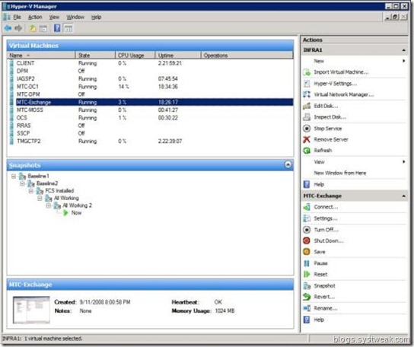
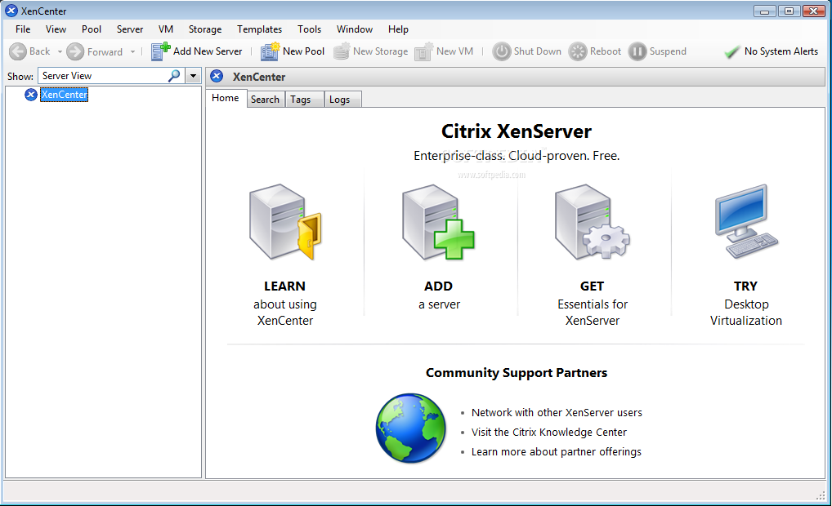
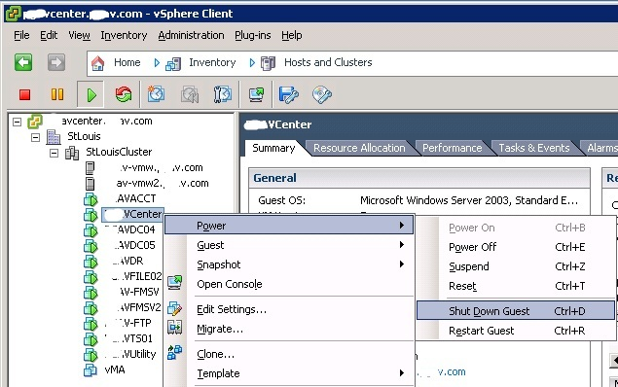
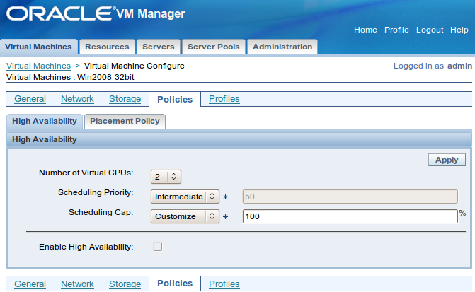
Many Players...
Notes:
What is Ovirt?
ROBUST PLATFORM
FEATURE REACH
SVI & VDI
MANAGING VIRTUALIZED DC – THOUSANDS OF VMS ?HYPERVISORS
KVM
A PARALLEL to VMWARE VSPHERE/ VCENTER
SINGLE POINT OF MANAGEMENT – NET STORAGE

Slide 5
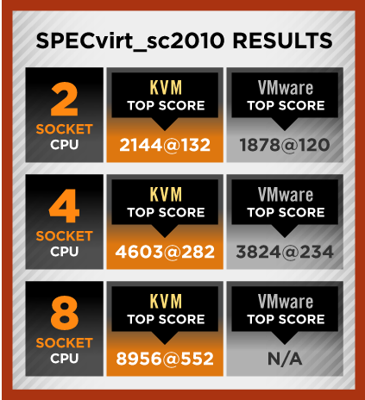
... but the best is free!

Slide 6
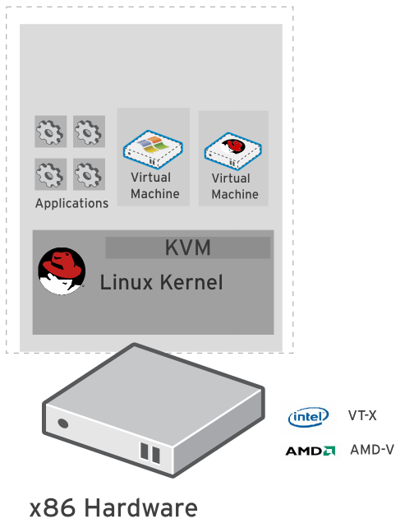
KVM
“Kernel-based Virtual Machine”
Included in Linux kernel since 2006
Runs Linux, Windows and other operating system guests
  Advanced features
  Live migration
  Memory page sharing
  Thin provisioning
  PCI Pass-through
KVM architecture provides high “feature-velocity” – leverages the power of Linux

Slide 7
Using KVM
/usr/libexec/qemu-kvm -name vm-f16-buildmachine -S -M rhel6.4.0 -cpu Westmere -enable-kvm -m 2048 -smp 2,sockets=2,cores=1,threads=1 -uuid a8ccdb60-8a42-44f5-9669-d74c3b2eff43 -smbios type=1,manufacturer=Red Hat,product=RHEV Hypervisor,version=6Server-6.4.0.4.el6,serial=30353036-3837-4247-3831-30394635324C_78:e7:d1:22:46:d8,uuid=a8ccdb60-8a42-44f5-9669-d74c3b2eff43 -nodefconfig -nodefaults -chardev socket,id=charmonitor,path=/var/lib/libvirt/qemu/vm-f16-buildmachine.monitor,server,nowait -mon chardev=charmonitor,id=monitor,mode=control -rtc base=2013-10-08T12:16:16,driftfix=slew -no-shutdown -device piix3-usb-uhci,id=usb,bus=pci.0,addr=0x1.0x2 -device virtio-serial-pci,id=virtio-serial0,bus=pci.0,addr=0x4 -drive if=none,media=cdrom,id=drive-ide0-1-0,readonly=on,format=raw,serial= -device ide-drive,bus=ide.1,unit=0,drive=drive-ide0-1-0,id=ide0-1-0 -drive file=/rhev/data-center/f79b0b28-c82f-11e0-8739-78e7d1e48c4c/5bab6470-8825-4e3a-b408-ebcde93678b6/images/4c213cd2-c4d5-441b-a1ac-dfb1a6868699/11b3e132-50a5-481b-b48b-e3b1f2879e69,if=none,id=drive-virtio-disk0,format=qcow2,serial=4c213cd2-c4d5-441b-a1ac-dfb1a6868699,cache=none,werror=stop,rerror=stop,aio=native -device virtio-blk-pci,scsi=off,bus=pci.0,addr=0x5,drive=drive-virtio-disk0,id=virtio-disk0,bootindex=1 -drive file=/rhev/data-center/f79b0b28-c82f-11e0-8739-78e7d1e48c4c/5bab6470-8825-4e3a-b408-ebcde93678b6/images/02330fa2-d1ff-48e0-a843-842c2376756f/5a283126-4d27-4eef-86dd-fb538d8d08e4,if=none,id=drive-virtio-disk1,format=qcow2,serial=02330fa2-d1ff-48e0-a843-842c2376756f,cache=none,werror=stop,rerror=stop,aio=native -device virtio-blk-pci,scsi=off,bus=pci.0,addr=0x6,drive=drive-virtio-disk1,id=virtio-disk1 -netdev tap,fd=31,id=hostnet0,vhost=on,vhostfd=32 -device virtio-net-pci,netdev=hostnet0,id=net0,mac=00:1a:4a:23:12:13,bus=pci.0,addr=0x3,bootindex=2 -chardev socket,id=charchannel0,path=/var/lib/libvirt/qemu/channels/vm-f16-buildmachine.com.redhat.rhevm.vdsm,server,nowait -device virtserialport,bus=virtio-serial0.0,nr=1,chardev=charchannel0,id=channel0,name=com.redhat.rhevm.vdsm -chardev socket,id=charchannel1,path=/var/lib/libvirt/qemu/channels/vm-f16-buildmachine.org.qemu.guest_agent.0,server,nowait -device virtserialport,bus=virtio-serial0.0,nr=2,chardev=charchannel1,id=channel1,name=org.qemu.guest_agent.0 -chardev spicevmc,id=charchannel2,name=vdagent -device virtserialport,bus=virtio-serial0.0,nr=3,chardev=charchannel2,id=channel2,name=com.redhat.spice.0 -spice port=5904,tls-port=5905,addr=10.35.16.4,x509-dir=/etc/pki/vdsm/libvirt-spice,tls-channel=main,tls-channel=display,tls-channel=inputs,tls-channel=cursor,tls-channel=playback,tls-channel=record,tls-channel=smartcard,tls-channel=usbredir,seamless-migration=on -k en-us -vga qxl -global qxl-vga.ram_size=67108864 -global qxl-vga.vram_size=67108864

Slide 8
Introducing oVirt

Slide 9

What is oVirt?
Large scale, centralized management for server and desktop virtualization
Based on leading performance, scalability and security infrastructure technologies
Provide an open source alternative to vCenter/vSphere
Focus on KVM for best integration/performance
Focus on ease of use/deployment
Notes:
What is Ovirt?
ROBUST PLATFORM
FEATURE REACH
SVI & VDI
MANAGING VIRTUALIZED DC – THOUSANDS OF VMS ?HYPERVISORS
KVM
A PARALLEL to VMWARE VSPHERE/ VCENTER
SINGLE POINT OF MANAGEMENT – NET STORAGE

Slide 10
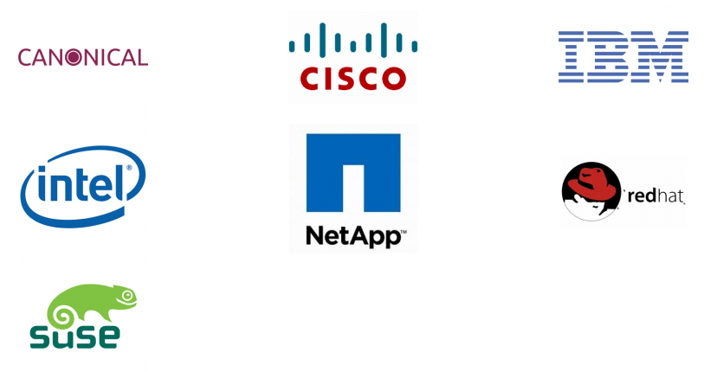
Who is Behind It?
Notes:
[Note: Make sure this is updated!]
Open source for three years
Release cycle is every 6 months so we already have 4 stable versions out there, the last one that was released in April 2014 is oVirt 3.4 that included features like live snapshots, self-hosted engines, and hot-plug CPUs.

Slide 11















Who is Using It?

Slide 12
oVirt: Not a Single Project
oVirt-Engine
VDSM
oVirt-Node
oVirt-Engine-SDK
oVirt-Engine-CLI
oVirt-Guest-Agent
oVirt-hosted-engine
oVirt-webadmin
oVirt-Image-Uploader
oVirt-ISO-Uploader
oVirt-Log-Collector
oVirt-DWH
oVirt-Reports
oVirt-API
oVirt-mom
oVirt-userportal
Notes:
BUILD COMMUNITY AROUND THE VIRTUALIZATION STACK
FOCUSED AROUND KVM

Slide 13
Architecture

Slide 14



Architecture from 30k feet
Servers
Engine
Client
Storage

Slide 15
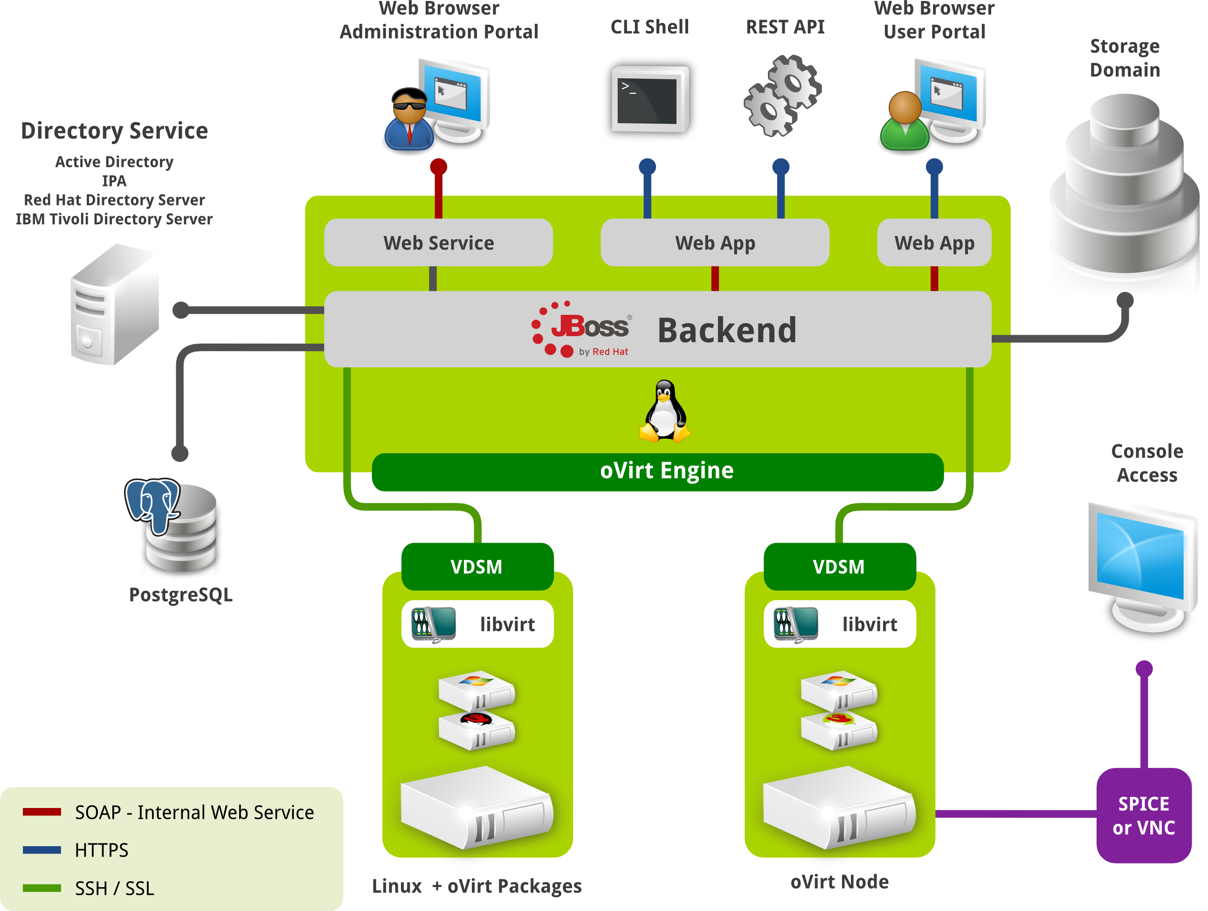

Slide 16
How does it look?

Slide 17
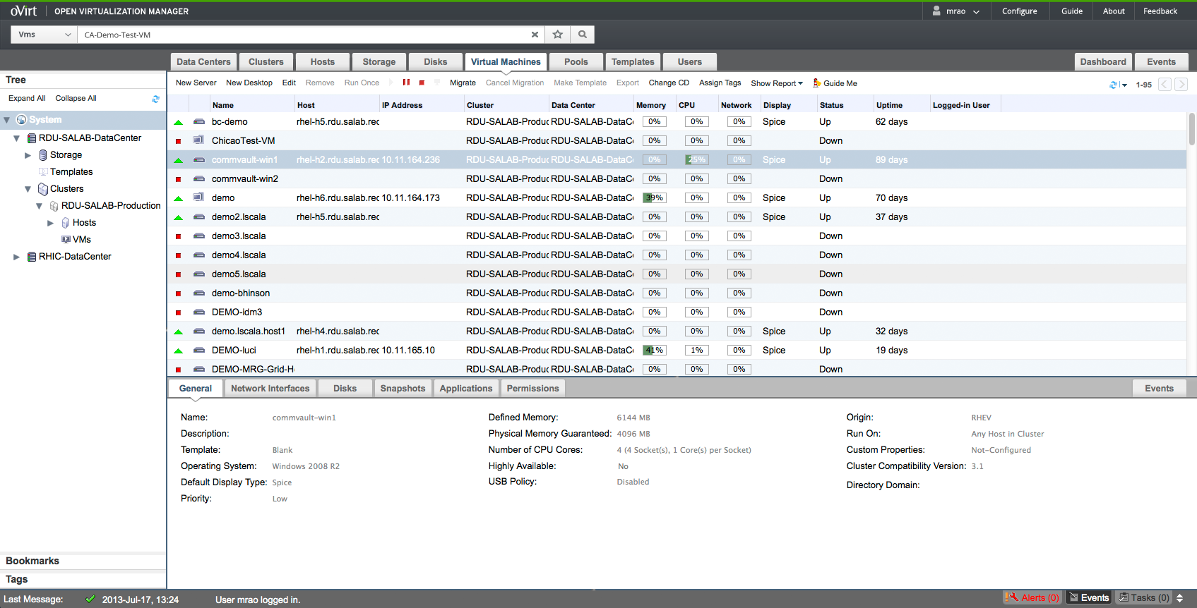
Administration Portal

Slide 18
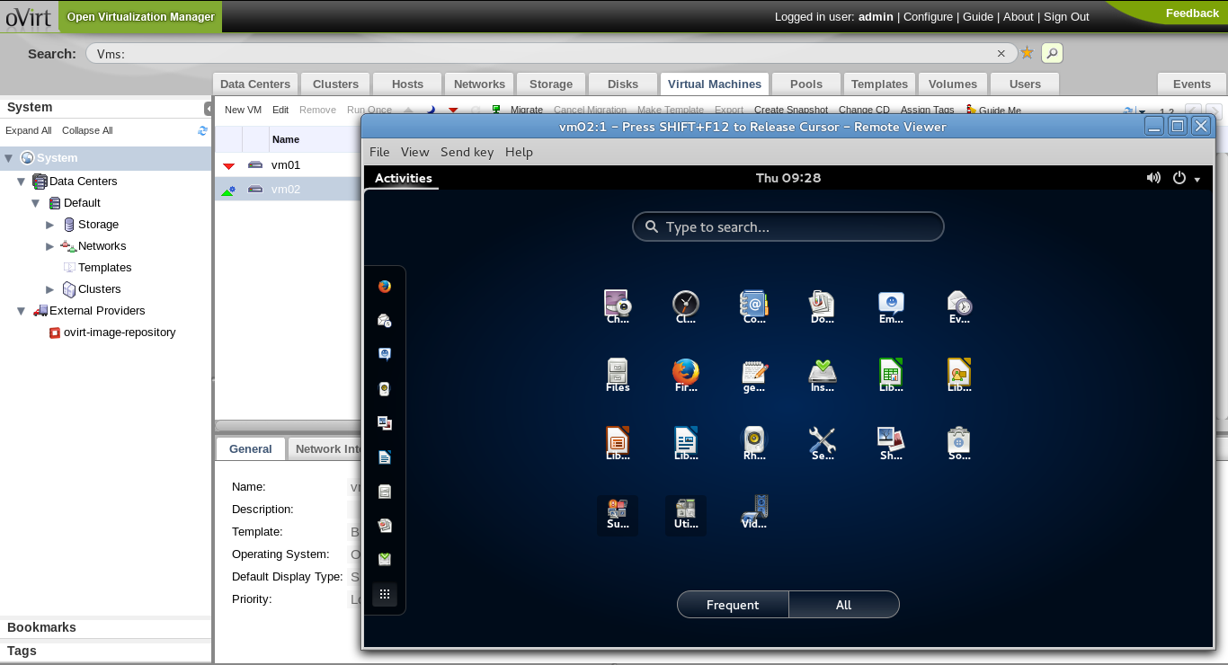
VM UP!

Slide 19
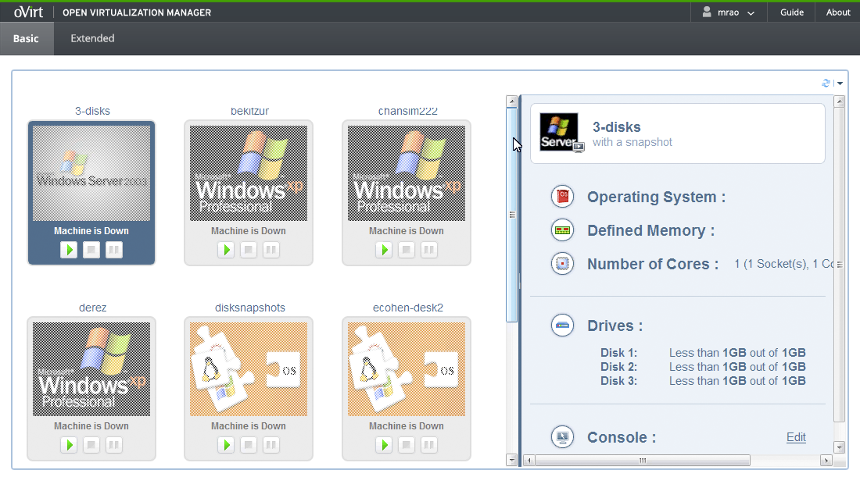
User Portal - Basic

Slide 20
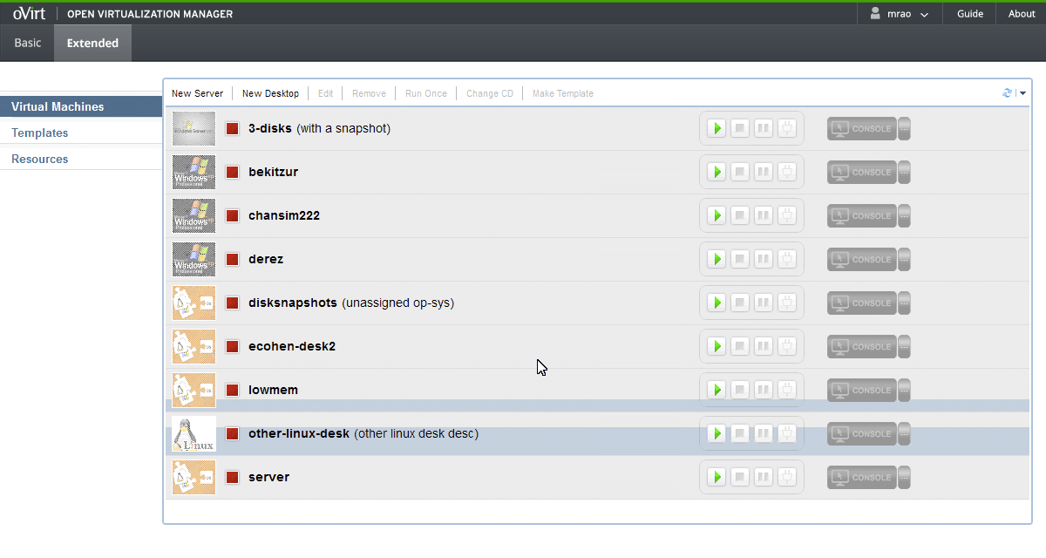
User Portal - Extended

Slide 21
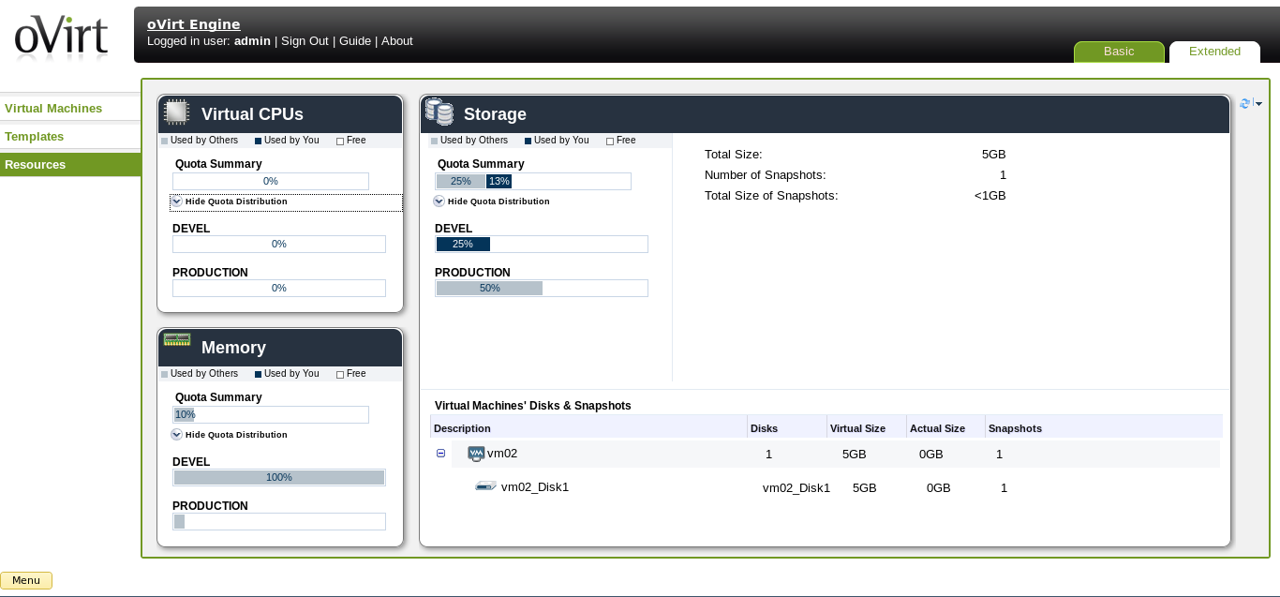
User Portal - Extended

Slide 22
Key Features

Slide 23
All Basic Features
High Availability
Live Migration
Storage Live Migration
CPU/Memory Overcommit
System Scheduler
V2V
Storage iSCSI, FC, NFS, GlusterFS, Local...
Template / Pools
Memory Deduplication and Balloon
VDI / SPICE
Disk Alignment scan
and...

Slide 24
New Features in
oVirt 3.5

Slide 25
Live Merge
Delete disk snapshots while VM is UP
Available in fedora virt-preview
'Remove' snapshot command is no longer disabled when a VM is running
RemoveSnapshotSingleDiskLiveCommand
vdsm Race condition protection
(!!!) libvirt will fail to perform live merges due to a problem with the SELinux policy https://bugzilla.redhat.com/show_bug.cgi?id=1102881

Slide 26
Import Data Storage Domain
In addition to the ISO and Export domains, now Data domain can also be imported
Disks volumes and VMs'/Templates' OVF files which can be retrieved in a DC
Need 3.5v compatibility version set
VMs will be registered with down status.
Detach will not be permitted if there are VMs/Templates which are delete protected / in preview mode / are part of pools
Storage Domain can not be detached if it contains disks which are related to a running VM, unless this disks are inactive.
Shareable and Direct lun disks are not supported in the OVF

Slide 27
Foreman Integration
Foreman is a complete lifecycle management tool for physical and virtual servers
To help adding hypervisor hosts that are managed by Foreman to the oVirt engine, VM configuration, package management, etc.
Supported in oVirt>=3.5 over RHEL>=6.6

Slide 28
AAA (Authentication, Authorization and Accounting)
oVirt-engine-extension-aaa-ldap: LDAP based authentication and authorization
oVirt-engine-extension-aaa-misc HTTP Authentication: SSO Helper
oVirt-engine-extension-aaa-misc RegExp Mapper: Mapper implementation to transform user and principal names
Authentication: A process to resolve and validate user credentials
Authorization: A process to retrieve principal name information such as unique id, group membership, attributes
Mapping: A user name and/or principal name transformation. Helpful when authn and authz needs different inputs than provided.

Slide 29
Optaplanner (Tech-prev)
A feature to be able to make (hints) a better usage of the hardware
Cluster-aware, computes an optimized VM to Host assignment solution based on snapshots (list of hosts and Vms)
Separated from the ovirt-engine to not damage datacenter performance. Uses API
Each cluster will have a new subtab – Optimizer results - and makes it possible to start a migration by clicking the relevant buttons from there.
Each VM will have two new elements in their context menu - Optimize start and Cancel start optimization
This solution should obey the cluster policy to some extent

Slide 30
HE iSCSI Support
iSCSI storage for Hosted Engine data domain is now supported
hosted-engine.conf will need to store some of the iSCSI portal / target parameters
An answer file will need to store answers for all of the questions except for portal password

Slide 31
Wiki
Install/Quick Start
Admin. Guide
User Guide
Use Cases
Features Doccumentation

Slide 32
Numbers
Commiters:
  ovirt-engine: ~159
  vdsm: ~171
List members:
  users@ovirt.org: ~800
  users-pt@ovirt.org: ~50
  devel@ovirt.org: ~400

Slide 33
Get Involved!
http://www.ovirt.org
http://lists.ovirt.org/mailman/listinfo/users
http://lists.ovirt.org/mailman/listinfo/users-pt
http://lists.ovirt.org/mailman/listinfo/devel

