Slide 1
GlusterFS quick start
Marcelo Barbosa
oVirt Contributor and Fedora Packager
Datacom
FISL 16, 07/11/2015

Slide 2

Agenda
GlusterFS Architecture
Simple install
Create my first volume
Check and test
CTDB – virtual IP address
Connect volume in oVirt Engine

Slide 3
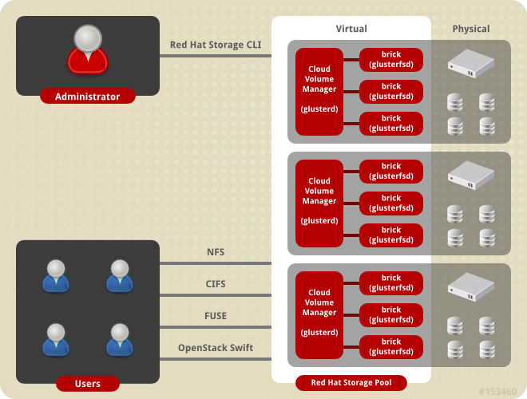
GlusterFS Architecture

Slide 4
Simple Install
# yum install -y glusterfs-server

Slide 5
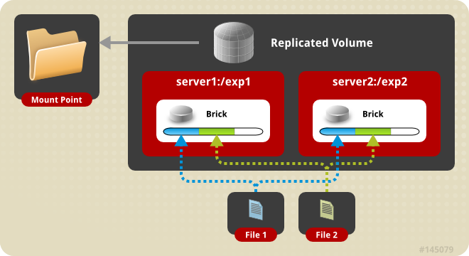
Create my first volume
server1 # gluster peer probe server2
# gluster peer status
# gluster volume create test-volume replica 2 transport tcp server1:/exp1 server2:/exp2

Slide 6
Check and test
# gluster volume info test-volume
or
# gluster volume status test-volume
# mount -t glusterfs my-host-ip-virtual:/test-volume /mnt
or
# mount -t nfs my-host-ip-virtual:/test-volume /mnt

Slide 7

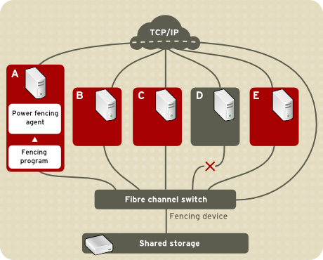
CTDB – virtual IP address

Slide 8
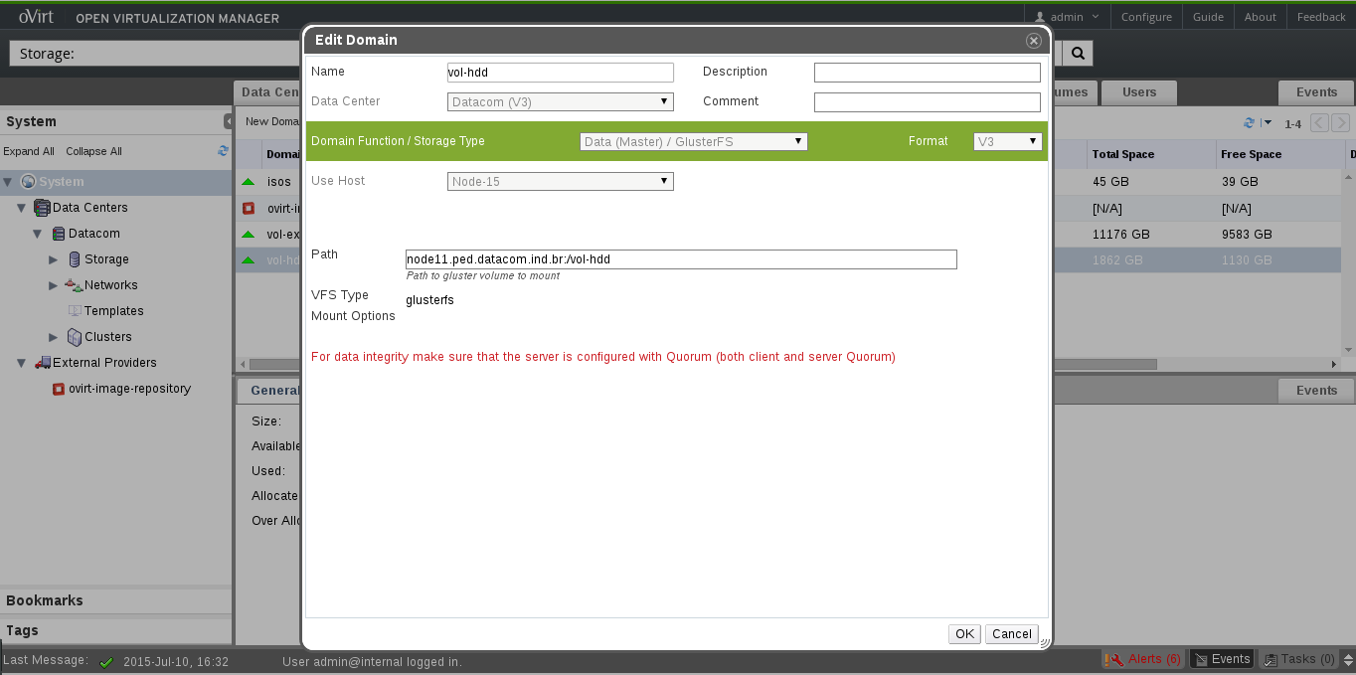
Connect volume in oVirt Engine

Slide 9
THANK YOU!
http://www.ovirt.org
firemanxbr@fedoraproject.org
users-pt@lists.ovirt.org - Portuguese Official Mailing List

