Slide 1
oVirt 3.6.0 Release Meetup
Sandro Bonazzola
Senior Software Engineer
Red Hat Inc.
oVirt community meetup, November 2015

Slide 2

What Is oVirt?
Large scale, centralized management for server and desktop virtualization
Based on leading performance, scalability and security infrastructure technologies
Provide an open source alternative to vCenter/vSphere
Focus on KVM for best integration/performance
Focus on ease of use/deployment

Slide 3
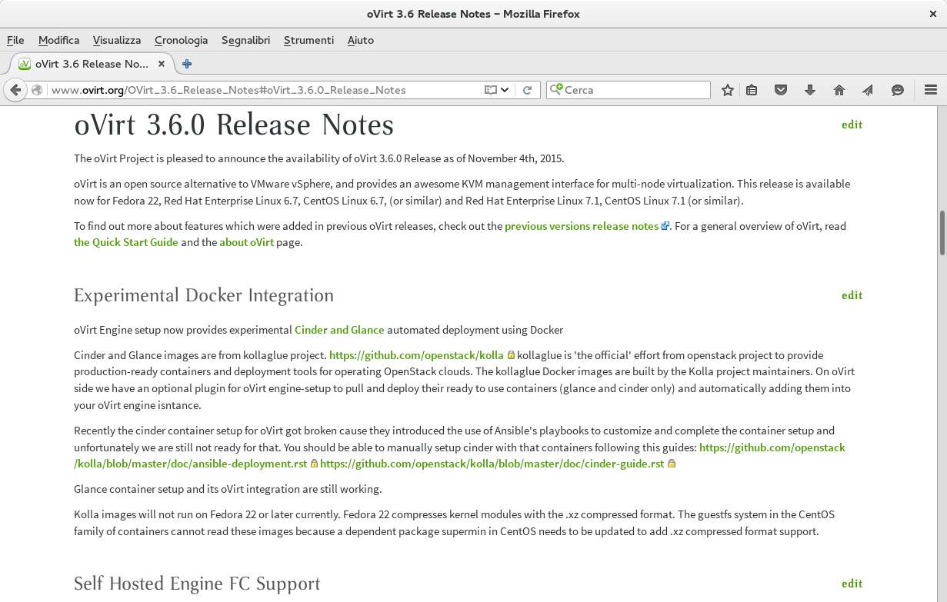
Yeah we know,what about 3.6.0?

Slide 4

Oh, we get it. Now what?
Celebrate the 3.6.0 release
Meet the oVirt community
Celebrate the 3.6.0 release
Meet the oVirt community

Slide 5
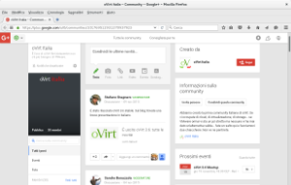
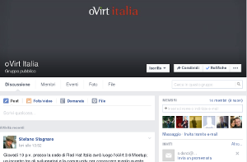
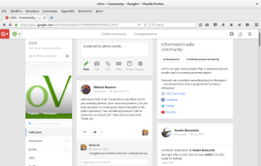

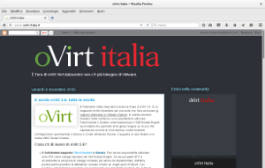
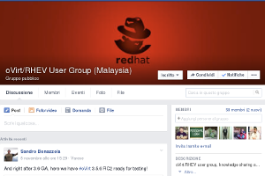
oVirt is a global community

Slide 6
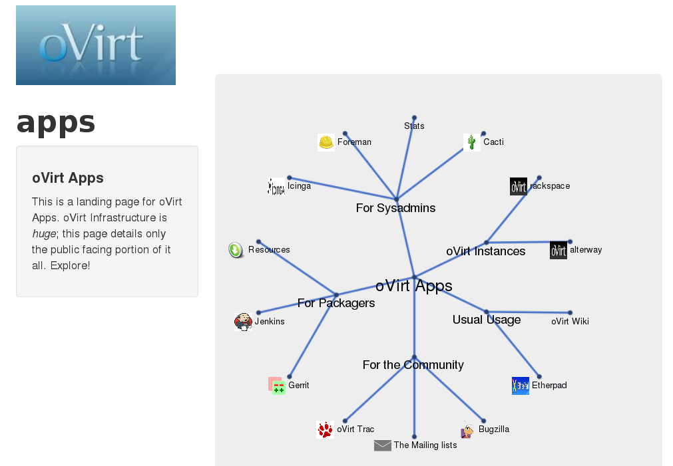
How to contribute

Slide 7















Integration with other projects
OS
HW
oVirt Node

Slide 8
Community news (@ThatDocsLady)
FOSDEM 2016 and DevConf 2016
Local oVirt events in 2016
New ovirt.org website WIP
Your oVirt story

Slide 9
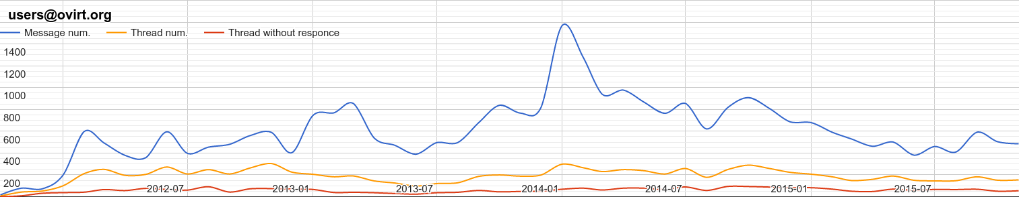
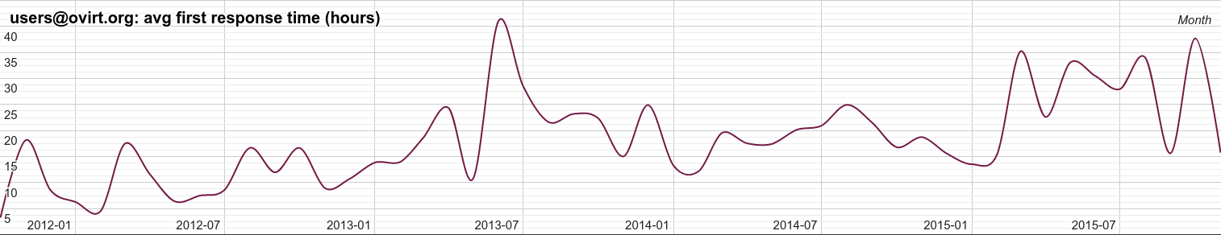
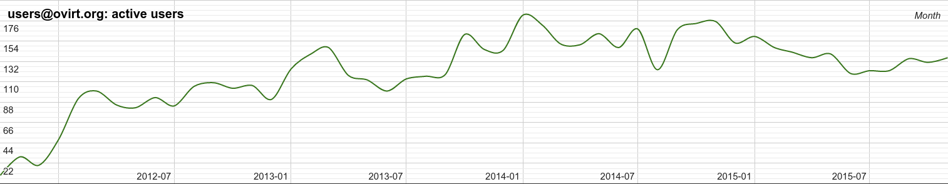
Community stats: users@ovirt.org

Slide 10

Community Q & A
Stefan Baudy- CC BY 2.0 - No modification made

Slide 11
THANK YOU!
sbonazzo@redhat.com
@SandroBonazzola on twitter
+Sandro Bonazzola on G+
sbonazzo on IRC

