Slide 1

Installation Process
Open your virtual data-center
Marcelo Barbosa <firemanxbr@fedoraproject.org>

Slide 2
Agenda
About
Demo Environment
What is NESTED KVM ?
Using virt-manager for your environment
Create first installation using Fedora Node
Create second installation using oVirt Node

Slide 3
About
Install process - oVirt with Fedora
Install process - oVirt with oVirt Node

Slide 4
Demo environment
One server
Architecture:
  Fedora 20 (NESTED KVM)
    VM Fedora 19 (oVirt Engine)
    VM Fedora 19 (Host)
    VM oVirt Node (Host)

Slide 5
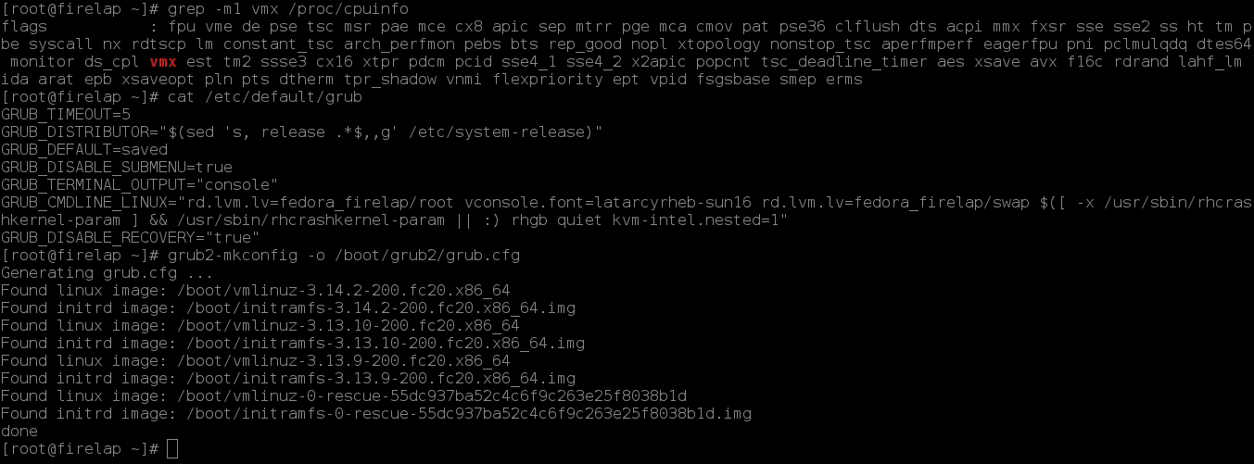
What is NESTED KVM ?
NESTED support “vmx” on INTEL or “svm” on AMD
Reference:
http://www.ovirt.org/Vdsm_Developers#Running_Node_as_guest_-_Nested_KVM

Slide 6
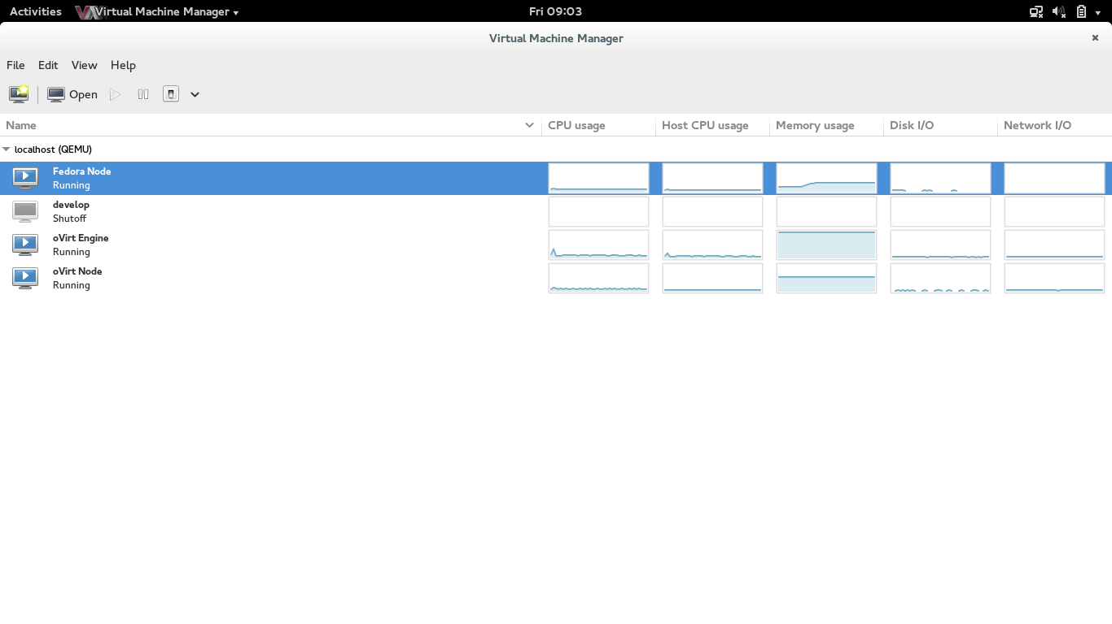
Using virt-manager for your environment
Install qemu-kvm/libvirt/virt-manager

Slide 7
Using virt-manager
Install Fedora 19 for oVirt Engine
Install repo oVirt in Fedora 19:
# yum localinstall -y http://resources.ovirt.org/releases/ovirt-release.noarch.rpm
Clone oVirt Engine(vm) for Fedora Node
Install oVirt Engine:
# yum install -y ovirt-engine

Slide 8
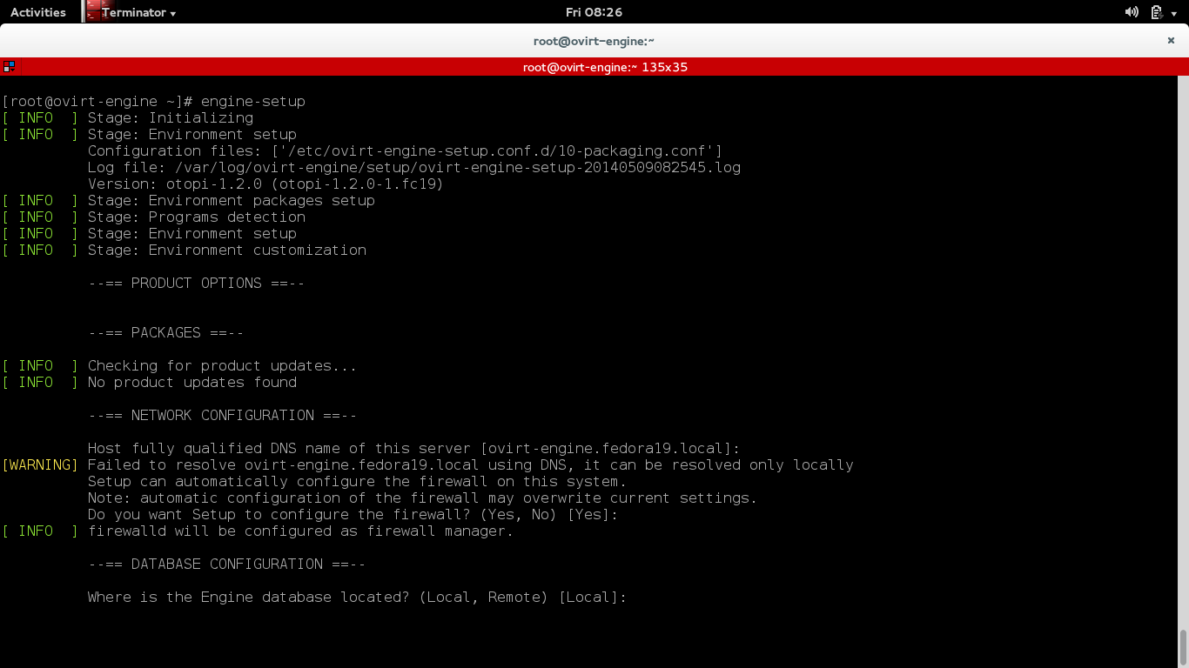
Engine Setup
Run: # engine-setup

Slide 9
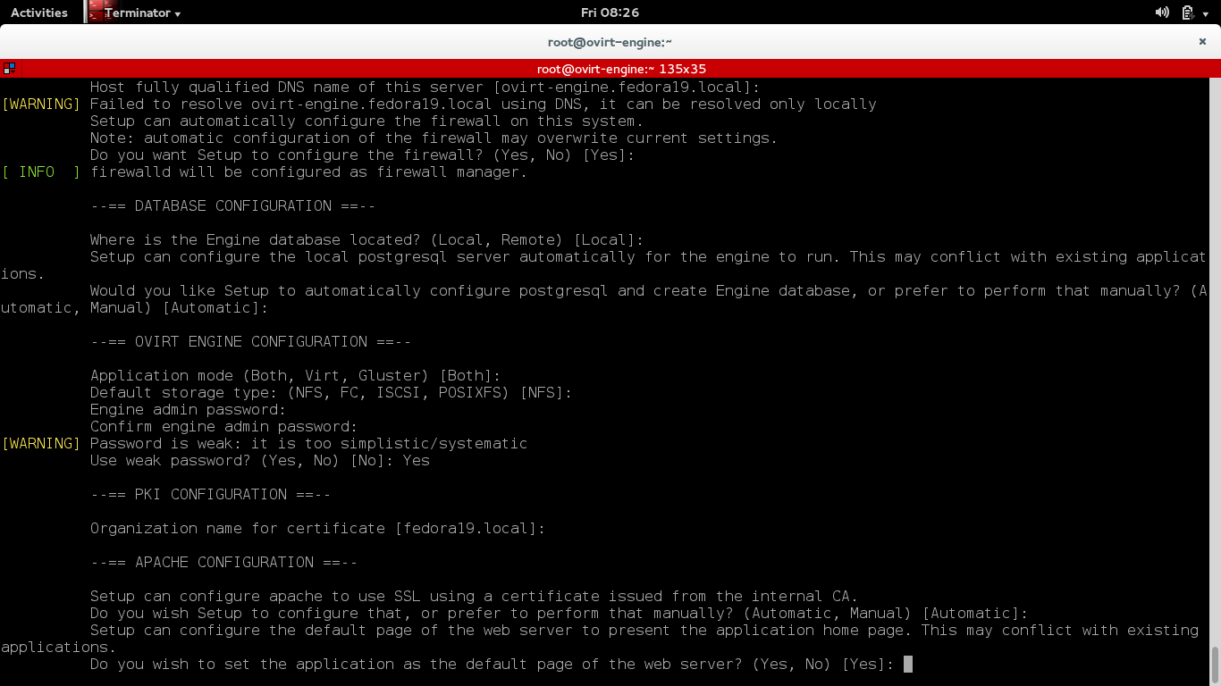
Engine Setup

Slide 10
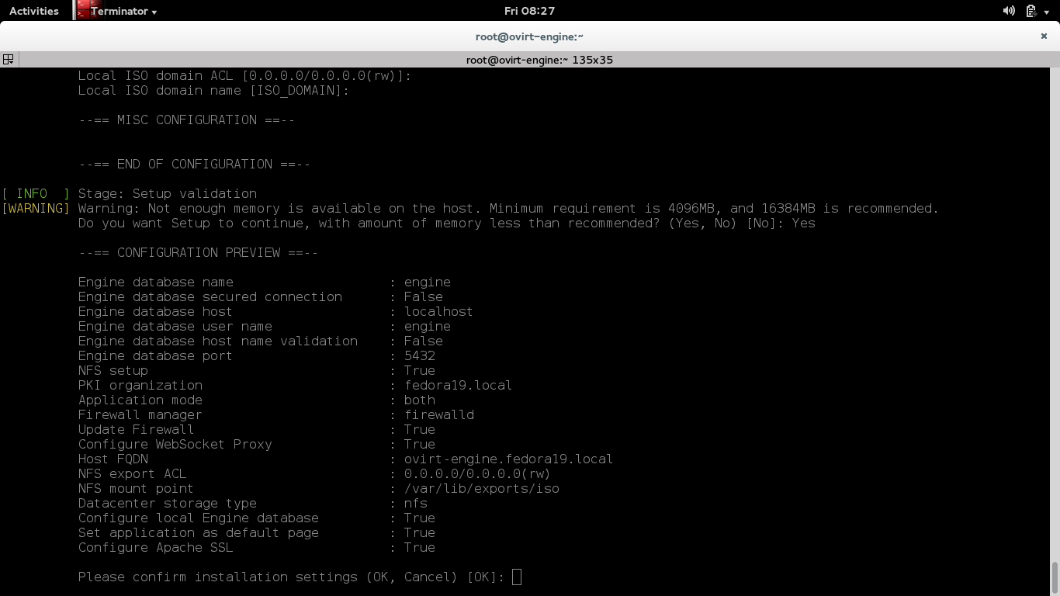
Engine Setup

Slide 11
Installing Fedora as Hypervisor
Install repo oVirt in Fedora 19:
# yum localinstall -y http://resources.ovirt.org/releases/ovirt-release.noarch.rpm
Add Fedora Node in oVirt Engine

Slide 12
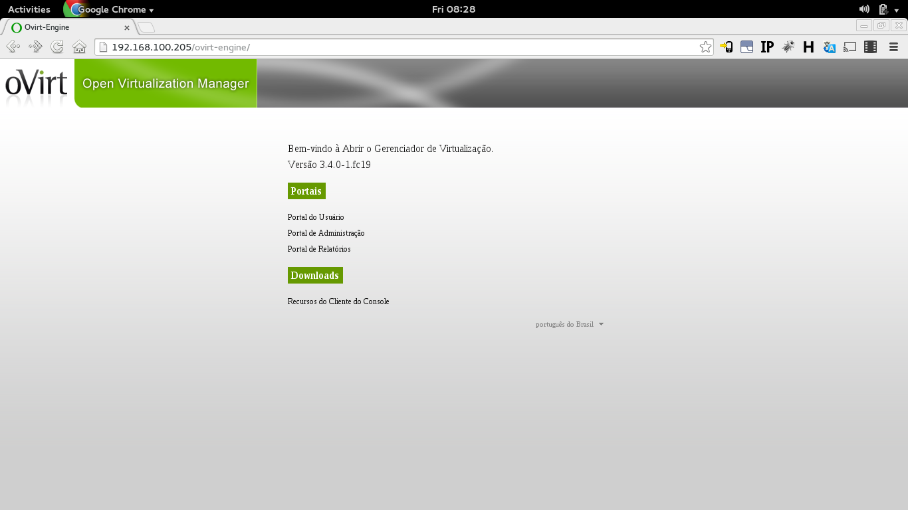
Installing Fedora as Hypervisor

Slide 13
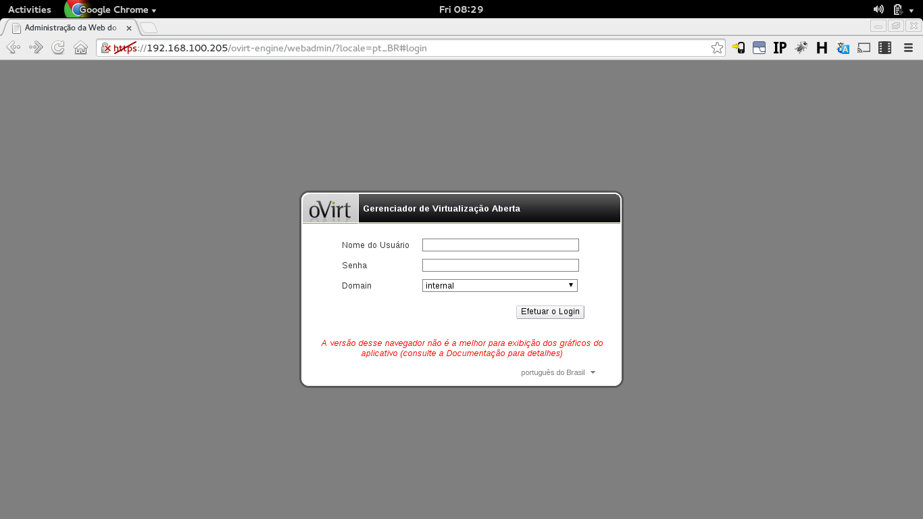
Installing Fedora as Hypervisor

Slide 14
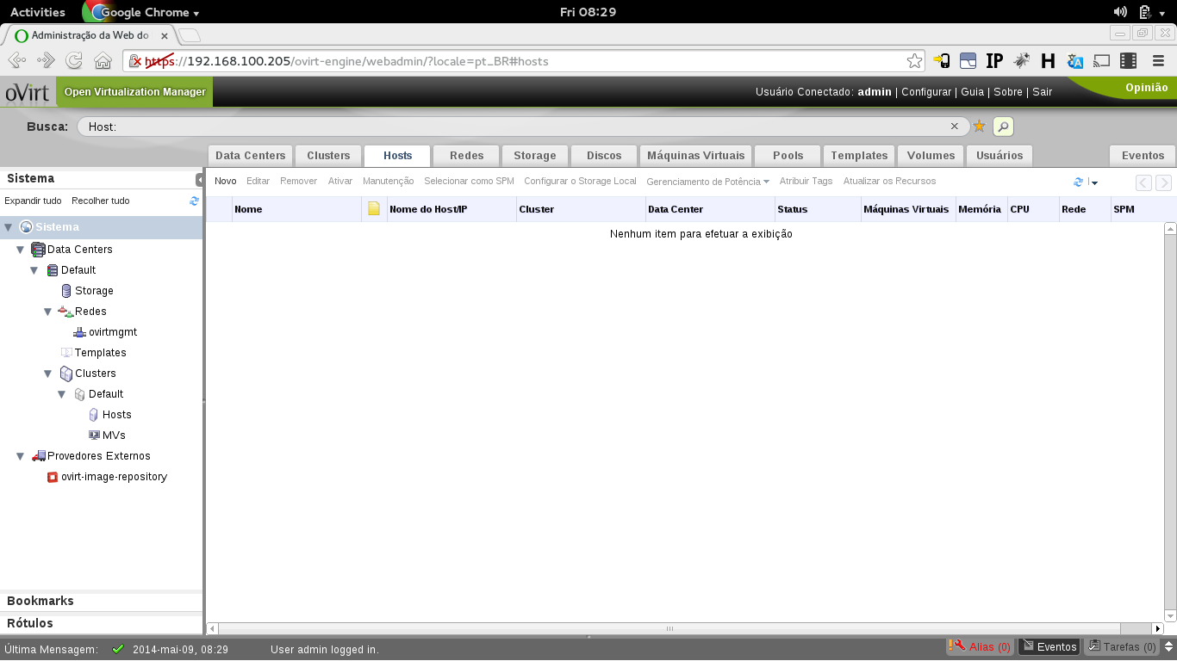
Installing Fedora as Hypervisor

Slide 15
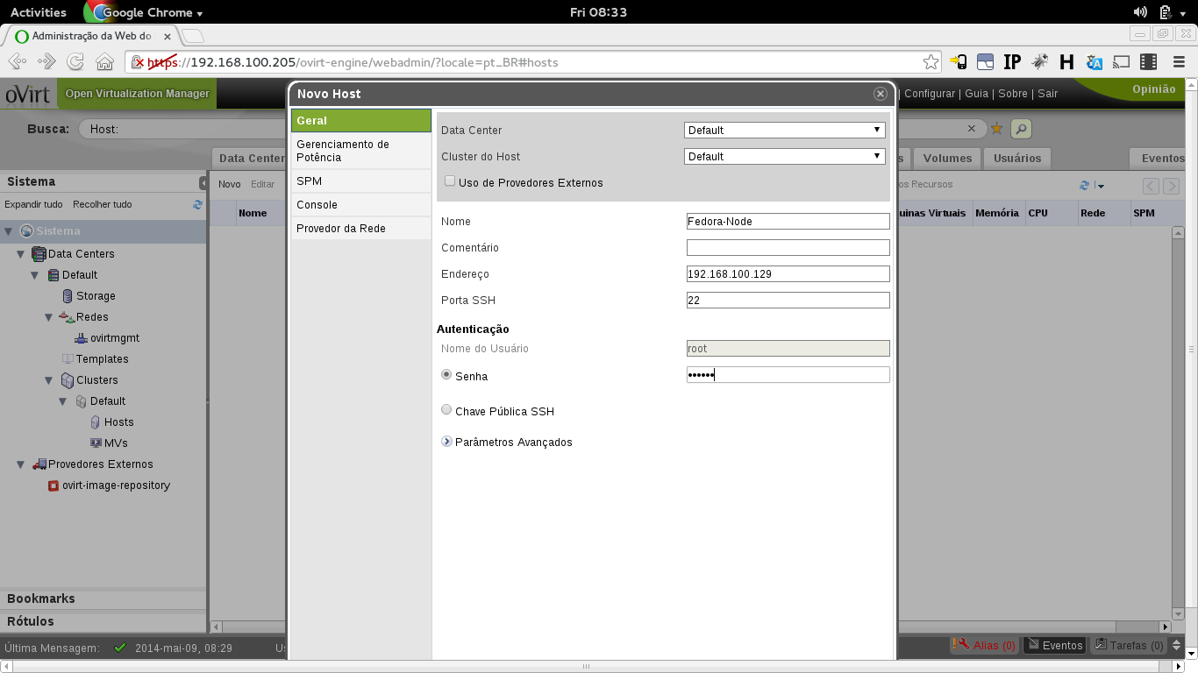
Installing Fedora as Hypervisor

Slide 16
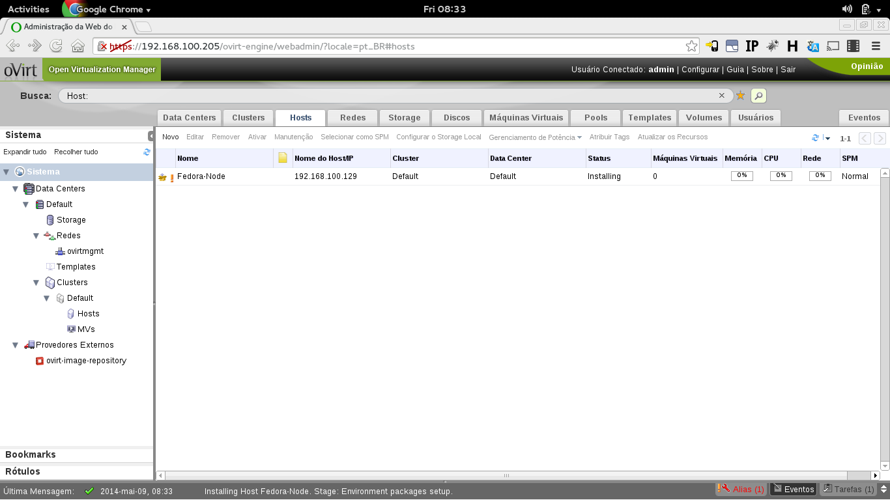
Installing Fedora as Hypervisor

Slide 17
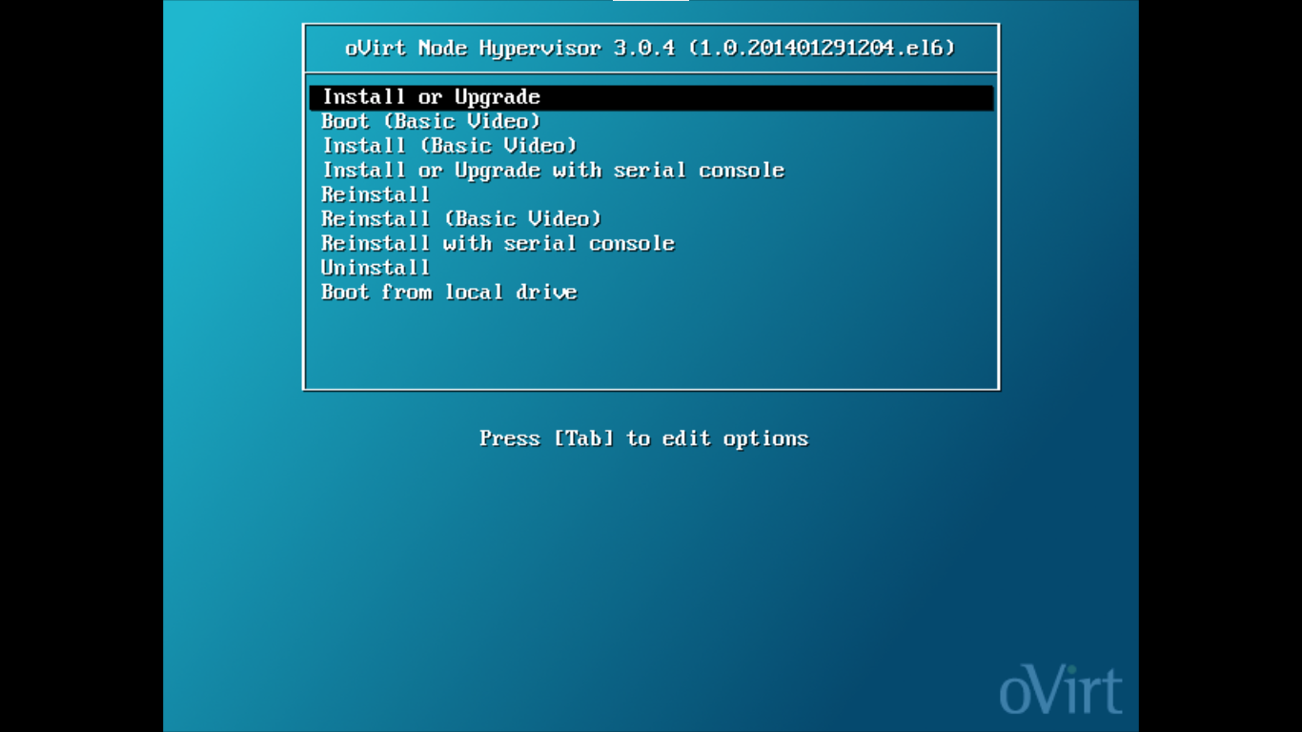
Installing oVirt Node
Boot using oVirt Node ISO

Slide 18
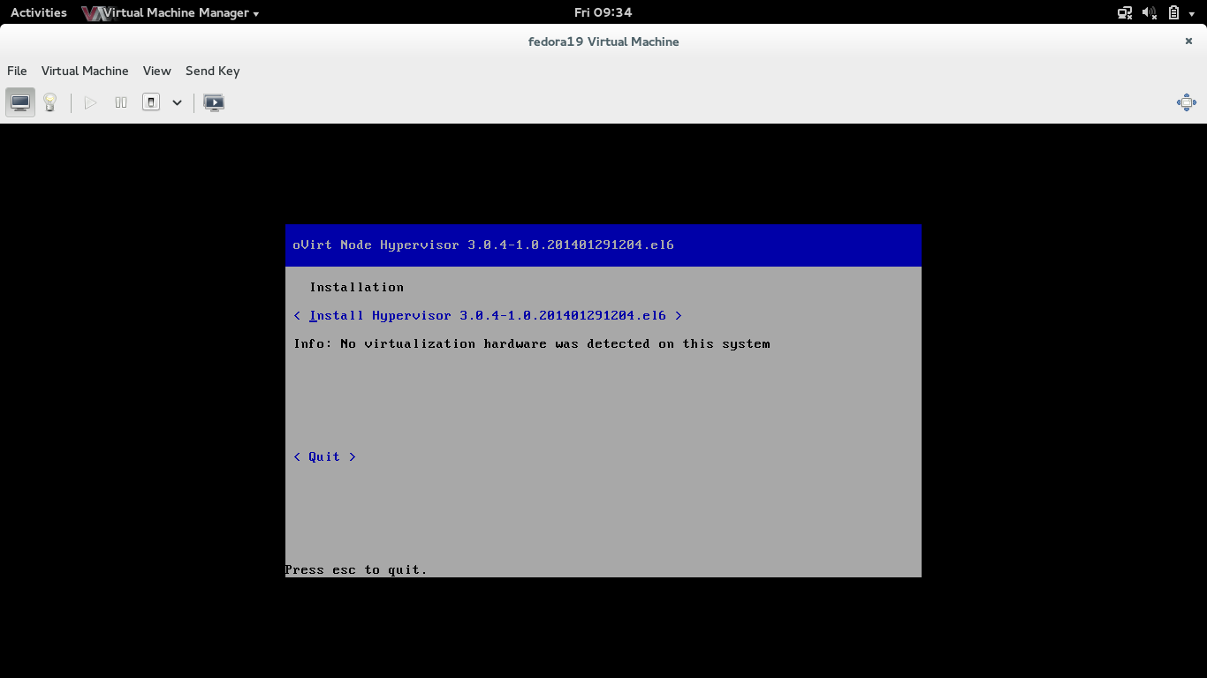
Installing oVirt Node

Slide 19
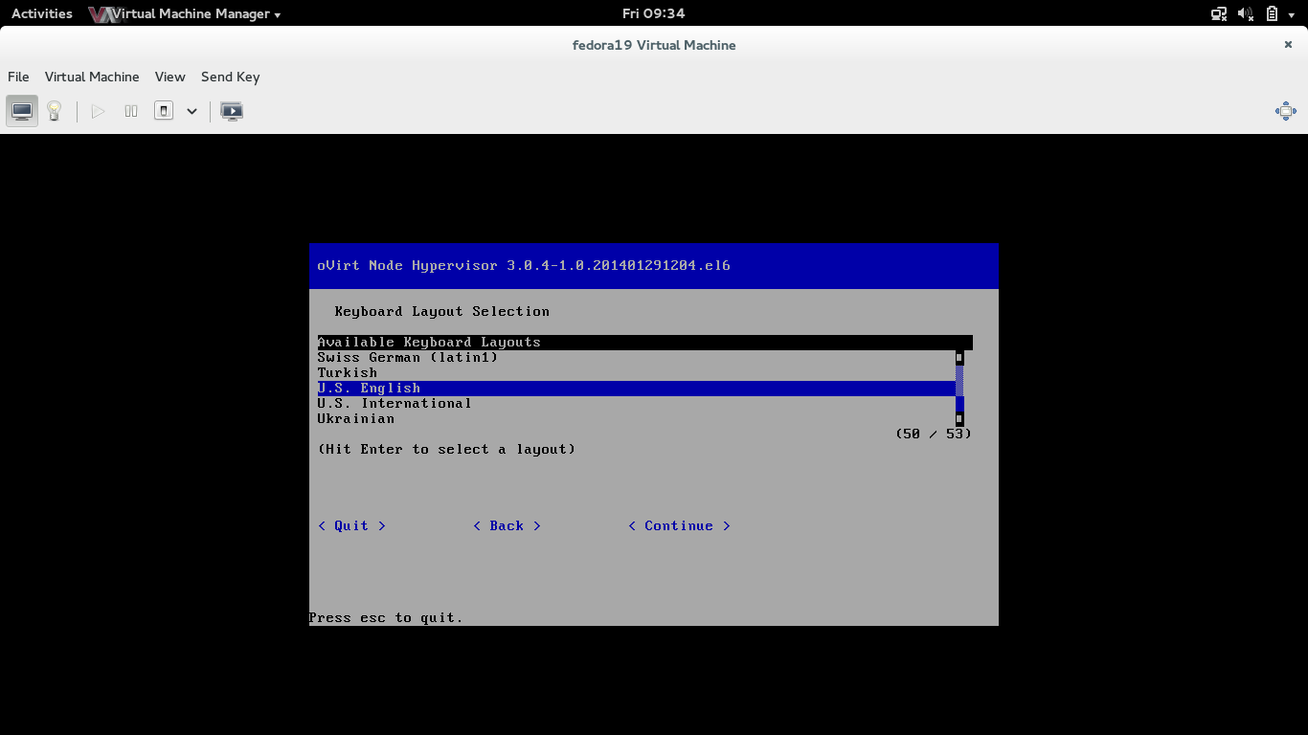
Installing oVirt Node

Slide 20
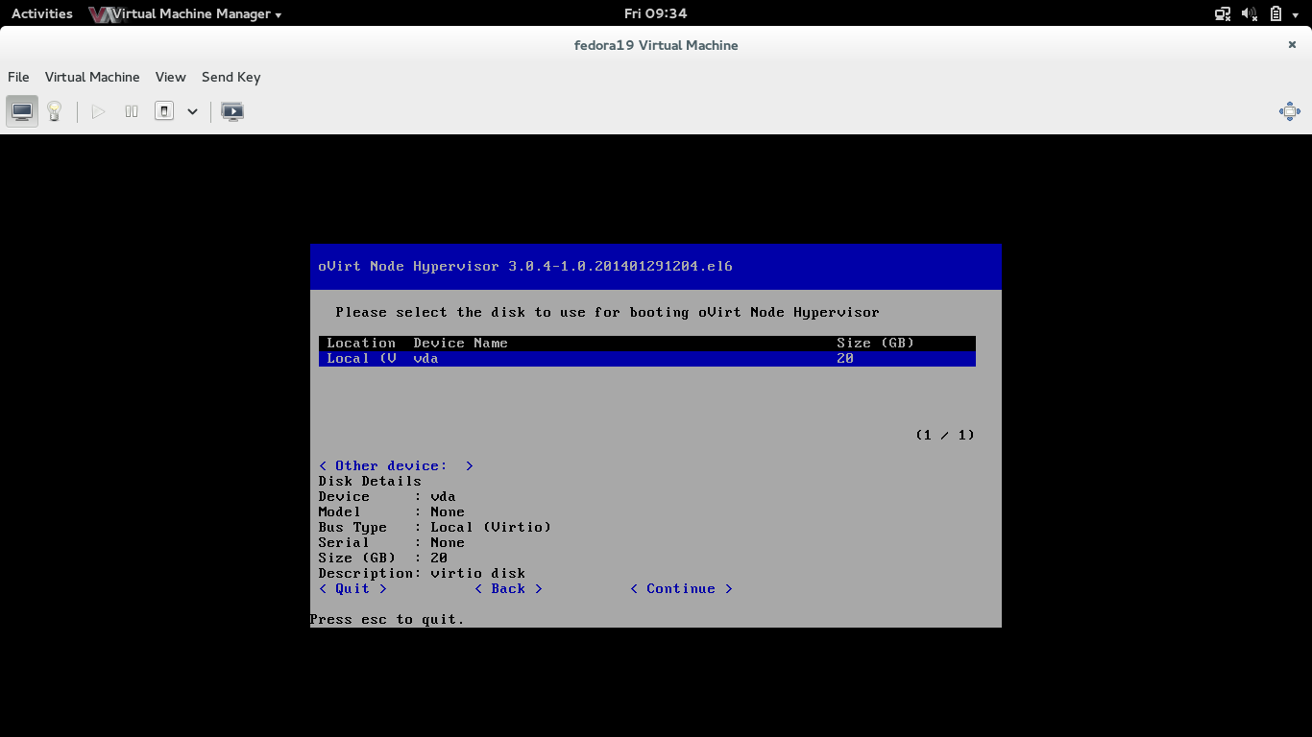
Installing oVirt Node

Slide 21
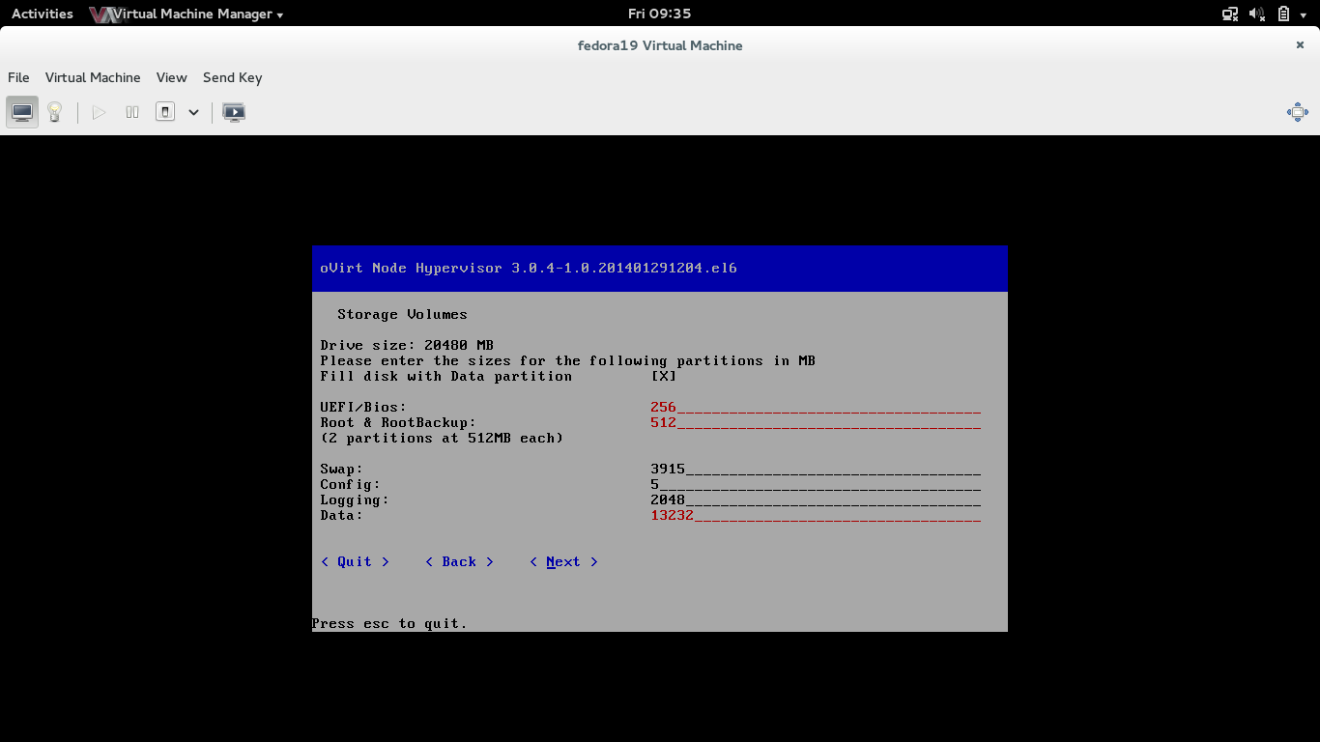
Installing oVirt Node

Slide 22
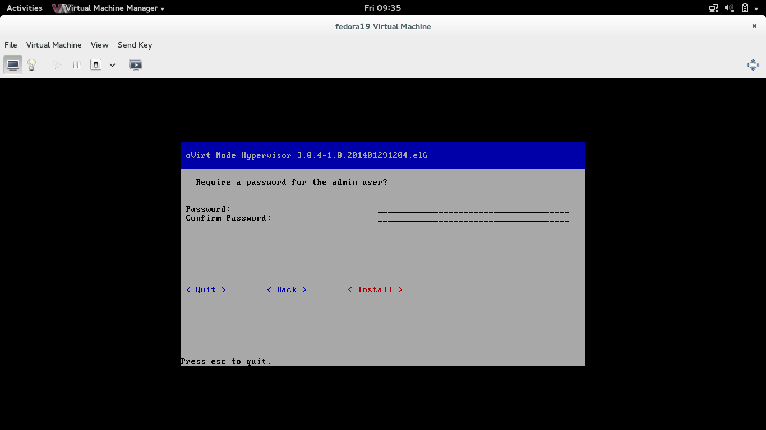
Installing oVirt Node

Slide 23
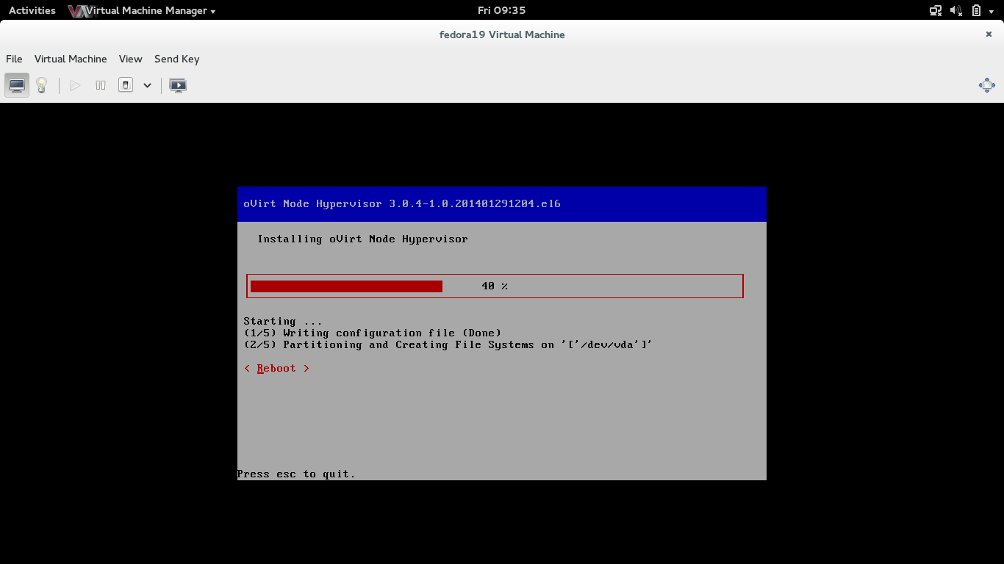
Installing oVirt Node

Slide 24
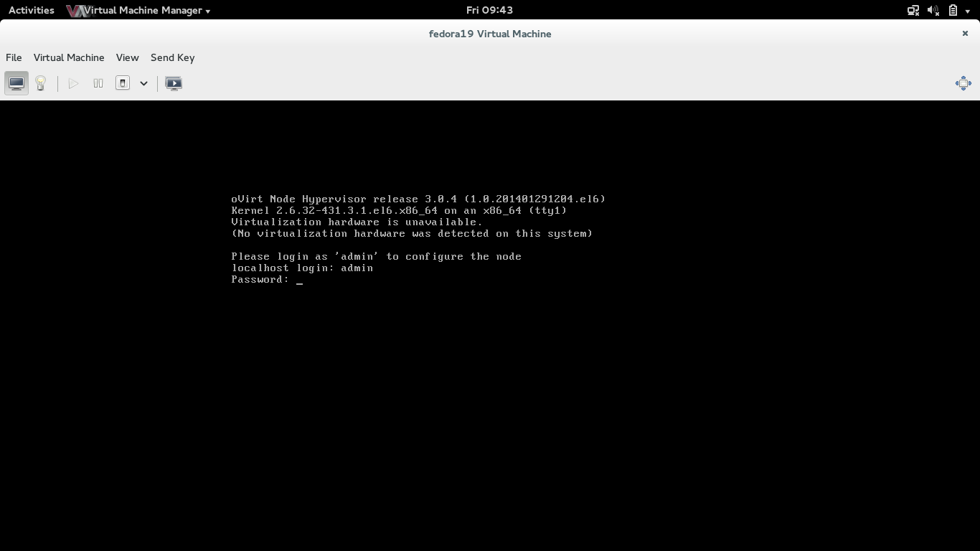
Installing oVirt Node

Slide 25
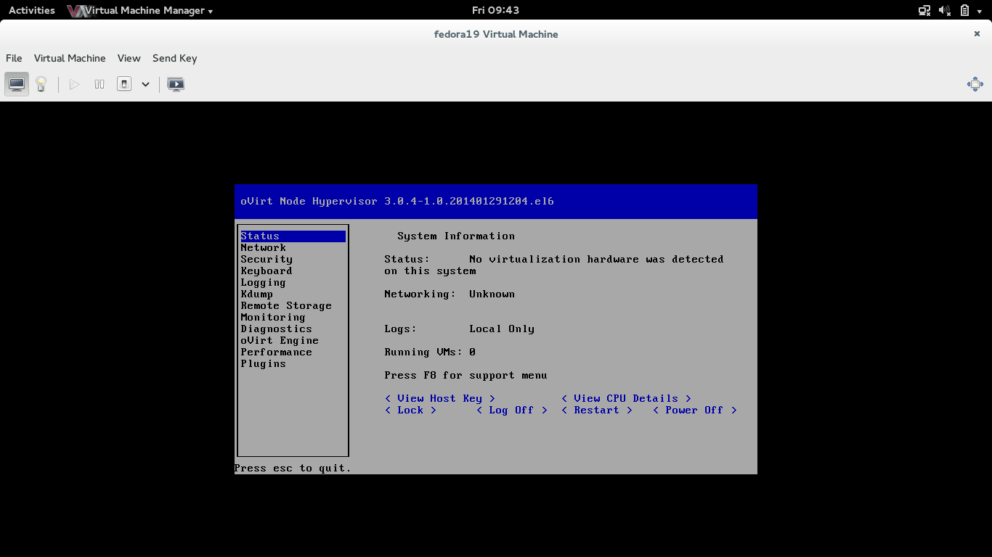
Installing oVirt Node

Slide 26
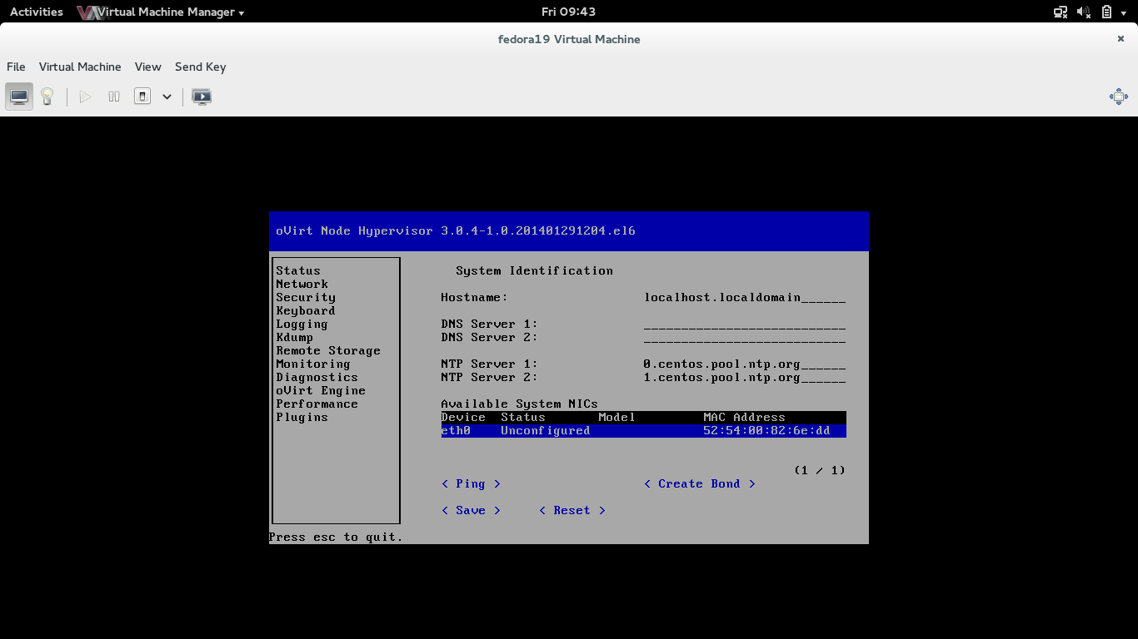
Installing oVirt Node

Slide 27
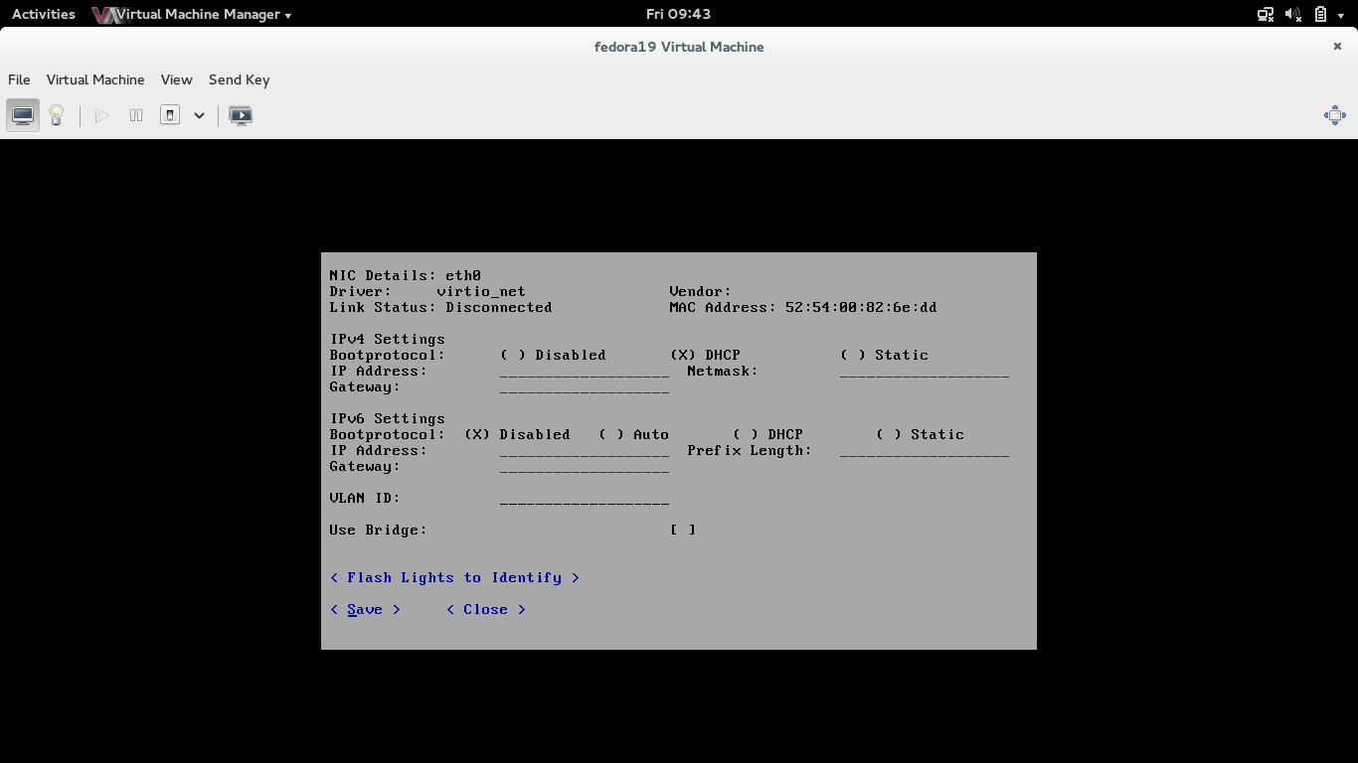
Installing oVirt Node

Slide 28
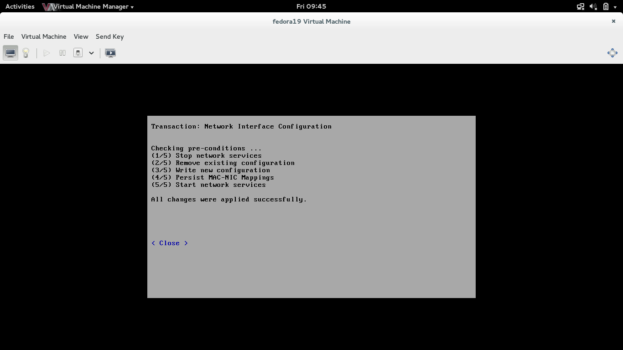
Installing oVirt Node

Slide 29
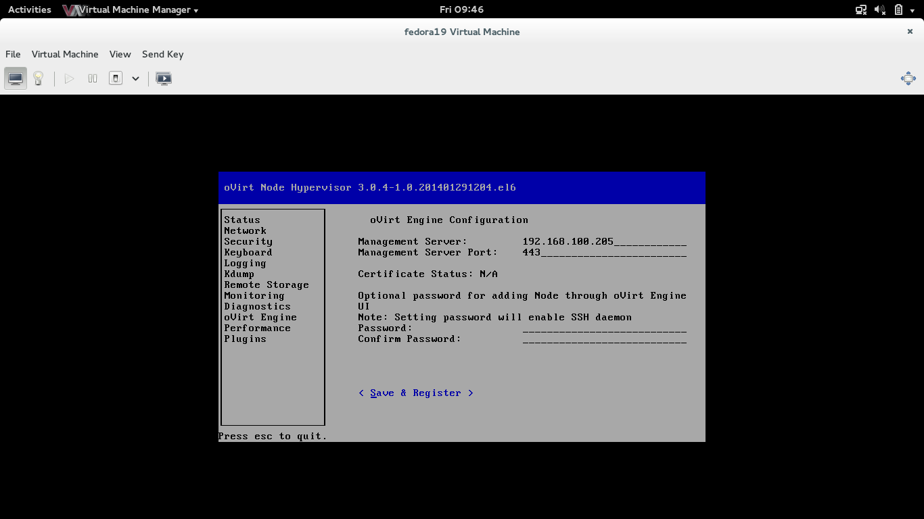
Installing oVirt Node

Slide 30
Thanks
firemanxbr@fedoraproject.org
www.ovirt.org

