Slide 1

Virtualization Management
The oVirt Way
Amador Pahim (apahim)
oVirt Contributor
Fedora Ambassador
Software Maintenance Engineer at Red Hat
20140810 - APAHIM

Slide 2



Architecture from 30k feet
Servers
Engine
Client
Storage

Slide 3
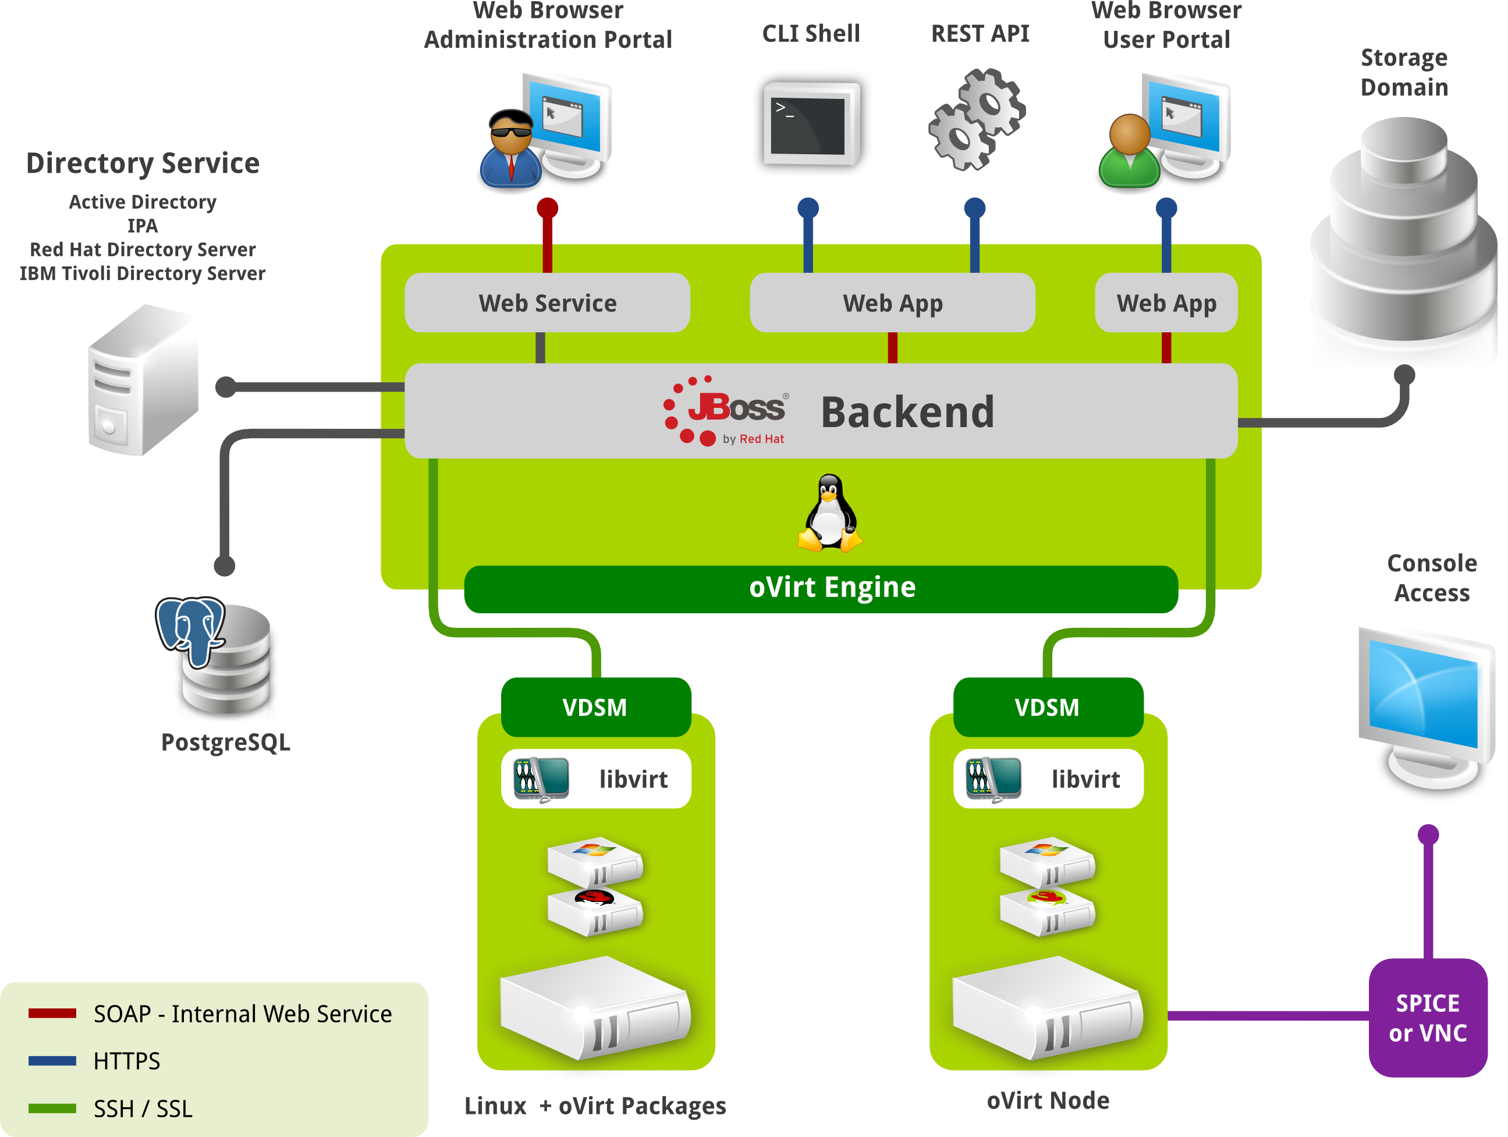
The Real World

Slide 4
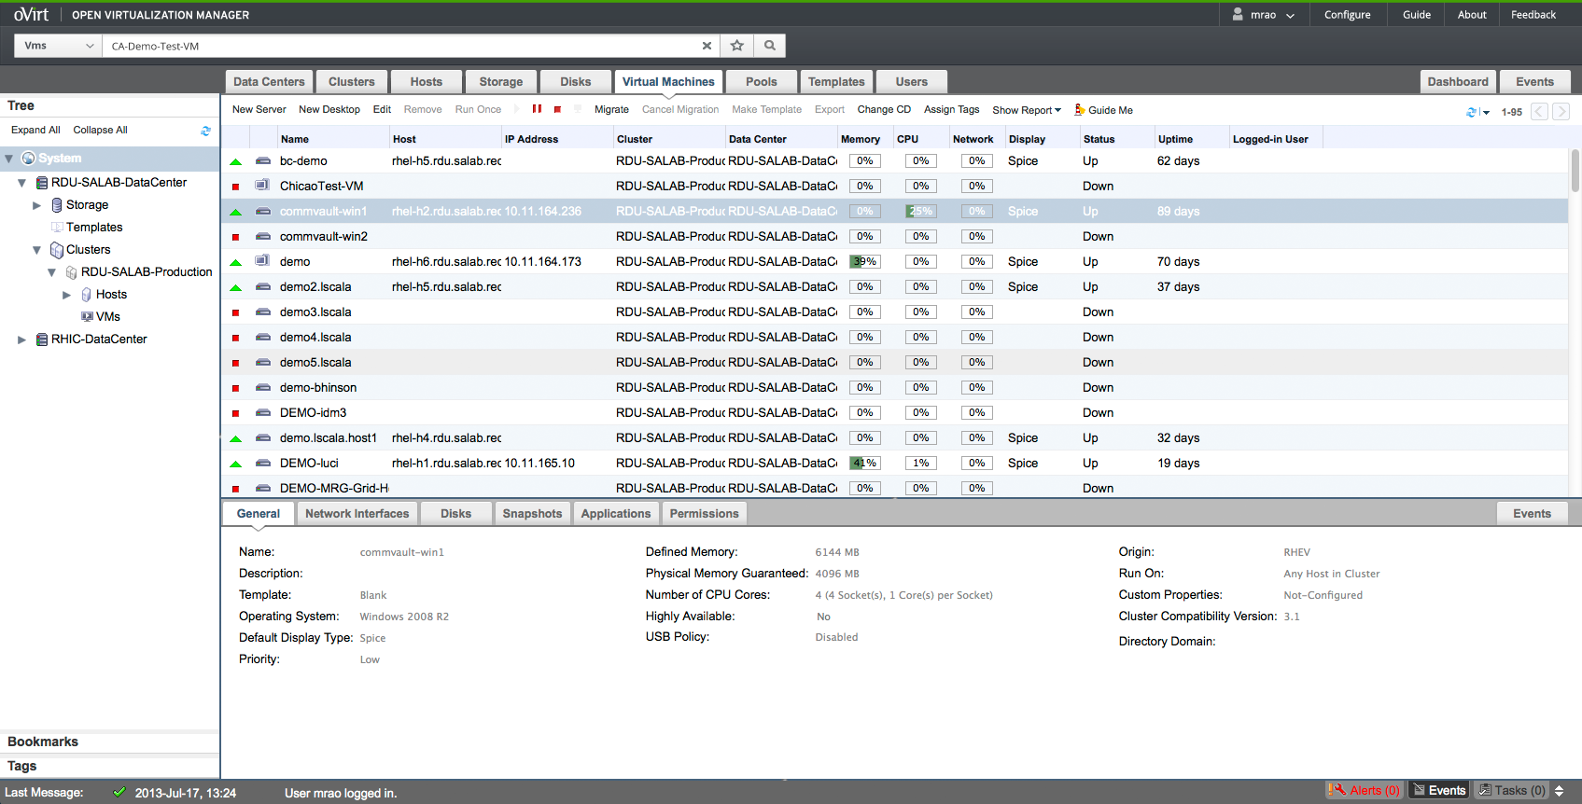
Administration Portal

Slide 5
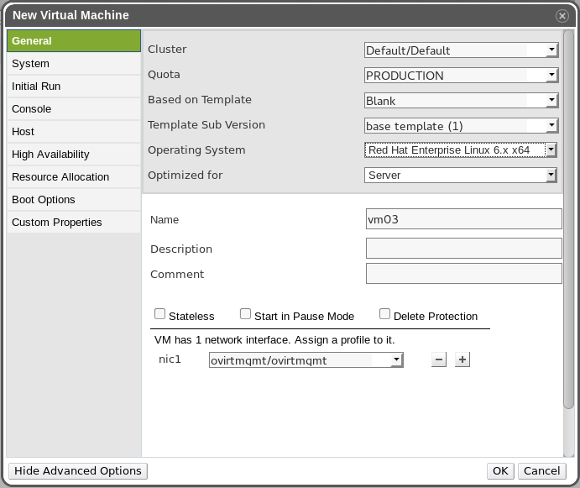
New VM

Slide 6
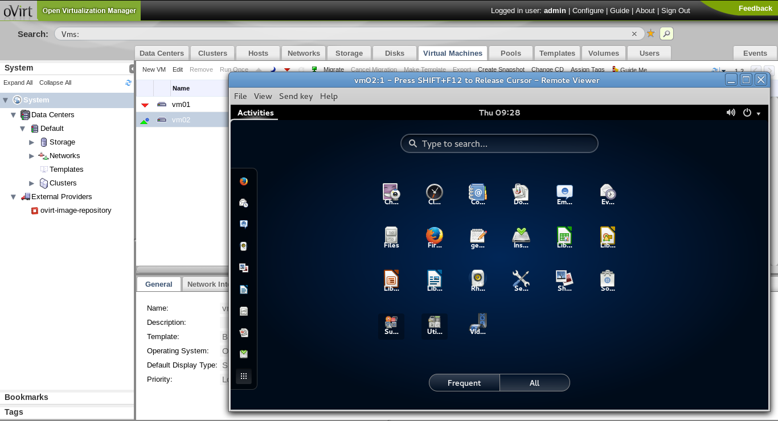
VM UP!

Slide 7
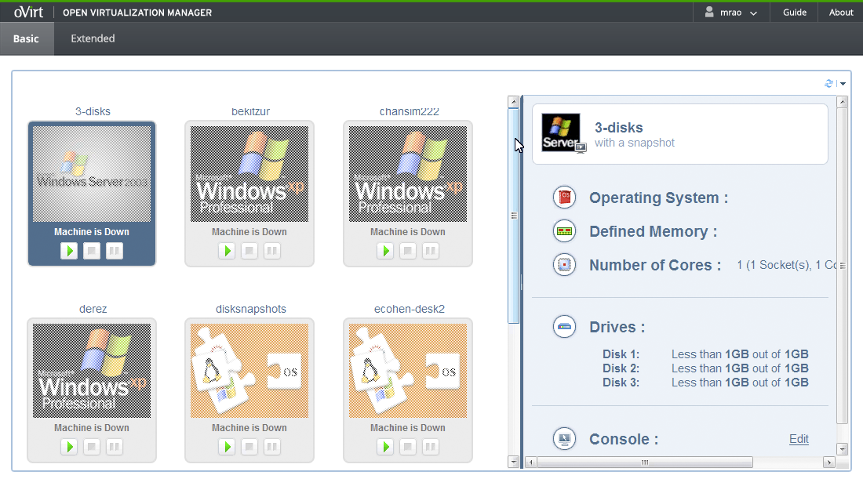
User Portal - Basic

Slide 8
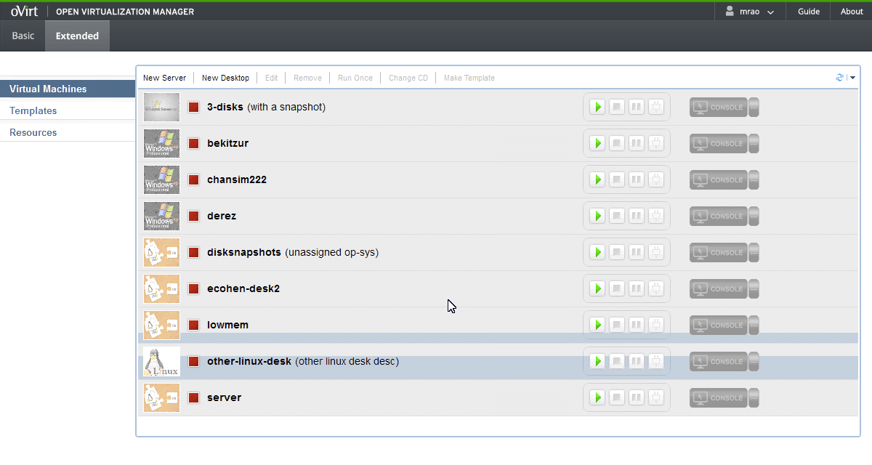
User Portal - Extended

Slide 9
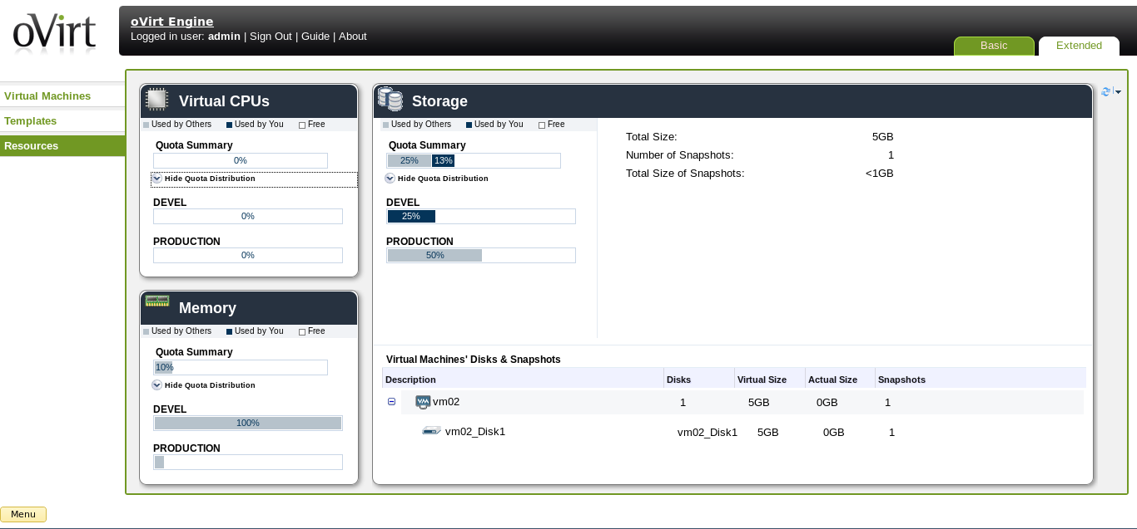
User Portal - Extended

Slide 10
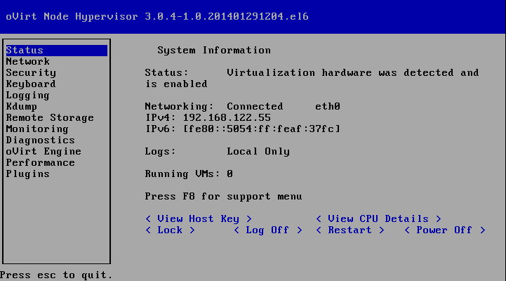
oVirt Node

Slide 11
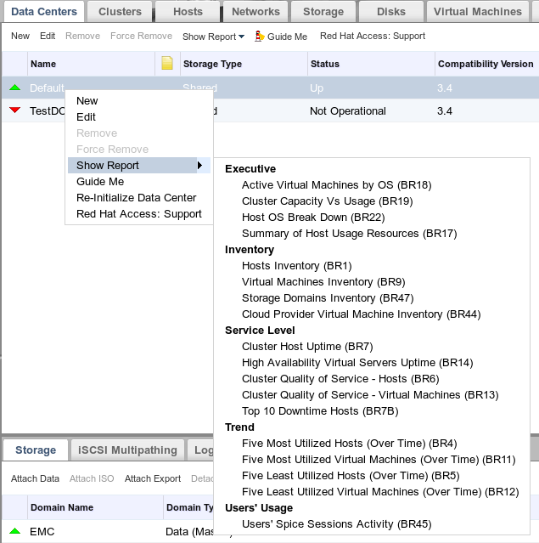
oVirt Reports

Slide 12
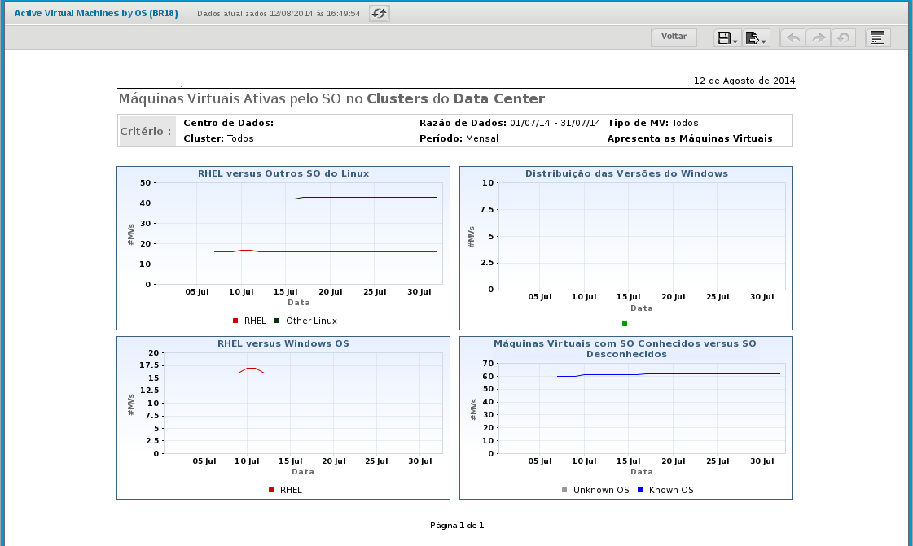
oVirt Reports

Slide 13
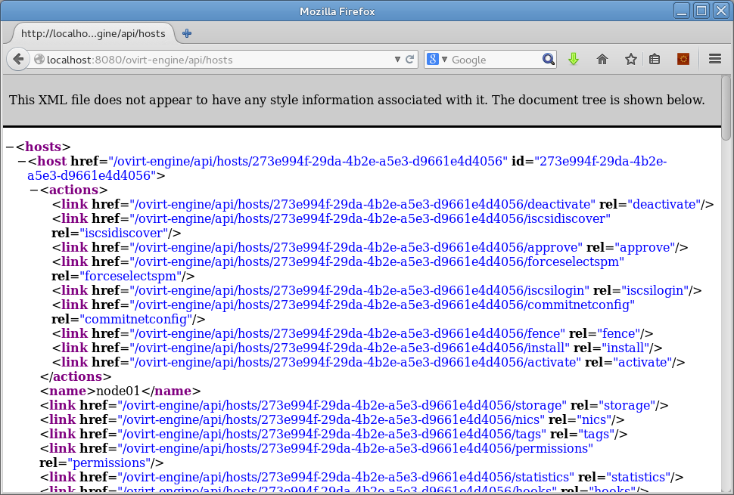
REST API

Slide 14
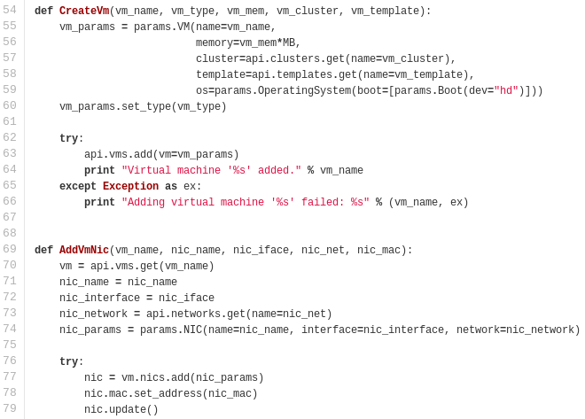
SDK

Slide 15
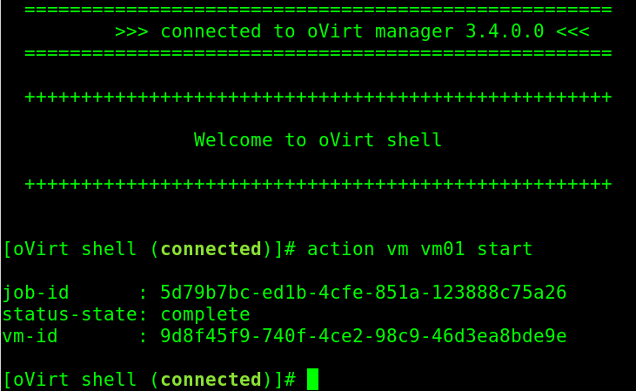
Shell

Slide 16
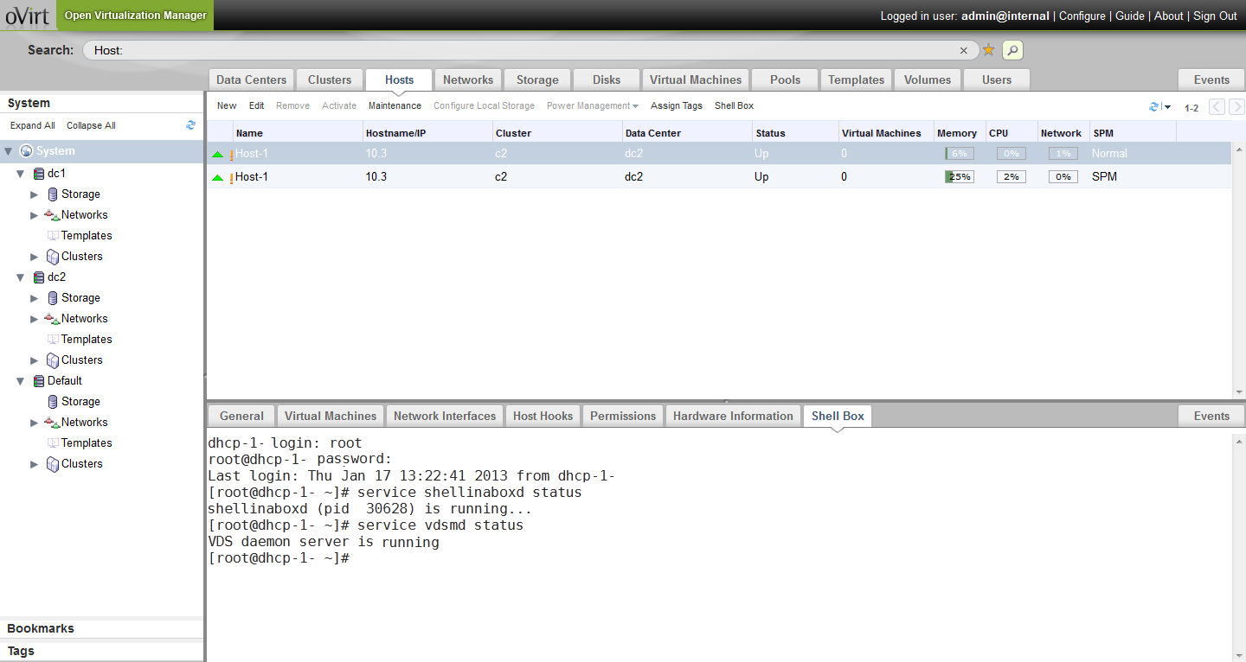
oVirt Plugins

Slide 17
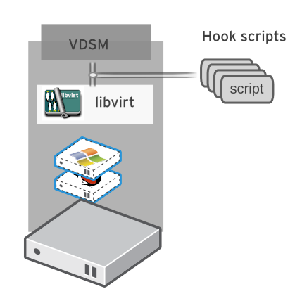
vdsm Hooks
NestedVT
SpiceOpts
QemuCmd
MacBind
...

Slide 18
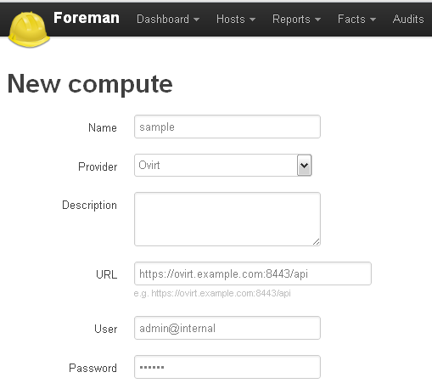
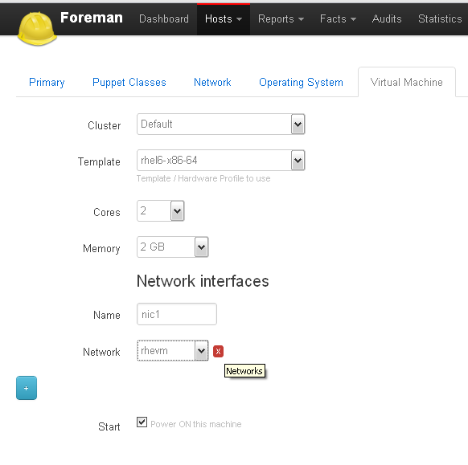
The Foreman - VM

Slide 19
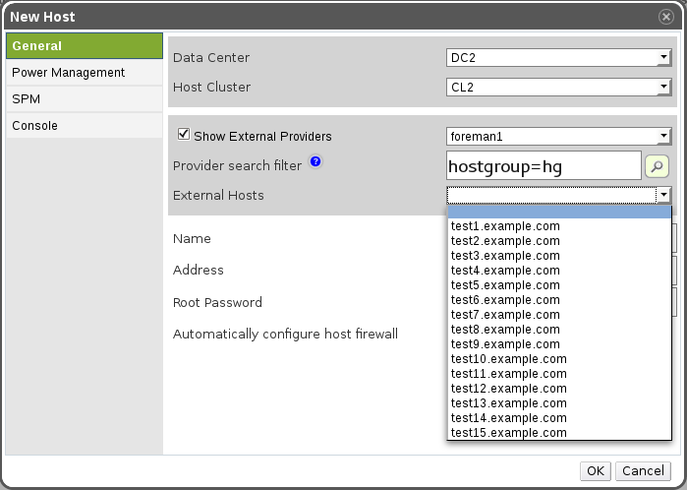
The Foreman - Host

Slide 20
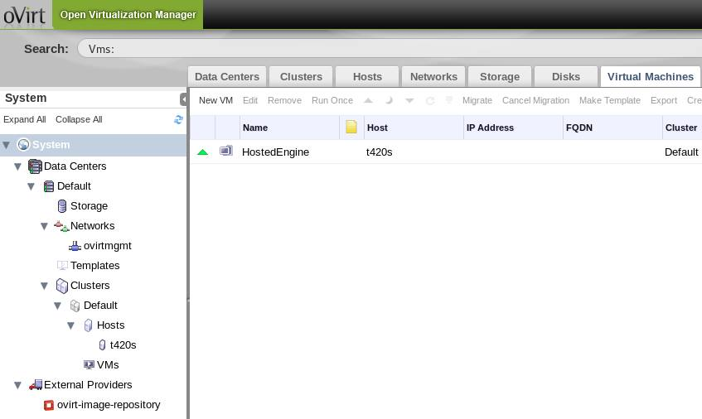
Hosted Engine

Slide 21
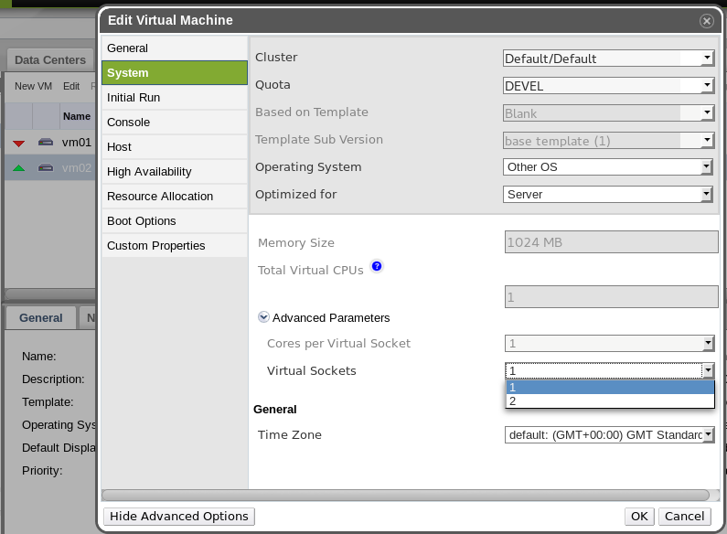
Hot-plug CPU
On The Way...

Slide 22
Guest Agent
OpenSUSE
http://download.opensuse.org/repositories/home:/evilissimo/openSUSE_13.1/
Ubuntu
https://launchpad.net/~zhshzhou/+archive/vdsm-ubuntu

Slide 23
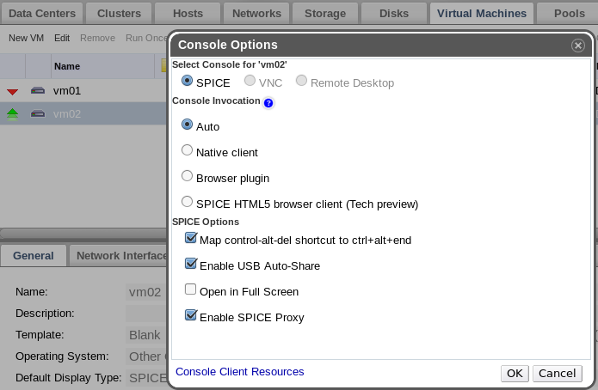
Spice Proxy
# engine-config -s SpiceProxyDefault=my.proxy.com:3128

Slide 24
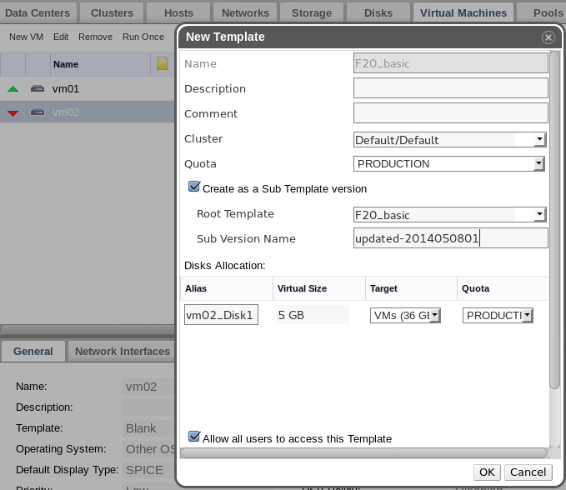
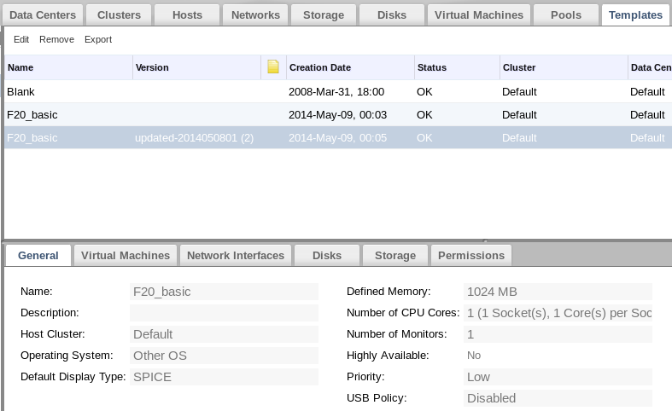
Template Versioning

Slide 25
SNMP Traps
Extends the events notifier
Integration with generic monitoring systems

Slide 26
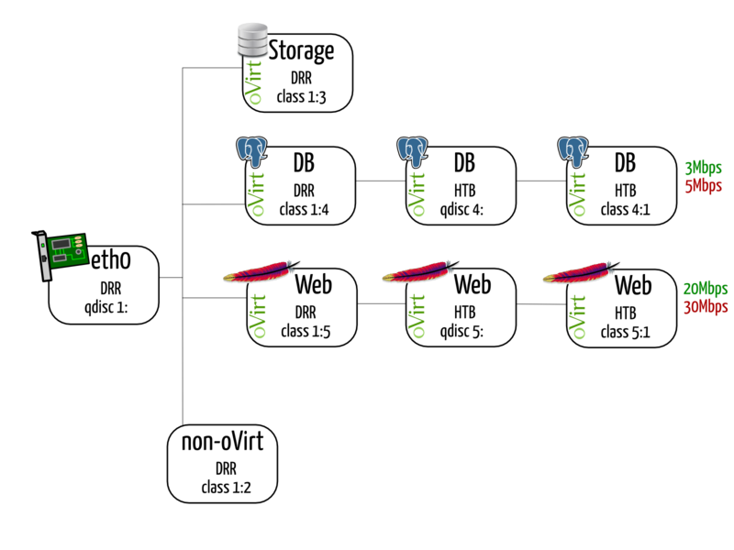
Host QoS

Slide 27
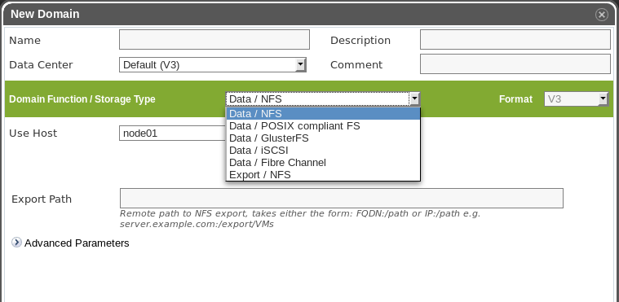
Multiple Storage Domains

Slide 28
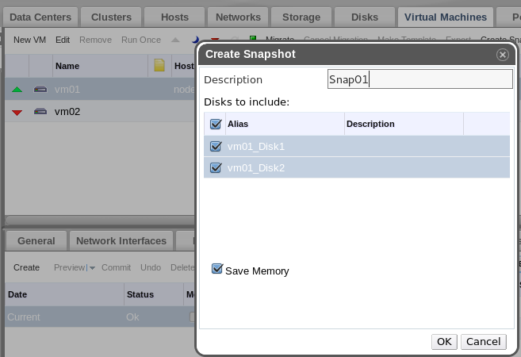
Single-disk Snapshot

Slide 29
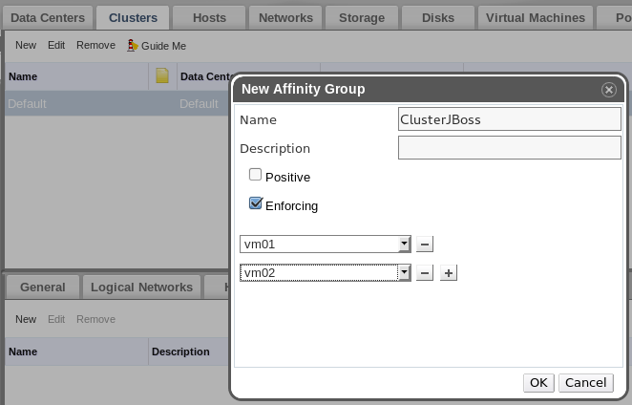
VM Affinity

Slide 30
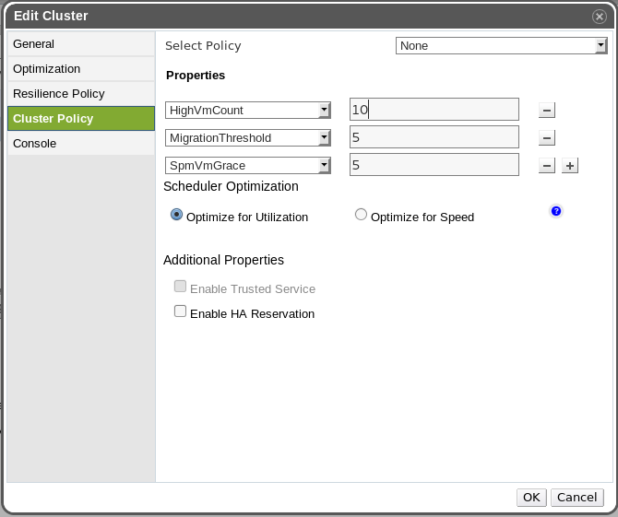
VM Count Distribution

Slide 31
HA Reservation

Slide 32
Community
Commiters:
  ovirt-engine: 139
  vdsm: 142
List members:
  users@ovirt.org: 715
  users-pt@ovirt.org: 41
  devel@ovirt.org: 369

Slide 33
Get Involved
http:/ /www.ovirt.org
http://lists.ovirt.org/mailman/listinfo/users
http://lists.ovirt.org/mailman/listinfo/users-pt
http://lists.ovirt.org/mailman/listinfo/devel
apahim AT redhat DOT com
apahim AT #ovirt (irc.oftc.net)

