Slide 1

3.4 HOT FEATURES
20140508 - APAHIM

Slide 2
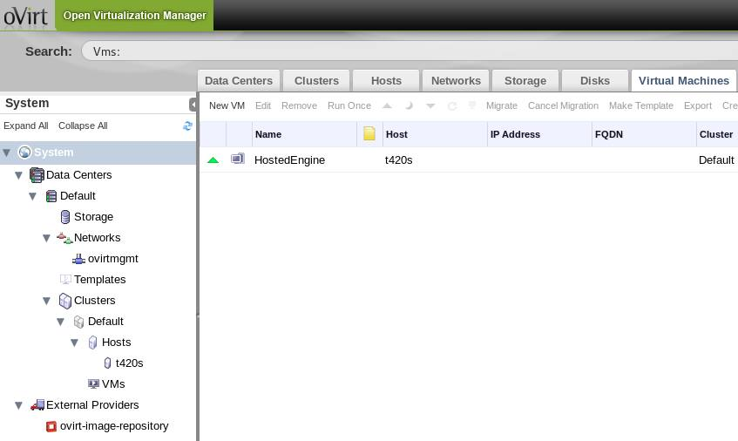
Hosted Engine

Slide 3
PPC64 Preview
Engine Awareness
vdsm Support

Slide 4
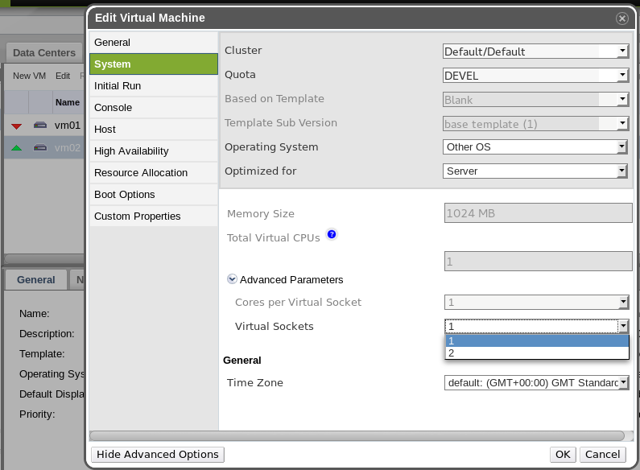
Hot-plug CPU
On The Way...

Slide 5
Guest Agent
OpenSUSE
http://download.opensuse.org/repositories/home:/evilissimo/openSUSE_13.1/
Ubuntu
https://launchpad.net/~zhshzhou/+archive/vdsm-ubuntu

Slide 6
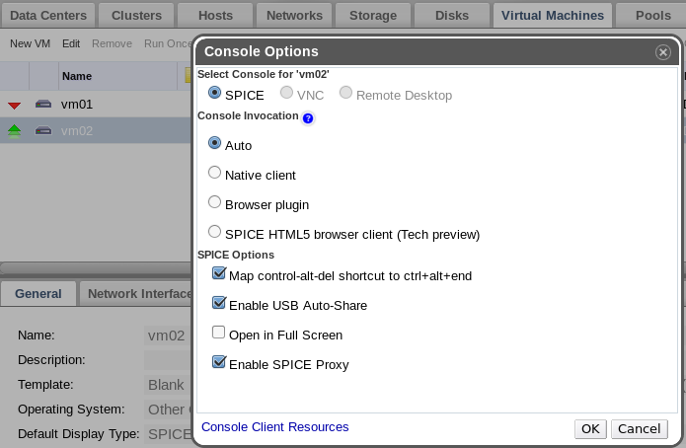
Spice Proxy
# engine-config -s SpiceProxyDefault=my.proxy.com:3128

Slide 7
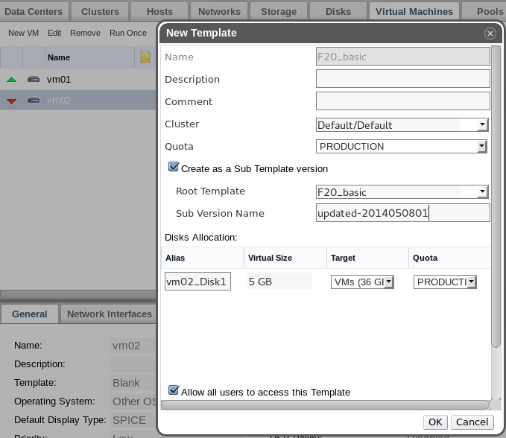
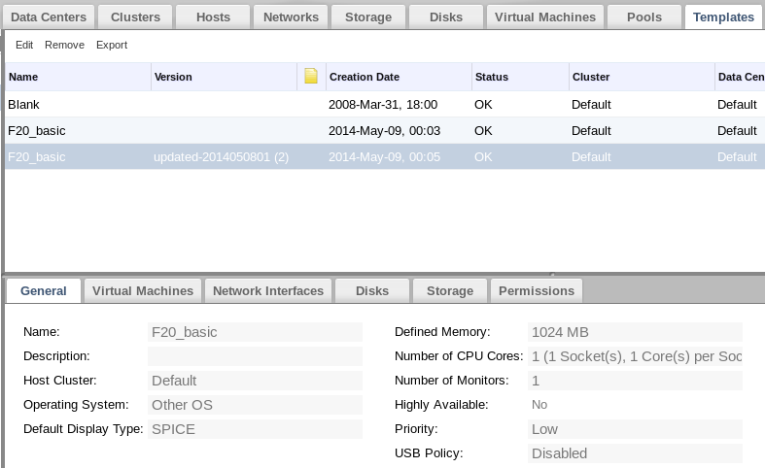
Template Versioning

Slide 8
SNMP Traps
Extends the events notifier
Integration with generic monitoring systems

Slide 9
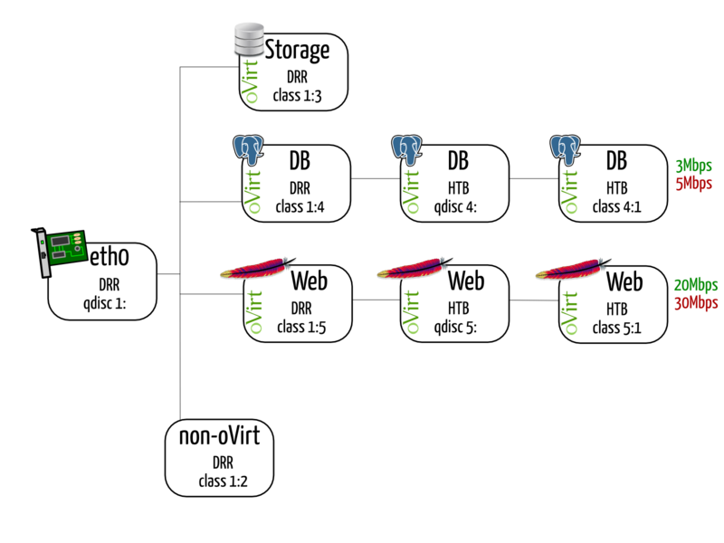
Host QoS

Slide 10
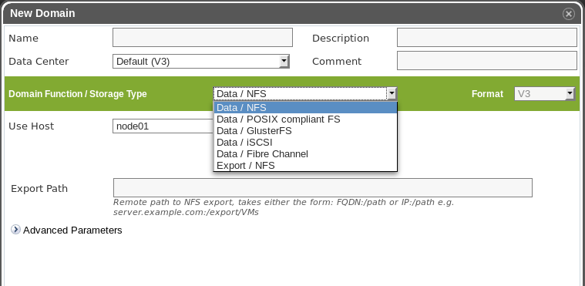
Multiple Storage Domains

Slide 11
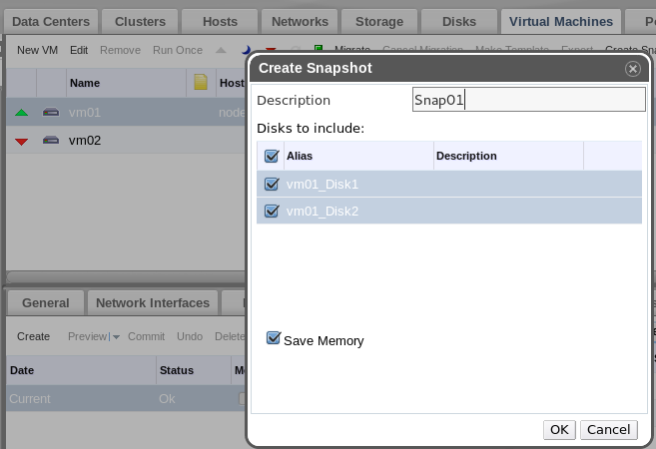
Single-disk Snapshot

Slide 12
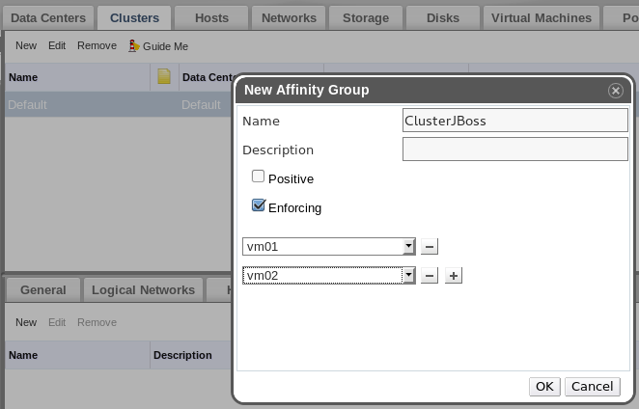
VM Affinity

Slide 13
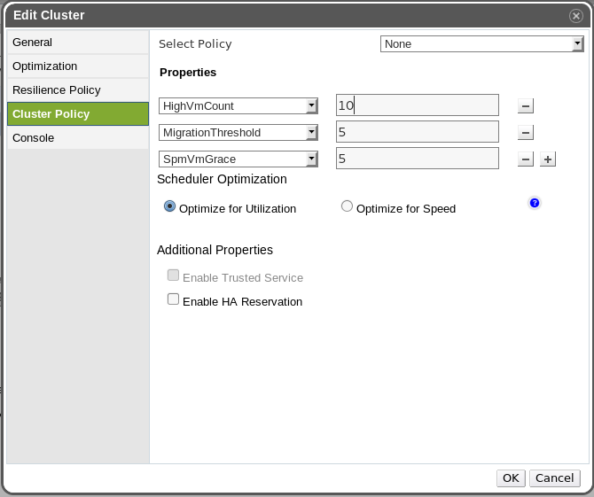
VM Count Distribution

Slide 14
HA Reservation

Slide 15
Get Involved
http:/ /www.ovirt.org
http://lists.ovirt.org/mailman/listinfo/users
http://lists.ovirt.org/mailman/listinfo/users-pt
apahim AT redhat DOT com
apahim AT #ovirt (irc.oftc.net)

