Slide 1
Open Source Virtualization with oVirt
DI (FH) René Koch
Systems Engineer
Siedl Networks GmbH
Chemnitzer Linuxtage, 22.03.2015

Slide 2
Agenda
What is oVirt?
Architecture and Components
    oVirt Node
    oVirt Engine
    API/SDK/CLI
    Extensions
Use Cases & Getting Started

Slide 3
What is oVirt?

Slide 4

What is oVirt?
Large scale, centralized management for server and desktop virtualization
Based on leading performance, scalability and security infrastructure technologies
Provide an open source alternative to vCenter/vSphere
Focus on KVM for best integration/performance
Focus on ease of use/deployment

Slide 5
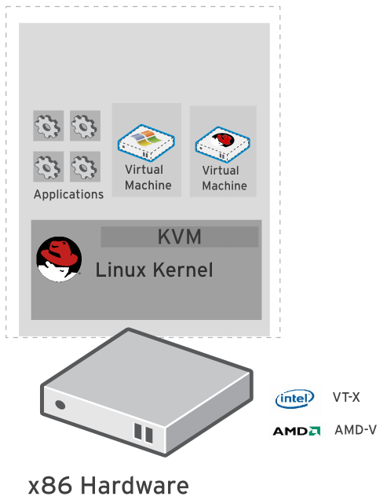
Kernel-based Virtual Machine
Included in Linux kernel since 2006
Runs Linux, Windows and other operating system guests
Advanced features
Live migration
Memory page sharing
Thin provisioning
PCI Pass-through
KVM architecture provides high
“feature-velocity” – leverages the power of Linux

Slide 6
Using KVM
/usr/libexec/qemu-kvm -name vm-f16-buildmachine -S -M rhel6.4.0 -cpu Westmere -enable-kvm -m 2048 -smp 2,sockets=2,cores=1,threads=1 -uuid a8ccdb60-8a42-44f5-9669-d74c3b2eff43 -smbios type=1,manufacturer=Red Hat,product=RHEV Hypervisor,version=6Server-6.4.0.4.el6,serial=30353036-3837-4247-3831-30394635324C_78:e7:d1:22:46:d8,uuid=a8ccdb60-8a42-44f5-9669-d74c3b2eff43 -nodefconfig -nodefaults -chardev socket,id=charmonitor,path=/var/lib/libvirt/qemu/vm-f16-buildmachine.monitor,server,nowait -mon chardev=charmonitor,id=monitor,mode=control -rtc base=2013-10-08T12:16:16,driftfix=slew -no-shutdown -device piix3-usb-uhci,id=usb,bus=pci.0,addr=0x1.0x2 -device virtio-serial-pci,id=virtio-serial0,bus=pci.0,addr=0x4 -drive if=none,media=cdrom,id=drive-ide0-1-0,readonly=on,format=raw,serial= -device ide-drive,bus=ide.1,unit=0,drive=drive-ide0-1-0,id=ide0-1-0 -drive file=/rhev/data-center/f79b0b28-c82f-11e0-8739-78e7d1e48c4c/5bab6470-8825-4e3a-b408-ebcde93678b6/images/4c213cd2-c4d5-441b-a1ac-dfb1a6868699/11b3e132-50a5-481b-b48b-e3b1f2879e69,if=none,id=drive-virtio-disk0,format=qcow2,serial=4c213cd2-c4d5-441b-a1ac-dfb1a6868699,cache=none,werror=stop,rerror=stop,aio=native -device virtio-blk-pci,scsi=off,bus=pci.0,addr=0x5,drive=drive-virtio-disk0,id=virtio-disk0,bootindex=1 -drive file=/rhev/data-center/f79b0b28-c82f-11e0-8739-78e7d1e48c4c/5bab6470-8825-4e3a-b408-ebcde93678b6/images/02330fa2-d1ff-48e0-a843-842c2376756f/5a283126-4d27-4eef-86dd-fb538d8d08e4,if=none,id=drive-virtio-disk1,format=qcow2,serial=02330fa2-d1ff-48e0-a843-842c2376756f,cache=none,werror=stop,rerror=stop,aio=native -device virtio-blk-pci,scsi=off,bus=pci.0,addr=0x6,drive=drive-virtio-disk1,id=virtio-disk1 -netdev tap,fd=31,id=hostnet0,vhost=on,vhostfd=32 -device virtio-net-pci,netdev=hostnet0,id=net0,mac=00:1a:4a:23:12:13,bus=pci.0,addr=0x3,bootindex=2 -chardev socket,id=charchannel0,path=/var/lib/libvirt/qemu/channels/vm-f16-buildmachine.com.redhat.rhevm.vdsm,server,nowait -device virtserialport,bus=virtio-serial0.0,nr=1,chardev=charchannel0,id=channel0,name=com.redhat.rhevm.vdsm -chardev socket,id=charchannel1,path=/var/lib/libvirt/qemu/channels/vm-f16-buildmachine.org.qemu.guest_agent.0,server,nowait -device virtserialport,bus=virtio-serial0.0,nr=2,chardev=charchannel1,id=channel1,name=org.qemu.guest_agent.0 -chardev spicevmc,id=charchannel2,name=vdagent -device virtserialport,bus=virtio-serial0.0,nr=3,chardev=charchannel2,id=channel2,name=com.redhat.spice.0 -spice port=5904,tls-port=5905,addr=10.35.16.4,x509-dir=/etc/pki/vdsm/libvirt-spice,tls-channel=main,tls-channel=display,tls-channel=inputs,tls-channel=cursor,tls-channel=playback,tls-channel=record,tls-channel=smartcard,tls-channel=usbredir,seamless-migration=on -k en-us -vga qxl -global qxl-vga.ram_size=67108864 -global qxl-vga.vram_size=67108864

Slide 7
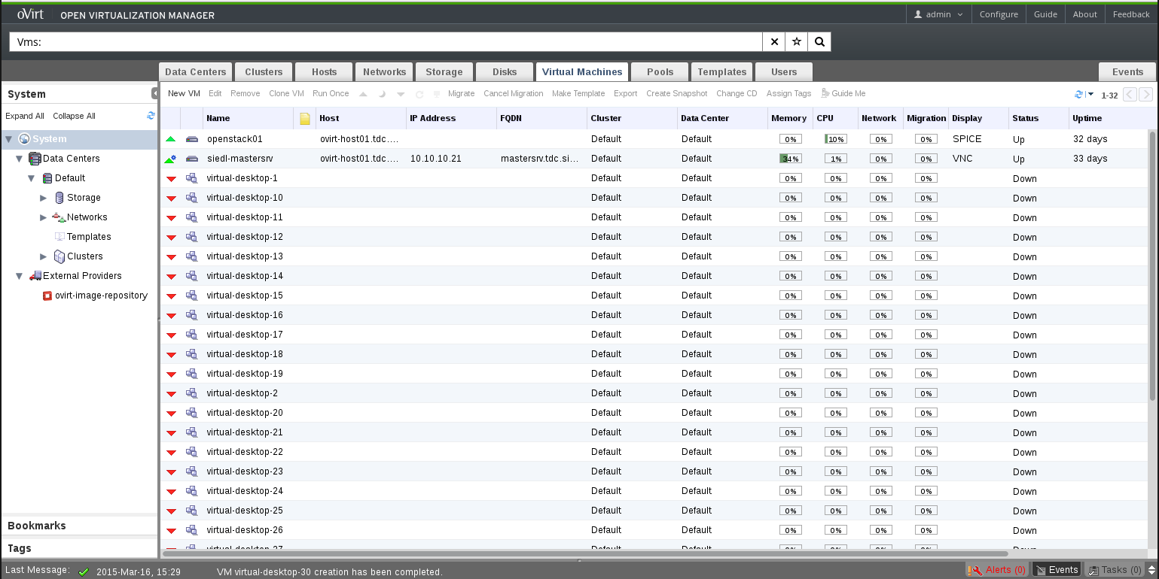
How Does it Look?

Slide 8
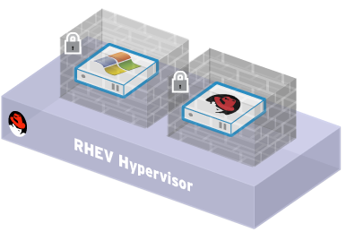
Security
oVirt inherits the security features of Linux
SELinux security policy infrastructure
Provides protection and isolation for virtual machines and host
Compromised virtual machine cannot access other VMs or host
sVirt Project
Sub-project of SELinux community. Provides “hardened” hypervisors
Multilevel security. Isolate guests
Contain any hypervisor breaches

Slide 9
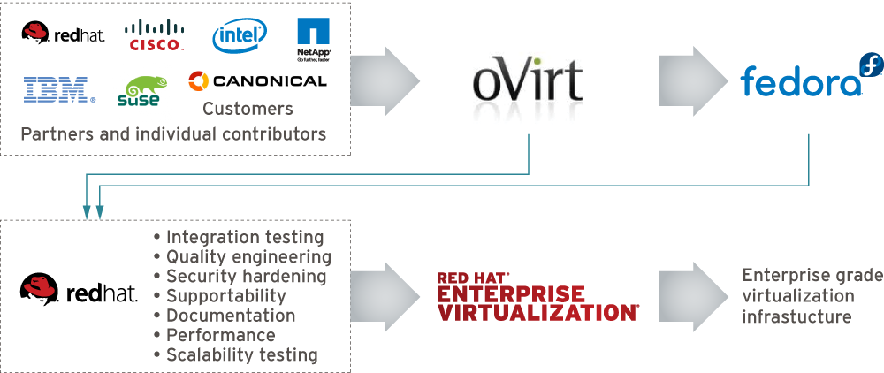
How is Behind it?

Slide 10
Architecture and Components

Slide 11
oVirt: Not a Single Project
Current List of Upstream Projects
oVirt-Engine
VDSM
oVirt-Node
ovirt-Engine-SDK
oVirt-Engine-CLI
oVirt-Guest-Agent
oVirt-Image-Uploader
oVirt-iso-Uploader
oVirt-Log-Collector
oVirt-DWH
oVirt-Reports
Incubation Projects
  MOM
  moVirt
Test Projects

Slide 12
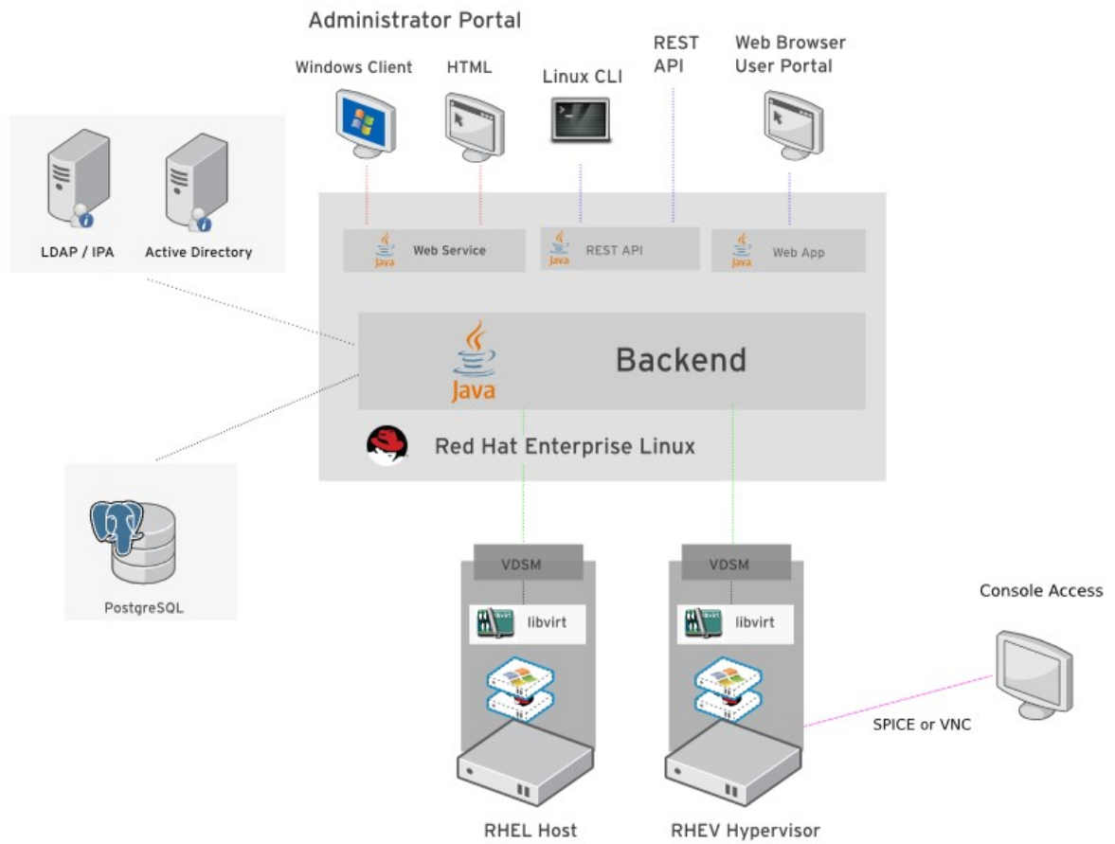
Architecture

Slide 13
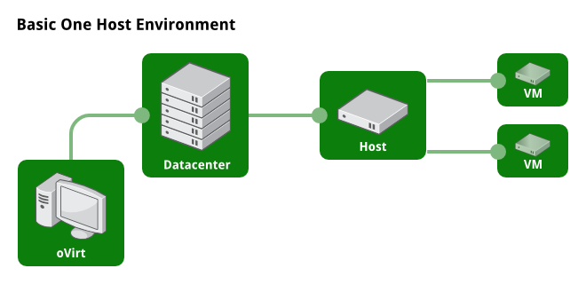
Example Setup

Slide 14
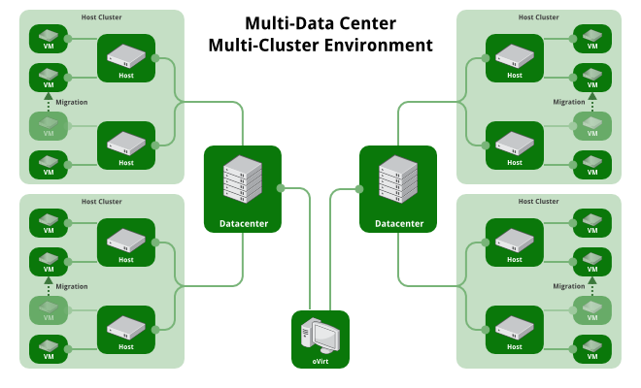
Example Setup

Slide 15
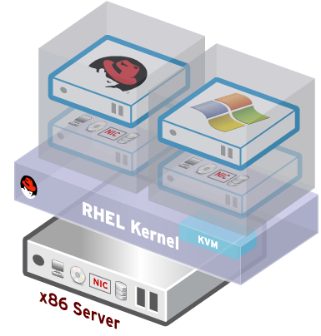
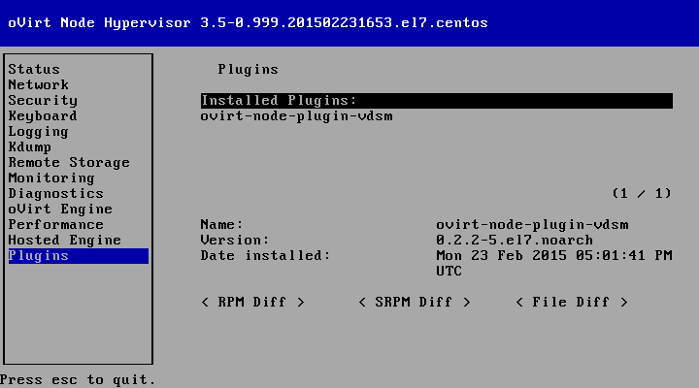
oVirt Node
Standalone hypervisor
  Small footprint < 100MB
    Customized 'spin' of CentOS + KVM
    'Just enough' CentOS to run virtual machines
    Runs on all RHEL hardware
    with Intel VT/AMD-V CPUs
  Easy to install, configure and upgrade
    PXE boot, USB boot, CD or Hard drive

Slide 16
oVirt Engine
High Availability
Live Migration
Load Balancing (DRS)
Power Saver (DPM)
Maintenance Manager (oVirt Node Updates)
Image Management (Templates, Thin Provisioning, Snapshots)
Storage and Network Management
Monitoring and Reporting
V2V and P2V (VMware, XEN, KVM -> oVirt)
VDI for Windows and Linux guests

Slide 17
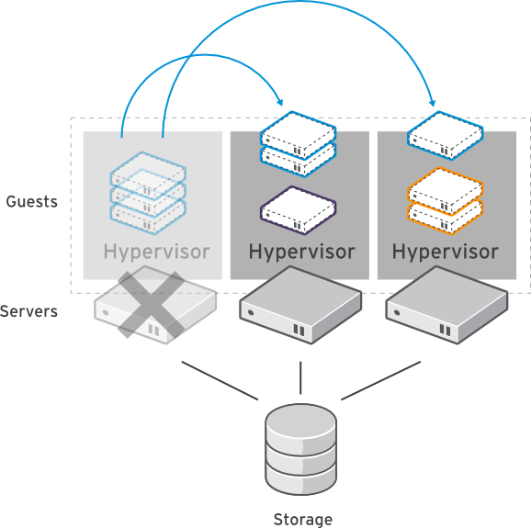
High Availability
Build a highly available enterprise infrastructure
Continually monitor host systems and virtual machines
Automatically restart virtual machines in case of host failure
Restart virtual machine on another node in the cluster
Use live migration to “fail-back” a VM to it's original host when the server is restored

Slide 18
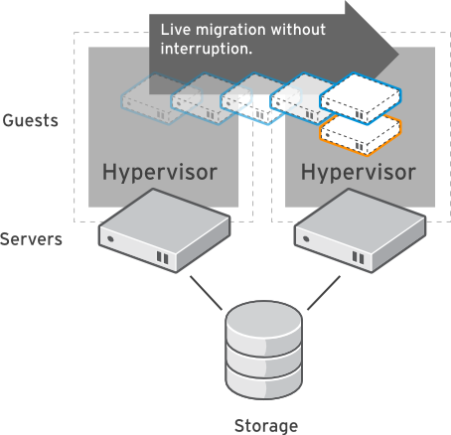
Live Migration
Dynamically move virtual machines between hosts
  No service interruption
  Applications continue to run
Migrate even I/O intensive workloads such as databases
Perform hardware maintenance without application downtime
Dynamically balance workloads between host systems

Slide 19
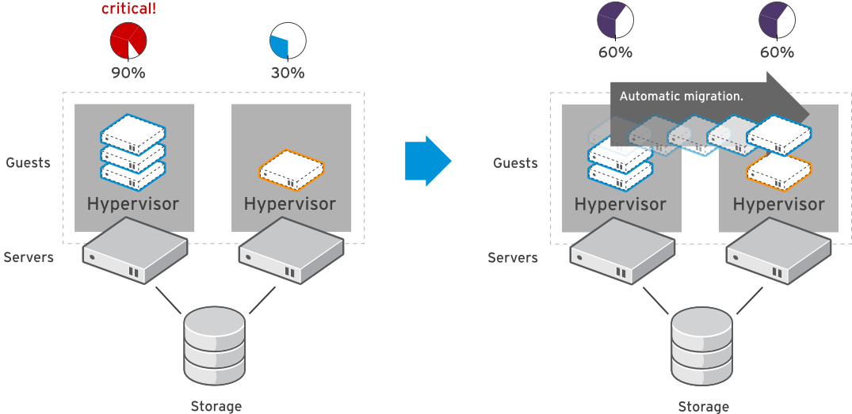
System Scheduler
Dynamically balance workloads in the data center.
Automatically live migrate virtual machines based on resources
Define custom policies for distribution of virtual machines
Maintain consistent resource usage across the enterprise data center

Slide 20
Storage
Data Domain
  NFS
  iSCSI
  Fibre Channel
  POSIX compliant storage
  GlusterFS
  Local on host
ISO Domain
Export Domain

Slide 21
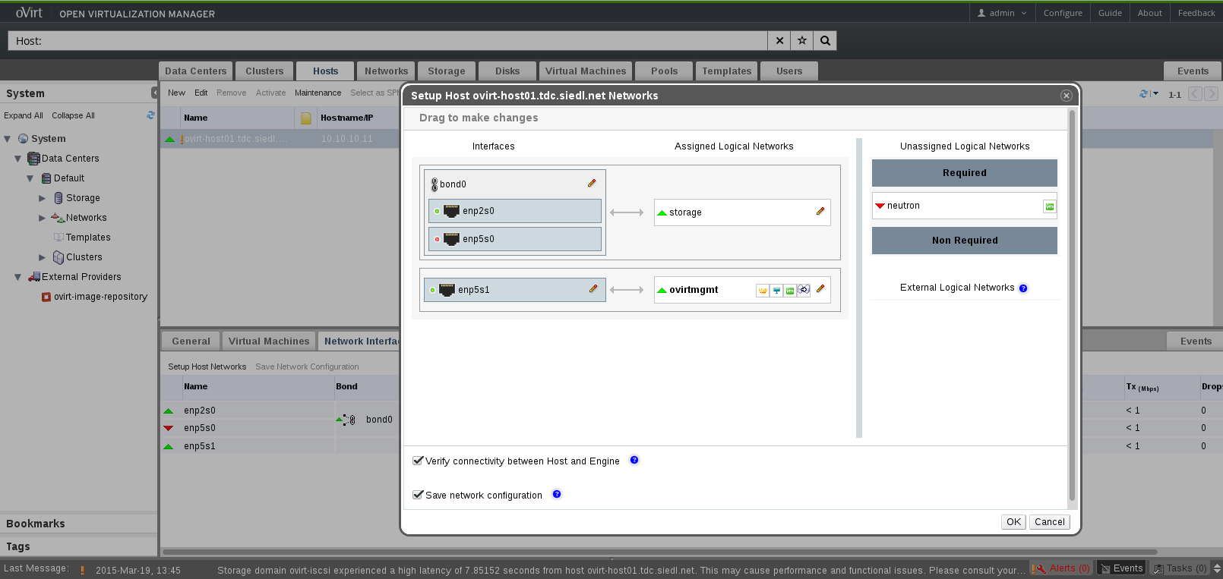
Configure Network

Slide 22
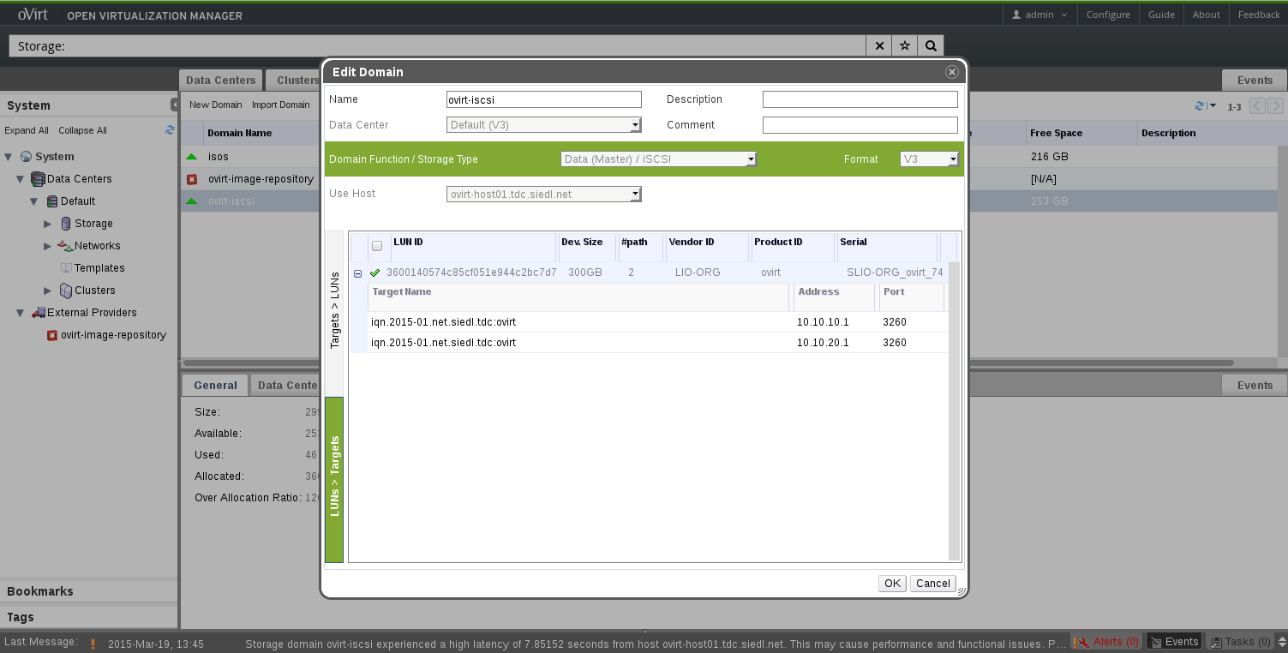
Configure Storage

Slide 23
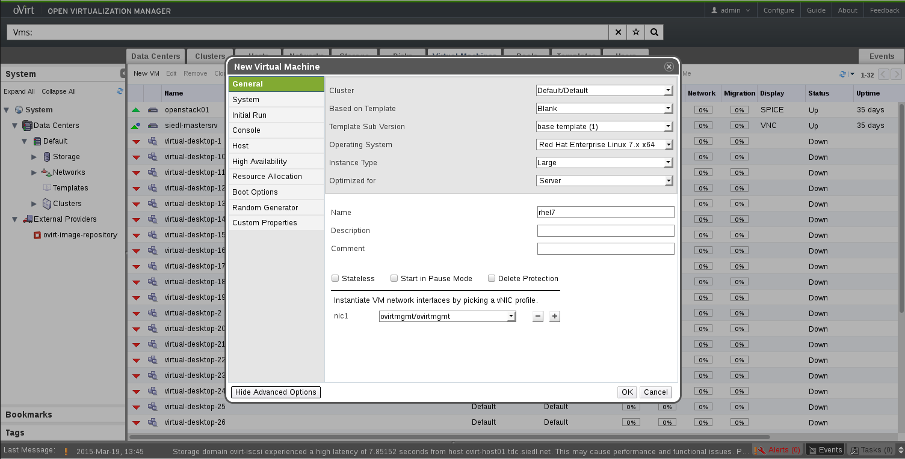
Add Virtual Servers or Desktops

Slide 24
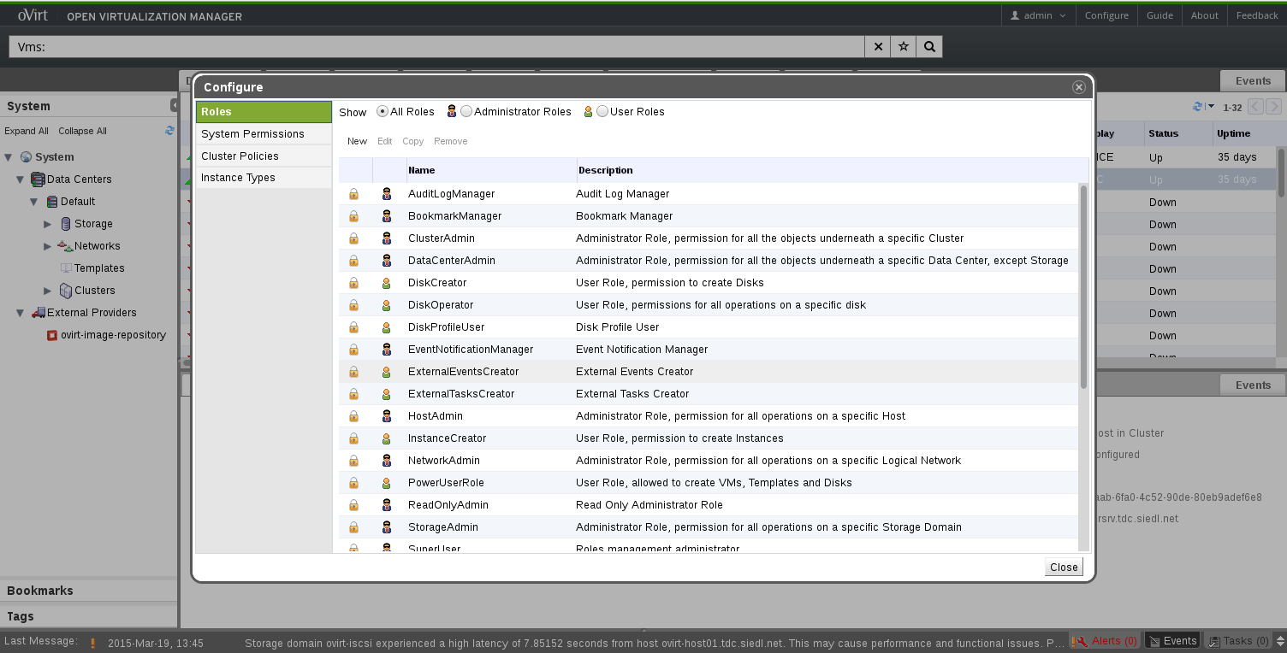
Add Permissions to Objects

Slide 25
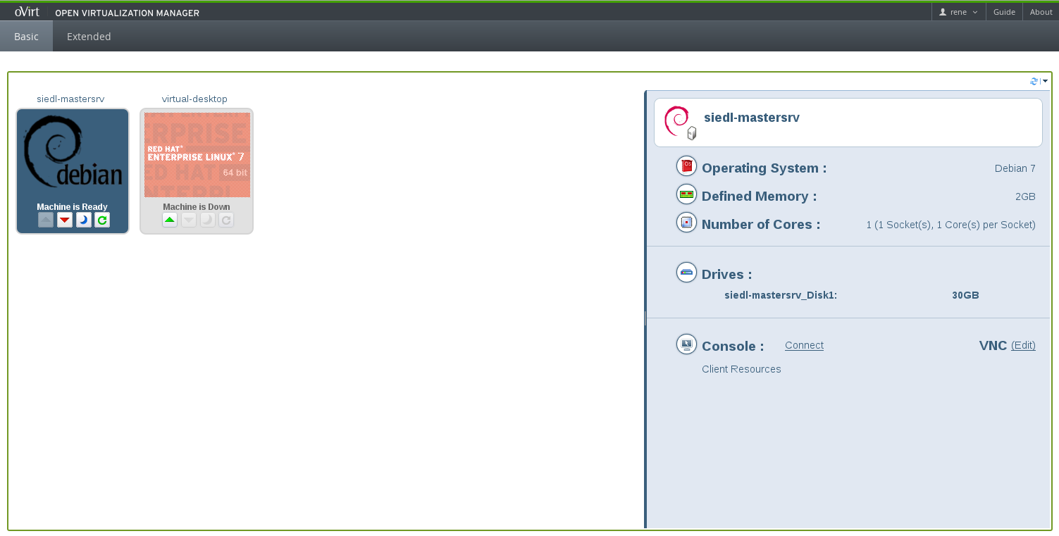
User Portal

Slide 26
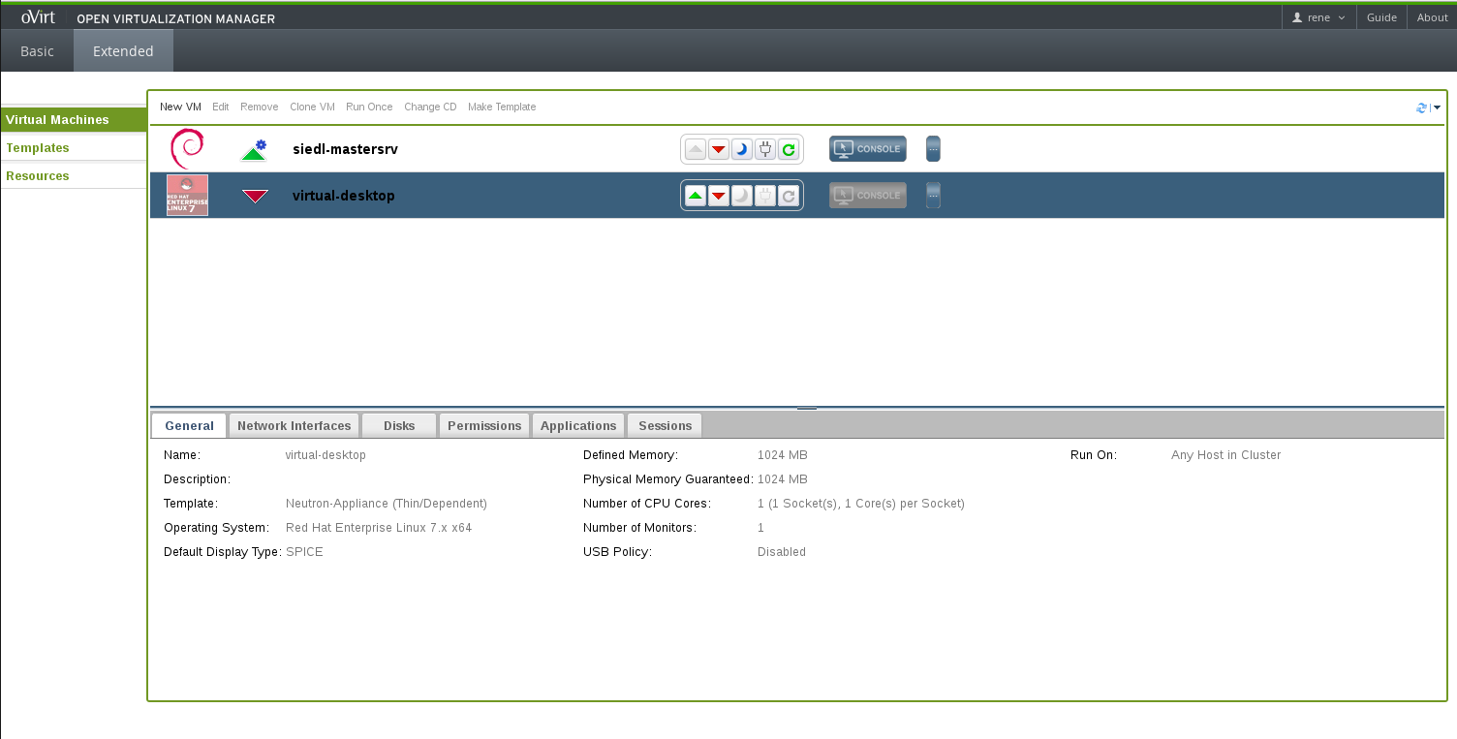
Self-Provisioning Portal

Slide 27
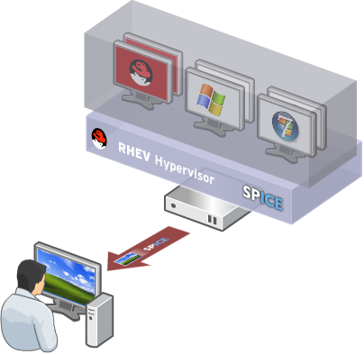
Virtual Desktop Infrastructure (VDI)
Centralized management, security and policy enforcement
Virtual desktops with user experience of a physical PC
  Multiple monitors
  HD-quality video
  Bi-directional audio/video for VoIP or video-conferencing
  Smartcard support
  USB support
Industry-leading density of virtual desktops/server

Slide 28
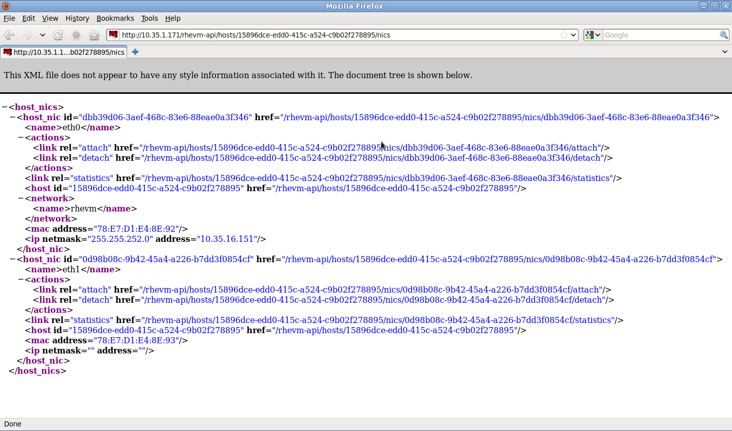
REST-API
Representational State Transfer
HTTP Actions
  GET
  PUT
  POST
  DELETE
Execute all tasks like in Admin Portal and even more

Slide 29
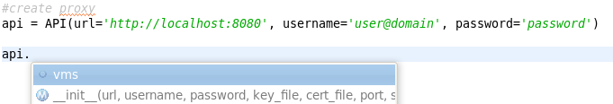

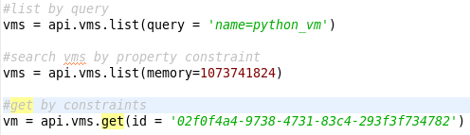

Python SDK
- Creating the proxy
- Listing all collections
- Listing collection's methods.
- Querying collection with oVirt search
engine.
- Querying collection by custom constraint.
- Querying collection for specific resource.
- Accessing resource methods and
properties.

Slide 30
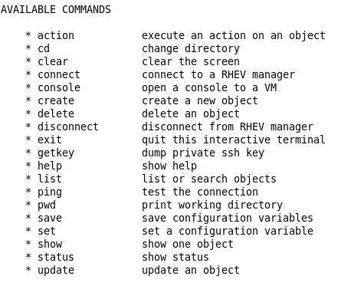
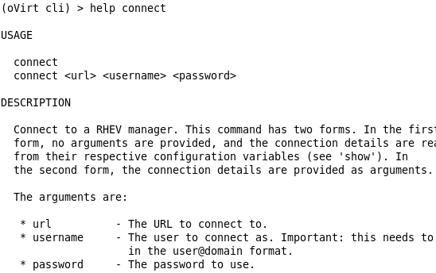
oVirt CLI

Slide 31
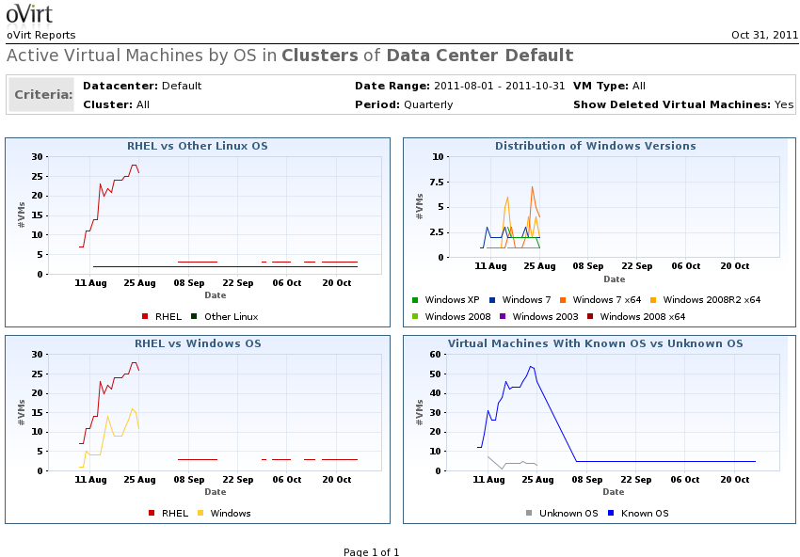
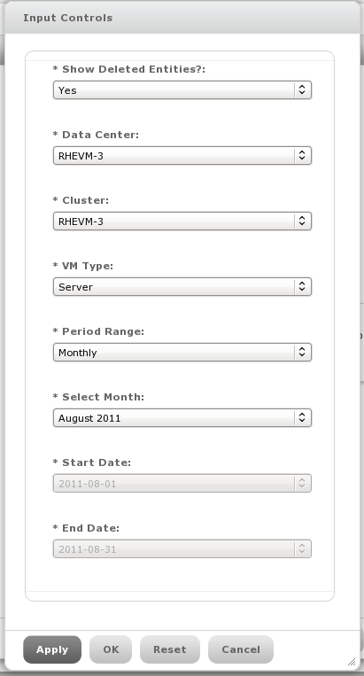
oVirt Reports

Slide 32
UI Plugins
Infrastructure and API for Creating User Interface Plugins for oVirt Engine
Introduced in oVirt 3.2
Extend oVirt Webadmin with:
  Main Tabs
  Sub Tabs
  Buttons
  Dialogs
More Information:
  http://www.ovirt.org/Features/UIPlugins

Slide 33
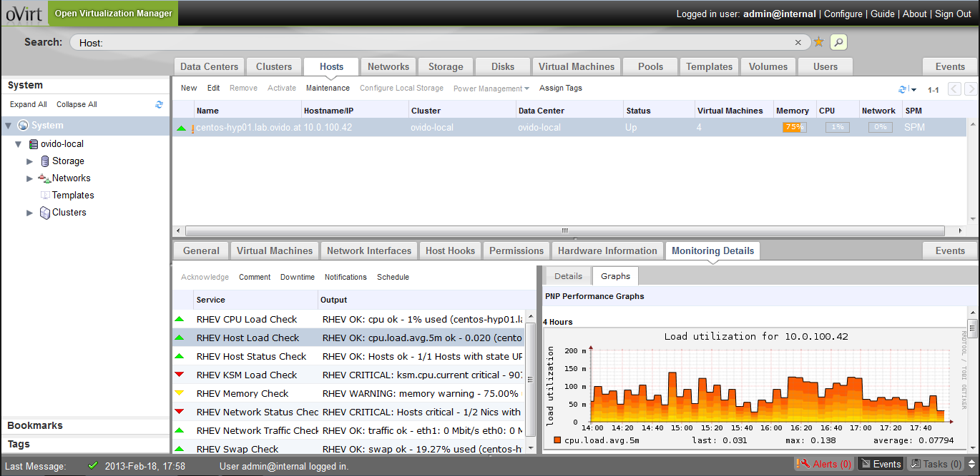
UI Plugins
More information: https://github.com/monitoring-ui-plugin

Slide 34
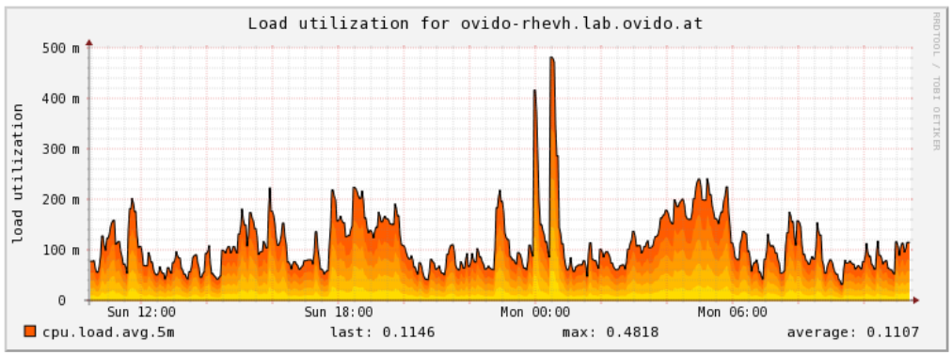
Monitoring - check_rhev3
Nagios/Icinga plugin for monitoring an oVirt environment: check_rhev3
https://github.com/ovido/check_rhev3
Monitoring of:
  Datacenters
  Clusters
  Hosts
  Storagedomains
  Virtual Machines
  Virtual Machine Pools

Slide 35
Use Cases and Getting Started with oVirt

Slide 36
Use Cases
Server Virtualization
Desktop Virtualization (VDI)
Private Clouds
  Use DWH/PostgreSQL database for resource usage or runtime billing
  Developer Portal
Virtualized Call Centers
Virtualized Computer Rooms (Schools, Universities)
Remote offices
Admin VMs

Slide 37
Getting oVirt
Obtain from oVirt website -
  http://www.ovirt.org/Download
Fedora repositories
CentOS/RHEL repositories
Live USB - http://wiki.ovirt.org/wiki/OVirt_Live
Build from source

Slide 38
How to Contribute
Join the community
- Find bugs, file them, correct them.
- Translate, write documentation.
- Design interfaces, develop new features
- Share your experiences.
Everyone can make a difference.
Mailing lists:
  http://lists.ovirt.org/mailman/listinfo
IRC:
  #ovirt on OFTC
Website and Repository:
  http://www.ovirt.org
  http://www.ovirt.org/wiki
  http://www.ovirt.org/project/subprojects/

Slide 39
THANK YOU!
http://www.ovirt.org
rene.koch@siedl.net

