Slide 1
Open Source Virtualization with oVirt
DI (FH) René Koch
Systems Engineer
Siedl Networks GmbH
Grazer Linuxtage, 25.04.2015

Slide 2
Agenda
What is oVirt?
Architecture and Components
New Features in oVirt 3.5
Planned Features in oVirt 3.6
Interaction with OpenStack
Use Cases & Getting Started

Slide 3
What is oVirt?

Slide 4

What is oVirt?
Large scale, centralized management for server and desktop virtualization
Based on leading performance, scalability and security infrastructure technologies
Provide an open source alternative to vCenter/vSphere
Focus on KVM for best integration/performance
Focus on ease of use/deployment

Slide 5
Using KVM
/usr/libexec/qemu-kvm -name vm-f16-buildmachine -S -M rhel6.4.0 -cpu Westmere -enable-kvm -m 2048 -smp 2,sockets=2,cores=1,threads=1 -uuid a8ccdb60-8a42-44f5-9669-d74c3b2eff43 -smbios type=1,manufacturer=Red Hat,product=RHEV Hypervisor,version=6Server-6.4.0.4.el6,serial=30353036-3837-4247-3831-30394635324C_78:e7:d1:22:46:d8,uuid=a8ccdb60-8a42-44f5-9669-d74c3b2eff43 -nodefconfig -nodefaults -chardev socket,id=charmonitor,path=/var/lib/libvirt/qemu/vm-f16-buildmachine.monitor,server,nowait -mon chardev=charmonitor,id=monitor,mode=control -rtc base=2013-10-08T12:16:16,driftfix=slew -no-shutdown -device piix3-usb-uhci,id=usb,bus=pci.0,addr=0x1.0x2 -device virtio-serial-pci,id=virtio-serial0,bus=pci.0,addr=0x4 -drive if=none,media=cdrom,id=drive-ide0-1-0,readonly=on,format=raw,serial= -device ide-drive,bus=ide.1,unit=0,drive=drive-ide0-1-0,id=ide0-1-0 -drive file=/rhev/data-center/f79b0b28-c82f-11e0-8739-78e7d1e48c4c/5bab6470-8825-4e3a-b408-ebcde93678b6/images/4c213cd2-c4d5-441b-a1ac-dfb1a6868699/11b3e132-50a5-481b-b48b-e3b1f2879e69,if=none,id=drive-virtio-disk0,format=qcow2,serial=4c213cd2-c4d5-441b-a1ac-dfb1a6868699,cache=none,werror=stop,rerror=stop,aio=native -device virtio-blk-pci,scsi=off,bus=pci.0,addr=0x5,drive=drive-virtio-disk0,id=virtio-disk0,bootindex=1 -drive file=/rhev/data-center/f79b0b28-c82f-11e0-8739-78e7d1e48c4c/5bab6470-8825-4e3a-b408-ebcde93678b6/images/02330fa2-d1ff-48e0-a843-842c2376756f/5a283126-4d27-4eef-86dd-fb538d8d08e4,if=none,id=drive-virtio-disk1,format=qcow2,serial=02330fa2-d1ff-48e0-a843-842c2376756f,cache=none,werror=stop,rerror=stop,aio=native -device virtio-blk-pci,scsi=off,bus=pci.0,addr=0x6,drive=drive-virtio-disk1,id=virtio-disk1 -netdev tap,fd=31,id=hostnet0,vhost=on,vhostfd=32 -device virtio-net-pci,netdev=hostnet0,id=net0,mac=00:1a:4a:23:12:13,bus=pci.0,addr=0x3,bootindex=2 -chardev socket,id=charchannel0,path=/var/lib/libvirt/qemu/channels/vm-f16-buildmachine.com.redhat.rhevm.vdsm,server,nowait -device virtserialport,bus=virtio-serial0.0,nr=1,chardev=charchannel0,id=channel0,name=com.redhat.rhevm.vdsm -chardev socket,id=charchannel1,path=/var/lib/libvirt/qemu/channels/vm-f16-buildmachine.org.qemu.guest_agent.0,server,nowait -device virtserialport,bus=virtio-serial0.0,nr=2,chardev=charchannel1,id=channel1,name=org.qemu.guest_agent.0 -chardev spicevmc,id=charchannel2,name=vdagent -device virtserialport,bus=virtio-serial0.0,nr=3,chardev=charchannel2,id=channel2,name=com.redhat.spice.0 -spice port=5904,tls-port=5905,addr=10.35.16.4,x509-dir=/etc/pki/vdsm/libvirt-spice,tls-channel=main,tls-channel=display,tls-channel=inputs,tls-channel=cursor,tls-channel=playback,tls-channel=record,tls-channel=smartcard,tls-channel=usbredir,seamless-migration=on -k en-us -vga qxl -global qxl-vga.ram_size=67108864 -global qxl-vga.vram_size=67108864

Slide 6
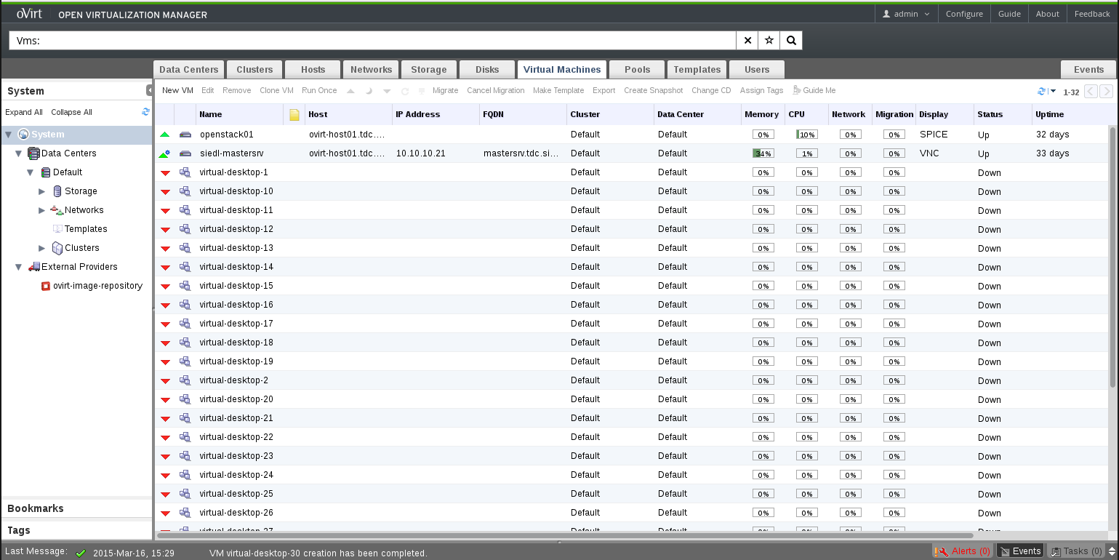
How Does it Look?

Slide 7
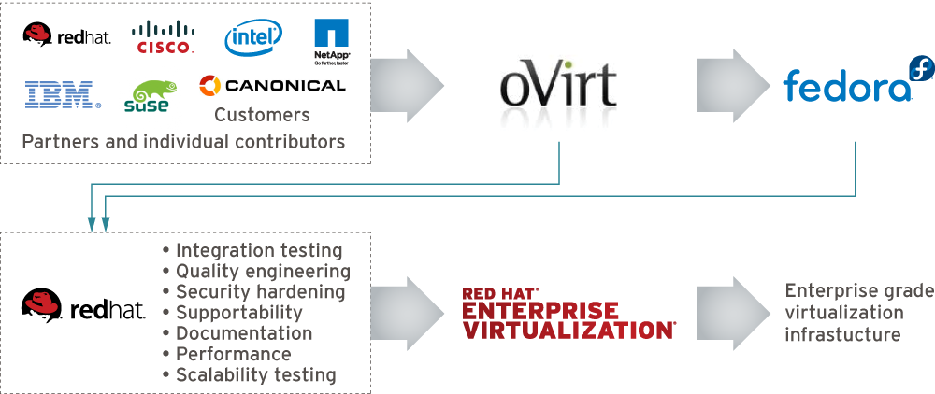
How is Behind it?

Slide 8
Architecture and Components

Slide 9
oVirt: Not a Single Project
Current List of Upstream Projects
oVirt-Engine
VDSM
oVirt-Node
ovirt-Engine-SDK
oVirt-Engine-CLI
oVirt-Guest-Agent
oVirt-Image-Uploader
oVirt-iso-Uploader
oVirt-Log-Collector
oVirt-DWH
oVirt-Reports
Incubation Projects
  MOM
  moVirt
Test Projects

Slide 10
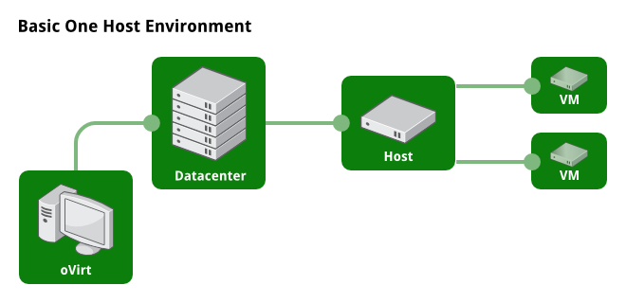
Example Setup

Slide 11
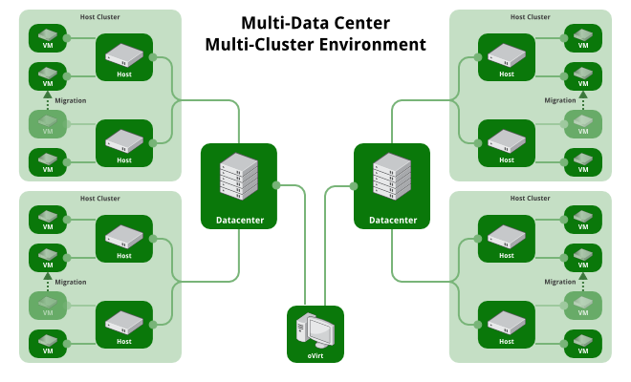
Example Setup

Slide 12
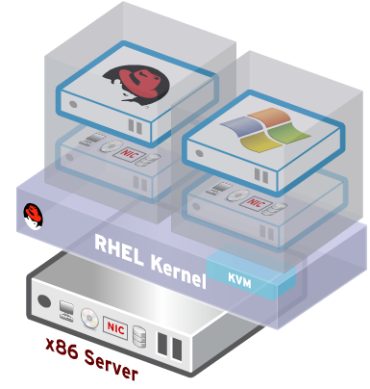
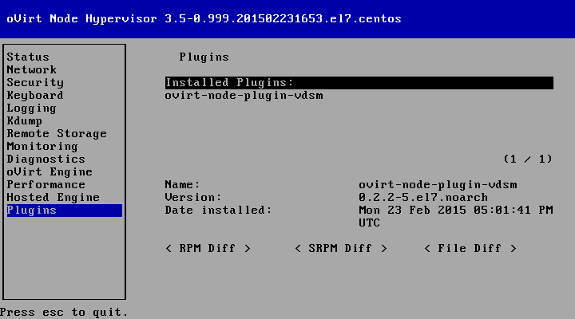
oVirt Node
Standalone hypervisor
  Small footprint < 100MB
    Customized 'spin' of CentOS + KVM
    'Just enough' CentOS to run virtual machines
    Runs on all RHEL hardware
    with Intel VT/AMD-V CPUs
  Easy to install, configure and upgrade
    PXE boot, USB boot, CD or Hard drive

Slide 13
oVirt Engine
High Availability
Live Migration
Load Balancing (DRS)
Power Saver (DPM)
Maintenance Manager (oVirt Node Updates)
Image Management (Templates, Thin Provisioning, Snapshots)
Storage and Network Management
Monitoring and Reporting
V2V and P2V (VMware, XEN, KVM -> oVirt)
VDI for Windows and Linux guests

Slide 14
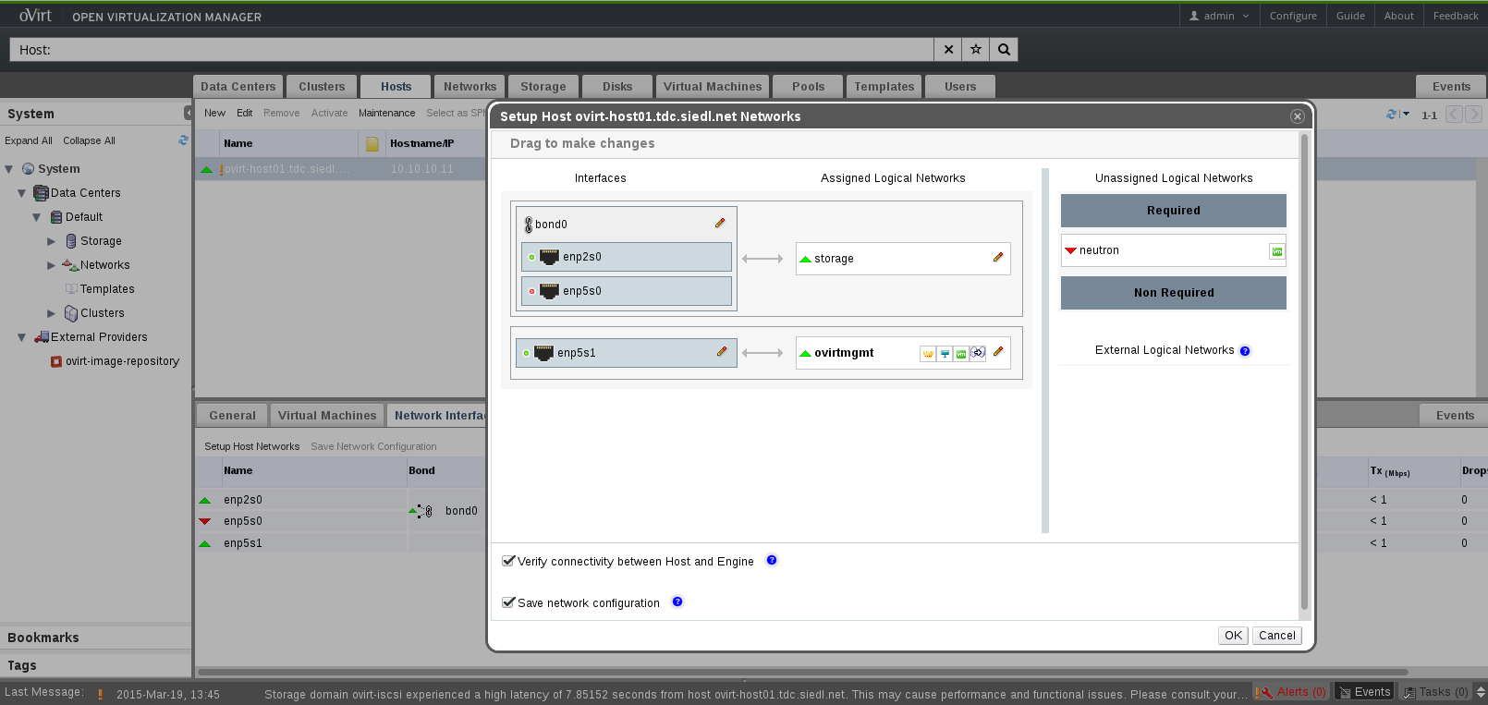
Configure Network

Slide 15
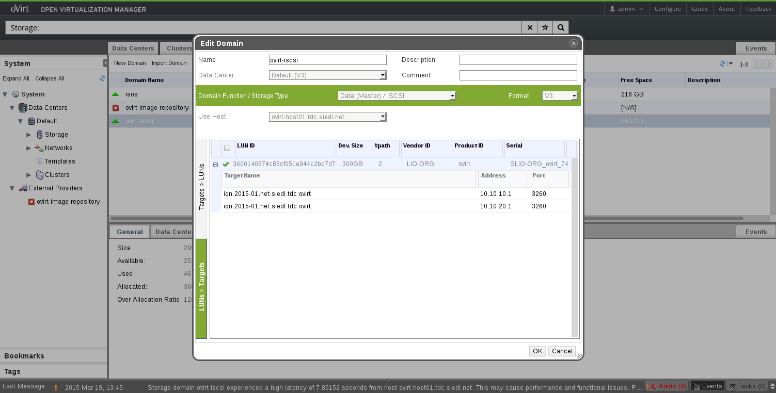
Configure Storage

Slide 16
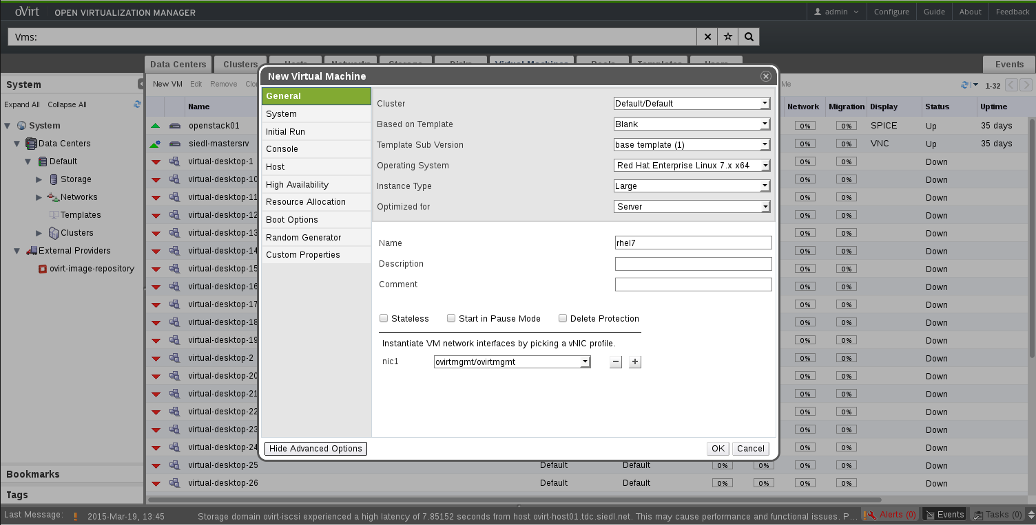
Add Virtual Servers or Desktops

Slide 17
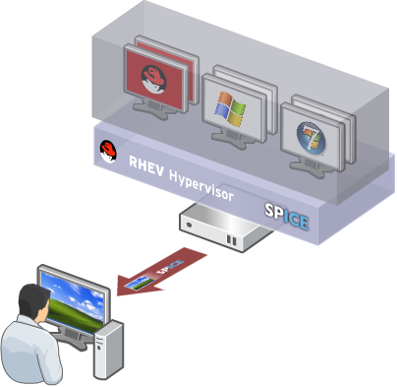
Virtual Desktop Infrastructure (VDI)
Centralized management, security and policy enforcement
Virtual desktops with user experience of a physical PC
  Multiple monitors
  HD-quality video
  Bi-directional audio/video for VoIP or video-conferencing
  Smartcard support
  USB support
Industry-leading density of virtual desktops/server

Slide 18
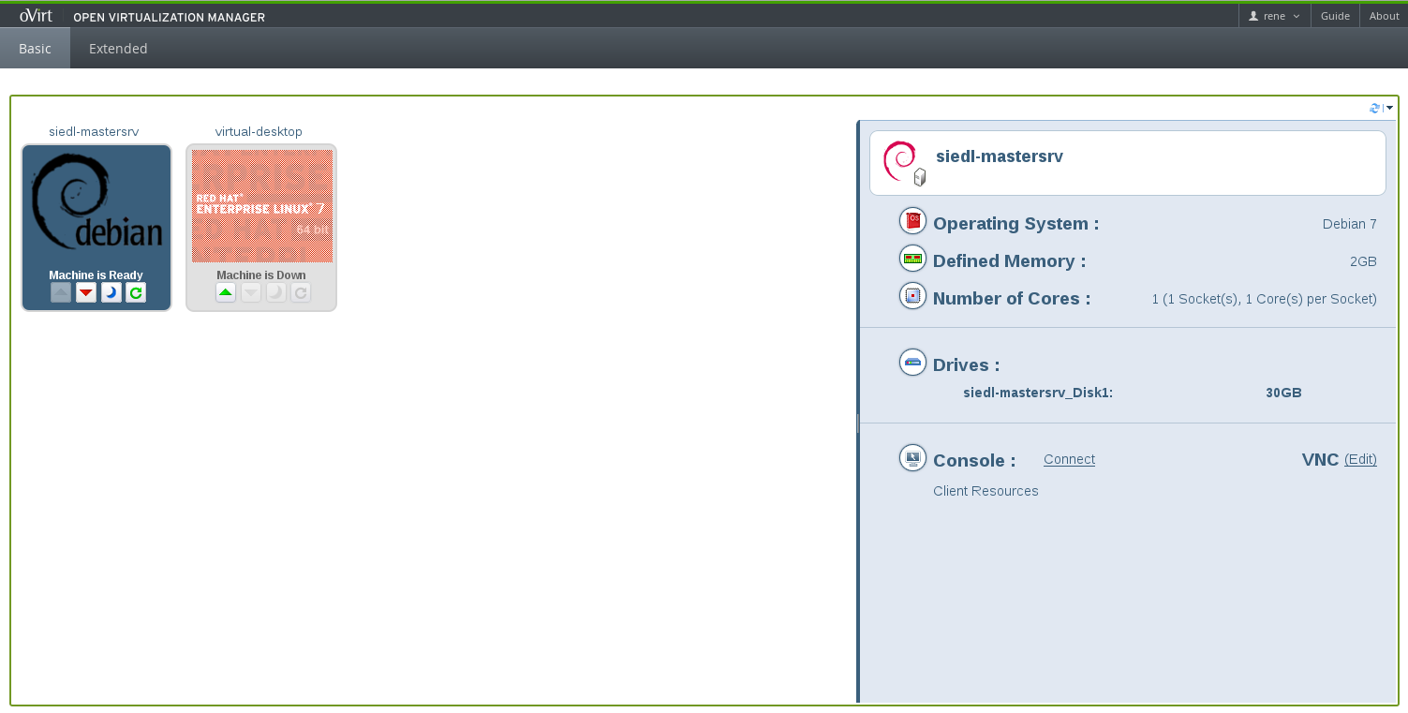
User Portal

Slide 19
UI Plugins
Infrastructure and API for Creating User Interface Plugins for oVirt Engine
Introduced in oVirt 3.2
Extend oVirt Webadmin with:
  Main Tabs
  Sub Tabs
  Buttons
  Dialogs
More Information:
  http://www.ovirt.org/Features/UIPlugins

Slide 20
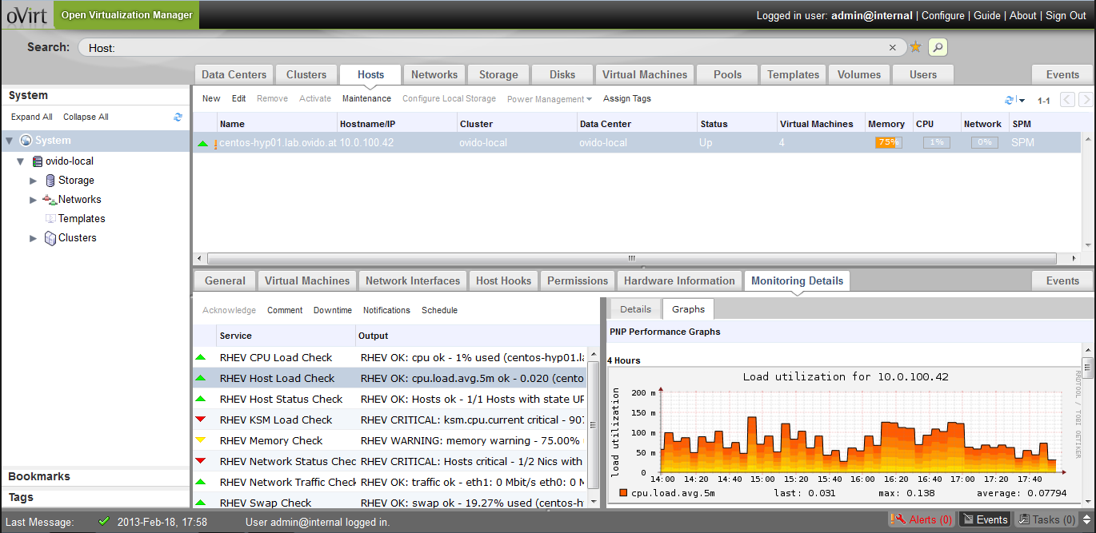
UI Plugins
More information: https://github.com/monitoring-ui-plugin

Slide 21
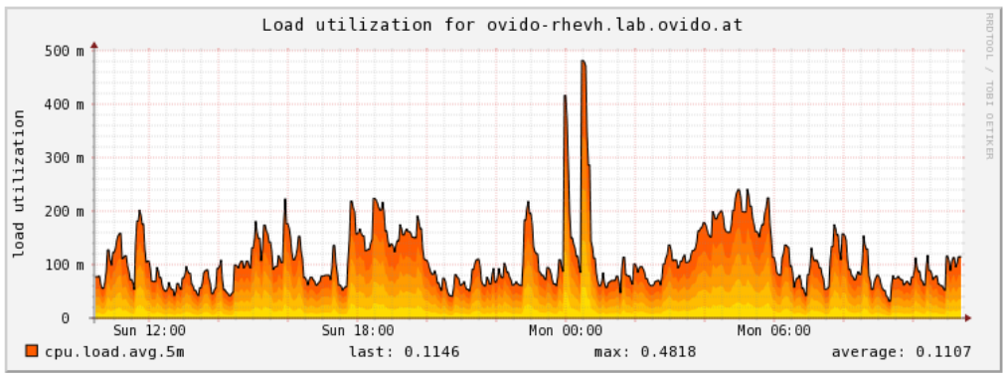
Monitoring - check_rhev3
Nagios/Icinga plugin for monitoring an oVirt environment: check_rhev3
https://github.com/ovido/check_rhev3
Monitoring of:
  Datacenters
  Clusters
  Hosts
  Storagedomains
  Virtual Machines
  Virtual Machine Pools

Slide 22
New Features in oVirt 3.5

Slide 23
New Features in oVirt 3.5
Live Merge
  Live Merge Snapshots
  Requires Fedora 20 with virt-preview yum-Repo
Import Storage Domain
  Import existing Data Storage Domain (e.g. for disaster recovery)
Advanced Foreman Integration
  Provision and add hypervisors to oVirt from bare metal
Enhanced Anthentication, Authorization and Accounting Support

Slide 24
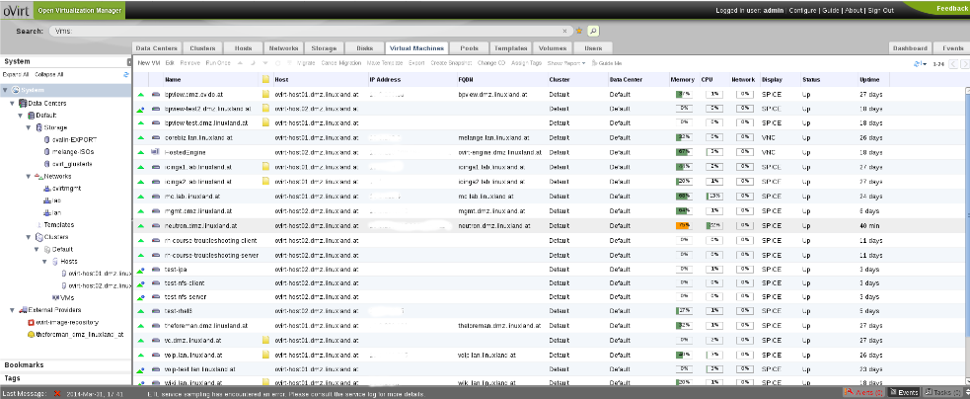
New Features in oVirt 3.5
New PaternFly Interface
Advanced Scheduling with Optaplaner

Slide 25
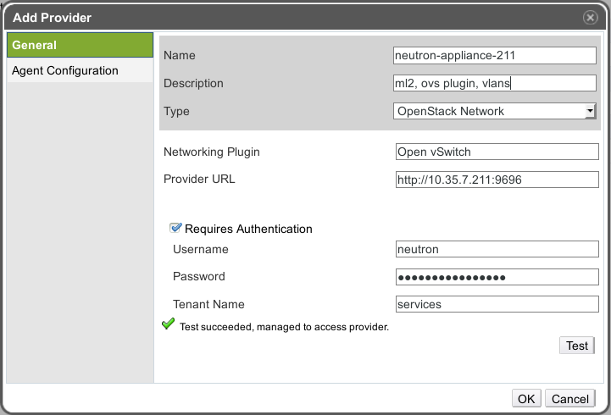
New Features in oVirt 3.5
Neutron Virtual Appliance
  Appliance for OpenStack Neutron (Networking)

Slide 26
New Features in oVirt 3.5
Hosted Engines supports:
  iSCSI Storage
  VLAN-tagged network interfaces
  Bonded Network Interfaces
  RHEL/CentOS 7
oVirt Windows Guest Tools available as RC

Slide 27
New Features in oVirt 3.5.1
Red Hat Enterprise Linux 7 / CentOS 7 Support
oVirt Engine Extensions
  Log4J logger bridge (remote Logging)
  LDAP Authentication and Authorization
Migration of local DWH Reports to remote

Slide 28
Planned Features in oVirt 3.6

Slide 29
Planned Features in oVirt 3.6
Release planned September 2015
Management Network as a Role
  Different VLANs for ovirtmgmt in different Clusters
Host Networking API
Detailed Host Networking API
Isolated (Host-only) Networks
Drop support for Fedora 20
Add support for Fedora 22

Slide 30

Planned Features in oVirt 3.6
Add support for Debian/Ubuntu hosts
No support for new features on EL6 hosts
OpenStack Cinder Integration (Ceph)
GlusterFS:
  Support for GeoReplication
  Network for Gluster
  Gluster Volume Snapshots
Hosted Engine:
  FC Support
  GlusterFS Support

Slide 31
Interaction with OpenStack

Slide 32
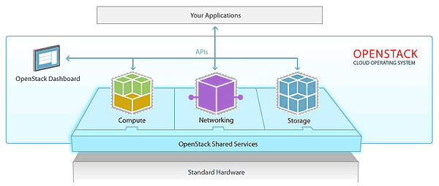
Interaction with OpenStack
OpenStack: Open Source software for creating private and public clouds

Slide 33
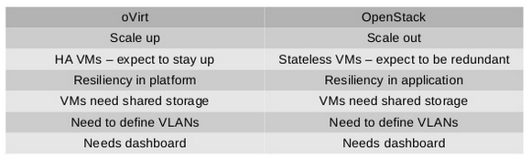
Interaction with OpenStack
oVirt vs OpenStack

Slide 34
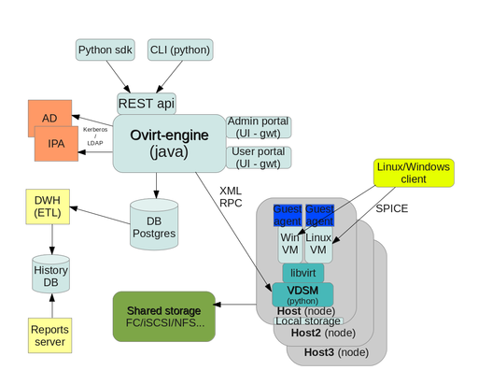
Interaction with OpenStack
oVirt AND OpenStack

Slide 35
Interaction with OpenStack
oVirt AND OpenStack
Horizon
Neutron
Glance/Cinder
Nova

Slide 36
Interaction with OpenStack
Install oVirt and OpenStack side by side
Shared image storage with Glance
Shared block storage (GlusterFS, NFS, iSCSI, FC for oVirt, Cinder for OpenStack consuming same storage)
Shared Software Defined Network (define VM network in OpenStack and use it in oVirt)
Monitor and control oVirt VMs in Horizon

Slide 37
Use Cases and Getting Started with oVirt

Slide 38
Use Cases
Server Virtualization
Desktop Virtualization (VDI)
Private Clouds
  Use DWH/PostgreSQL database for resource usage or runtime billing
  Developer Portal
Virtualized Call Centers
Virtualized Computer Rooms (Schools, Universities)
Remote offices
Admin VMs

Slide 39
Getting oVirt
Obtain from oVirt website -
  http://www.ovirt.org/Download
Fedora repositories
CentOS/RHEL repositories
Live USB - http://wiki.ovirt.org/wiki/OVirt_Live
Build from source

Slide 40
How to Contribute
Join the community
- Find bugs, file them, correct them.
- Translate, write documentation.
- Design interfaces, develop new features
- Share your experiences.
Everyone can make a difference.
Mailing lists:
  http://lists.ovirt.org/mailman/listinfo
IRC:
  #ovirt on OFTC
Website and Repository:
  http://www.ovirt.org
  http://www.ovirt.org/wiki
  http://www.ovirt.org/project/subprojects/

Slide 41
THANK YOU!
http://www.ovirt.org
rene.koch@siedl.net

