Slide 1


oVirt Node Project
Douglas Schilling Landgraf
Software Engineer – Red Hat
17 Oct 2014, #latinoware2014
Notes:
Hey All.
My name is Oved.
I'm a Senior Software Engineer at Red Hat, and today I'm show you how to use EC2/CIMI on top of oVirt, via deltacloud.

Slide 2

Agenda
General information
What's oVirt Node?
Deployment modes
Main Package on oVirt Node
oVirt Node Plugins
Installing
Menu
Updating
Use cases
Contributing to oVirt Node
Notes:
Let's go over the agenda.
I'll start with an Overview, talking about the oVirt engine,Then I'll talk about the motivation for exposing EC2/CIMI APIs on
Top of ovirt, describing
Some cloud APIs, and their differences.
, and proceed to describing deltacloud, which enables
Ovirt to support that.
After the overview, I'll talk about the integration with deltacloud
Describe the different use-cases, and Show some samples of using
EC2 and CIMI on top of oVirt
There is always future work, so I'll go over that as well
Finish with a Summary, and I'll leave a few minutes for Questions.
If something isn't clear, and it can't wait til the end of the lecture,
Please raise your hand, and I'll do my best to answer your questions.

Slide 3
General information
About the speaker
oVirt Project
oVirt Node Project
  Get started: http://www.ovirt.org/Download
Notes:
Let's go over the agenda.
I'll start with an Overview, talking about the oVirt engine,Then I'll talk about the motivation for exposing EC2/CIMI APIs on
Top of ovirt, describing
Some cloud APIs, and their differences.
, and proceed to describing deltacloud, which enables
Ovirt to support that.
After the overview, I'll talk about the integration with deltacloud
Describe the different use-cases, and Show some samples of using
EC2 and CIMI on top of oVirt
There is always future work, so I'll go over that as well
Finish with a Summary, and I'll leave a few minutes for Questions.
If something isn't clear, and it can't wait til the end of the lecture,
Please raise your hand, and I'll do my best to answer your questions.

Slide 4
What's oVirt Node?
Dedicated Hypervisor
Based on KVM
Minimum OS to run and manage Virtual Machines
Require at least 1G of RAM
Small image size
Kickstart
LVM
Supports the same hardware as Fedora/CentOS
Runs with Selinux on enforcing mode
Pre-configured Firewall settings for oVirt
Notes:
Let's go over the agenda.
I'll start with an Overview, talking about the oVirt engine,Then I'll talk about the motivation for exposing EC2/CIMI APIs on
Top of ovirt, describing
Some cloud APIs, and their differences.
, and proceed to describing deltacloud, which enables
Ovirt to support that.
After the overview, I'll talk about the integration with deltacloud
Describe the different use-cases, and Show some samples of using
EC2 and CIMI on top of oVirt
There is always future work, so I'll go over that as well
Finish with a Summary, and I'll leave a few minutes for Questions.
If something isn't clear, and it can't wait til the end of the lecture,
Please raise your hand, and I'll do my best to answer your questions.

Slide 5
What's oVirt Node?
No default root user, only admin user. What?
Read-only mode
Most of code in python
Why should I use oVirt Node instead of Fedora or CentOS?
Does it support others distributions?
Notes:
Let's go over the agenda.
I'll start with an Overview, talking about the oVirt engine,Then I'll talk about the motivation for exposing EC2/CIMI APIs on
Top of ovirt, describing
Some cloud APIs, and their differences.
, and proceed to describing deltacloud, which enables
Ovirt to support that.
After the overview, I'll talk about the integration with deltacloud
Describe the different use-cases, and Show some samples of using
EC2 and CIMI on top of oVirt
There is always future work, so I'll go over that as well
Finish with a Summary, and I'll leave a few minutes for Questions.
If something isn't clear, and it can't wait til the end of the lecture,
Please raise your hand, and I'll do my best to answer your questions.

Slide 6
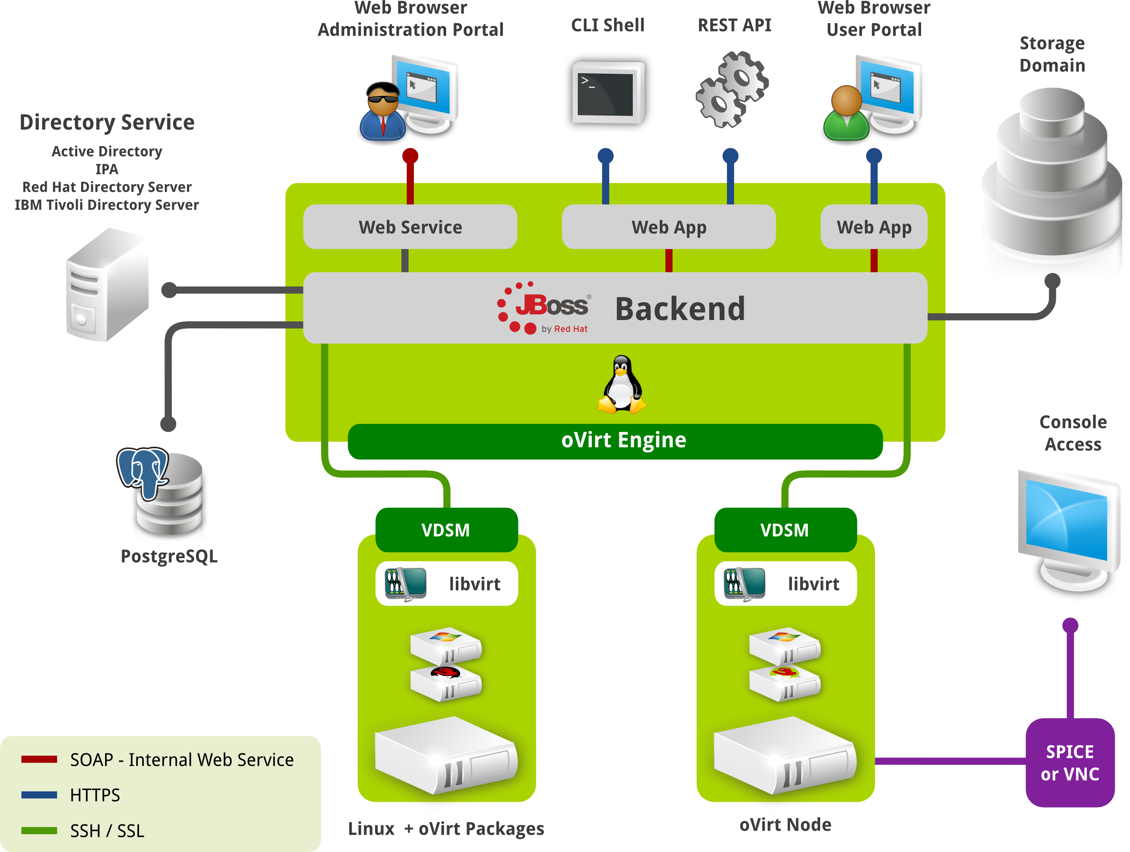
What's oVirt Node?
Notes:
Let's go over the agenda.
I'll start with an Overview, talking about the oVirt engine,Then I'll talk about the motivation for exposing EC2/CIMI APIs on
Top of ovirt, describing
Some cloud APIs, and their differences.
, and proceed to describing deltacloud, which enables
Ovirt to support that.
After the overview, I'll talk about the integration with deltacloud
Describe the different use-cases, and Show some samples of using
EC2 and CIMI on top of oVirt
There is always future work, so I'll go over that as well
Finish with a Summary, and I'll leave a few minutes for Questions.
If something isn't clear, and it can't wait til the end of the lecture,
Please raise your hand, and I'll do my best to answer your questions.

Slide 7

Deployment Modes
CD-ROM
  Burn ISO image to writable CD
  Boot server with CDROM
Flash USB
  Use livecd-iso-to-disk to copy image to USB or SD card
  Boot from USB/SD and install to local disk
Network PXE
  Use livecd-iso-to-pxeboot on the iso
  Deploy generated vmlinuz0/initrd0 files to PXE/tftp server
  Boot server from PXE
Notes:
Let's go over the agenda.
I'll start with an Overview, talking about the oVirt engine,Then I'll talk about the motivation for exposing EC2/CIMI APIs on
Top of ovirt, describing
Some cloud APIs, and their differences.
, and proceed to describing deltacloud, which enables
Ovirt to support that.
After the overview, I'll talk about the integration with deltacloud
Describe the different use-cases, and Show some samples of using
EC2 and CIMI on top of oVirt
There is always future work, so I'll go over that as well
Finish with a Summary, and I'll leave a few minutes for Questions.
If something isn't clear, and it can't wait til the end of the lecture,
Please raise your hand, and I'll do my best to answer your questions.

Slide 8
Main Packages on Node
VDSM (vdsm-reg, vdsm-cli, vdsm*)
qemu-kvm
Libvirt
ovirt-host-deploy
ovirt-node-plugin*
Notes:
Let's go over the agenda.
I'll start with an Overview, talking about the oVirt engine,Then I'll talk about the motivation for exposing EC2/CIMI APIs on
Top of ovirt, describing
Some cloud APIs, and their differences.
, and proceed to describing deltacloud, which enables
Ovirt to support that.
After the overview, I'll talk about the integration with deltacloud
Describe the different use-cases, and Show some samples of using
EC2 and CIMI on top of oVirt
There is always future work, so I'll go over that as well
Finish with a Summary, and I'll leave a few minutes for Questions.
If something isn't clear, and it can't wait til the end of the lecture,
Please raise your hand, and I'll do my best to answer your questions.

Slide 9
oVirt Node Plugins
ovirt-node-plugin-vdsm
ovirt-node-plugin-hosted-engine
ovirt-node-plugin-puppet
ovirt-node-plugin-ipmi
ovirt-node-plugin-snmp
ovirt-node-plugin-cim
ovirt-node-plugin-foreman
Notes:
Let's go over the agenda.
I'll start with an Overview, talking about the oVirt engine,Then I'll talk about the motivation for exposing EC2/CIMI APIs on
Top of ovirt, describing
Some cloud APIs, and their differences.
, and proceed to describing deltacloud, which enables
Ovirt to support that.
After the overview, I'll talk about the integration with deltacloud
Describe the different use-cases, and Show some samples of using
EC2 and CIMI on top of oVirt
There is always future work, so I'll go over that as well
Finish with a Summary, and I'll leave a few minutes for Questions.
If something isn't clear, and it can't wait til the end of the lecture,
Please raise your hand, and I'll do my best to answer your questions.

Slide 10
Installation Modes
Text User Interface (TUI)
Autoinstall
Notes:
Let's go over the agenda.
I'll start with an Overview, talking about the oVirt engine,Then I'll talk about the motivation for exposing EC2/CIMI APIs on
Top of ovirt, describing
Some cloud APIs, and their differences.
, and proceed to describing deltacloud, which enables
Ovirt to support that.
After the overview, I'll talk about the integration with deltacloud
Describe the different use-cases, and Show some samples of using
EC2 and CIMI on top of oVirt
There is always future work, so I'll go over that as well
Finish with a Summary, and I'll leave a few minutes for Questions.
If something isn't clear, and it can't wait til the end of the lecture,
Please raise your hand, and I'll do my best to answer your questions.

Slide 11
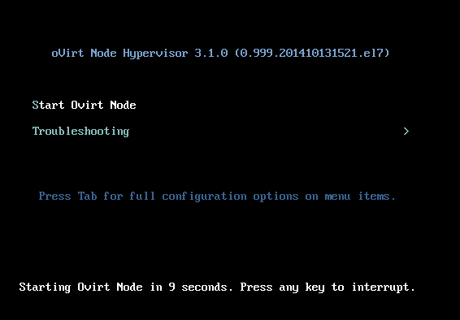
Installing
Notes:
Let's go over the agenda.
I'll start with an Overview, talking about the oVirt engine,Then I'll talk about the motivation for exposing EC2/CIMI APIs on
Top of ovirt, describing
Some cloud APIs, and their differences.
, and proceed to describing deltacloud, which enables
Ovirt to support that.
After the overview, I'll talk about the integration with deltacloud
Describe the different use-cases, and Show some samples of using
EC2 and CIMI on top of oVirt
There is always future work, so I'll go over that as well
Finish with a Summary, and I'll leave a few minutes for Questions.
If something isn't clear, and it can't wait til the end of the lecture,
Please raise your hand, and I'll do my best to answer your questions.

Slide 12
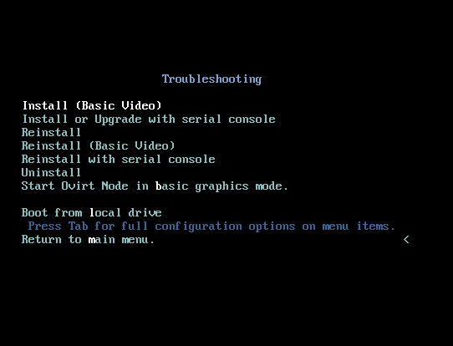
Installing
Notes:
Let's go over the agenda.
I'll start with an Overview, talking about the oVirt engine,Then I'll talk about the motivation for exposing EC2/CIMI APIs on
Top of ovirt, describing
Some cloud APIs, and their differences.
, and proceed to describing deltacloud, which enables
Ovirt to support that.
After the overview, I'll talk about the integration with deltacloud
Describe the different use-cases, and Show some samples of using
EC2 and CIMI on top of oVirt
There is always future work, so I'll go over that as well
Finish with a Summary, and I'll leave a few minutes for Questions.
If something isn't clear, and it can't wait til the end of the lecture,
Please raise your hand, and I'll do my best to answer your questions.

Slide 13
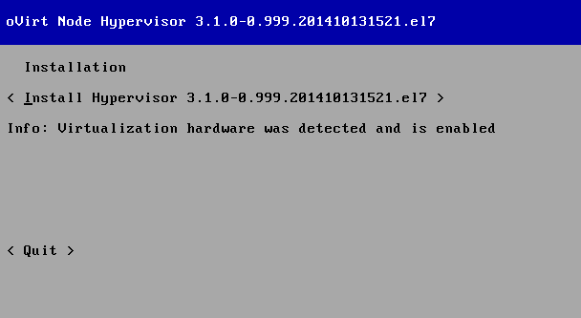
Installing
Notes:
Let's go over the agenda.
I'll start with an Overview, talking about the oVirt engine,Then I'll talk about the motivation for exposing EC2/CIMI APIs on
Top of ovirt, describing
Some cloud APIs, and their differences.
, and proceed to describing deltacloud, which enables
Ovirt to support that.
After the overview, I'll talk about the integration with deltacloud
Describe the different use-cases, and Show some samples of using
EC2 and CIMI on top of oVirt
There is always future work, so I'll go over that as well
Finish with a Summary, and I'll leave a few minutes for Questions.
If something isn't clear, and it can't wait til the end of the lecture,
Please raise your hand, and I'll do my best to answer your questions.

Slide 14
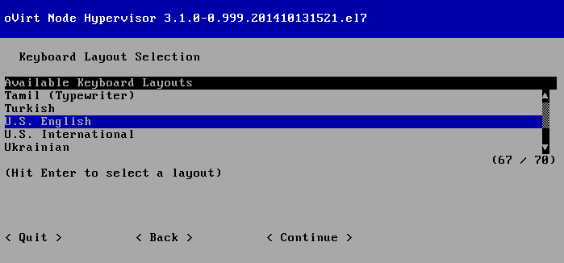
Installing – Keyboard
Notes:
Let's go over the agenda.
I'll start with an Overview, talking about the oVirt engine,Then I'll talk about the motivation for exposing EC2/CIMI APIs on
Top of ovirt, describing
Some cloud APIs, and their differences.
, and proceed to describing deltacloud, which enables
Ovirt to support that.
After the overview, I'll talk about the integration with deltacloud
Describe the different use-cases, and Show some samples of using
EC2 and CIMI on top of oVirt
There is always future work, so I'll go over that as well
Finish with a Summary, and I'll leave a few minutes for Questions.
If something isn't clear, and it can't wait til the end of the lecture,
Please raise your hand, and I'll do my best to answer your questions.

Slide 15
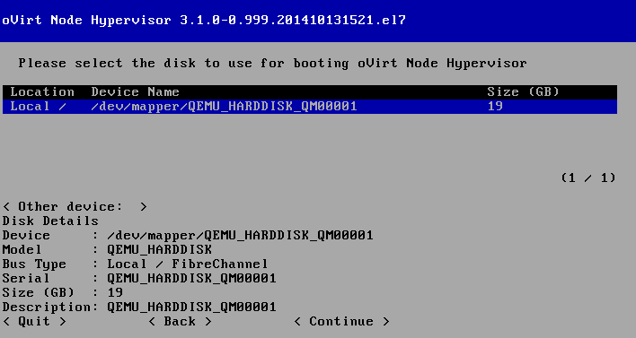
Installing – Disk for booting
Notes:
Let's go over the agenda.
I'll start with an Overview, talking about the oVirt engine,Then I'll talk about the motivation for exposing EC2/CIMI APIs on
Top of ovirt, describing
Some cloud APIs, and their differences.
, and proceed to describing deltacloud, which enables
Ovirt to support that.
After the overview, I'll talk about the integration with deltacloud
Describe the different use-cases, and Show some samples of using
EC2 and CIMI on top of oVirt
There is always future work, so I'll go over that as well
Finish with a Summary, and I'll leave a few minutes for Questions.
If something isn't clear, and it can't wait til the end of the lecture,
Please raise your hand, and I'll do my best to answer your questions.

Slide 16
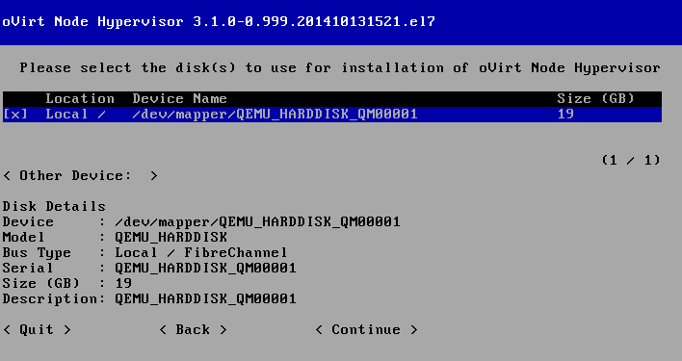
Installing – Disk for installation
Notes:
Let's go over the agenda.
I'll start with an Overview, talking about the oVirt engine,Then I'll talk about the motivation for exposing EC2/CIMI APIs on
Top of ovirt, describing
Some cloud APIs, and their differences.
, and proceed to describing deltacloud, which enables
Ovirt to support that.
After the overview, I'll talk about the integration with deltacloud
Describe the different use-cases, and Show some samples of using
EC2 and CIMI on top of oVirt
There is always future work, so I'll go over that as well
Finish with a Summary, and I'll leave a few minutes for Questions.
If something isn't clear, and it can't wait til the end of the lecture,
Please raise your hand, and I'll do my best to answer your questions.

Slide 17
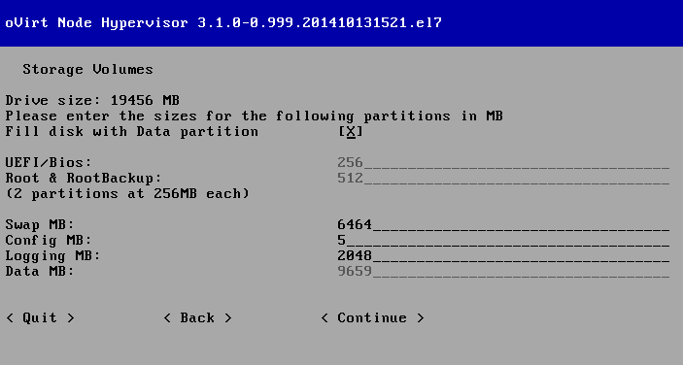
Installing – Storage Volumes
Notes:
Let's go over the agenda.
I'll start with an Overview, talking about the oVirt engine,Then I'll talk about the motivation for exposing EC2/CIMI APIs on
Top of ovirt, describing
Some cloud APIs, and their differences.
, and proceed to describing deltacloud, which enables
Ovirt to support that.
After the overview, I'll talk about the integration with deltacloud
Describe the different use-cases, and Show some samples of using
EC2 and CIMI on top of oVirt
There is always future work, so I'll go over that as well
Finish with a Summary, and I'll leave a few minutes for Questions.
If something isn't clear, and it can't wait til the end of the lecture,
Please raise your hand, and I'll do my best to answer your questions.

Slide 18
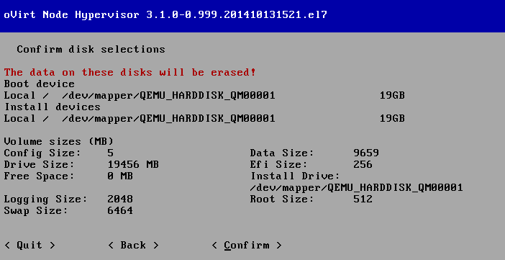
Installing – Confirm data
Notes:
Let's go over the agenda.
I'll start with an Overview, talking about the oVirt engine,Then I'll talk about the motivation for exposing EC2/CIMI APIs on
Top of ovirt, describing
Some cloud APIs, and their differences.
, and proceed to describing deltacloud, which enables
Ovirt to support that.
After the overview, I'll talk about the integration with deltacloud
Describe the different use-cases, and Show some samples of using
EC2 and CIMI on top of oVirt
There is always future work, so I'll go over that as well
Finish with a Summary, and I'll leave a few minutes for Questions.
If something isn't clear, and it can't wait til the end of the lecture,
Please raise your hand, and I'll do my best to answer your questions.

Slide 19
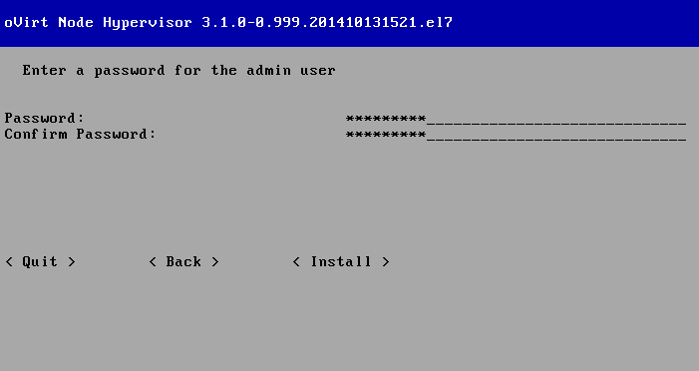
Installing – admin user
Notes:
Let's go over the agenda.
I'll start with an Overview, talking about the oVirt engine,Then I'll talk about the motivation for exposing EC2/CIMI APIs on
Top of ovirt, describing
Some cloud APIs, and their differences.
, and proceed to describing deltacloud, which enables
Ovirt to support that.
After the overview, I'll talk about the integration with deltacloud
Describe the different use-cases, and Show some samples of using
EC2 and CIMI on top of oVirt
There is always future work, so I'll go over that as well
Finish with a Summary, and I'll leave a few minutes for Questions.
If something isn't clear, and it can't wait til the end of the lecture,
Please raise your hand, and I'll do my best to answer your questions.

Slide 20
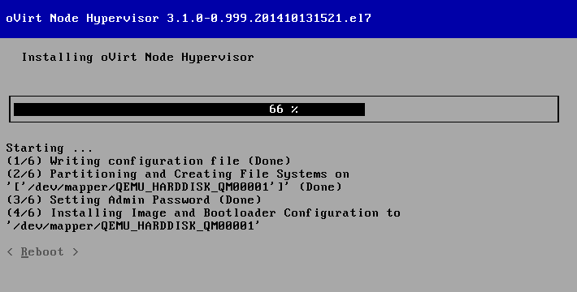
Installing – writing the changes
Notes:
Let's go over the agenda.
I'll start with an Overview, talking about the oVirt engine,Then I'll talk about the motivation for exposing EC2/CIMI APIs on
Top of ovirt, describing
Some cloud APIs, and their differences.
, and proceed to describing deltacloud, which enables
Ovirt to support that.
After the overview, I'll talk about the integration with deltacloud
Describe the different use-cases, and Show some samples of using
EC2 and CIMI on top of oVirt
There is always future work, so I'll go over that as well
Finish with a Summary, and I'll leave a few minutes for Questions.
If something isn't clear, and it can't wait til the end of the lecture,
Please raise your hand, and I'll do my best to answer your questions.

Slide 21
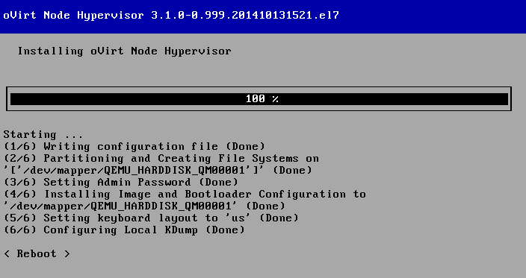
Installing – Installation Completed!
Notes:
Let's go over the agenda.
I'll start with an Overview, talking about the oVirt engine,Then I'll talk about the motivation for exposing EC2/CIMI APIs on
Top of ovirt, describing
Some cloud APIs, and their differences.
, and proceed to describing deltacloud, which enables
Ovirt to support that.
After the overview, I'll talk about the integration with deltacloud
Describe the different use-cases, and Show some samples of using
EC2 and CIMI on top of oVirt
There is always future work, so I'll go over that as well
Finish with a Summary, and I'll leave a few minutes for Questions.
If something isn't clear, and it can't wait til the end of the lecture,
Please raise your hand, and I'll do my best to answer your questions.

Slide 22
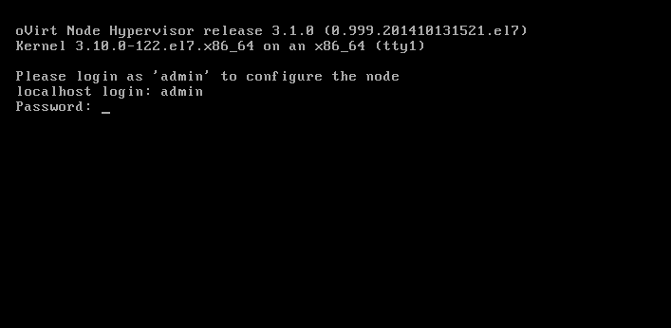
First login, remember the admin user!
Notes:
Let's go over the agenda.
I'll start with an Overview, talking about the oVirt engine,Then I'll talk about the motivation for exposing EC2/CIMI APIs on
Top of ovirt, describing
Some cloud APIs, and their differences.
, and proceed to describing deltacloud, which enables
Ovirt to support that.
After the overview, I'll talk about the integration with deltacloud
Describe the different use-cases, and Show some samples of using
EC2 and CIMI on top of oVirt
There is always future work, so I'll go over that as well
Finish with a Summary, and I'll leave a few minutes for Questions.
If something isn't clear, and it can't wait til the end of the lecture,
Please raise your hand, and I'll do my best to answer your questions.

Slide 23
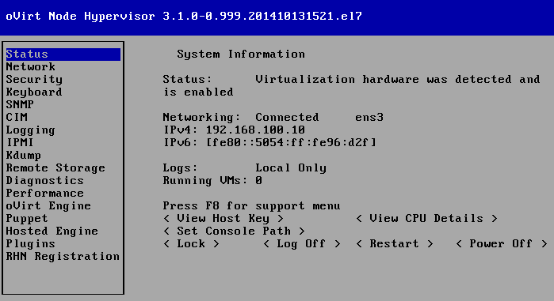
Menu Overview
Notes:
Let's go over the agenda.
I'll start with an Overview, talking about the oVirt engine,Then I'll talk about the motivation for exposing EC2/CIMI APIs on
Top of ovirt, describing
Some cloud APIs, and their differences.
, and proceed to describing deltacloud, which enables
Ovirt to support that.
After the overview, I'll talk about the integration with deltacloud
Describe the different use-cases, and Show some samples of using
EC2 and CIMI on top of oVirt
There is always future work, so I'll go over that as well
Finish with a Summary, and I'll leave a few minutes for Questions.
If something isn't clear, and it can't wait til the end of the lecture,
Please raise your hand, and I'll do my best to answer your questions.

Slide 24
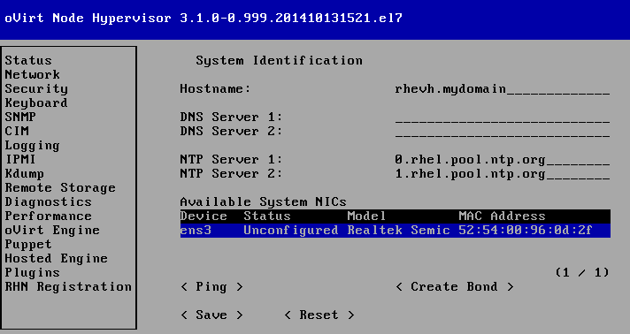
Setting Network
Notes:
Let's go over the agenda.
I'll start with an Overview, talking about the oVirt engine,Then I'll talk about the motivation for exposing EC2/CIMI APIs on
Top of ovirt, describing
Some cloud APIs, and their differences.
, and proceed to describing deltacloud, which enables
Ovirt to support that.
After the overview, I'll talk about the integration with deltacloud
Describe the different use-cases, and Show some samples of using
EC2 and CIMI on top of oVirt
There is always future work, so I'll go over that as well
Finish with a Summary, and I'll leave a few minutes for Questions.
If something isn't clear, and it can't wait til the end of the lecture,
Please raise your hand, and I'll do my best to answer your questions.

Slide 25
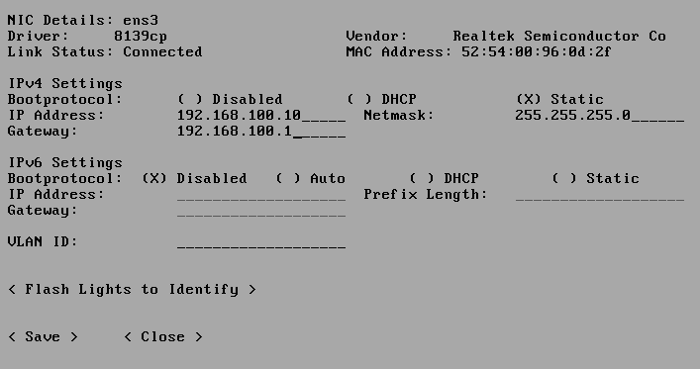
Setting Network
Notes:
Let's go over the agenda.
I'll start with an Overview, talking about the oVirt engine,Then I'll talk about the motivation for exposing EC2/CIMI APIs on
Top of ovirt, describing
Some cloud APIs, and their differences.
, and proceed to describing deltacloud, which enables
Ovirt to support that.
After the overview, I'll talk about the integration with deltacloud
Describe the different use-cases, and Show some samples of using
EC2 and CIMI on top of oVirt
There is always future work, so I'll go over that as well
Finish with a Summary, and I'll leave a few minutes for Questions.
If something isn't clear, and it can't wait til the end of the lecture,
Please raise your hand, and I'll do my best to answer your questions.

Slide 26
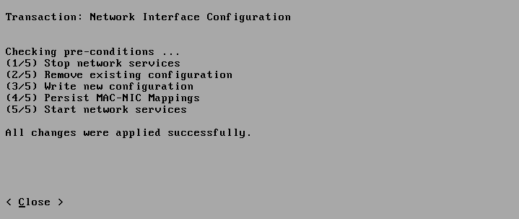
Setting Network
Notes:
Let's go over the agenda.
I'll start with an Overview, talking about the oVirt engine,Then I'll talk about the motivation for exposing EC2/CIMI APIs on
Top of ovirt, describing
Some cloud APIs, and their differences.
, and proceed to describing deltacloud, which enables
Ovirt to support that.
After the overview, I'll talk about the integration with deltacloud
Describe the different use-cases, and Show some samples of using
EC2 and CIMI on top of oVirt
There is always future work, so I'll go over that as well
Finish with a Summary, and I'll leave a few minutes for Questions.
If something isn't clear, and it can't wait til the end of the lecture,
Please raise your hand, and I'll do my best to answer your questions.

Slide 27
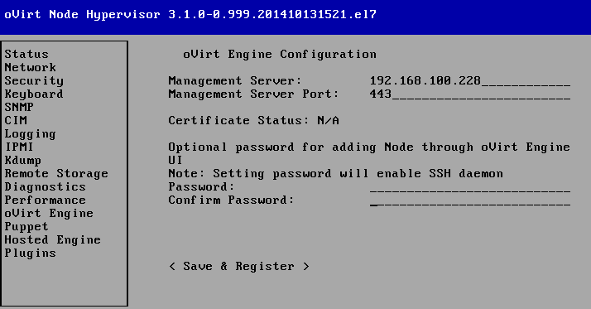
Registering the Node to oVirt Engine
Notes:
Let's go over the agenda.
I'll start with an Overview, talking about the oVirt engine,Then I'll talk about the motivation for exposing EC2/CIMI APIs on
Top of ovirt, describing
Some cloud APIs, and their differences.
, and proceed to describing deltacloud, which enables
Ovirt to support that.
After the overview, I'll talk about the integration with deltacloud
Describe the different use-cases, and Show some samples of using
EC2 and CIMI on top of oVirt
There is always future work, so I'll go over that as well
Finish with a Summary, and I'll leave a few minutes for Questions.
If something isn't clear, and it can't wait til the end of the lecture,
Please raise your hand, and I'll do my best to answer your questions.

Slide 28
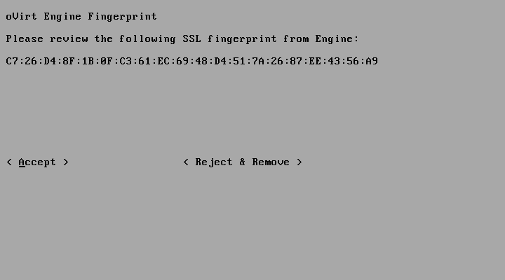
Registering the Node to oVirt Engine
Notes:
Let's go over the agenda.
I'll start with an Overview, talking about the oVirt engine,Then I'll talk about the motivation for exposing EC2/CIMI APIs on
Top of ovirt, describing
Some cloud APIs, and their differences.
, and proceed to describing deltacloud, which enables
Ovirt to support that.
After the overview, I'll talk about the integration with deltacloud
Describe the different use-cases, and Show some samples of using
EC2 and CIMI on top of oVirt
There is always future work, so I'll go over that as well
Finish with a Summary, and I'll leave a few minutes for Questions.
If something isn't clear, and it can't wait til the end of the lecture,
Please raise your hand, and I'll do my best to answer your questions.

Slide 29
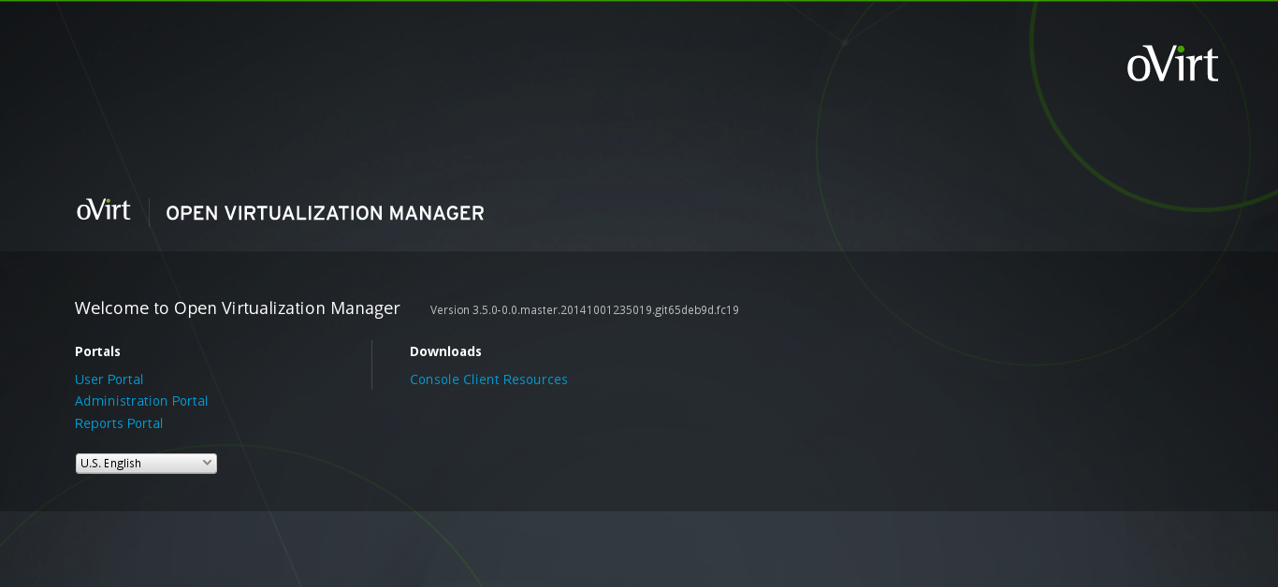
Registering the Node to oVirt Engine
Notes:
Let's go over the agenda.
I'll start with an Overview, talking about the oVirt engine,Then I'll talk about the motivation for exposing EC2/CIMI APIs on
Top of ovirt, describing
Some cloud APIs, and their differences.
, and proceed to describing deltacloud, which enables
Ovirt to support that.
After the overview, I'll talk about the integration with deltacloud
Describe the different use-cases, and Show some samples of using
EC2 and CIMI on top of oVirt
There is always future work, so I'll go over that as well
Finish with a Summary, and I'll leave a few minutes for Questions.
If something isn't clear, and it can't wait til the end of the lecture,
Please raise your hand, and I'll do my best to answer your questions.

Slide 30
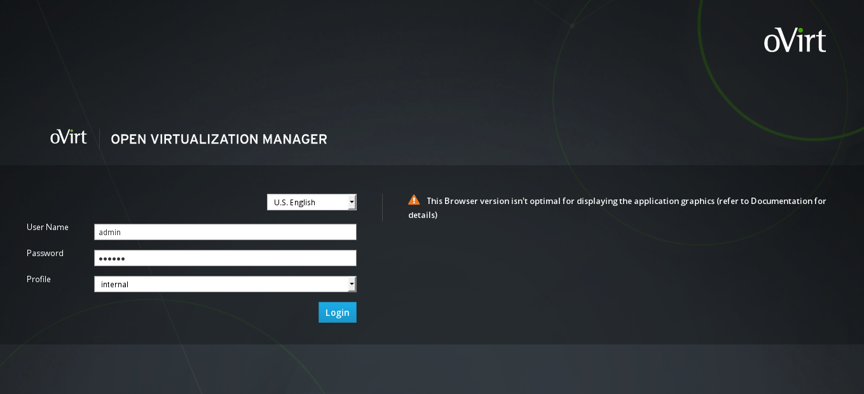
Registering the Node to oVirt Engine
Notes:
Let's go over the agenda.
I'll start with an Overview, talking about the oVirt engine,Then I'll talk about the motivation for exposing EC2/CIMI APIs on
Top of ovirt, describing
Some cloud APIs, and their differences.
, and proceed to describing deltacloud, which enables
Ovirt to support that.
After the overview, I'll talk about the integration with deltacloud
Describe the different use-cases, and Show some samples of using
EC2 and CIMI on top of oVirt
There is always future work, so I'll go over that as well
Finish with a Summary, and I'll leave a few minutes for Questions.
If something isn't clear, and it can't wait til the end of the lecture,
Please raise your hand, and I'll do my best to answer your questions.

Slide 31
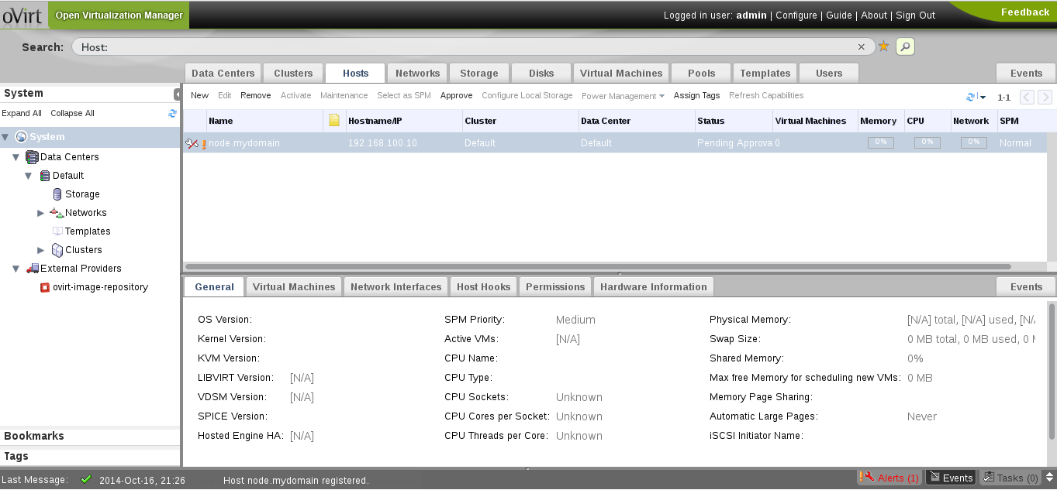
Registering the Node to oVirt Engine
Notes:
Let's go over the agenda.
I'll start with an Overview, talking about the oVirt engine,Then I'll talk about the motivation for exposing EC2/CIMI APIs on
Top of ovirt, describing
Some cloud APIs, and their differences.
, and proceed to describing deltacloud, which enables
Ovirt to support that.
After the overview, I'll talk about the integration with deltacloud
Describe the different use-cases, and Show some samples of using
EC2 and CIMI on top of oVirt
There is always future work, so I'll go over that as well
Finish with a Summary, and I'll leave a few minutes for Questions.
If something isn't clear, and it can't wait til the end of the lecture,
Please raise your hand, and I'll do my best to answer your questions.

Slide 32
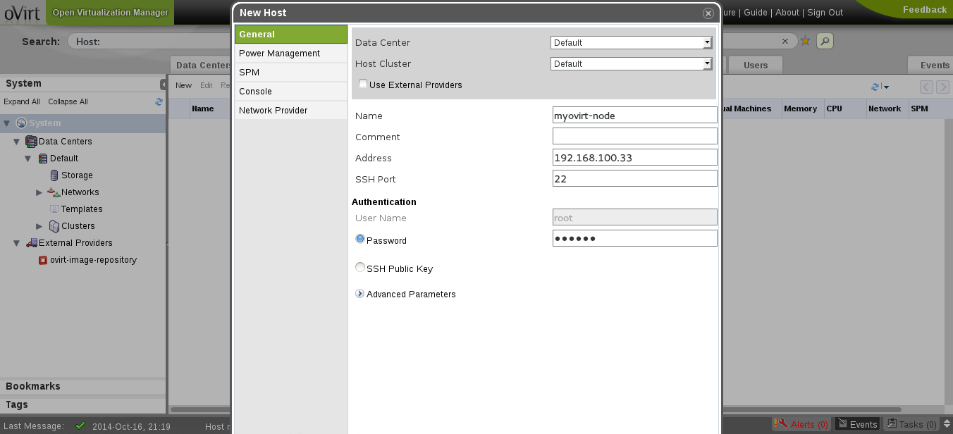
Registering the Node from oVirt Engine
Notes:
Let's go over the agenda.
I'll start with an Overview, talking about the oVirt engine,Then I'll talk about the motivation for exposing EC2/CIMI APIs on
Top of ovirt, describing
Some cloud APIs, and their differences.
, and proceed to describing deltacloud, which enables
Ovirt to support that.
After the overview, I'll talk about the integration with deltacloud
Describe the different use-cases, and Show some samples of using
EC2 and CIMI on top of oVirt
There is always future work, so I'll go over that as well
Finish with a Summary, and I'll leave a few minutes for Questions.
If something isn't clear, and it can't wait til the end of the lecture,
Please raise your hand, and I'll do my best to answer your questions.

Slide 33
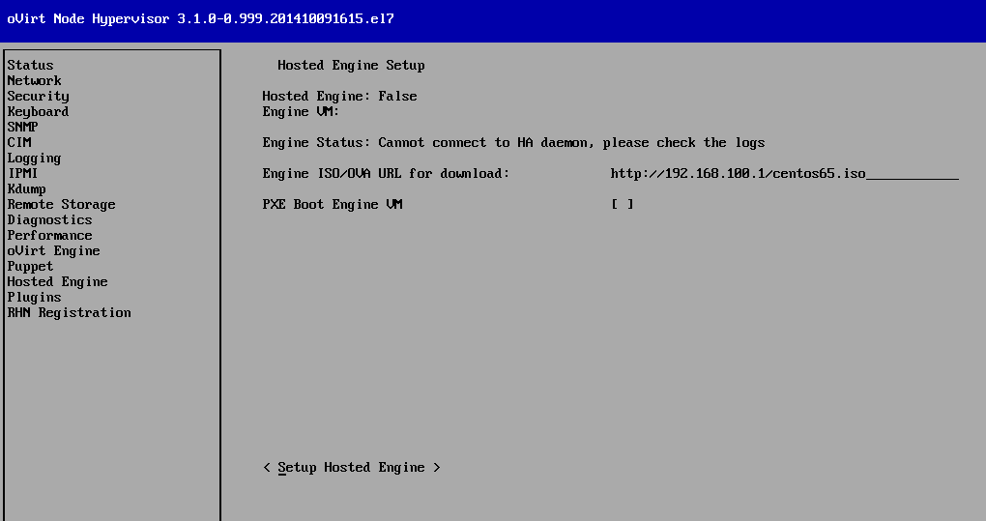
Hosted-engine
Hosted-engine
What's hosted-engine?
Notes:
Let's go over the agenda.
I'll start with an Overview, talking about the oVirt engine,Then I'll talk about the motivation for exposing EC2/CIMI APIs on
Top of ovirt, describing
Some cloud APIs, and their differences.
, and proceed to describing deltacloud, which enables
Ovirt to support that.
After the overview, I'll talk about the integration with deltacloud
Describe the different use-cases, and Show some samples of using
EC2 and CIMI on top of oVirt
There is always future work, so I'll go over that as well
Finish with a Summary, and I'll leave a few minutes for Questions.
If something isn't clear, and it can't wait til the end of the lecture,
Please raise your hand, and I'll do my best to answer your questions.

Slide 34
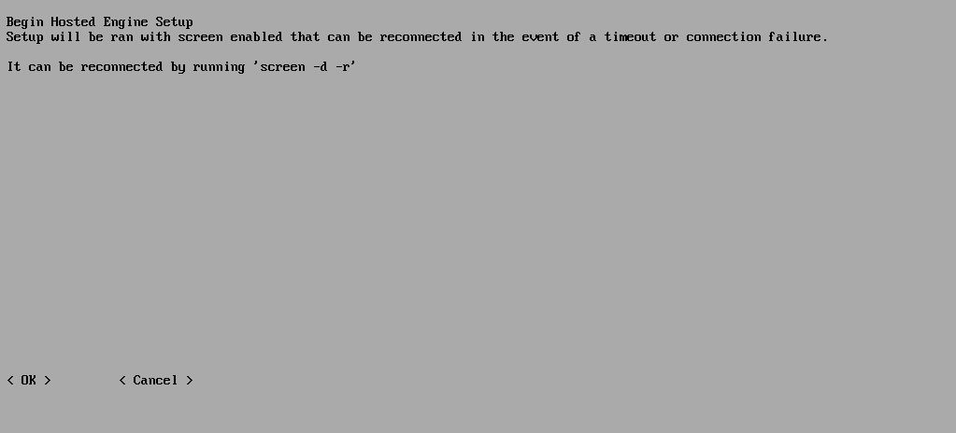
Hosted-engine
Notes:
Let's go over the agenda.
I'll start with an Overview, talking about the oVirt engine,Then I'll talk about the motivation for exposing EC2/CIMI APIs on
Top of ovirt, describing
Some cloud APIs, and their differences.
, and proceed to describing deltacloud, which enables
Ovirt to support that.
After the overview, I'll talk about the integration with deltacloud
Describe the different use-cases, and Show some samples of using
EC2 and CIMI on top of oVirt
There is always future work, so I'll go over that as well
Finish with a Summary, and I'll leave a few minutes for Questions.
If something isn't clear, and it can't wait til the end of the lecture,
Please raise your hand, and I'll do my best to answer your questions.

Slide 35
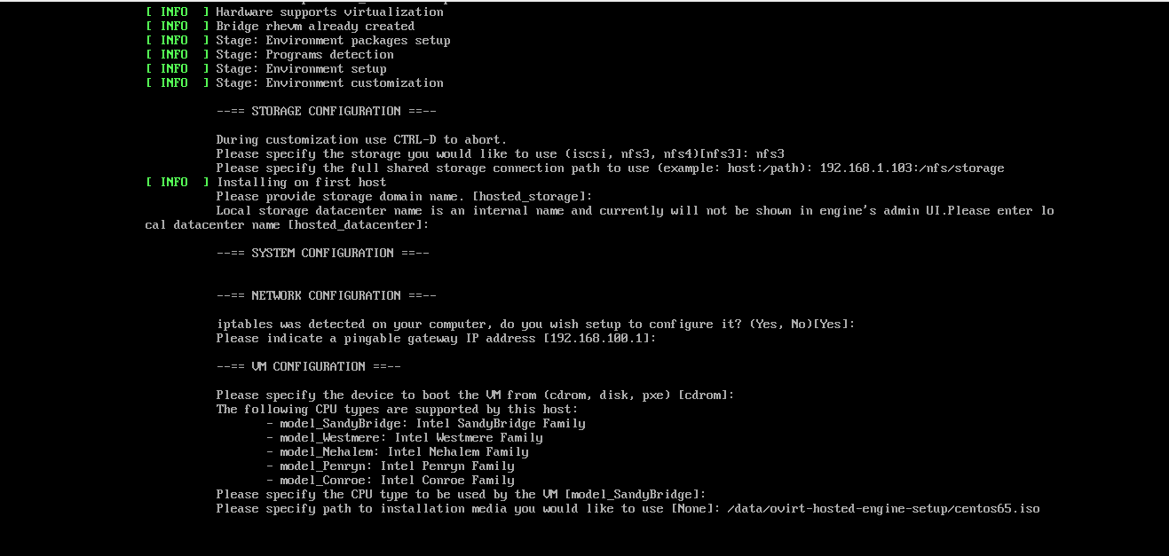
Hosted-engine
Notes:
Let's go over the agenda.
I'll start with an Overview, talking about the oVirt engine,Then I'll talk about the motivation for exposing EC2/CIMI APIs on
Top of ovirt, describing
Some cloud APIs, and their differences.
, and proceed to describing deltacloud, which enables
Ovirt to support that.
After the overview, I'll talk about the integration with deltacloud
Describe the different use-cases, and Show some samples of using
EC2 and CIMI on top of oVirt
There is always future work, so I'll go over that as well
Finish with a Summary, and I'll leave a few minutes for Questions.
If something isn't clear, and it can't wait til the end of the lecture,
Please raise your hand, and I'll do my best to answer your questions.

Slide 36
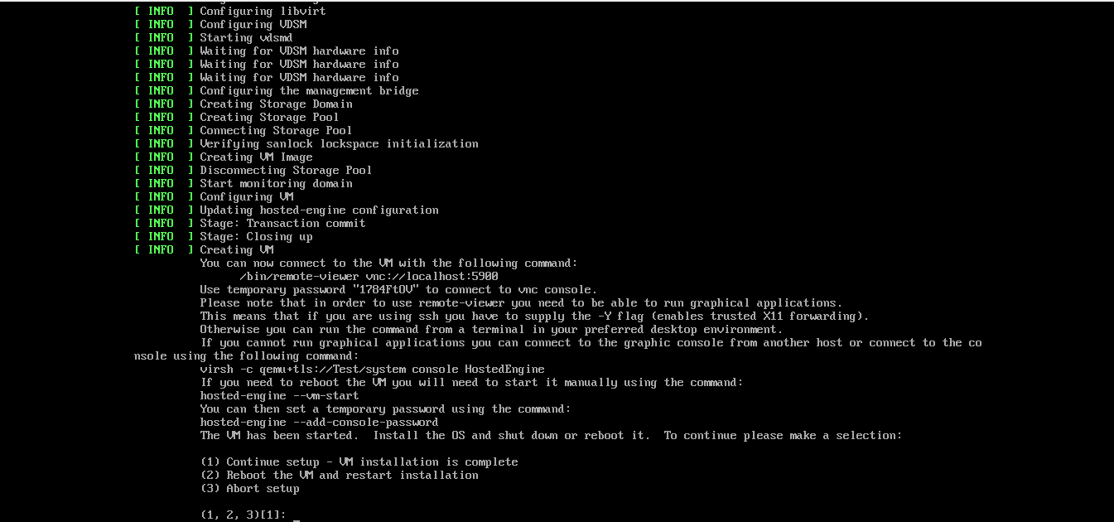
Hosted-engine
Notes:
Let's go over the agenda.
I'll start with an Overview, talking about the oVirt engine,Then I'll talk about the motivation for exposing EC2/CIMI APIs on
Top of ovirt, describing
Some cloud APIs, and their differences.
, and proceed to describing deltacloud, which enables
Ovirt to support that.
After the overview, I'll talk about the integration with deltacloud
Describe the different use-cases, and Show some samples of using
EC2 and CIMI on top of oVirt
There is always future work, so I'll go over that as well
Finish with a Summary, and I'll leave a few minutes for Questions.
If something isn't clear, and it can't wait til the end of the lecture,
Please raise your hand, and I'll do my best to answer your questions.

Slide 37
Upgrading oVirt Node
oVirt Engine Admin Page
  Put Host in Maintenance
  Execute upgrade
USB/CDROM
  Boot the the server with device attached
Notes:
Let's go over the agenda.
I'll start with an Overview, talking about the oVirt engine,Then I'll talk about the motivation for exposing EC2/CIMI APIs on
Top of ovirt, describing
Some cloud APIs, and their differences.
, and proceed to describing deltacloud, which enables
Ovirt to support that.
After the overview, I'll talk about the integration with deltacloud
Describe the different use-cases, and Show some samples of using
EC2 and CIMI on top of oVirt
There is always future work, so I'll go over that as well
Finish with a Summary, and I'll leave a few minutes for Questions.
If something isn't clear, and it can't wait til the end of the lecture,
Please raise your hand, and I'll do my best to answer your questions.

Slide 38
Future
oVirt Node “Next”
  No more custom installer
  Persist vs a Non Persist system
  Stateless
  Increase the split of “main” code
  And more.. stay tuned! :)
More info: https://fedorapeople.org/~fabiand/slides/2014-10-Where_Node_can_be_going_from_10000_ft.pdf
  .
Notes:
Let's go over the agenda.
I'll start with an Overview, talking about the oVirt engine,Then I'll talk about the motivation for exposing EC2/CIMI APIs on
Top of ovirt, describing
Some cloud APIs, and their differences.
, and proceed to describing deltacloud, which enables
Ovirt to support that.
After the overview, I'll talk about the integration with deltacloud
Describe the different use-cases, and Show some samples of using
EC2 and CIMI on top of oVirt
There is always future work, so I'll go over that as well
Finish with a Summary, and I'll leave a few minutes for Questions.
If something isn't clear, and it can't wait til the end of the lecture,
Please raise your hand, and I'll do my best to answer your questions.

Slide 39
Contributing to oVirt Node
Why contribute ?
  You are making history!
  Have you heard about http://www.openhub.net ?
Facts :-)
  First commit happened at Sep 2007
  We are > 50 contributors from different part of world
  4192 commits in total at moment
Where to download the source code?
  git clone http://gerrit.ovirt.org/p/ovirt-node
Notes:
Let's go over the agenda.
I'll start with an Overview, talking about the oVirt engine,Then I'll talk about the motivation for exposing EC2/CIMI APIs on
Top of ovirt, describing
Some cloud APIs, and their differences.
, and proceed to describing deltacloud, which enables
Ovirt to support that.
After the overview, I'll talk about the integration with deltacloud
Describe the different use-cases, and Show some samples of using
EC2 and CIMI on top of oVirt
There is always future work, so I'll go over that as well
Finish with a Summary, and I'll leave a few minutes for Questions.
If something isn't clear, and it can't wait til the end of the lecture,
Please raise your hand, and I'll do my best to answer your questions.

Slide 40
Contributing to oVirt Node
Where to download the source code?
  git clone http://gerrit.ovirt.org/p/ovirt-node
Do we need only developers?
Building oVirt Node
  http://www.ovirt.org/Node_Building
Gerrit
  http://www.ovirt.org/Working_with_oVirt_Gerrit
  .
Notes:
Let's go over the agenda.
I'll start with an Overview, talking about the oVirt engine,Then I'll talk about the motivation for exposing EC2/CIMI APIs on
Top of ovirt, describing
Some cloud APIs, and their differences.
, and proceed to describing deltacloud, which enables
Ovirt to support that.
After the overview, I'll talk about the integration with deltacloud
Describe the different use-cases, and Show some samples of using
EC2 and CIMI on top of oVirt
There is always future work, so I'll go over that as well
Finish with a Summary, and I'll leave a few minutes for Questions.
If something isn't clear, and it can't wait til the end of the lecture,
Please raise your hand, and I'll do my best to answer your questions.

Slide 41

Want more? Join the force!!
oVirt website
  http://ovirt.org
Users mailing list
  http://www.ovirt.org/Mailing_lists
  http://lists.ovirt.org/mailman/listinfo/users-pt (Portuguese)
Ovirt Node IRC
  #ovirt #ovirt-node irc.oftc.net
  http://lists.ovirt.org/mailman/listinfo/node-devel

Slide 42

THANK YOU !
http://www.ovirt.org
dougsland@redhat.com
dougsland at #ovirt #ovirt-node (irc.oftc.net)

