Slide 1

Project Overview
Amador Pahim (apahim)
oVirt Contributor
Fedora Ambassador
Software Maintenance Engineer @ Red Hat
20141016 - APAHIM

Slide 2
Introducing oVirt

Slide 3

What is oVirt?
Large scale, centralized management for server and desktop virtualization
Based on leading performance, scalability and security infrastructure technologies
Provide an open source alternative to vCenter/vSphere
Focus on KVM for best integration/performance
Focus on ease of use/deployment
Notes:
What is Ovirt?
ROBUST PLATFORM
FEATURE REACH
SVI & VDI
MANAGING VIRTUALIZED DC – THOUSANDS OF VMS ?HYPERVISORS
KVM
A PARALLEL to VMWARE VSPHERE/ VCENTER
SINGLE POINT OF MANAGEMENT – NET STORAGE

Slide 4
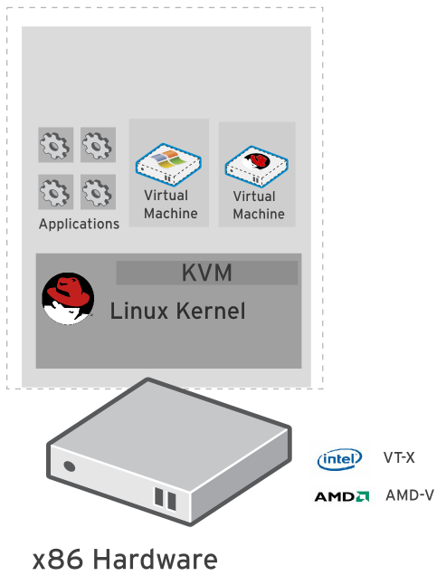
KVM
“Kernel-based Virtual Machine”
Included in Linux kernel since 2006
Runs Linux, Windows and other operating system guests
  Advanced features
  Live migration
  Memory page sharing
  Thin provisioning
  PCI Pass-through
KVM architecture provides high “feature-velocity” – leverages the power of Linux

Slide 5
Using KVM
/usr/libexec/qemu-kvm -name vm-f16-buildmachine -S -M rhel6.4.0 -cpu Westmere -enable-kvm -m 2048 -smp 2,sockets=2,cores=1,threads=1 -uuid a8ccdb60-8a42-44f5-9669-d74c3b2eff43 -smbios type=1,manufacturer=Red Hat,product=RHEV Hypervisor,version=6Server-6.4.0.4.el6,serial=30353036-3837-4247-3831-30394635324C_78:e7:d1:22:46:d8,uuid=a8ccdb60-8a42-44f5-9669-d74c3b2eff43 -nodefconfig -nodefaults -chardev socket,id=charmonitor,path=/var/lib/libvirt/qemu/vm-f16-buildmachine.monitor,server,nowait -mon chardev=charmonitor,id=monitor,mode=control -rtc base=2013-10-08T12:16:16,driftfix=slew -no-shutdown -device piix3-usb-uhci,id=usb,bus=pci.0,addr=0x1.0x2 -device virtio-serial-pci,id=virtio-serial0,bus=pci.0,addr=0x4 -drive if=none,media=cdrom,id=drive-ide0-1-0,readonly=on,format=raw,serial= -device ide-drive,bus=ide.1,unit=0,drive=drive-ide0-1-0,id=ide0-1-0 -drive file=/rhev/data-center/f79b0b28-c82f-11e0-8739-78e7d1e48c4c/5bab6470-8825-4e3a-b408-ebcde93678b6/images/4c213cd2-c4d5-441b-a1ac-dfb1a6868699/11b3e132-50a5-481b-b48b-e3b1f2879e69,if=none,id=drive-virtio-disk0,format=qcow2,serial=4c213cd2-c4d5-441b-a1ac-dfb1a6868699,cache=none,werror=stop,rerror=stop,aio=native -device virtio-blk-pci,scsi=off,bus=pci.0,addr=0x5,drive=drive-virtio-disk0,id=virtio-disk0,bootindex=1 -drive file=/rhev/data-center/f79b0b28-c82f-11e0-8739-78e7d1e48c4c/5bab6470-8825-4e3a-b408-ebcde93678b6/images/02330fa2-d1ff-48e0-a843-842c2376756f/5a283126-4d27-4eef-86dd-fb538d8d08e4,if=none,id=drive-virtio-disk1,format=qcow2,serial=02330fa2-d1ff-48e0-a843-842c2376756f,cache=none,werror=stop,rerror=stop,aio=native -device virtio-blk-pci,scsi=off,bus=pci.0,addr=0x6,drive=drive-virtio-disk1,id=virtio-disk1 -netdev tap,fd=31,id=hostnet0,vhost=on,vhostfd=32 -device virtio-net-pci,netdev=hostnet0,id=net0,mac=00:1a:4a:23:12:13,bus=pci.0,addr=0x3,bootindex=2 -chardev socket,id=charchannel0,path=/var/lib/libvirt/qemu/channels/vm-f16-buildmachine.com.redhat.rhevm.vdsm,server,nowait -device virtserialport,bus=virtio-serial0.0,nr=1,chardev=charchannel0,id=channel0,name=com.redhat.rhevm.vdsm -chardev socket,id=charchannel1,path=/var/lib/libvirt/qemu/channels/vm-f16-buildmachine.org.qemu.guest_agent.0,server,nowait -device virtserialport,bus=virtio-serial0.0,nr=2,chardev=charchannel1,id=channel1,name=org.qemu.guest_agent.0 -chardev spicevmc,id=charchannel2,name=vdagent -device virtserialport,bus=virtio-serial0.0,nr=3,chardev=charchannel2,id=channel2,name=com.redhat.spice.0 -spice port=5904,tls-port=5905,addr=10.35.16.4,x509-dir=/etc/pki/vdsm/libvirt-spice,tls-channel=main,tls-channel=display,tls-channel=inputs,tls-channel=cursor,tls-channel=playback,tls-channel=record,tls-channel=smartcard,tls-channel=usbredir,seamless-migration=on -k en-us -vga qxl -global qxl-vga.ram_size=67108864 -global qxl-vga.vram_size=67108864

Slide 6
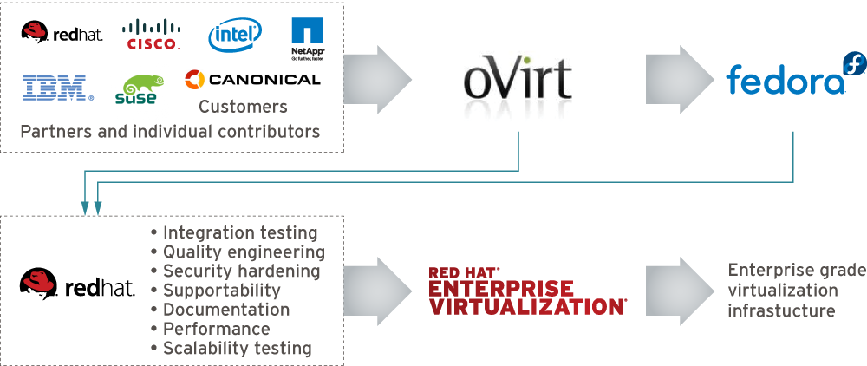
Who is Behind It
Notes:
[Note: Make sure this is updated!]
Open source for three years
Release cycle is every 6 months so we already have 4 stable versions out there, the last one that was released in April 2014 is oVirt 3.4 that included features like live snapshots, self-hosted engines, and hot-plug CPUs.

Slide 7
oVirt: Not a Single Project
oVirt-Engine
VDSM
oVirt-Node
oVirt-Engine-SDK
oVirt-Engine-CLI
oVirt-Guest-Agent
oVirt-Image-Uploader
oVirt-ISO-Uploader
oVirt-Log-Collector
oVirt-DWH
oVirt-Reports
Notes:
BUILD COMMUNITY AROUND THE VIRTUALIZATION STACK
FOCUSED AROUND KVM

Slide 8
Architecture

Slide 9



Architecture from 30k feet
Servers
Engine
Client
Storage

Slide 10
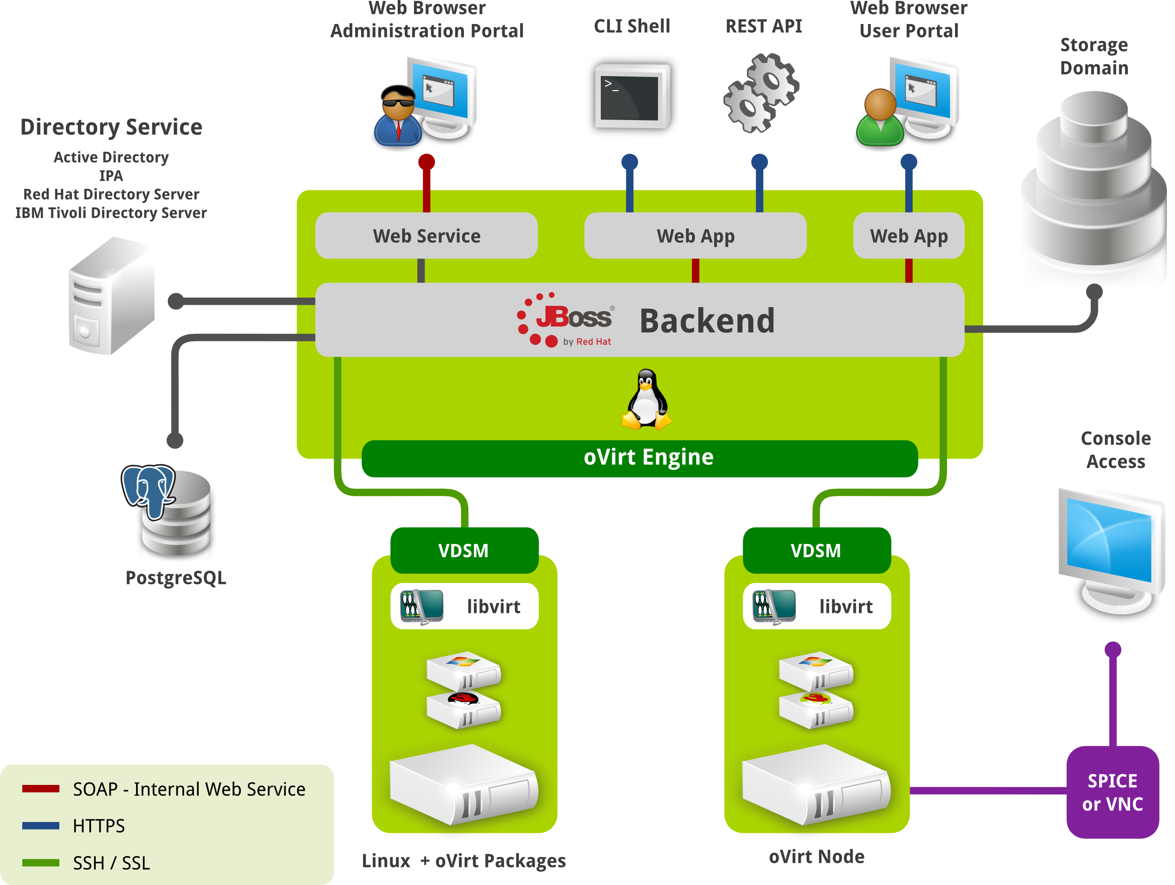

Slide 11
How does it look?

Slide 12
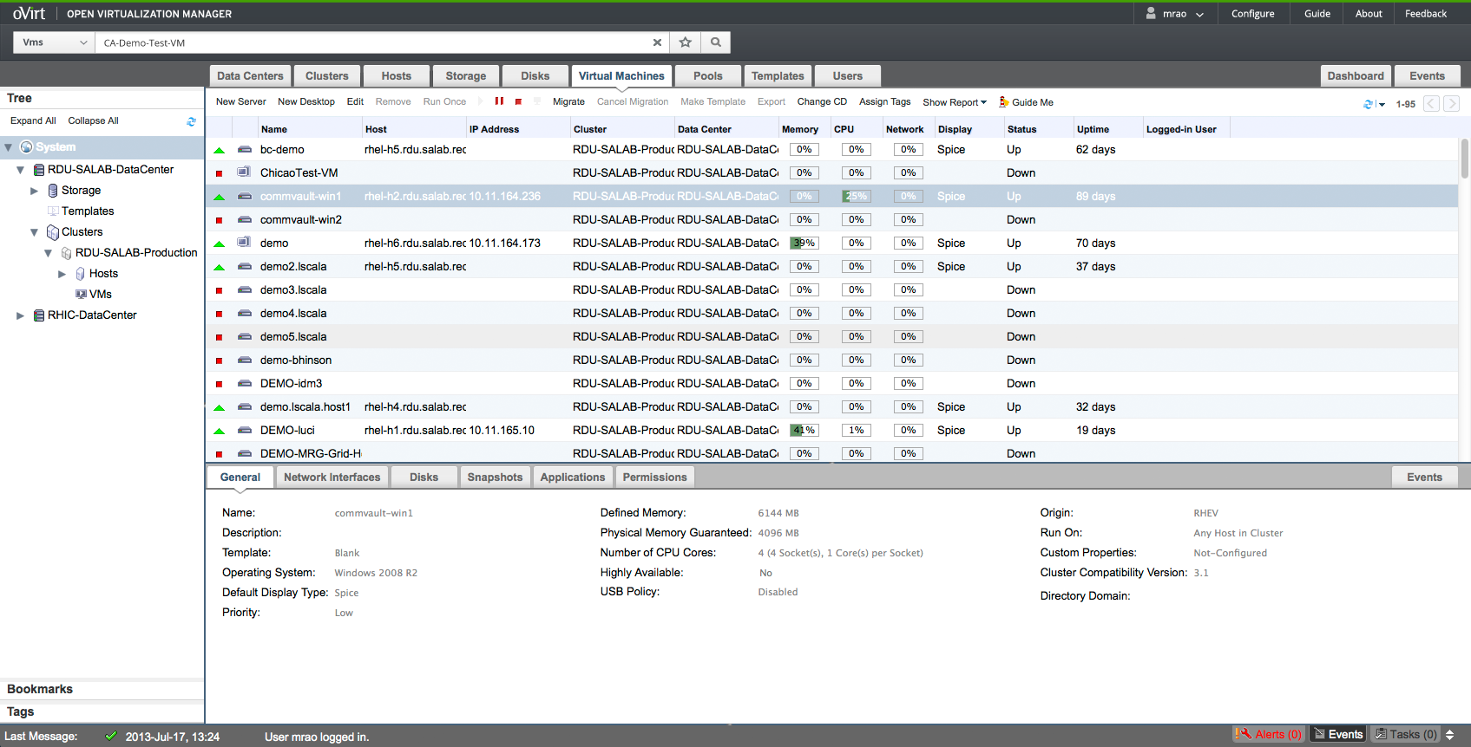
Administration Portal

Slide 13
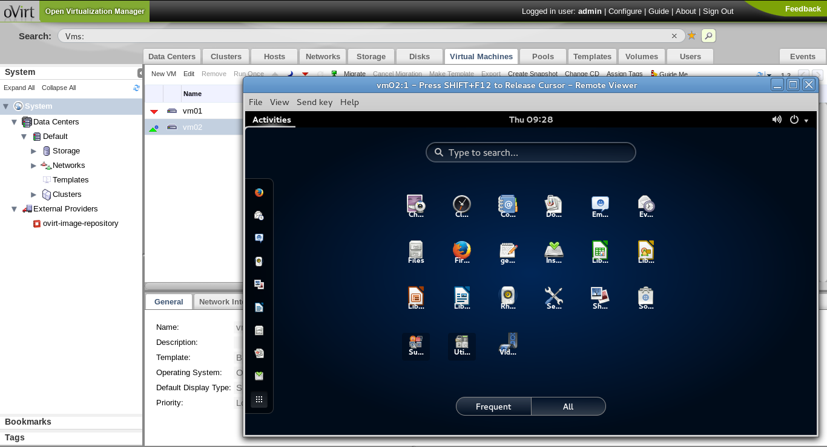
VM UP!

Slide 14
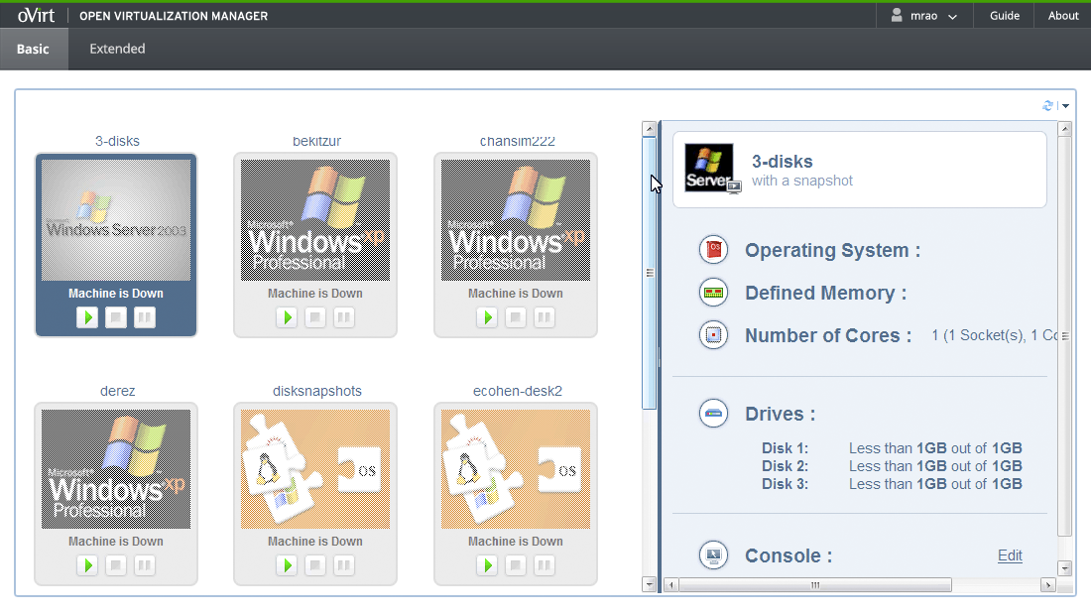
User Portal - Basic

Slide 15
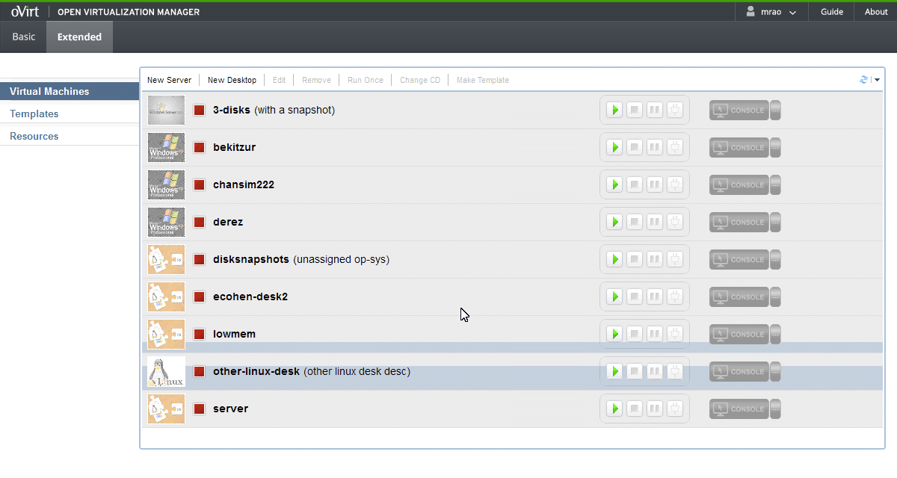
User Portal - Extended

Slide 16
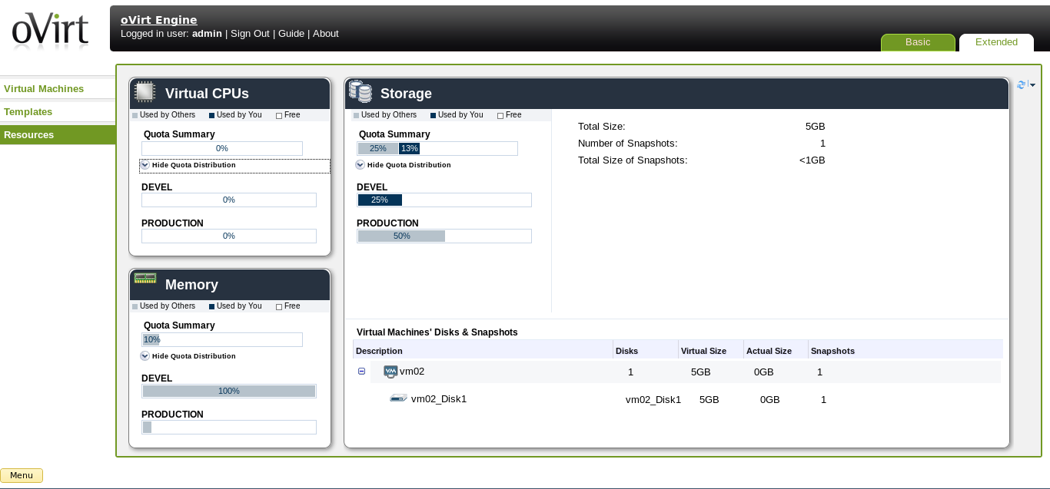
User Portal - Extended

Slide 17
Key Features

Slide 18
All Basic Features
High Availability
Live Migration
Storage Live Migration
CPU/Memory Overcommit
System Scheduler
V2V
Storage iSCSI, FC, NFS, GlusterFS, Local...
Template
Memory Deduplication and Balloon
VDI

Slide 19
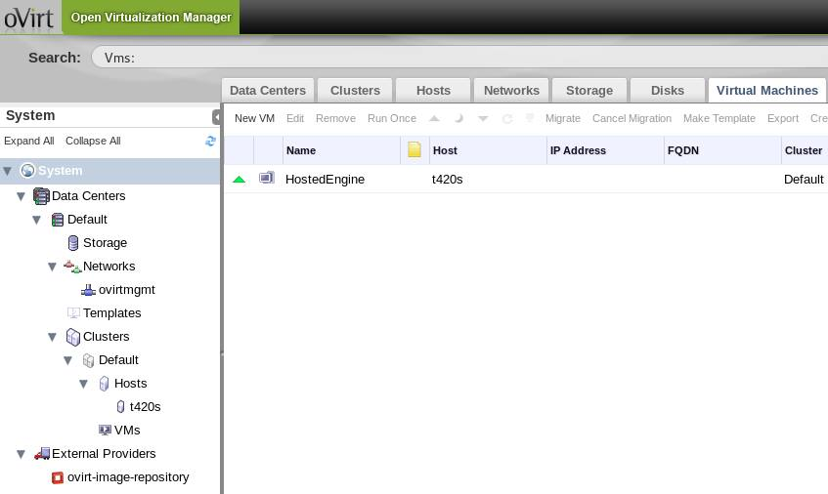
Hosted Engine

Slide 20
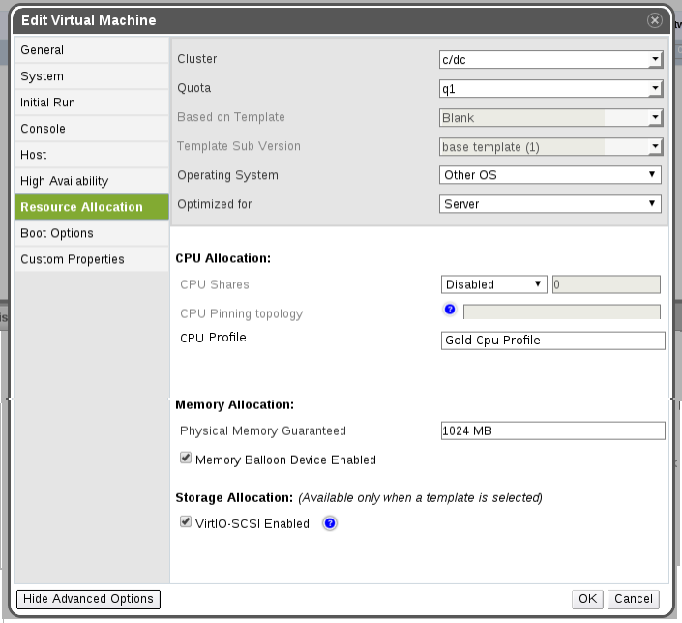
CPU SLA
Percentage
Fixed MHz
Bogomips

Slide 21
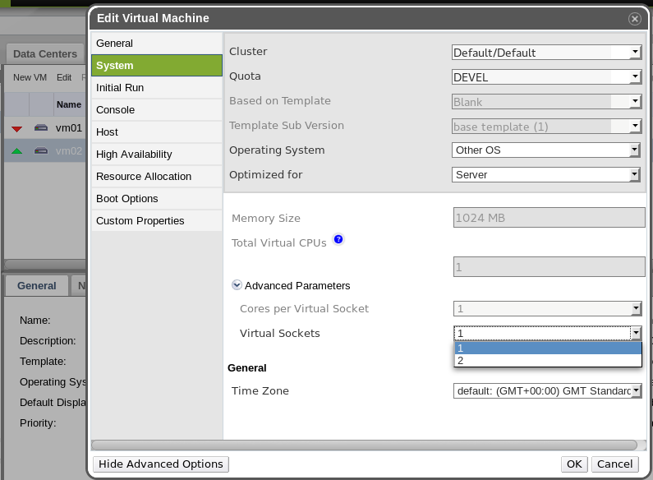
Hot-plug CPU

Slide 22
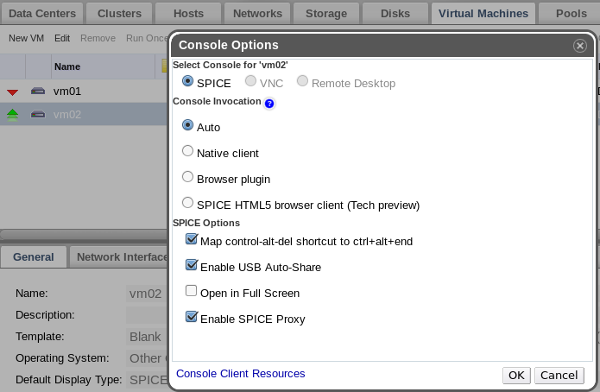
Console Options

Slide 23
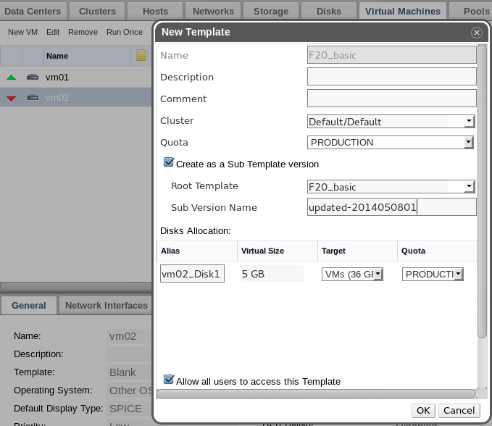
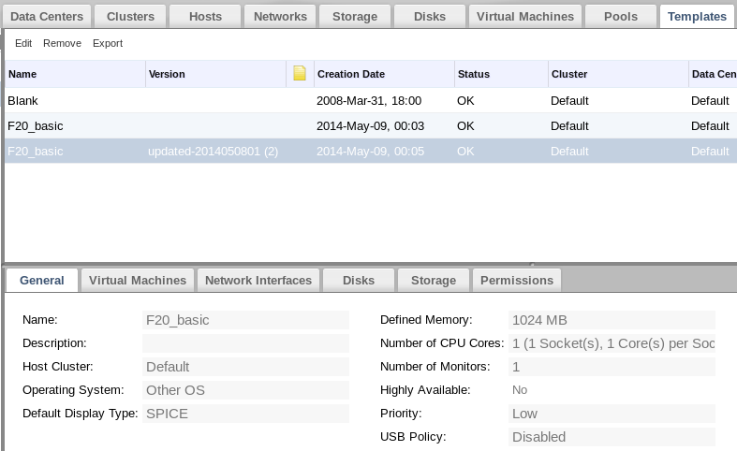
Template Versioning

Slide 24
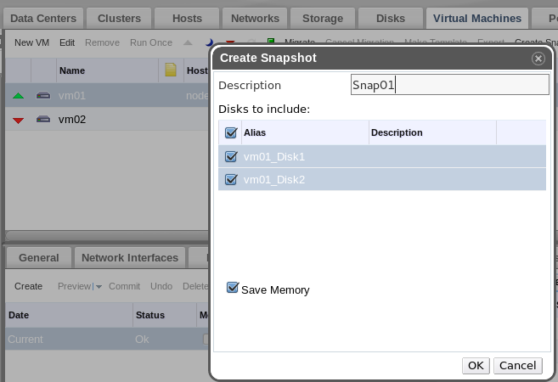
Single-disk Snapshot

Slide 25
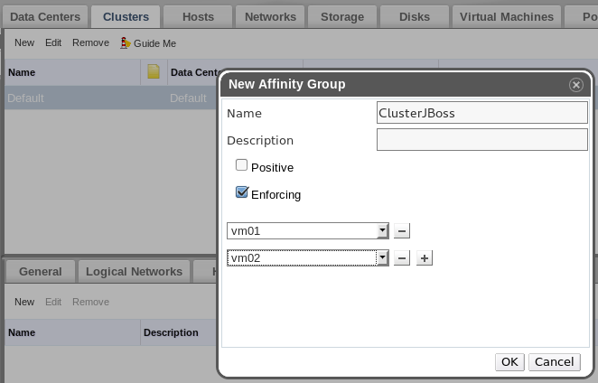
VM Affinity

Slide 26
oVirt Node

Slide 27
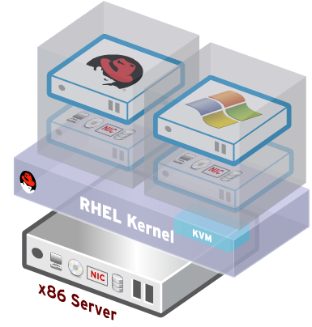
oVirt Node
Standalone Hypervisor
Small footprint
Customized 'spin' of CentOS or Fedora + KVM
“Just enough OS” to run virtual machines
Easy to install, configure and upgrade
PXE boot, USB boot, CD or Hard drive

Slide 28
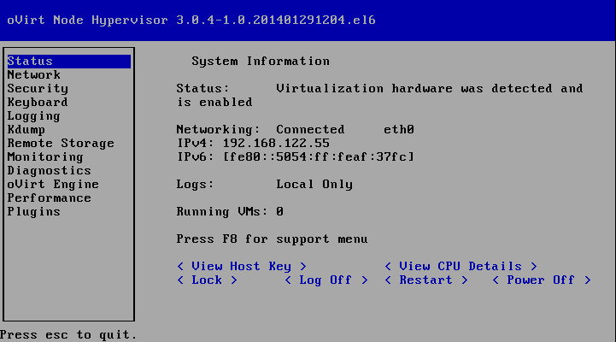
oVirt Node

Slide 29
oVirt Reports

Slide 30
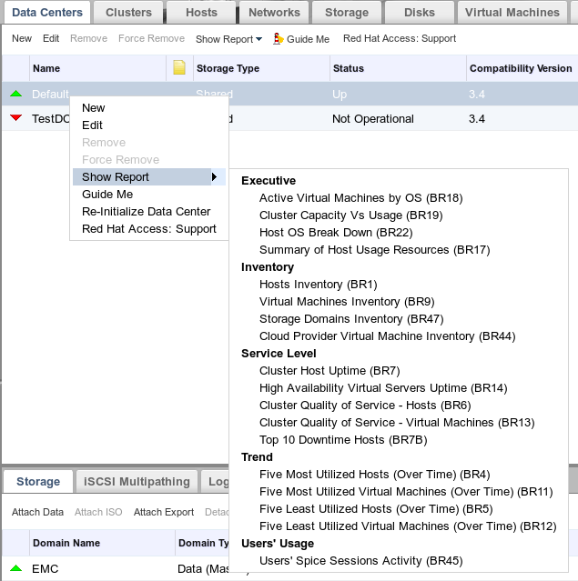
oVirt Reports

Slide 31
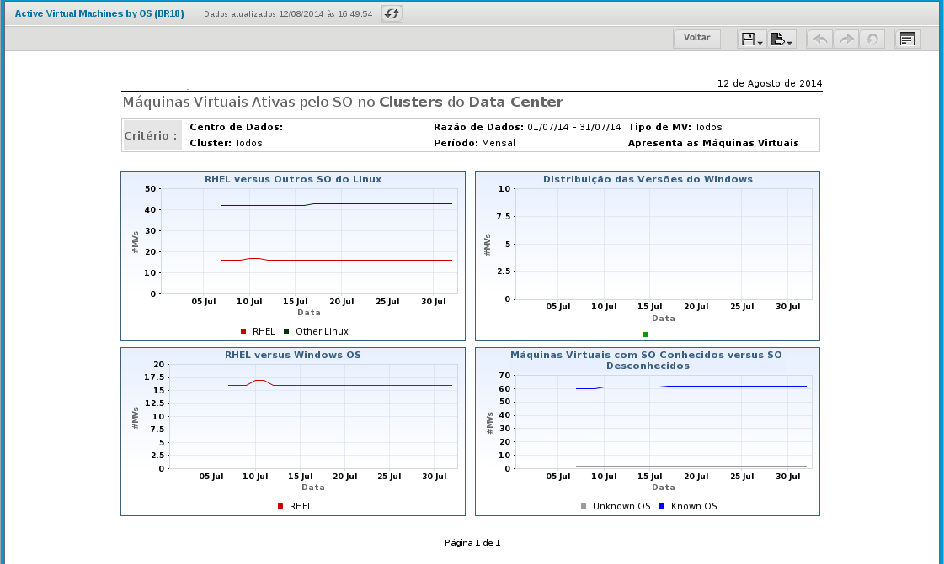
oVirt Reports

Slide 32
Interacting / Extending

Slide 33
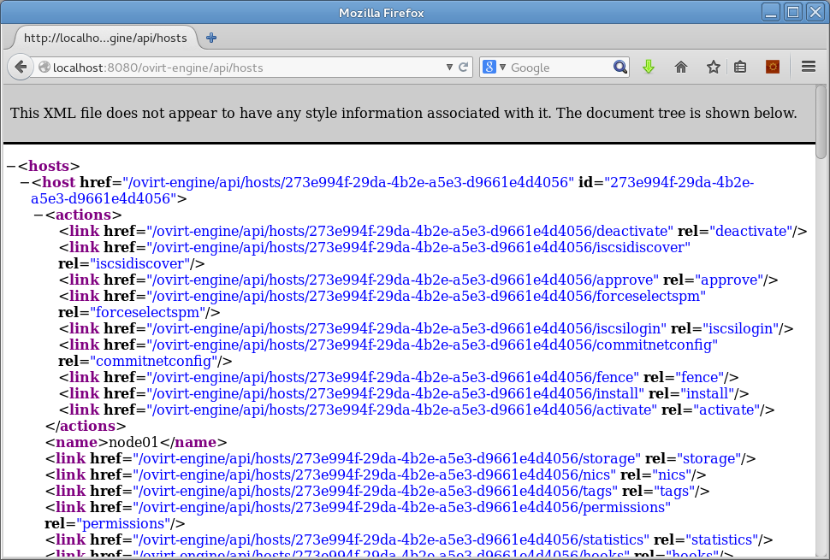
REST API

Slide 34
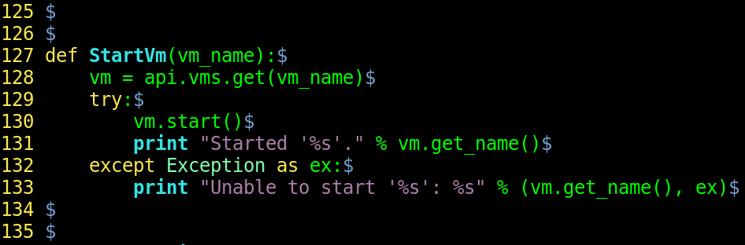
SDK

Slide 35
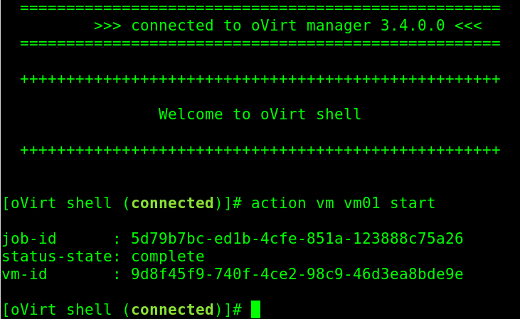
Shell

Slide 36
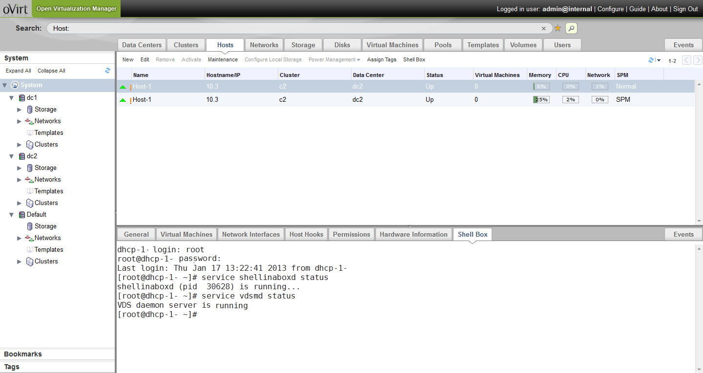
oVirt Plugins

Slide 37
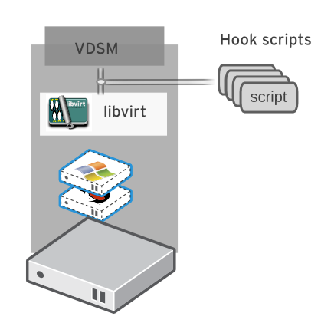
vdsm Hooks
NestedVT
SpiceOpts
QemuCmd
MacBind
...
NestedVT
SpiceOpts
QemuCmd
MacBind
...

Slide 38
Integrating oVirt

Slide 39
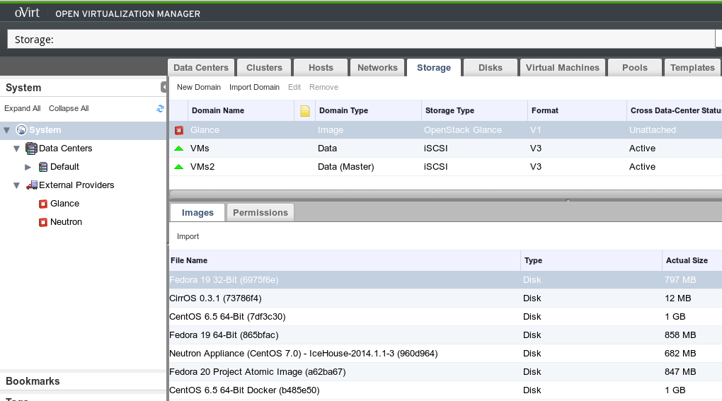
OpenStack

Slide 40
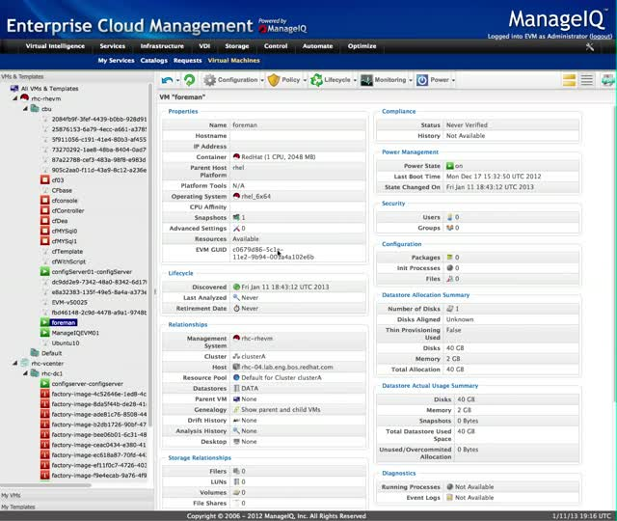
ManageIQ

Slide 41
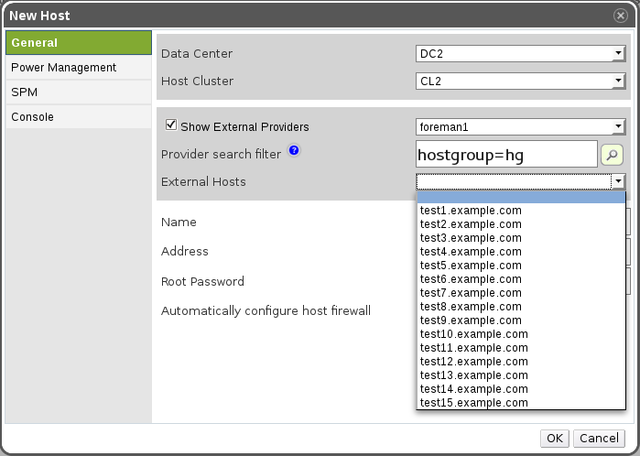
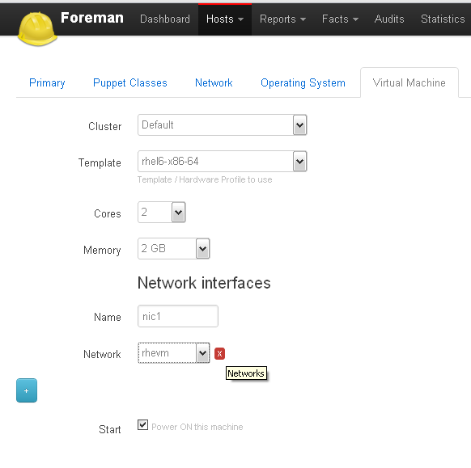
The Foreman

Slide 42
Community

Slide 43
Wiki
Install/Quick Start
Admin. Guide
User Guide
Use Cases
Features Doccumentation

Slide 44
Numbers
Commiters:
  ovirt-engine: 145
  vdsm: 146
List members:
  users@ovirt.org: 764
  users-pt@ovirt.org: 46
  devel@ovirt.org: 386

Slide 45
Get Involved!
http://www.ovirt.org
http://lists.ovirt.org/mailman/listinfo/users
http://lists.ovirt.org/mailman/listinfo/users-pt
http://lists.ovirt.org/mailman/listinfo/devel
apahim AT redhat DOT com
apahim AT #ovirt (irc.oftc.net)

