Slide 1
The Architecture of oVirt Node
Douglas Landgraf <dougsland@redhat.com>
Ryan Barry <rbarry@redhat.com>
Red Hat Inc.

Slide 2
What is oVirt Node?
Minimal, firmware-like hypervisor for KVM
Small footprint
Built on EL/Fedora, so hardware support is excellent
Firewall is configured out of the box
Selinux is on, as it should be
Everything you need to run virtual machines and not much more
But extensible if you need it to be, by modifying the image with supplied tools

Slide 3
But what does that mean?
Composed from standard kickstarts and packages, which makes it easy to re-use existing build infrastructure
The default user is not root, and the default shell is a python-based setup utility which presents friendly configuration for essential values to users
Just enough configuration to connect to the management engine, with additional screens to easily configure things the management engine does not handle (CIM, SNMP, kdump locations)

Slide 4
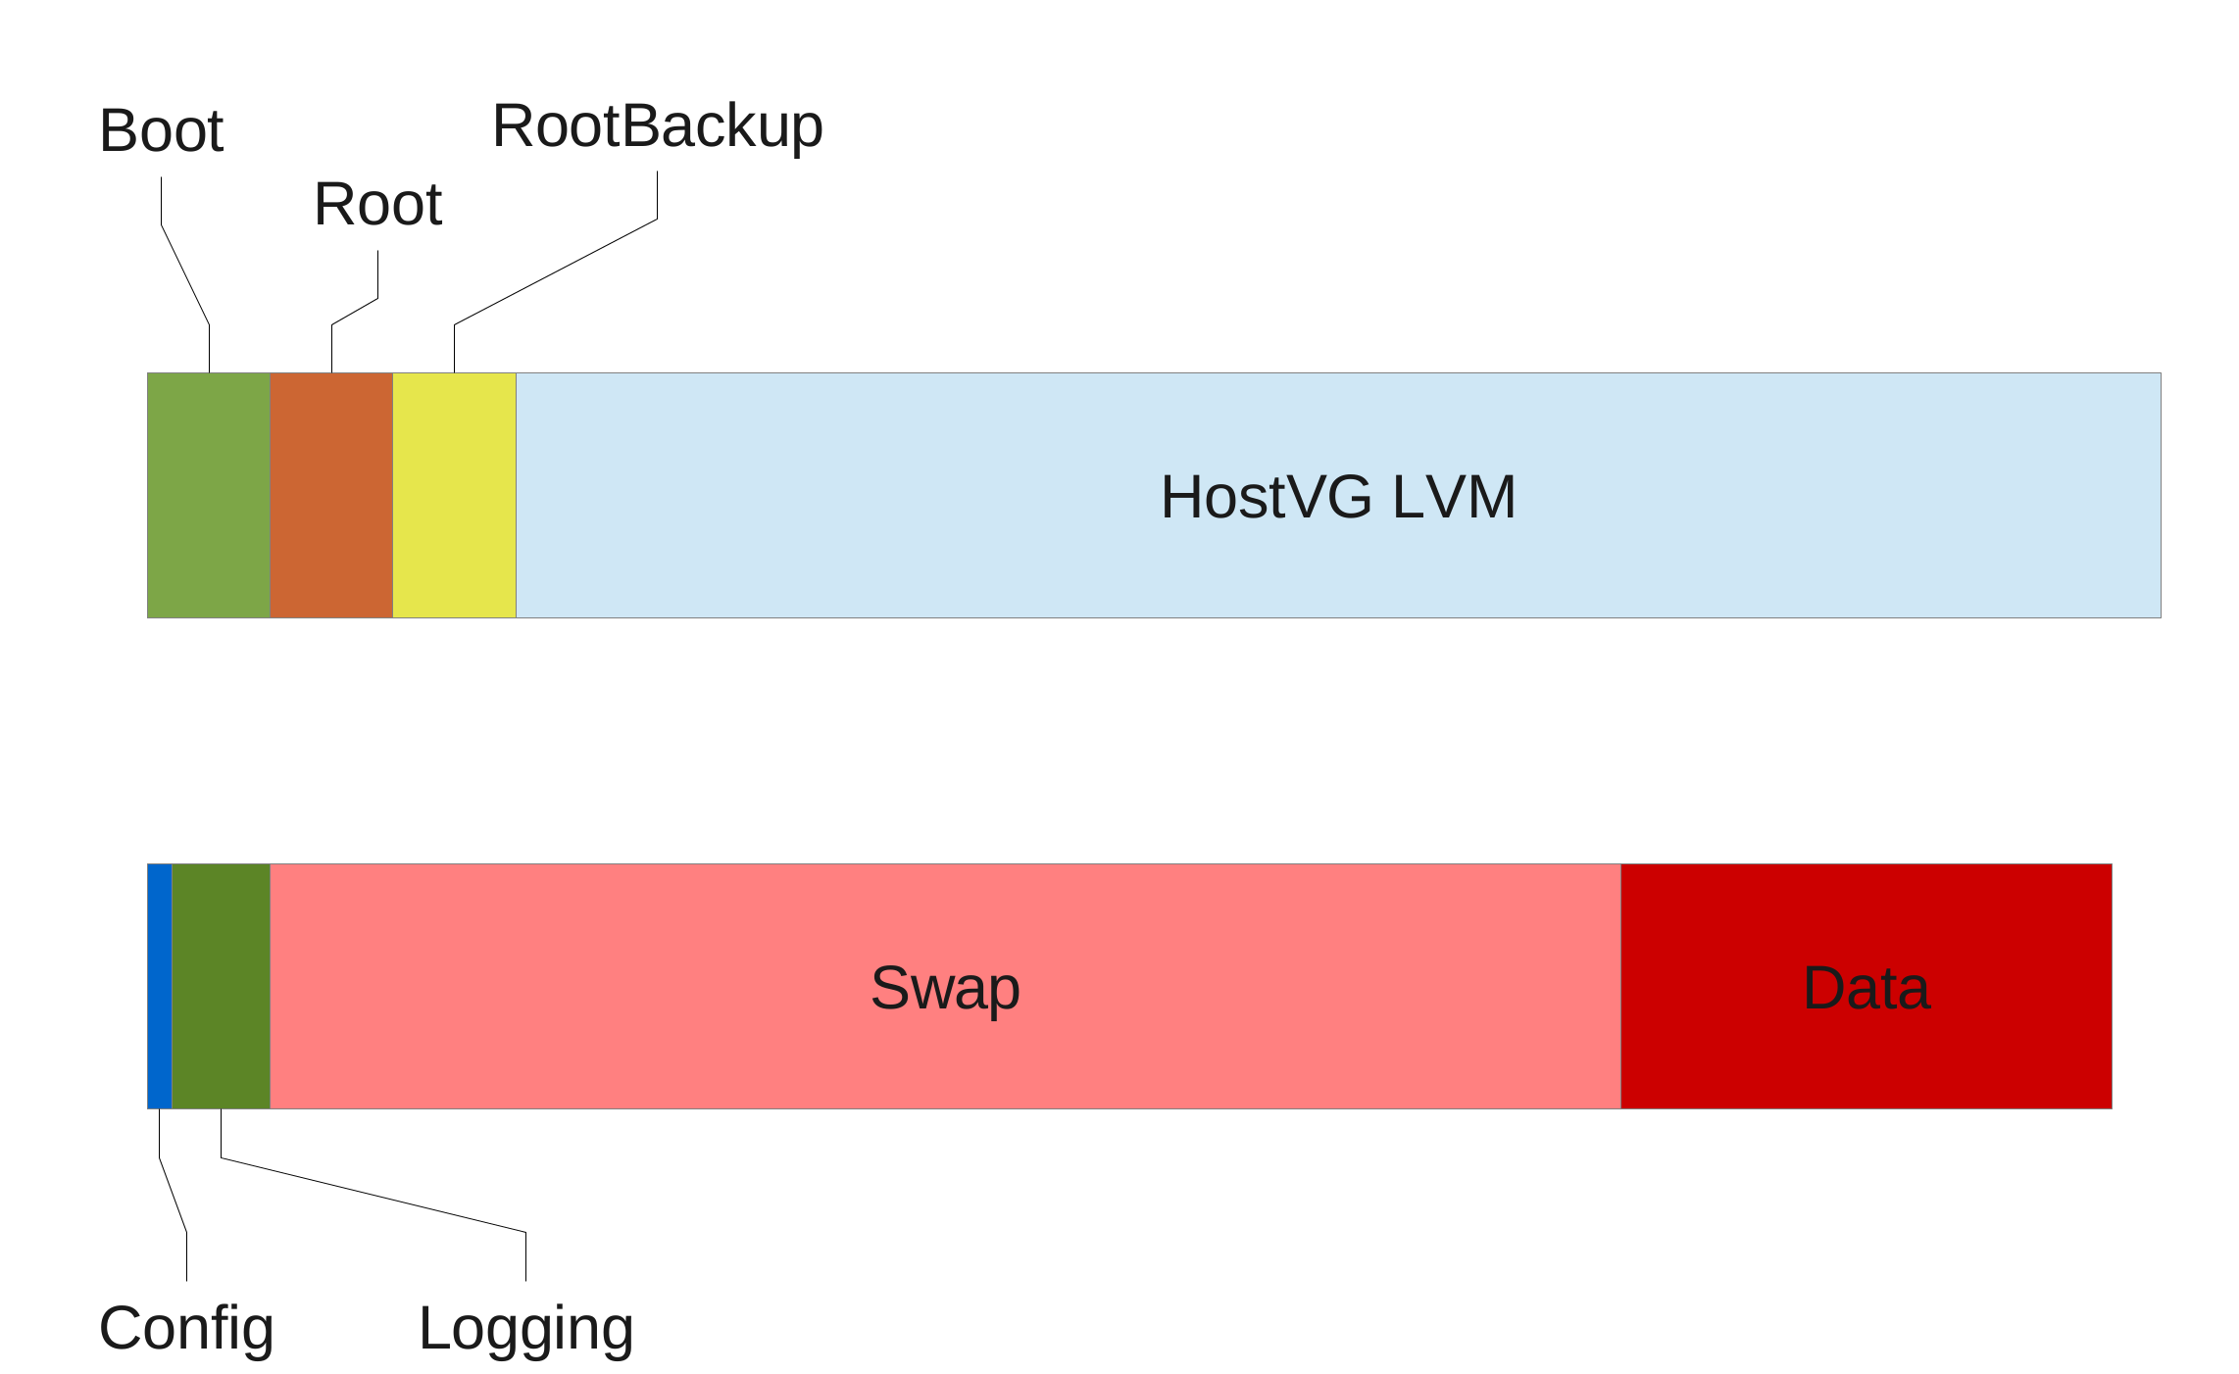
Installation Details
Image is composed as a LiveCD
Installer partitions the disk, creates LVM volumes, and lays down the image by copying the squashfs filesystem

Slide 5
Advantages
Clearly defined, easily supported package set
Standard build tools make it easy for other projects/teams to re-use the base image (ex: foreman installer)
Installation is a simple copy. Upgrades can be done by copying into another partition and adding a bootloader entry.
Configuration, logging, and data on a separate logical volume ensures that they can be trivially re-used, and that rolling back to a previous image does not discard potentially valuable data

Slide 6
Disadvantages
Many packages and utilities to not expect to be running in a read-only root filesystem
They also don't expect to be running in an unpacked squashfs filesystem which experiences significant changes
Persisted files are bind mounted, but the timing of this can be a problem in parallel init systems, since new/changed services may start before the bind mounts and ghost the actual configuration and/or not receive user updates
We don't get to inherit most standard SElinux policies – constant effort to keep SElinux behaving on package/image updates
Practically a new distro. Making changes to core functionality (bootloader arguments) is non-obvious and requires additional tooling to present easy changes to users
Reverse engineering and patching of files from packages we don't own in order to keep them running as expected

Slide 7
What happens when Node boots?
Bootloader loads kernel and an initramfs capable of reading squashfs volumes
squashfs is unpacked and normal boot starts
Ovirt startup scripts block of services with known dependencies on persisted
files, mount the config and logging volumes
Logging is restarted, along with some services
Alternative startup scripts are run for some services (ex: cim). Node does not
persist enabled/disabled services (potentially possible in EL7), so all services
on the image are started at each boot, though they may fail
Login prompt is presented
Optional breakpoints in ovirt startup scripts. “grep breakpoint ovirt-node/scripts/*
and add “node.break=somebreakpoint” to the cmdline

Slide 8
The user interface
Loose MVC with python-urwid as the presentation layer
Keyboard-driven configuration with a list of pages for various nodes (SNMP, RHN, Networking, etc) in a sidebar
Changes trigger configuration changes when the page is saved
Configuration management is mostly homegrown, with heavy use of augeas to set values, some templating

Slide 9
Future
Next-generation Node
Use an existing configuration management system to ease maintenance burden
Use filesystem snapshots and overlays instead of squashfs to reduce patching and SElinux modifications
Will hopefully look like a standard EL/Fedora installation, slightly stripped
Ask Fabian <fabiand@fedoraproject.org> or in #ovirt-node on freenode for info and updates. CI bot also posts there on patches

Slide 10
Comments? Questions?
http://www.ovirt.org

