Slide 1


V2V – Migrating virtual machines to oVirt
Douglas Schilling Landgraf
Software Engineer – Red Hat
09 May 2014, Porto Alegre, RS
Notes:
Hey All.
My name is Oved.
I'm a Senior Software Engineer at Red Hat, and today I'm show you how to use EC2/CIMI on top of oVirt, via deltacloud.

Slide 2

Agenda
General information
Planing the migration
What hypervisors v2v supports ?
Supported guests
Installing and Setting the virt-v2v tool
Migrating: VMWare guest
Debugging
Others virt-v2v examples
Useful links
Notes:
Let's go over the agenda.
I'll start with an Overview, talking about the oVirt engine,Then I'll talk about the motivation for exposing EC2/CIMI APIs on
Top of ovirt, describing
Some cloud APIs, and their differences.
, and proceed to describing deltacloud, which enables
Ovirt to support that.
After the overview, I'll talk about the integration with deltacloud
Describe the different use-cases, and Show some samples of using
EC2 and CIMI on top of oVirt
There is always future work, so I'll go over that as well
Finish with a Summary, and I'll leave a few minutes for Questions.
If something isn't clear, and it can't wait til the end of the lecture,
Please raise your hand, and I'll do my best to answer your questions.

Slide 3
General information
About the speaker
What's v2v process?
The virt-v2v tool
Fedora and oVirt version in this presentation
Let's start?
Notes:
Let's go over the agenda.
I'll start with an Overview, talking about the oVirt engine,Then I'll talk about the motivation for exposing EC2/CIMI APIs on
Top of ovirt, describing
Some cloud APIs, and their differences.
, and proceed to describing deltacloud, which enables
Ovirt to support that.
After the overview, I'll talk about the integration with deltacloud
Describe the different use-cases, and Show some samples of using
EC2 and CIMI on top of oVirt
There is always future work, so I'll go over that as well
Finish with a Summary, and I'll leave a few minutes for Questions.
If something isn't clear, and it can't wait til the end of the lecture,
Please raise your hand, and I'll do my best to answer your questions.

Slide 4
Planing the migration
Remove any specific drivers or tools required from your previous hypervisor
Be aware of network load during the migration
Storage size
Create an NFS export domain
Shutdown the virtual machine
Use the maintenance window
Notes:
Let's go over the agenda.
I'll start with an Overview, talking about the oVirt engine,Then I'll talk about the motivation for exposing EC2/CIMI APIs on
Top of ovirt, describing
Some cloud APIs, and their differences.
, and proceed to describing deltacloud, which enables
Ovirt to support that.
After the overview, I'll talk about the integration with deltacloud
Describe the different use-cases, and Show some samples of using
EC2 and CIMI on top of oVirt
There is always future work, so I'll go over that as well
Finish with a Summary, and I'll leave a few minutes for Questions.
If something isn't clear, and it can't wait til the end of the lecture,
Please raise your hand, and I'll do my best to answer your questions.

Slide 5
What hypervisors virt-v2v supports?
KVM
XEN (managed by libvirt)
VMware 3.5, 4.0, 4.1, 5.0, 5.1
Notes:
Let's go over the agenda.
I'll start with an Overview, talking about the oVirt engine,Then I'll talk about the motivation for exposing EC2/CIMI APIs on
Top of ovirt, describing
Some cloud APIs, and their differences.
, and proceed to describing deltacloud, which enables
Ovirt to support that.
After the overview, I'll talk about the integration with deltacloud
Describe the different use-cases, and Show some samples of using
EC2 and CIMI on top of oVirt
There is always future work, so I'll go over that as well
Finish with a Summary, and I'll leave a few minutes for Questions.
If something isn't clear, and it can't wait til the end of the lecture,
Please raise your hand, and I'll do my best to answer your questions.

Slide 6
Supported guests
Fedora
Red Hat Enterprise Linux 3.9
Red Hat Enterprise Linux 4
Red Hat Enterprise Linux 5
Red Hat Enterprise Linux 6
Windows XP
Windows Vista
Windows 7
Windows Server 2000, 2003, 2008
....
Notes:
Let's go over the agenda.
I'll start with an Overview, talking about the oVirt engine,Then I'll talk about the motivation for exposing EC2/CIMI APIs on
Top of ovirt, describing
Some cloud APIs, and their differences.
, and proceed to describing deltacloud, which enables
Ovirt to support that.
After the overview, I'll talk about the integration with deltacloud
Describe the different use-cases, and Show some samples of using
EC2 and CIMI on top of oVirt
There is always future work, so I'll go over that as well
Finish with a Summary, and I'll leave a few minutes for Questions.
If something isn't clear, and it can't wait til the end of the lecture,
Please raise your hand, and I'll do my best to answer your questions.

Slide 7
Installing and Setting virt-v2v
Yum install
# yum install virt-v2v
Setting .netrc
# cat /root/.netrc
machine my.esx.address login root password mySuperPass
Setting permissions
# chmod 0600 /root/.netrc
Notes:
Let's go over the agenda.
I'll start with an Overview, talking about the oVirt engine,Then I'll talk about the motivation for exposing EC2/CIMI APIs on
Top of ovirt, describing
Some cloud APIs, and their differences.
, and proceed to describing deltacloud, which enables
Ovirt to support that.
After the overview, I'll talk about the integration with deltacloud
Describe the different use-cases, and Show some samples of using
EC2 and CIMI on top of oVirt
There is always future work, so I'll go over that as well
Finish with a Summary, and I'll leave a few minutes for Questions.
If something isn't clear, and it can't wait til the end of the lecture,
Please raise your hand, and I'll do my best to answer your questions.

Slide 8
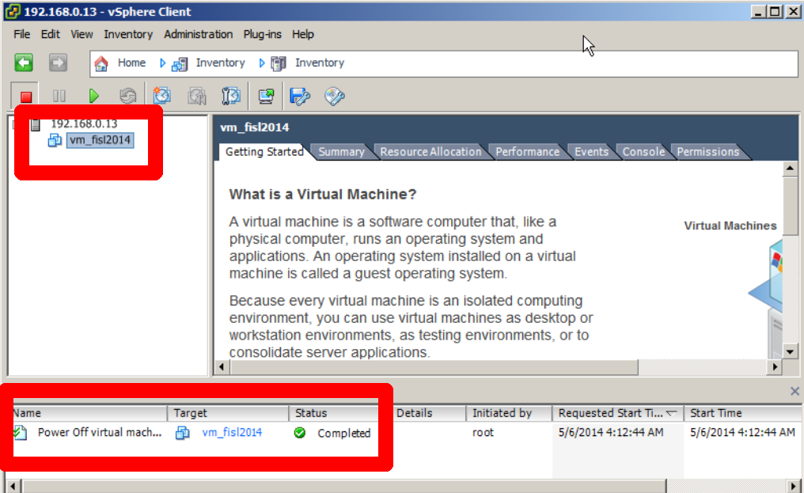
Migrating: VMWare guest
1) Stop the virtual Machine in vSphere
Notes:
Let's go over the agenda.
I'll start with an Overview, talking about the oVirt engine,Then I'll talk about the motivation for exposing EC2/CIMI APIs on
Top of ovirt, describing
Some cloud APIs, and their differences.
, and proceed to describing deltacloud, which enables
Ovirt to support that.
After the overview, I'll talk about the integration with deltacloud
Describe the different use-cases, and Show some samples of using
EC2 and CIMI on top of oVirt
There is always future work, so I'll go over that as well
Finish with a Summary, and I'll leave a few minutes for Questions.
If something isn't clear, and it can't wait til the end of the lecture,
Please raise your hand, and I'll do my best to answer your questions.

Slide 9
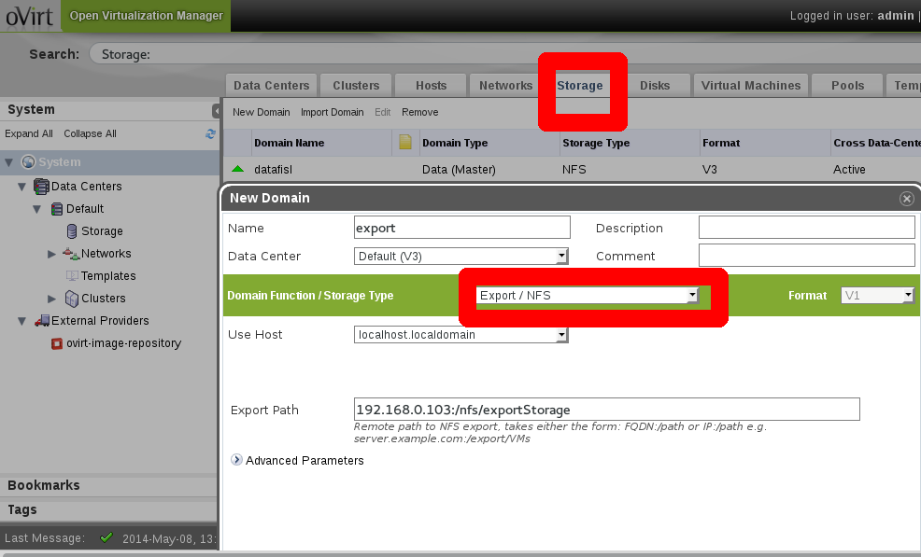
Migrating: VMWare guest
2) Create the Storage type: Export Domain
Notes:
Let's go over the agenda.
I'll start with an Overview, talking about the oVirt engine,Then I'll talk about the motivation for exposing EC2/CIMI APIs on
Top of ovirt, describing
Some cloud APIs, and their differences.
, and proceed to describing deltacloud, which enables
Ovirt to support that.
After the overview, I'll talk about the integration with deltacloud
Describe the different use-cases, and Show some samples of using
EC2 and CIMI on top of oVirt
There is always future work, so I'll go over that as well
Finish with a Summary, and I'll leave a few minutes for Questions.
If something isn't clear, and it can't wait til the end of the lecture,
Please raise your hand, and I'll do my best to answer your questions.

Slide 10

Migrating: VMWare guest
3) Execute the virt-v2v
Note you can use /etc/virt-v2v.conf to map profiles
Use ?no_verify=1 only if you want to avoid the CA validation
Notes:
Let's go over the agenda.
I'll start with an Overview, talking about the oVirt engine,Then I'll talk about the motivation for exposing EC2/CIMI APIs on
Top of ovirt, describing
Some cloud APIs, and their differences.
, and proceed to describing deltacloud, which enables
Ovirt to support that.
After the overview, I'll talk about the integration with deltacloud
Describe the different use-cases, and Show some samples of using
EC2 and CIMI on top of oVirt
There is always future work, so I'll go over that as well
Finish with a Summary, and I'll leave a few minutes for Questions.
If something isn't clear, and it can't wait til the end of the lecture,
Please raise your hand, and I'll do my best to answer your questions.

Slide 11
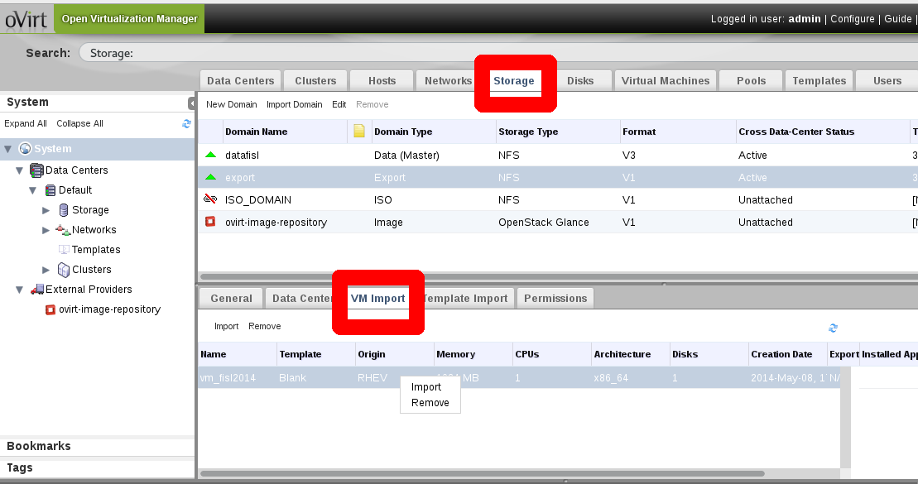
Migrating: VMWare guest
4) Import the guest
Notes:
Let's go over the agenda.
I'll start with an Overview, talking about the oVirt engine,Then I'll talk about the motivation for exposing EC2/CIMI APIs on
Top of ovirt, describing
Some cloud APIs, and their differences.
, and proceed to describing deltacloud, which enables
Ovirt to support that.
After the overview, I'll talk about the integration with deltacloud
Describe the different use-cases, and Show some samples of using
EC2 and CIMI on top of oVirt
There is always future work, so I'll go over that as well
Finish with a Summary, and I'll leave a few minutes for Questions.
If something isn't clear, and it can't wait til the end of the lecture,
Please raise your hand, and I'll do my best to answer your questions.

Slide 12
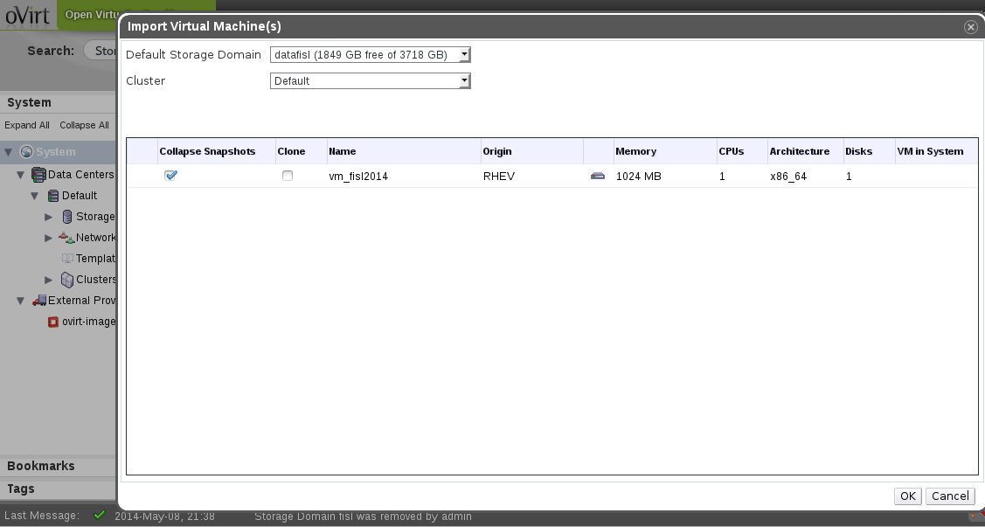
Migrating: VMWare guest
5) Confirm Storage Domain, Cluster
Notes:
Let's go over the agenda.
I'll start with an Overview, talking about the oVirt engine,Then I'll talk about the motivation for exposing EC2/CIMI APIs on
Top of ovirt, describing
Some cloud APIs, and their differences.
, and proceed to describing deltacloud, which enables
Ovirt to support that.
After the overview, I'll talk about the integration with deltacloud
Describe the different use-cases, and Show some samples of using
EC2 and CIMI on top of oVirt
There is always future work, so I'll go over that as well
Finish with a Summary, and I'll leave a few minutes for Questions.
If something isn't clear, and it can't wait til the end of the lecture,
Please raise your hand, and I'll do my best to answer your questions.

Slide 13
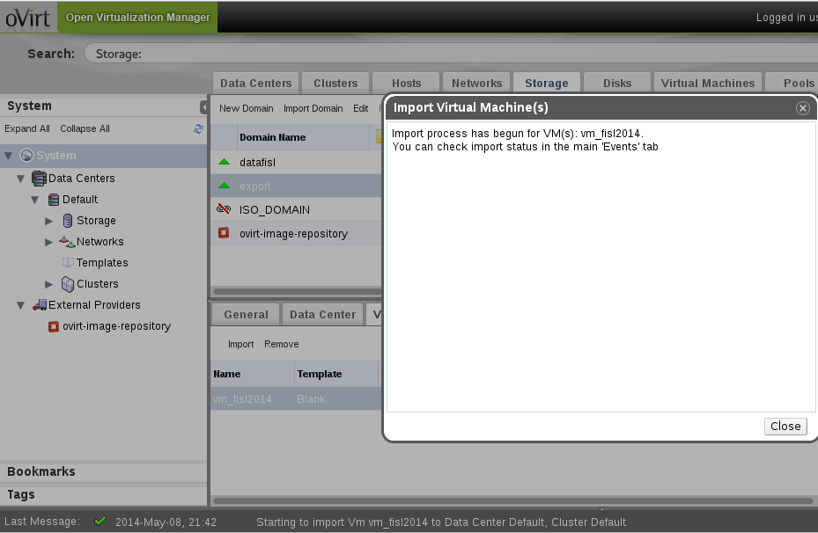
Migrating: VMWare guest
Process started
Notes:
Let's go over the agenda.
I'll start with an Overview, talking about the oVirt engine,Then I'll talk about the motivation for exposing EC2/CIMI APIs on
Top of ovirt, describing
Some cloud APIs, and their differences.
, and proceed to describing deltacloud, which enables
Ovirt to support that.
After the overview, I'll talk about the integration with deltacloud
Describe the different use-cases, and Show some samples of using
EC2 and CIMI on top of oVirt
There is always future work, so I'll go over that as well
Finish with a Summary, and I'll leave a few minutes for Questions.
If something isn't clear, and it can't wait til the end of the lecture,
Please raise your hand, and I'll do my best to answer your questions.

Slide 14
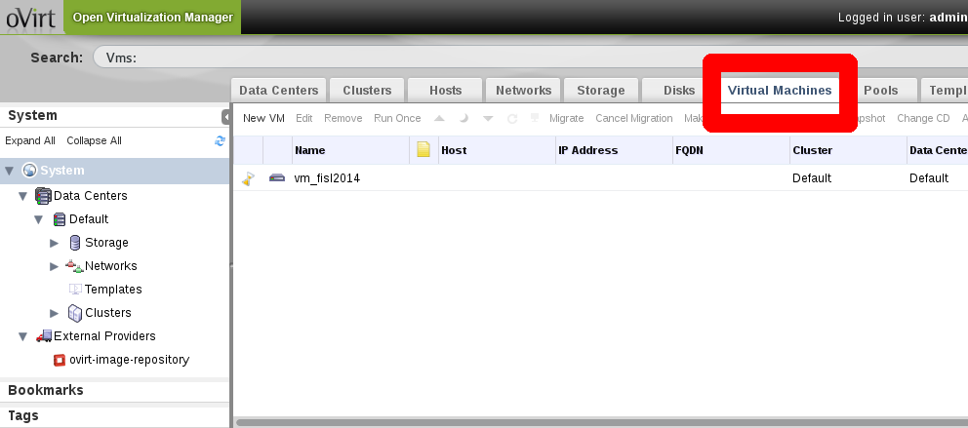
Migrating: VMWare guest
Notes:
Let's go over the agenda.
I'll start with an Overview, talking about the oVirt engine,Then I'll talk about the motivation for exposing EC2/CIMI APIs on
Top of ovirt, describing
Some cloud APIs, and their differences.
, and proceed to describing deltacloud, which enables
Ovirt to support that.
After the overview, I'll talk about the integration with deltacloud
Describe the different use-cases, and Show some samples of using
EC2 and CIMI on top of oVirt
There is always future work, so I'll go over that as well
Finish with a Summary, and I'll leave a few minutes for Questions.
If something isn't clear, and it can't wait til the end of the lecture,
Please raise your hand, and I'll do my best to answer your questions.

Slide 15
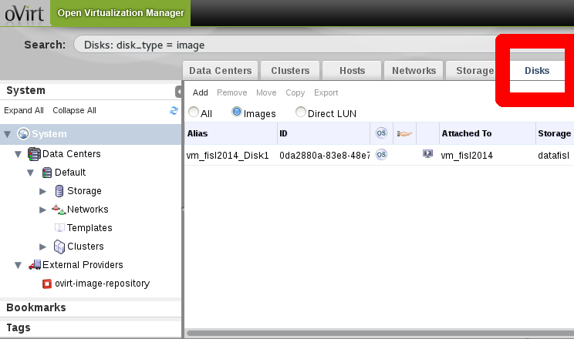
Migrating: VMWare guest
Notes:
Let's go over the agenda.
I'll start with an Overview, talking about the oVirt engine,Then I'll talk about the motivation for exposing EC2/CIMI APIs on
Top of ovirt, describing
Some cloud APIs, and their differences.
, and proceed to describing deltacloud, which enables
Ovirt to support that.
After the overview, I'll talk about the integration with deltacloud
Describe the different use-cases, and Show some samples of using
EC2 and CIMI on top of oVirt
There is always future work, so I'll go over that as well
Finish with a Summary, and I'll leave a few minutes for Questions.
If something isn't clear, and it can't wait til the end of the lecture,
Please raise your hand, and I'll do my best to answer your questions.

Slide 16
Others virt-v2v examples
KVM
# virt-v2v -ic qemu+ssh://root@kvmhost/system -o rhev -os mystorage.example.com:/exportdomain --network ovirtmgmt guest_name
XEN
# virt-v2v -ic xen+ssh://root@host -o rhev -os mystorage.example.com:/exportdomain --network ovirtmgmt guest_name
Notes:
Let's go over the agenda.
I'll start with an Overview, talking about the oVirt engine,Then I'll talk about the motivation for exposing EC2/CIMI APIs on
Top of ovirt, describing
Some cloud APIs, and their differences.
, and proceed to describing deltacloud, which enables
Ovirt to support that.
After the overview, I'll talk about the integration with deltacloud
Describe the different use-cases, and Show some samples of using
EC2 and CIMI on top of oVirt
There is always future work, so I'll go over that as well
Finish with a Summary, and I'll leave a few minutes for Questions.
If something isn't clear, and it can't wait til the end of the lecture,
Please raise your hand, and I'll do my best to answer your questions.

Slide 17
Debugging
LIBGUESTFS_TRACE=1
LIBGUESTFS_DEBUG=1,
# LIBGUESTFS_TRACE=1 LIBGUESTFS_DEBUG=1 virt-v2v .. | tee virt-v2v.log
Notes:
Let's go over the agenda.
I'll start with an Overview, talking about the oVirt engine,Then I'll talk about the motivation for exposing EC2/CIMI APIs on
Top of ovirt, describing
Some cloud APIs, and their differences.
, and proceed to describing deltacloud, which enables
Ovirt to support that.
After the overview, I'll talk about the integration with deltacloud
Describe the different use-cases, and Show some samples of using
EC2 and CIMI on top of oVirt
There is always future work, so I'll go over that as well
Finish with a Summary, and I'll leave a few minutes for Questions.
If something isn't clear, and it can't wait til the end of the lecture,
Please raise your hand, and I'll do my best to answer your questions.

Slide 18


Useful Links
oVirt website
  http://ovirt.org
Users mailing list
  http://www.ovirt.org/Mailing_lists
  http://lists.ovirt.org/mailman/listinfo/users-pt (Portuguese)
Virt-v2v
  http://libguestfs.org/virt-v2v/
  https://access.redhat.com/site/documentation/en-US/Red_Hat_Enterprise_Virtualization/3.3/html-single/V2V_Guide/index.html

Slide 19

THANK YOU !
http://www.ovirt.org
dougsland@redhat.com
dougsland at #ovirt (irc.oftc.net)

