Slide 1


oVirt Data Warehouse
02/11/11
Yaniv Dary
BI Software Engineer, Red Hat

Slide 2
oVirt Data Warehouse Overview
API for historical configuration and statistical data .
Used to create SQL reports using any tool.
Currently provides information on host, vm, disks, storage domain and more.
Uses ETL (Extract Transform Load) service to receive data from the ovirt engine database.

Slide 3
Importance of Business Intelligence
Right decisions on solid data.
Know everything about your product.
Preparing for the future.
Summarizing and simplifying large data.
Integral part of managing virtualization.

Slide 4
oVirt Engine DWH Views
The engine API for the ETL.
Creates a more user friendly interface of the engine tables.
Gaps the differences between the engine to the history database tables.
First stage in data transformation.

Slide 5
Talend Open Studio
Powerful and versatile open source solution for data integration.
Easy-to-use graphical development environment.
Support for all types of data integration, data migration and data synchronization operations.
Strong open source community.
Based on the eclipse UI.

Slide 6
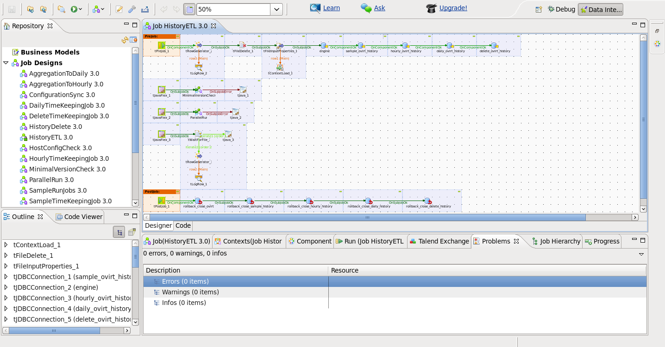
Talend Open Studio

Slide 7
TOS demo

Slide 8
DB Tables and API Views
Sample data is collected at the end of every minute and is kept for up to 48 hours.
Hourly level is aggregated every hour for the hour before last and is kept for 2 months.
Daily level is aggregated every day for the day before last and is kept for 5 years.
Upgrade is done via reentrent PL/pgSQL files.

Slide 9
Roadmap
Support hibernate create database to enable cross database compatibility.
Add fedora packaging.
Add more columns of statistics.
Add more sources other than ovirt-engine database.

Slide 10

Q & A

Slide 11
oVirt Reports
02/11/11
Yaniv Dary
BI Software Engineer, Red Hat

Slide 12
JasperReports and JasperReports Server Overview
JasperReports is an open source Java reporting tool that can produce reports and export them to PDF, HTML, Microsoft Excel, RTF, ODT, Comma-separated values and XML files.
It generates the reports from an XML or .jasper file.
JasperReports Server is a reporting server for JasperReports. Using it you can generate, organize, secure and deliver interactive reports.

Slide 13
oVirt Reports Overview
oVirt reports package provides a suite of pre-configured reports that enable you to monitor the system.
The reports module is based on JasperReports and JasperServer.

Slide 14
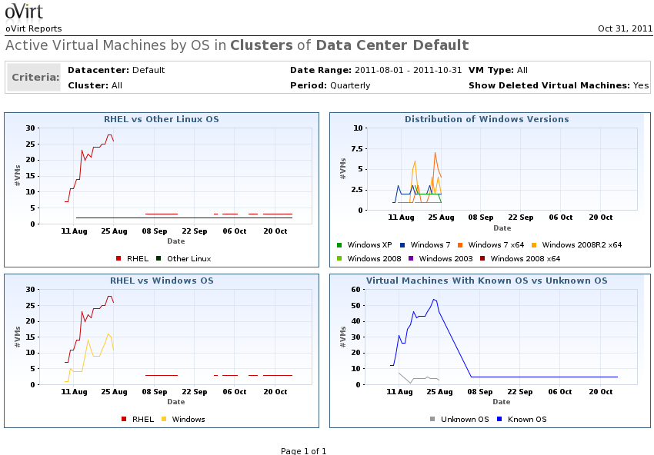
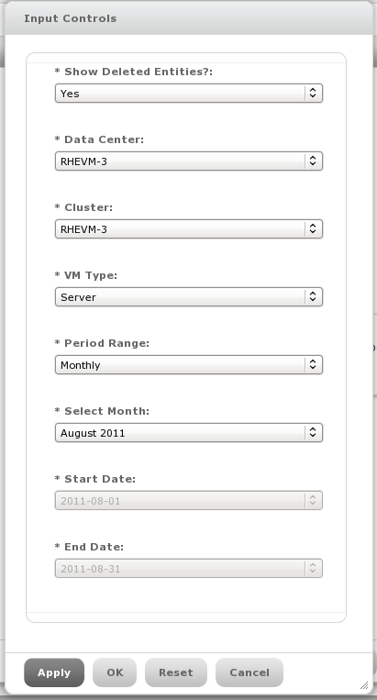
Reports Example

Slide 15
oVirt Reports Topics
Executive – High level reports that highly summarize data on resources and system entities.
Inventory – Reports that list entities or display data about there status.
Service Level – Report that are used to examine system health and service quality to users.
Trends – Graphs that indicate resource usage for planning of resources.

Slide 16
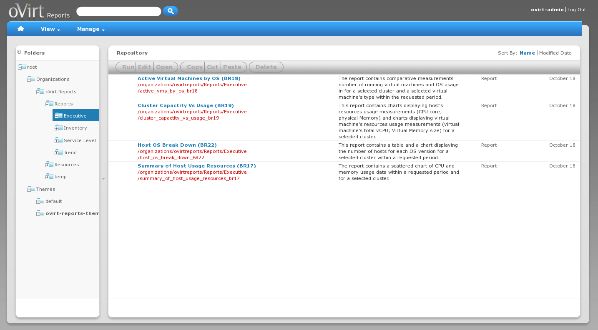
Reports Tree

Slide 17
IReport Demo
Notes:
Report creation demo.
Reports structure.
Pro edition demo
Themes and charts.

Slide 18
Roadmap
Hibernate data source based reports.
Adding more reports and reports types (Like events log reports).
Adding localization to reports.
Web admin integration.
Integrated authentication with engine.

Slide 19
How To Contribute?
DWH
Git: git://gerrit.ovirt.org/ovirt-dwh
Wiki: http://ovirt.org/wiki/Ovirt_DWH
mailing list: engine-devel@ovirt.org
Reports
Git: git://gerrit.ovirt.org/ovirt-reports
Wiki: http://ovirt.org/wiki/Ovirt_Reports
mailing list: engine-devel@ovirt.org

Slide 20
THANK YOU !
http://www.ovirt.org

